Slide 1
CORE JAVA
BY AKSHITHA GONUR

Slide 2
WHAT IS JAVA???
Java is Object Oriented Programming language
It was developed by James Gosling at Sun MicroSystems
There are many devices where Java is currently Used

Slide 3
FEATURES OF JAVA
Java is Simple
Java is Object Oriented
Java is Distributed
Java is Portable
Java is Multi-Threaded

Slide 4
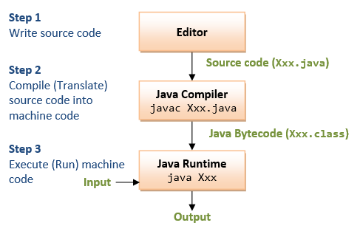
JAVA PROGRAM TRANSLATION

Slide 5
JAVA VIRTUAL MACHINE
JVM translates high level language into machine level language.
It is available for many hardware and software platforms.

Slide 6
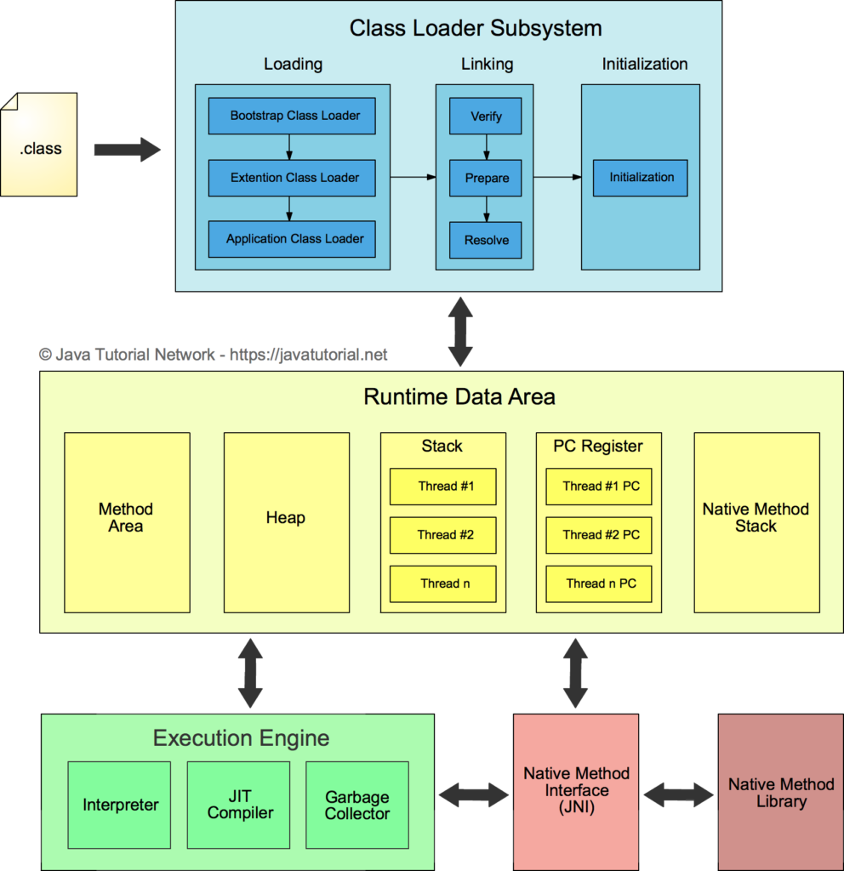

Slide 7
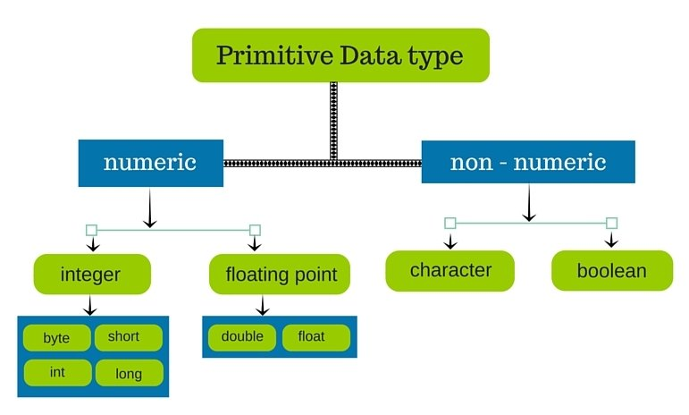
DATATYPES IN JAVA

Slide 8
ADVANTAGES OF JAVA
Java is simple language
No usage of pointers
Write Once Run Anywhere(WORA)

Slide 9
DISADVANTAGES OF JAVA
No support for low level programming
No control over garbage collection

Slide 10


