Slide 1
collections in java
By
G. Padmavathi Shilpa

Slide 2
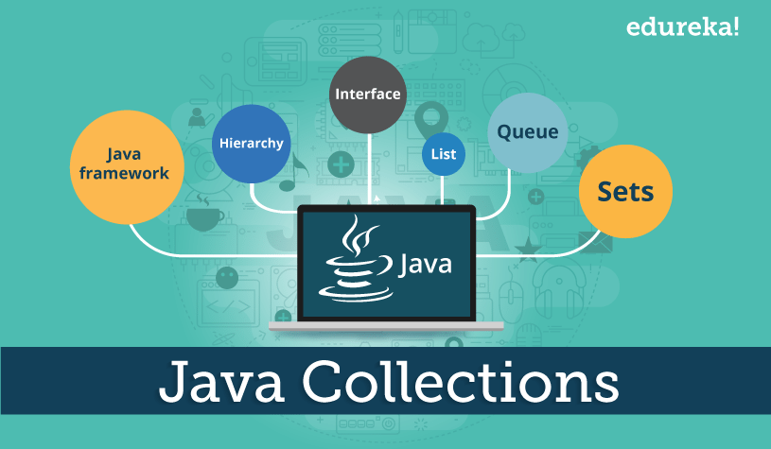
Why do we need Collections in Java?
A collection is an object that groups multiple elements into a single unit

Slide 3
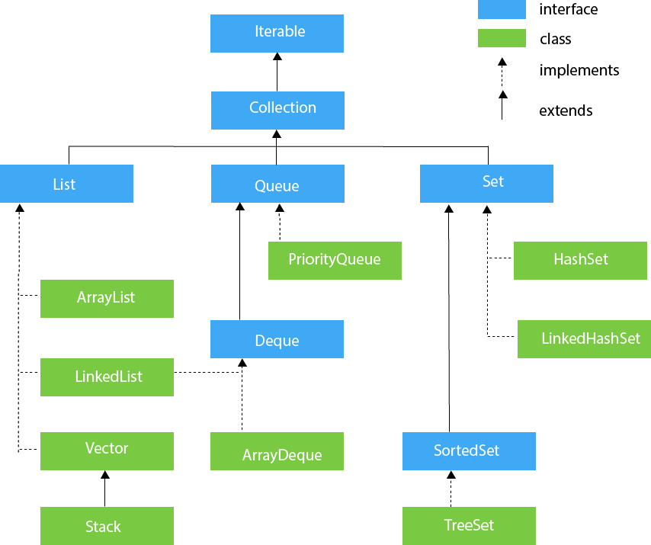
Classification of Collections

Slide 4
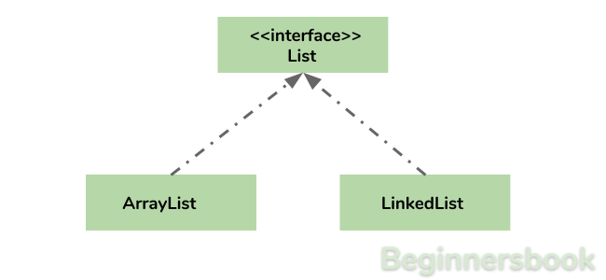
List in Java
List Interface in java is classified into Array List and Linked List

Slide 5
Array list in Collection Framework
Array List in Java is used to store dynamically sized collection of elements. Array list is the java collection frame work and implements list interface. Java ArrayList allows duplicate and null values.
Linked list in Collection Framework
Java Linked List is an implementation of the List and Deque interfaces. It is one of the frequently used List implementation class. It supports duplicate elements. It stores or maintains it’s elements in Insertion order. any number of null elements can be added.

Slide 6
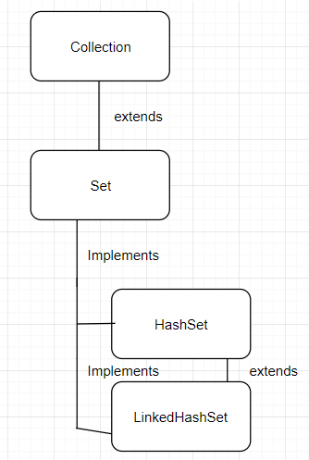
Set in Java
Set Interface in Java contains Hash Set and Linked hash Set

Slide 7
Hash Set in Java
Hash Set is an unordered collection. It does not maintain the order in which
the elements are inserted. Hash Set cannot contain duplicate values. Hash Set allows null values
Linked Hash Set in Java
Linked Hash Set maintains the insertion order. Elements get sorted in the same set in which
they have been added to the set.

Slide 8
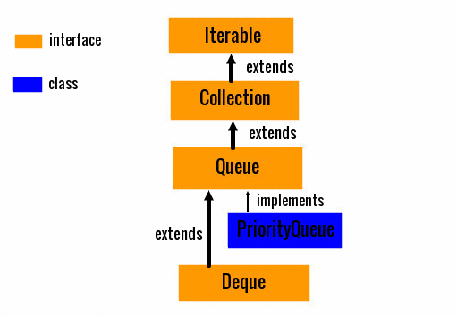
Queue In Java
Java Queue Contains interfaces Queue, De-queue and a class priority Queue

Slide 9
Queue in Java
Java Queue represents an ordered list of elements. Java Queue follows FIFO order to insert and
remove it’s elements. FIFO stands for First In First Out. Java Queue supports all methods of
Collection interface. Most frequently used Queue implementations are Linked List,
Array Blocking Queue and Priority Queue.
Priority Queue in Java
The Priority Queue class provides the facility of using queue. But it does not orders the
elements in FIFO manner.
Deque in Java
The deque is a double ended queue and data elements can be added or removed from
either end.

Slide 10


