Slide 1
COLLECTIONS -KISHORE KUMAAR V.S

Slide 2
WHY COLLECTIONS
To store similar or dissimilar types of objects into a single unit.
Group of objects into a single entity.
To represent group of individual objects as a single entity.

Slide 3
COLLECTIONS PROS AND CONS
PROS:
Growable in nature
Homogenous and Heterogenous elements
Ready Made Methods
CONS:
It can store only in the form of objects

Slide 4
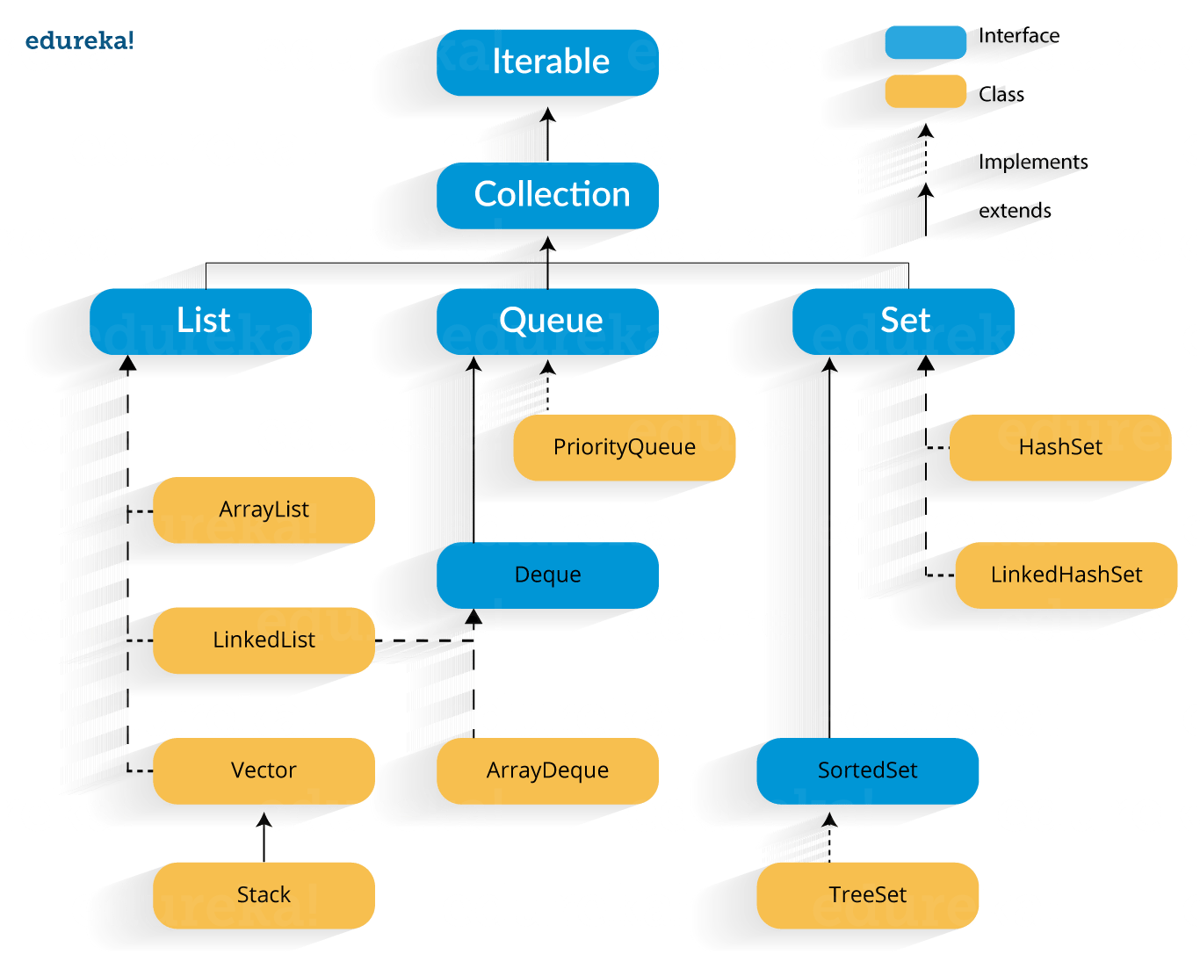

Slide 5
INTERFACES
Collection
List
Set
Sorted Set
Navigable Set
Queue
Map
Sorted Map
Navigable Map

Slide 6
COLLECTION (INTERFACE)
Collection interface defines the most common methods which are applicable for any Collection class
It is an root interface of collection frame work Interface's
There is no concrete class which implements collection interface directly.

Slide 7
METHODS IN COLLECTION INTERFACE
Add()
Remove()
IsEmpty()
Contains()

Slide 8
COLLECTION AND COLLECTIONS
Collection is an interface and Collections is Utility class(which defines many utility methods Like for Sorting and Searching)

Slide 9
Collection
List
ArrayList
LinkedList
Vector
Stack

Slide 10
LIST INTERFACE
It is an child interface of Collection Interface
Duplicates are allowed
Insertion order preserved
Implementation classes for List Interface
ArrayList(1.2)
LinkedList(1.2)
Vector(1.0)
Stack(1.0)

Slide 11
Collection
Set
HashSet
SortedSet(I)
LinkedHashSet
NavigableSet(I)
Treeset

Slide 12
SET INTERFACE
It is the child interface of Collection
Duplicates are not allowed
Insertion order not preserved
Implementation classes for Set
HashSet(1.2)
LinkedHashSet(1.4)

Slide 13
DIFFERENCE BETWEEN LIST AND SET
LIST
Duplicates are allowed
Insertion order is preserved
SET
Duplicates are not allowed
Insertion order is not preserved

Slide 14
SORTEDSET(Interface)
It is an Child interface of Set
Duplicates are not allowed
Objects are going to be inserted in some sorting order

Slide 15
NAVIGABLESET(Interface)
It is the child interface of SortedSet
It is used to navigate the elements like next and previous.
Implementation classes for NavigableSet:-
TreeSet

Slide 16
THANK YOU

