Slide 1
JVM ARCHITECTURE
-MAHITHA YADAM
Analyst, Capgemini

Slide 2
Points to be discussed:
What is JVM?
Architecture of JVM.
Layers In Detail.
Advantages of JVM.

Slide 3
What And Why do we use JVM?
JVM: Java Virtual Machine.
A Java virtual machine (JVM) is a virtual machine that enables a computer to run Java programs as well as programs written in other languages that are also compiled to Java byte code .

Slide 4
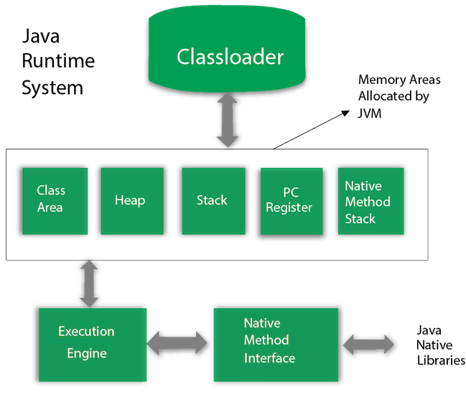
Architecture

Slide 5
Layers in Detail
Class Loader:
A)Boot Strap –loads the rt.jar files.
B)Execution-loads the .exe files
C)Application-loads from the environmental variables.
Memory Areas:
A)Class Area-consists of all the class level information such as name, methods, variables etc.,
B)Heap Area-consists information of all the objects.
C)Stack Area-For every thread, JVM will create one run time stack which will get stored here.

Slide 6
D)PC Register- It stores the address of the current executing thread.
E)Native Method Stack-Stores the native method information.
Execution Engine:
A)Interpreter-reads the byte code line by line.
B)JIT-Just In Time Compiler. It increases the efficiency of the interpreter.
C)Garbage Collector-It destroys the unused variables and saves memory.
Native Method Libraries:
It interacts with the native method libraries and provides necessary libraries for execution.

Slide 7
Advantages of JVM
Security-JVM built in features allows user to write highly secured java programs.
Performance.
Correctness-free of errors.

Slide 8
THANK YOU.

