Slide 1
COLLECTIONS -KISHORE KUMAAR V.S

Slide 2
WHY COLLECTIONS
To store similar or dissimilar types of objects into a single unit.
Group of objects into a single entity.
To represent group of individual objects as a single entity.

Slide 3
COLLECTIONS PROS AND CONS
PROS:
Growable in nature
Homogenous and Heterogenous elements
Ready Made Methods
CONS:
It can store only in the form of objects

Slide 4
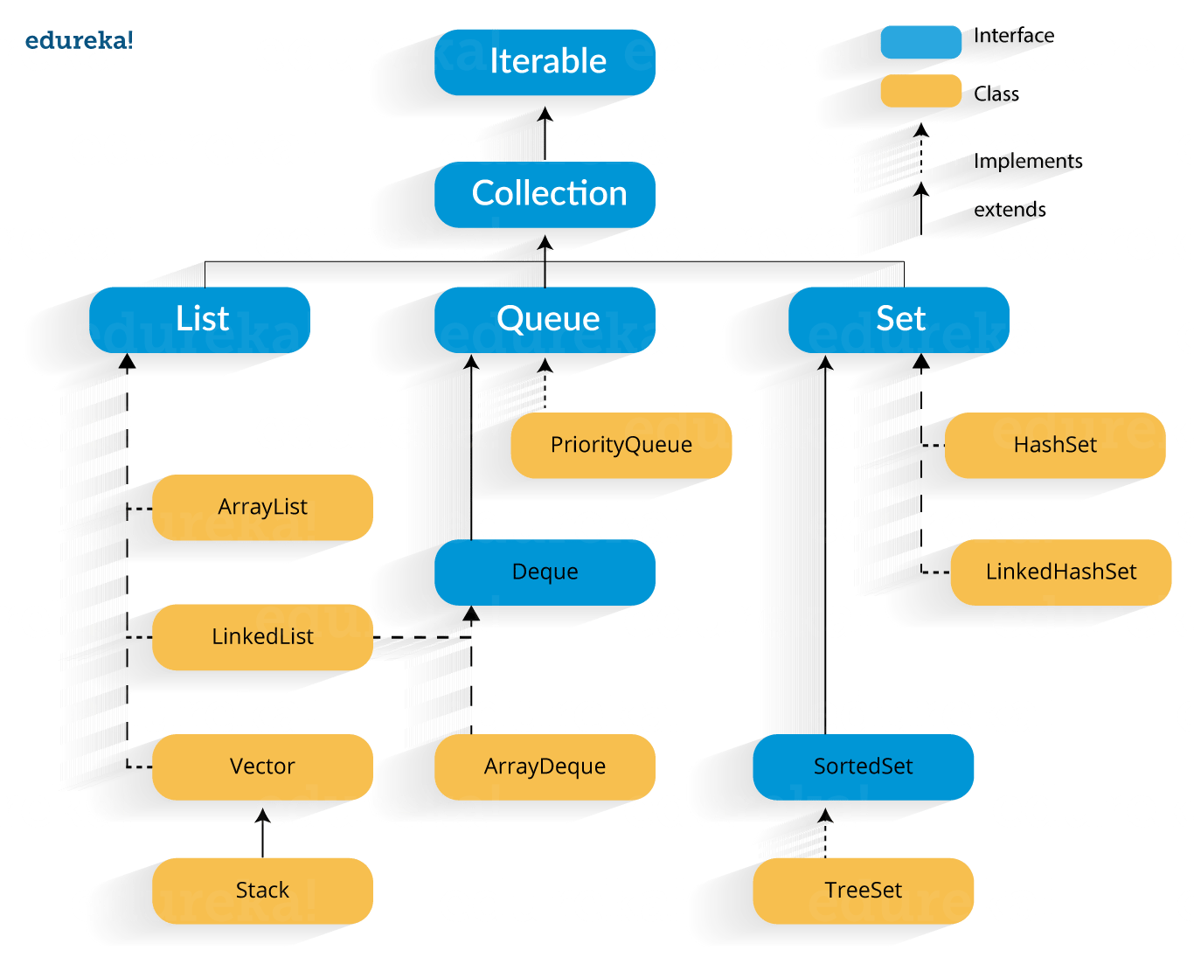

Slide 5
INTERFACES
Collection
List
Set
Sorted Set
Navigable Set
Queue
Map
Sorted Map
Navigable Map

Slide 6
COLLECTION (INTERFACE)
Collection interface defines the most common methods which are applicable for any Collection class
It is an root interface of collection frame work Interface's
There is no concrete class which implements collection interface directly.

Slide 7
METHODS IN COLLECTION INTERFACE
Add()
Remove()
IsEmpty()
Contains()

Slide 8
COLLECTION AND COLLECTIONS
Collection is a interface and Collections is Utility class(which defines many utility methods Like for Sorting and Searching)

