Slide 1


DEPARTMENT OF COMPUTER SCIENCE AND ENGINEERING
20CS8504 & PROJECT WORK
END SEMESTER PRACTICAL EXAMINATION- APRIL / MAY - 2026
Batch No.: 5
Date: 30-03-2026
Session: FN

Slide 2
SEMANTIC AND SIMILARITY-BASED ANSWER EVALUATION SYSTEM USING NLP
Guide Name:
Mr. D.P. Devan M.E.,
Assistant professor, CSE
Team Members:
811722104078 – KISHORE M
811722104097 – NACHIAPPAN PL
811722104119 – RAKSHANA G
811722104305 – RASEEN RAJA R

Slide 3
OBJECTIVE OF THE PROJECT
Manual evaluation of descriptive answer sheets is time-consuming and subjective.
Different evaluators may assign different marks for the same answer due to bias.
With the growth of AI, Natural Language Processing (NLP) enables understanding the meaning of text rather than exact words.
It proposes an automated answer evaluation system that compares student answers with model answers using semantic similarity techniques.
The system ensures fair, consistent, and faster evaluation of subjective answers.

Slide 4
INTRODUCTION
Automation of descriptive answer evaluation.
Reduction of human bias and subjectivity in grading.
Semantic comparison between student answers and model answers.
Fair, accurate, and consistent mark allocation.
Minimization of time and effort in manual evaluation.

Slide 5
LITERATURE SURVEY
TITLE | AUTHORS | PUBLISHER | TECHNOLOGY USED
Automated Answer Sheet Evaluation Using OCR and NLP | B. Santhosh, A. Sagar, B. Manikanta, A. Abhiram, Ch. Mani Bhargavi | International Journal of Research Publication and Reviews (2025) | EasyOCR, NLP, Cosine Similarity, Flask
ASSESS – Automated Subjective Answer Evaluation Using Semantic Learning | Johri E., Dedhia N., Bohra K., Chandak P., Adhikari H. | ICAST Conference (2021) | Semantic Learning, NLP, Similarity Matching
Automated Evaluation of Handwritten Answer Script Using Deep Learning Approach | Rahaman M.A., Mahmud H. | Transactions on Machine Learning and Artificial Intelligence (2022) | CNN, Deep Learning, OCR
Towards Automated Evaluation of Handwritten Assessments | Rowtula V., Oota S.R., Jawahar C.V. | IEEE ICDAR Conference (2019) | Document Analysis, OCR, Machine Learning
Digital Handwritten Answer Sheet Evaluation System | Kulkarni M., Adhav G., Wadile K., Chavan R., Deshmukh V. | Research Publication (2024) | OCR, NLP, Similarity Scoring

Slide 6
LITERATURE SURVEY
TITLE | AUTHORS | PUBLISHER | TECHNOLOGY USED
Automated Grading of Student Answers using NLP | Rahul Gupta, Ankit Sharma | International Journal of Computer Applications (2019) | NLP, Machine Learning, Feature Extraction, Semantic Similarity
Text Similarity Detection using NLP Techniques | Daniel Cer, Yinfei Yang, Sheng-yi Kong | Google Research / ACL Publication (2018) | Sentence Embeddings, Deep Learning, Cosine Similarity
Attention Is All You Need | Ashish Vaswani, Noam Shazeer, Niki Parmar | NeurIPS Conference (2017) | Transformer, Self-Attention, Deep Learning
Semantic Similarity using Word Embeddings | Tomas Mikolov, Kai Chen, Greg Corrado | IEEE / Google Research (2017) | Word2Vec, Word Embeddings, Cosine Similarity
Descriptive Handwritten Paper Grading System using NLP and Fuzzy Logic | Nandwalkar B., Pardeshi S., Shahade M., Awate A. | International Journal of Performability Engineering (2023) | NLP, Fuzzy Logic, Feature Extraction, Grading Classification

Slide 7
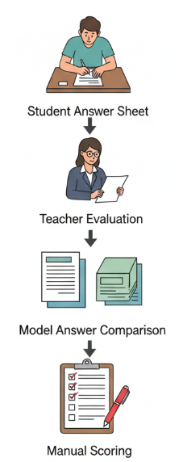
EXISTING SYSTEM ARCHITECTURE

Slide 8
PROBLEMS IDENTIFIED
Time consumption in manual evaluation
Possibility of errors in grading
Lack of consistency in evaluation
Difficulty in evaluating more number of paper
Delay in result publication
Possibility of Human Bias

Slide 9
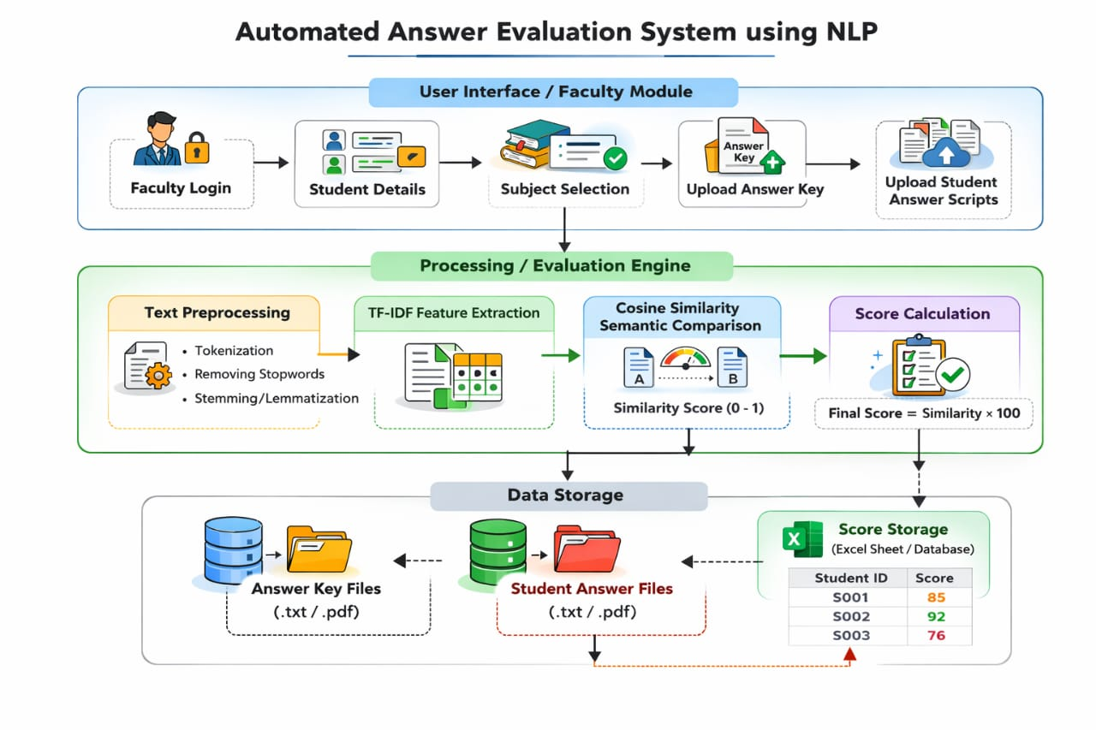
PROPOSED SYSTEM ARCHITECTURE
UI

Slide 10
SOFTWARE AND HARDWARE REQUIREMENTS
HARDWARE
Processor: Intel i5 / Ryzen 5 or above
RAM: Minimum 8 GB
Hard Disk: 256 GB
System Type: 64-bit Architecture
SOFTWARE
Operating System: Windows / Linux
Programming Language: Python
Frontend: HTML, CSS, JavaScript
Backend: Flask
NLP Libraries: NLTK, spaCy, Scikit-learn, Sentence-Transformers
Database: MySQL / SQLite
IDE: VS Code / PyCharm

Slide 11
MODULES
User Interface Module
Text Pre-processing and Representation Module
Semantic Similarity Evaluation Module
Scoring and Feedback Module
Data Storage and Result Management System

Slide 12
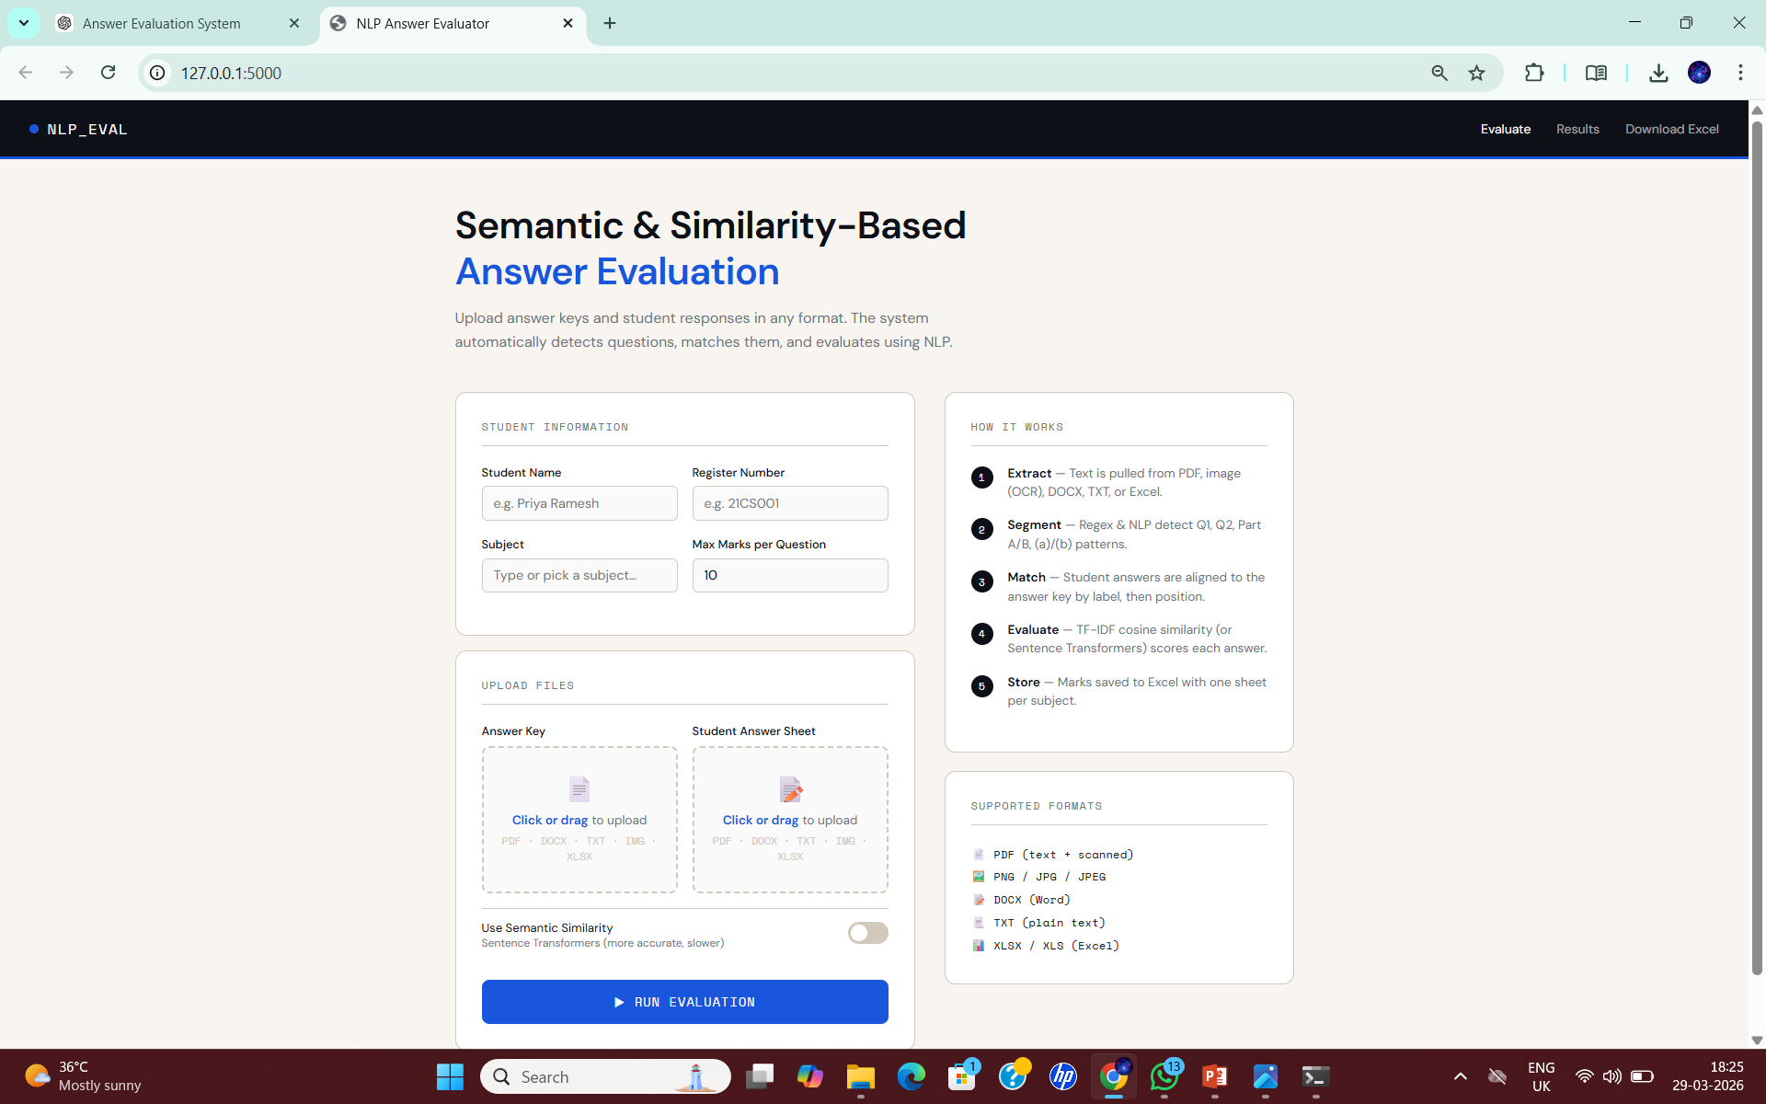
1. USER INTERFACE MODULE
Provides a web-based interface for teachers.
Allows entry of student details and subject selection.
Enables uploading of student answers and model answer key.
Displays evaluation results in a clear and structured format.
Ensures a simple, user-friendly, and efficient interaction.

Slide 13
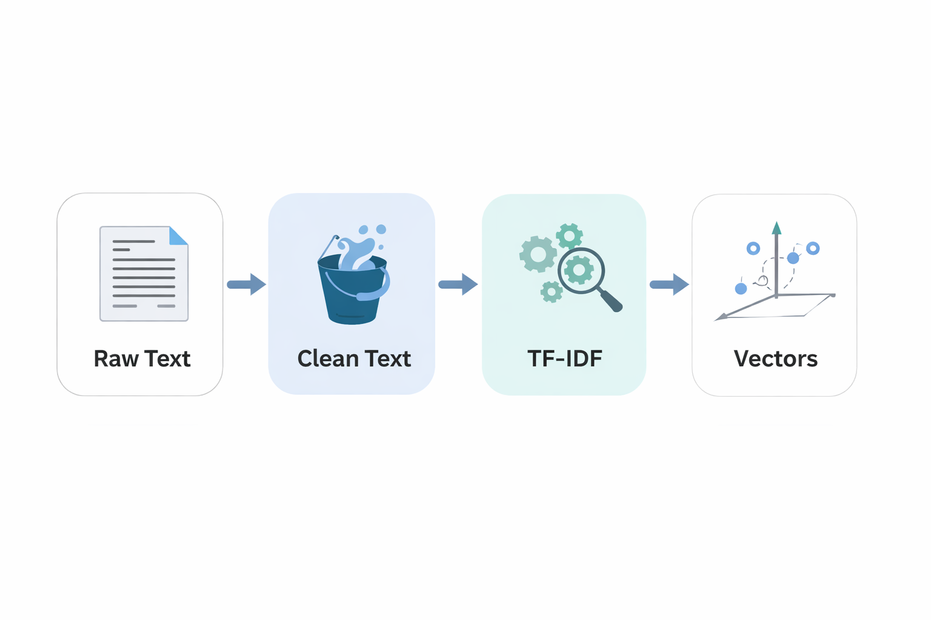
2. TEXT PRE-PROCESSING AND REPRESENTATION MODULE
Cleans and normalizes input text for accurate processing.
Performs tokenization, stopword removal, and stemming.
Converts text into numerical representations using
TF-IDF.
Extracts meaningful features for semantic evaluation.
Prepares data for similarity computation.

Slide 14
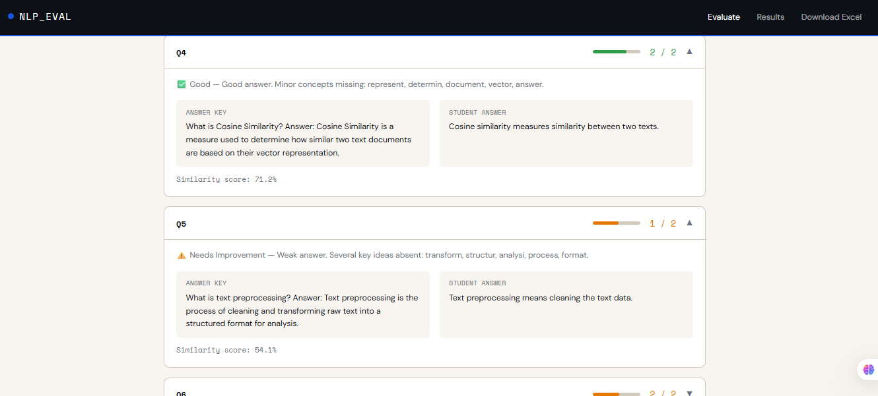
3. SEMANTIC SIMILARITY EVALUATION MODULE
Compares student answers with the model answer key.
Uses cosine similarity to measure semantic similarity between answers.
Evaluates the meaning of the text rather than exact word matching.
Generates similarity scores for each answer.
Ensures accurate and consistent evaluation of responses.

Slide 15
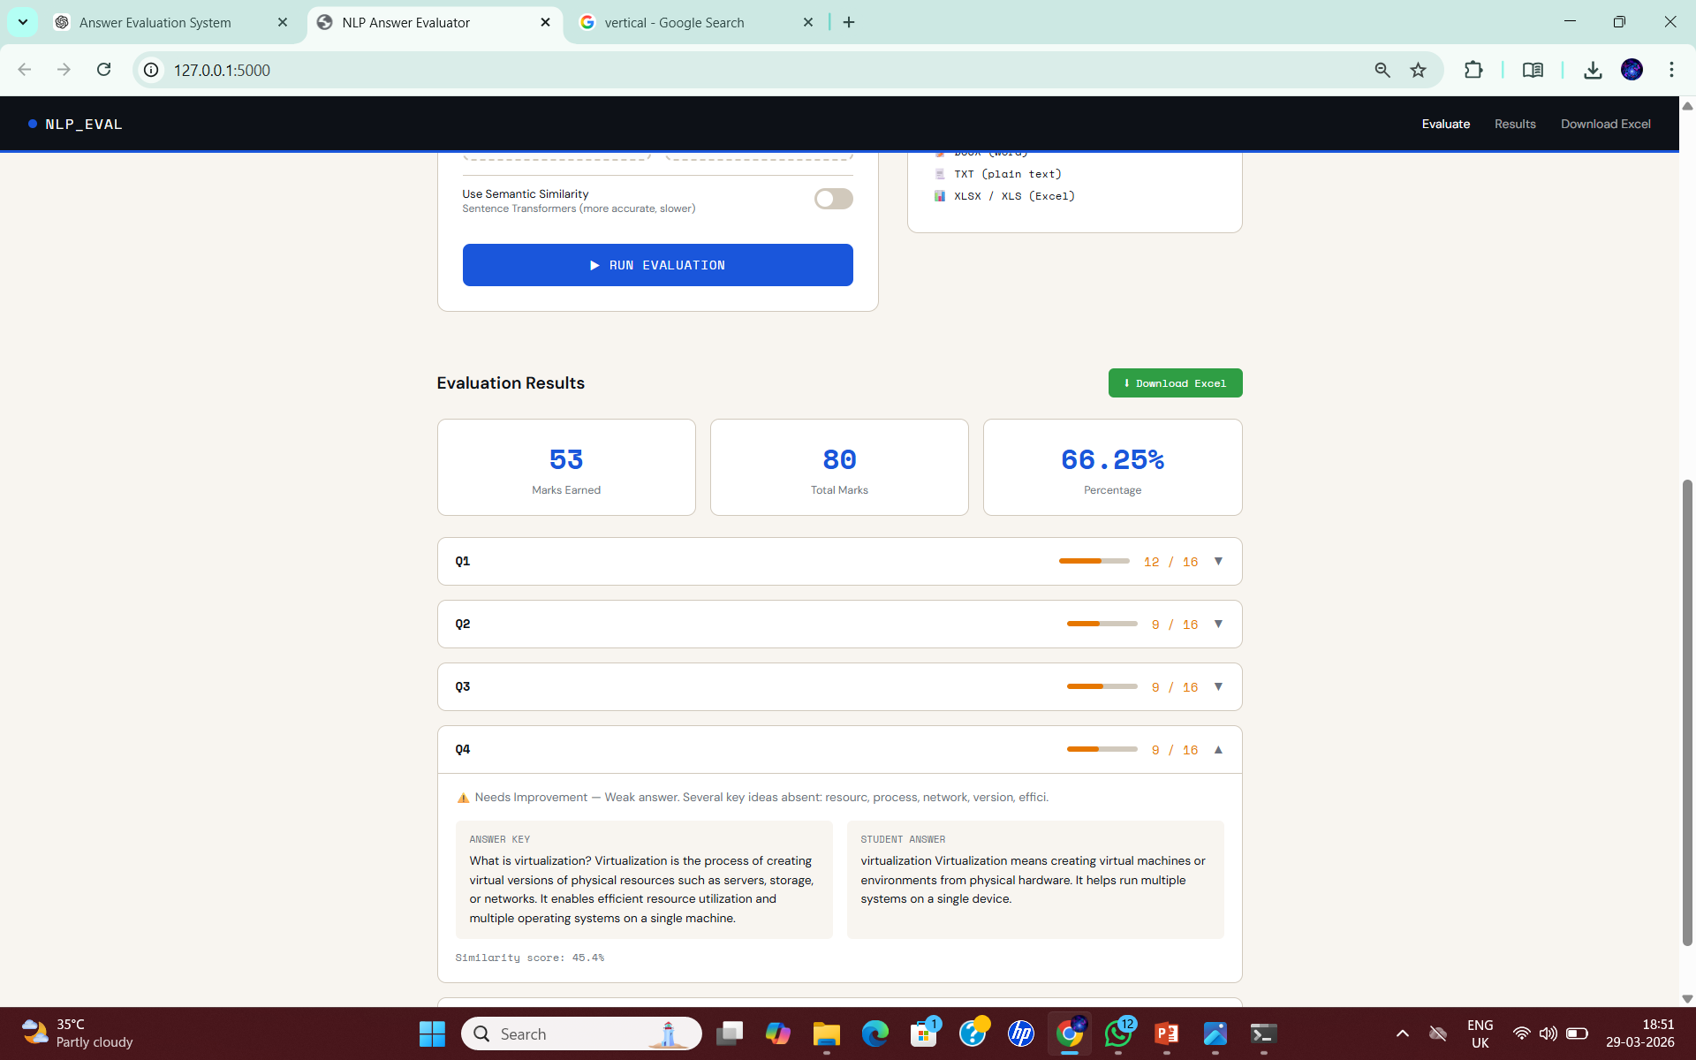
4. SCORING AND FEEDBACK MODULE
Assigns marks based on the computed similarity score.
Calculates total marks and percentage for evaluation.
Classifies answers as correct, partially correct, or incorrect.
Provides feedback highlighting missing or weak concepts.
Displays results in a clear and structured format for easy understanding.

Slide 16
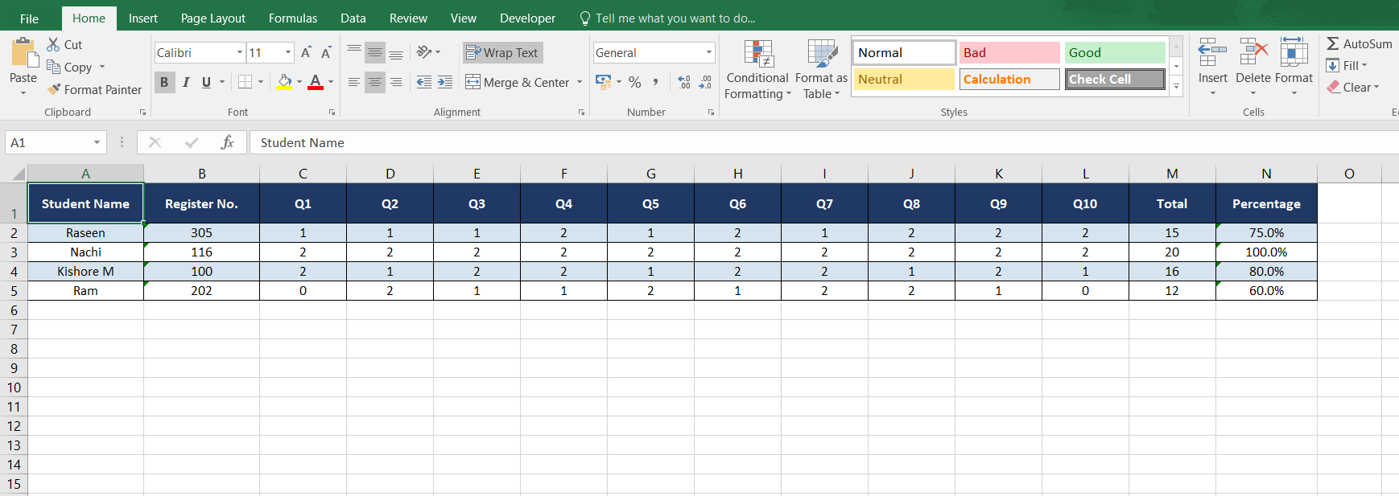
5. DATA STORAGE AND RESULT MANAGEMENT MODULE
Stores evaluation results in a structured format.
Saves student scores, total marks, and percentage.
Maintains question-wise evaluation details.
Generates downloadable reports
(Excel format).
Enables easy access, analysis, and record management.

Slide 17
CONCLUSION
The proposed system successfully,
Automates descriptive answer evaluation using NLP.
Ensures fair, consistent, and efficient grading.
Uses semantic similarity for accurate assessment.
Provides fast results with feedback.
Scalable for future educational applications.

Slide 18
FUTURE ENHANCEMENTS
Mobile application development
Online exam system integration
Grammar and spelling evaluation
Multi-lingual support
LMS integration
Cloud deployment

