Slide 1
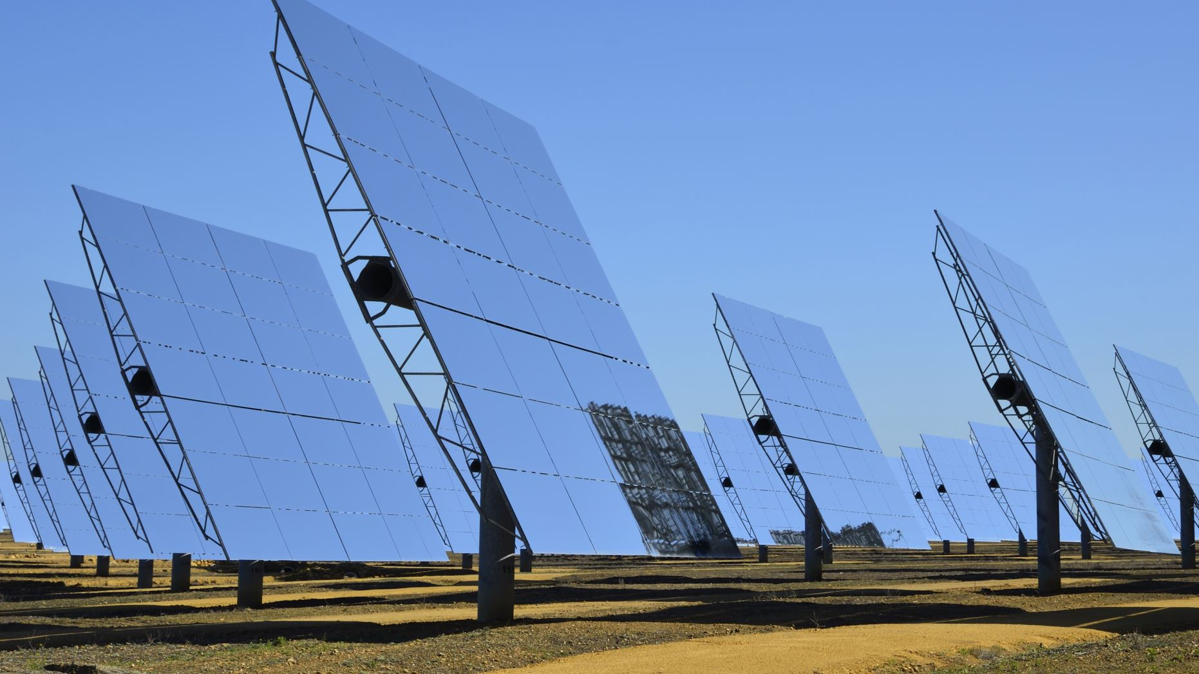
Dual Axis Solar Power Tracker System

Slide 2
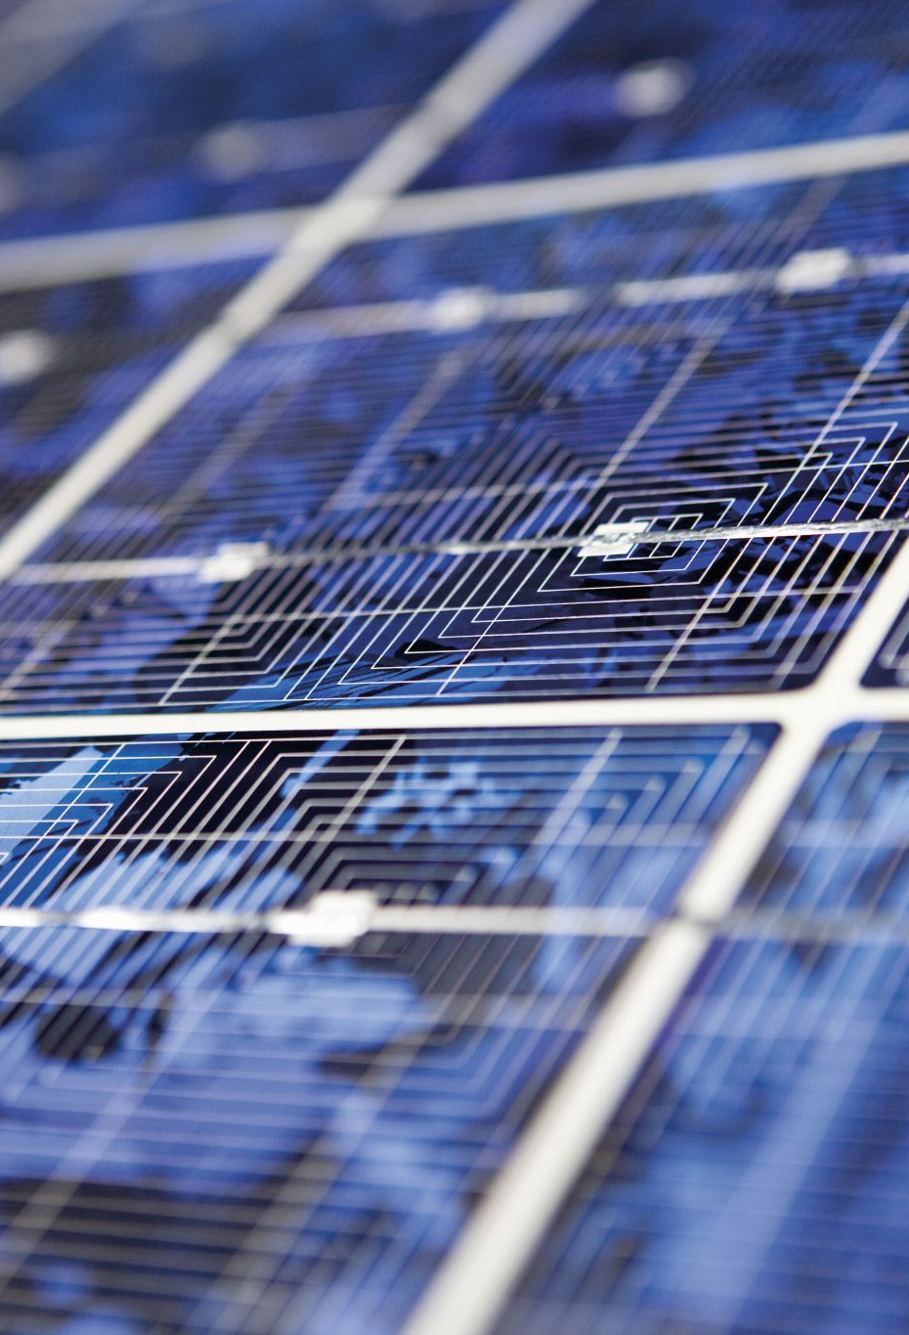
DESCRIPTION
This system requires the involvement of a wide range of engineering including mechanical, electrical, and electronics. The mechanical part would involve designing a smooth gear system to move as per requirement. The electrical part would be the working of solar panel and battery requirement.The electronics would involve designing the sensor system that would generate commands for the gear system to act accordingly. The system employs spur gear for the implementation of the dual-axis solar tracker. The system is implemented using Atmel IC AT89C51.This electrical project is available at Dual Axis solar tracker system.

