Slide 1

Signal Generator and Inverter Using NE555 Timers

Slide 2
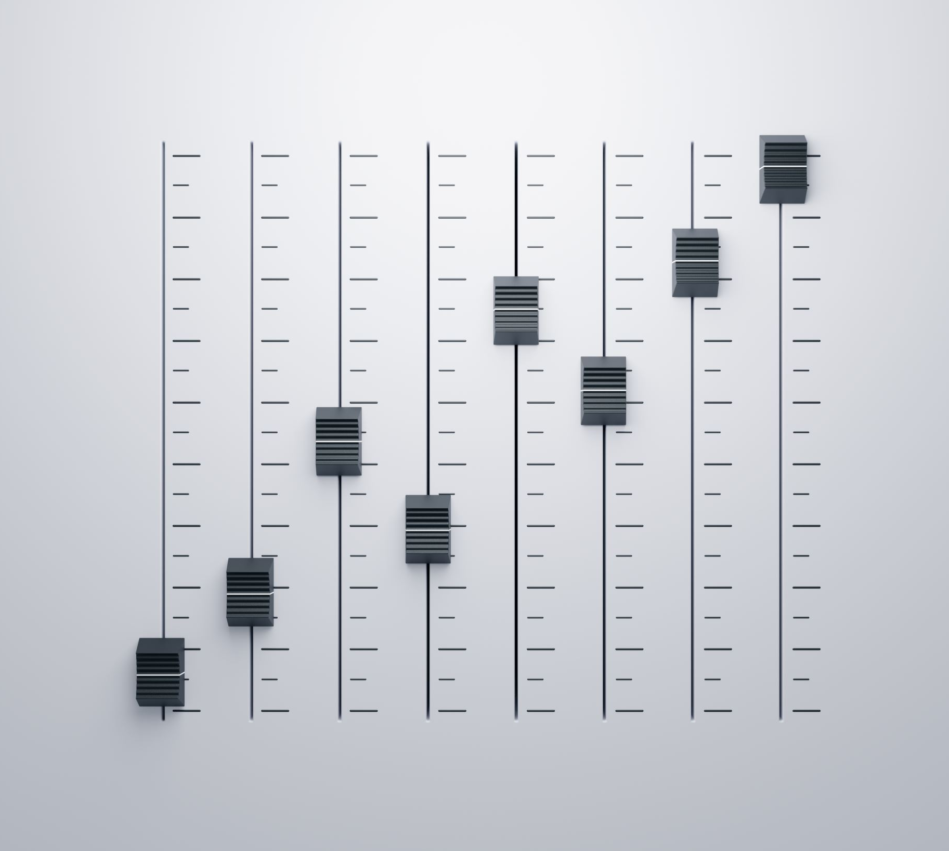
DESCRIPTION
Often we require a squarewave signal generator with adjustable frequency, almost equal high and low output pulses, and adjustable amplitudes.Here we present a simple, useful, and low-cost signal generator built around NE555 timers. Using external switches, you can control or select frequency ranges as per your requirements.This project is available at Signal Generator and Inverter Using NE555 Timers

