Slide 1
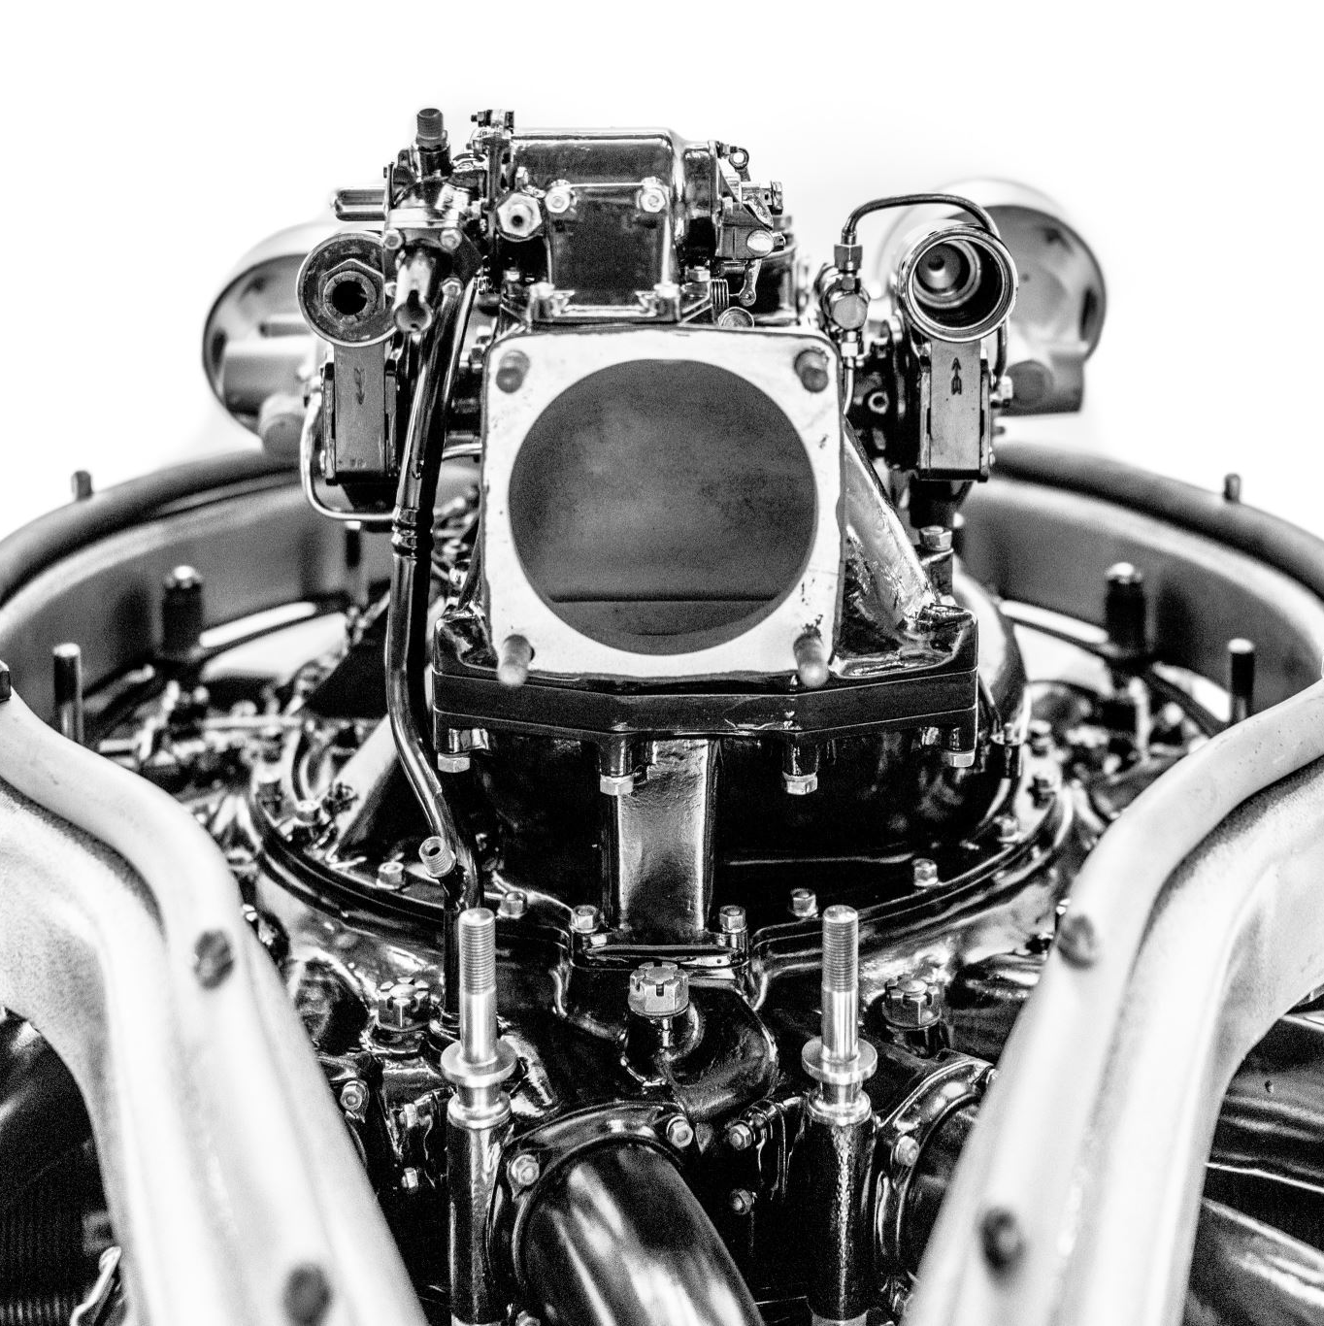
Brushless DC Motor Driver

Slide 2

DESCRIPTION
The brushless DC motor driver circuit described here uses a DRV10866 driver IC to drive a small BLDC fan, without using any position sensors.This project is available at Brushless DC Motor Driver

