Slide 1
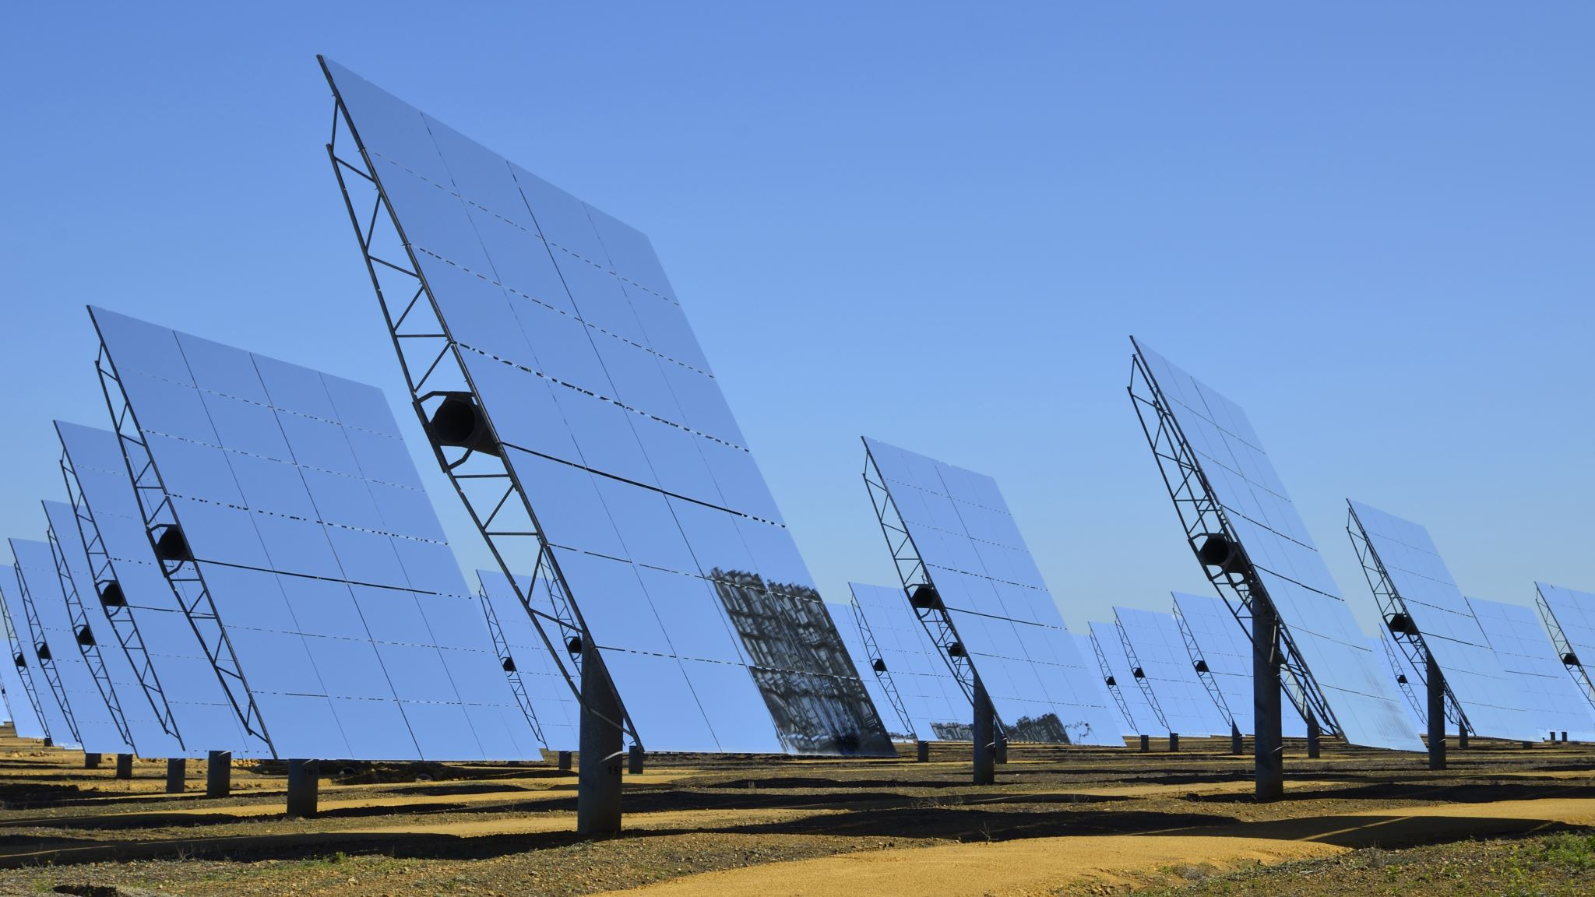
Solar Wireless Electric Vehicle Charging System

Slide 2

DESCRIPTION
Electric vehicles have now hit the road worldwide and are slowly growing in numbers. Apart from environmental benefits electric vehicles have also proven helpful in reducing cost of travel by replacing fuel by electricity which is way cheaper.

Slide 3

Electric vehicles have 2 major disadvantages:
Long charging time – 1-3 hours required for chargingNon availability of power for charging stations in off city and remote areas.

Slide 4
Well here we develop an EV charging system that solves both these problems with a unique innovative solution. This EV charging system delivers following benefits:Wireless charging of vehicles without any wiresNo need to stop for charging, vehicle charges while movingSolar power for keeping the charging system goingNo external power supply neededCoils integrated in road to avoid wear and tear

Slide 5
The system makes use of a solar panel, battery, transformer, regulator circuitry, copper coils, AC to DC converter, atmega controller and LCD display to develop the system. The system demonstrates how electric vehicles can be charged while moving on road, eliminating the need to stop for charging.The solar panel is used to power the battery through a charge controller. The battery is charged and stores dc power. The DC power now needs to be converted to AC for transmission. For this purpose we here use a transformer.The power is converted to AC using transformer and the regulated using regulator circuitry. This power is now used to power the copper coils that are used for wireless energy transmission.

Slide 6
A copper coil is also mounted underneath the electric vehicle. When the vehicle is driven over the coils energy is transmitted from the transmitter coil to ev coil. Please note the energy is still DC current that is induced into this coil. Now we convert this to DC again so that it can be used t charge the EV battery.We use AC to DC conversion circuitry to convert it back to DC current. Now we also measure the input voltage using an atmega microcontroller and display this on an LCD display. Thus the system demonstrates a solar powered wireless charging system for electric vehicle that can be integrated in the road.

Slide 7

COMPONENTS
Atmega ControllerVoltage SensorLCD DisplayTransformerRegulator CircuitryTransmitter and Receiver CoilsVehicle BodyWheelsSwitchesLED’sPCB BoardResistorsCapacitorsTransistorsCables and Connectors

