Slide 1
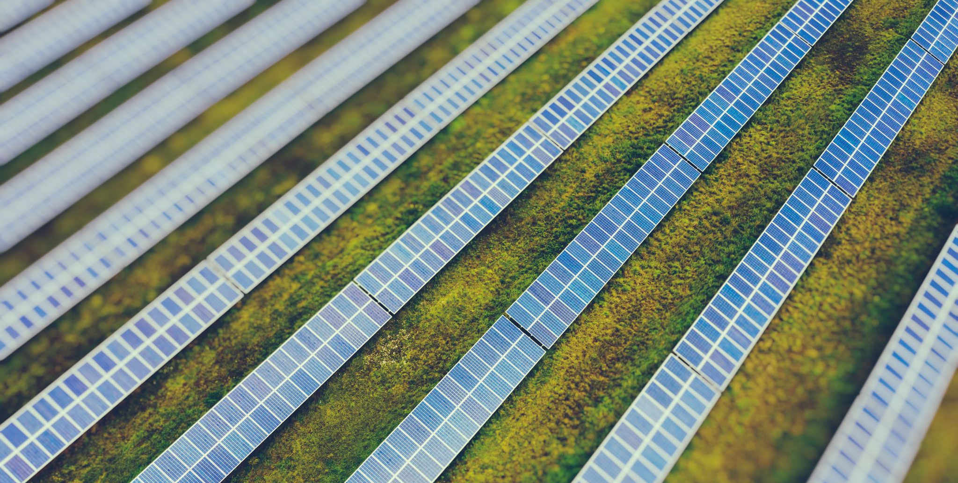

Solar UPS Project

Slide 2

DESCRIPTION
Here we propose a solar based ups project that uses solar energy to charge battery and then the DC battery is used to power an AC load using inverter. Our solar panel is used to constantly charge the 12V DC battery using charge controller circuitry. And once we turn on the load switch the battery charge is inverted and stepped up from 12V DC to around 140 – 150 V AC. This is now provided to the AC load. Thus our system successfully powers AC load using a solar panel and battery. The system can be used as a UPS in case of emergency power cuts or outage and has the capacity to work as a standalone system without the need of any external electricity supply.

Slide 3

COMPONENTS
Hardware SpecificationsSolar PanelResistorsCapacitorsTransistorsCables and ConnectorsDiodesPCB and BreadboardsLEDTransformer/AdapterPush ButtonsSwitchICIC Sockets

