Slide 1
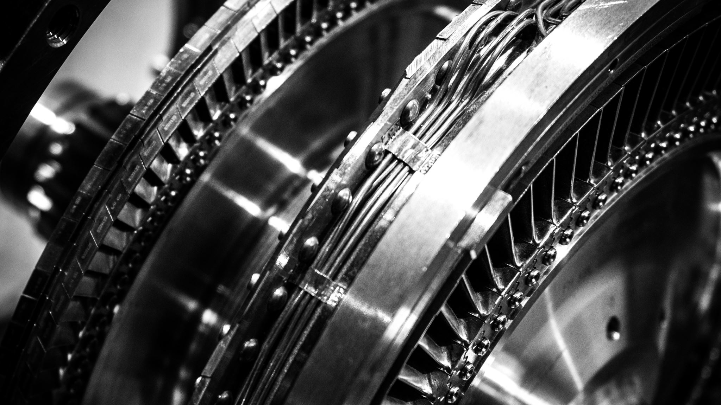
Flexible AC Transmission Using TSC Project

Slide 2

DESCRIPTION
Electrical distribution system suffers from various problems like reactive power burden, unbalanced loading, voltage regulation and harmonic distortion.This project aims at achieving FACTS by using TSC (Thyristor Switch Capacitor). The FACTS device has many advantages over the mechanical switch operated capacitors in the aspects of faster control, improved system performance and system voltage stability. The project requires an operational amplifier that generates lag time between zero voltage pulse and zero current pulse. This lag time is given to two interrupt pins of microcontroller of 8051 family. The programmed microcontroller then initiates shunt capacitors for compensating the current. SCRs arranged in series interfaced with microcontroller through optical isolation are used for switching capacitor.

Slide 3
Hardware Specifications
Lamp
Choke
8051 Microcontroller
LCD Display
Crystal Oscillator
Resistors
Capacitors
Transistors
Cables and Connectors
Diodes
PCB and Breadboards
LED
Transformer/Adapter
Push Buttons
Switch
IC
IC Sockets
Software Specifications
Keil Compiler
MC Programming Language: C

