Slide 1


Supervisory Controlling Plus Data Acquisition For Remote Industry

Slide 2

DESCRIPTION
The project designed is a data acquisition system under supervisory control which is essential in large industrial environment. SCADA is a technology that is used to track and control all the processes in industries and saves a lot of manpower. The project uses temperature sensors interfaced to a microcontroller of 8051 family to constantly monitor the remote plant operations. The microcontroller is connected to a PC which constantly receives the data recorded by the temperature sensors through microcontroller. With the help of a DAQ system software installed on the PC, the temperature values are displayed and stored in the database. There are parameters provided in the system such as set point, high or low point in the PC. Whenever the recorded temperature goes beyond or below the set point, the microcontroller turns off or on the lamps through relays interfaced to it respectively. When the temperature reaches high or low limit an alarm on the PC is initiated to avoid system failure.

Slide 3
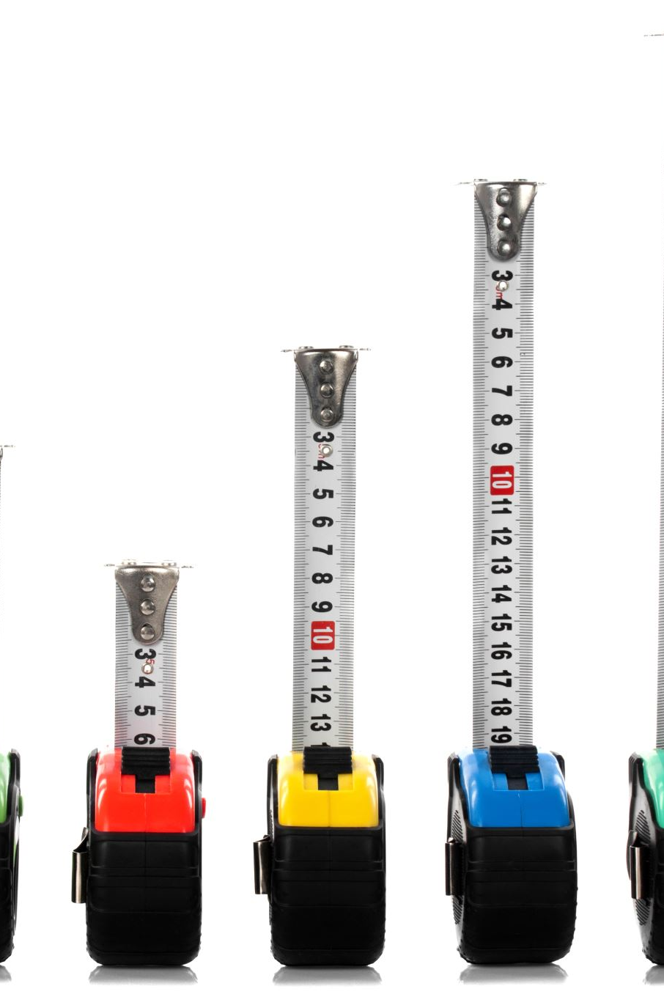
Hardware Specifications
8051 Microcontrolle,Relay,Relay Driver IC,MAX232 IC,IC Socket,LM35 Temperature Sensor,DB9 Connectors,Resistors,Capacitors,Transistors,Cables and Connectors ,Diodes,PCB and Breadboards,LED,Transformer/Adapter,Push Buttons,Switch,IC,IC Sockets,Loads,Software Specifications,Keil µVision IDE,MC Programming Language: C,

