Slide 1

Monthly Electricity Billing Display With Bill SMS Feature

Slide 2
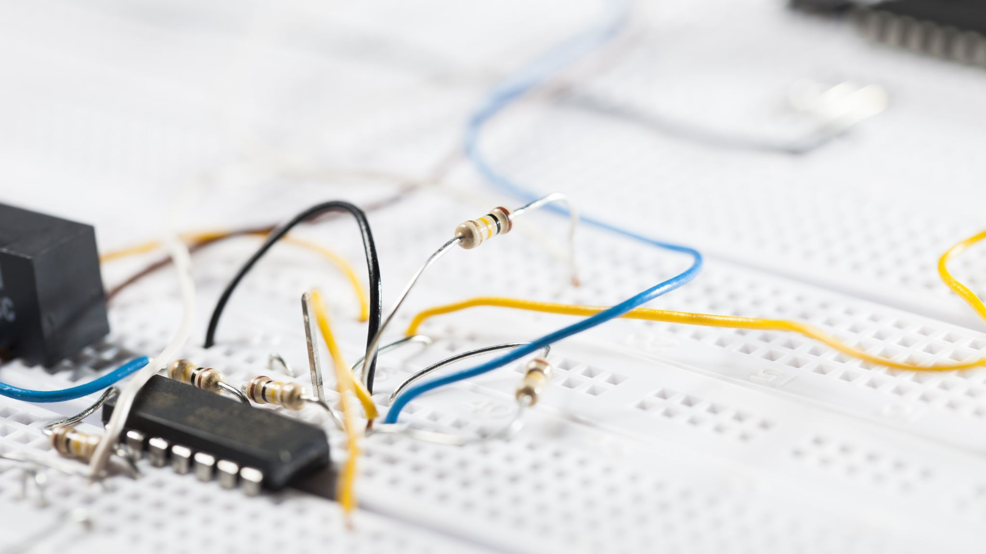
DESCRIPTION
The project provides a system that allows for consumed electricity reading in units as well as the amount charged over it to the user. Our system provides the electricity readings on an LCD screen as well as can sms this reading and cost in rupees to the user.This lets the user know about his exact electricity units consumed and cost directly from his meter so that there is no chance of bill tampering. The project allows a two way reading. One on LCD display and the second on sms.Our project consists of n gsm modem connected to a microcontroller of 8051 family. The system continuously monitors electrical pulses and calculates the unit consumption. The system then uses the cost of each unit to calculate the electricity cost.It then sends all this data to user and electric company via sms and also displays it on an LCD screen for viewing. The system can be further enhanced to receive user messages and control load operations.

Slide 3
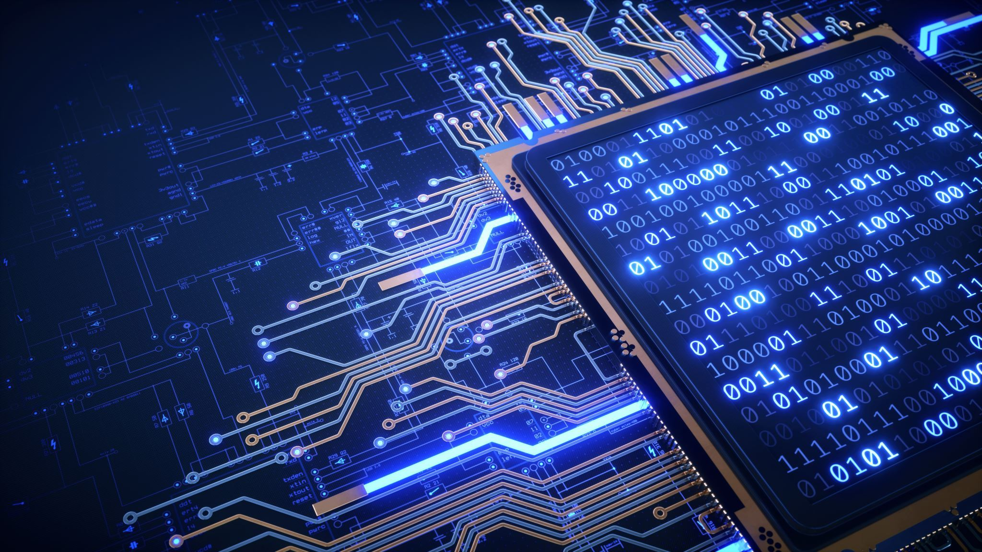
Hardware Specifications
8051 MicrocontrollerSIM 800 GSM ModuleCrystal OscillatorResistorsCapacitorsTransistorsCables and ConnectorsDiodesPCB and BreadboardsLEDTransformer/AdapterPush ButtonsSwitchICIC SocketsEnergy MeterLampSoftware SpecificationsKeil µVision IDEMC Programming Language: C

