Slide 1


Automated Pump System & Irrigation to Farm lands
KISHORE KUMAR P B (II YEAR CSE)
ASWIN KUMAR S (II YEAR CSE)
ARUN A D (II YEAR CSE)

Slide 2
CONTENT
Problem
Solution
Abstract
Hardware and Software Implementation
Application

Slide 3
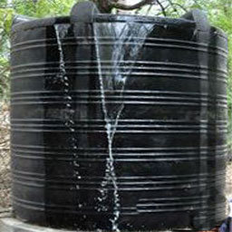
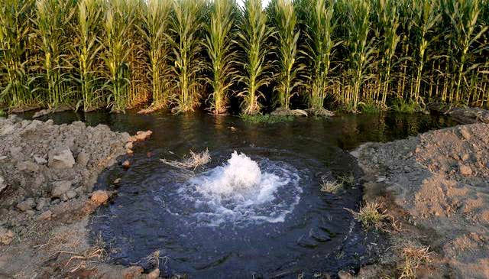
PROBLEM
*Overflow of water in Tank *Overflow of Water in soil during
irrigation(it affect top layer of soil)

Slide 4
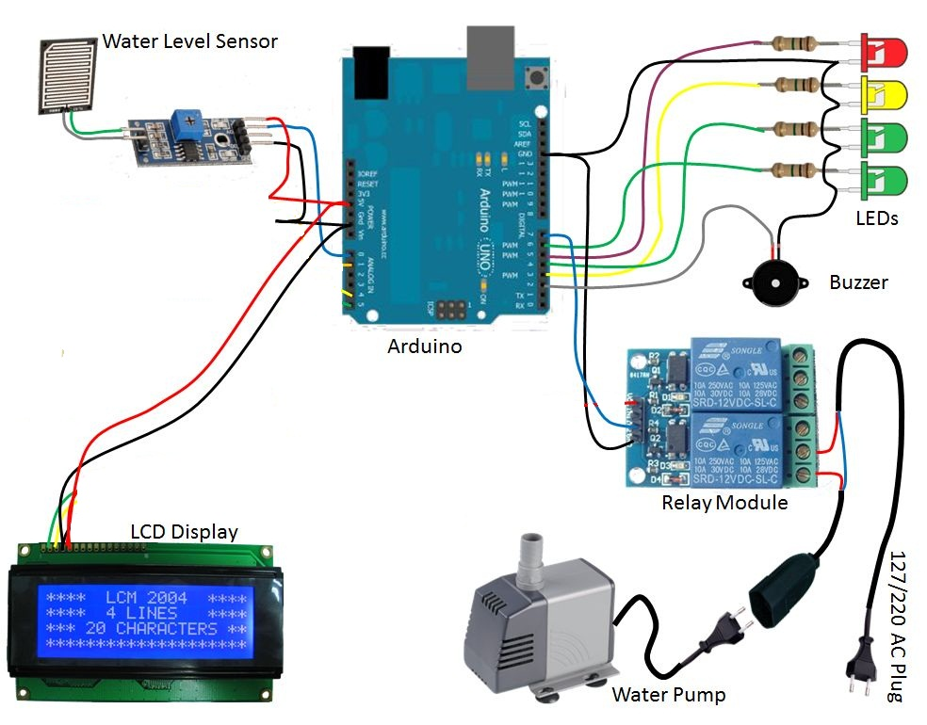
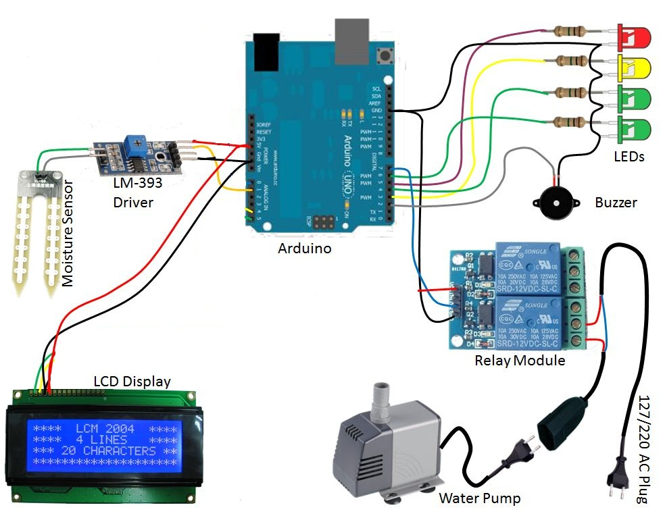
SOLUTION
*Automated Water Pump System *Automated Irrigation System

Slide 5
ABSTRACT
Water supply is the most important activity in daily home/office environment.
The Project is designed to develop an automated Water Pump System /irrigation system which switches the pump motor ON/OFF on sensing the water level of the tank and the moisture content of the soil.
The Project uses an Arduino UNO r3 (AT mega18)Microcontroller which is programmed to receive the input signal of Water Level in the tank and moisture content of the soil.
This is achieved by using LM392 comparator which acts as interface between the sensing arrangement and the microcontroller.
An LCD display is also interfaced to the microcontroller to display status of the water level and moisture content.

Slide 6
To improve irrigation water use efficiency, reduce cost of irrigation water, we design of wireless Internet technology of farmland uses automatic irrigation control.
mobile phone or wireless of iot will constitute a variety of sensors intelligent network, thus enhancing the overall automation system and monitoring level
User use mobile phones to measure soil moisture content and control to realize the irrigation automation by sms when farms get dry .
When user receive the message user manually can ON the system by calling/sms to particular number . A Mobile app is developed to ON/OFF of the motor.
We hope this system in society will enjoy supplying water without their worries related to water spills and electrical consumption.

Slide 7
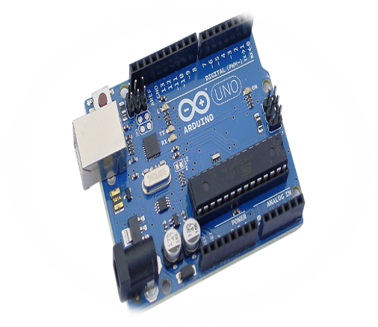
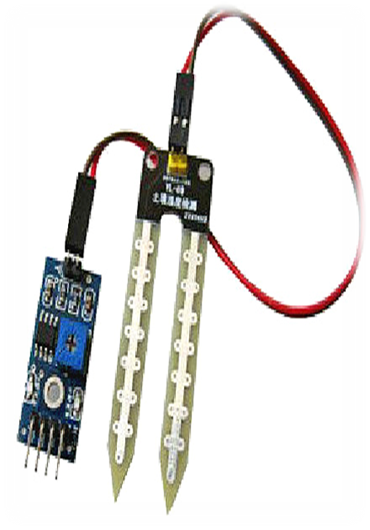
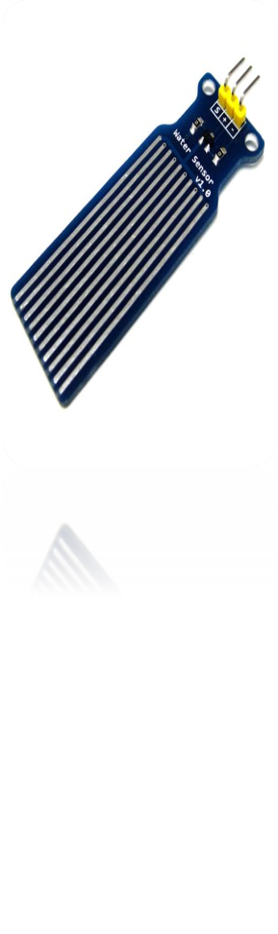
HARDWARE AND SOFTWARE IMPLEMENTAION
HARDWARE:
Arduino uno R3
Soil Moisture sensor
Water level sensor
2 – channel relay
Jumped wires
16x2 LCD display
Gsm module

Slide 8
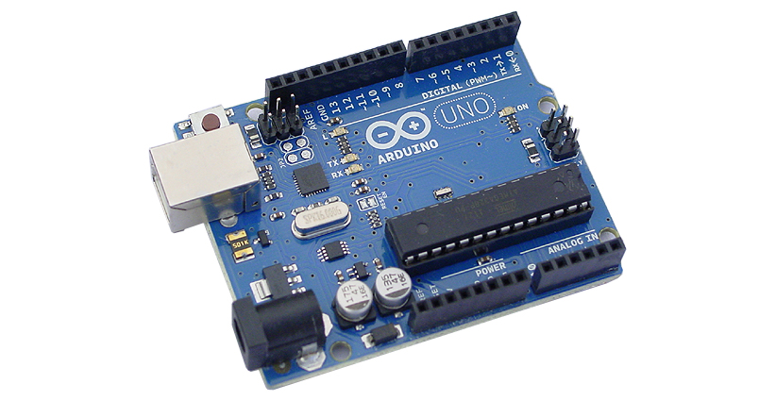
ARDUINO UNO R3
Arduino is a popular open-source development board for engineering based projects.
It consists of a microcontroller (AT mega 32), with a USB programmer. The crystal oscillator used to convert the signals in form of electrical inputs.

Slide 9
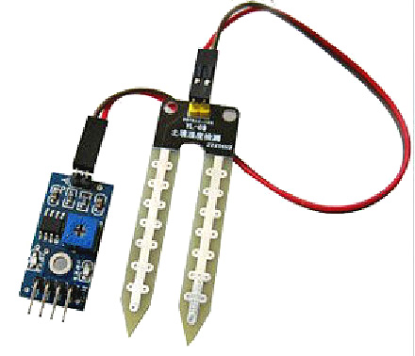
MOISTURE SENSOR
The moisture sensor provides an analogue output, which can easily be interfaced with Arduino.
Each sensor has four pins (Vcc, Gnd, Ao and Do) available for interfacing with the Arduino board.

Slide 10
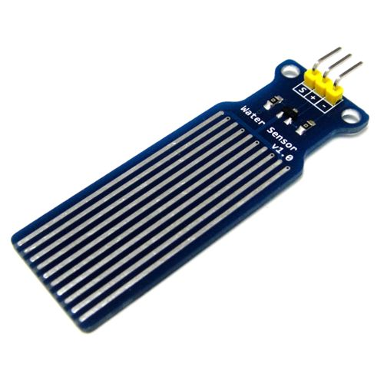
Water Level Sensor
The role of the water level sensor is used to measure the water content in the tank.
Level sensors are used to detect the level of water .
Level measurements can be done inside the tank with help of the sensor.
Such measurements can be used to determine the amount of water within a water tank .

Slide 11
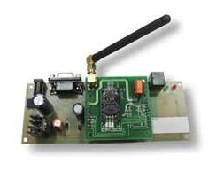
GSMModule
GSM system was developed as a digital system using time division multiple access (TDMA) technique for communication purpose.
A GSM digitizes and reduces the data, then sends it down through a channel with two different streams of client data, each in its own particular time slot.
The digital system has an ability to carry 64 kbps to 120 Mbps of data rates.

Slide 12
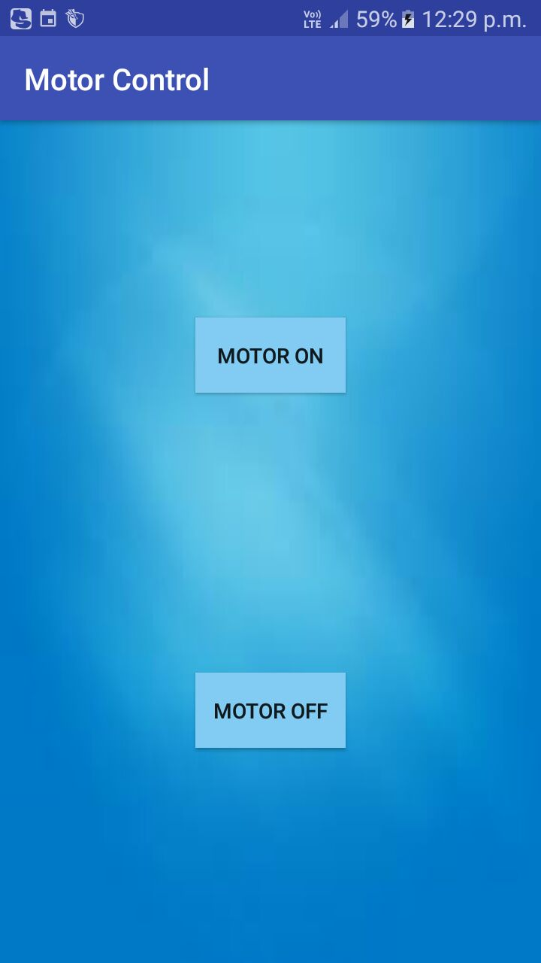
SOFTWARE:
Mobile Application to ON/OFF the motor manually.

Slide 13
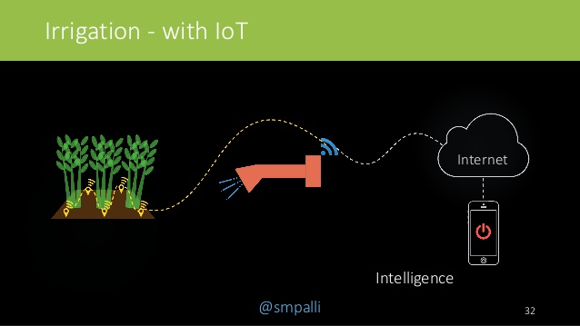
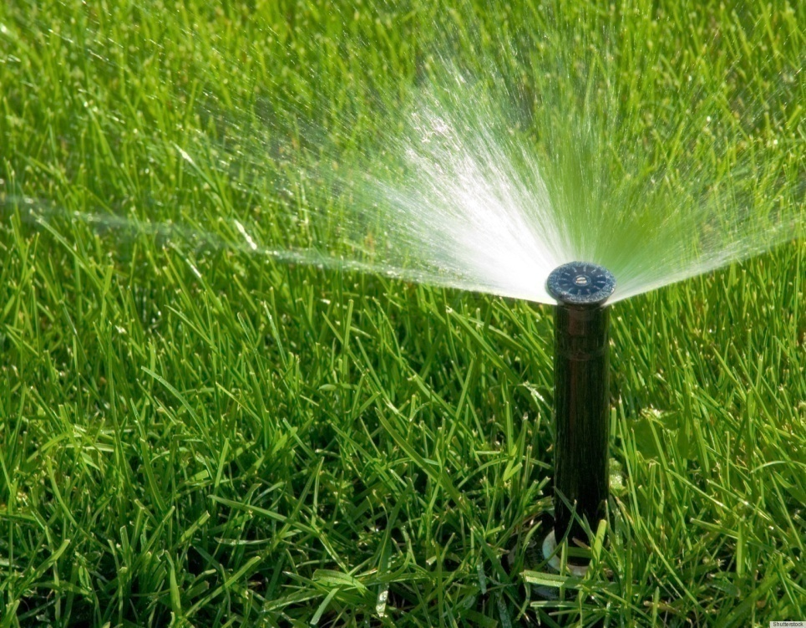
Irrigation using iot:

Slide 14
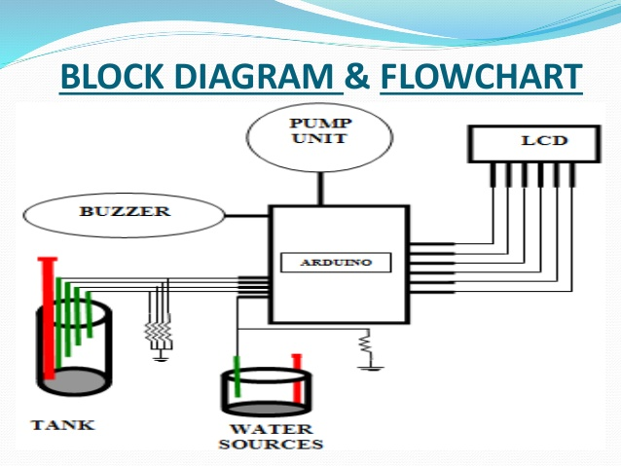
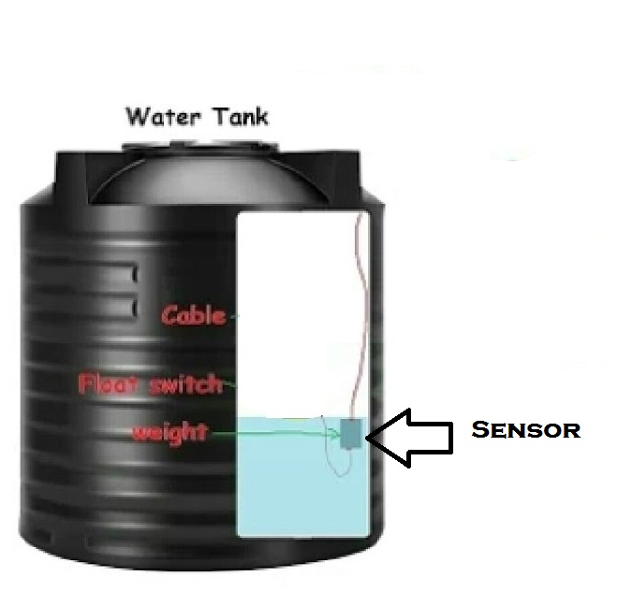
TANK SYSTEM USING IOT:

Slide 15
APPLICATION:
Minimizes water waste, water spills and wasteful electrical consumption.
The circuit is designed to work automatically
There is no need for any human intervention and maintenance free .
The real time access of this project is easy to operate for farmers .
Manual ON/OFF of Motor can also be done.

Slide 16

Thank you
DEPARTMENT OF CSE
JAYA ENGINEERING COLLEGE
THANKS TO:
Mr.Kumaran(HOD OF CSE)
Mr.Bharathi Mohan
Mr.Subbiah
PROJECT CO-ORDINATOR:
GOWTHAMANN (4th year)
LOKESH KUMAR (4th year)
SHIVA SHANKAR
THANKS TO:
Mr.Kumaran (HOD OF CSE)
Mr.Bharathi Mohan
Mr.Subbiah

