Slide 1
Analysing Job Portal using Twitter Data
Internship Project | March – June 2025
Kishore P
St. Peter’s College of Engineering and Technology

Slide 2
Project Overview
Objective: Analyze job postings using Twitter data and build a dashboard in Power BI.
Tools Used: ChatGPT, Excel, Power BI
Skills Applied: Data Extraction, Cleaning, DAX, Visualization

Slide 3
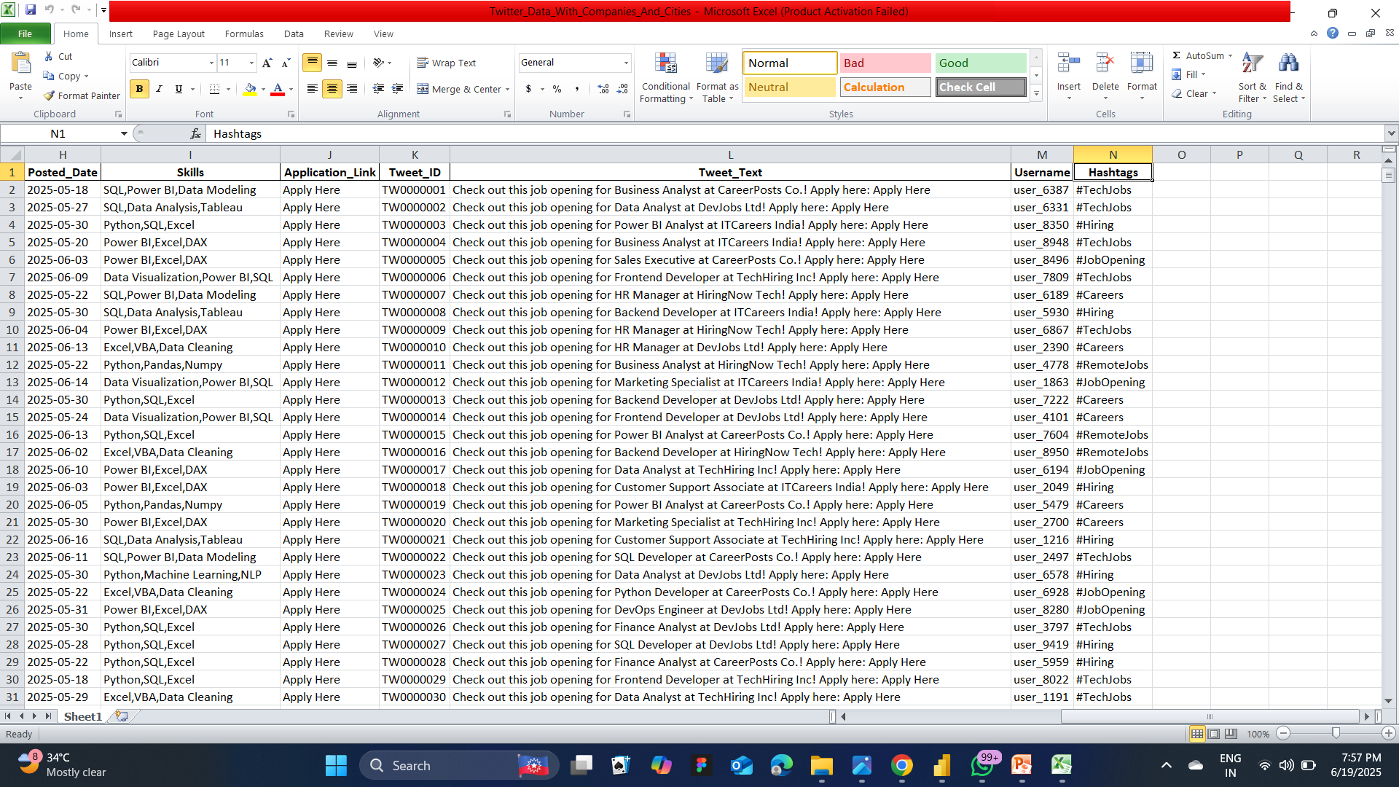
Dataset Snapshot from Excel

Slide 4
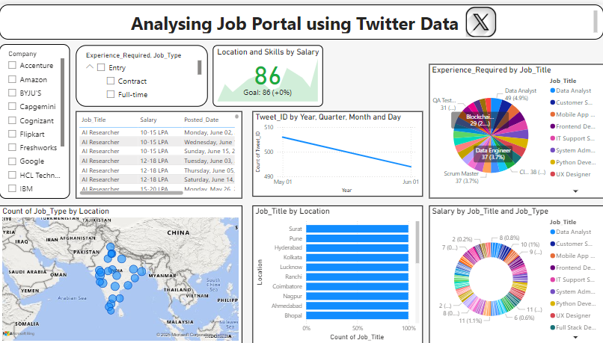
Power BI Dashboard View

Slide 5
Workflow Overview
Extract Dataset using ChatGPT
Filter and Clean Data in Excel
Create Interactive Dashboard using Power BI

Slide 6
Key Insights
AI Researcher and Data Engineer are top roles
Full-time positions are most common
Locations like Mumbai, Pune, and Hyderabad dominate job count
Job type and salary vary across experience levels

Slide 7
Challenges Faced
Raw tweet data required extensive cleaning
Mapping correct job attributes
Ensuring visual clarity and dashboard interactivity

Slide 8
Why This Project?
To explore real-time job data trends from Twitter
To apply data analysis in a meaningful context
To develop strong visualization and storytelling skills

Slide 9
Skills Gained
Power BI Dashboard Development
Excel-based Data Cleaning
Using ChatGPT for dataset generation and automation

Slide 10
Conclusion
Successfully analyzed job data extracted from Twitter using ChatGPT, Excel, and Power BI.
Built an interactive dashboard to visualize job trends by role, location, type, and salary.

Slide 11
THANK YOU

