Slide 1

Internet of Things (IOT)
Connecting the World through Smart Technology
NOV
2025
Name:-KISHORE R
Course:-CP01
Section:-D1-B
Centre:-THALASSERY

Slide 2
Topic:- Introduction
IOT stands for Internet of Things.
It refers to a network of physical devices connected to the internet.
These devices collect and share data with each other.
IOT helps in making our daily life easier, smarter, and more efficient.
Examples: Smartwatches, smart homes, connected cars, etc.

Slide 3
Topic:- Definition
“The Internet of Things (IOT) is a system of interrelated computing devices, mechanical and digital machines, or objects that can transfer data over a network without human intervention.”

Slide 4
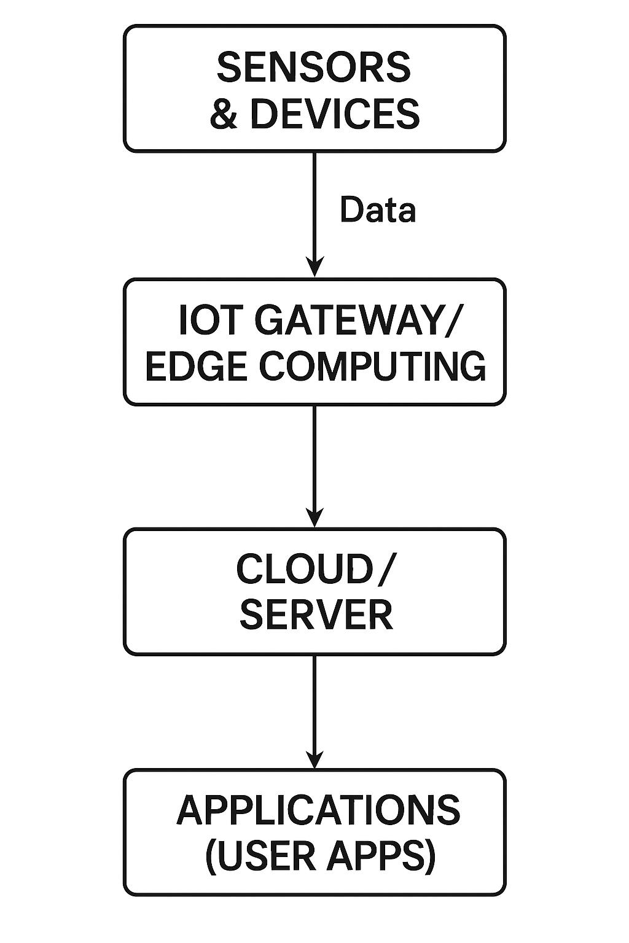
Topic:- IOT Diagram

Slide 5
Topic:- Applications of IOT
Smart Homes (lighting, security, appliances)
Smart Cities (traffic control, waste management)
Healthcare (patient monitoring)
Agriculture (smart irrigation)
Industrial automation

Slide 6

Topic:- VIDEO

Slide 7
Topic:- Conclusion
IOT is revolutionizing the way we live and work.
It creates smart, connected environments.
Future of IOT is promising with AI, cloud, and 5G.
However, security and privacy are key challenges.

Slide 8
THANK YOU

