Slide 1
Real-time data from Classroom
Challenge 2- Brac Education Program
Team- Shongshoptok
Kishwara Sadia
Albina Alam
Rehnuma Reza Deepty

Slide 2

Brac Education Program
Pre-primary schools: 6102
Primary schools: 2485
Single Classroom School:2235
Multi Classroom School:81
Total Number of Schools:8024

Slide 3
Problems BEP facing
Lack of connectivity between rural schools with Management
Time constraint of teacher
Manual attendance system leaving no evidence
No real-time data of student performance
Dropouts
No real-time school infrastructure data
Lack of variations
Large Number of PO involvements

Slide 4
Existing Solutions
SMS-based Attendance System
BEP Management System
School Supervision Tools (SST)
Teacher-Student App

Slide 5


What we bring Here
Real-Time data collection System compatible with BEP- MIS
Easy Bangla Android app for teachers
BEP-MIS

Slide 6
How our System works
Teacher Operating Mobile App
1
Uploading image for attendance
Teacher Operating Mobile App
Sending student evaluation and emergency information
2
3
Real-time database
Storing all information sent by the teacher
BEP-MIS
Attendance & Monthly/weekly information representation and analysis
4
5
BEP-MIS
Sending Education tools according to analysis and responsing to emergency situation
Teacher Mobile App
Happy Learing!
6

Slide 7
How our system will make a differenence
1
Management reponsing to emergency situation immediately
2
Evaluation Analysis based Education Tool and variations

Slide 8
How our system will make a differenence
1
Management reponsing to emergency situation immediately
Evaluation Analysis based particular study plan and education materials
2
information of dropout students and take actions for it
3

Slide 9
How our system will make a differenence
1
Management reponsing to emergency situation immediately
2
Evaluation Analysis based particular study plan and education materials
3
information of dropout students and take actions for it
4
Low cost Technology

Slide 10
How our system will make a differenence
1
Management reponsing to emergency situation immediately
2
Evaluation Analysis based particular study plan and education materials
3
information of dropout students and take actions for it
4
Low cost Technology
5
User-Friendly and Sustainable

Slide 11
How our system will make a differenence
Management reponsing to emergency situation immediately
1
Evaluation Analysis based particular study plan and education materials
2
3
information of dropout students and take actions for it
4
lessening number of PO visits
5
Low cost Technology
6
User-Friendly and Sustainable

Slide 12
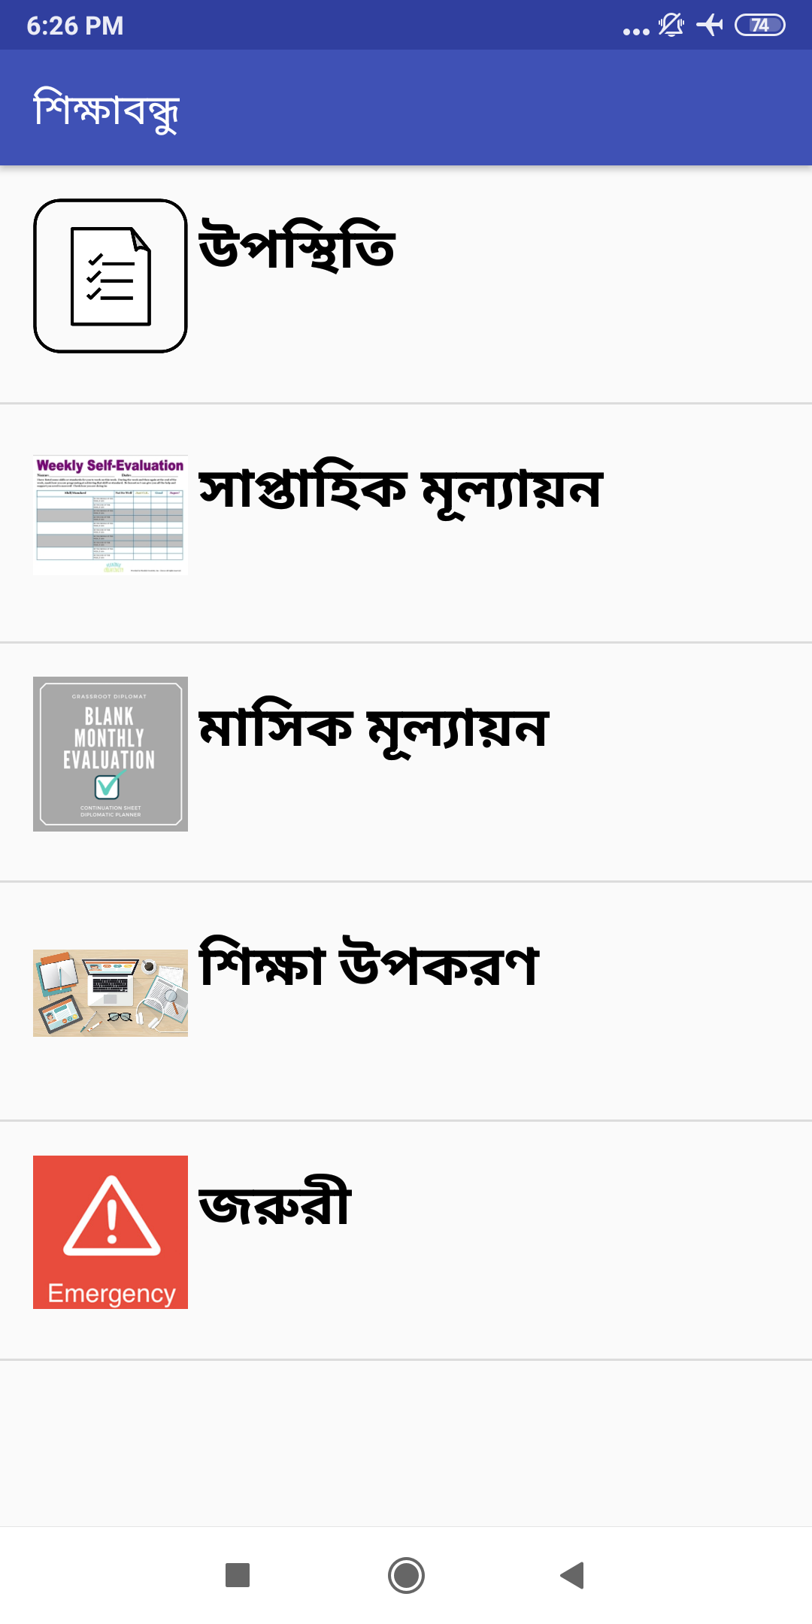
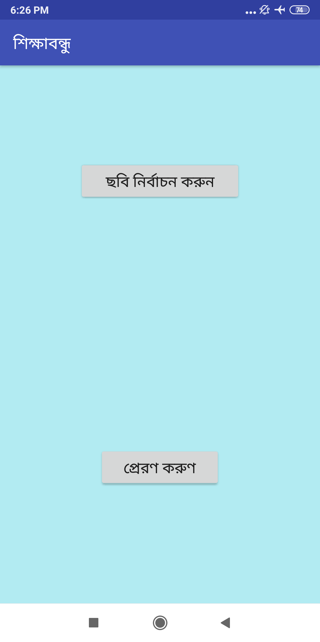
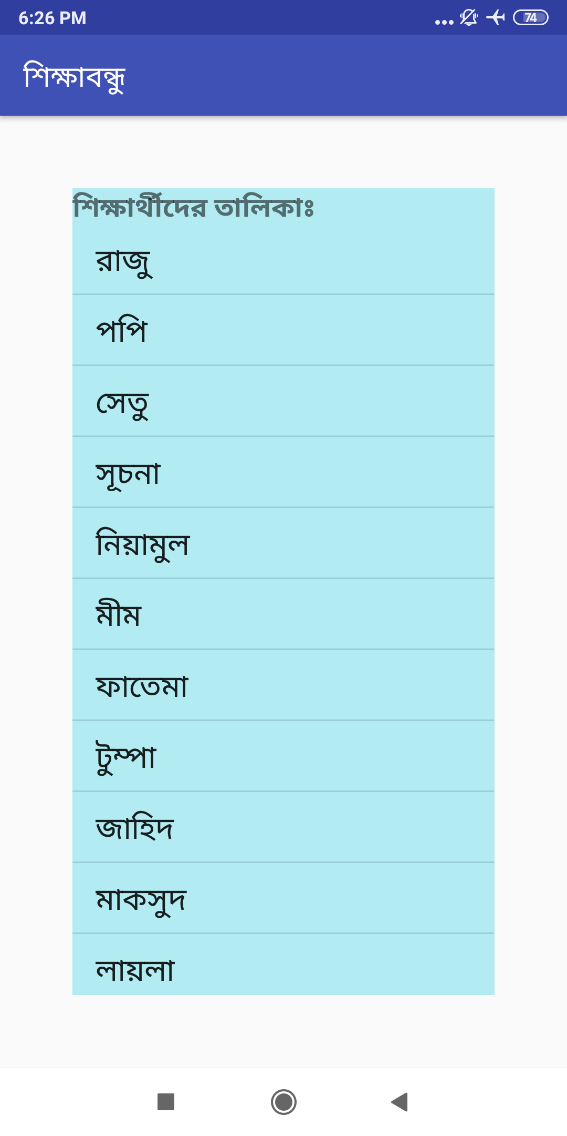

Slide 13
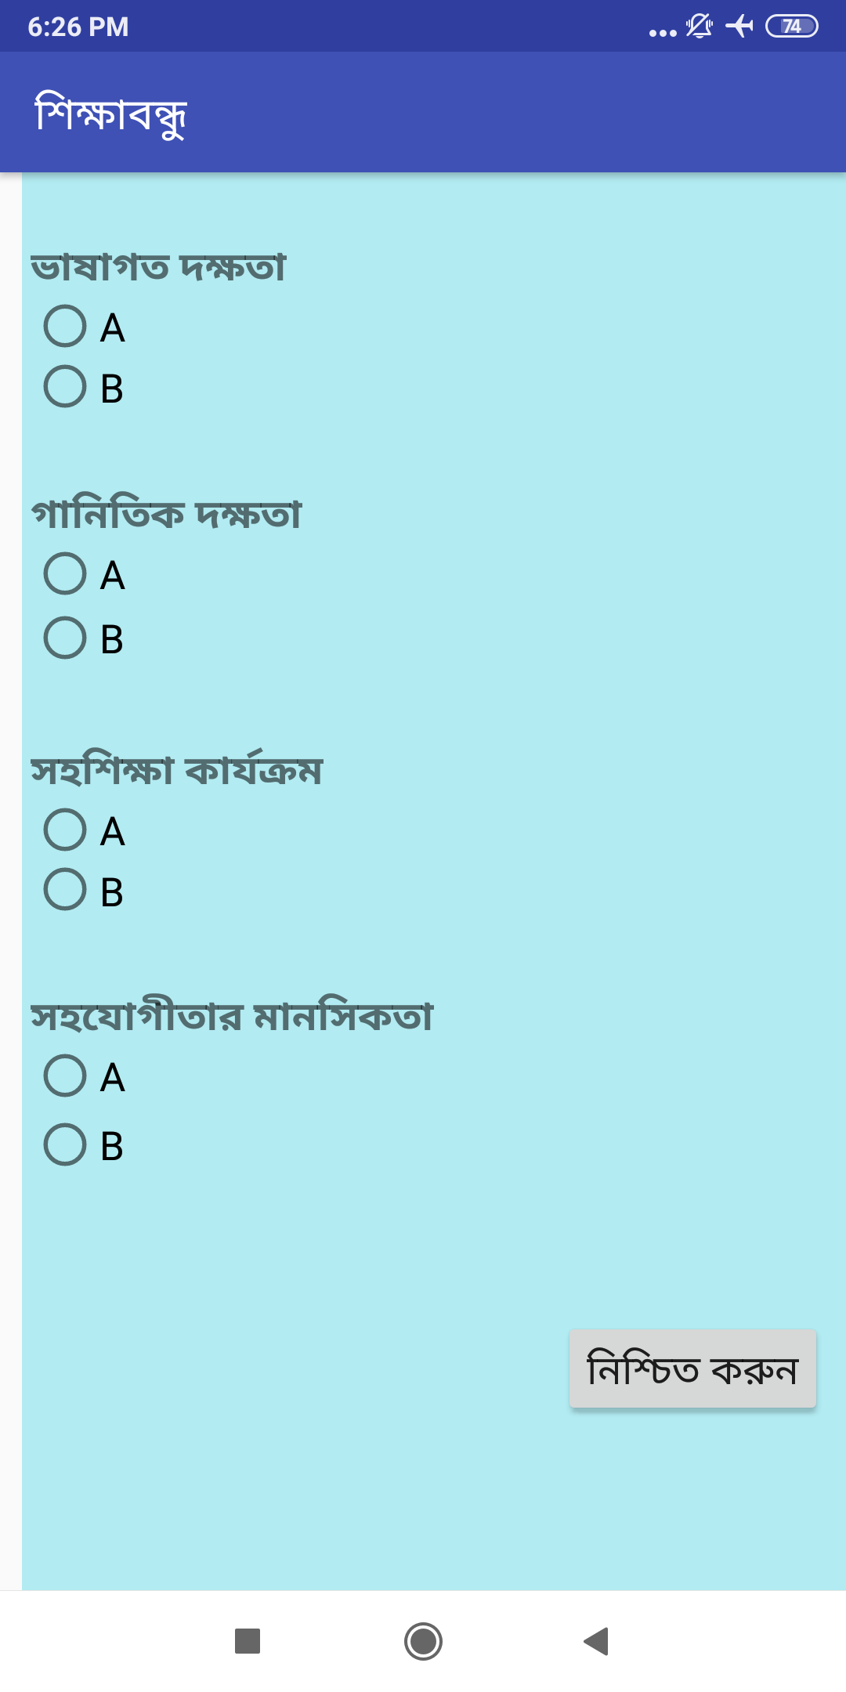

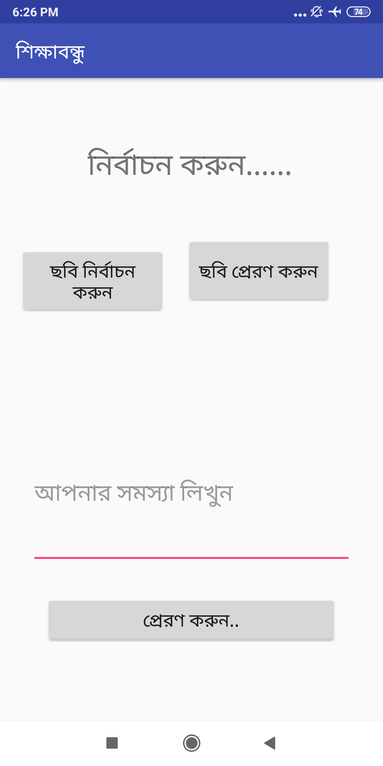

Slide 14
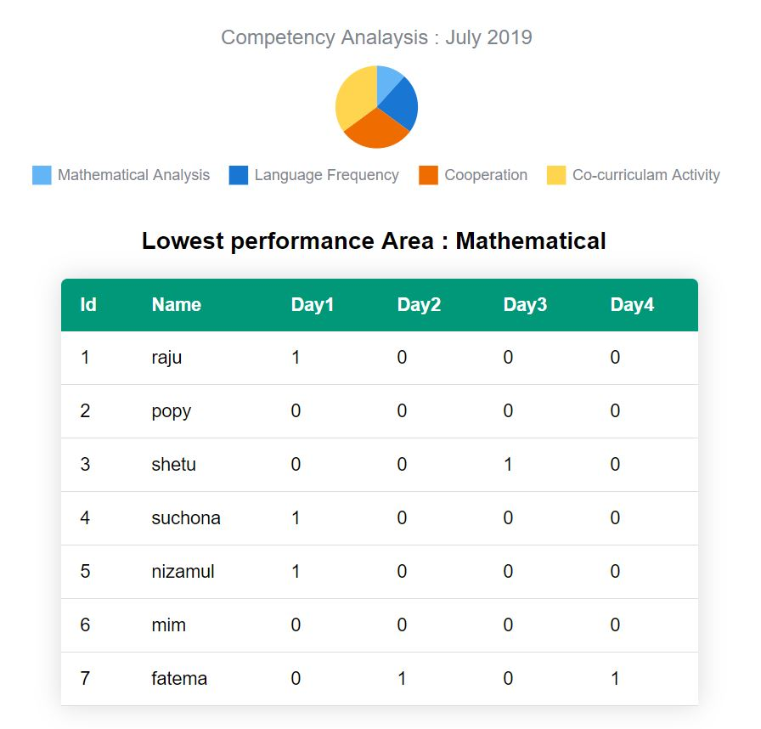

Slide 15
THANKS

