Slide 1

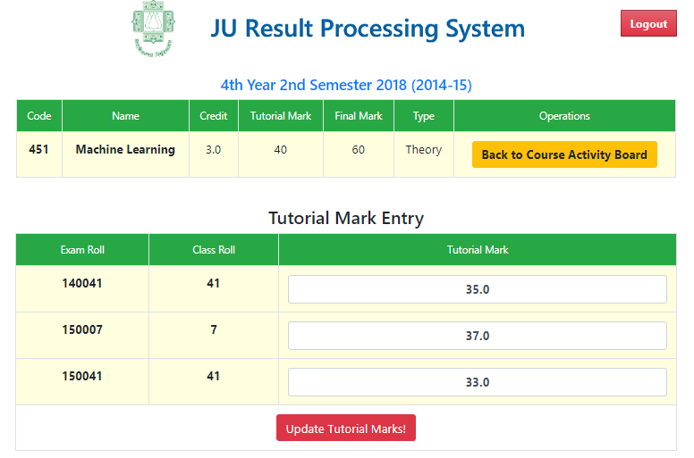
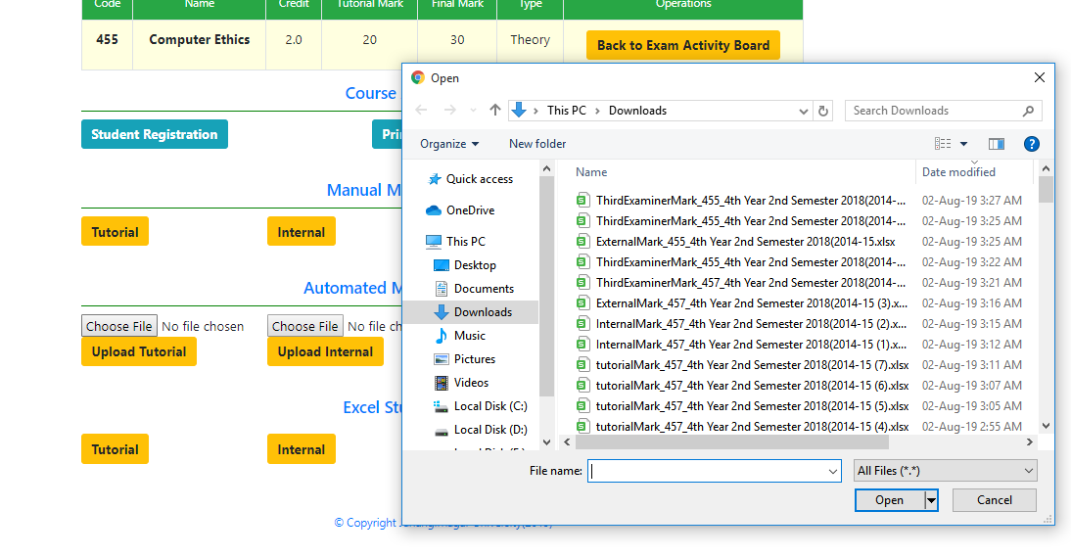
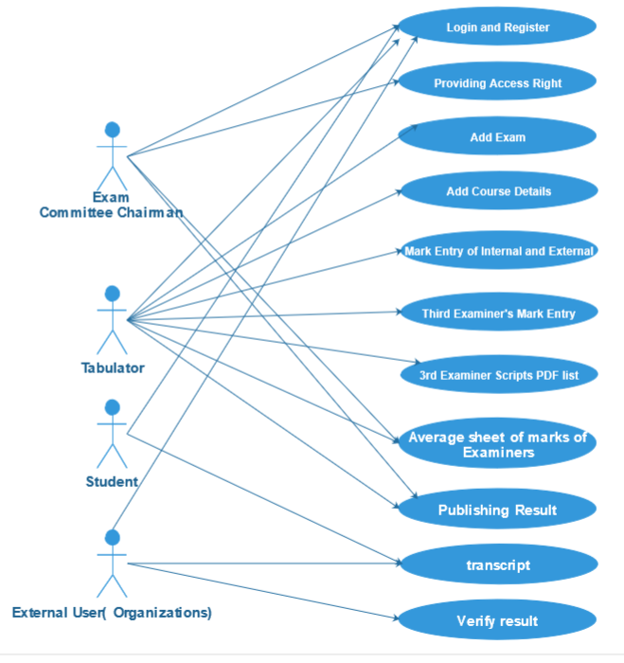
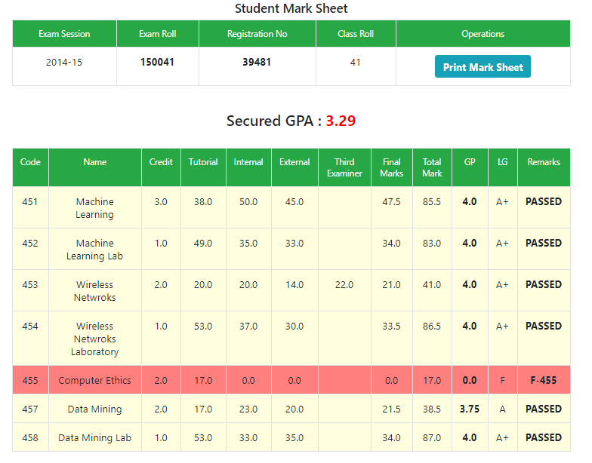
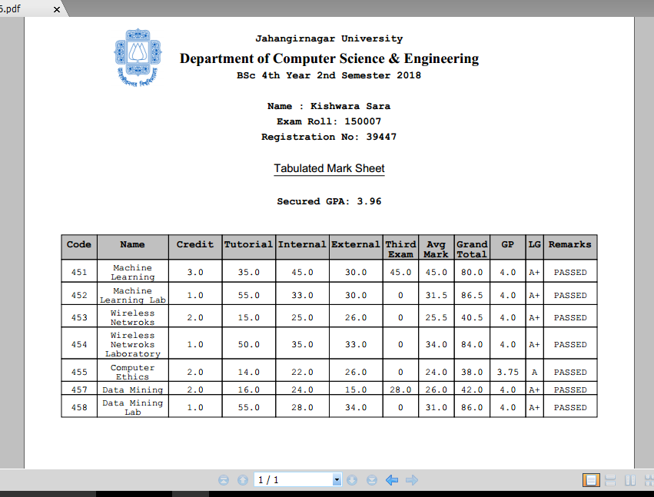
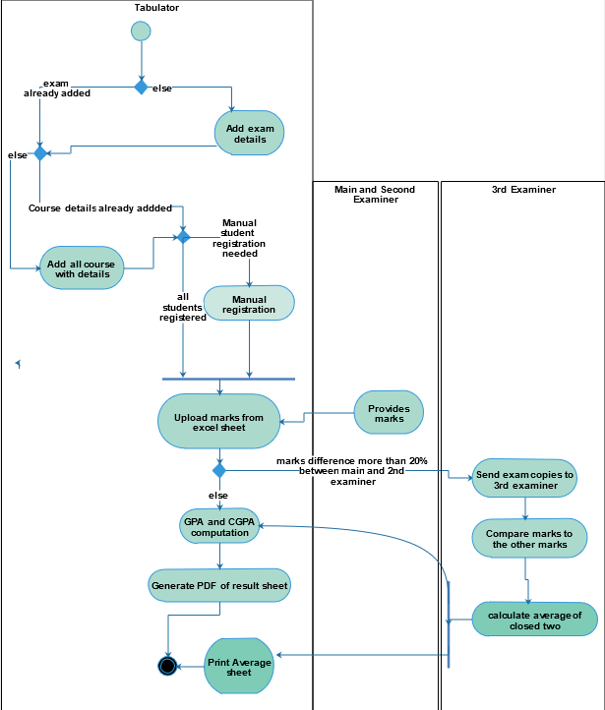
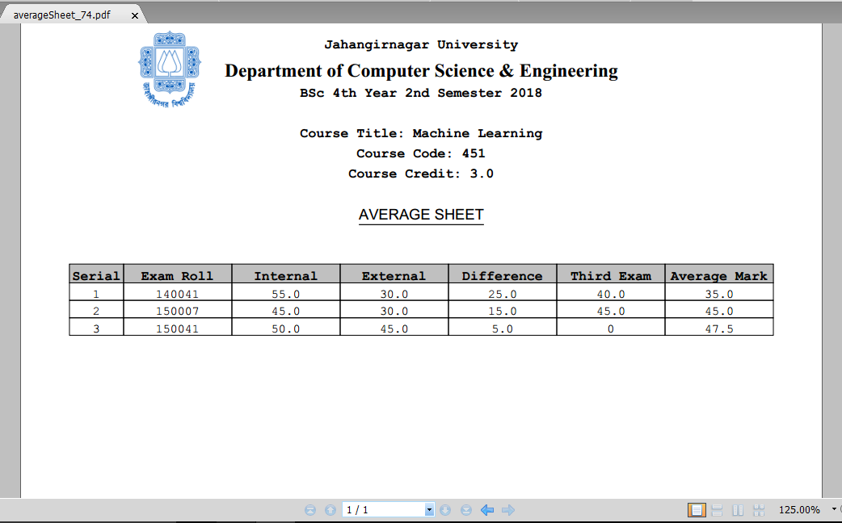
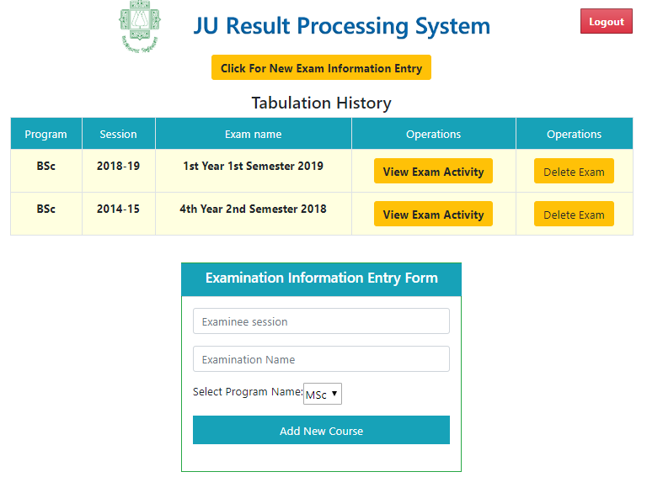
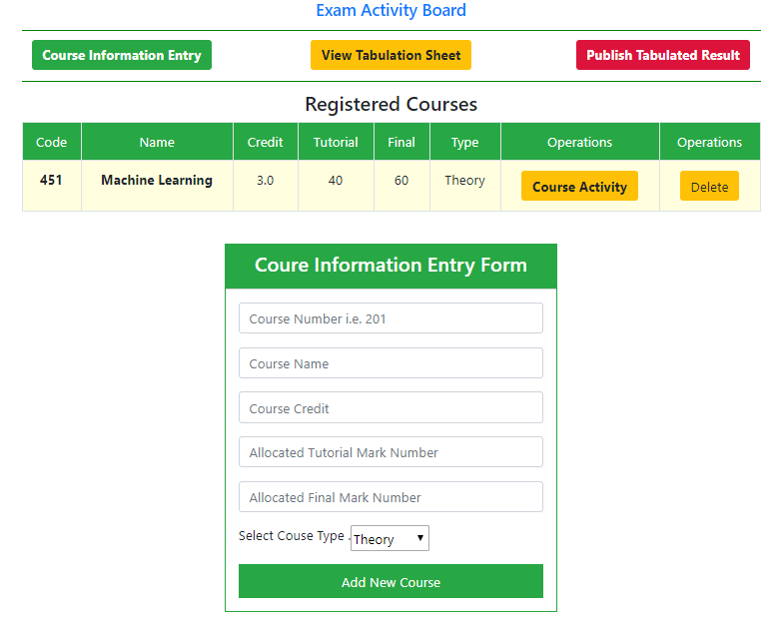
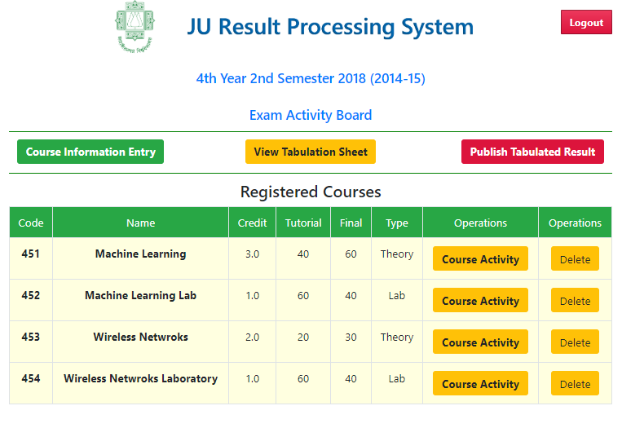
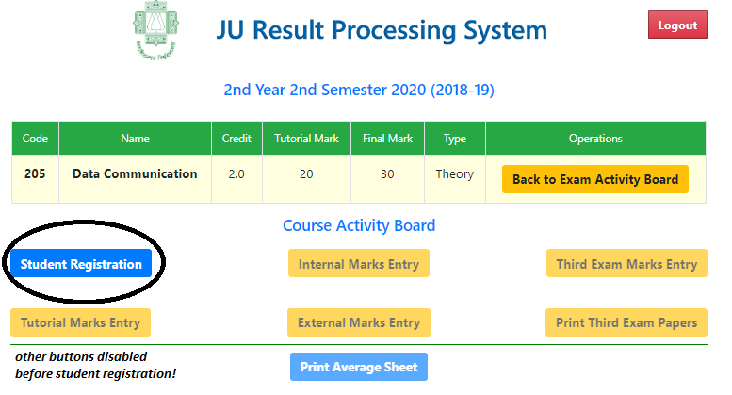
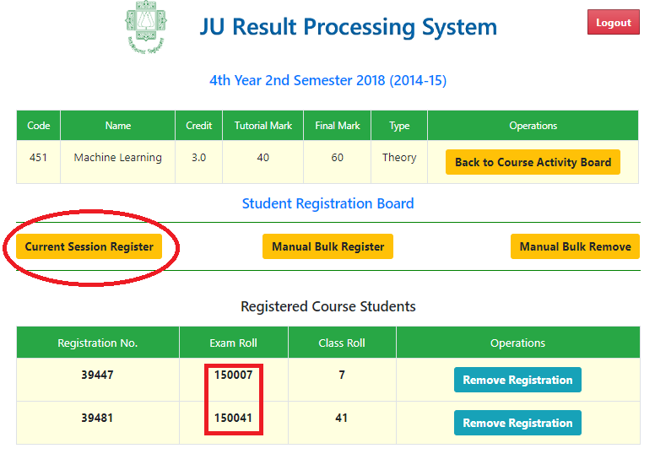
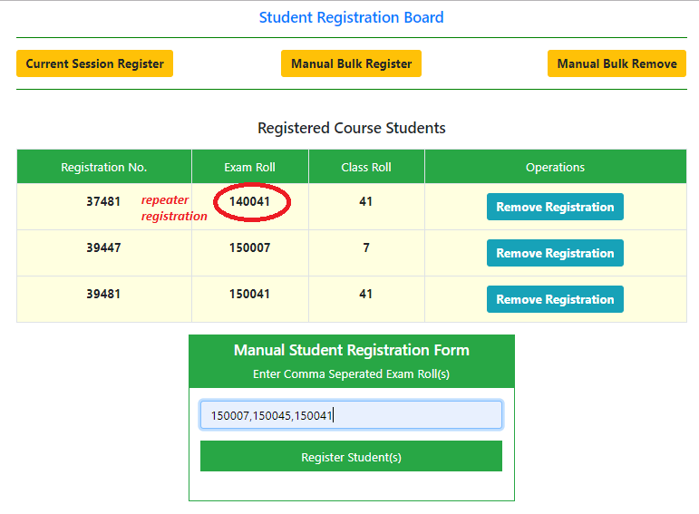
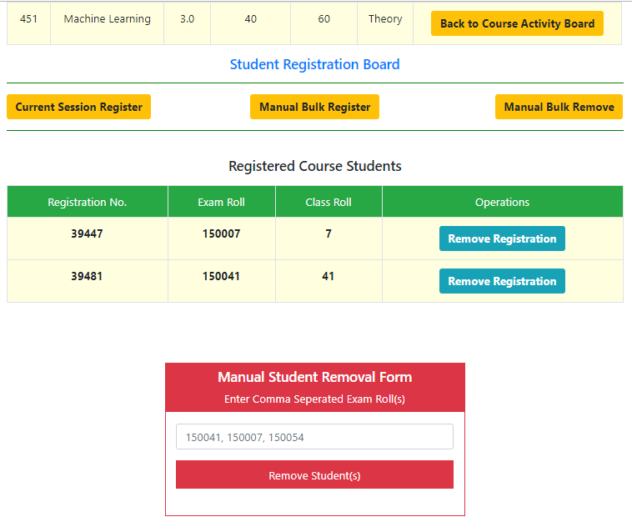
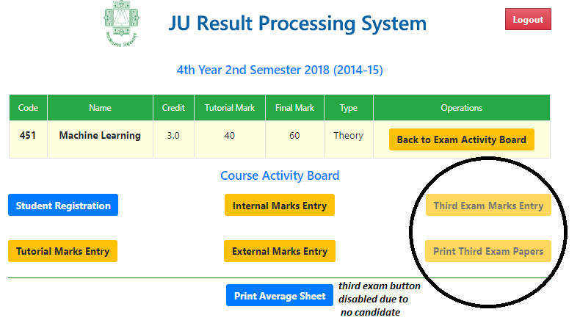
Result Processing System: A Web Based Approach
Kishwara Sadia (Exam Roll-150007, Class Roll-07)
G. M. Ariful Islam (Exam Roll-150041, Class Roll-41)
Department of Computer Science and Engineering
Jahangirnagar University
Abstract
Tools and Technologies
Result
To evaluate the degree of effective teaching examinations were introduced. The result of those exams provides a measurement about the depth of learning of the students. Processing the final results by accumulating all the course records is a challenging task since the beginning. Almost all the academic institutions are still facing some hurdles in result processing. The legacy system requires lots of manual paperwork which is error prune as well as time consuming. To achieve a sustainable solution to this problem lots of methods were proposed. In this project, we have proposed as well as implemented an automated web based application for that tedious problem which reduces huge amount of human effort and provides a secured and reliable solution with the cost of a limited resource. Our system maintains a database to store all the academic records, and based on that records it can generate all types of critical reports like, Average Sheet, Third Examiner Paper List, Tabulation Sheet, Academic Transcript etc. While developing the system, for the back-end we have used technologies like Spring Boot, Spring MVC, Hibernate ORM, Spring Security, iText PDF, Apache POI, MySQL and for the front-end Bootstrap, JavaScript, CSS, and HTML5.
For implementation, tools like Spring Boot, Spring MVC, Hibernate ORM, Spring Security, iText PDF, Apache POI, MySQL and for the front-end Bootstrap, JavaScript, CSS, HTML5 were used.
System Model
Fig. 9: Tutorial Mark Entry
Fig. 10: Excel Mark Entry
Fig. 11: Tabulation Sheet
Fig. 1: Use Case diagram of the system
Introduction
Fig. 12: Tabulation Sheet PDF
Result processing system is the process of computing student's result from their marks on different courses. It is a robust application that automates the processes of examination mark entry, grade calculation and various result related report generation.
In the existing manual result processing system, teachers have to spend more time to input marks on tabulation sheet and to prepare result. Preparing these reports is time consuming and troublesome.
Hence, it is necessary to evolve a computerized process that will effectively and efficiently capture the important objects associated with result processing.
Feature
• Add and keep records of teachers and students information.
• Student registration to central Info Database
• Student Registration in various course
• Automated entry by excel mark upload
• Manual mark entry by web form entry.
• Process the marks automatically for result.
• Show tabulation sheet and mark sheet.
• Display Individual result sheet whenever asked.
• Make the result processing faster.
• Make the result processing error free.
• Generate PDF of each student’s result.
• Generate third examiner papers list in PDF format
• Generate average marks sheet for peer checking
• Lock mark entry after result publish
Fig. 2: Activity Diagram of the System
Fig. 13: Average Sheet PDF
Result
Conclusion and Future Work
The system is designed to reduce time for calculating result. The proposed system is of high operational speed and it is user-friendly. The project work will help in a good number of ways to ease the delay in manual examination result processing. The security of the system has been maintained as a high priority.
In future, the project can be extended to digitize the total life cycle of an examination starting from exam schedule fixing to result entry, result processing, result management, historical result storage of students, comparing statistical data of result among different departments completely automated.
Fig. 1: New Exam Info Entry
Fig. 2: New Course Info Entry
Fig. 3: Available Course List
Fig. 4: Course Activity Board
Reference
Fig. 5: Import Current Session
Fig. 6: Manual Student Register
[1] Grey, S. (2010). Mode of processing result System. Himachal Pradesh University Journal
[2] Mohini.B. and Amar. J. S. (2011). Mode of processing result System. Himachal Pradesh University Journal
[3] Ogbeifun,E. and Ekpeyong,(2008). Packages used in designing result processing. Volume9, issue2)
Fig. 7: Manual Student Deregister
Fig 8. Mark Entry Enabled

