Slide 1
TEXTURE GUIDED MURAL INPAINTING USING DEEP LEARNING
KISHORE N

Slide 2
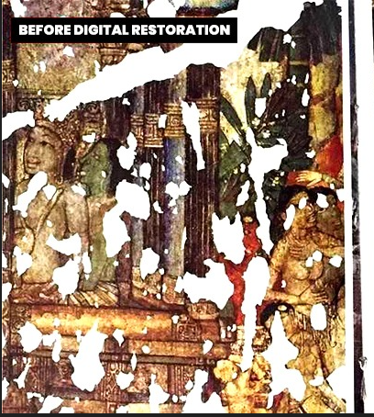
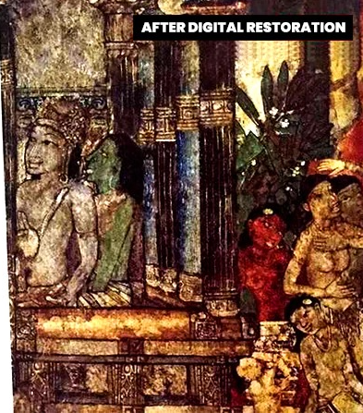
PROBLEM STATEMENT
Reconstruction of ancient murals and heritage site images.

Slide 3
MOTIVATION
Digital reconstruction of ancient painting, monuments and heritage sites can help us see how they would have looked like In the past without facilitating further damage, further helping us learn about the cultural history.
Due to natural calamities and several other reasons these heritages sites have been ruined; one such example is the VITHALA temple at HAMPI in India where the visitors are not allowed to touch and experience the chimes from the musical pillars.
We could think of the physical renovation of the paintings, but there is an absolute chance that we won't be able to mimic the original skillful work done in the past.
This is where digital reconstruction is introduced. By digitally correcting any damaged regions by means of inpainting and enhancing the resolution using super resolution or different types of super resolution we'd be able to give the viewers an enhanced visual portrayal of the digital reconstruction. One such example is the VIRTUAL ASUKA-KYO project.
Since then, several novel approaches and techniques are proposed for image inpainting, but it has been difficult to complete images with complex structures and large mask ratio(>50 % pixels are missing) and blurriness. Thus, we'll try to address all these issues.

Slide 4
DATA COLLECTION
TRAIN SET : Art images dataset from Kaggle which consists of 9000 images of paintings, watercolors, sculpture, graphic art and iconography.
We will separate the labels from these images and scrap them to use as inputs to our model.
Different API's could be used to scrap these data such as Fatkun.
The data would consist of both damaged and non damaged regions.
In all images fairly large cracks would be visible and we'll aim to restore images as if they had no cracks at all.
TEST SET: Images of mural paintings and heritage sites from google images and social media websites such as Facebook, Instagram and Reddit.

Slide 5
DATA PREPROCESSING
SCRAPING OUR IMAGES PRESENTED IN DATASET TO CREATE A TRAINING SET.
DENOISING.
CONVERTING HIGH RESOLUTION IMAGES TO LOW RESOLUTION IMAGES.
BATCHING AND PREFETCHING(FOR REDUCING TRAINING TIME).

Slide 6
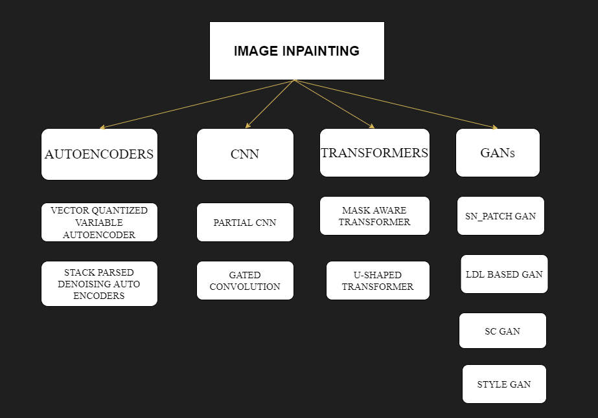
OVERVIEW OF LITERATURE SURVEY

Slide 7
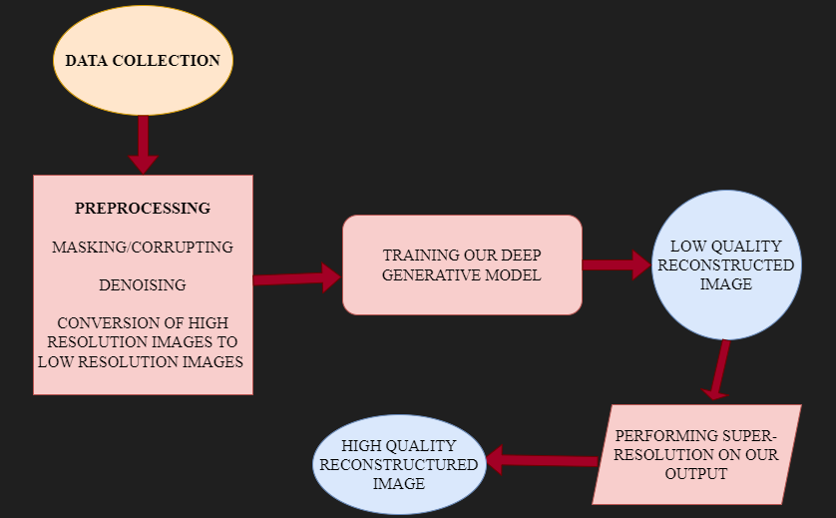
MODEL PURPOSED:

Slide 8
EVALUATION METRICS
PSNR
SSIM
GAN Loss
Perceptual Loss

Slide 9
OUTCOME
High quality reconstructed images.
Reduced computational complexity.
Improved efficiency.

Slide 10
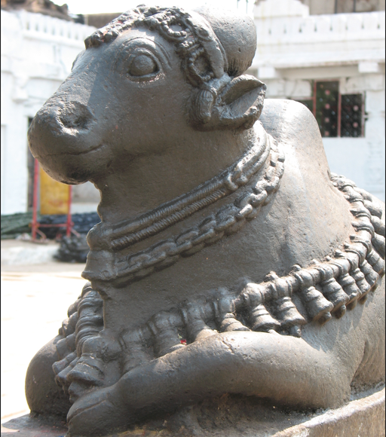
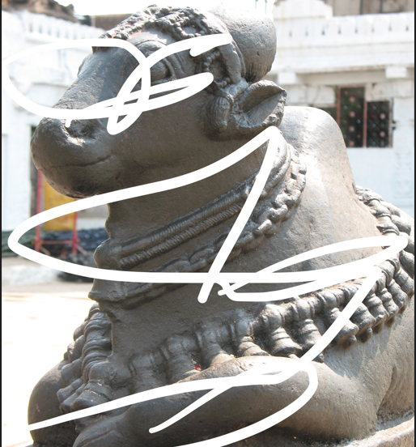
WORK DONE SO FAR
We have created our own dataset by corrupting/masking the data collected from IIT Kharagpur.

Slide 11
WORK DONE SO FAR
We converted images to low-resolution images in order to speed-up processing.
Then we created a super resolution GAN to convert the low resolution reconstructed output to an high resolution image.
We used upsampling and downsampling layers(Conv2DTranspose,Conv2D) to create generator and discriminator respectively.
We used to perceptual loss(From pre-trained VGG16) and adversarial loss for training.

Slide 12
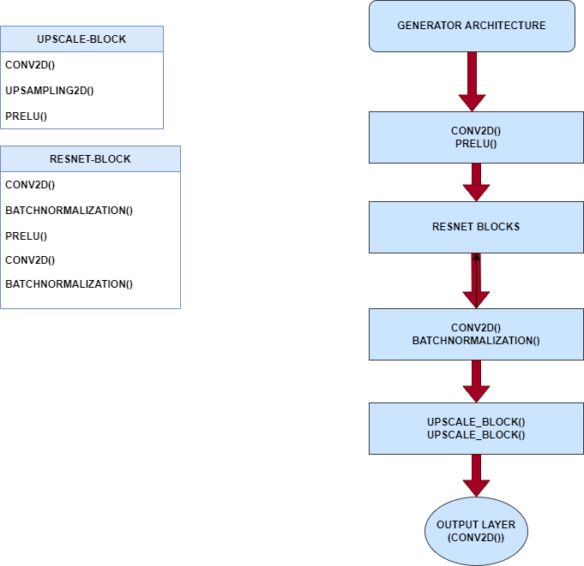
SUPER RESOLUTION GAN ARCHITECTURE
GENERATOR

Slide 13
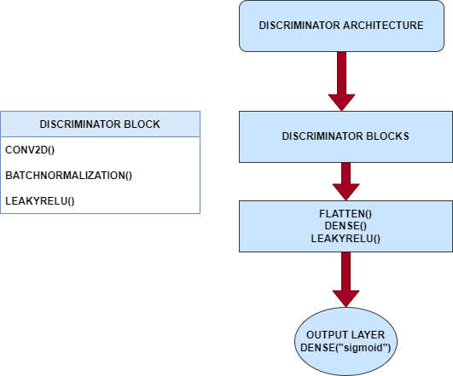
SUPER RESOLUTION GAN ARCHITECTURE
DISCRIMINATOR

Slide 14
THANK YOU

