Slide 1

REVERSE BIDDING WEB APPLICATION
ECE-1901
Technical answers for real world problems (TARP)
Group Members:
Nagendran K -19BEC1042
Kishore N -19BEC1069
Madan S -19BEC1158
Stanley Kingston -19BEC1254
Prassanth A -19BEC1327
Sanjay S -19BEC1370

Slide 2
INTRODUCTION
A type of negotiation process used in Strategic Sourcing; and is exactly the opposite of a forward auction.
Ebay auctions are forward auctions initiated by the Seller in which the Buyer bids the price up.
In a reverse auction, the roles are reversed, the auction is initiated by the Buyer and the Supplier bids in real time driving the price down.
It is a type of competitive bidding conducted on reverse auction websites, which is suitable when the only point being negotiated between the Buyer and the Supplier is price.
Always ensure that all other points such as supplier capability, quality of service, timelines of delivery, financial stability, etc. have already been confirmed as per your satisfaction.

Slide 3
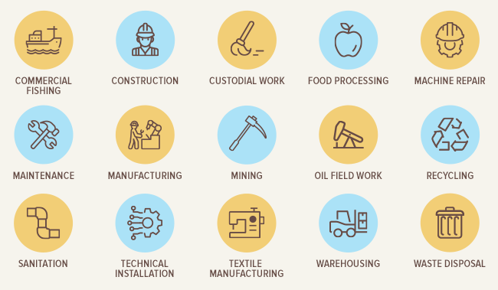
MOTivation
To provide cost efficient services with proper quality checks through reverse bidding
To bring all blue collar jobs into a common platform
To provide exposure/opportunities to small scale companies/service providers
To provide opportunities for aspiring freelancers
To create a common platform for any reverse bidding related application

Slide 4




SOFTWARE REQUIREMENTS

Slide 5
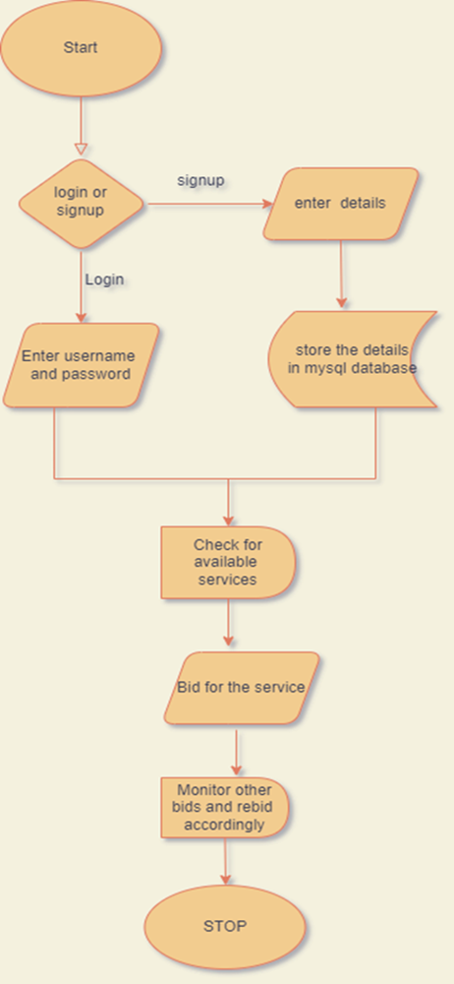
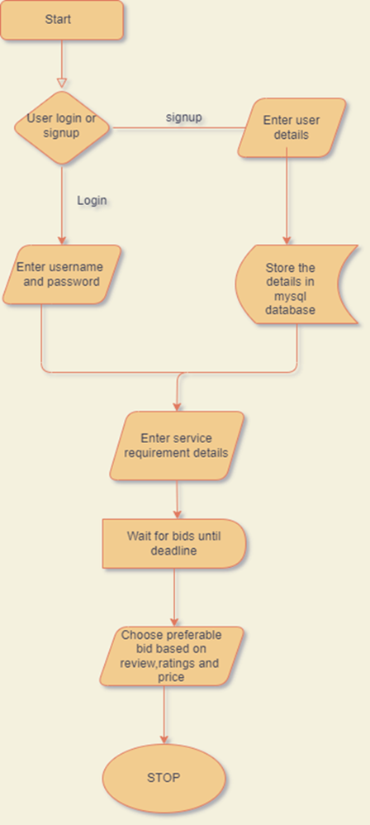
FLOWCHART
CUSTOMER SIDE SERVICE PROVIDER

Slide 6
QUALITY ASSURANCE -HOW ITS DONE!
INDIVIDUAL WORKERS
PLUMBERS, ELECTRICIANS, DELIVERY MEN — SKILL TEST
PRIVATE ENTITIES
Basically, companies register themselves with Government of India through a scheme such as SPICe [Simplified Proforma for Incorporating Company electronically Plus].
So we will be verifying those documents either through online or offline through QA centers across country by scheduling meetings with these respective owners.

Slide 7
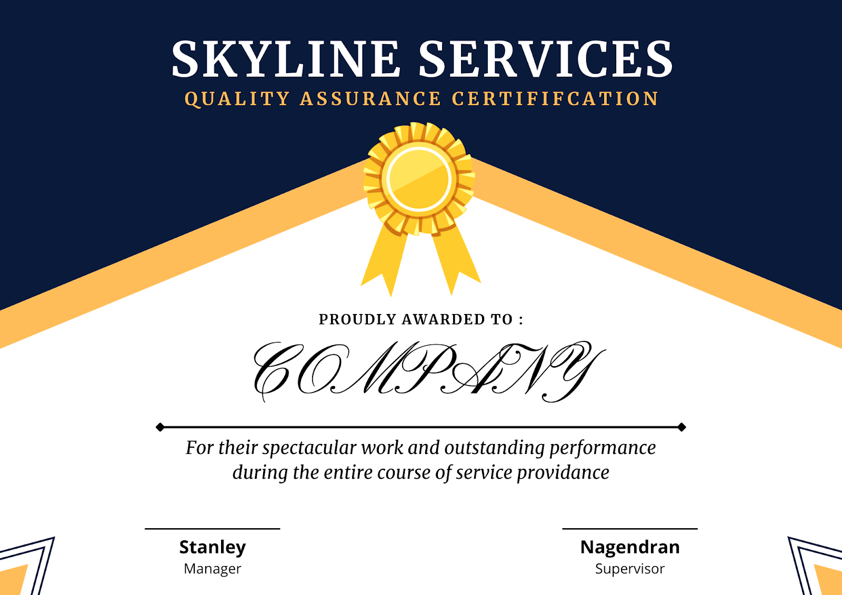
QUALITY ASSURANCE CERTIFICATE

Slide 8
SETTING QA CENTRES ACROSS VARIOUS REGIONS!

Slide 9
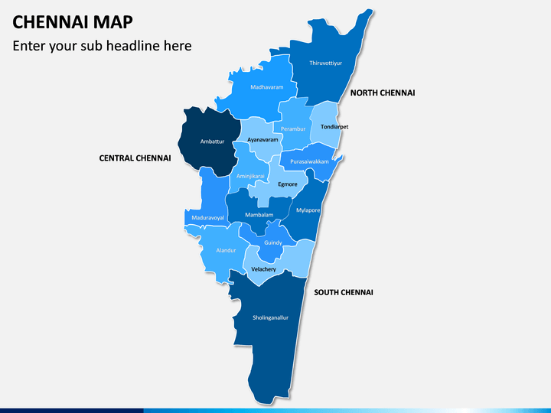


Slide 10
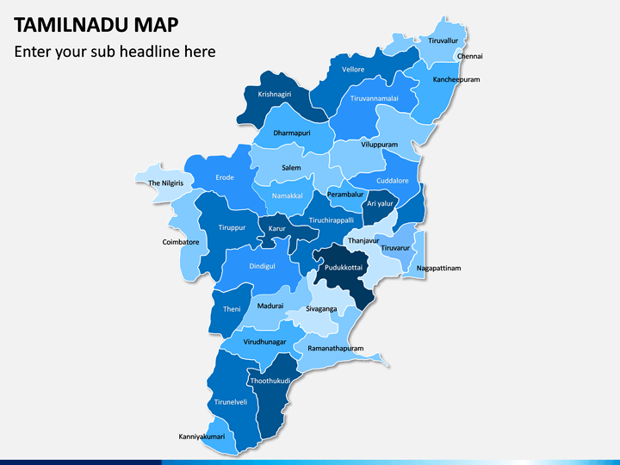

Slide 11
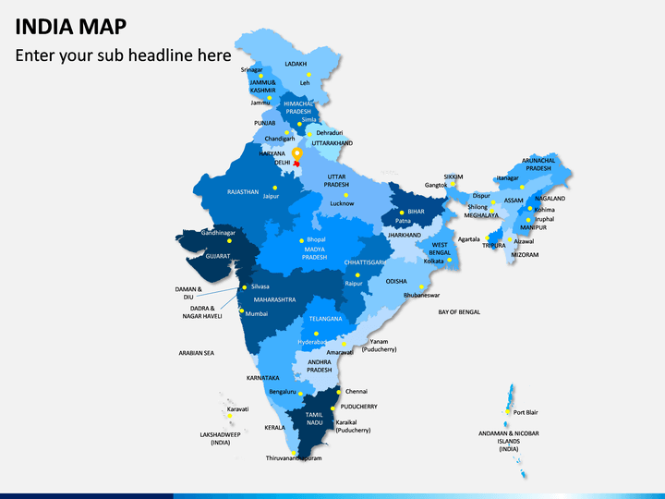

Slide 12


