Slide 1
Statistical Inference & A/B Testing
Module 3 Sprint 4 final project.
Soon to be data analyst Dovydas Kiškelis
December 2024

Slide 2
Objective
The goal is to evaluate the effectiveness of three promotions (Promotion 1, Promotion 2, and Promotion 3) in driving higher sales for a fast-food restaurant and recommend the best-performing promotion. Key metrics included:
Main metric: Average sales.
Other metrics: Number of restaurants, promotion performance during different weeks, and performance in restaurants of different sizes.

Slide 3
Table of Contents
Promotion Performance Comparison
Analysis and Overview of Weekly Sales
Analysis and Overview of Sales in Different Size Markets
Conclusion and Recommendations

Slide 4
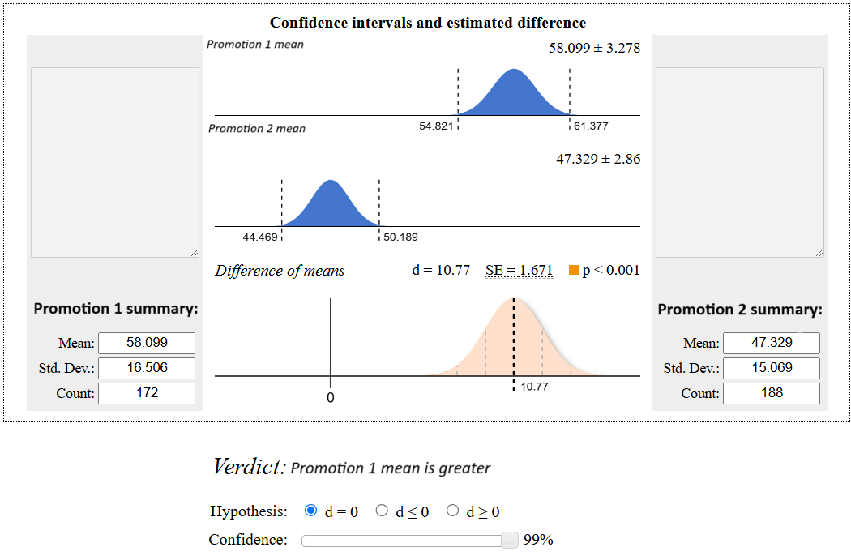
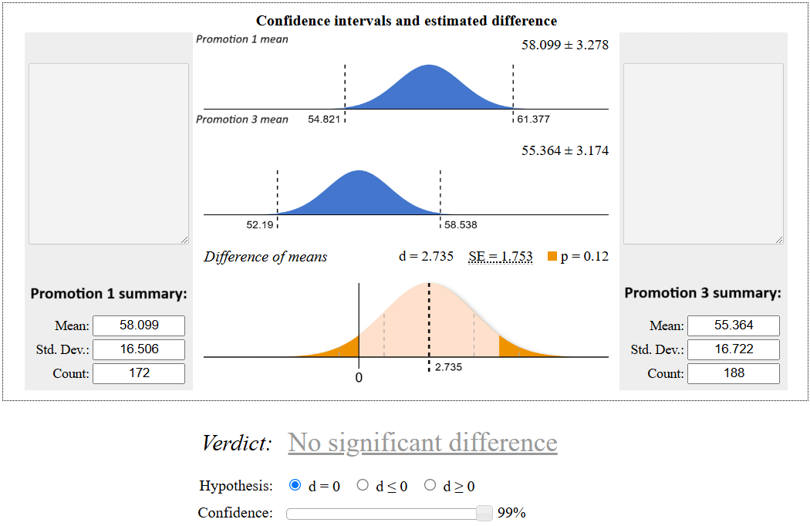
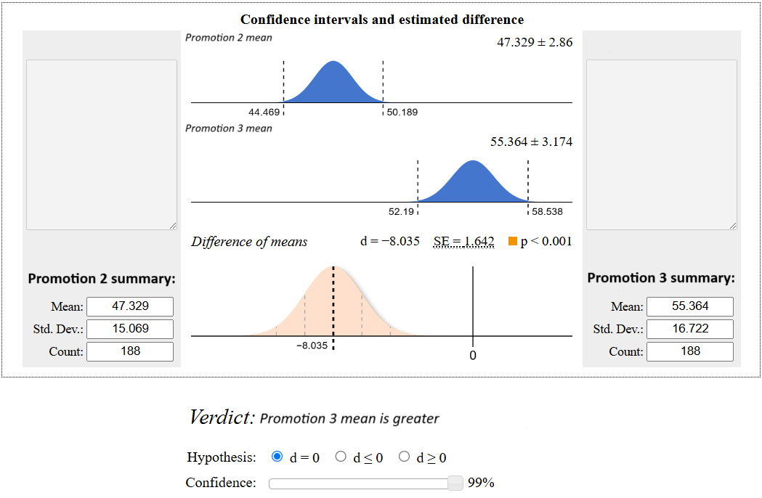
Comparison
Promotion 1 is leading across multiple comparisons and has the best overall (58.1) performance in terms of average sales.
Promotion 3 shows promise and performs competitively with Promotion 1 but doesn't clearly outperform it. It slightly edges out Promotion 1 in large markets based on average sales (77.2 vs. 75.24).
Promotion 2 consistently underperforms compared to the other promotions and should not be selected.

Slide 5
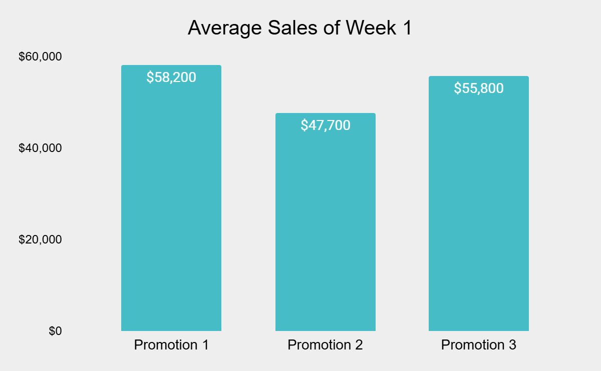

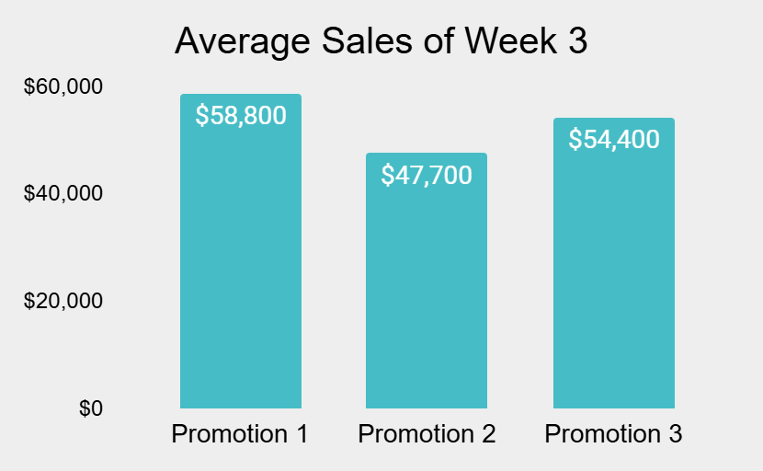
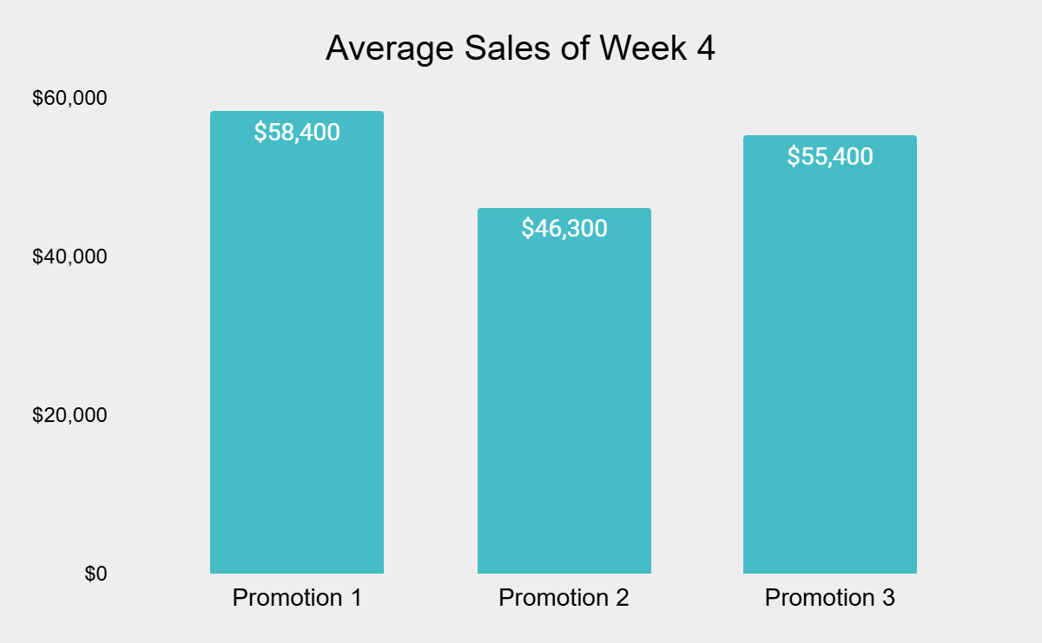
Analysis and Overview of Weekly Sales
The weekly averages for each promotion show minimal fluctuations, with variations of less than $2,000 in most cases.
Promotion 1 delivers the highest sales with reliable performance, Promotion 3 shows potential but higher variability, and Promotion 2 underperforms consistently.

Slide 6
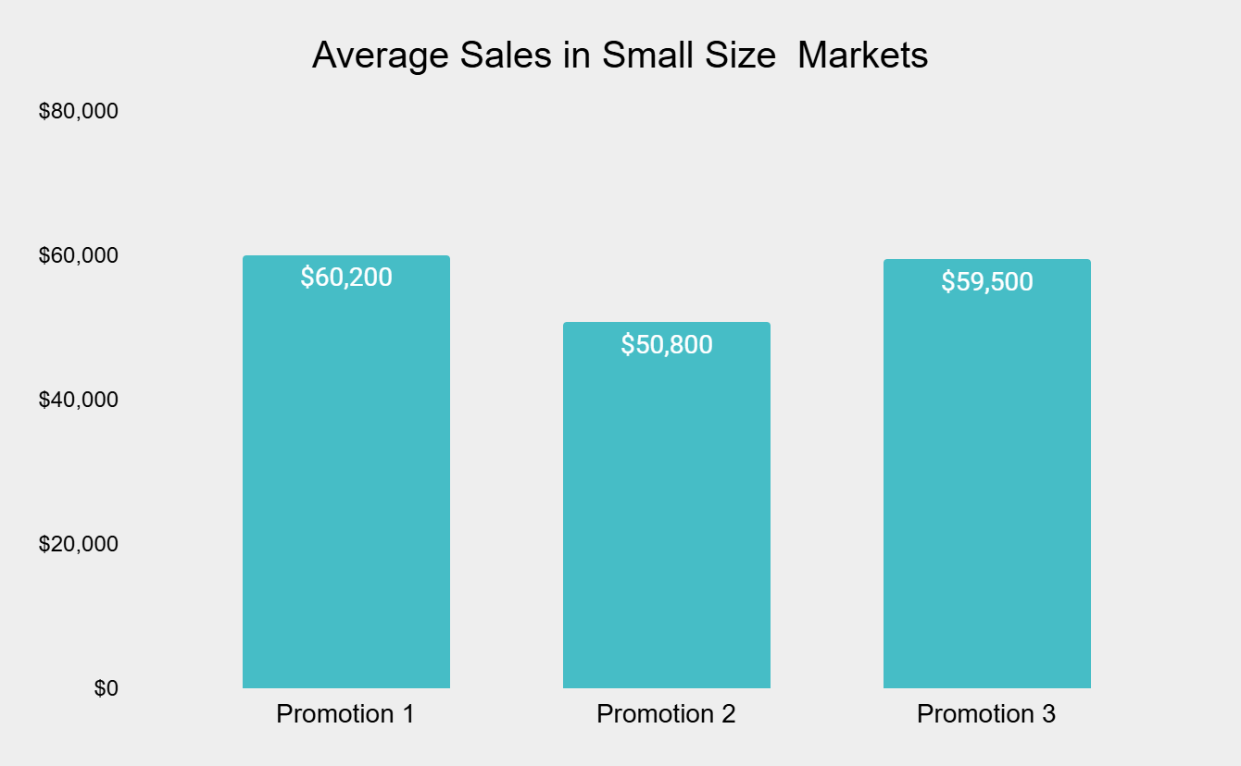
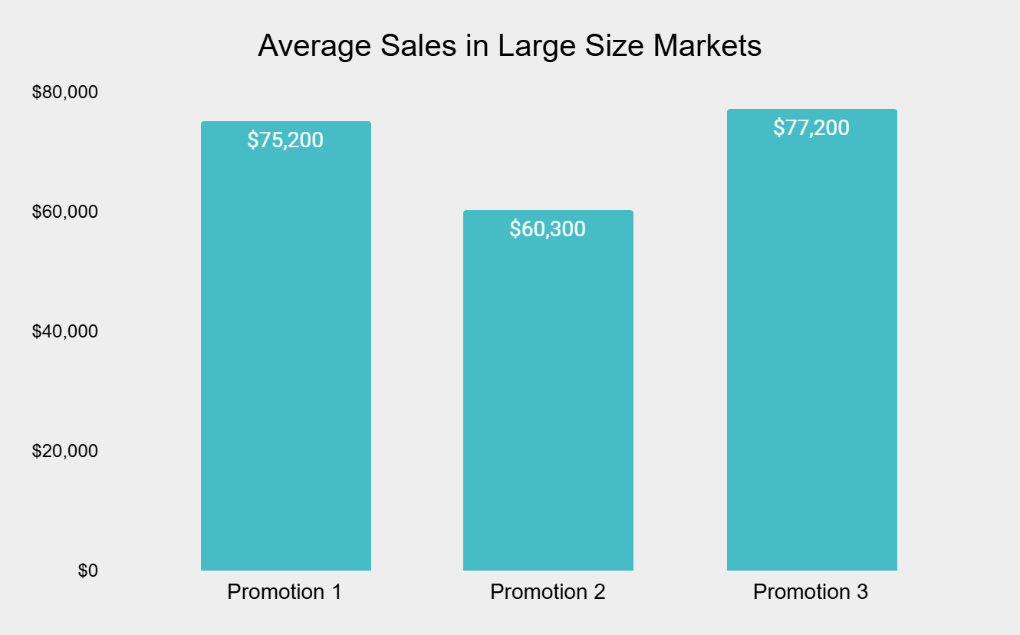
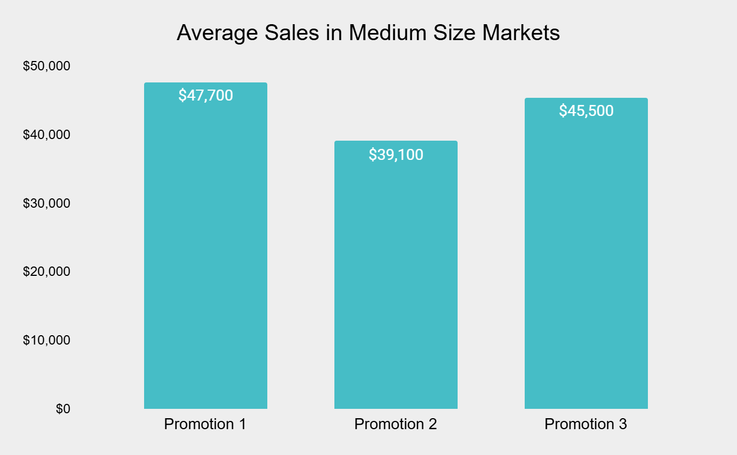
Analysis and Overview of Sales in Different Markets
Promotion 1 consistently performs best across small and medium markets, while remaining competitive in large markets, making it the most versatile and reliable choice.
Promotion 3 excels in large markets but underperforms elsewhere, while Promotion 2 consistently lags in all market sizes

Slide 7
Conclusion and Recommendations
After carefully analyzing the three promotions, it’s clear that Promotion 1 consistently achieves the highest (58.1K) average sales across different market sizes and time periods, making it the most effective and reliable option for widespread use. On the other hand, Promotion 2 falls short in performance across all metrics, suggesting it needs to be significantly revised or discontinued. Promotion 3 demonstrates promise, especially in large markets, but would benefit from further adjustments to deliver more consistent results across all segments.

