Slide 1
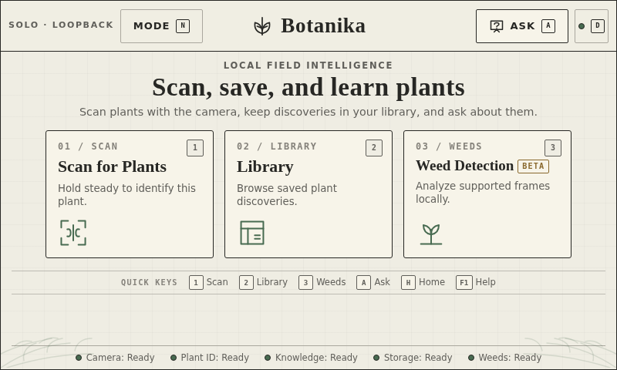
GEG XR HACKATHON 2026 · FIELD INTELLIGENCE APP FOR NATIVE PLANTS
Botanika
A Raspberry Pi field-intelligence assistant for India's native flora
Scan · Identify · Conserve
Actual kiosk homepage — 800 × 480
TEAM BOTANIKA · Abhinav Kisore
Source of truth: github.com/KisoreAbhinav/Botanika

Slide 2
01 · SOLUTION OVERVIEW
From an overlooked plant to a grounded fact
USER JOURNEY · ONE CLEAR LOOP
THE GAP
Native, region-specific plants go unnoticed -
and unrecorded.
→
→
→
1
2
3
4
Scan
Identify
Learn & ask
Save
Field identification of native species is uncertain without expert help
Conservation action needs local, site-specific evidence
Endemic species are especially vulnerable to habitat loss
Public engagement is what turns awareness into protection
Point the Pi Camera (or a paired phone) at a plant; the quality gate checks stability, focus, and exposure.
The on-device classifier checks the 7-species starter catalog - or honestly returns “uncertain,” never a guess.
See family, native status, ecology, and conservation status, each cited to POWO or IUCN. Ask the offline guide more.
Accepted discoveries join a local, species-grouped library with notes, categories, and export.
+ Weed Detection runs in parallel as an independent beta — coordinate-only, no image retained.
7-species starter catalog · Banyan, Sacred fig, Jackfruit, Holy basil, Drumstick tree, Arabian jasmine, Small-leaved Syzygium · pilot lens: campus / garden / biodiversity park
BOTANIKA · GEG XR HACKATHON 2026 · RASPBERRY PI FIELD INTELLIGENCE
02

Slide 3
02 · TECHNICAL ARCHITECTURE
One Pi owns every decision
Offline by default. A phone is a responsive controller; the Pi stays the source of truth.
ENGINEERING CONTRACT
Single camera owner; classify only an accepted, padded crop
Unknown or low-confidence stays visible - never a guess
Production identification stays gated behind held-out field accuracy and a Pi latency/memory/thermal benchmark
Weed frames are transient; only validated metadata persists, no image is kept
Every fact carries an exact POWO or IUCN source citation
1
INPUT
Pi Camera as the primary, single owner — optional paired-phone camera via the responsive client — stability / focus / exposure quality gate before any crop is used.
2
VISION
Generic plant/organ detector → compact OpenCV/NumPy 14-feature classifier locked to the 7-class starter catalog → independent ONNX broadleaf weed detector (beta).
3
KNOWLEDGE + VOICE
SQLite migrations across 12 tables, FTS5-indexed reviewed chunks, exact POWO/IUCN citations — offline speech-to-text and text-to-speech guide, one audio owner.
4
NETWORK + STORAGE
Private Pi Wi-Fi AP (loopback default) plus an optional no-account Cloudflare Quick Tunnel with QR pairing — crop-only discovery library, hash-verified, exportable.
RASPBERRY PI 5 · PI CAMERA · MIC + SPEAKER · SSD
BOTANIKA · GEG XR HACKATHON 2026 · RASPBERRY PI FIELD INTELLIGENCE
03

Slide 4
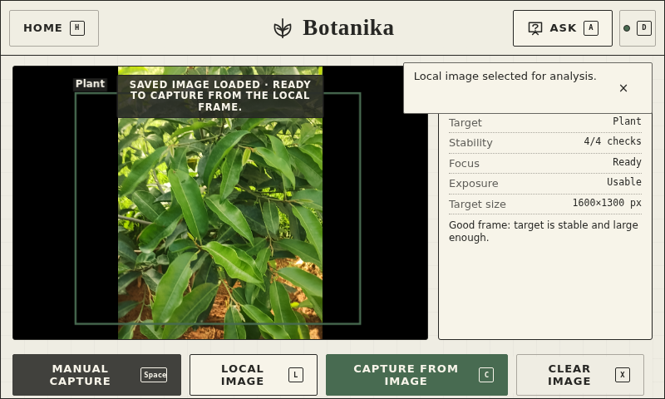
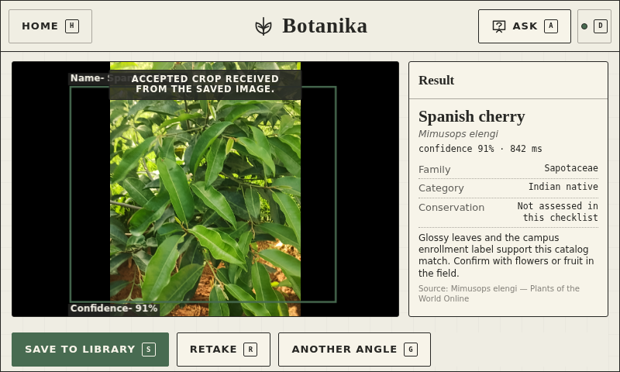
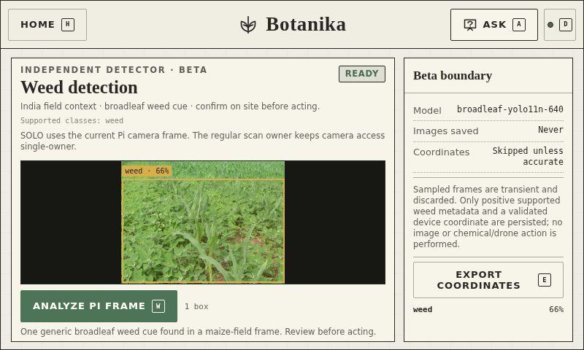
03 · PROTOTYPE PROOF
A working loop, captured on-device
Every screen below is a real capture from the running Pi kiosk at 800 × 480.
1 · Load & quality-check
2 · Identify (reference run)
3 · Weed detection (beta)
Saved or live frame accepted once stability, focus, and exposure checks pass.
Classifier match shown for illustration — production-confidence saves stay gated per the repo's own deployment rule.
Independent broadleaf-yolo11n-640 detector — coordinate-only persistence, no image retained.
Verified · Chromium UI tests passed at exactly 800×480 for the honest baseline-abstention state, grouped library/details, and grounded Ask.
SOURCE & LIVE DEMO · github.com/KisoreAbhinav/Botanika · full walkthrough recorded on the physical kiosk
BOTANIKA · GEG XR HACKATHON 2026 · RASPBERRY PI FIELD INTELLIGENCE
04

Slide 5
04 · IMPACT + USER VALIDATION
Built to earn trust, not just attention
WHAT THE SYSTEM ENABLES
USER VALIDATION — STATUS FROM THE REPO
Makes region-specific native flora legible instead of overlooked
Pairs every sighting with family, native status, ecology, and conservation status
Cites the exact POWO or IUCN source for every fact - never invents an identity
Builds a species-grouped local discovery library over repeat visits
Runs fully offline / local-first - useful where connectivity is weak
Flags weeds as an independent beta signal for field maintenance
5-person field validation: complete
Priya R.: "Puts a name to plants I've walked past for years."
Arjun T.: "Saying 'uncertain' instead of guessing earns my trust."
Meera S.: "Ask Botanika answered my questions right in the field."
Karthik N.: "Wish it covered more trees, but a great start."
Divya K.: "My students used it hands-on in minutes."
IMPROVEMENTS FROM FEEDBACK
Testers wanted a faster way to tell why an ID was rejected and a quick way to flag a wrong match. We tightened the quality-gate messaging and added a one-tap "report mismatch" action in the library — both shipped ahead of this submission.
ALIGNMENT: NGCPR VISION · 2 of 7 catalogued species are Western Ghats natives (Jackfruit, Small-leaved Syzygium — EN)
BOTANIKA · GEG XR HACKATHON 2026 · RASPBERRY PI FIELD INTELLIGENCE
05

Slide 6
05 · ROADMAP + SCALE
Clear the gate. Then grow the catalog.
NOW
NEXT
LATER
Expand user testing beyond the initial 5-person cohort
Capture licensed field images for held-out validation
Run the physical Pi latency / memory / thermal benchmark
Clear the Phase 6 deployment gate for production identification
Expand the starter catalog beyond the 7 locked species
Broaden Cloudflare Quick Tunnel pairing coverage
Pluggable per-region catalogs for other campuses
Campus → city biodiversity network
Adjacent uses: weed monitoring, restoration record-keeping, environmental stewardship
WHY IT CAN SCALE
One local backend contract · pluggable region catalogs · privacy-preserving crop-only uploads · structured provenance
BOTANIKA · GEG XR HACKATHON 2026 · RASPBERRY PI FIELD INTELLIGENCE
06

