Slide 1
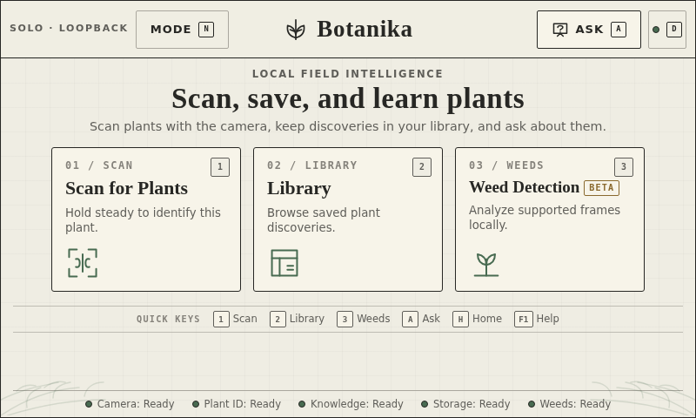
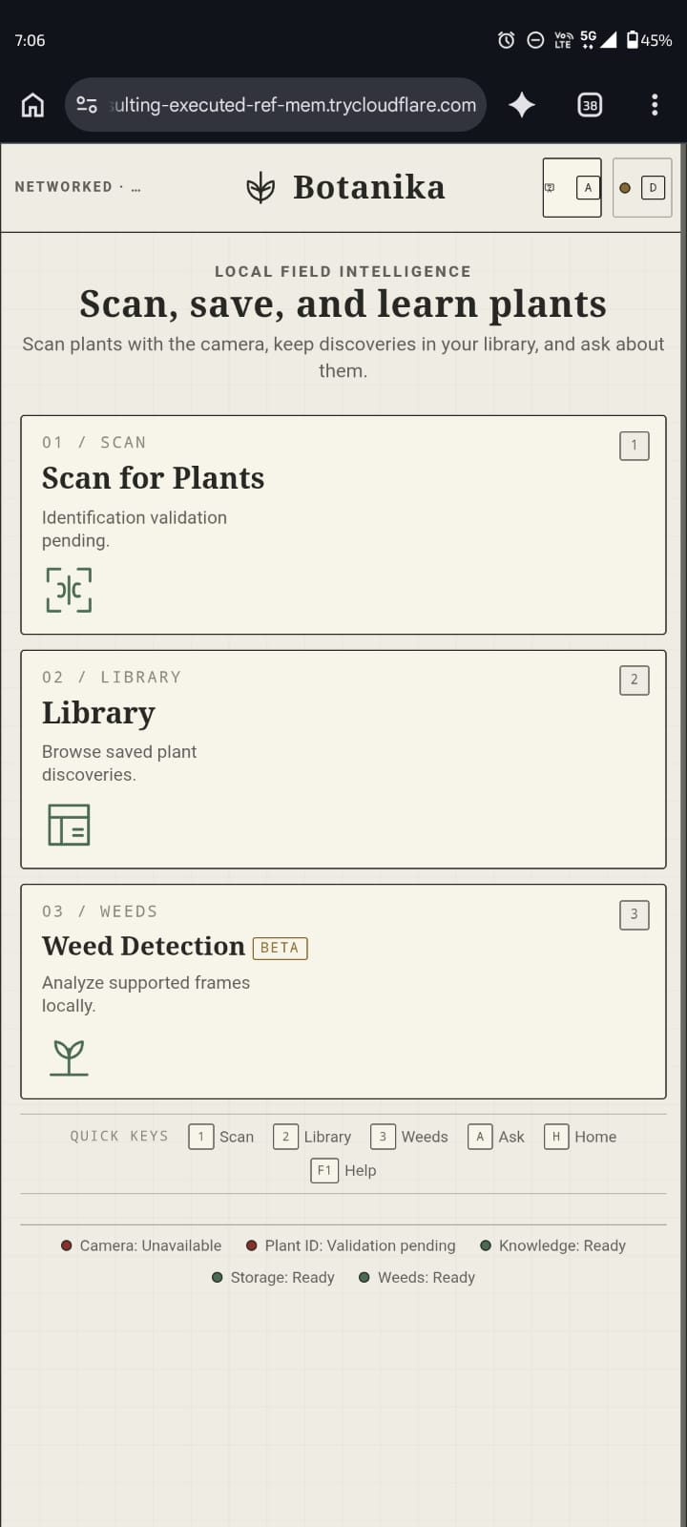
PI-POWERED FIELD INTELLIGENCE
ONE SYSTEM · TWO SURFACES
Botanika
Raspberry Pi intelligence.
Any phone as the field interface.
PI KIOSK · AUTHORITATIVE CONSOLE
The phone supplies a browser and camera. The Pi supplies the models, botanical knowledge, storage, and decisions—over an optional secure remote link or an offline private Wi-Fi fallback.
NO APP INSTALL · NO MODEL ON THE PHONE · CROP-ONLY PLANT UPLOAD
LIVE PHONE · RESPONSIVE CONTROLLER
TEAM BOTANIKA · ABHINAV KISORE
BOTANIKA · GEG XR HACKATHON 2026 · LOCAL-FIRST FIELD INTELLIGENCE
01

Slide 2
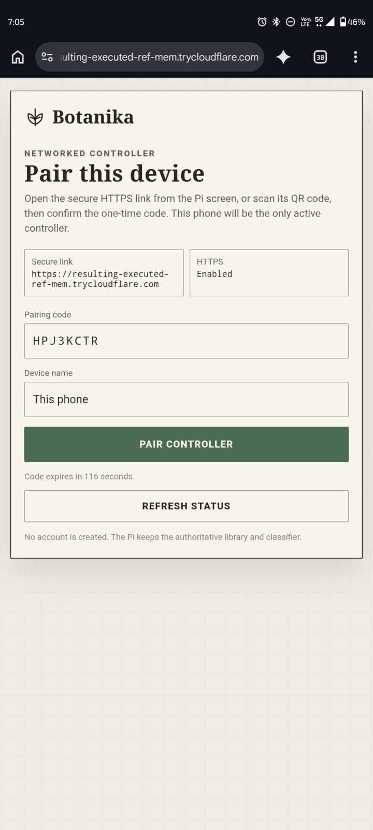
01 · ACTUAL REMOTE WORKFLOW
Pair once. Send only what the Pi needs.
The remote path is a browser-to-Pi handoff—not a mobile AI app and not remote desktop control.
1
Pi opens access
Operator enters NETWORKED. The Pi starts a temporary HTTPS Quick Tunnel; its private Wi-Fi AP remains the offline fallback.
2
Phone pairs
The Pi shows a QR link and one-time code. The first successful browser receives the only active, revocable controller lease.
3
Browser prepares
The phone owns its camera preview, captures one still, limits it to 2048 px, applies the manual crop, checks quality, and computes SHA-256.
4
Pi decides
Only the approved JPEG crop, hash, dimensions, and request ID are posted. The Pi validates them, classifies, and returns the result.
5
Pi records
Only an accepted result can be saved. Optional phone location is added at save time; the Pi keeps the authoritative SQLite record and image.
LIVE PAIRING SCREEN
BOTANIKA · GEG XR HACKATHON 2026 · LOCAL-FIRST FIELD INTELLIGENCE
02

Slide 3
02 · TECHNICAL ARCHITECTURE
The phone never becomes the compute node
One React interface spans the Pi kiosk and paired browser; FastAPI on the Pi is the single backend contract and source of truth.
PHONE · THIN CLIENT
SECURE TRANSPORT
RASPBERRY PI · AUTHORITY
• Responsive UI served by the Pi
• getUserMedia or still-file capture
• Local preview, crop, quality check
• ≤2048 px JPEG + SHA-256
• Result rendering + optional location
No model weights. No database. No live plant video upload.
• Same-origin /api/v1 requests
• Temporary trycloudflare HTTPS URL
• QR + one-time pairing code
• One bearer lease; heartbeat + polling
• Hash/dimensions/request ID travel with crop
Private Pi Wi-Fi is the no-internet fallback.
• FastAPI mode + authorization
• OpenCV/NumPy plant classifier
• Separate ONNX weed beta
• SQLite + FTS knowledge/library
• Crop provenance and save checks
• Local kiosk, camera, voice services
Inference, policy, knowledge, and persistence stay here.
→
→
PLANT PATH · one approved crop per request | WEED PATH · bounded JPEG samples, never a MediaStream; no overlap while Pi inference runs
BOTANIKA · GEG XR HACKATHON 2026 · LOCAL-FIRST FIELD INTELLIGENCE
03

Slide 4
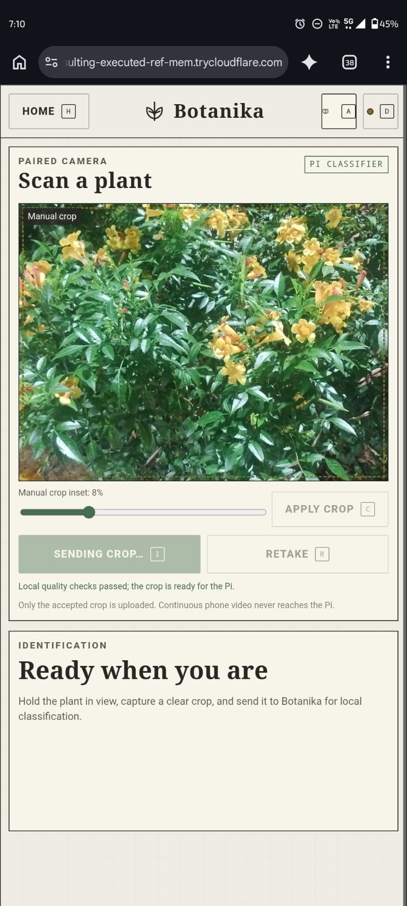
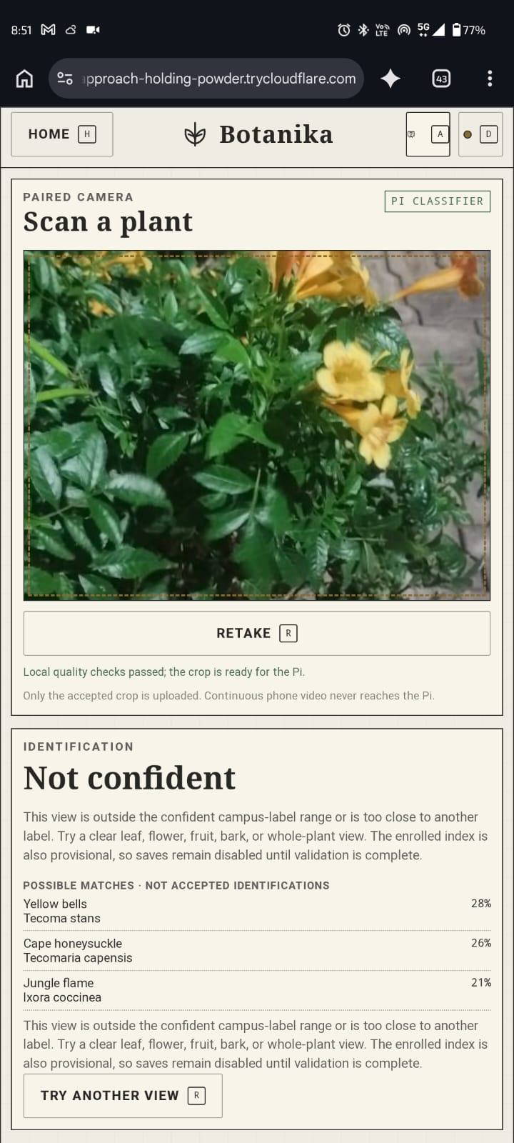
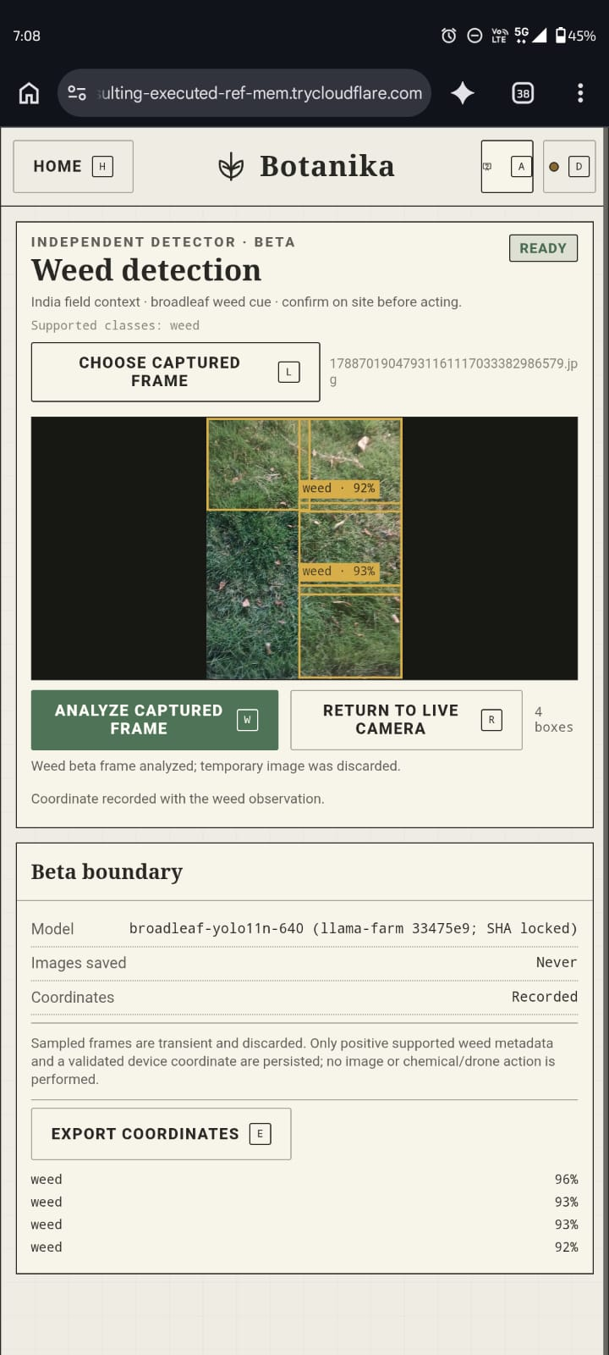
03 · LIVE CROSS-NETWORK EVIDENCE
The remote phone ↔ Pi path is visible in the test captures
Real handset screenshots show the temporary HTTPS origin, pairing, crop handoff, honest abstention, and the separate weed-beta response.
1 · PAIR
2 · SEND CROP
3 · PI RESPONSE
4 · WEED BETA
Temporary HTTPS + one-time code
Local checks pass before upload
Low confidence remains unsaved
Boxes returned; image discarded
Evidence boundary · these captures prove the live interaction path; they do not claim production-grade species accuracy.
BOTANIKA · GEG XR HACKATHON 2026 · LOCAL-FIRST FIELD INTELLIGENCE
04

Slide 5
04 · LIGHTWEIGHT BY DESIGN
The user carries a camera and a webpage—not the AI stack
ON THE PHONE
ON THE RASPBERRY PI
Short-lived interface work
Long-lived intelligence and evidence
• Browser UI loaded from the Pi
• Camera preview stays on-device
• One resized, manually approved plant crop
• Local quality check + SHA-256
• Optional plant-save / weed coordinates
• Result display, heartbeat, and polling
• Pairing, authorization, and mode state
• Plant and weed inference runtimes
• Confidence / acceptance policy
• Botanical catalog, FTS knowledge, citations
• Discovery images, notes, and map records
• Pi camera, kiosk, local voice, and exports
NO INSTALL · NO WEIGHTS · NO LOCAL DATABASE
PI REMAINS THE SOURCE OF TRUTH
Privacy boundary · plant video is never streamed to the Pi. Weed samples are bounded still JPEGs, processed in memory and discarded; only supported detections with validated coordinates may persist.
BOTANIKA · GEG XR HACKATHON 2026 · LOCAL-FIRST FIELD INTELLIGENCE
05

Slide 6
05 · MODES, GUARANTEES + LIMITS
Three access paths. One authoritative backend.
SOLO · OFFLINE
PRIVATE AP · OFFLINE
QUICK TUNNEL · REMOTE
Pi kiosk + Pi Camera
FastAPI bound to loopback
Models, knowledge, voice, and library local
No phone or network required
Phone joins Botanika Wi-Fi
Same pairing and crop API
Firewall blocks forwarding
Fallback when internet is unavailable
Phone may use another network
Temporary HTTPS URL + QR
Pi backend remains loopback-only
Development/test transport; no SLA
FAIL-CLOSED CONTRACT
One active controller · lease revoked on SOLO / disconnect / expiry / takeover / restart · stale crop and save rejected · uncertain stays visible
Current limit · production identification remains gated until held-out field accuracy and Raspberry Pi latency / memory / thermal benchmarks pass.
BOTANIKA · GEG XR HACKATHON 2026 · LOCAL-FIRST FIELD INTELLIGENCE
06

