Slide 1
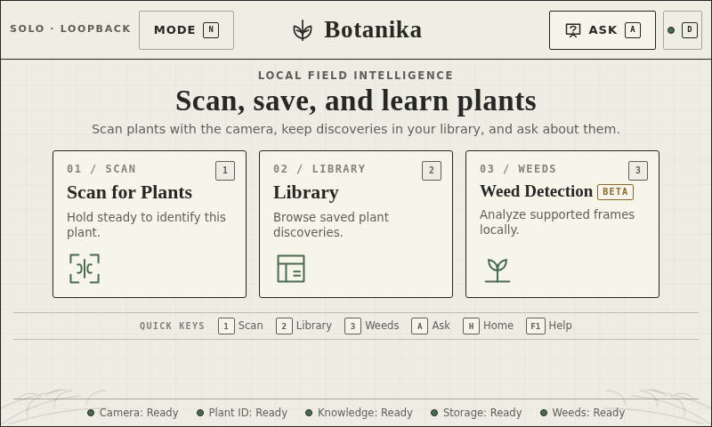
LOCAL FIELD INTELLIGENCE
Turn a phone into a
biodiversity field assistant.
Botanika
A campus-focused prototype combining plant identification, AR-style context, an offline botanical guide, and conservation-aware discovery records.
An AR + AI assistant for
India’s native flora
Scan · understand · conserve
TEAM BOTANIKA · MEMBERS TO BE ADDED
BOTANIKA · GEG XR HACKATHON 2026 · LOCAL-FIRST FIELD INTELLIGENCE
01

Slide 2
01 · SOLUTION OVERVIEW
From plant sighting to local knowledge
USER JOURNEY · ONE CLEAR LOOP
THE GAP
Native plants are
visible but overlooked.
01
02
03
04
Find
Frame
Learn
Keep
• Scientific context is scattered
• Field identification can be uncertain
• Conservation action needs local evidence
• Connectivity cannot be assumed
Open Scan or Weed Detection
Hold steady; crop the target
Name, family, ecology, status
Save a discovery and build the campus record
Pilot lens: campus / garden / biodiversity park
Minimum brief fit: 7-species starter catalog · offline guide · regional library · conservation-aware copy
BOTANIKA · GEG XR HACKATHON 2026 · LOCAL-FIRST FIELD INTELLIGENCE
02

Slide 3
02 · TECHNICAL ARCHITECTURE
One Pi owns the intelligence
Offline by default. The phone is a responsive controller; the Raspberry Pi remains the source of truth.
FIELD INPUT
Pi Camera · phone camera · saved image fallback
ENGINEERING CONTRACT
INTERACTION
React + Vite · fixed 800×480 kiosk · responsive paired client
• Single camera owner; stale frames dropped
• Classify only an accepted padded crop
• Unknown / low-confidence stays visible
• Image provenance and model metadata retained
• Weed images are transient; only validated metadata can persist
• Local AP / Quick Tunnel pairing is optional
LOCAL SERVICES
FastAPI · OpenCV / ONNX · crop quality + lock-on + AR-style overlay
AUTHORITATIVE DATA
SQLite · discovery library · offline knowledge base · coordinate-only weed runs
PI 5 · 16 GB · 512 GB SSD
BOTANIKA · GEG XR HACKATHON 2026 · LOCAL-FIRST FIELD INTELLIGENCE
03

Slide 4
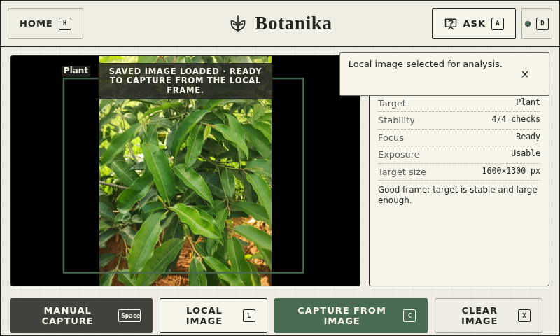
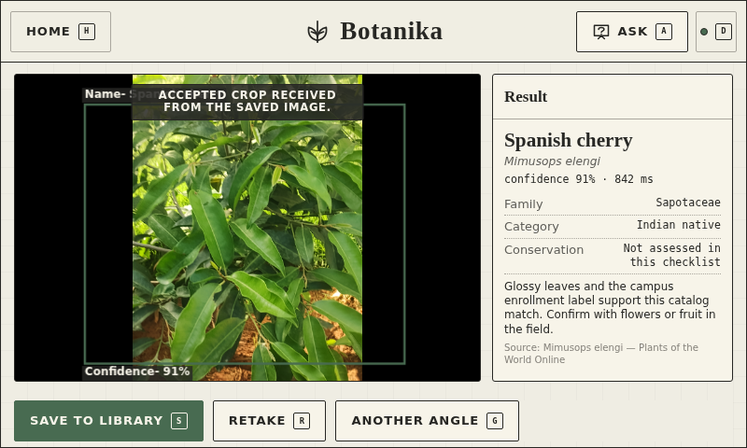
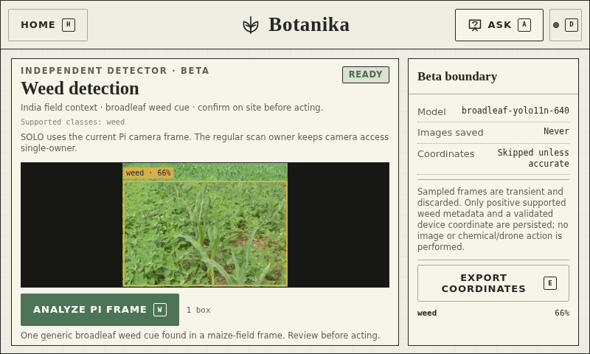
03 · PROTOTYPE PROOF
A working Pi loop, captured at 800 × 480
Saved campus image → local crop quality → Pi classifier response → library + map save. The beta weed cue stays visibly separate.
01 · LOAD SAVED IMAGE
02 · IDENTIFY + SAVE
03 · MAIZE / WEED CUE
DEMO VIDEO · 25.9 s slow Pi walkthrough · botanika-pi-demo-slow.mp4
The saved record is marked synthetic: R-block east planting bed, VIT Vellore · 12.96930, 79.15650.
BOTANIKA · GEG XR HACKATHON 2026 · LOCAL-FIRST FIELD INTELLIGENCE
04

Slide 5
04 · IMPACT + USER VALIDATION
Conservation value needs local evidence
WHAT THE SYSTEM ENABLES
ILLUSTRATIVE UX READOUT
• Make native flora legible to non-specialists
• Pair every sighting with ecology, family, and conservation context
• Grow a species-grouped campus discovery library
• Keep uncertain answers honest and actionable
• Support offline field work where connectivity is weak
• Create a future evidence base for restoration and stewardship
Mixed opinions to validate with 5 real users
LIKED · The single Scan → crop → save loop is easy to explain.
MIXED · The manual crop slider helps control the result, but is unfamiliar on first use.
CONCERN · Camera permission and “why local?” need a clearer first-run cue.
RESPONSE · Stream reattachment, saved-image fallback, visible quality checks, and local-first copy.
Alignment: NGCPR · native species · public outreach
STATUS · Real five-person study still required before submission.
BOTANIKA · GEG XR HACKATHON 2026 · LOCAL-FIRST FIELD INTELLIGENCE
05

Slide 6
05 · ROADMAP + SCALE
Start on one campus. Scale the field intelligence layer.
NOW
NEXT
LATER
Stabilise phone camera + crop flow
Complete five-user validation
Add accepted local campus images
Benchmark Pi latency and confidence
Calibrate the seven-species catalog
Expand regional checklist and map
Add multilingual botanical guidance
Introduce richer AR-style annotations
Campus → city biodiversity network
Restoration and nursery workflows
Agriculture and sustainability scouting
Environmental monitoring APIs
One local backend contract · pluggable catalogs · privacy-preserving crop uploads · structured provenance
WHY IT CAN SCALE
Judging fit · Innovation 15% · Technical execution 20% · AI + AR 20% · UX + validation 10% · NGCPR alignment 20% · Presentation 15%
BOTANIKA · GEG XR HACKATHON 2026 · LOCAL-FIRST FIELD INTELLIGENCE
06

