Slide 1
Computer Networks
DU, Hongwei(hwdu@hit.edu.cn)
Department of Computer Science and Technology
Harbin Institute of Technology Shenzhen

Slide 2
Reference Books
Computer Networks
Fourth Edition, By Andrew S. Tanenbaum , Prentice Hall, 5th edition, Published
Computer Networking: A top-down approach, by James Kurose, K. W. Ross, Addison Wesley

Slide 3

Course and TA information
course information
Teaching Assistant (TA)
聂子雄, 手机：13617917245
邮箱： 19S051046@stu.hit.edu.cn
曾国钛, 手机：13713522790
邮箱： 443834259@qq.com

Slide 4
Assessment Methods
Final grade will be determined as follows:
— homework & class presentations (30%)
— lab experiments (20%)
— exams (50%)

Slide 5
Chapter 1: Introduction
Our goal:
get “feel” and terminology
more depth, detail later in course
approach:
use Internet as example
Overview:
what’s the computer network
what’s a protocol?
network edge
network core
Internet/ISP structure
performance: loss, delay

Slide 6
Roadmap
1.1 What is the computer network?
1.2 Network edge
1.3 Network core
1.4 Network access and physical media
1.5 Internet structure and ISPs
1.6 Delay & loss in packet-switched networks
1.7 Protocol layers, service models
1.8 History

Slide 7
What’s the Internet: “nuts and bolts” view 什么是Internet：组成细节角度
millions of connected computing devices: hosts = end systems
running network apps
communication links
fiber, copper, radio, satellite
transmission rate = bandwidth
routers: forward packets (chunks of data)
Hardware,Software
router
workstation
server
mobile
local ISP
regional ISP
company
network

Slide 8

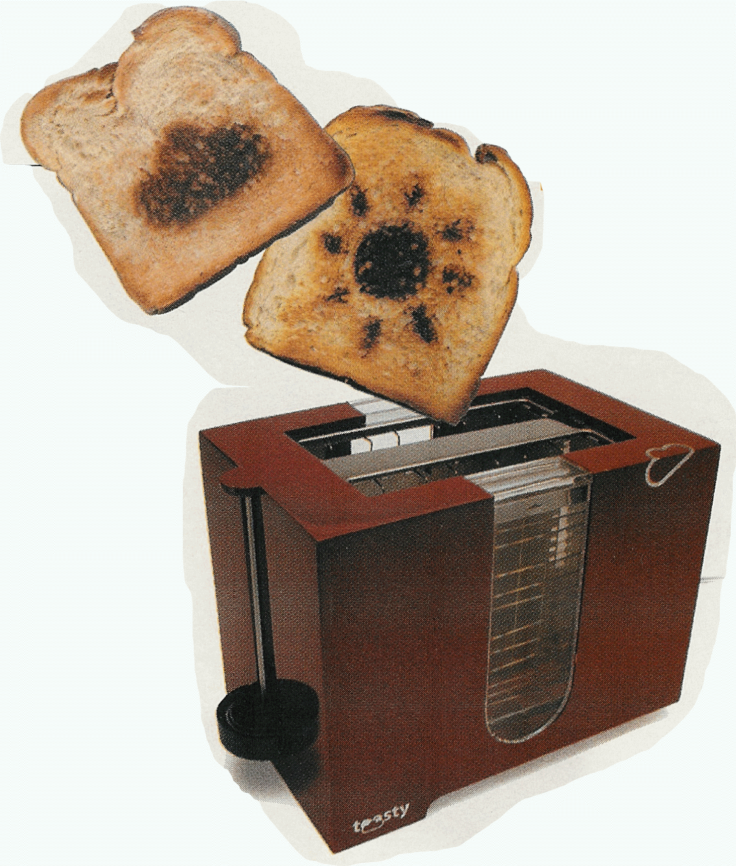
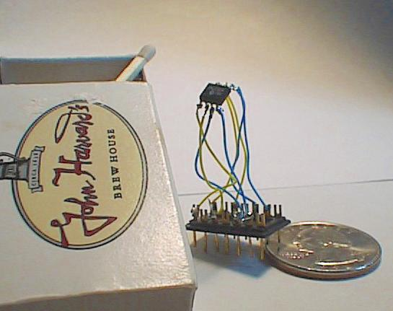

“Cool” internet appliances
Web-enabled toaster +
weather forecaster
IP picture frame
http://www.ceiva.com/
World’s smallest web server
http://www-ccs.cs.umass.edu/~shri/iPic.html
Internet phones

Slide 9
What’s the Internet: “nuts and bolts” view 什么是Internet：组成细节角度
protocols control sending, receiving of msgs
e.g., TCP, IP, HTTP, FTP, PPP
Internet: “network of networks”
loosely hierarchical
public Internet versus private intranet
Internet standards
RFC: Request for comments
IETF: Internet Engineering Task Force
router
workstation
server
mobile
local ISP
regional ISP
company
network
Notes:
RFC：请求评论文档

Slide 10
What’s the Internet: a service view 什么是Internet：服务的角度
communication infrastructure enables distributed applications:
Web, email, games, e-commerce, file sharing
communication services provided to apps:
Connectionless unreliable
connection-oriented reliable
Question：仅有硬件足够吗？No！需要协议protocols！

Slide 11
What’s a protocol?
human protocols:
“what’s the time?”
“I have a question”
introductions
语法：数据与控制信息的结构或格式
语义：完成何种动作以及做出何种响应
次序（时序）：事件顺序…
network protocols:
machines rather than humans
all communication activity in Internet governed by protocols
protocols define format, order of msgs sent and received among network entities, and actions taken on msg transmission, receipt

Slide 12


What’s a protocol?
a human protocol and a computer network protocol:
Hi
TCP connection
request
Hi
TCP connection
response
Got the
time?
Get http://www.awl.com/kurose-ross
2:00
<file>
time
Q: Other human protocols?

Slide 13
What’s a protocol?
Case study: web server:
1: type URL of web page
2. Your computer will send a connection request message to the web server and wait for reply.
3. The web server will receive your message and return a connection reply message.
4. Knowing that it is now okay to request the web document, your computer then sends the name of the webpage it wants.

Slide 14
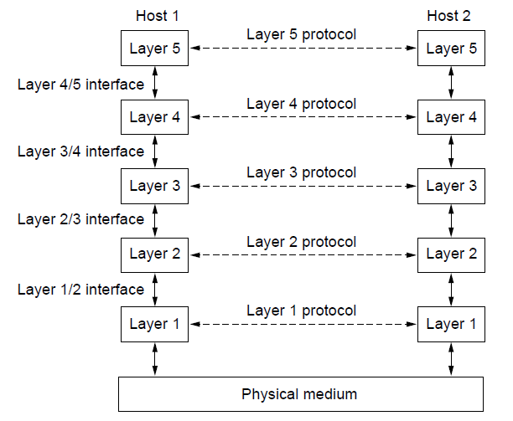
Protocol hierarchies

Slide 15
Roadmap
1.1 What is the computer network?
1.2 Network edge
1.3 Network core
1.4 Network access and physical media
1.5 Internet structure and ISPs
1.6 Delay & loss in packet-switched networks
1.7 Protocol layers, service models
1.8 History

Slide 16
A closer look at network structure: 网络的结构
network edge: applications and hosts
network core:
routers
network of networks
access networks, physical media: communication links

Slide 17
The network edge: 网络边缘
end systems (hosts):
run application programs
e.g. Web, email
at “edge of network”
client/server model
client host requests, receives service from always-on server
e.g. Web browser/server; email client/server
peer-peer model:
minimal (or no) use of dedicated servers
e.g. Skype, BitTorrent, KaZaA

Slide 18
Network edge: connection-oriented service
Goal: data transfer between end systems
handshaking: setup (prepare for) data transfer ahead of time
Hello, hello back human protocol
set up “state” in two communicating hosts
TCP - Transmission Control Protocol
Internet’s connection-oriented service
TCP service [RFC 793]
reliable, in-order byte-stream data transfer
loss: acknowledgements and retransmissions
flow control:
sender won’t overwhelm receiver
congestion control:
senders “slow down sending rate” when network congested

Slide 19
Network edge: connectionless service
Goal: data transfer between end systems
same as before!
UDP - User Datagram Protocol [RFC 768]:
connectionless
unreliable data transfer
no flow control
no congestion control
App’s using TCP:
HTTP (Web), FTP (file transfer), Telnet (remote login), SMTP (email)
App’s using UDP:
streaming media, teleconferencing, DNS, Internet telephony

Slide 20
Chapter 1: roadmap
1.1 What is the Internet?
1.2 Network edge
1.3 Network core
1.4 Network access and physical media
1.5 Internet structure and ISPs
1.6 Delay & loss in packet-switched networks
1.7 Protocol layers, service models
1.8 History

Slide 21
The Network Core网络核心
mesh of interconnected routers
the fundamental question: how is data transferred through net?
circuit switching: （电路交换）dedicated circuit per call: telephone net
packet-switching: （分组交换）data sent thru net in discrete “chunks”

Slide 22
数据交换
网络的核心进行数据交换：
电路交换 circuit switching
报文交换 message switching
分组交换 packet switching

Slide 23
Network Core: Circuit Switching电路交换
End-end resources reserved for “call”
link bandwidth, switch capacity
dedicated resources: no sharing
circuit-like (guaranteed) performance
call setup required
电路交换的三个阶段： ▪
建立连接（呼叫/电路建立） ▪
通信 ▪
释放连接（拆除电路）
Notes:
电话网络，独占资源

Slide 24
Network Core: Circuit Switching 电路交换
network resources (e.g., bandwidth) divided into “pieces”
pieces allocated to calls
resource piece idle if not used by owning call (no sharing)
Mutiplexing 多路复用
dividing link bandwidth into “pieces”
frequency division频分复用
time division时分复用

Slide 25
Circuit Switching: FDM and TDM
FDM
Example:
4 users
frequency
time
TDM
frequency
time
Notes:
ping

Slide 26
Numerical example
How long does it take to send a file of 640,000 bits from host A to host B over a circuit-switched (TDM) network?
All links are 1.536 Mbps
Each link uses TDM with 24 slots/sec
500 msec to establish end-to-end circuit
Let’s work it out!
Notes:
For a TDM link, time is divided into frames of fixed duration and each frame is divided into a fixed number of time slots. When the network establish a connection across a link, the network dedicates one time slot in every frame to the connection. These slots are dedicated for the sole use of that connection, with a time slot available for use (in every frame) to transmit the connection's data. Each circuit has a transmission rate of (1.536 Mbps)/24 = 64 Kbps, so it takes (640bits)/(64 Kbps) = 10 seconds to transmit the file. To this 10 seconds we add the circuit establishment time, giving 10.5 seconds to send the file. Note that the transmission time is independent of the number links: the transmission time would be 10 seconds if the end-to-end circuit passes through one link or one-hundred links.

Slide 27
Message switching:报文交换
报文：源（应用）发送信息整体 ▪
比如：一个文件
L
R
R

Slide 28
Network Core: Packet Switching 分组交换
each end-end data stream divided into packets
user A, B packets share network resources
each packet uses full link bandwidth
resources used as needed
resource contention:
aggregate resource demand can exceed amount available
congestion: packets queue, wait for link use
store and forward: packets move one hop at a time
Node receives complete packet before forwarding
Bandwidth division into “pieces”
Dedicated allocation
Resource reservation

Slide 29
Packet switching 分组交换
分组：报文分拆出来的一系列相对较小的数据包 
分组交换需要报文的拆分与重组 
产生额外开销

Slide 30
Packet Switching: Statistical Multiplexing 统计多路复用
100 Mb/s
Ethernet
A
C
statistical multiplexing
1.5 Mb/s
B
queue of packets
waiting for output
link
D
E
Sequence of A & B packets does not have fixed pattern, shared on demand ➔ statistical multiplexing.
TDM: each host gets same slot in revolving TDM frame.
Notes:
按需共享链路

Slide 31
Packet-switching: store-and-forward 存储转发
L
R
R
R
Takes L/R seconds to transmit (push out) packet of L bits on to link of R bps
Entire packet must arrive at router before it can be transmitted on next link: store and forward
delay = 3L/R (assuming zero propagation delay)
Example:
L = 7.5 Mbits
R = 1.5 Mbps
delay = 15 sec
Notes:
存储-转发

Slide 32
Store and forwarding:存储转发
报文交换与分组交换均采用存储-转发交换方式 
区别： ▪
报文交换以完整报文进行“存储-转发” ▪
分组交换以较小的分组进行“存储-转发”

Slide 33
Roadmap
1.1 What is the Internet?
1.2 Network edge
1.3 Network core
1.4 Network access and physical media
1.5 Internet structure and ISPs
1.6 Delay & loss in packet-switched networks
1.7 Protocol layers, service models
1.8 History

Slide 34
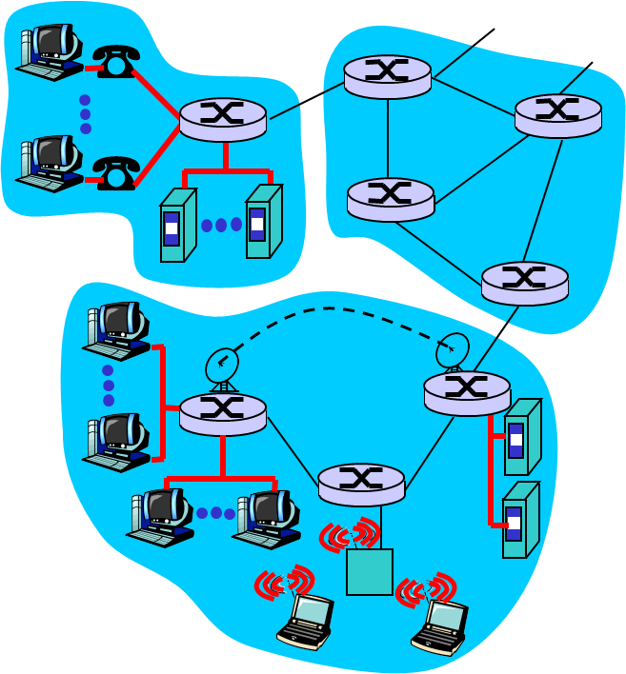
Access networks and physical media
Q: How to connect end systems to edge router?
residential access nets
institutional access networks (school, company)
mobile access networks
Keep in mind:
bandwidth (bits per second) of access network?
shared or dedicated?

Slide 35
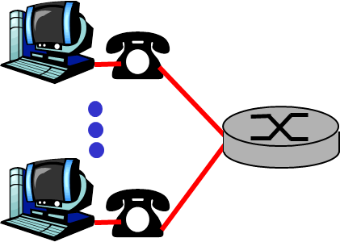
Residential access: point to point access
Dialup via modem
up to 56Kbps direct access to router (often less)
Can’t surf and phone at same time: can’t be “always on”
ADSL: asymmetric digital subscriber line
up to 1 Mbps upstream (today typically < 256 kbps)
up to 8 Mbps downstream (today typically < 1 Mbps)
FDM: 50 kHz - 1 MHz for downstream
4 kHz - 50 kHz for upstream
0 kHz - 4 kHz for ordinary telephone

Slide 36
Residential access: cable modems
HFC: hybrid fiber coax
asymmetric: up to 30Mbps downstream, 2 Mbps upstream
network of cable and fiber attaches homes to ISP router
homes share access to router
deployment: available via cable TV companies
Notes:
hybrid fiber coax 混合光纤同轴系统
Cable modems 电缆调制解调器

Slide 37
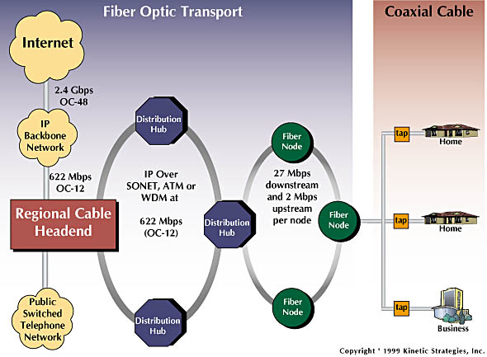
Residential access: cable modems

Slide 38

Cable Network Architecture: Overview
Typically 500 to 5,000 homes
cable headend
cable distribution
network (simplified)
home

Slide 39
Cable Network Architecture: Overview
FDM:
C
O
N
T
R
O
L
V
I
D
E
O
V
I
D
E
O
V
I
D
E
O
V
I
D
E
O
V
I
D
E
O
V
I
D
E
O
D
A
T
A
D
A
T
A
1
2
3
4
5
6
7
8
9
Channels
cable headend
cable distribution
network
home

Slide 40
Company access: local area networks
company/univ local area network (LAN) connects end system to edge router
Ethernet:
shared or dedicated link connects end system and router
10 Mbs, 100Mbps, Gigabit Ethernet

Slide 41
Wireless access networks
shared wireless access network connects end system to router
via base station aka “access point”
wireless LANs:
802.11b/g (WiFi): 11 or 54 Mbps
wider-area wireless access
provided by telco operator
3G ~ 384 kbps
4G ~ 100 mbps
5G ~ 10 Gbps
router
base
station
mobile
hosts

Slide 42
Home networks
Typical home network components:
ADSL or cable modem
router/firewall/NAT
Ethernet
wireless access
point

Slide 43
Roadmap
1.1 What is the Internet?
1.2 Network edge
1.3 Network core
1.4 Network access and physical media
1.5 Internet structure and ISPs
1.6 Delay & loss in packet-switched networks
1.7 Protocol layers, service models
1.8 History

Slide 44
EXAMPLE NETWORKS
Internet
ARPANET
NSFNET
Third-generation mobile phone networks
Wireless LANs: 802.11
RFID and sensor networks

Slide 45
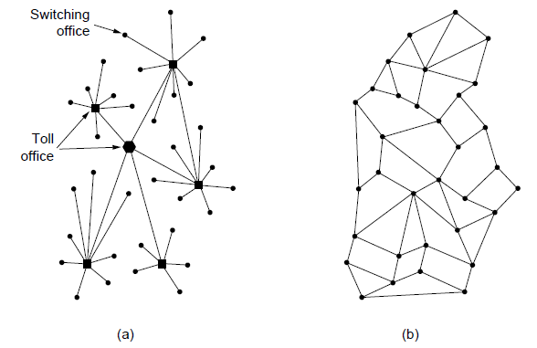
The ARPANET (1)
1. Structure of the telephone system.
2. Baran’s proposed distributed switching system (early ARPRNET).
Notes:
20

Slide 46
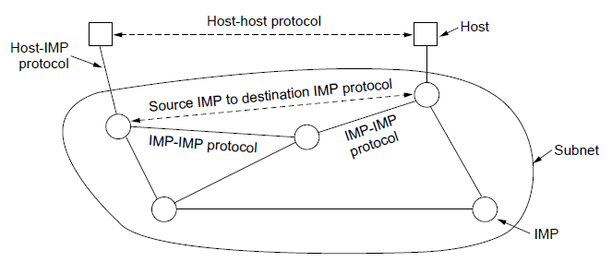
The ARPANET (2)
The original ARPANET design

Slide 47
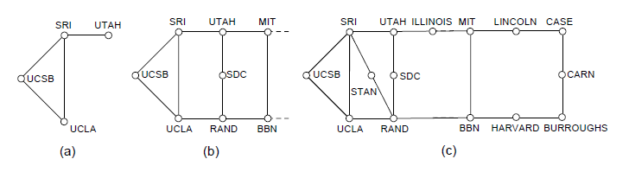
The ARPANET (3)
Growth of the ARPANET.
December 1969.
July 1970.
March 1971.

Slide 48
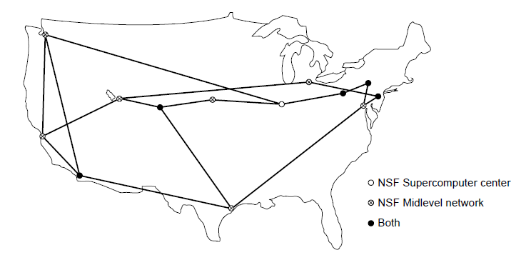
NSFNET
The NSFNET backbone in 1988.

Slide 49
Internet structure: network of networks
roughly hierarchical
at center: “tier-1” ISPs (e.g., MCI, Sprint, AT&T, Cable and Wireless), national/international coverage
treat each other as equals
Tier-1 providers also interconnect at public network access points (NAPs)
Tier-1 providers interconnect (peer) privately
Tier 1 ISP
NAP
Tier 1 ISP
Tier 1 ISP

Slide 50
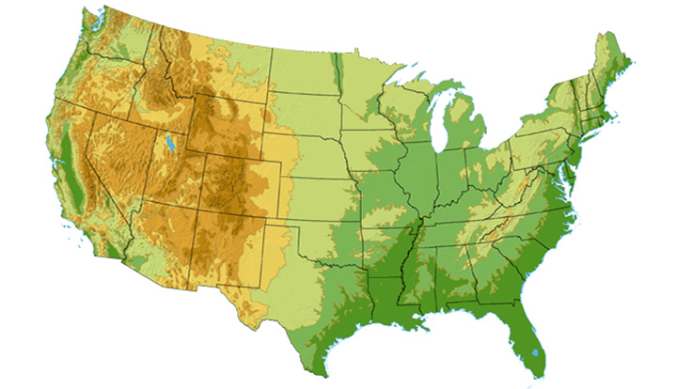

Tier-1 ISP: e.g., Sprint
Sprint US backbone network
DS3 (45 Mbps)
OC3 (155 Mbps)
OC12 (622 Mbps)
OC48 (2.4 Gbps)
Seattle
Tacoma
POP: point-of-presence
to/from backbone
Stockton
New York
Cheyenne
Chicago
Pennsauken
…
peering
….
Relay
San Jose
Roachdale
Wash. DC
Kansas City
Anaheim
…
…
…
Atlanta
to/from customers
Fort Worth
Orlando

Slide 51
Internet structure: network of networks
“Tier-2” ISPs: smaller (often regional) ISPs
Connect to one or more tier-1 ISPs, possibly other tier-2 ISPs
Tier-2 ISPs also peer privately with each other, interconnect at NAP
Tier-2 ISP pays tier-1 ISP for connectivity to rest of Internet
tier-2 ISP is customer of
tier-1 provider
Tier-2 ISP
Tier-2 ISP
Tier 1 ISP
NAP
Tier 1 ISP
Tier 1 ISP
Tier-2 ISP
Tier-2 ISP
Tier-2 ISP

Slide 52
Internet structure: network of networks
“Tier-3” ISPs and local ISPs
last hop (“access”) network (closest to end systems)
local
ISP
Tier 3
ISP
local
ISP
local
ISP
local
ISP
Local and tier- 3 ISPs are customers of
higher tier ISPs
connecting them to rest of Internet
Tier-2 ISP
Tier-2 ISP
Tier 1 ISP
NAP
Tier 1 ISP
Tier 1 ISP
Tier-2 ISP
Tier-2 ISP
Tier-2 ISP
local
ISP
local
ISP
local
ISP
local
ISP

Slide 53
Internet structure: network of networks
a packet passes through many networks!
local
ISP
Tier 3
ISP
local
ISP
local
ISP
local
ISP
Tier-2 ISP
Tier-2 ISP
Tier 1 ISP
NAP
Tier 1 ISP
Tier 1 ISP
Tier-2 ISP
Tier-2 ISP
Tier-2 ISP
local
ISP
local
ISP
local
ISP
local
ISP

Slide 54
Roadmap
1.1 What is the Internet?
1.2 Network edge
1.3 Network core
1.4 Network access and physical media
1.5 Internet structure and ISPs
1.6 Delay & loss in packet-switched networks
（网络性能)
1.7 Protocol layers, service models
1.8 History

Slide 55
How do loss and delay occur?
packets queue in router buffers
packet arrival rate to link exceeds output link capacity
packets queue, wait for turn
packet being transmitted (delay)
A
B
packets queueing (delay)
free (available) buffers: arriving packets
dropped (loss) if no free buffers

Slide 56
Four sources of packet delay
1. nodal processing:
check bit errors
determine output link
2. queueing
time waiting at output link for transmission
depends on congestion level of router
transmission
A
propagation
B
nodal
processing
queueing

Slide 57
Delay in packet-switched networks
3. Transmission delay:
R=link bandwidth (bps)
L=packet length (bits)
time to send bits into link = L/R
4. Propagation delay:
d = length of physical link
s = propagation speed in medium (~2x10⁸ m/sec)
propagation delay = d/s
Note: s and R are very different quantities!
transmission
A
propagation
B
nodal
processing
queueing

Slide 58
Caravan analogy
100 km
100 km
ten-car
caravan
toll
booth
toll
booth
Cars “propagate” at 100 km/hr
Toll booth takes 12 sec to service a car (transmission time)
car~bit; caravan ~ packet
Q: How long until caravan is lined up before 2nd toll booth?
Time to “push” entire caravan through toll booth onto highway = 12*10 = 120 sec
Time for last car to propagate from 1st to 2nd toll both: 100km/(100km/hr)= 1 hr
A: 62 minutes

Slide 59
Caravan analogy (more)
100 km
100 km
ten-car
caravan
toll
booth
toll
booth
Yes! After 7 min, 1st car at 2nd booth and 3 cars still at 1st booth.
1st bit of packet can arrive at 2nd router before packet is fully transmitted at 1st router!
See Ethernet applet at AWL Web site
Cars now “propagate” at 1000 km/hr
Toll booth now takes 1 min to service a car
Q: Will cars arrive to 2nd booth before all cars serviced at 1st booth?

Slide 60
Nodal delay
d_{proc} = processing delay
typically a few microsecs or less
d_{queue} = queuing delay
depends on congestion
d_{trans} = transmission delay
= L/R, significant for low-speed links
d_{prop} = propagation delay
a few microsecs to hundreds of msecs

Slide 61
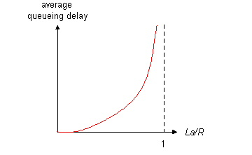
Queueing delay (revisited)
R=link bandwidth (bps)
L=packet length (bits)
a=average packet arrival rate
traffic intensity = La/R
La/R ~ 0: average queueing delay small
La/R -> 1: delays become large
La/R > 1: more “work” arriving than can be serviced, average delay infinite!

Slide 62
“Real” Internet delays and routes
What do “real” Internet delay & loss look like?
Traceroute program: provides delay measurement from source to router along end-end Internet path towards destination. For all i:
sends three packets that will reach router i on path towards destination
router i will return packets to sender
sender times interval between transmission and reply.
3 probes
3 probes
3 probes

Slide 63
“Real” Internet delays and routes
traceroute: gaia.cs.umass.edu to www.eurecom.fr
Three delay measurements from
gaia.cs.umass.edu to cs-gw.cs.umass.edu
1 cs-gw (128.119.240.254) 1 ms 1 ms 2 ms
2 border1-rt-fa5-1-0.gw.umass.edu (128.119.3.145) 1 ms 1 ms 2 ms
3 cht-vbns.gw.umass.edu (128.119.3.130) 6 ms 5 ms 5 ms
4 jn1-at1-0-0-19.wor.vbns.net (204.147.132.129) 16 ms 11 ms 13 ms
5 jn1-so7-0-0-0.wae.vbns.net (204.147.136.136) 21 ms 18 ms 18 ms
6 abilene-vbns.abilene.ucaid.edu (198.32.11.9) 22 ms 18 ms 22 ms
7 nycm-wash.abilene.ucaid.edu (198.32.8.46) 22 ms 22 ms 22 ms
8 62.40.103.253 (62.40.103.253) 104 ms 109 ms 106 ms
9 de2-1.de1.de.geant.net (62.40.96.129) 109 ms 102 ms 104 ms
10 de.fr1.fr.geant.net (62.40.96.50) 113 ms 121 ms 114 ms
11 renater-gw.fr1.fr.geant.net (62.40.103.54) 112 ms 114 ms 112 ms
12 nio-n2.cssi.renater.fr (193.51.206.13) 111 ms 114 ms 116 ms
13 nice.cssi.renater.fr (195.220.98.102) 123 ms 125 ms 124 ms
14 r3t2-nice.cssi.renater.fr (195.220.98.110) 126 ms 126 ms 124 ms
15 eurecom-valbonne.r3t2.ft.net (193.48.50.54) 135 ms 128 ms 133 ms
16 194.214.211.25 (194.214.211.25) 126 ms 128 ms 126 ms
17 * * *
18 * * *
19 fantasia.eurecom.fr (193.55.113.142) 132 ms 128 ms 136 ms
trans-oceanic
link
* means no response (probe lost, router not replying)

Slide 64
Packet loss
queue (aka buffer) preceding link in buffer has finite capacity
when packet arrives to full queue, packet is dropped (aka lost)
lost packet may be retransmitted by previous node, by source end system, or not retransmitted at all

Slide 65
Roadmap
1.1 What is the Internet?
1.2 Network edge
1.3 Network core
1.4 Network access and physical media
1.5 Internet structure and ISPs
1.6 Delay & loss in packet-switched networks
1.7 Protocol layers, service models
1.8 History

Slide 66
Protocol “Layers”
Networks are complex!
many “pieces”:
hosts
routers
links of various media
applications
protocols
hardware, software
Question:
Is there any hope of organizing structure of network?
Or at least our discussion of networks?

Slide 67
Organization of air travel
ticket (purchase)
baggage (check)
gates (load)
runway takeoff
airplane routing
ticket (complain)
baggage (claim)
gates (unload)
runway landing
airplane routing
airplane routing
a series of steps

Slide 68
Layering of airline functionality
ticket (purchase)
baggage (check)
gates (load)
runway (takeoff)
airplane routing
ticket (complain)
baggage (claim
gates (unload)
runway (land)
airplane routing
ticket
baggage
gate
takeoff/landing
airplane routing
airplane routing
airplane routing
departure
airport
intermediate air-traffic
control centers
arrival
airport
Layers: each layer implements a service
via its own internal-layer actions
relying on services provided by layer below

Slide 69
Why layering?
Dealing with complex systems:
explicit structure allows identification, relationship of complex system’s pieces
layered reference model for discussion
modularization eases maintenance, updating of system
change of implementation of layer’s service transparent to rest of system
e.g., change in gate procedure doesn’t affect rest of system
layering considered harmful?

Slide 70
为什么需要计算机网络体系结构?
计算机网络是一个非
常复杂的系统,涉及许
多组成部分:
▪ 主机（hosts）
问题:
是否存在一种系统结
构有效描述网络？
▪
路由器（routers）
▪
▪
▪
▪
▪
各种链路（links）
应用（applications）
协议（protocols）
硬件、软件
……
利用什么样的结构？
….
至少用于讨论网络？
A：分层结构

Slide 71
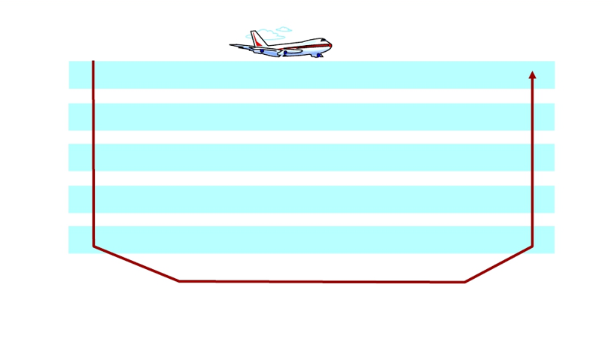
复杂系统的分层结构
❖
类比：航空旅行
票务 (购票)
行李 (托运)
登机口 (登机)
起飞
飞机路由、飞行
票务 (投诉)
行李(领取)
登机口(下机)
着陆
飞机路由、飞行
飞机路由、飞行
❖
每层完成一种（类）特定服务/功能
▪
每层依赖底层提供的服务，通过层内动作完成相应功能

Slide 72
计算机网络的体系结构？
网络体系结构是从功能上描述计算机网络结构
计算机网络体系结构简称网络体系结构
(network architecture)是分层结构
每层遵循某个/些网络协议完成本层功能
计算机网络体系结构是计算机网络的各层及其
协议的集合
体系结构是一个计算机网络的功能层次及其关
系的定义
体系结构是抽象的

Slide 73
为什么采用分层结构？
结构清晰，有利于识别复杂系统的部件及
其关系
▪ 分层的参考模型（reference model ）
模块化的分层易于系统更新、维护
▪ 任何一层服务实现的改变对于系统其它层都是
透明的
▪ 例如，登机过程的改变并不影响航空系统的其
它部分（层）
有利于标准化
分层是否有不利之处？

Slide 74
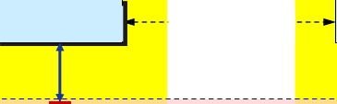
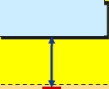


分层网络体系结构基本概念
系统A
系统B
服务用户
实体(n + 1)
协议(n + 1)
实体(n + 1)
第 n+1 层
交换原语
SAP
交换原语
SAP
服务提供者
实体(n)
协议(n)
实体(n)
第 n 层
❖ 实体(entity) 表示任何可发送或接收信息的硬件或软件进程。
❖ 协议是控制两个对等实体进行通信的规则的集合，协议是“水平的” 。
❖ 任一层实体需要使用下层服务，遵循本层协议，实现本层功能，向上
层提供服务，服务是“垂直的”。
❖ 下层协议的实现对上层的服务用户是透明的。
❖ 同系统的相邻层实体间通过接口进行交互，通过服务访问点 SAP
(Service Access Point)，交换原语，指定请求的特定服务。

Slide 75

OSI参考模型
OSI参考模型
❖ 开放系统互连 (OSI)参考模型
是由国际标准化组织 (ISO) 于
1984年提出的分层网络体系结
构模型
❖ 目的是支持异构网络系统的互
联互通
❖ 异构网络系统互连的国际标准
❖ 理解网络通信的最佳学习工具
（理论模型）
▪ 理论成功，市场失败
❖ 7层（功能）,每层完成特定的
网络功能
7:
6:
5:
4:
3:
2:
1:
应用层（Application）
表示层（Presentation）
会话层（Session）
传输层（Transport）
网络层（Network）
数据链路层（Data link）
物理层（Physical）

Slide 76
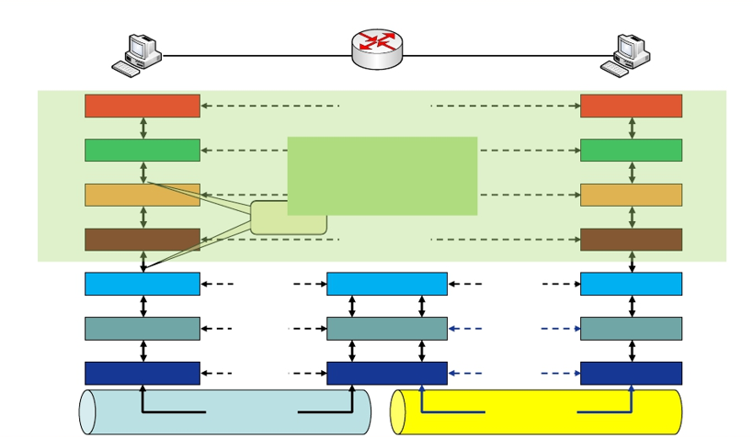
OSI参考模型解释的通信过程
主机 A
应用层
表示层
会话层
传输层
中间系统
协议
协议
协议
协议
主机 B
应用层
表示层
会话层
传输层
端- 端层
（end-end）
接口
网络层
数据链路层
物理层
协议
协议
协议
网络层
数据链路层
物理层
协议
协议
协议
网络层
数据链路层
物理层
传输介质
传输介质

Slide 77
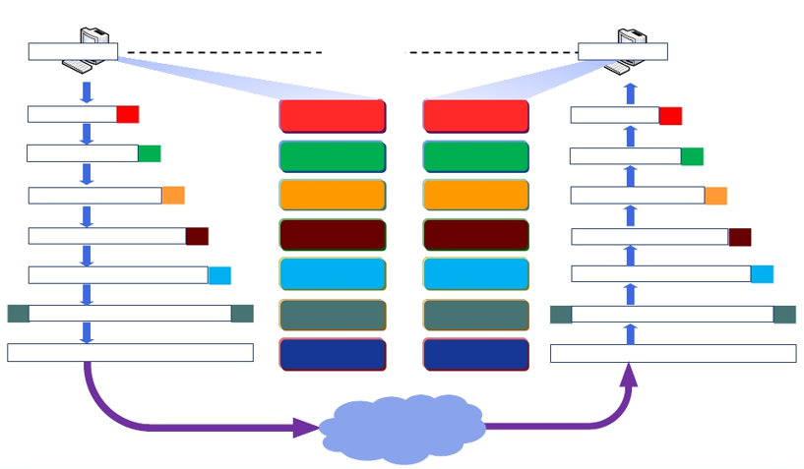
OSI参考模型数据封装与通信过程
主机 A
主机 B
用户数据
用户数据
用户数据
用户数据
A-PDU
P-PDU
AH
7
6
5
应用层
表示层
会话层
应用层
表示层
会话层
7
6
5
用户数据
A-PDU
P-PDU
AH
PH
PH
SH
SH
S-PDU
T-PDU
TH
4
3
传输层
网络层
传输层
网络层
4
3
S-PDU
T-PDU
TH
NH
NH
DT
N-PDU
DH
2
数据链路层
数据链路层
2 DT
N-PDU
DH
10101010101011111110000000101010
1
物理层
物理层
1
10101010101011111110000000101010
Network

Slide 78
为什么需要数据封装？
增加控制信息
▪ 构造协议数据单元 (PDU)
控制信息主要包括:
▪ 地址（Address）: 标识发送端/接收端
▪ 差错检测编码（Error-detecting code）: 用于差错检测
或纠正
▪ 协议控制（Protocol control）: 实现协议功能的附加信
息，如: 优先级（priority）、服务质量（QoS）、 和安
全控制等

Slide 79
Internet protocol stack
application: supporting network applications
FTP, SMTP, HTTP
transport: process-process data transfer
TCP, UDP
network: routing of datagrams from source to destination
IP, routing protocols
link: data transfer between neighboring network elements
PPP, Ethernet
physical: bits “on the wire”
application
transport
network
link
physical

Slide 80
Encapsulation
source
message
M
application
transport
network
link
physical
segment
H_{t}
M
H_{t}
datagram
H_{n}
H_{n}
H_{t}
M
frame
H_{l}
H_{n}
H_{t}
M
link
physical
switch
destination
H_{n}
H_{t}
M
network
link
physical
M
application
transport
network
link
physical
H_{l}
H_{n}
H_{t}
M
H_{n}
H_{t}
M
H_{t}
M
H_{n}
H_{t}
M
H_{l}
H_{n}
H_{t}
M
router

Slide 81
Chapter 1: roadmap
1.1 What is the Internet?
1.2 Network edge
1.3 Network core
1.4 Network access and physical media
1.5 Internet structure and ISPs
1.6 Delay & loss in packet-switched networks
1.7 Protocol layers, service models
以下章节供阅读参考
1.8 History

Slide 82
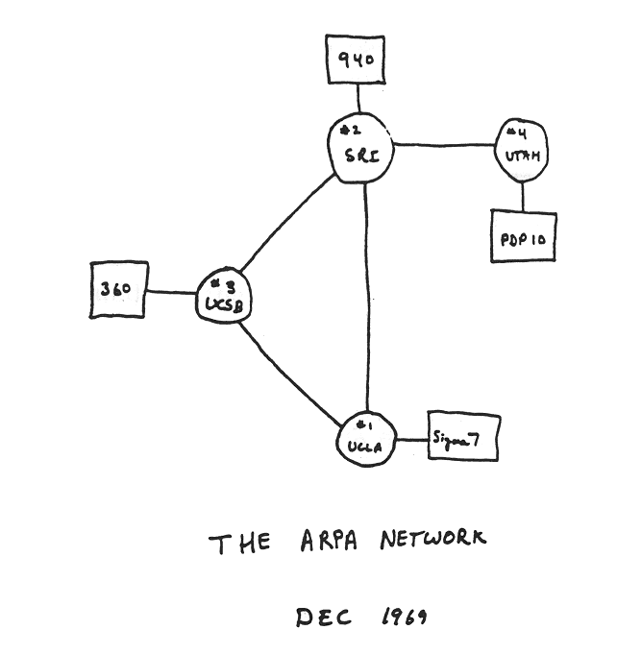
Internet History
1961-1972: Early packet-switching principles
1961: Kleinrock - queueing theory shows effectiveness of packet-switching
1964: Baran - packet-switching in military nets
1967: ARPAnet conceived by Advanced Research Projects Agency
1969: first ARPAnet node operational
1972:
ARPAnet public demonstration
NCP (Network Control Protocol) first host-host protocol
first e-mail program
ARPAnet has 15 nodes

Slide 83
Internet History
1972-1980: Internetworking, new and proprietary nets
1970: ALOHAnet satellite network in Hawaii
1974: Cerf and Kahn - architecture for interconnecting networks
1976: Ethernet at Xerox PARC
ate70’s: proprietary architectures: DECnet, SNA, XNA
late 70’s: switching fixed length packets (ATM precursor)
1979: ARPAnet has 200 nodes
Cerf and Kahn’s internetworking principles:
minimalism, autonomy - no internal changes required to interconnect networks
best effort service model
stateless routers
decentralized control
define today’s Internet architecture

Slide 84
Internet History
1980-1990: new protocols, a proliferation of networks
1983: deployment of TCP/IP
1982: smtp e-mail protocol defined
1983: DNS defined for name-to-IP-address translation
1985: ftp protocol defined
1988: TCP congestion control
new national networks: Csnet, BITnet, NSFnet, Minitel
100,000 hosts connected to confederation of networks

Slide 85
Internet History
1990, 2000’s: commercialization, the Web, new apps
Early 1990’s: ARPAnet decommissioned
1991: NSF lifts restrictions on commercial use of NSFnet (decommissioned, 1995)
early 1990s: Web
hypertext [Bush 1945, Nelson 1960’s]
HTML, HTTP: Berners-Lee
1994: Mosaic, later Netscape
late 1990’s: commercialization of the Web
Late 1990’s – 2000’s:
more killer apps: instant messaging, P2P file sharing
network security to forefront
est. 50 million host, 100 million+ users
backbone links running at Gbps

Slide 86
Introduction: Summary
Covered a “ton” of material!
Internet overview
what’s a protocol?
network edge, core, access network
packet-switching versus circuit-switching
Internet/ISP structure
performance: loss, delay
layering and service models
history
You now have:
context, overview, “feel” of networking
more depth, detail to follow!

