Slide 1
Chapter 4: Network Layer
Chapter goals:
understand principles behind network layer services:
  network layer service models
  forwarding versus routing
  how a router works
  routing (path selection)
  dealing with scale
  advanced topics: IPv6, mobility
instantiation, implementation in the Internet

Slide 2
Chapter 4: Network Layer
4. 1 Introduction
4.2 Virtual circuit and datagram networks
4.3 What’s inside a router
4.4 IP: Internet Protocol
  Datagram format
  IPv4 addressing
  ICMP
  IPv6
4.5 Routing algorithms
  Link state
  Distance Vector
  Hierarchical routing
4.6 Routing in the Internet
  RIP
  OSPF
  BGP
4.7 Broadcast and multicast routing

Slide 3
Network layer
transport segment from sending to receiving host
on sending side encapsulates segments into datagrams
on rcving side, delivers segments to transport layer
network layer protocols in every host, router
Router examines header fields in all IP datagrams passing through it
application
transport
network
data link
physical
network
data link
physical
network
data link
physical
network
data link
physical
network
data link
physical
network
data link
physical
network
data link
physical
network
data link
physical
network
data link
physical
application
transport
network
data link
physical

Slide 4
Two Key Network-Layer Functions
forwarding: move packets from router’s input to appropriate router output
routing: determine route taken by packets from source to dest.
  routing algorithms
analogy:
routing: process of planning trip from source to dest
forwarding: process of getting through single interchange

Slide 5
Interplay between routing and forwarding
routing algorithm
local forwarding table
header value
output link
0100
0101
0111
1001
3
2
2
1
value in arriving
packet’s header
0111
1
3
2

Slide 6
Connection setup
3rd important function in some network architectures:
  ATM, frame relay, X.25
before datagrams flow, two end hosts and intervening routers establish virtual connection
  routers get involved
network vs transport layer connection service:
  network: between two hosts (may also involve intervening routers in case of VCs)
  transport: between two processes

Slide 7
Network service model
Q: What service model for “channel” transporting datagrams from sender to receiver?
Example services for individual datagrams:
guaranteed delivery
guaranteed delivery with less than 40 msec delay
Example services for a flow of datagrams:
in-order datagram delivery
guaranteed minimum bandwidth to flow
restrictions on changes in inter-packet spacing

Slide 8
Network layer service models:
Network
Architecture
Internet
ATM
ATM
ATM
ATM
Service
Model
best effort
CBR
VBR
ABR
UBR
Guarantees ?
Congestion
feedback
no (inferred
via loss)
no
congestion
no
congestion
yes
no
Bandwidth
none
constant
rate
guaranteed
rate
guaranteed
minimum
none
Loss
no
yes
yes
no
no
Order
no
yes
yes
yes
yes
Timing
no
yes
yes
no
no

Slide 9
Chapter 4: Network Layer
4. 1 Introduction
4.2 Virtual circuit and datagram networks
4.3 What’s inside a router
4.4 IP: Internet Protocol
  Datagram format
  IPv4 addressing
  ICMP
  IPv6
4.5 Routing algorithms
  Link state
  Distance Vector
  Hierarchical routing
4.6 Routing in the Internet
  RIP
  OSPF
  BGP
4.7 Broadcast and multicast routing

Slide 10
Network layer connection and connection-less service
datagram network provides network-layer connectionless service
VC network provides network-layer connection service
analogous to the transport-layer services, but:
  service: host-to-host
  no choice: network provides one or the other
  implementation: in network core

Slide 11
Virtual circuits
“source-to-dest path behaves much like telephone circuit”
  performance-wise
  network actions along source-to-dest path
call setup, teardown for each call before data can flow
each packet carries VC identifier (not destination host address)
every router on source-dest path maintains “state” for each passing connection
link, router resources (bandwidth, buffers) may be allocated to VC (dedicated resources = predictable service)

Slide 12
VC implementation
a VC consists of:
  path from source to destination
  VC numbers, one number for each link along path
  entries in forwarding tables in routers along path
packet belonging to VC carries VC number (rather than dest address)
VC number can be changed on each link.
  New VC number comes from forwarding table

Slide 13
Forwarding table
VC number
12
22
32
1
3
2
Forwarding table in
northwest router:
interface
number
Incoming interface Incoming VC # Outgoing interface Outgoing VC #
1 12 3 22
2 63 1 18
3 7 2 17
1 97 3 87
… … … …
Routers maintain connection state information!

Slide 14
Virtual circuits: signaling protocols
used to setup, maintain teardown VC
used in ATM, frame-relay, X.25
not used in today’s Internet
application
transport
network
data link
physical
5. Data flow begins
6. Receive data
application
transport
network
data link
physical
4. Call connected
3. Accept call
1. Initiate call
2. incoming call

Slide 15
Datagram networks
no call setup at network layer
routers: no state about end-to-end connections
  no network-level concept of “connection”
packets forwarded using destination host address
  packets between same source-dest pair may take different paths
application
transport
network
data link
physical
application
transport
network
data link
physical
1. Send data
2. Receive data

Slide 16
Forwarding table
4 billion
possible entries
Destination Address Range Link Interface
11001000 00010111 00010000 00000000
through 0
11001000 00010111 00010111 11111111
11001000 00010111 00011000 00000000
through 1
11001000 00010111 00011000 11111111
11001000 00010111 00011001 00000000
through 2
11001000 00010111 00011111 11111111
otherwise 3

Slide 17
Longest prefix matching
Prefix Match Link Interface
11001000 00010111 00010 0
11001000 00010111 00011000 1
11001000 00010111 00011 2
otherwise 3
Examples
DA: 11001000 00010111 00010110 10100001
Which interface?
DA: 11001000 00010111 00011000 10101010
Which interface?

Slide 18
Datagram or VC network: why?
Internet (datagram)
data exchange among computers
  “elastic” service, no strict timing req.
“smart” end systems (computers)
  can adapt, perform control, error recovery
  simple inside network, complexity at “edge”
many link types
  different characteristics
  uniform service difficult
ATM (VC)
evolved from telephony
human conversation:
  strict timing, reliability requirements
  need for guaranteed service
“dumb” end systems
  telephones
  complexity inside network

Slide 19
Chapter 4: Network Layer
4. 1 Introduction
4.2 Virtual circuit and datagram networks
4.3 What’s inside a router
4.4 IP: Internet Protocol
  Datagram format
  IPv4 addressing
  ICMP
  IPv6
4.5 Routing algorithms
  Link state
  Distance Vector
  Hierarchical routing
4.6 Routing in the Internet
  RIP
  OSPF
  BGP
4.7 Broadcast and multicast routing

Slide 20

Router Architecture Overview
Two key router functions:
run routing algorithms/protocol (RIP, OSPF, BGP)
forwarding datagrams from incoming to outgoing link

Slide 21
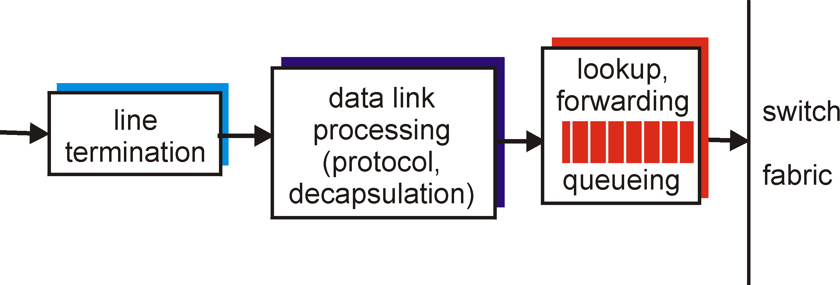
Input Port Functions
Physical layer:
bit-level reception
Data link layer:
e.g., Ethernet
see chapter 5
Decentralized switching:
given datagram dest., lookup output port using forwarding table in input port memory
goal: complete input port processing at ‘line speed’
queuing: if datagrams arrive faster than forwarding rate into switch fabric

Slide 22
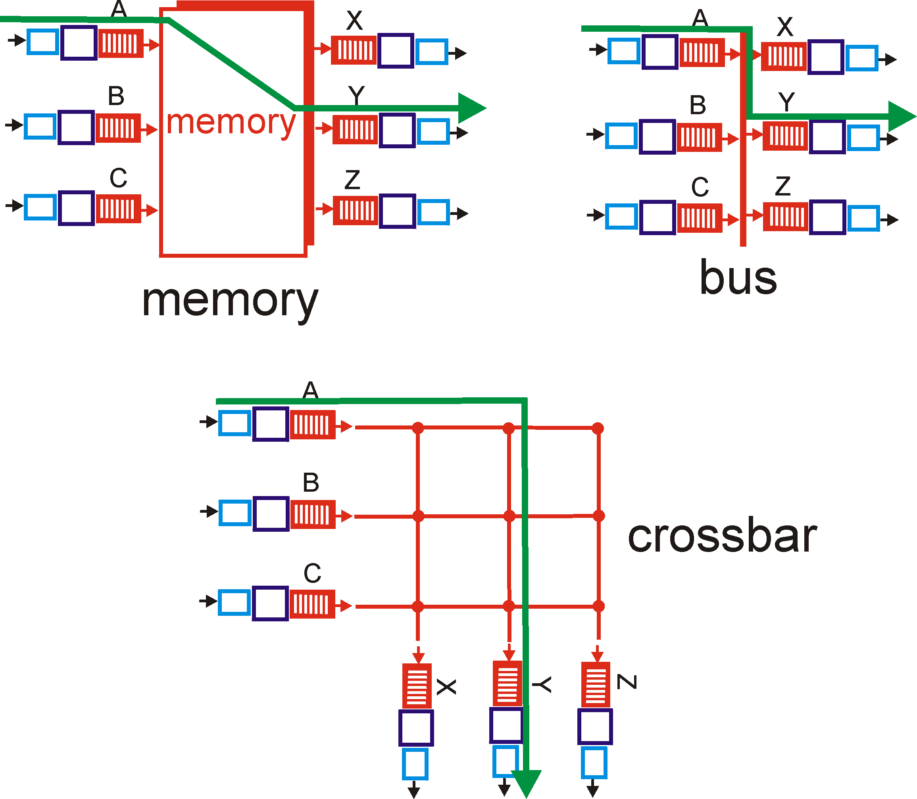
Three types of switching fabrics

Slide 23
Switching Via Memory
First generation routers:
traditional computers with switching under direct control of CPU
packet copied to system’s memory
speed limited by memory bandwidth (2 bus crossings per datagram)
Input
Port
Memory
Output
Port
System Bus

Slide 24
Switching Via a Bus
datagram from input port memory
to output port memory via a shared bus
bus contention: switching speed limited by bus bandwidth
1 Gbps bus, Cisco 1900: sufficient speed for access and enterprise routers (not regional or backbone)

Slide 25
Switching Via An Interconnection Network
overcome bus bandwidth limitations
Banyan networks, other interconnection nets initially developed to connect processors in multiprocessor
Advanced design: fragmenting datagram into fixed length cells, switch cells through the fabric.
Cisco 12000: switches Gbps through the interconnection network

Slide 26
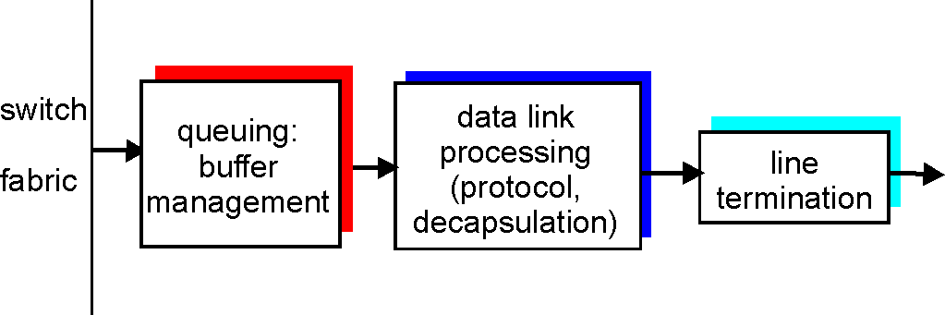
Output Ports
Buffering required when datagrams arrive from fabric faster than the transmission rate
Scheduling discipline chooses among queued datagrams for transmission

Slide 27
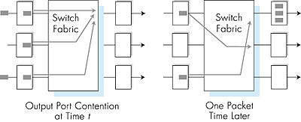
Output port queueing
buffering when arrival rate via switch exceeds output line speed
queueing (delay) and loss due to output port buffer overflow!

Slide 28
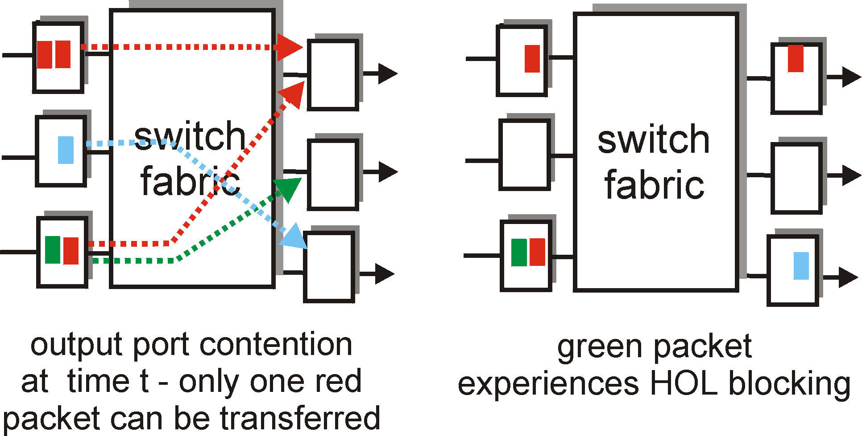
Input Port Queuing
Fabric slower than input ports combined -> queueing may occur at input queues
Head-of-the-Line (HOL) blocking: queued datagram at front of queue prevents others in queue from moving forward
queueing delay and loss due to input buffer overflow!

Slide 29
Chapter 4: Network Layer
4. 1 Introduction
4.2 Virtual circuit and datagram networks
4.3 What’s inside a router
4.4 IP: Internet Protocol
  Datagram format
  IPv4 addressing
  ICMP
  IPv6
4.5 Routing algorithms
  Link state
  Distance Vector
  Hierarchical routing
4.6 Routing in the Internet
  RIP
  OSPF
  BGP
4.7 Broadcast and multicast routing

Slide 30
The Internet Network layer
Host, router network layer functions:
Transport layer: TCP, UDP
Routing protocols
path selection
RIP, OSPF, BGP
IP protocol
addressing conventions
datagram format
packet handling conventions
Network
layer
forwarding
table
ICMP protocol
error reporting
router “signaling”
Link layer
physical layer

Slide 31
Chapter 4: Network Layer
4. 1 Introduction
4.2 Virtual circuit and datagram networks
4.3 What’s inside a router
4.4 IP: Internet Protocol
  Datagram format
  IPv4 addressing
  ICMP
  IPv6
4.5 Routing algorithms
  Link state
  Distance Vector
  Hierarchical routing
4.6 Routing in the Internet
  RIP
  OSPF
  BGP
4.7 Broadcast and multicast routing

Slide 32
IP datagram format
IP protocol version
number
32 bits
total datagram
length (bytes)
header length
(bytes)
head.
len
type of
service
ver
length
for
fragmentation/
reassembly
“type” of data
flgs
fragment
offset
16-bit identifier
max number
remaining hops
(decremented at
each router)
time to
live
upper
layer
header
checksum
32 bit source IP address
upper layer protocol
to deliver payload to
32 bit destination IP address
Options (if any)
E.g. timestamp,
record route
taken, specify
list of routers
to visit.
how much overhead with TCP?
20 bytes of TCP
20 bytes of IP
= 40 bytes + app layer overhead
data
(variable length,
typically a TCP
or UDP segment)

Slide 33
IP Fragmentation & Reassembly
network links have MTU (max.transfer size) - largest possible link-level frame.
  different link types, different MTUs
large IP datagram divided (“fragmented”) within net
  one datagram becomes several datagrams
  “reassembled” only at final destination
  IP header bits used to identify, order related fragments
fragmentation:
in: one large datagram
out: 3 smaller datagrams
reassembly

Slide 34
IP Fragmentation and Reassembly
length
=4000
ID
=x
fragflag
=0
offset
=0
Example
4000 byte datagram
MTU = 1500 bytes
One large datagram becomes
several smaller datagrams
length
=1500
ID
=x
fragflag
=1
offset
=0
1480 bytes in
data field
length
=1500
ID
=x
fragflag
=1
offset
=185
offset =
1480/8
length
=1040
ID
=x
fragflag
=0
offset
=370

Slide 35
Chapter 4: Network Layer
4. 1 Introduction
4.2 Virtual circuit and datagram networks
4.3 What’s inside a router
4.4 IP: Internet Protocol
  Datagram format
  IPv4 addressing
  ICMP
  IPv6
4.5 Routing algorithms
  Link state
  Distance Vector
  Hierarchical routing
4.6 Routing in the Internet
  RIP
  OSPF
  BGP
4.7 Broadcast and multicast routing

Slide 36
IP Addressing: introduction
IP address: 32-bit identifier for host, router interface
interface: connection between host/router and physical link
  router’s typically have multiple interfaces
  host typically has one interface
  IP addresses associated with each interface
223.1.1.1
223.1.2.1
223.1.1.2
223.1.1.4
223.1.2.9
223.1.2.2
223.1.1.3
223.1.3.27
223.1.3.1
223.1.3.2
223.1.1.1 = 11011111 00000001 00000001 00000001
223
1
1
1

Slide 37
IP address: Original Classful
Netid and hostid:
Class A - supports 16 million hosts on each of 126 networks
  0netid.. hostid.. …….. …….. ……..
Class B - supports 65,000 hosts on each of 16,000 networks
  10netid. …….. Hostid.. ……..
Class C - supports 254 hosts on each of 2 million networks
  110netid …….. …….. Hostid..

Slide 38
IP Address
Class D – multicast
  1110…. …….. …….. ……..
Class E – Reserved
  1111…. …….. …….. ……..

Slide 39
Special IP Address
NetID HostID IP Src Add IP Dest. Add Marks
all 0 all 0 Y N this Host
all 0 hostid N Y Host on this network
all 1 all 1 N Y broadcast on local network
Network all 0 N N a network address
Network all1 N Y broadcast on a network
127 anything Y Y Loopback

Slide 40
Subnets
IP address:
  subnet part (high order bits)
  host part (low order bits)
What’s a subnet ?
  device interfaces with same subnet part of IP address
  can physically reach each other without intervening router
223.1.1.1
223.1.2.1
223.1.1.2
223.1.1.4
223.1.2.9
223.1.1.3
223.1.2.2
223.1.3.27
subnet
223.1.3.1
223.1.3.2
network consisting of 3 subnets

Slide 41
Subnets
223.1.1.0/24
223.1.2.0/24
Recipe
To determine the subnets, detach each interface from its host or router, creating islands of isolated networks. Each isolated network is called a subnet.
Subnet mask: SubID:1
HostID:0
223.1.3.0/24
Subnet mask: /24

Slide 42
Subnet Mask
Class A: 255.0.0.0
Class B: 255.255.0.0
Class C: 255.255.255.0
What is the original class of network with subnet mask as: 255.255.224.0?

Slide 43
Subnet
Subnet 201.2.3.0 subnet mask 255.255.255.0
Divide into 4 equal networks
  201.2.3.0 255.255.255.192
  201.2.3.64 255.255.255.192
  201.2.3.128 255.255.255.192
  201.2.3.192 255.255.255.192

Slide 44
Subnet
How Router forward?
IP Dest Address: 172.32.1.112，
Subnet mask 255.255.254.0
With “and “ operation on bit
172.32.1.112 = 10101100 00100000 00000001 01110000
255.255.254.0 = 11111111 11111111 11111110 00000000
10101100 00100000 00000000 00000000
172 32 0 0
Subnet add: 172.32.0.0
Address range: 172.32.0.0~172.32.1.255
Address for Host:172.32.0.1~172.32.1.254
Address for broadcast: 172.32.1.255

Slide 45
Subnets
223.1.1.2
How many?
223.1.1.1
223.1.1.4
223.1.1.3
223.1.9.2
223.1.7.0
223.1.9.1
223.1.7.1
223.1.8.1
223.1.8.0
223.1.2.6
223.1.3.27
223.1.2.1
223.1.2.2
223.1.3.1
223.1.3.2

Slide 46
IP addressing: CIDR
CIDR: Classless InterDomain Routing
  subnet portion of address of arbitrary length
  address format: a.b.c.d/x, where x is # bits in subnet portion of address
subnet
part
host
part
11001000 00010111 00010000 00000000
200.23.16.0/23

Slide 47
IP addresses: how to get one?
Q: How does host get IP address?
hard-coded by system admin in a file
  Wintel: control-panel->network->configuration->tcp/ip->properties
  UNIX: /etc/rc.config
DHCP: Dynamic Host Configuration Protocol: dynamically get address from as server
  “plug-and-play”
(more in next chapter)

Slide 48
IP addresses: how to get one?
Q: How does network get subnet part of IP addr?
A: gets allocated portion of its provider ISP’s address space
ISP's block 11001000 00010111 00010000 00000000 200.23.16.0/20
Organization 0 11001000 00010111 00010000 00000000 200.23.16.0/23
Organization 1 11001000 00010111 00010010 00000000 200.23.18.0/23
Organization 2 11001000 00010111 00010100 00000000 200.23.20.0/23
... ….. …. ….
Organization 7 11001000 00010111 00011110 00000000 200.23.30.0/23

Slide 49
Hierarchical addressing: route aggregation
Hierarchical addressing allows efficient advertisement of routing
information:
Organization 0
200.23.16.0/23
Organization 1
200.23.18.0/23
“Send me anything
with addresses
beginning
200.23.16.0/20”
Organization 2
200.23.20.0/23
.
Fly-By-Night-ISP
.
.
.
.
Internet
Organization 7
.
200.23.30.0/23
ISPs-R-Us
“Send me anything
with addresses
beginning
199.31.0.0/16”

Slide 50
Hierarchical addressing: more specific routes
ISPs-R-Us has a more specific route to Organization 1
Organization 0
200.23.16.0/23
“Send me anything
with addresses
beginning
200.23.16.0/20”
Organization 2
200.23.20.0/23
.
Fly-By-Night-ISP
.
.
.
.
Internet
Organization 7
.
200.23.30.0/23
ISPs-R-Us
“Send me anything
with addresses
beginning 199.31.0.0/16
or 200.23.18.0/23”
Organization 1
200.23.18.0/23

Slide 51
IP addressing: the last word...
Q: How does an ISP get block of addresses?
A: ICANN: Internet Corporation for Assigned
Names and Numbers
  allocates addresses
  manages DNS
  assigns domain names, resolves disputes

Slide 52
NAT: Network Address Translation
rest of
Internet
local network
(e.g., home network)
10.0.0/24
10.0.0.1
10.0.0.4
10.0.0.2
138.76.29.7
10.0.0.3
All datagrams leaving local
network have same single source NAT IP address: 138.76.29.7,
different source port numbers
Datagrams with source or
destination in this network
have 10.0.0/24 address for
source, destination (as usual)

Slide 53
NAT: Network Address Translation
Motivation: local network uses just one IP address as far as outside world is concerned:
  range of addresses not needed from ISP: just one IP address for all devices
  can change addresses of devices in local network without notifying outside world
  can change ISP without changing addresses of devices in local network
  devices inside local net not explicitly addressable, visible by outside world (a security plus).

Slide 54
NAT: Network Address Translation
Implementation: NAT router must:
  outgoing datagrams: replace (source IP address, port #) of every outgoing datagram to (NAT IP address, new port #)
    . . . remote clients/servers will respond using (NAT IP address, new port #) as destination addr.
  remember (in NAT translation table) every (source IP address, port #) to (NAT IP address, new port #) translation pair
  incoming datagrams: replace (NAT IP address, new port #) in dest fields of every incoming datagram with corresponding (source IP address, port #) stored in NAT table

Slide 55
NAT: Network Address Translation
NAT translation table
WAN side addr LAN side addr
1: host 10.0.0.1
sends datagram to
128.119.40.186, 80
2: NAT router
changes datagram
source addr from
10.0.0.1, 3345 to
138.76.29.7, 5001,
updates table
138.76.29.7, 5001 10.0.0.1, 3345
…… ……
S: 10.0.0.1, 3345
D: 128.119.40.186, 80
10.0.0.1
1
2
S: 138.76.29.7, 5001
D: 128.119.40.186, 80
10.0.0.4
10.0.0.2
138.76.29.7
S: 128.119.40.186, 80
D: 10.0.0.1, 3345
4
S: 128.119.40.186, 80
D: 138.76.29.7, 5001
3
10.0.0.3
4: NAT router
changes datagram
dest addr from
138.76.29.7, 5001 to 10.0.0.1, 3345
3: Reply arrives
dest. address:
138.76.29.7, 5001

Slide 56
NAT: Network Address Translation
16-bit port-number field:
  60,000 simultaneous connections with a single LAN-side address!
NAT is controversial:
  routers should only process up to layer 3
  violates end-to-end argument
    NAT possibility must be taken into account by app designers, eg, P2P applications
  address shortage should instead be solved by IPv6

Slide 57
Chapter 4: Network Layer
4. 1 Introduction
4.2 Virtual circuit and datagram networks
4.3 What’s inside a router
4.4 IP: Internet Protocol
  Datagram format
  IPv4 addressing
  ICMP
  IPv6
4.5 Routing algorithms
  Link state
  Distance Vector
  Hierarchical routing
4.6 Routing in the Internet
  RIP
  OSPF
  BGP
4.7 Broadcast and multicast routing

Slide 58
ICMP: Internet Control Message Protocol
used by hosts & routers to communicate network-level information
  error reporting: unreachable host, network, port, protocol
  echo request/reply (used by ping)
network-layer “above” IP:
  ICMP msgs carried in IP datagrams
ICMP message: type, code plus first 8 bytes of IP datagram causing error
Type Code description
0 0 echo reply (ping)
3 0 dest. network unreachable
3 1 dest host unreachable
3 2 dest protocol unreachable
3 3 dest port unreachable
3 6 dest network unknown
3 7 dest host unknown
4 0 source quench (congestion
control - not used)
8 0 echo request (ping)
9 0 route advertisement
10 0 router discovery
11 0 TTL expired
12 0 bad IP header

Slide 59
Traceroute and ICMP
Source sends series of UDP segments to dest
  First has TTL =1
  Second has TTL=2, etc.
  Unlikely port number
When nth datagram arrives to nth router:
  Router discards datagram
  And sends to source an ICMP message (type 11, code 0)
  Message includes name of router& IP address
When ICMP message arrives, source calculates RTT
Traceroute does this 3 times
Stopping criterion
UDP segment eventually arrives at destination host
Destination returns ICMP “host unreachable” packet (type 3, code 3)
When source gets this ICMP, stops.

Slide 60
Chapter 4: Network Layer
4. 1 Introduction
4.2 Virtual circuit and datagram networks
4.3 What’s inside a router
4.4 IP: Internet Protocol
  Datagram format
  IPv4 addressing
  ICMP
  IPv6
4.5 Routing algorithms
  Link state
  Distance Vector
  Hierarchical routing
4.6 Routing in the Internet
  RIP
  OSPF
  BGP
4.7 Broadcast and multicast routing

Slide 61
IPv6
Initial motivation: 32-bit address space soon to be completely allocated.
Additional motivation:
  header format helps speed processing/forwarding
  header changes to facilitate QoS
  IPv6 datagram format:
  fixed-length 40 byte header
  no fragmentation allowed

Slide 62
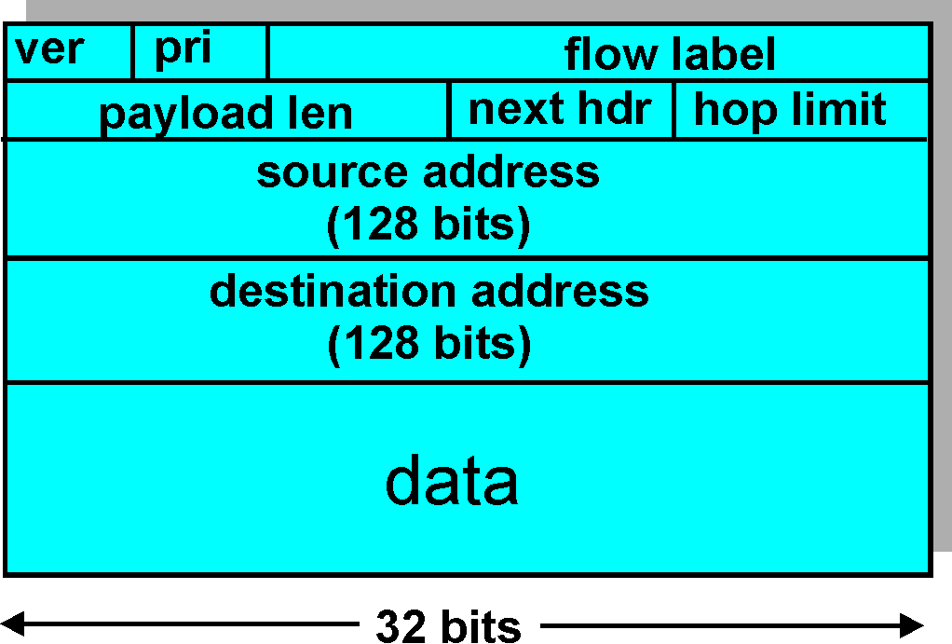
IPv6 Header (Cont)
Priority: identify priority among datagrams in flow
Flow Label: identify datagrams in same “flow.”
(concept of“flow” not well defined).
Next header: identify upper layer protocol for data

Slide 63
Other Changes from IPv4
Checksum: removed entirely to reduce processing time at each hop
Options: allowed, but outside of header, indicated by “Next Header” field
ICMPv6: new version of ICMP
  additional message types, e.g. “Packet Too Big”
  multicast group management functions

Slide 64
Transition From IPv4 To IPv6
Not all routers can be upgraded simultaneous
  no “flag days”
  How will the network operate with mixed IPv4 and IPv6 routers?
Tunneling: IPv6 carried as payload in IPv4 datagram among IPv4 routers

Slide 65
Tunneling
A
B
E
F
Logical view:
tunnel
IPv6
IPv6
IPv6
IPv6
A
B
E
F
Physical view:
IPv6
IPv6
IPv4
IPv4
IPv6
IPv6

Slide 66
Tunneling
A
B
E
F
Logical view:
tunnel
IPv6
IPv6
IPv6
IPv6
A
B
C
D
E
F
Physical view:
IPv6
IPv6
IPv4
IPv4
IPv6
IPv6
Flow: X
Src: A
Dest: F
data
Src:B
Dest: E
Src:B
Dest: E
Flow: X
Src: A
Dest: F
data
Flow: X
Src: A
Dest: F
data
Flow: X
Src: A
Dest: F
data
A-to-B:
IPv6
B-to-C:
IPv6 inside
IPv4
B-to-C:
IPv6 inside
IPv4
E-to-F:
IPv6

Slide 67
Chapter 4: Network Layer
4. 1 Introduction
4.2 Virtual circuit and datagram networks
4.3 What’s inside a router
4.4 IP: Internet Protocol
  Datagram format
  IPv4 addressing
  ICMP
  IPv6
4.5 Routing algorithms
  Link state
  Distance Vector
  Hierarchical routing
4.6 Routing in the Internet
  RIP
  OSPF
  BGP
4.7 Broadcast and multicast routing

Slide 68
Interplay between routing, forwarding
routing algorithm
local forwarding table
header value
output link
0100
0101
0111
1001
3
2
2
1
value in arriving
packet’s header
0111
1
3
2

Slide 69
Graph abstraction
5
v
3
w
2
5
u
2
1
z
3
1
2
x
y
1
Graph: G = (N,E)
N = set of routers = { u, v, w, x, y, z }
E = set of links ={ (u,v), (u,x), (v,x), (v,w), (x,w), (x,y), (w,y), (w,z), (y,z) }
Remark: Graph abstraction is useful in other network contexts
Example: P2P, where N is set of peers and E is set of TCP connections

Slide 70
Graph abstraction: costs
5
c(x,x’) = cost of link (x,x’)
- e.g., c(w,z) = 5
cost could always be 1, or
inversely related to bandwidth,
or inversely related to
congestion
v
3
w
2
5
u
2
1
z
3
1
2
x
y
1
Cost of path (x₁, x₂, x₃,…, x_{p}) = c(x₁,x₂) + c(x₂,x₃) + … + c(x_{p-1},x_{p})
Question: What’s the least-cost path between u and z ?
Routing algorithm: algorithm that finds least-cost path

Slide 71
Routing Algorithm classification
Global or decentralized information?
Global:
all routers have complete topology, link cost info
“link state” algorithms
Decentralized:
router knows physically-connected neighbors, link costs to neighbors
iterative process of computation, exchange of info with neighbors
“distance vector” algorithms
Static or dynamic?
Static:
routes change slowly over time
Dynamic:
routes change more quickly
  periodic update
  in response to link cost changes

Slide 72
Chapter 4: Network Layer
4. 1 Introduction
4.2 Virtual circuit and datagram networks
4.3 What’s inside a router
4.4 IP: Internet Protocol
  Datagram format
  IPv4 addressing
  ICMP
  IPv6
4.5 Routing algorithms
  Link state
  Distance Vector
  Hierarchical routing
4.6 Routing in the Internet
  RIP
  OSPF
  BGP
4.7 Broadcast and multicast routing

Slide 73
A Link-State Routing Algorithm
Dijkstra’s algorithm
net topology, link costs known to all nodes
  accomplished via “link state broadcast”
  all nodes have same info
computes least cost paths from one node (‘source”) to all other nodes
  gives forwarding table for that node
iterative: after k iterations, know least cost path to k dest.’s
Notation:
c(x,y): link cost from node x to y; = ∞ if not direct neighbors
D(v): current value of cost of path from source to dest. v
p(v): predecessor node along path from source to v
N': set of nodes whose least cost path definitively known

Slide 74
Dijsktra’s Algorithm
1 Initialization:
2 N' = {u}
3 for all nodes v
4 if v adjacent to u
5 then D(v) = c(u,v)
6 else D(v) = ∞
7
8 Loop
9 find w not in N' such that D(w) is a minimum
10 add w to N'
11 update D(v) for all v adjacent to w and not in N' :
12 D(v) = min( D(v), D(w) + c(w,v) )
13 /* new cost to v is either old cost to v or known
14 shortest path cost to w plus cost from w to v */
15 until all nodes in N'

Slide 75
Dijkstra’s algorithm: example
Step
0
1
2
3
4
5
N'
u
ux
uxy
uxyv
uxyvw
uxyvwz
D(v),p(v)
2,u
2,u
2,u
D(w),p(w)
5,u
4,x
3,y
3,y
D(x),p(x)
1,u
D(y),p(y)
∞
2,x
D(z),p(z)
∞
∞
4,y
4,y
4,y
5
v
3
w
2
5
u
2
1
z
3
1
2
x
y
1

Slide 76
Dijkstra’s algorithm: example (2)
Resulting shortest-path tree from u:
v
w
u
z
x
y
Resulting forwarding table in u:
destination
link
v
(u,v)
x
(u,x)
y
(u,x)
w
(u,x)
z
(u,x)

Slide 77
Dijkstra’s algorithm, discussion
Algorithm complexity: n nodes
each iteration: need to check all nodes, w, not in N
n(n+1)/2 comparisons: O(n²)
more efficient implementations possible: O(nlogn)
Oscillations possible:
e.g., link cost = amount of carried traffic
1
A
A
A
A
1+e
2+e
0
0
2+e
2+e
0
D
0
0
B
D
B
D
B
D
B
1+e
1
0
0
1+e
1
0
e
0
0
1
1+e
0
e
C
C
C
C
1
1
e
… recompute
routing
… recompute
… recompute
initially

Slide 78
Chapter 4: Network Layer
4. 1 Introduction
4.2 Virtual circuit and datagram networks
4.3 What’s inside a router
4.4 IP: Internet Protocol
  Datagram format
  IPv4 addressing
  ICMP
  IPv6
4.5 Routing algorithms
  Link state
  Distance Vector
  Hierarchical routing
4.6 Routing in the Internet
  RIP
  OSPF
  BGP
4.7 Broadcast and multicast routing

Slide 79
Distance Vector Algorithm
Bellman-Ford Equation (dynamic programming)
Define
d_{x}(y) := cost of least-cost path from x to y
Then
d_{x}(y) = min {c(x,v) + d_{v}(y) }
where min is taken over all neighbors v of x
v

Slide 80
Bellman-Ford example
5
Clearly, d_{v}(z) = 5, d_{x}(z) = 3, d_{w}(z) = 3
v
3
w
2
5
u
z
B-F equation says:
2
1
3
1
2
d_{u}(z) = min { c(u,v) + d_{v}(z),
c(u,x) + d_{x}(z),
c(u,w) + d_{w}(z) }
= min {2 + 5,
1 + 3,
5 + 3} = 4
x
y
1
Node that achieves minimum is next
hop in shortest path ➜ forwarding table

Slide 81
Distance Vector Algorithm
D_{x}(y) = estimate of least cost from x to y
Node x knows cost to each neighbor v: c(x,v)
Node x maintains distance vector D_{x} = [D_{x}(y): y є N ]
Node x also maintains its neighbors’ distance vectors
  For each neighbor v, x maintains
  D_{v} = [D_{v}(y): y є N ]

Slide 82
Distance vector algorithm (4)
Basic idea:
Each node periodically sends its own distance vector estimate to neighbors
When a node x receives new DV estimate from neighbor, it updates its own DV using B-F equation:
D_{x}(y) ← min_{v}{c(x,v) + D_{v}(y)} for each node y ∊ N
Under minor, natural conditions, the estimate D_{x}(y) converge to the actual least cost d_{x}(y)

Slide 83
Distance Vector Algorithm (5)
Iterative, asynchronous: each local iteration caused by:
local link cost change
DV update message from neighbor
Distributed:
each node notifies neighbors only when its DV changes
  neighbors then notify their neighbors if necessary
Each node:
wait for (change in local link cost or msg from neighbor)
recompute estimates
if DV to any dest has changed, notify neighbors

Slide 84
D_{x}(y) = min{c(x,y) + D_{y}(y), c(x,z) + D_{z}(y)}
= min{2+0 , 7+1} = 2
D_{x}(z) = min{c(x,y) +
D_{y}(z), c(x,z) + D_{z}(z)}
= min{2+1 , 7+0} = 3
node x table
cost to
cost to
x y z
x y z
x
0 2 7
x
0
2
3
y
y
from
∞
∞
∞
from
2 0 1
z
∞
∞
∞
z
7 1 0
node y table
cost to
x y z
y
2
1
x
∞
∞
z
∞
2 0 1
x
y
7
from
z
∞
∞
∞
node z table
cost to
x y z
x
∞ ∞ ∞
y
from
∞
∞
∞
z
7
1
0
time

Slide 85
D_{x}(y) = min{c(x,y) + D_{y}(y), c(x,z) + D_{z}(y)}
= min{2+0 , 7+1} = 2
D_{x}(z) = min{c(x,y) +
D_{y}(z), c(x,z) + D_{z}(z)}
= min{2+1 , 7+0} = 3
node x table
cost to
cost to
cost to
x y z
x y z
x y z
x
0 2 7
x
0 2 3
x
0 2 3
y
y
from
∞
∞
∞
from
2 0 1
y
from
2 0 1
z
∞
∞
∞
z
7 1 0
z
3 1 0
node y table
cost to
cost to
cost to
x y z
x y z
x y z
y
2
1
x
∞
∞
x
0 2 7
z
∞
2 0 1
x
0 2 3
x
y
y
7
from
from
2 0 1
y
from
2 0 1
z
∞
∞
∞
z
7 1 0
z
3 1 0
node z table
cost to
cost to
cost to
x y z
x y z
x y z
x
∞ ∞ ∞
x
0 2 7
x
0 2 3
y
y
2 0 1
y
from
2 0 1
from
from
∞
∞
∞
z
z
3 1 0
z
3 1 0
7
1
0
time

Slide 86
Distance Vector: link cost changes
Link cost changes:
node detects local link cost change
updates routing info, recalculates
distance vector
if DV changes, notify neighbors
1
y
4
1
x
z
50
At time t₀, y detects the link-cost change, updates its DV,
and informs its neighbors.
“good
news
travels
fast”
At time t₁, z receives the update from y and updates its table.
It computes a new least cost to x and sends its neighbors its DV.
At time t₂, y receives z’s update and updates its distance table.
y’s least costs do not change and hence y does not send any
message to z.

Slide 87
Distance Vector: link cost changes
Link cost changes:
good news travels fast
bad news travels slow - “count to infinity” problem!
44 iterations before algorithm stabilizes: see text
Poisoned reverse:
If Z routes through Y to get to X :
  Z tells Y its (Z’s) distance to X is infinite (so Y won’t route to X via Z)
will this completely solve count to infinity problem?
60
y
4
1
x
z
50

Slide 88
Comparison of LS and DV algorithms
Message complexity
LS: with n nodes, E links, O(nE) msgs sent
DV: exchange between neighbors only
  convergence time varies
Speed of Convergence
LS: O(n²) algorithm requires O(nE) msgs
  may have oscillations
DV: convergence time varies
  may be routing loops
  count-to-infinity problem
Robustness: what happens if router malfunctions?
LS:
  node can advertise incorrect link cost
  each node computes only its own table
DV:
  DV node can advertise incorrect path cost
  each node’s table used by others
    error propagate thru network

Slide 89
Chapter 4: Network Layer
4. 1 Introduction
4.2 Virtual circuit and datagram networks
4.3 What’s inside a router
4.4 IP: Internet Protocol
  Datagram format
  IPv4 addressing
  ICMP
  IPv6
4.5 Routing algorithms
  Link state
  Distance Vector
  Hierarchical routing
4.6 Routing in the Internet
  RIP
  OSPF
  BGP
4.7 Broadcast and multicast routing

Slide 90
Hierarchical Routing
Our routing study thus far - idealization
all routers identical
network “flat”
… not true in practice
scale: with 200 million destinations:
can’t store all dest’s in routing tables!
routing table exchange would swamp links!
administrative autonomy
internet = network of networks
each network admin may want to control routing in its own network

Slide 91
Hierarchical Routing
aggregate routers into regions, “autonomous systems” (AS)
routers in same AS run same routing protocol
  “intra-AS” routing protocol
  routers in different AS can run different intra-AS routing protocol
Gateway router
Direct link to router in another AS

Slide 92
Interconnected ASes
3c
3a
2c
3b
2a
AS3
2b
1c
AS2
1a
1b
1d
AS1
Forwarding table is configured by both intra- and inter-AS routing algorithm
  Intra-AS sets entries for internal dests
  Inter-AS & Intra-As sets entries for external dests
Intra-AS
Routing
algorithm
Inter-AS
Routing
algorithm
Forwarding
table

Slide 93
Inter-AS tasks
AS1 needs:
to learn which dests are reachable through AS2 and which through AS3
to propagate this reachability info to all routers in AS1
Job of inter-AS routing!
Suppose router in AS1 receives datagram for which dest is outside of AS1
  Router should forward packet towards one of the gateway routers, but which one?
3c
3a
2c
3b
2a
AS3
2b
1c
AS2
1a
1b
1d
AS1

Slide 94
Example: Setting forwarding table in router 1d
Suppose AS1 learns (via inter-AS protocol) that subnet x is reachable via AS3 (gateway 1c) but not via AS2.
Inter-AS protocol propagates reachability info to all internal routers.
Router 1d determines from intra-AS routing info that its interface I is on the least cost path to 1c.
Puts in forwarding table entry (x,I).
3c
3a
2c
3b
2a
AS3
2b
1c
AS2
1a
1b
1d
AS1

Slide 95
Example: Choosing among multiple ASes
Now suppose AS1 learns from the inter-AS protocol that subnet x is reachable from AS3 and from AS2.
To configure forwarding table, router 1d must determine towards which gateway it should forward packets for dest x.
This is also the job on inter-AS routing protocol!
3c
3a
2c
3b
2a
AS3
2b
1c
AS2
1a
1b
1d
AS1

Slide 96
Example: Choosing among multiple ASes
Now suppose AS1 learns from the inter-AS protocol that subnet x is reachable from AS3 and from AS2.
To configure forwarding table, router 1d must determine towards which gateway it should forward packets for dest x.
This is also the job on inter-AS routing protocol!
Hot potato routing: send packet towards closest of two routers.
Use routing info
from intra-AS
protocol to determine
costs of least-cost
paths to each
of the gateways
Determine from
forwarding table the
interface I that leads
to least-cost gateway.
Enter (x,I) in
forwarding table
Learn from inter-AS
protocol that subnet
x is reachable via
multiple gateways
Hot potato routing:
Choose the gateway
that has the
smallest least cost

Slide 97
Chapter 4: Network Layer
4. 1 Introduction
4.2 Virtual circuit and datagram networks
4.3 What’s inside a router
4.4 IP: Internet Protocol
  Datagram format
  IPv4 addressing
  ICMP
  IPv6
4.5 Routing algorithms
  Link state
  Distance Vector
  Hierarchical routing
4.6 Routing in the Internet
  RIP
  OSPF
  BGP
4.7 Broadcast and multicast routing

Slide 98
Intra-AS Routing
Also known as Interior Gateway Protocols (IGP)
Most common Intra-AS routing protocols:
  RIP: Routing Information Protocol
  OSPF: Open Shortest Path First
  IGRP: Interior Gateway Routing Protocol (Cisco proprietary)

Slide 99
Chapter 4: Network Layer
4. 1 Introduction
4.2 Virtual circuit and datagram networks
4.3 What’s inside a router
4.4 IP: Internet Protocol
  Datagram format
  IPv4 addressing
  ICMP
  IPv6
4.5 Routing algorithms
  Link state
  Distance Vector
  Hierarchical routing
4.6 Routing in the Internet
  RIP
  OSPF
  BGP
4.7 Broadcast and multicast routing

Slide 100
RIP ( Routing Information Protocol)
Distance vector algorithm
Included in BSD-UNIX Distribution in 1982
Distance metric: # of hops (max = 15 hops)
From router A to subsets:
u
v
destination hops
u 1
v 2
w 2
x 3
y 3
z 2
A
B
w
x
z
C
D
y

Slide 101
RIP advertisements
Distance vectors: exchanged among neighbors every 30 sec via Response Message (also called advertisement)
Each advertisement: list of up to 25 destination nets within AS

Slide 102
RIP: Example
z
w
x
y
A
D
B
C
Destination Network Next Router Num. of hops to dest.
w A 2
y B 2
z B 7
x -- 1
…. …. ....
Routing table in D

Slide 103
RIP: Example
Dest Next hops
w - 1
x - 1
z C 4
…. … ...
Advertisement
from A to D
z
w
x
y
A
D
B
C
Destination Network Next Router Num. of hops to dest.
w A 2
y B 2
z B A 7 5
x -- 1
…. …. ....
Routing table in D

Slide 104
RIP: Link Failure and Recovery
If no advertisement heard after 180 sec --> neighbor/link declared dead
  routes via neighbor invalidated
  new advertisements sent to neighbors
  neighbors in turn send out new advertisements (if tables changed)
  link failure info quickly (?) propagates to entire net
  poison reverse used to prevent ping-pong loops (infinite distance = 16 hops)

Slide 105
RIP Table processing
RIP routing tables managed by application-level process called route-d (daemon)
advertisements sent in UDP packets, periodically repeated
routed
routed
Transprt
(UDP)
Transprt
(UDP)
network forwarding
(IP) table
network
(IP)
forwarding
table
link
link
physical
physical

Slide 106
Chapter 4: Network Layer
4. 1 Introduction
4.2 Virtual circuit and datagram networks
4.3 What’s inside a router
4.4 IP: Internet Protocol
  Datagram format
  IPv4 addressing
  ICMP
  IPv6
4.5 Routing algorithms
  Link state
  Distance Vector
  Hierarchical routing
4.6 Routing in the Internet
  RIP
  OSPF
  BGP
4.7 Broadcast and multicast routing

Slide 107
OSPF (Open Shortest Path First)
“open”: publicly available
Uses Link State algorithm
  LS packet dissemination
  Topology map at each node
  Route computation using Dijkstra’s algorithm
OSPF advertisement carries one entry per neighbor router
Advertisements disseminated to entire AS (via flooding)
  Carried in OSPF messages directly over IP (rather than TCP or UDP

Slide 108
OSPF “advanced” features (not in RIP)
Security: all OSPF messages authenticated (to prevent malicious intrusion)
Multiple same-cost paths allowed (only one path in RIP)
For each link, multiple cost metrics for different TOS (e.g., satellite link cost set “low” for best effort; high for real time)
Integrated uni- and multicast support:
  Multicast OSPF (MOSPF) uses same topology data base as OSPF
Hierarchical OSPF in large domains.

Slide 109

Hierarchical OSPF

Slide 110
Hierarchical OSPF
Two-level hierarchy: local area, backbone.
  Link-state advertisements only in area
  each nodes has detailed area topology; only know direction (shortest path) to nets in other areas.
Area border routers: “summarize” distances to nets in own area, advertise to other Area Border routers.
Backbone routers: run OSPF routing limited to backbone.
Boundary routers: connect to other AS’s.

Slide 111
Chapter 4: Network Layer
4. 1 Introduction
4.2 Virtual circuit and datagram networks
4.3 What’s inside a router
4.4 IP: Internet Protocol
  Datagram format
  IPv4 addressing
  ICMP
  IPv6
4.5 Routing algorithms
  Link state
  Distance Vector
  Hierarchical routing
4.6 Routing in the Internet
  RIP
  OSPF
  BGP
4.7 Broadcast and multicast routing

Slide 112
Internet inter-AS routing: BGP
BGP (Border Gateway Protocol): the de facto standard
BGP provides each AS a means to:
  Obtain subnet reachability information from neighboring ASs.
  Propagate reachability information to all AS-internal routers.
  Determine “good” routes to subnets based on reachability information and policy.
allows subnet to advertise its existence to rest of Internet: “I am here”

Slide 113
BGP basics
Pairs of routers (BGP peers) exchange routing info over semi-permanent TCP connections: BGP sessions
  BGP sessions need not correspond to physical links.
When AS2 advertises a prefix to AS1, AS2 is promising it will forward any datagrams destined to that prefix towards the prefix.
  AS2 can aggregate prefixes in its advertisement
3c
3a
2c
3b
2a
AS3
2b
1c
AS2
1a
1b
AS1
1d
eBGP session
iBGP session

Slide 114
Distributing reachability info
With eBGP session between 3a and 1c, AS3 sends prefix reachability info to AS1.
1c can then use iBGP do distribute this new prefix reach info to all routers in AS1
1b can then re-advertise new reachability info to AS2 over 1b-to-2a eBGP session
When router learns of new prefix, creates entry for prefix in its forwarding table.
3c
3a
2c
3b
2a
AS3
2b
1c
AS2
1a
1b
AS1
1d
eBGP session
iBGP session

Slide 115
Path attributes & BGP routes
When advertising a prefix, advert includes BGP attributes.
  prefix + attributes = “route”
Two important attributes:
  AS-PATH: contains ASs through which prefix advertisement has passed: AS 67 AS 17
  NEXT-HOP: Indicates specific internal-AS router to next-hop AS. (There may be multiple links from current AS to next-hop-AS.)
When gateway router receives route advertisement, uses import policy to accept/decline.

Slide 116
BGP route selection
Router may learn about more than 1 route to some prefix. Router must select route.
Elimination rules:
  Local preference value attribute: policy decision
  Shortest AS-PATH
  Closest NEXT-HOP router: hot potato routing
  Additional criteria

Slide 117
BGP messages
BGP messages exchanged using TCP.
BGP messages:
  OPEN: opens TCP connection to peer and authenticates sender
  UPDATE: advertises new path (or withdraws old)
  KEEPALIVE keeps connection alive in absence of UPDATES; also ACKs OPEN request
  NOTIFICATION: reports errors in previous msg; also used to close connection

Slide 118
BGP routing policy
A,B,C are provider networks
X,W,Y are customer (of provider networks)
X is dual-homed: attached to two networks
  X does not want to route from B via X to C
  .. so X will not advertise to B a route to C

Slide 119
BGP routing policy (2)
A advertises to B the path AW
B advertises to X the path BAW
Should B advertise to C the path BAW?
  No way! B gets no “revenue” for routing CBAW since neither W nor C are B’s customers
  B wants to force C to route to w via A
  B wants to route only to/from its customers!

Slide 120
Why different Intra- and Inter-AS routing ?
Policy:
Inter-AS: admin wants control over how its traffic routed, who routes through its net.
Intra-AS: single admin, so no policy decisions needed
Scale:
hierarchical routing saves table size, reduced update traffic
Performance:
Intra-AS: can focus on performance
Inter-AS: policy may dominate over performance

Slide 121
Chapter 4: Network Layer
4. 1 Introduction
4.2 Virtual circuit and datagram networks
4.3 What’s inside a router
4.4 IP: Internet Protocol
  Datagram format
  IPv4 addressing
  ICMP
  IPv6
4.5 Routing algorithms
  Link state
  Distance Vector
  Hierarchical routing
4.6 Routing in the Internet
  RIP
  OSPF
  BGP
4.7 Broadcast and multicast routing

Slide 122
Broadcast Routing
Deliver packets from source to all other nodes
Source duplication is inefficient:
duplicate
duplicate
creation/transmission
R1
R1
duplicate
R2
R2
R3
R4
R3
R4
source
duplication
in-network
duplication
Source duplication: how does source determine recipient addresses?

Slide 123
In-network duplication
Flooding: when node receives brdcst pckt, sends copy to all neighbors
  Problems: cycles & broadcast storm
Controlled flooding: node only brdcsts pkt if it hasn’t brdcst same packet before
  Node keeps track of pckt ids already brdcsted
  Or reverse path forwarding (RPF): only forward pckt if it arrived on shortest path between node and source
Spanning tree
  No redundant packets received by any node

Slide 124
Spanning Tree
First construct a spanning tree
Nodes forward copies only along spanning tree
A
A
B
B
c
c
D
D
F
E
F
E
G
G
(a) Broadcast initiated at A
(b) Broadcast initiated at D

Slide 125
Spanning Tree: Creation
Center node
Each node sends unicast join message to center node
  Message forwarded until it arrives at a node already belonging to spanning tree
A
A
3
B
B
c
c
4
2
D
D
F
E
F
E
1
5
G
G
Stepwise construction of spanning tree
(b) Constructed spanning tree

Slide 126
Multicast Routing: Problem Statement
Goal: find a tree (or trees) connecting routers having local mcast group members
  tree: not all paths between routers used
  source-based: different tree from each sender to rcvrs
  shared-tree: same tree used by all group members
Shared tree
Source-based trees
Notes:
Notes:
3.3 Network Layer: Multicast Routing Algorithms 3-9

Slide 127
Approaches for building mcast trees
Approaches:
source-based tree: one tree per source
  shortest path trees
  reverse path forwarding
group-shared tree: group uses one tree
  minimal spanning (Steiner)
  center-based trees
…we first look at basic approaches, then specific protocols adopting these approaches
Notes:
Notes:
3.3 Network Layer: Multicast Routing Algorithms 3-11

Slide 128
Shortest Path Tree
mcast forwarding tree: tree of shortest path routes from source to all receivers
  Dijkstra’s algorithm
S: source
LEGEND
R1
2
1
R4
router with attached
group member
R2
5
3
router with no attached
group member
4
R5
R3
6
i
link used for forwarding,
i indicates order link
added by algorithm
R6
R7
Notes:
Notes:
3.3 Network Layer: Multicast Routing Algorithms 3-12

Slide 129
Reverse Path Forwarding
rely on router’s knowledge of unicast shortest path from it to sender
each router has simple forwarding behavior:
if (mcast datagram received on incoming link on shortest path back to center)
then flood datagram onto all outgoing links
else ignore datagram
Notes:
Notes:
3.3 Network Layer: Multicast Routing Algorithms 3-13

Slide 130
Reverse Path Forwarding: example
S: source
LEGEND
R1
R4
router with attached
group member
R2
router with no attached
group member
R5
R3
datagram will be forwarded
R6
R7
datagram will not be
forwarded
result is a source-specific reverse SPT
  may be a bad choice with asymmetric links
Notes:
Notes:
3.3 Network Layer: Multicast Routing Algorithms 3-14

Slide 131
Reverse Path Forwarding: pruning
forwarding tree contains subtrees with no mcast group members
  no need to forward datagrams down subtree
  “prune” msgs sent upstream by router with no downstream group members
S: source
LEGEND
R1
router with attached
group member
R4
R2
router with no attached
group member
P
R5
P
prune message
R3
P
links with multicast
forwarding
R6
R7
Notes:
Notes:
3.3 Network Layer: Multicast Routing Algorithms 3-15

Slide 132
Shared-Tree: Steiner Tree
Steiner Tree: minimum cost tree connecting all routers with attached group members
problem is NP-complete
excellent heuristics exists
not used in practice:
  computational complexity
  information about entire network needed
  monolithic: rerun whenever a router needs to join/leave
Notes:
Notes:
1. See L. Wei and D. Estrin, “A Comparison of multicast trees and algorithms,” TR USC-CD-93-560, Dept. Computer Science, University of California, Sept 1993 for a comparison of heuristic approaches.
3.3 Network Layer: Multicast Routing Algorithms 3-16

Slide 133
Center-based trees
single delivery tree shared by all
one router identified as “center” of tree
to join:
  edge router sends unicast join-msg addressed to center router
  join-msg “processed” by intermediate routers and forwarded towards center
  join-msg either hits existing tree branch for this center, or arrives at center
  path taken by join-msg becomes new branch of tree for this router
Notes:
Notes:
1. It’s always nice to see a PhD dissertation with impact. The earliest discussion of center-based trees for multicast appears to be D. Wall, “Mechanisms for Broadcast and Selective Broadcast,” PhD dissertation, Stanford U., June 1980.
3.3 Network Layer: Multicast Routing Algorithms 3-17

Slide 134
Center-based trees: an example
Suppose R6 chosen as center:
LEGEND
R1
router with attached
group member
R4
3
R2
router with no attached
group member
2
R5
1
path order in which join messages generated
R3
1
R6
R7
Notes:
Notes:
3.3 Network Layer: Multicast Routing Algorithms 3-18

Slide 135
Internet Multicasting Routing: DVMRP
DVMRP: distance vector multicast routing protocol, RFC1075
flood and prune: reverse path forwarding, source-based tree
  RPF tree based on DVMRP’s own routing tables constructed by communicating DVMRP routers
  no assumptions about underlying unicast
  initial datagram to mcast group flooded everywhere via RPF
  routers not wanting group: send upstream prune msgs
Notes:
Notes:
D. Waitzman, S. Deering, C. Partridge, “Distance Vector Multicast Routing Protocol,” RFC 1075, Nov. 1988. The version of DVMRP in use today is considerably enhanced over the RFC1075 spec.
A more up-to-date “work-in-progress” defines a version 3 of DVMRP: T. Pusateri, “Distance Vector Multicast Routing Protocol,” work-in-progress, draft-ietf-idmr-v3-05.ps
3.4 Network Layer: Internet Multicast Routing Algorithms 3-20

Slide 136
DVMRP: continued…
soft state: DVMRP router periodically (1 min.) “forgets” branches are pruned:
  mcast data again flows down unpruned branch
  downstream router: reprune or else continue to receive data
routers can quickly regraft to tree
  following IGMP join at leaf
odds and ends
  commonly implemented in commercial routers
  Mbone routing done using DVMRP
Notes:
Notes:
1. See www.mbone.com/mbone/routers.html for a (slightly outdatet) list of multicast capable routers (supporting DVMPR as well as other protocols) from various vendors.
2. ftp://parcftp.xerox.com/pub/net-research/ipmulti for circa 1996 public copy “mrouted” v3.8 of DVMRP routing software for various workstation routing platforms.
3.4 Network Layer: Internet Multicast Routing Algorithms 3-21

Slide 137
Tunneling
Q: How to connect “islands” of multicast routers in a “sea” of unicast routers?
physical topology
logical topology
mcast datagram encapsulated inside “normal” (non-multicast-addressed) datagram
normal IP datagram sent thru “tunnel” via regular IP unicast to receiving mcast router
receiving mcast router unencapsulates to get mcast datagram
Notes:
Notes:
For a general discussion of IP encapsulation, see C. Perkins, “IP Encapsulation within IP,” RFC 2003, Oct. 1996.
The book S. Bradner, A Mankin, “Ipng: Internet protocol next generation,” Addison Wesley, 1995 has a very nice discussion of tunneling
Tunneling can also be used to connect islands of IPv6 capable routers in a sea IPv4 capable routers. The long term hope is that the sea evaporates leaving only lands of IPv6!
3.4 Network Layer: Internet Multicast Routing Algorithms 3-22

Slide 138
Chapter 4: summary
4. 1 Introduction
4.2 Virtual circuit and datagram networks
4.3 What’s inside a router
4.4 IP: Internet Protocol
  Datagram format
  IPv4 addressing
  ICMP
  IPv6
4.5 Routing algorithms
  Link state
  Distance Vector
  Hierarchical routing
4.6 Routing in the Internet
  RIP
  OSPF
  BGP
4.7 Broadcast and multicast routing

