Slide 1
Augmented reality application for economic metrics visualization
Kiss Dániel Márk
Project Laboratory 1
MSc
Department of Telecommunications and Media Informatics

Slide 2
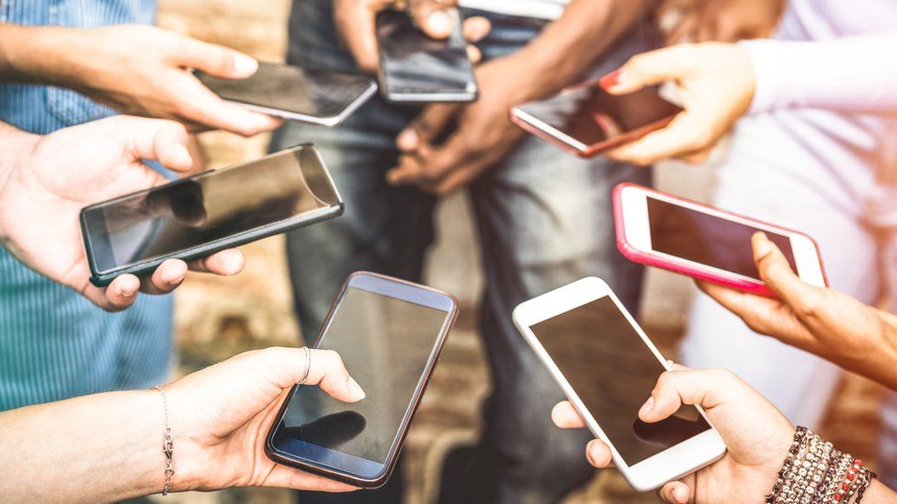
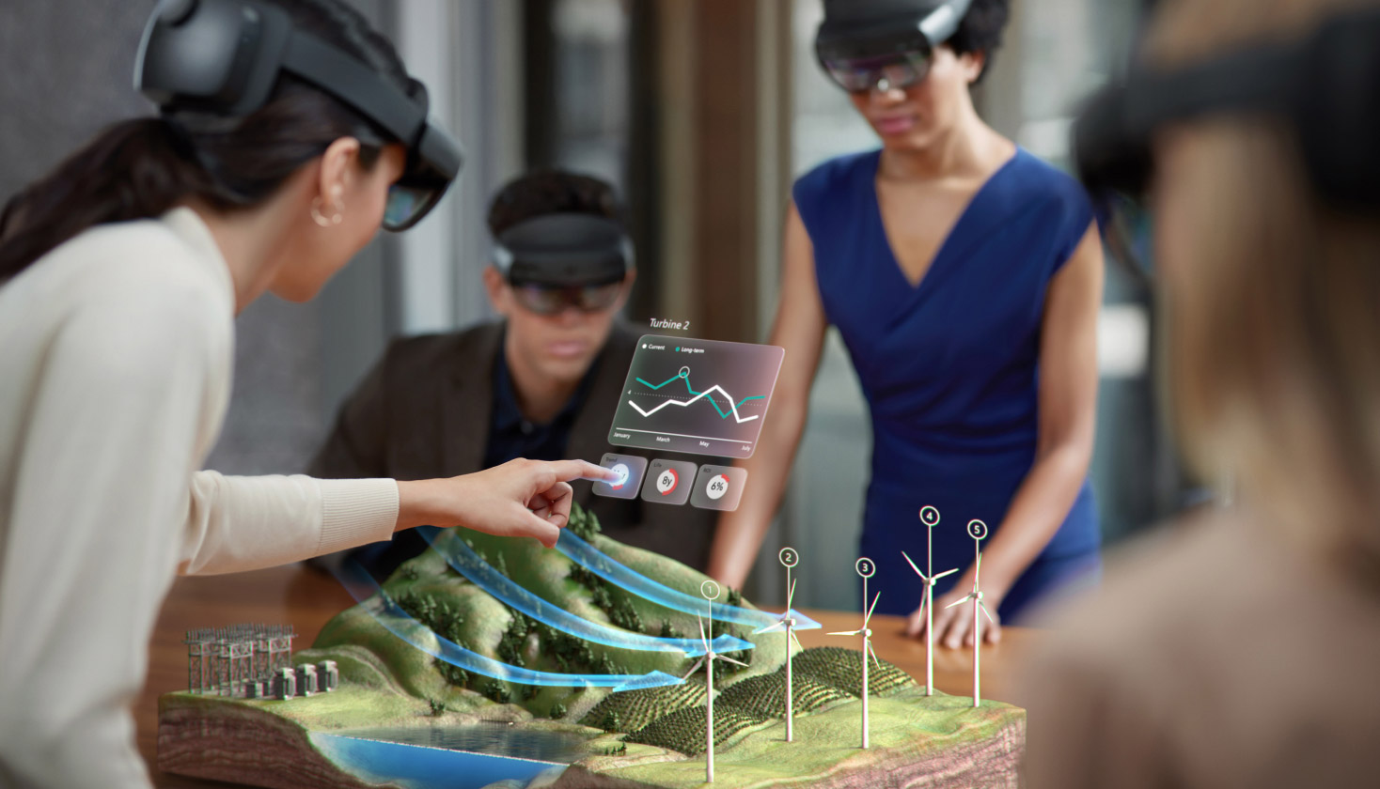
Introduction
The next big thing?
1/5

Slide 3




Used technologies
ARKit
SwiftUI
REST API
RealityKit
2/5

Slide 4

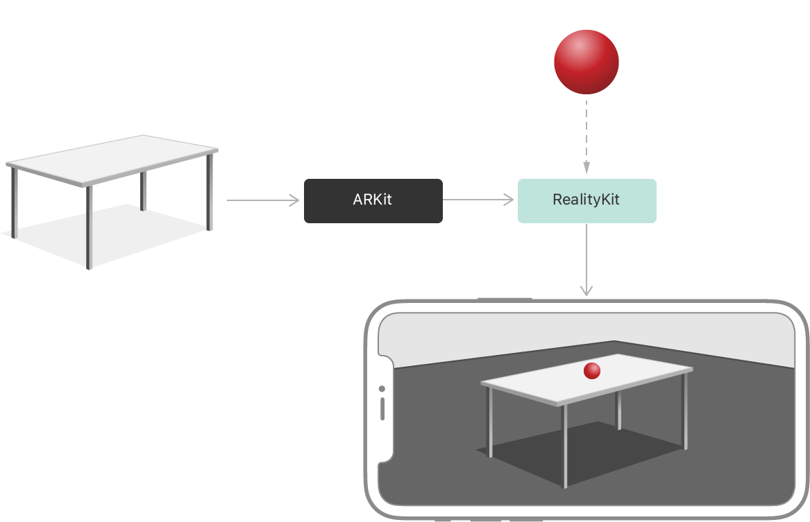
Development
3/5

Slide 5
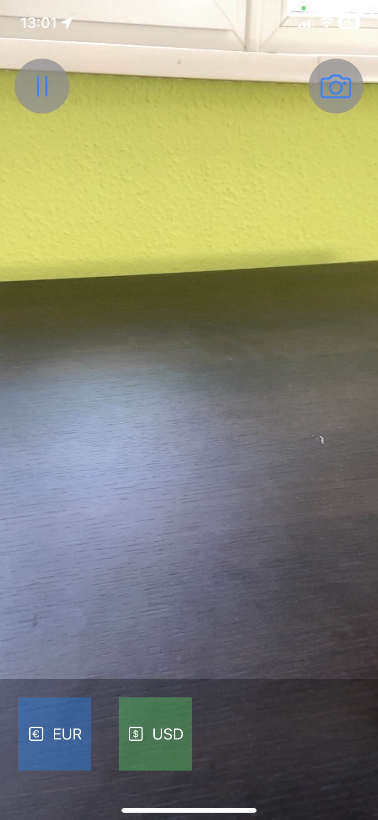
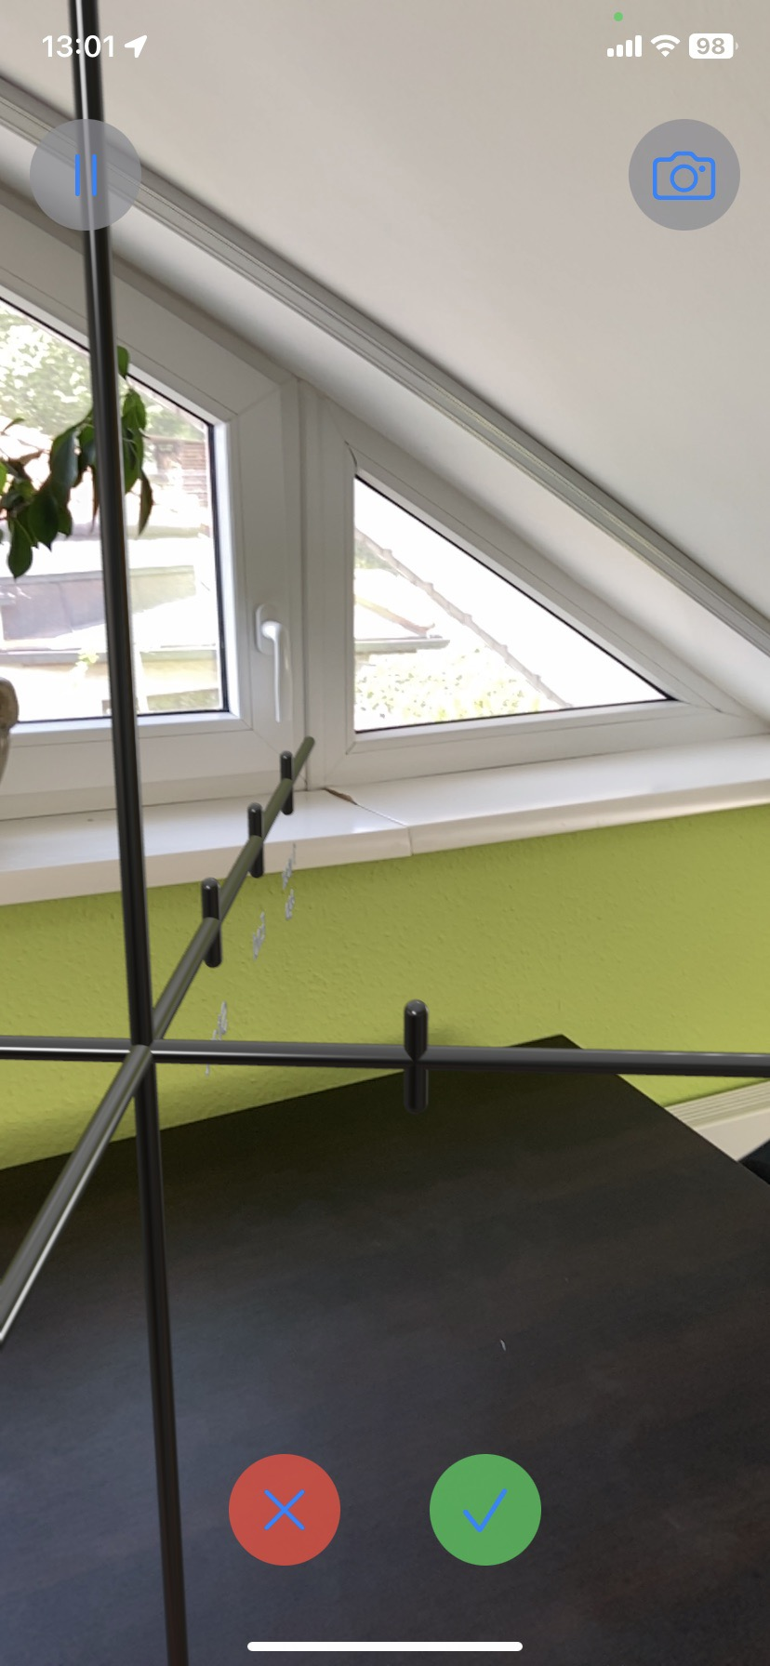
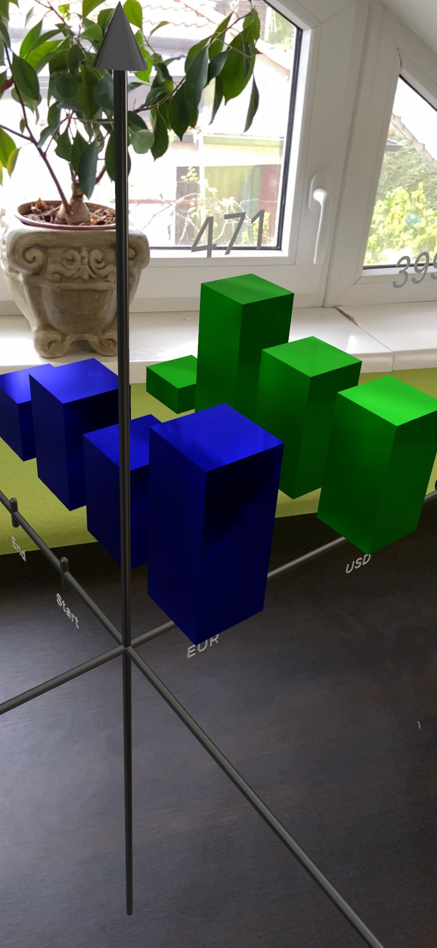
Finished work
4/5

Slide 6
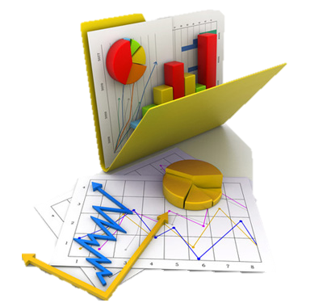

Future updates
Thank you for your attention!
5/5

