Slide 1
Augmented reality application for economic metrics visualization
Kiss Dániel Márk
Project Laboratory 1
MSc
Department of Telecommunications and Media Informatics

Slide 2
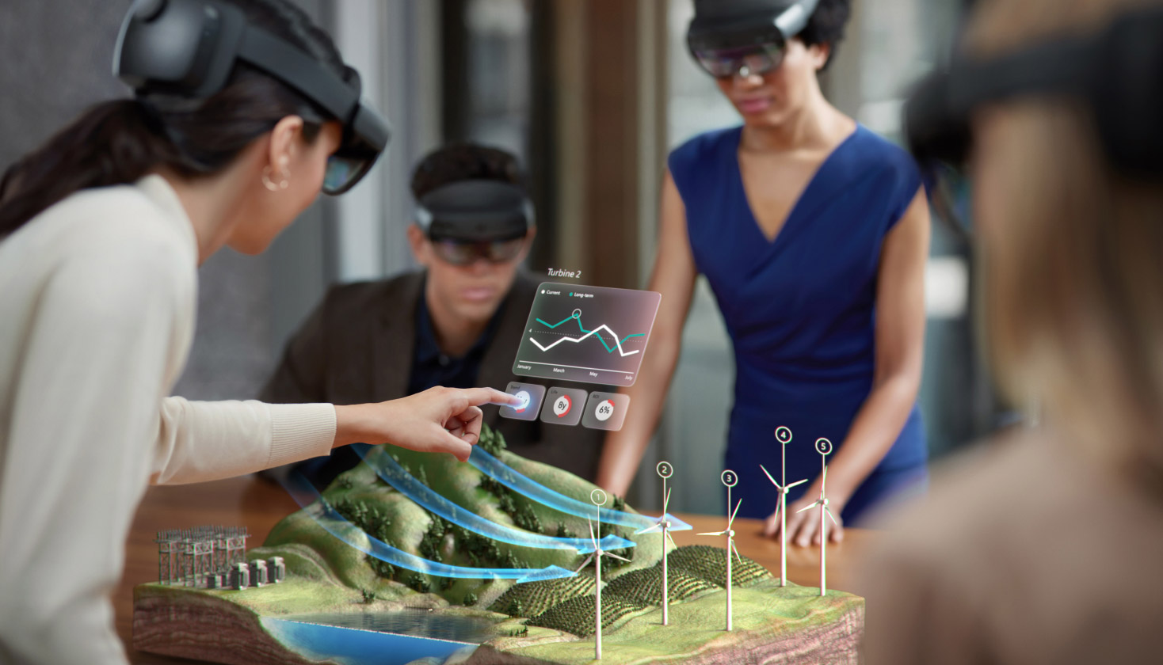
Introduction

Slide 3





Used technologies

Slide 4

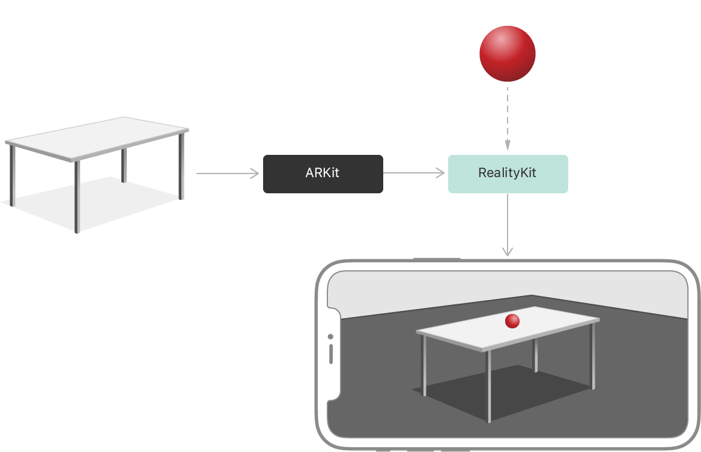
Development

Slide 5
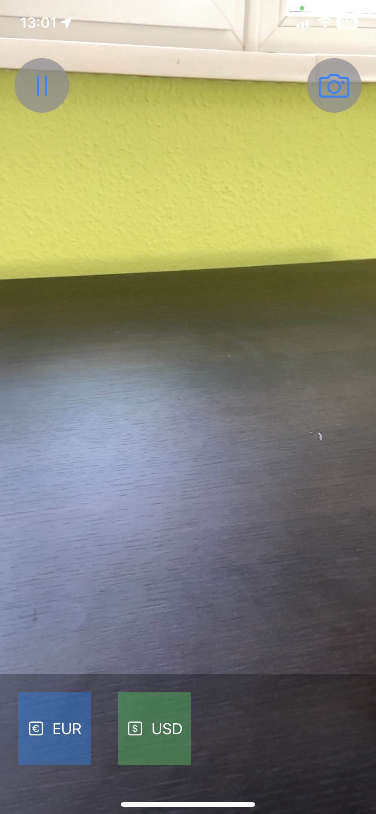
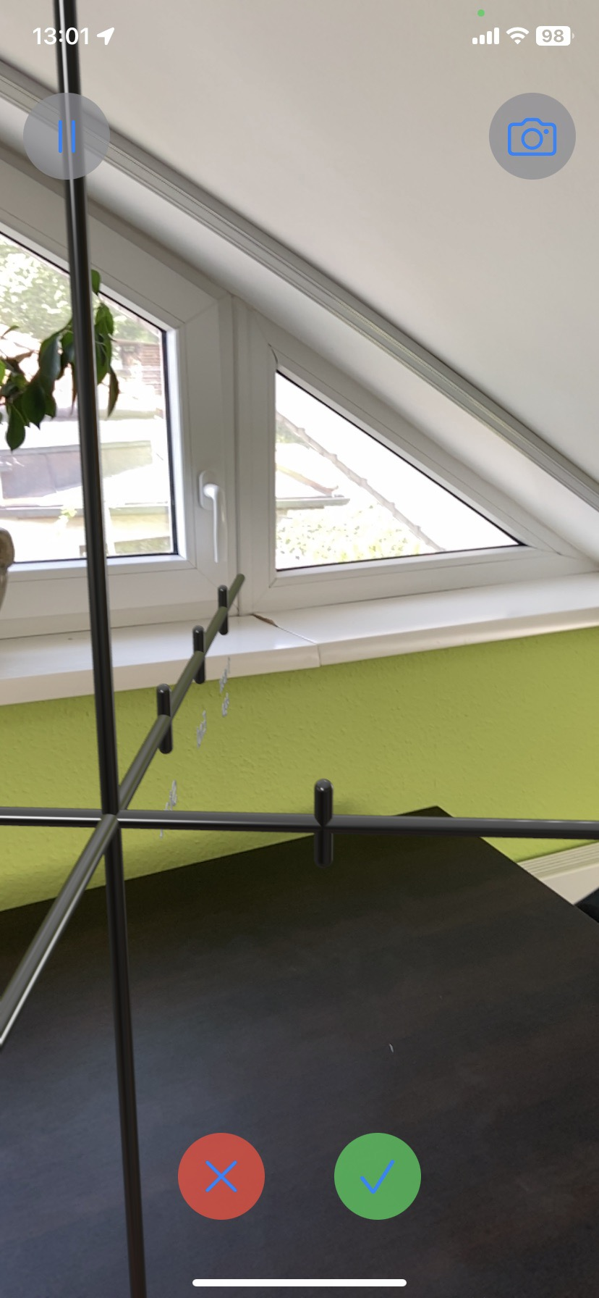
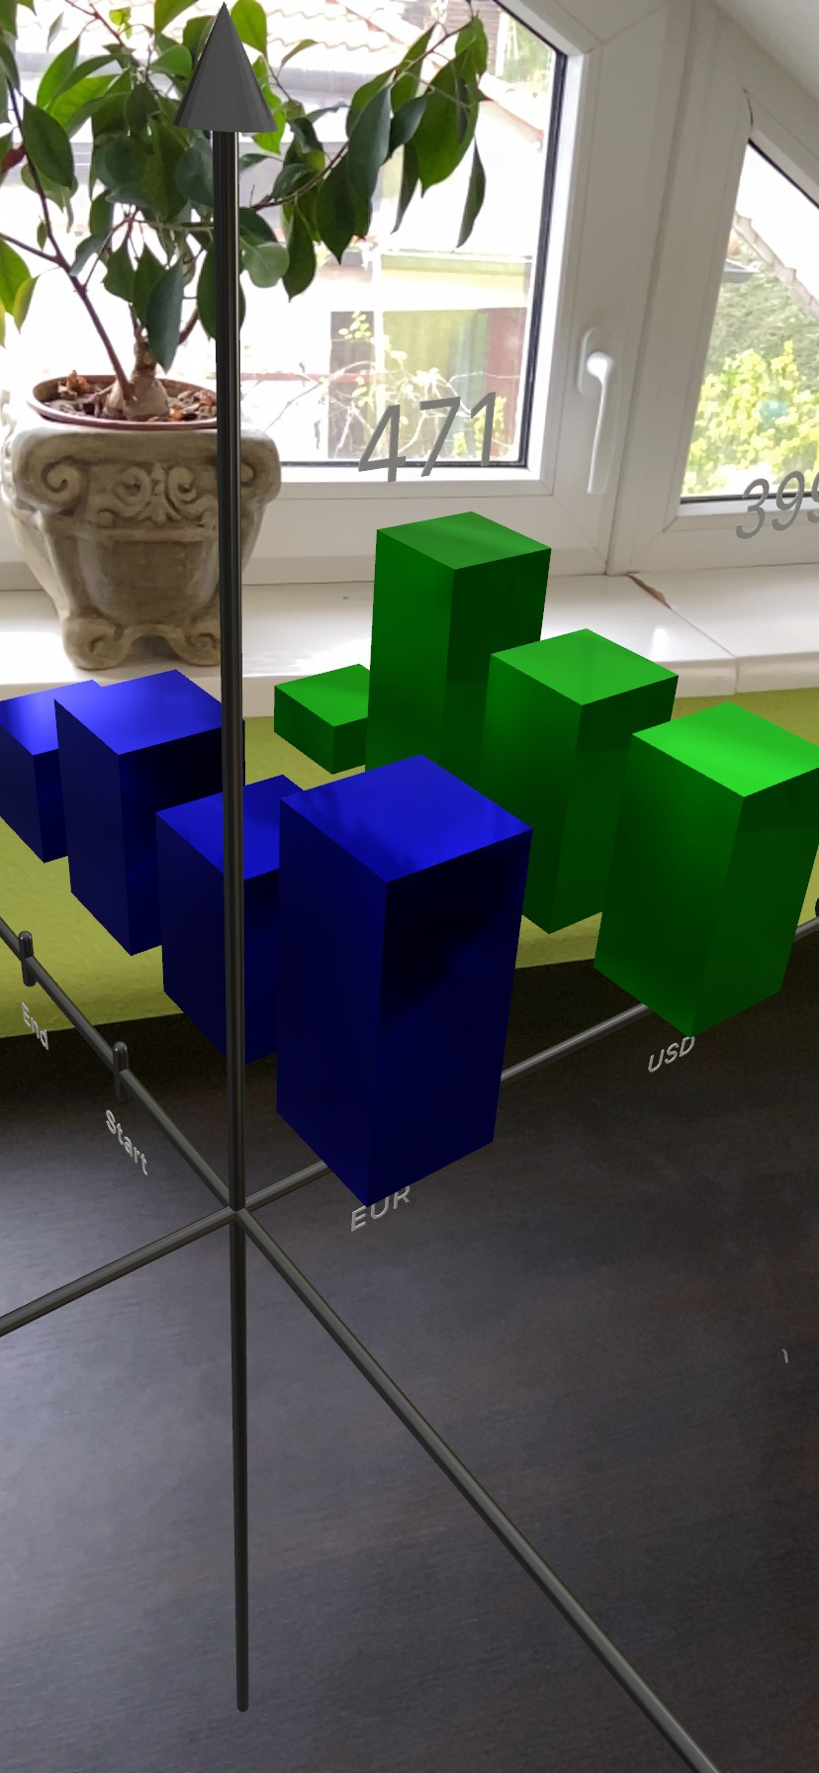
Finished work

Slide 6
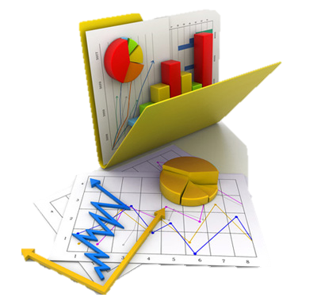

Future updates

Slide 7
Thank you for your attention!
Any questions?

