Slide 1
Kiss Dániel Márk
WP871Q
Customer Analytics

Slide 2

Exploratory data analysis
.columns() – 258 unique features
.describe() – statistical informations
Selecting target value
.dropna() – droping rows with nan value
Sorting values by variance – keeping only top 100

Slide 3
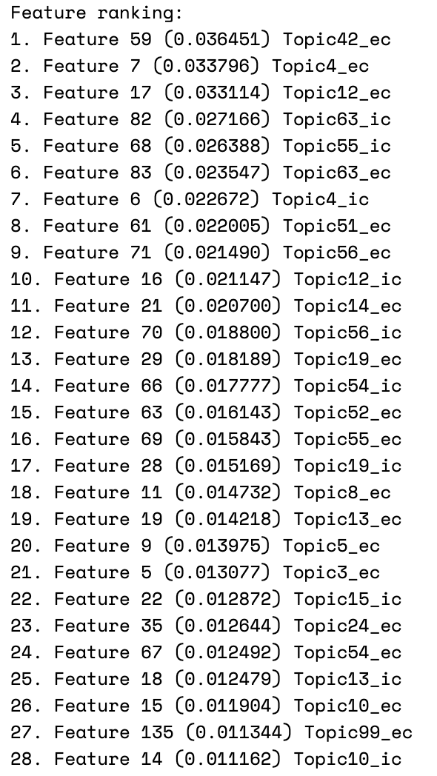
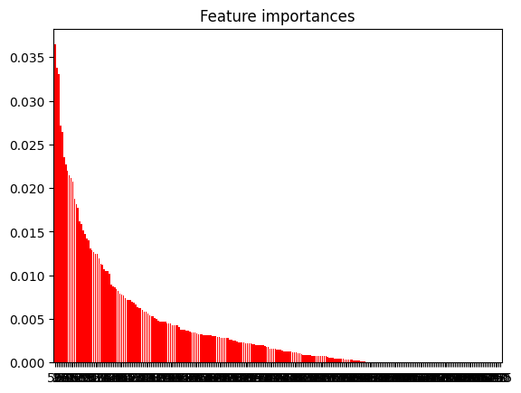
Feature importance – Decision tree

Slide 4
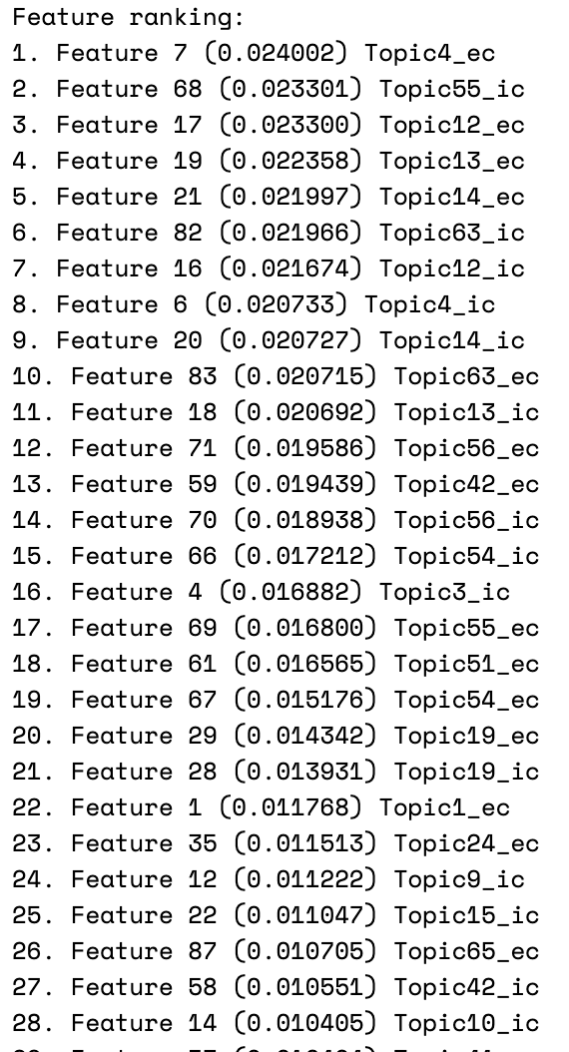
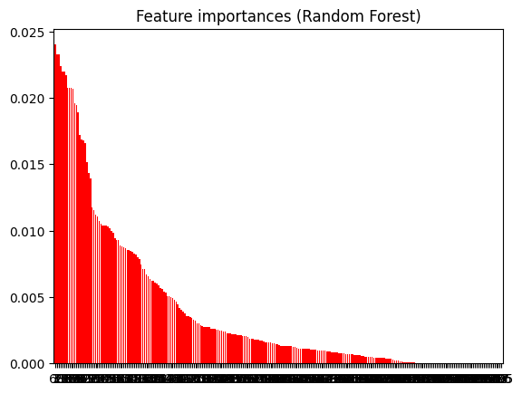
Feature importance – Random forest

Slide 5
PCA
Reducing 258 to 50 components
Scaling using StandardScaler

Slide 6
Evaluation – AdaBoost and Random forest with Voting
Parameter optimization
Random forest:
150 estimators
Max depth: 12 (15 too much, 10 too few)
Criterion for cutting: Entropy
AdaBoost
150 estimators
Learning rate: 1,5
0,84538 public score

Slide 7
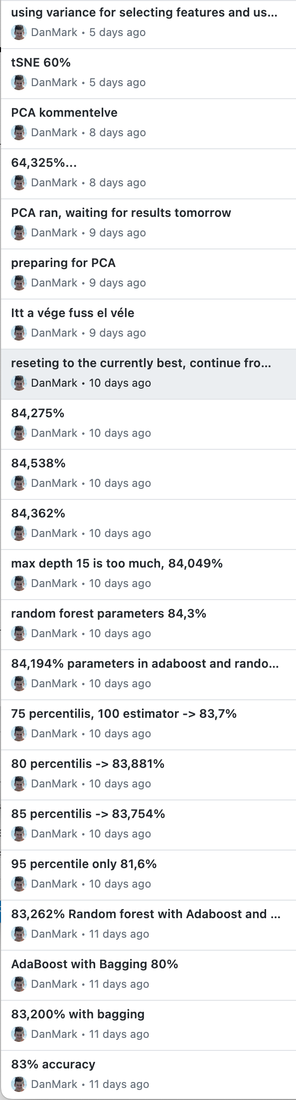
Hyper parameters & results
Before variance – treshold optimization for feature selection
Percentile trashold: 0,8 was the best, also tried 0,75;0,85;0,95
Random forest parameter optimization
Max_depth: 15 - overfitting
Estimators number: 100 - too few
Trying different criterions: “gini”, “entropy”,”log_loss”
Log_loss: emphasizes accuracy of probalistic prediction, penalizing confident but incorrect predictions
AdaBoost parameter optimization
Learning rate: 1,7 – too much(0,841), 1 – too slow
SAMME algorithm is worse (will be default in future)
Using GridSearch
Was too slow in Laboratory exercise

Slide 8
Evaluation - PCA
Using nearly the same parameters
0,779 best public score

Slide 9

Thank you for your attention!
Any questions?

