Slide 1



SMART INDIA HACKATHON 2026
Problem Statement ID : 26132
Problem Statement Title : Strengthening market linkages and price discovery for farmers
Theme : Agriculture, FoodTech & Rural Development
PS Category : Software
Team ID : CMRU027
Team Name : Kisan360 | CMR University
Name | Dept | M/F
Rian Hussain | CSE | M
Nishant Sutariya | CSE | M
Keerthan M S | CSE | M
Musalareddy Chaitna | CSE | F
Koneti Praneeth Kumar | CSE | M
Muruga Santhosh | CSE | M
Prof Bhagya (Mentor) | CSE | F
LIVE DEMO — scan or open in order (services wake on first visit):
1) https://kisan360-calc.onrender.com/health
2) https://kisan360-api.onrender.com/health
3) https://kisan360-web.onrender.com

Slide 2
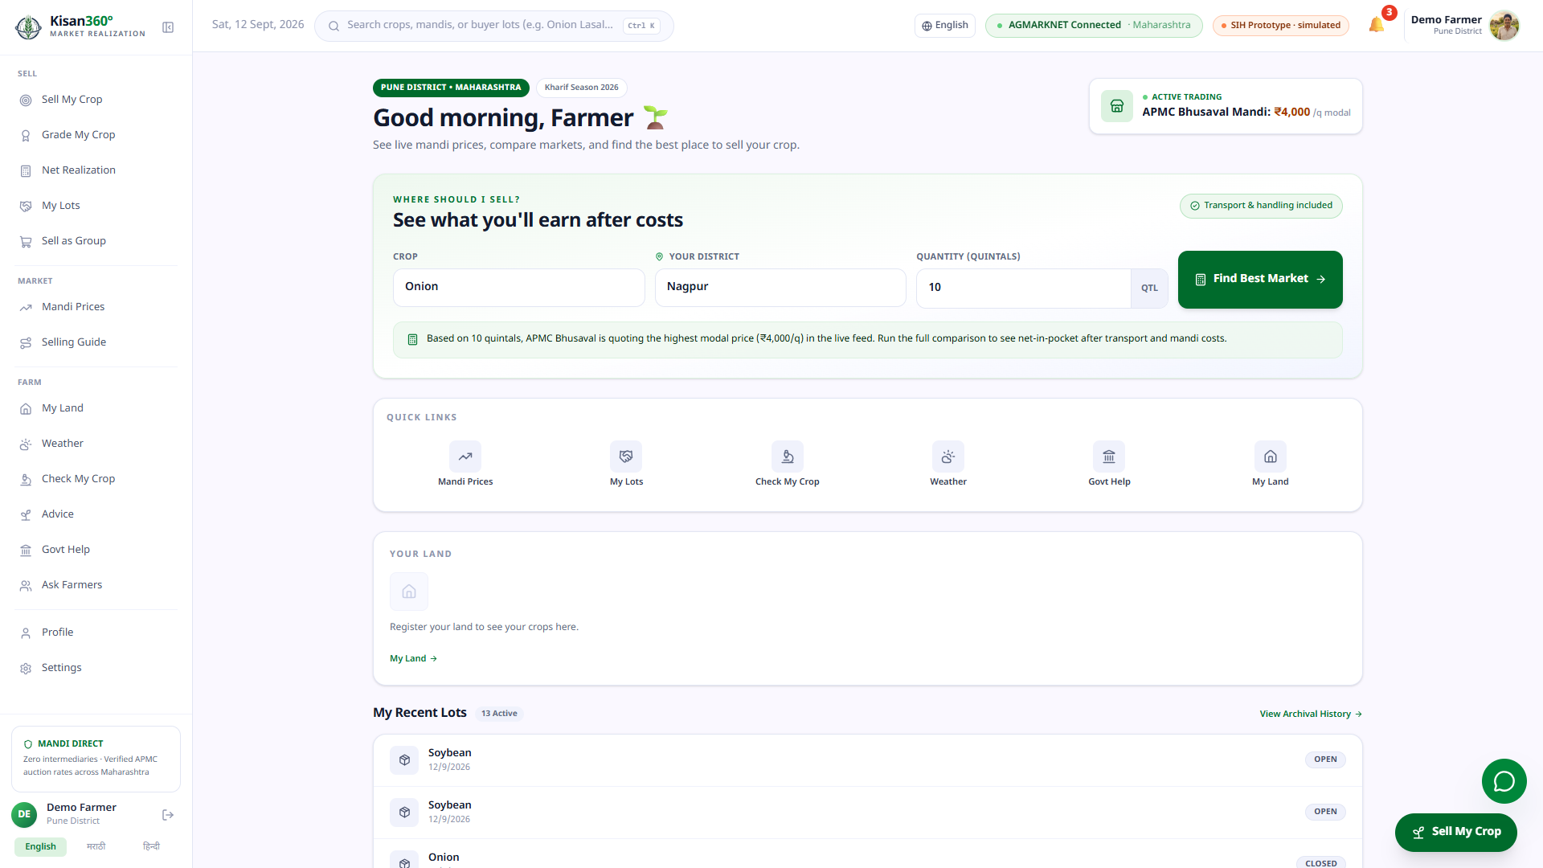
Kisan360: net-realization engine + market linkage
Idea in one line
  Kisan360 shows where a lot will actually realize the most — not just the highest headline mandi price — then connects that decision to buyers, offers and payment.
The problem (PS 26132)
  Headline price minus transport/loading/fees differs per mandi: the highest price can leave less money.
  ~86% of holdings are small & marginal (<2 ha, Agri Census) — they distress-sell at harvest with weak bargaining power.
Why it wins
  Deterministic net ranking + Why? evidence drawer; quantity what-if; buyer coverage; lot → offer → escrow → receipt; FPO pooling; AGMARK grading with trained vision model.
Live product: crop · district · quantity → one question — “where should I sell?”

Slide 3
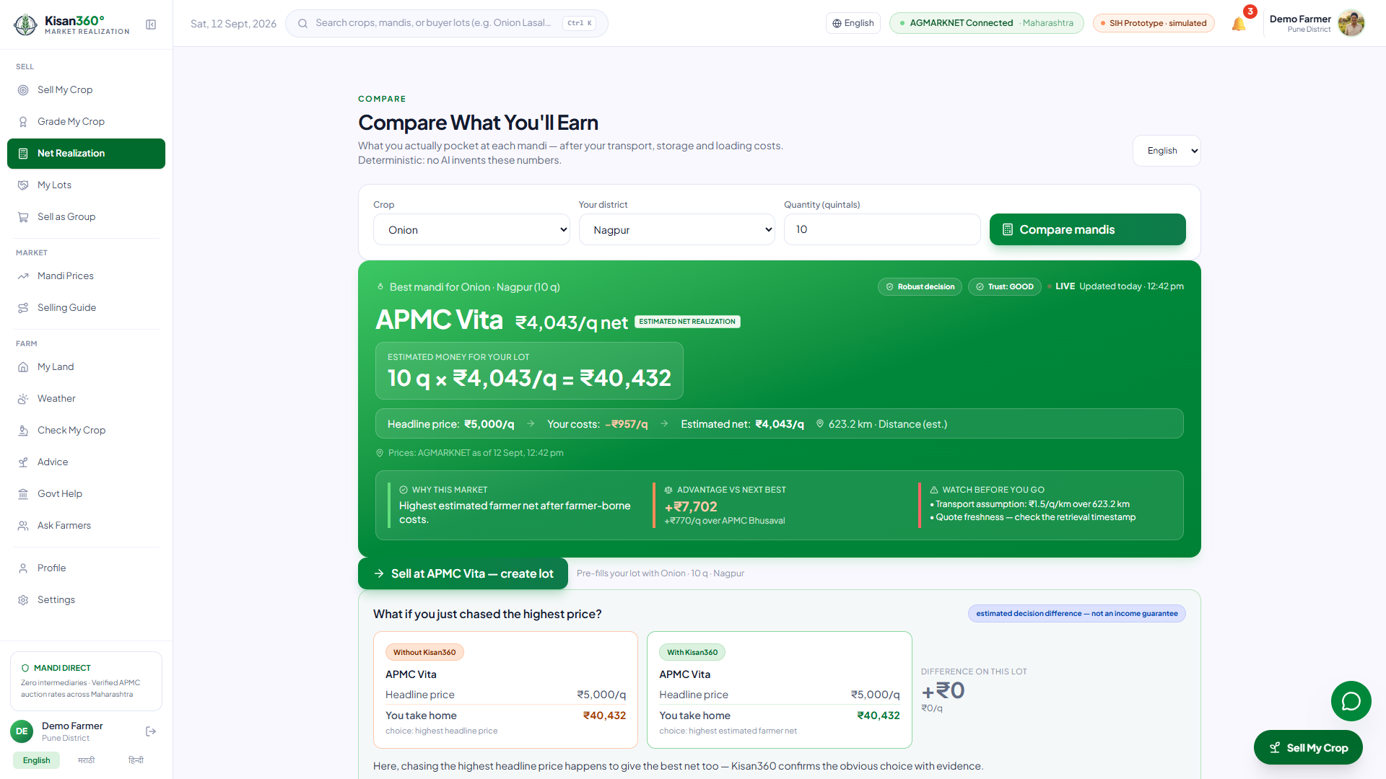
TECHNICAL APPROACH
Kisan360
AGMARKNET
Cache
Net Engine
Pathways
Trade
Receipt
Grade AI
AGMARK + vision
FPO Pool
40 q bulk
Data flow: every figure carries source + timestamp + assumption tags; simulated parts are labeled.
Tech stack
  React + Vite + Tailwind + TF.js (in-browser freshness grader).
  Node/Express API — 22 routes; Python FastAPI: net-realization (:8002, deployed); disease + advisory degrade gracefully.
  AGMARKNET live + stamped snapshot; MongoDB Atlas with memory fallback; Groq LLM explains only — never computes.
  Quality bar: 577 tests green; one-command boot; TRL 6 prototype.
Live engine: APMC Vita nets ₹40,432 on the 10 q lot — ranked by take-home, evidence attached.

Slide 4
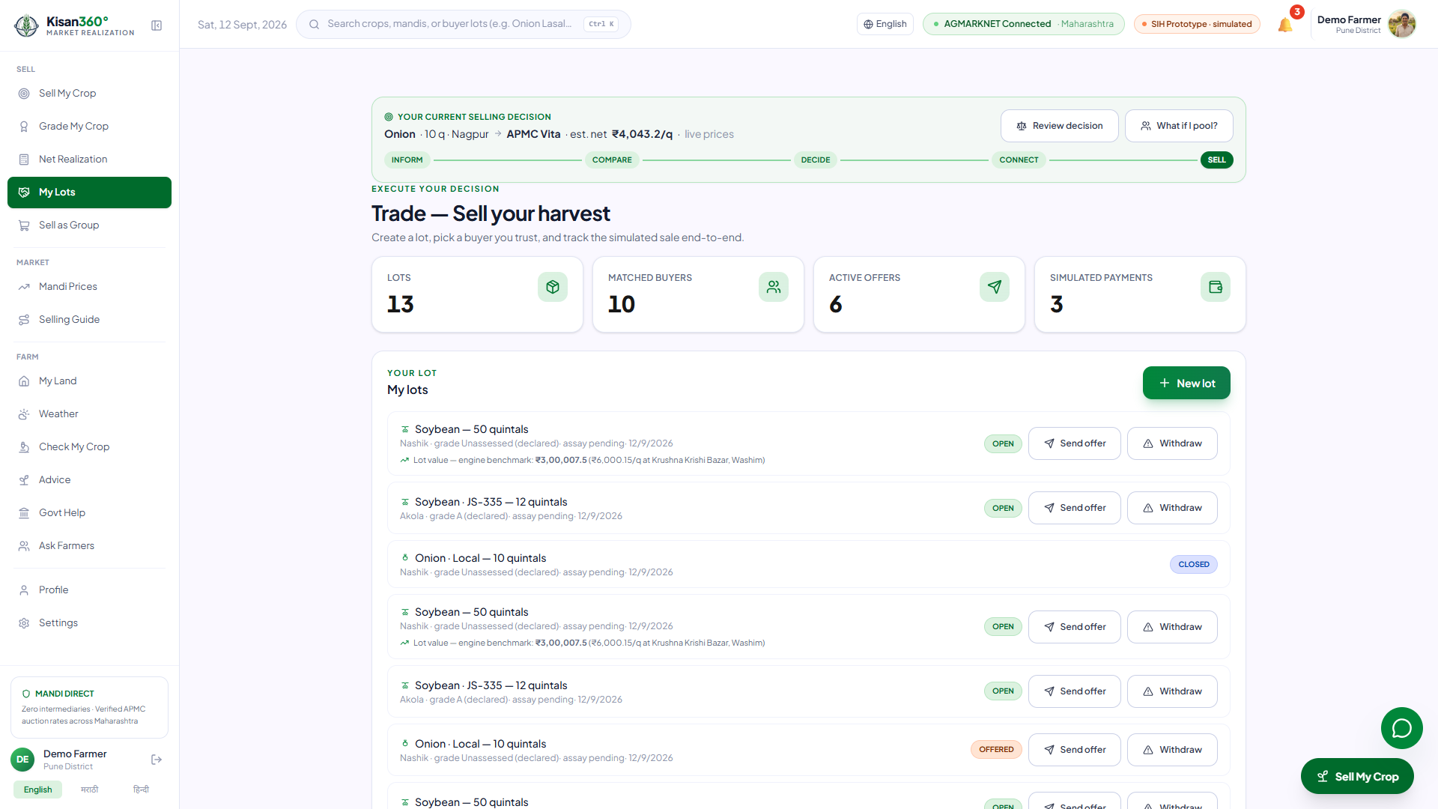
FEASIBILITY AND VIABILITY
Kisan360
Feasibility — prototype runs today
  Full journey clickable: dashboard → ranking → lot → offer → buyer accept → payment → receipt; deployable per-district over AGMARKNET/eNAM, nothing to replace.
Risks + mitigations
  AGMARKNET down → stamped snapshot, UI says CACHED. Atlas unreachable → memory DB + reseed.
  Cost assumptions → shown on screen, stress-tested, break-even rates published.
  Simulated buyers/payments → 4-tier trust labels + SIMULATED banners everywhere.
Decision tracker (INFORM → SELL) + lots → matched buyers → offers → escrow — one chain.

Slide 5
IMPACT AND BENEFITS
Kisan360
Beneficiaries
  Small & marginal farmers (better sale choice per lot); FPOs (bulk tier + buyer minimums unlocked); buyers (aggregated, graded lots); Government (decision layer on public data).
Benefits
  Economic: engine-estimated decision difference per lot (live values on screen — never an income guarantee).
  Social: bargaining power from data — offer benchmark vs reference; grievance workflow with resolution states.
  Post-harvest: sale-window + storage-breakeven guidance cuts distress sales; transparent receipts build credit history.
  Scalable: new crop/district/mandi/buyer = data entry; daily refresh; metrics declared before deployment, never fabricated.

Slide 6
RESEARCH AND REFERENCES
Kisan360
Data & standards
  AGMARKNET via data.gov.in API — live mandi price source behind the engine.
  eNAM (National Agriculture Market) — digital trading-channel integration reference.
  AGMARK standards, Directorate of Marketing & Inspection (DMI) — grade thresholds in the rule engine (7 crops × 3 grades).
Models & research
  MobileNetV2 (Sandler et al., 2018) — backbone of the shipped freshness grader (99.2% fresh/rotten, 6,738-image split) and the 38-class disease model.
  Agriculture Census 2015-16 — 86.2% holdings small & marginal (<2 ha): the core beneficiary group.
  Groq llama-3.3-70b-versatile — explanation-only LLM with deterministic template fallback.

