Slide 1


SMART INDIA HACKATHON 2026
“Find where you take home the most.”
Problem Statement ID : 26132
Problem Statement Title : Strengthening market linkages and price discovery for farmers
Theme : Agriculture, FoodTech & Rural Development
PS Category : Software
Team ID : TEAM_ID_HERE (update from portal)
Team Name : Kisan360 | CMR University
Name | Dept | M/F
Rian Hussain | CSE | M
Nishant Sutariya | CSE | M
Keerthan M S | CSE | M
Musalareddy Chaitna | CSE | F
Koneti Praneeth Kumar | CSE | M
Muruga Santhosh | CSE | M
Prof Bhagya (Mentor) | CSE | F

Slide 2
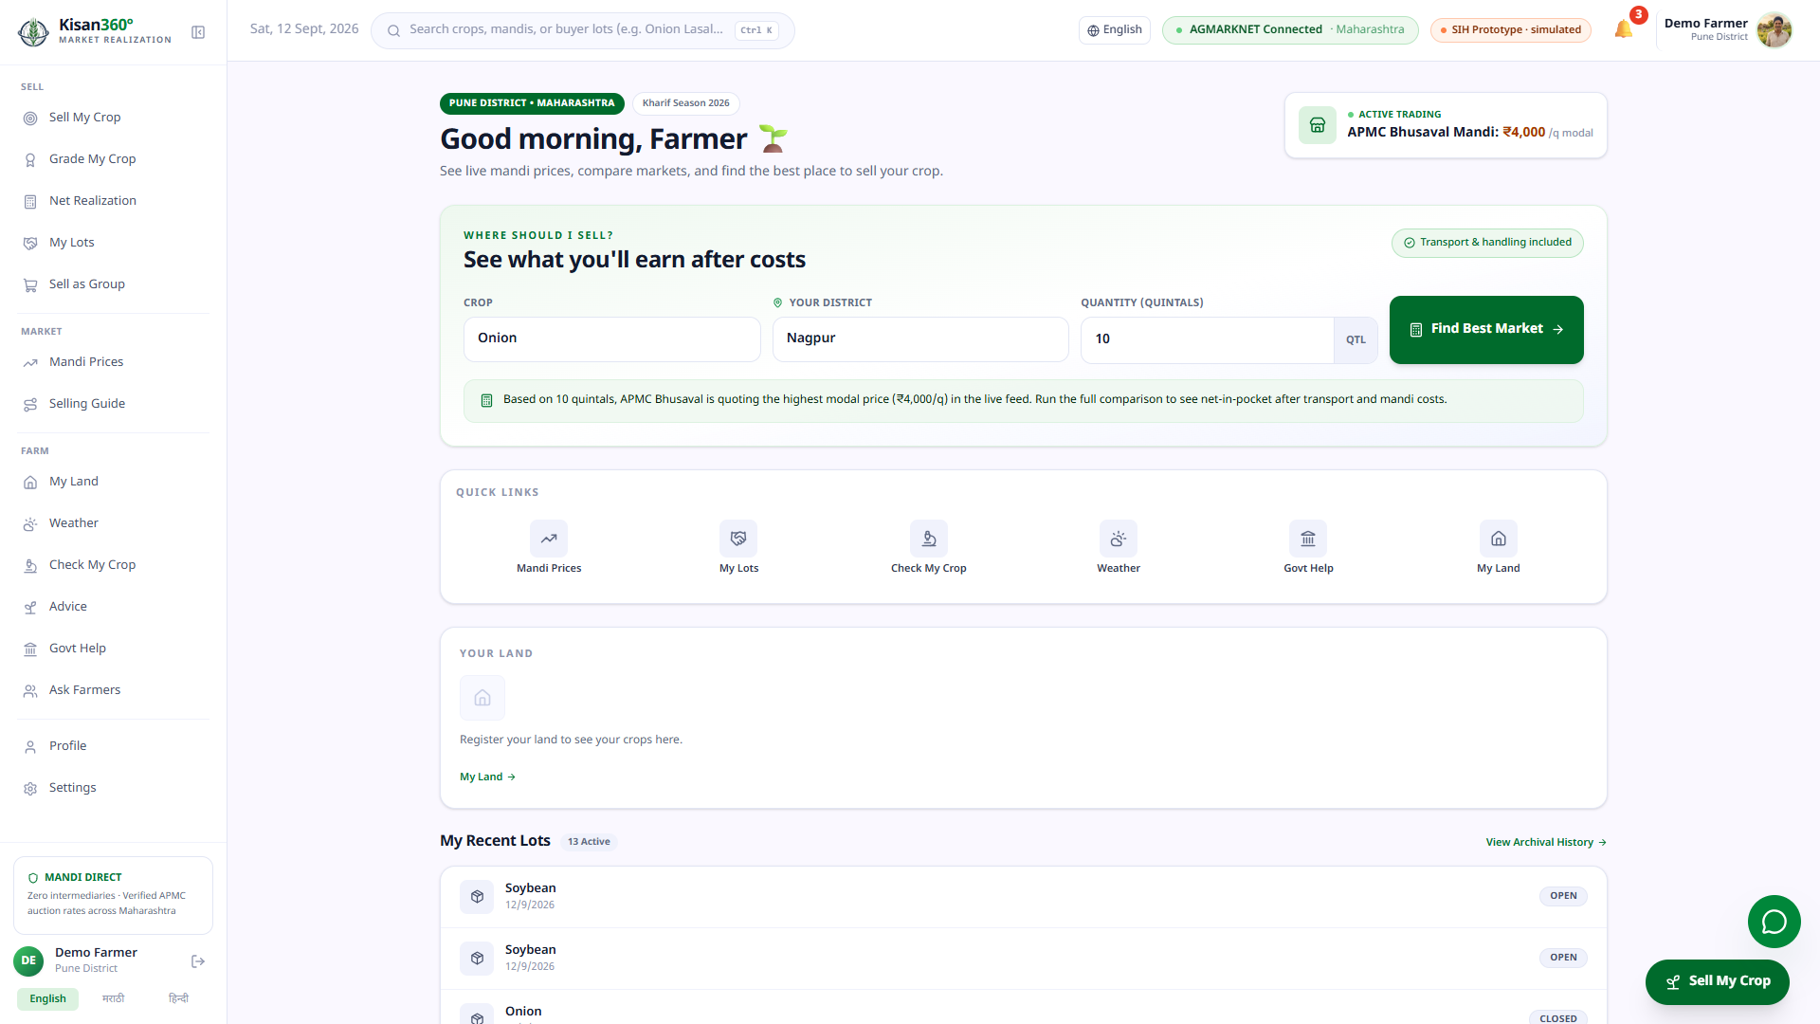
Kisan360: net-realization engine + market linkage
Idea in one line
Kisan360 shows where a lot will actually realize the most — not just the highest headline mandi price — then connects that decision to buyers, offers and payment.
The problem (PS 26132)
~86% of holdings are small & marginal — they distress-sell at harvest with weak bargaining power.
The highest mandi price can leave the farmer with less money after transport, loading, and fees.
Why it wins
Deterministic net ranking. Buyer coverage. Lot → offer → escrow → receipt. FPO pooling. AGMARK grading with trained vision model.
Live product: crop · district · quantity → one question — “where should I sell?”
HOW KISAN360 RANKS · ONION · NAGPUR · 10 q (LIVE)
HEADLINE
COSTS
NET (EST.)
₹5,000/q
−₹957/q
₹4,043/q
10 q × ₹4,043/q = ₹40,432 for this lot
Same mandi tops both price and take-home today. Edge vs next-best (APMC Bhusaval): +₹770/q.

Slide 3
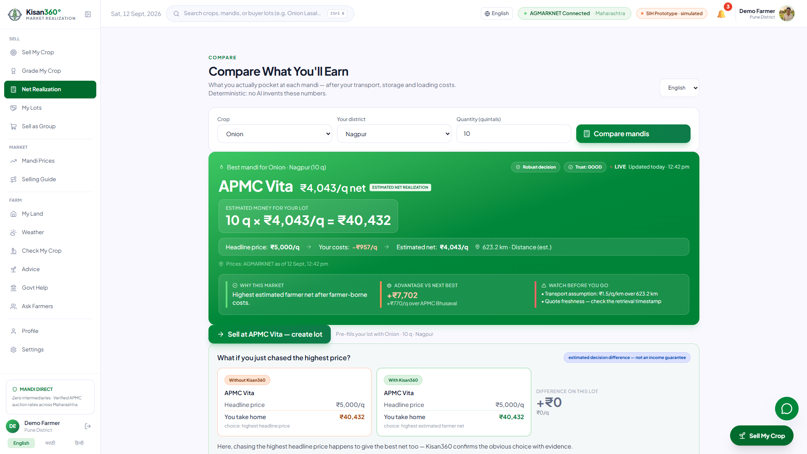
TECHNICAL APPROACH
Kisan360
AGMARKNET
Cache
Net Engine
Pathways
Trade
Receipt
Grade AI
AGMARK + vision
FPO Pool
50 q bulk
Data flow: every figure carries source + timestamp + assumption tags; simulated parts are labeled.
TRL 6
577 tests · 0 failures
22 API routes
Tech stack
React + Vite + Tailwind + TF.js (in-browser freshness grader).
Node/Express API — 22 routes; Python FastAPI: net-realization, disease CNN, advisory RAG.
AGMARKNET live + stamped snapshot; MongoDB Atlas with memory fallback; Groq LLM explains only.
Live engine: APMC Vita nets ₹40,432 on the 10 q lot — ranked by take-home, evidence attached.

Slide 4
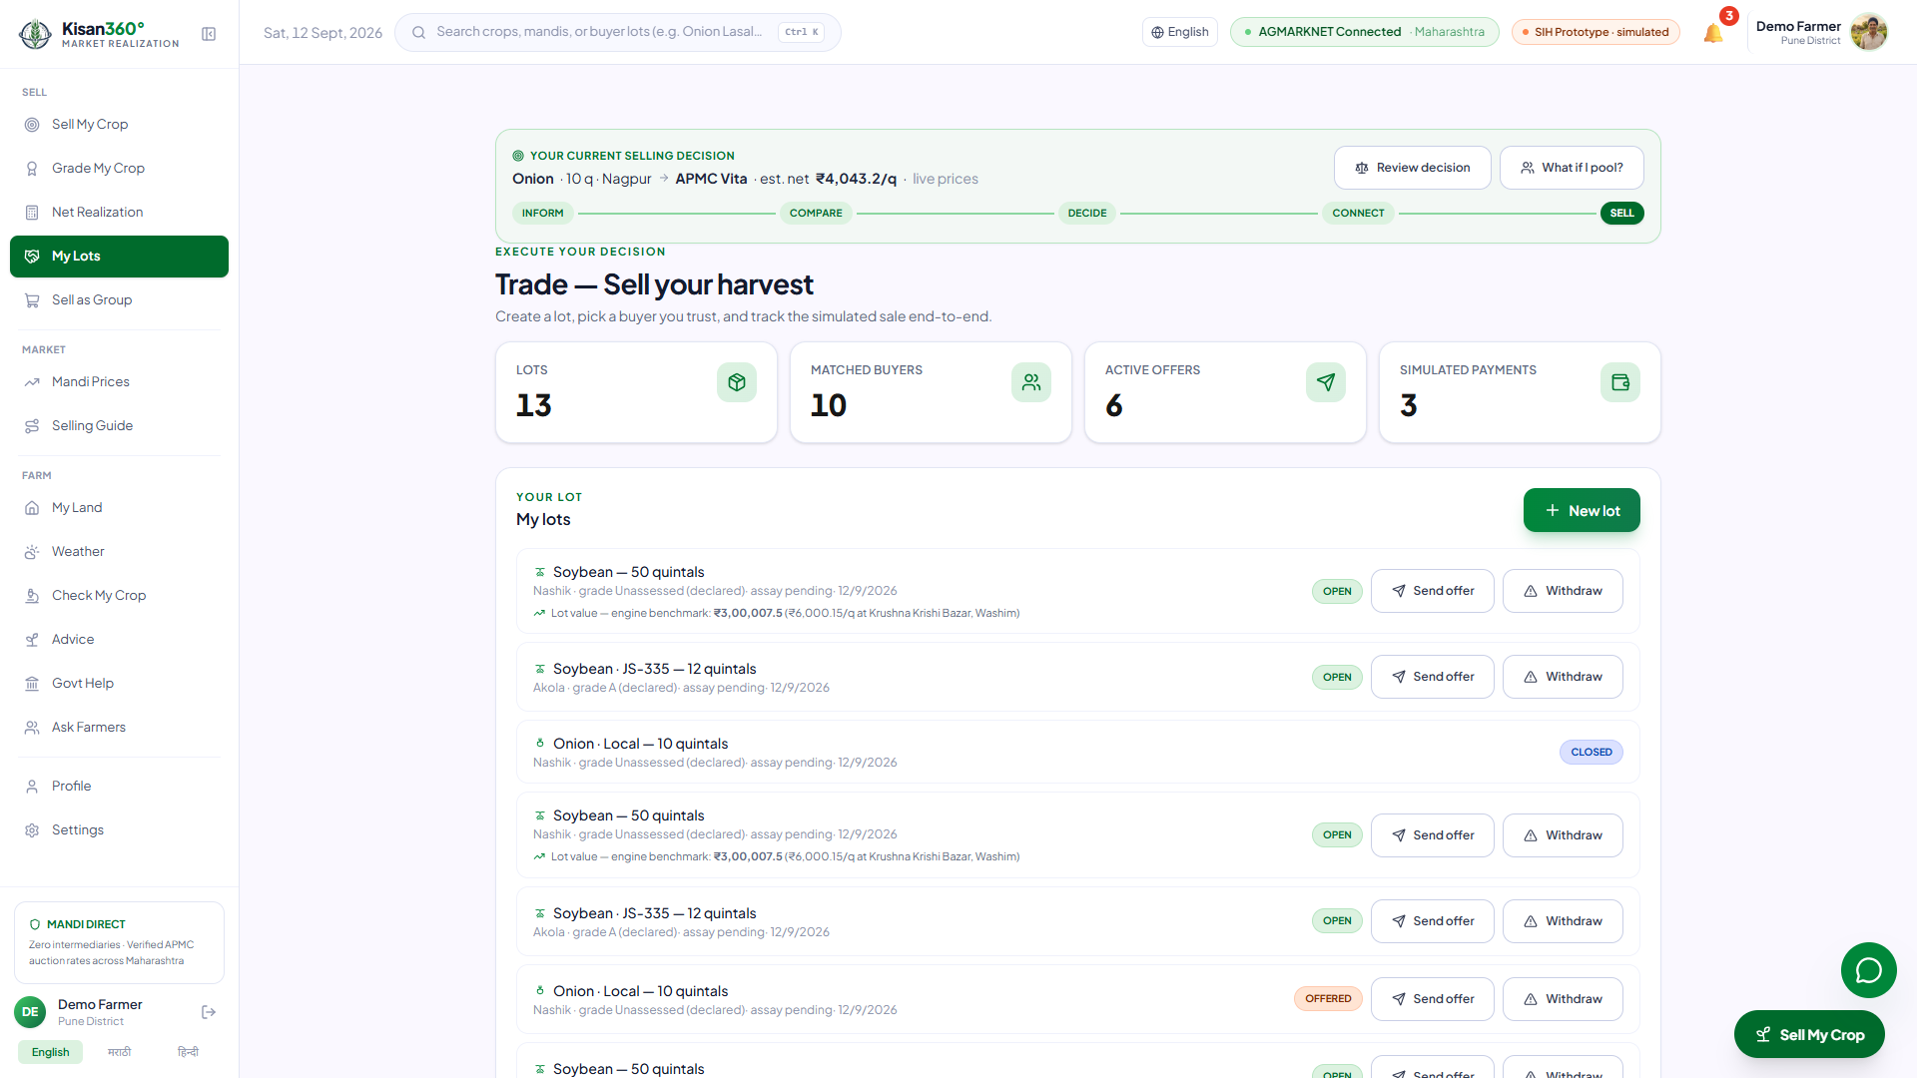
FEASIBILITY AND VIABILITY
Kisan360
Feasibility — prototype runs today
Full journey clickable: dashboard → ranking → lot → offer → buyer accept → payment → receipt.
Deployable per-district over AGMARKNET/eNAM, nothing to replace.
Risks — and where the screen says so
1. AGMARKNET API down → stamped snapshot fallback, UI badge says "CACHED"
→ visible on every price card as source + age
2. Transport/storage costs are assumptions → every assumption tagged on-screen
→ "Assumption" label next to each cost item in the calculator
3. Buyers & payments are simulated → 4-tier trust labels + "SIMULATED" banners
→ red SIMULATED badge on every payment and offer card
Decision tracker (INFORM → SELL) + lots → matched buyers → offers → escrow — one chain.
DECISION TRACKER — INFORM → COMPARE → DECIDE → CONNECT → SELL
13
10
6
3
LOTS
MATCHED
BUYERS
ACTIVE
OFFERS
SIMULATED
PAYMENTS

Slide 5
IMPACT AND BENEFITS
Kisan360
ESTIMATED TAKE-HOME · ONION · NAGPUR · 10 q
“Estimated decision difference — not an income guarantee.”
₹40,432
Every metric labeled: Live, Estimated, Assumption, or Simulated — never a guaranteed benefit.
⚠ ESTIMATED — NOT GUARANTEED
1
2
3
4
Farmer
FPO
Buyer
Government
Better sale choice per lot, backed by transparent net-realization evidence.
Bulk transport tier + buyer minimums unlocked through 50q+ pooling.
Aggregated, AGMARK-graded lots — lower sourcing risk.
Decision layer built on public AGMARKNET data; new district = data entry.
New crop, district, mandi or buyer = data entry, not a rebuild.

Slide 6
RESEARCH AND REFERENCES
Kisan360
Data & standards
  AGMARKNET via data.gov.in API — live mandi price source behind the engine.
  eNAM (National Agriculture Market) — digital trading-channel integration reference.
  AGMARK standards, Directorate of Marketing & Inspection (DMI) — grade thresholds in the rule engine (7 crops × 3 grades).
Models & research
  MobileNetV2 (Sandler et al., 2018) — backbone of the shipped freshness grader (99.2% fresh/rotten, 6,738-image split) and the 38-class disease model.
  Agriculture Census 2015-16 — 86.2% holdings small & marginal (<2 ha): the core beneficiary group.
  Groq llama-3.3-70b-versatile — explanation-only LLM with deterministic template fallback.

