Slide 1

CS1 Week 8 Empty
Time-Domain Specifications, PID Control

Slide 2
Recap Last Week

Slide 3
Quiz 1
The Root Locus plot is a plot that shows…
A. that shows us how a closed-loop system behaves for different poles/zeros
B. that shows us how a closed-loop system behaves for different gains
C. that shows us how a closed-loop system behaves when we close our eyes

Slide 4
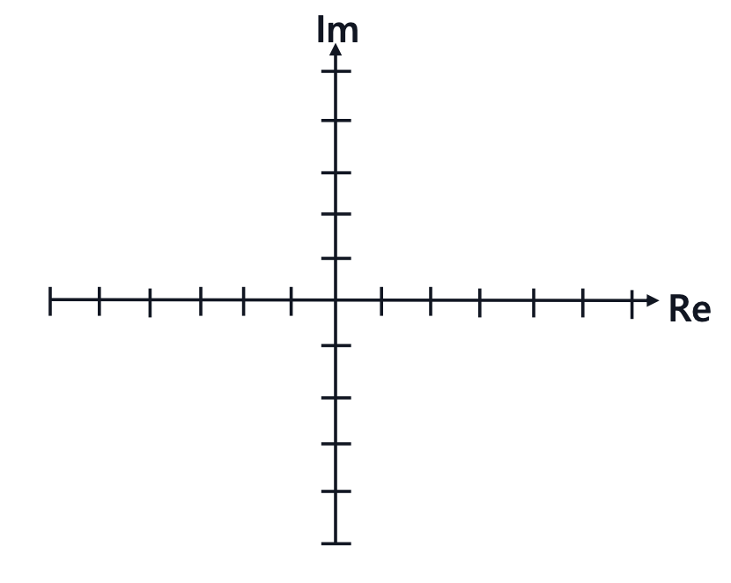

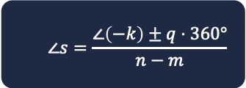

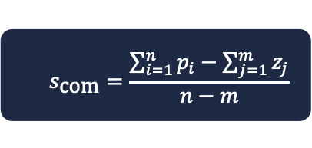






Quiz 2
$$∠s=\frac{∠\left(−k\right)±q⋅360°}{n−m}$$
$$s_{\text{com}}=\frac{\sum_{i=1}^{n}{p_{i}}−\sum_{j=1}^{m}{z_{j}}}{n−m}$$
$$r$$
$$u$$
$$y$$
$$e$$
$$k$$
$$P(s)$$
$$−$$
Draw the Root Locus of the following transfer function: $G\left(s\right)=\frac{s+2}{\left(s+3\right)\left(s+4\right)\left(s+5\right)\left(s+6\right)}$
Calculate poles & zeros of the open-loop
Analyze the real axis (which segments are on RL?)
Calculate the asymptotes for the excess poles:
Draw Root Locus

Slide 5
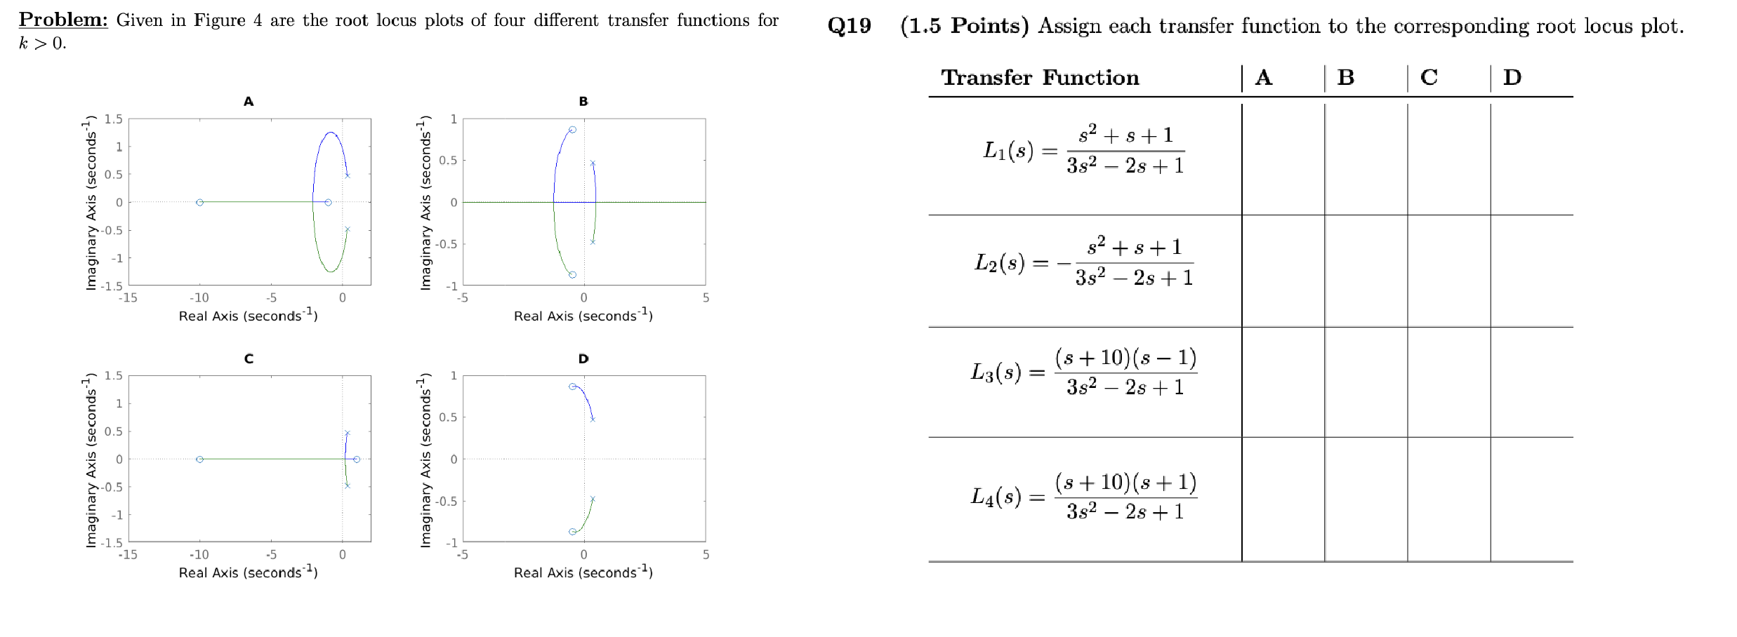
Quiz 3

Slide 6
Course Schedule
Subject | Week
Introduction, Control Architectures, Motivation | 1
Modeling, Model examples | 2
System properties, Linearization | 3
Analysis: Time response, Stability | 4
Transfer functions 1: Definition and properties | 5
Transfer functions 2: Poles and Zeros | 6
Proportional feedback control, Root Locus | 7
Time-Domain specifications, PID control | 8
Frequency response, Bode plots | 9
The Nyquist condition, Time delays | 10
Frequency-domain Specifications, Dynamic Compensation, Loop Shaping | 11
Time delays, Successive loop closure, Nonlinearities | 12
Describing functions | 13
Intro to Uncertainty and Robustness | 14
Modeling
Analysis
Synthesis

Slide 7
Today
System Specifications
Time-Domain Specifications
PID Control

Slide 8
1. System Specifications

Slide 9
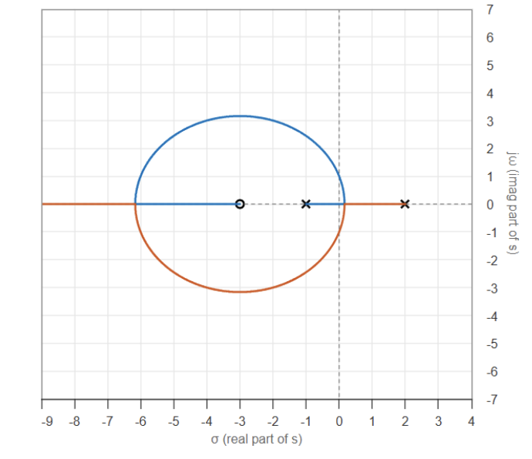

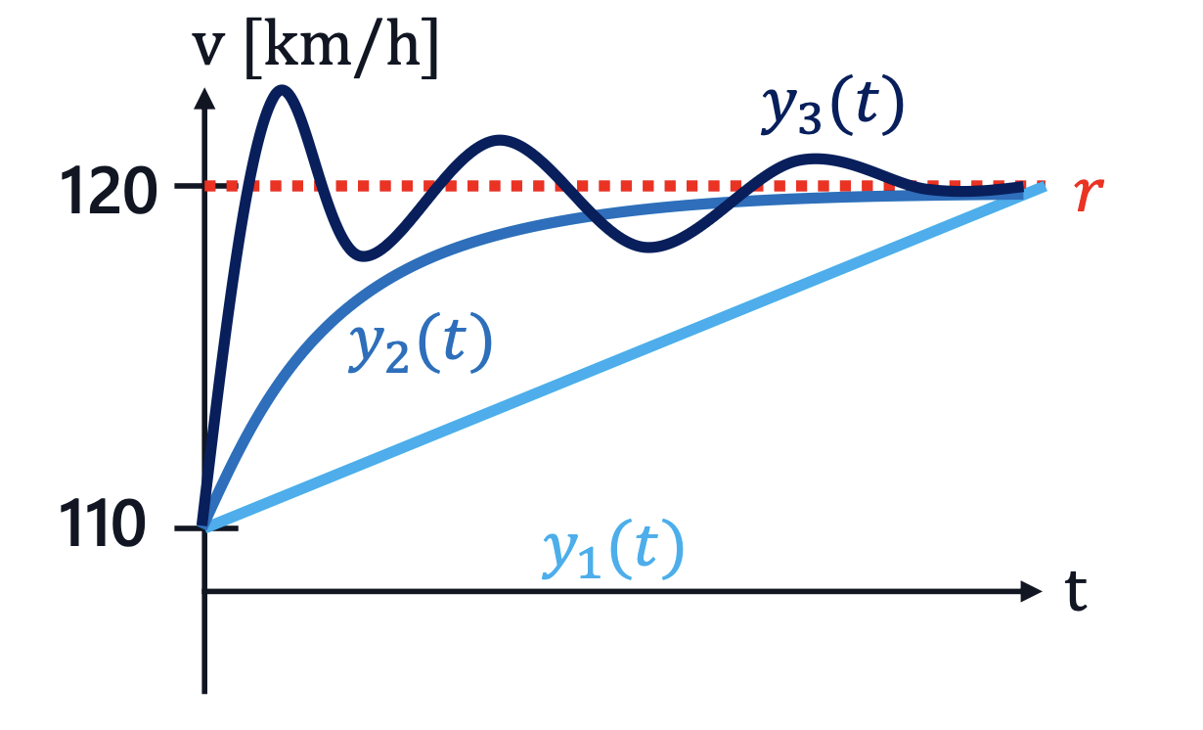

Introduction
$$r$$
$$e$$
$$u$$
$$y$$
$$k$$
$$P(s)$$
$$−$$
Week 7: Closed-Loop Stability
Job's finished? 🤔
Week 8: Closed-Loop Specifications
We need to make sure it's quick and can handle disturbances and errors well!

Slide 10






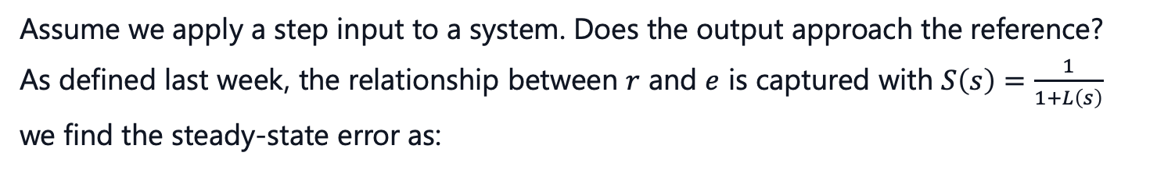





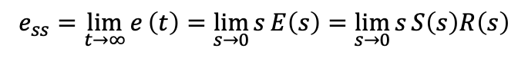



Steady-State Error
$$r$$
$$e$$
$$u$$
$$y$$
$$P(s)$$
$$C\left(s\right)$$
$$−$$
Assume we apply a step input to a system. Does the output approach the reference?
As defined last week, the relationship between $r$ and $e$ is captured with $S\left(s\right)=\frac{1}{1+L\left(s\right)}$
we find the steady-state error as:
using FVT
$$r\left(t\right)$$
$$e_{ss}=\lim_{t→∞}{e}\left(t\right)=\lim_{s→0}{s}E\left(s\right)=\lim_{s→0}{s}S\left(s\right)R\left(s\right)$$
$$e_{ss}$$
step input $R\left(s\right)=\frac{1}{s}$, hence
$$y\left(t\right)$$
$$e_{ss}=\lim_{s→0}{s}⋅\frac{1}{1+C\left(s\right)P\left(s\right)}⋅\frac{1}{s}=\frac{1}{1+C\left(0\right)P\left(0\right)}$$
$$t$$
That means, that for $e_{ss}$ to be zero $⟶L\left(0\right)=C\left(0\right)P\left(0\right)=∞$
⟶ What property must the general $L(s)$ possess for this to hold true?
We need a pole at $s=0$!
Integrators!

Slide 11



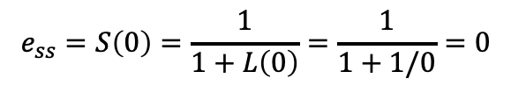




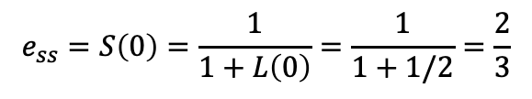

Integrators
$$r\left(t\right)$$
$$e_{ss}$$
$$y\left(t\right)$$
If constant error $e$ is integrated, it steadily grows
Controller tries to minimize this growth and drives $e(t)$ to zero
$$t$$
Example: Given an open loop system: $L\left(s\right)=\frac{1}{s+2}$ what is $e_{ss}$ for an step input?
$$e_{ss}=S\left(0\right)=\frac{1}{1+L\left(0\right)}=\frac{1}{1+1/2}=\frac{2}{3}$$
$e_{ss}=$ $\frac{1}{1+L\left(0\right)}$
Let's add an integrator: $L\left(s\right)=\frac{1}{s}⋅\frac{1}{s+2}=\frac{1}{s^{2}+2s}$
$$e_{ss}=S\left(0\right)=\frac{1}{1+L\left(0\right)}=\frac{1}{1+1/0}=0$$
Great, now we know to make the output actually go where we want it to go!

Slide 12
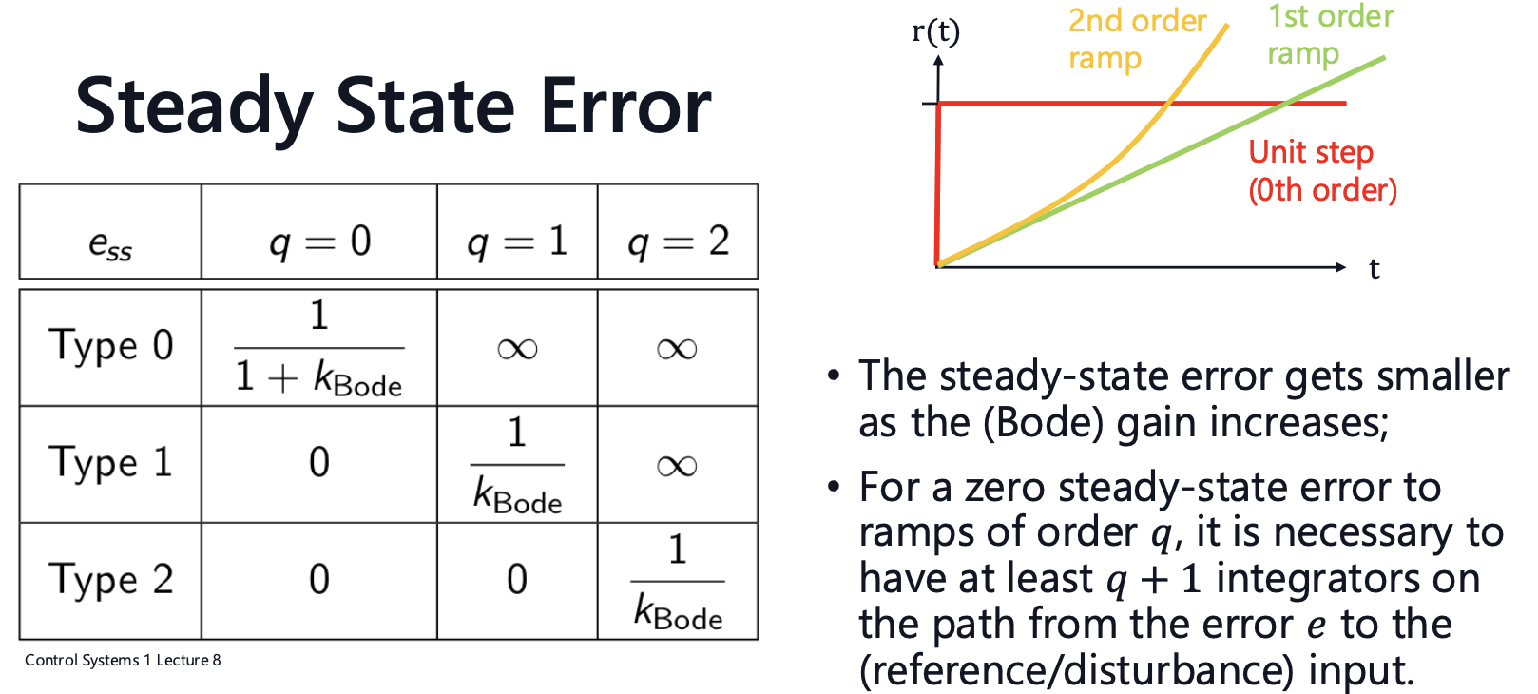
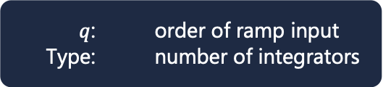
$q$: order of ramp input
Type: number of integrators

Slide 13
2. Time-Domain Specifications

Slide 14









Time-Domain Specifications
$$y\left(t\right)$$
$$M_{p}$$
$T_{100\%}$: Rise Time
$T_{p}:$ Peak Time
$T_{d}$: Settling Time
$M_{p}:$ Peak Overshoot
$$120$$
$$r$$
$$T_{d}$$
$$T_{p}$$
$$t$$
$$T_{100\%}$$

Slide 15
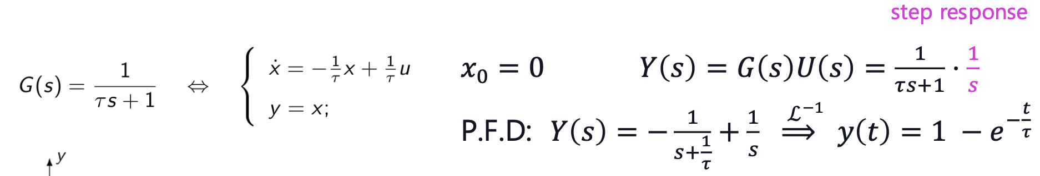

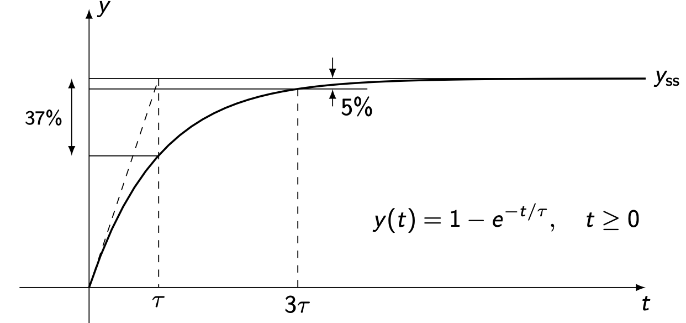
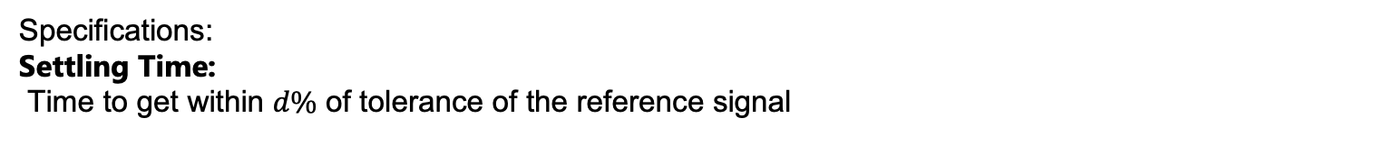



Step Response of a 1st Order System
$$y$$
$$−\frac{1}{τ}$$
x
Specifications: Settling Time:
Time to get within $d\%$ of tolerance of the reference signal

Slide 16
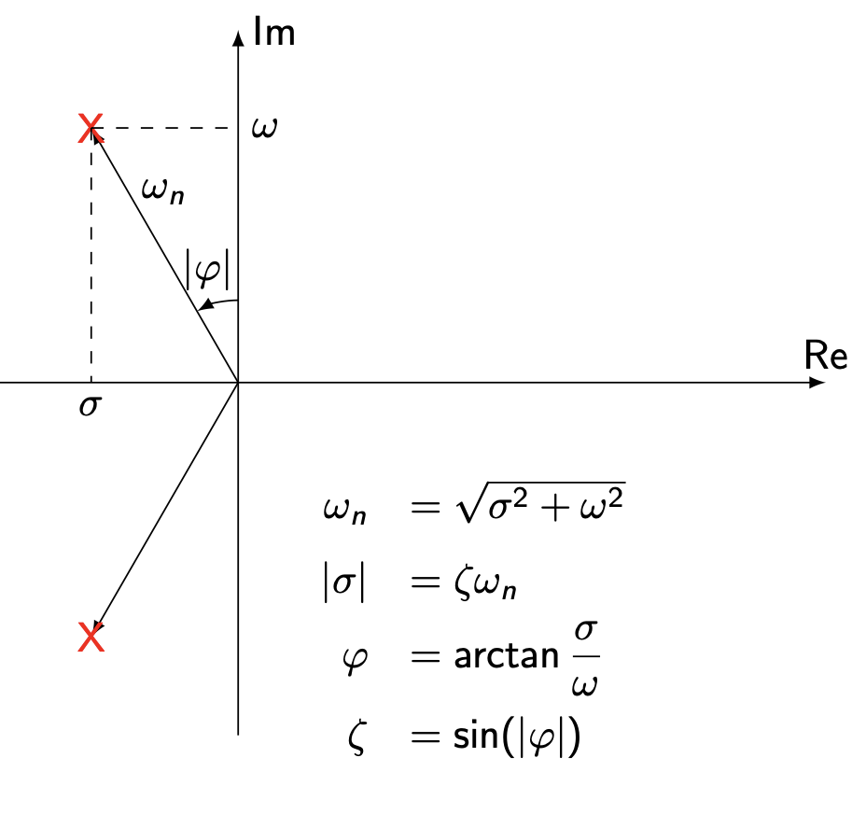
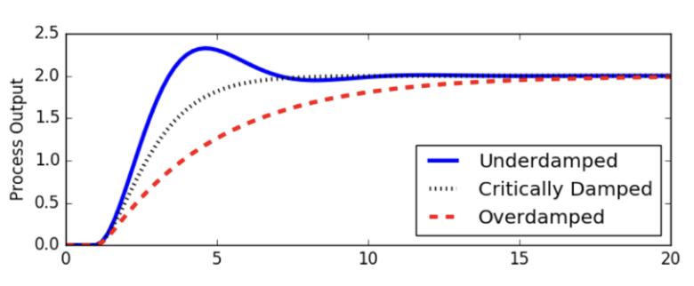
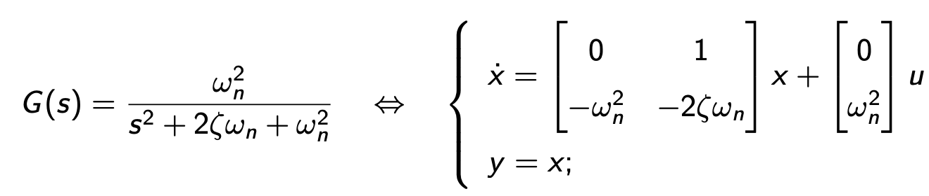
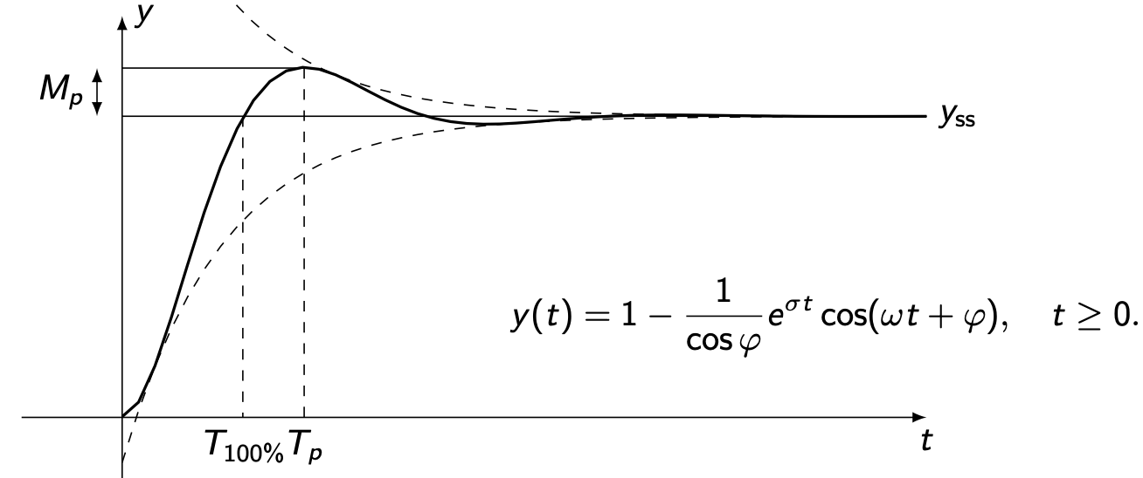
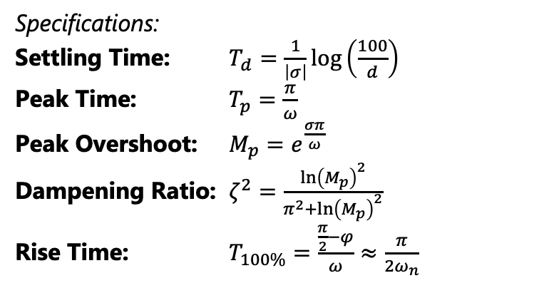

Step Response of a 2nd Order System
For an underdamped system $\left(ζ<1\right)$:
Specifications:
Settling Time: $T_{d}=\frac{1}{\left|σ\right|}log\left(\frac{100}{d}\right)$
Peak Time: $T_{p}=\frac{π}{ω}$
Peak Overshoot: $M_{p}=e^{\frac{σπ}{ω}}$
Dampening Ratio: $ζ^{2}=\frac{{\ln\left(M_{p}\right)}^{2}}{π^{2}+{\ln\left(M_{p}\right)}^{2}}$
Rise Time: $T_{100\%}=\frac{\frac{π}{2}−φ}{ω}≈\frac{π}{2ω_{n}}$

Slide 17
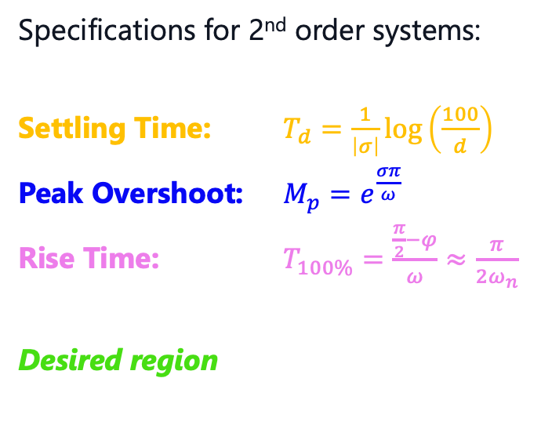

Time-Domain Specifications Visualization
Specifications for 2nd order systems:
Settling Time: $T_{d}=\frac{1}{\left|σ\right|}log\left(\frac{100}{d}\right)$
Peak Overshoot: $M_{p}=e^{\frac{σπ}{ω}}$
Rise Time: $T_{100\%}=\frac{\frac{π}{2}−φ}{ω}≈\frac{π}{2ω_{n}}$
Desired region
x
o
x

Slide 18
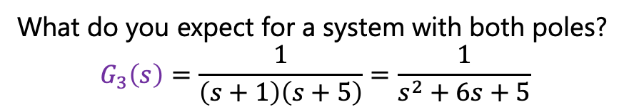

Dominant Poles Approximation
Thought experiment:
$G_{1}\left(s\right)=\frac{1}{s+1}$
$$G_{2}\left(s\right)=\frac{1}{s+5}$$
What do you expect for a system with both poles?
$$G_{3}\left(s\right)=\frac{1}{\left(s+1\right)\left(s+5\right)}=\frac{1}{s^{2}+6s+5}$$
Poles closer to the origin have a higher influence!!

Slide 19
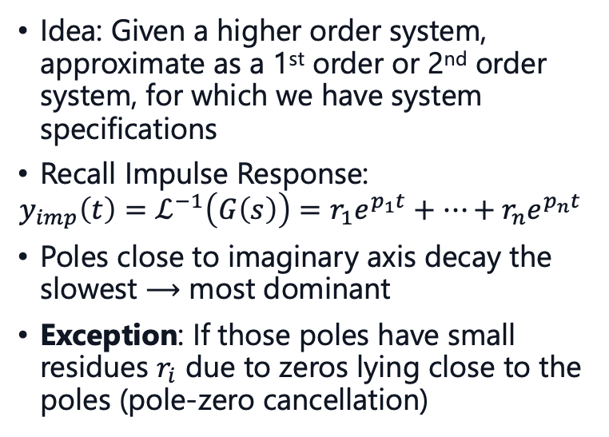
Dominant Poles Approximation
Idea: Given a higher order system, approximate as a 1st order or 2nd order system, for which we have system specifications
Recall Impulse Response:
$$y_{imp}\left(t\right)=ℒ^{−1}\left(G\left(s\right)\right)=r_{1}e^{p_{1}t}+…+r_{n}e^{p_{n}t}$$
Poles close to imaginary axis decay the slowest $⟶$ most dominant
Exception: If those poles have small residues $r_{i}$ due to zeros lying close to the poles (pole-zero cancellation)
x
x
dominant
x
x
x
x
x
o
x
o
x
dominant
x

Slide 20
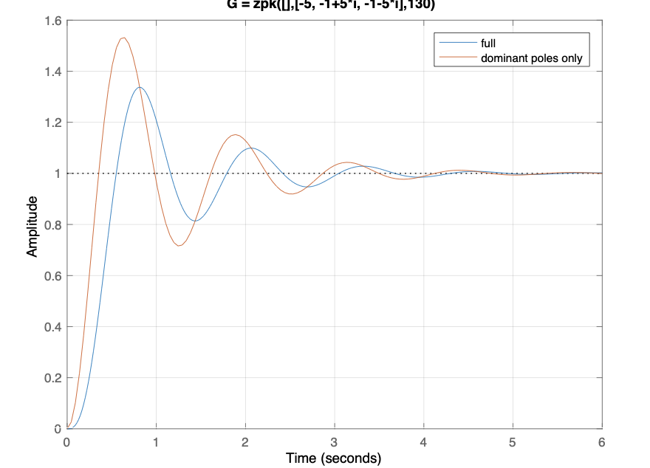
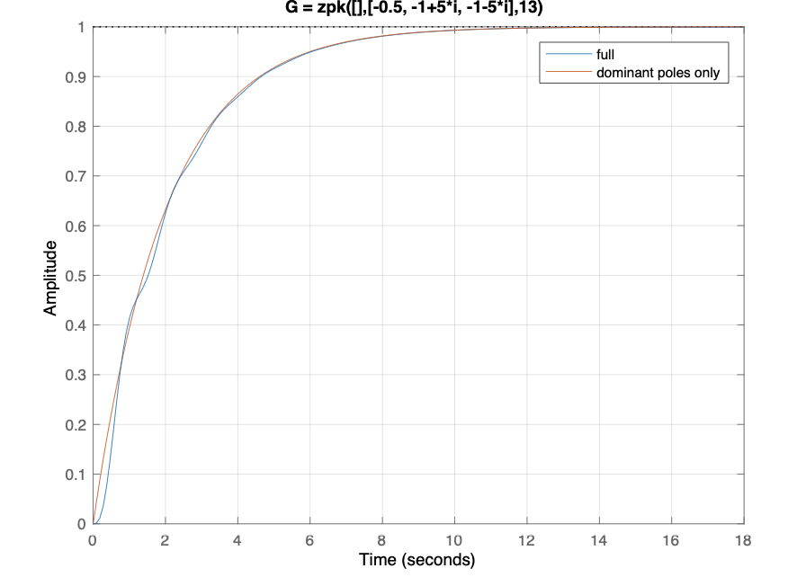
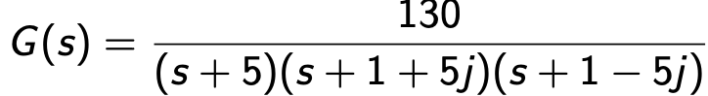
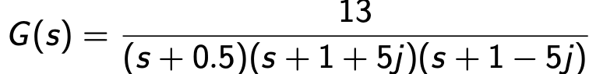
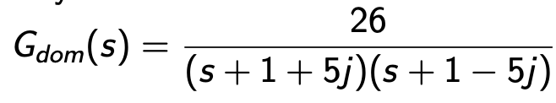
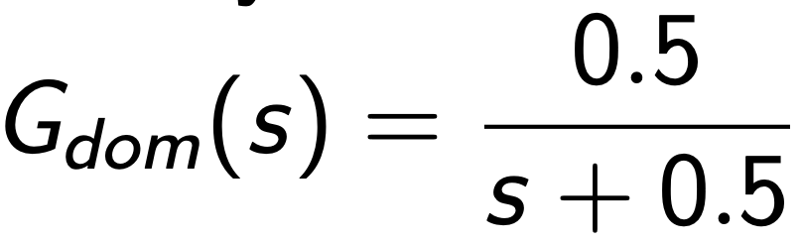

Dominant Poles Approximation
$$G_{approx}\left(0\right)=G\left(0\right)$$

Slide 21
3. PID-Control

Slide 22
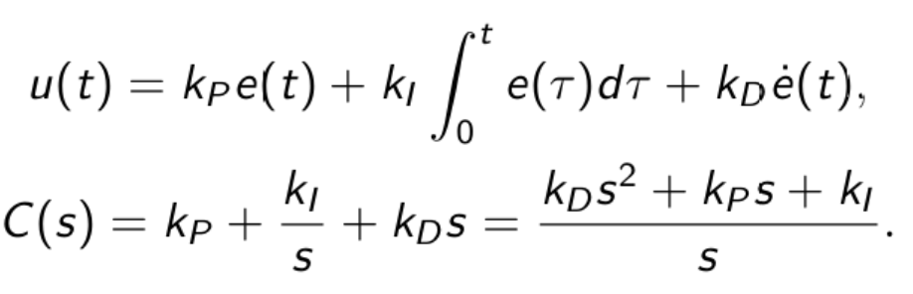
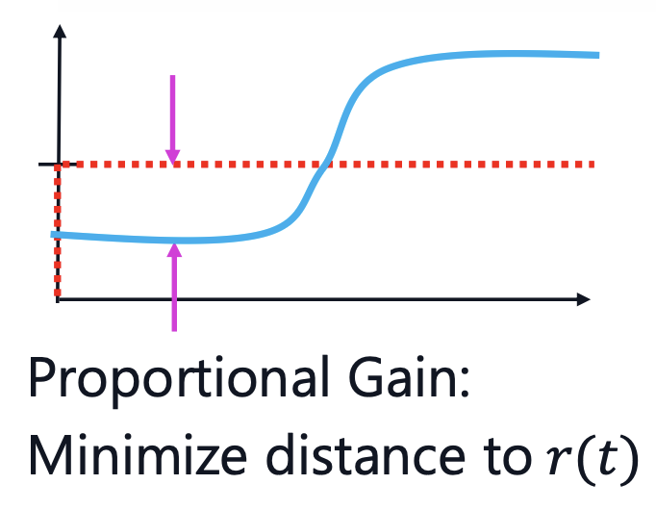
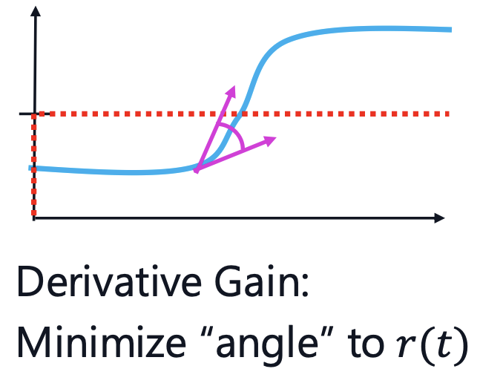
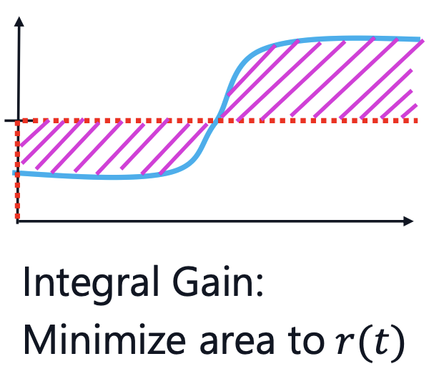















PID Control
$$r$$
$$e$$
$$u$$
$$y$$
$$C_{PID}\left(s\right)$$
$$P(s)$$
$$−$$
which really is just:
$$k_{P}$$
$$r$$
$$e$$
$$u$$
$$y$$
$$k_{I}\frac{1}{s}$$
$$P(s)$$
c
c
$$−$$
$$k_{D}s$$
graphs from Joel Tan

Slide 23
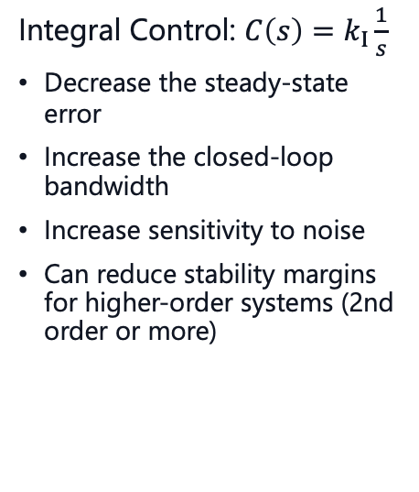
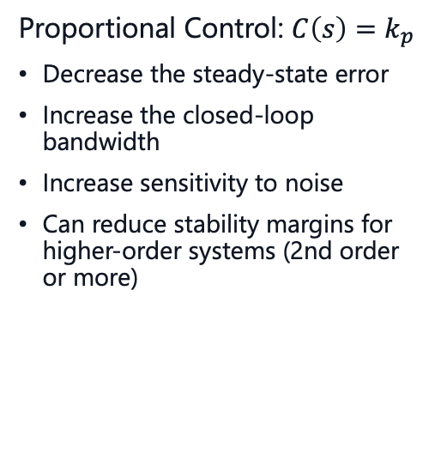

PID Effects
Proportional Control: $C\left(s\right)=k_{p}$
Decrease the steady-state error
Increase the closed-loop bandwidth
Increase sensitivity to noise
Can reduce stability margins for higher-order systems (2nd order or more)
Integral Control: $C\left(s\right)=k_{I}\frac{1}{s}$
Decrease the steady-state error
Increase the closed-loop bandwidth
Increase sensitivity to noise
Can reduce stability margins for higher-order systems (2nd order or more)
Derivative Control: $C\left(s\right)=k_{D}s$
Reduce overshooting, increase damping
Improves stability margins
Increase sensitivity to noise
Video recommendation: https://www.youtube.com/watch?v=UR0hOmjaHp0

Slide 24

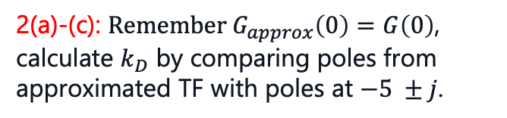
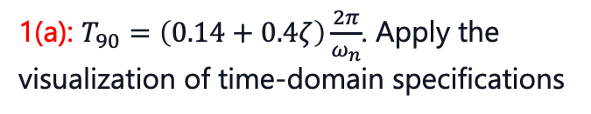
Tips for Problem Set 7
I personally would recommend solving at least the problems marked red
Easy | Medium | Hard
 | $$1,2,3$$
1(a): $T_{90}=\left(0.14+0.4ζ\right)\frac{2π}{ω_{n}}$. Apply the visualization of time-domain specifications
2(d): check solutions for the plot
3(a): here again remember the visualization of the time-domain specifications
1(b): Apply Root Locus form to TF and sketch Root Locus
3(b): from the time-domain specifications, remember how a 2nd order system is written:
if unsure check solutions
1(c): check if T(s) stable, messy calculations, loot at solutionn
2(a)-(c): $\text{Remember} G_{approx}\left(0\right)=G\left(0\right)$, calculate $k_{D}$ by comparing poles from approximated TF with poles at $−5 ±j$.

Slide 25
Questions?

Slide 26
Feedback?
Too fast? Too slow? Less theory, more exercises?
I would appreciate your feedback. Please let me know.
https://docs.google.com/forms/d/e/1FAIpQLSdHl0kjWo63aNzDkAV0cnmQadCAj5L0D7v7aSh0BK7BBdEgpA/viewform?usp=header

