Slide 1

CS1 Week 5 Annotated
Transfer functions

Slide 2
Attention
ETH no longer provides web hosting.
All my exercise class materials have been moved to GitHub Pages.
You can now find them under the following link:
https://kissanv.github.io
Or you can scan the QR-Code:

Slide 3
Recap Last week

Slide 4
Quiz 1
Into which parts do we split the solution of an ODE to obtain the time response?
A. Dynamic & Steady-state response
B. Natural & Forced response
C. Frequency & Time response
D. We don't split the solution

Slide 5

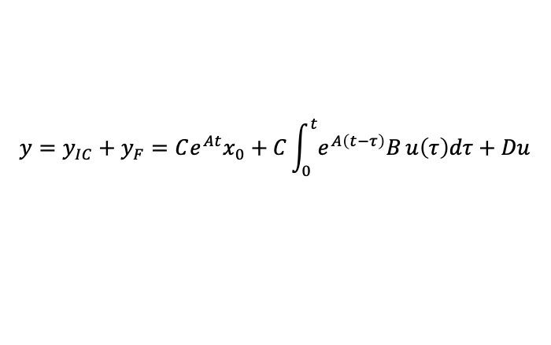
Quiz 1
Into which parts do we split the solution of an ODE to obtain the time response?
state-space representation:
A. Dynamic & Steady-state response
$$\dot{x}\left(t\right)=Ax\left(t\right)+Bu\left(t\right)$$
$$y(t)=Cx(t)+Du(t)$$
ODE
B. Natural & Forced response
→ solve ODE → get expression for $x(t)$ → plug in $y(t)$
C. Frequency & Time response
D. We don't split the solution
$$y=y_{IC}+y_{F}=Ce^{At}x_{0}+C\int_{0}^{t}{e^{A\left(t−τ\right)}B}u\left(τ\right)dτ+Du$$
initial/forced response
forced response
feedthrough

Slide 6
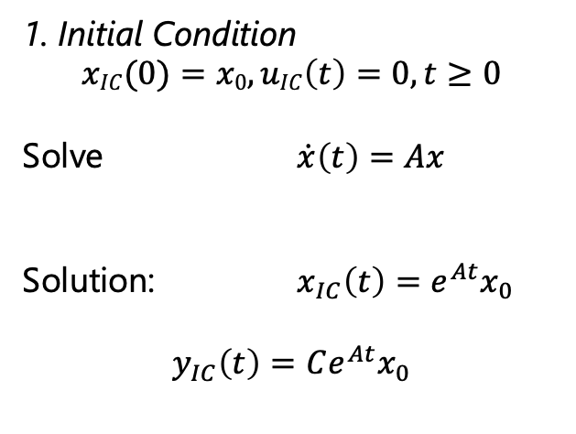
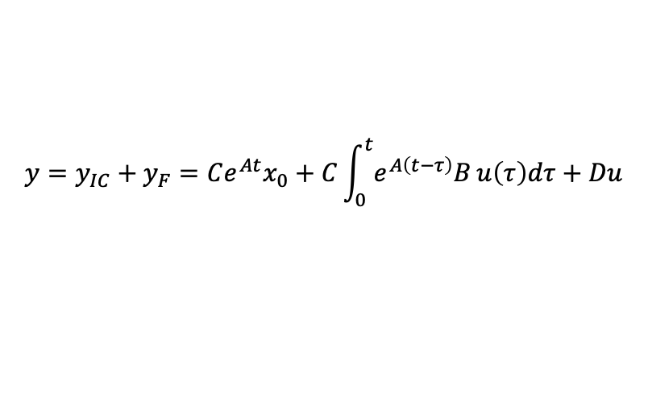
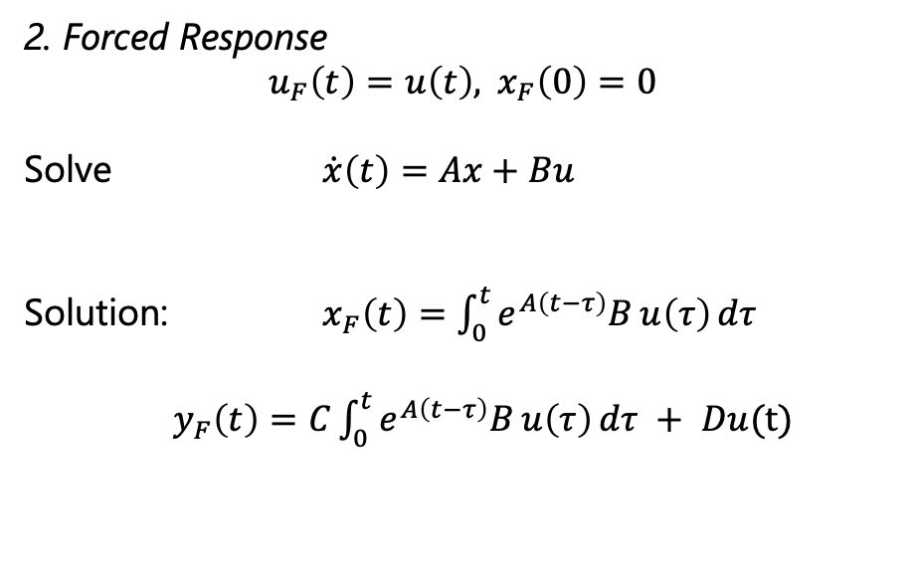
Initial and Forced Response Solution
1. Initial Condition
$$xIC(0)=x0,uIC\left(t\right)=0, t≥0$$
Solve $\dot{x}\left(t\right)=Ax$
Solution: $x_{IC}\left(t\right)=e^{At}x_{0}$
$$y_{IC}\left(t\right)=Ce^{At}x_{0}$$
2. Forced Response
$$u_{F}\left(t\right)=u\left(t\right), x_{F}\left(0\right)=0$$
Solve $\dot{x}\left(t\right)=Ax+Bu$
Solution: $x_{F}\left(t\right)=\int_{0}^{t}{e^{A\left(t−τ\right)}B}u\left(τ\right) dτ$
$y_{F}\left(t\right)=C\int_{0}^{t}{e^{A\left(t−τ\right)}B}u\left(τ\right) dτ + Du(t)$
$$y=y_{IC}+y_{F}=Ce^{At}x_{0}+C\int_{0}^{t}{e^{A\left(t−τ\right)}B}u\left(τ\right)dτ+Du$$
Time Response of an
LTI system
initial response
forced response
feedthrough

Slide 7
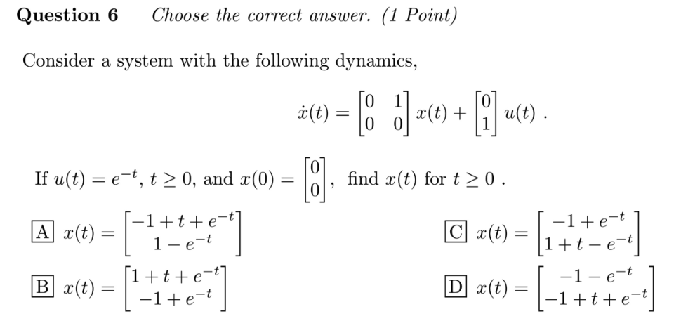
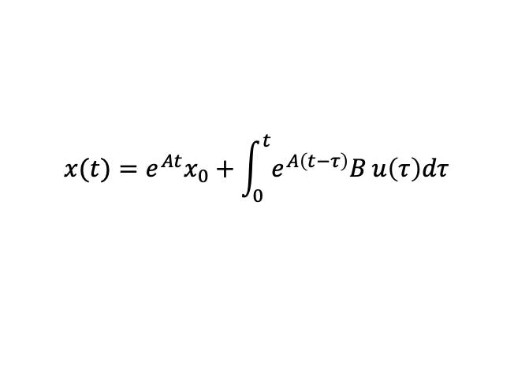
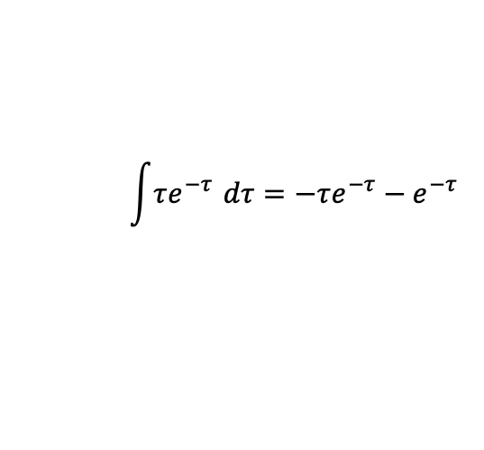
Quiz 2
$$x(t)=e^{At}x_{0}+\int_{0}^{t}{e^{A\left(t−τ\right)}B}u\left(τ\right)dτ$$
$$\int{τe^{−τ}} dτ=−τe^{−τ}−e^{−τ}$$

Slide 8

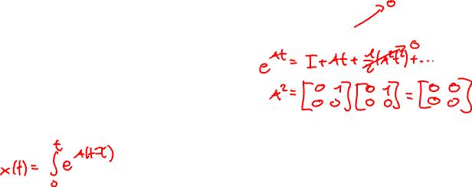
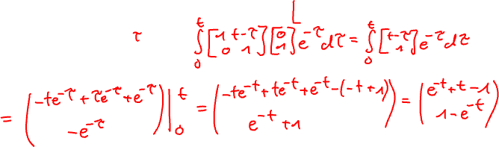
Quiz 2
$$x(t)=e^{At}x_{0}+\int_{0}^{t}{e^{A\left(t−τ\right)}B}u\left(τ\right)dτ$$
→ A)

Slide 9




Quiz 3
How is the stability of a system determined?
A. Imaginary part of eigenvalues of $A$
B. Real part of eigenvalues of $A$
C. Multiplicity of eigenvalues of $A$
D. Real Part of eigenvalues of $B$

Slide 10

Quiz 3
How is the stability of a system determined?
A. Imaginary part of eigenvalues of $A$
B. Real part of eigenvalues of $A$
C. Multiplicity of eigenvalues of $A$
D. Real Part of eigenvalues of $B$

Slide 11

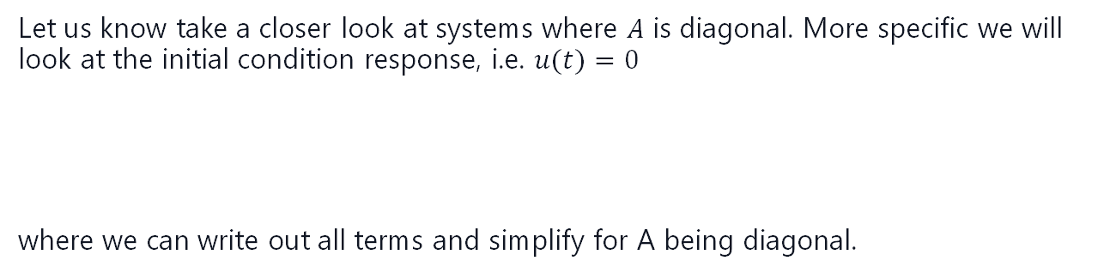


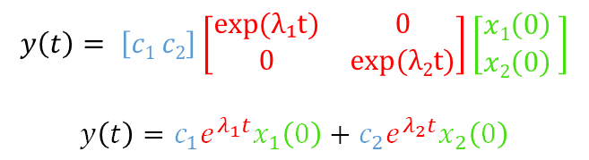
I.C Response: Real Eigenvalues
Let us know take a closer look at systems where $A$ is diagonal. More specific we will look at the initial condition response, i.e. $u(t)=0$
where we can write out all terms and simplify for A being diagonal.
⟶ For a diagonal, real matrix:
$$A= \left[\begin{matrix}λ1 & 0 \\ 0 & λ2\end{matrix}\right], λi ∈ R$$
$$y\left(t\right)= CeAtx0$$
$$y$$
$$y\left(t\right)= \left[c1 c2\right]\left[\begin{matrix}exp(λ₁t) & 0 \\ 0 & exp(λ2t)\end{matrix}\right]\left[\begin{matrix}x1\left(0\right) \\ x2\left(0\right)\end{matrix} \right]$$
$$y\left(t\right)=c_{1}e^{λ_{1}t}x_{1}\left(0\right)+c_{2}e^{λ_{2}t}x_{2}\left(0\right)$$
$$t$$
So for diagonal, real matrices the initial condition response is the linear combination of two exponentials.

Slide 12

Quiz 4
What does Asymptotic stability mean?
A. All eigenvalues have strictly negative real part
B. All eigenvalues are purely imaginary
C. All solutions converge to 0 as t $→∞$
D. every bounded inputs produces bounded output

Slide 13

Quiz 4
What does Asymptotic stability mean?
A. All eigenvalues have strictly negative real part
B. All eigenvalues are purely imaginary
C. All solutions converge to 0 as t $→∞$
D. every bounded inputs produces bounded output

Slide 14
Quiz 5
What is BIBO stability?
A. Binary Inputs, Boundless Outputs
B. Bounded Inputs, Bounded Outputs
C. Bounded Inputs, Boundless Outputs
D. Big Inputs, Bigger Outputs

Slide 15




Quiz 5
$$u(t)$$
What is BIBO stability?
$$t$$
A. Binary Inputs, Boundless Outputs
B. Bounded Inputs, Bounded Outputs
$$y(t)$$
C. Bounded Inputs, Boundless Outputs
$$t$$
D. Big Inputs, Bigger Outputs

Slide 16
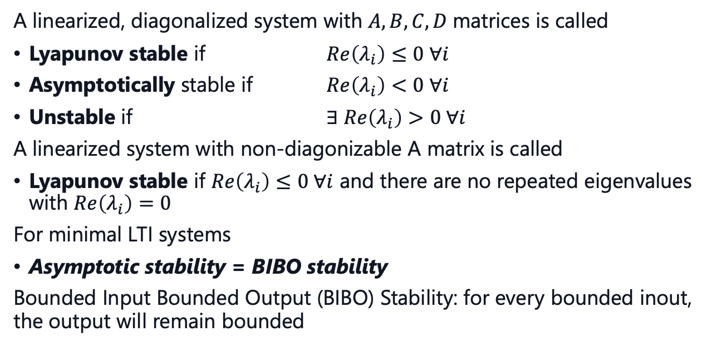
Stability Conditions
A linearized, diagonalized system with $A,B,C,D$matrices is called
Lyapunov stable if $Re\left(λ_{i}\right)≤0 ∀i$
Asymptotically stable if $Re\left(λ_{i}\right)<0 ∀i$
Unstable if $∃ Re\left(λ_{i}\right)>0 ∀i$
A linearized system with non-diagonizable A matrix is called
Lyapunov stable if $Re\left(λ_{i}\right)≤0 ∀i$ and there are no repeated eigenvalues with $Re\left(λ_{i}\right)=0$
For minimal LTI systems
Asymptotic stability = BIBO stability
Bounded Input Bounded Output (BIBO) Stability: for every bounded inout, the output will remain bounded

Slide 17
Course Schedule
Subject | Week
Introduction, Control Architectures, Motivation | 1
Modeling, Model examples | 2
System properties, Linearization | 3
Analysis: Time response, Stability | 4
Transfer functions 1: Definition and properties | 5
Transfer functions 2: Poles and Zeros | 6
Proportional feedback control, Root Locus | 7
Time-Domain specifications, PID control, Computer implementation | 8
Frequency response, Bode plots | 9
The Nyquist condition, Time delays | 10
Frequency-domain Specifications, Dynamic Compensation, Loop Shaping | 11
Time delays, Successive loop closure, Nonlinearities | 12
Describing functions | 13
Intro to Uncertainty and Robustness | 14
Modeling
Analysis
Synthesis

Slide 18
Today
Intro and Definition of Transfer Functions
Forms of TF
Laplace Transform

Slide 19
1. Intro and Definition
of Transfer Functions

Slide 20
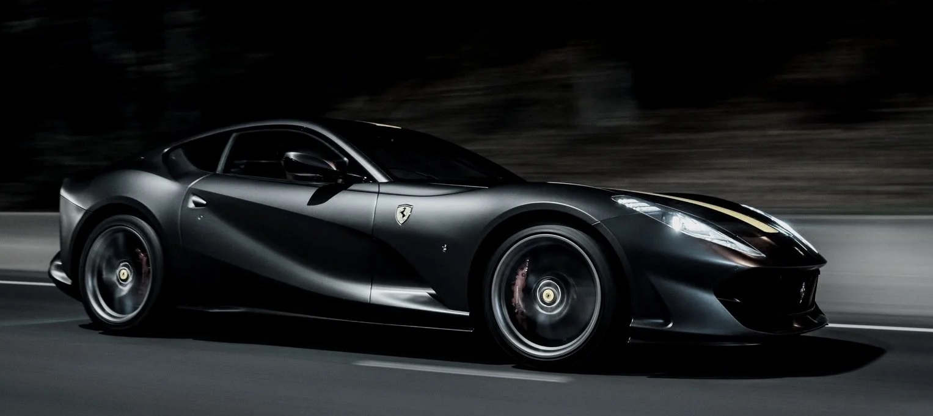

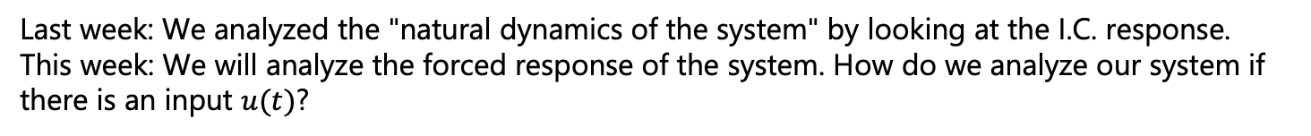

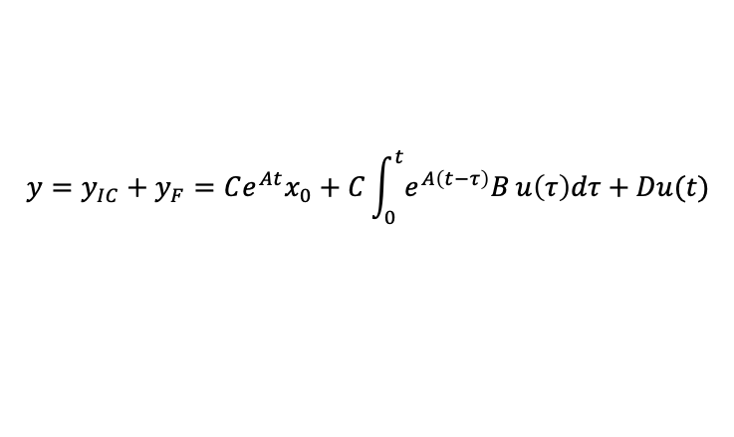






Motivation
$$r(t)$$
$$e(t)$$
$$u(t)$$
$$y(t)$$
$Controller$ $C$
$$Plant P$$
$$−$$
system modeling
state-space representation
$$\dot{x}\left(t\right)=Ax\left(t\right)+Bu\left(t\right)$$
$$y(t)=Cx(t)+Du(t)$$
Linearization
Plant P
Ferrari 812
Analysis
Time response:
Synthesis
Controller C
With information about our system
$$y=y_{IC}+y_{F}=Ce^{At}x_{0}+C\int_{0}^{t}{e^{A\left(t−τ\right)}B}u\left(τ\right)dτ+Du(t)$$
Last week
This Week
Last week: We analyzed the "natural dynamics of the system" by looking at the I.C. response.
This week: We will analyze the forced response of the system. How do we analyze our system if there is an input $u(t)$?

Slide 21
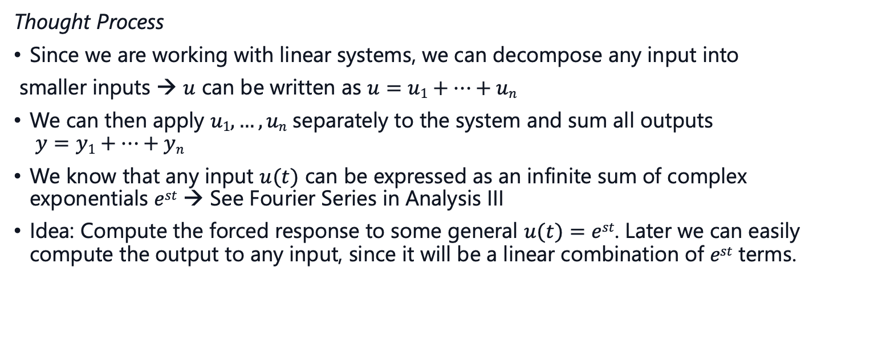
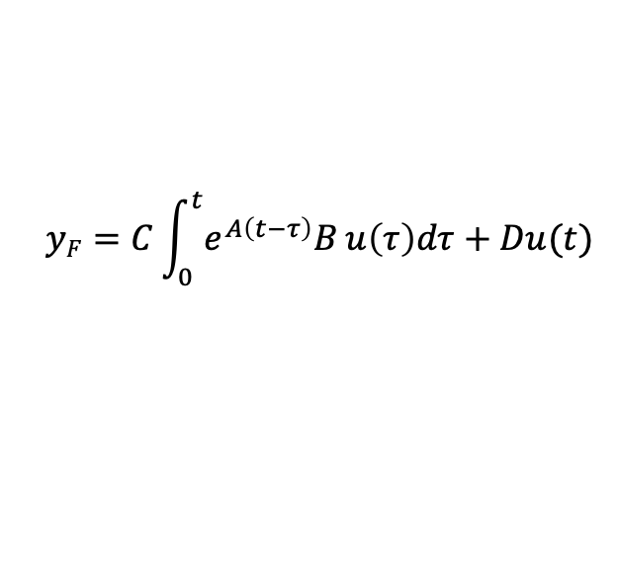
Forced Response
The forced response is given by the convolution integral:
This is harder to interpret, and the integral is difficult to compute.
$$yF=C\int_{0}^{t}{e^{A\left(t−τ\right)}B}u\left(τ\right)dτ+Du(t)$$
Thought Process
Since we are working with linear systems, we can decompose any input into
smaller inputs → $u$ can be written as $u=u1+…+un$
We can then apply $u1,…,un$ separately to the system and sum all outputs $y=y1+…+yn$
We know that any input $u(t)$ can be expressed as an infinite sum of complex exponentials $est$ → See Fourier Series in Analysis III
Idea: Compute the forced response to some general $u(t)=est$. Later we can easily compute the output to any input, since it will be a linear combination of $est$ terms.

Slide 22

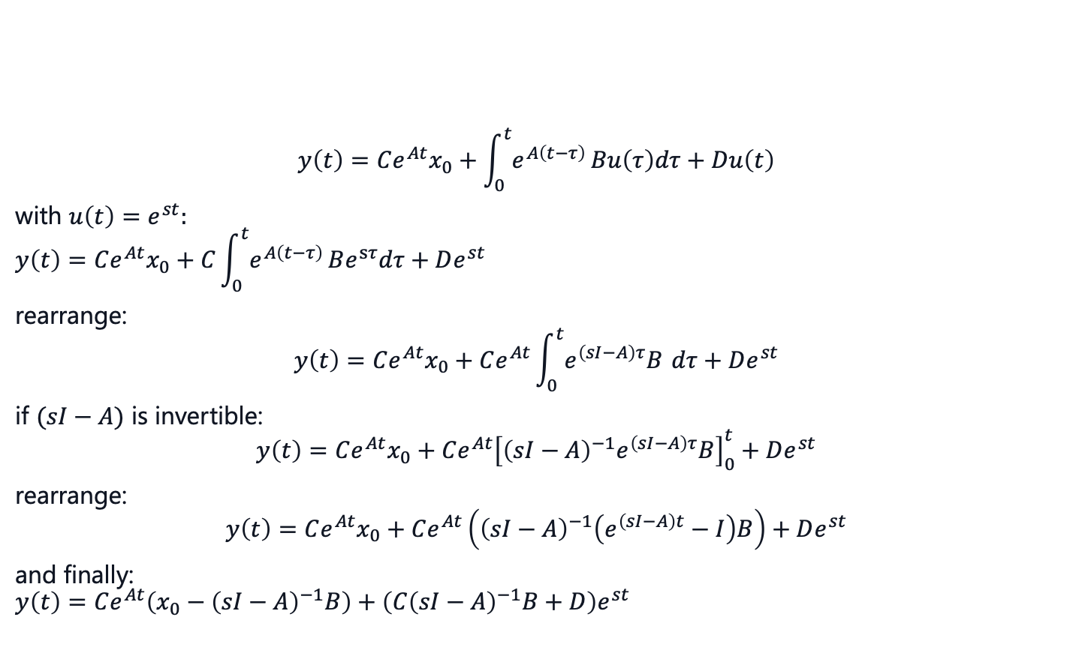
Forced Response: Derivation (Optional)
$$y\left(t\right)=Ce^{At}x_{0}+\int_{0}^{t}{e^{A\left(t−τ\right)}}Bu\left(τ\right)dτ+Du\left(t\right)$$
with $u\left(t\right)=e^{st}:$
$$y\left(t\right)=Ce^{At}x_{0}+C\int_{0}^{t}{e^{A\left(t−τ\right)}}Be^{sτ}dτ+De^{st}$$ rearrange:
$$y\left(t\right)=Ce^{At}x_{0}+Ce^{At}\int_{0}^{t}{e^{\left(sI−A\right)τ}B} dτ+De^{st}$$
if $(sI−A)$ is invertible:
$$y\left(t\right)=Ce^{At}x_{0}+Ce^{At}{\left[{\left(sI−A\right)}^{−1}e^{\left(sI−A\right)τ}B\right]}_{0}^{t}+De^{st}$$
rearrange: $$y\left(t\right)=Ce^{At}x_{0}+Ce^{At}\left({\left(sI−A\right)}^{−1}\left(e^{\left(sI−A\right)t}−I\right)B\right)+De^{st}$$
and finally: $$y\left(t\right)=Ce^{At}\left(x_{0}−{\left(sI−A\right)}^{−1}B\right)+\left(C{\left(sI−A\right)}^{−1}B+D\right)e^{st}$$
transient response → 0 if asy stable
steady-state response $yss$

Slide 23
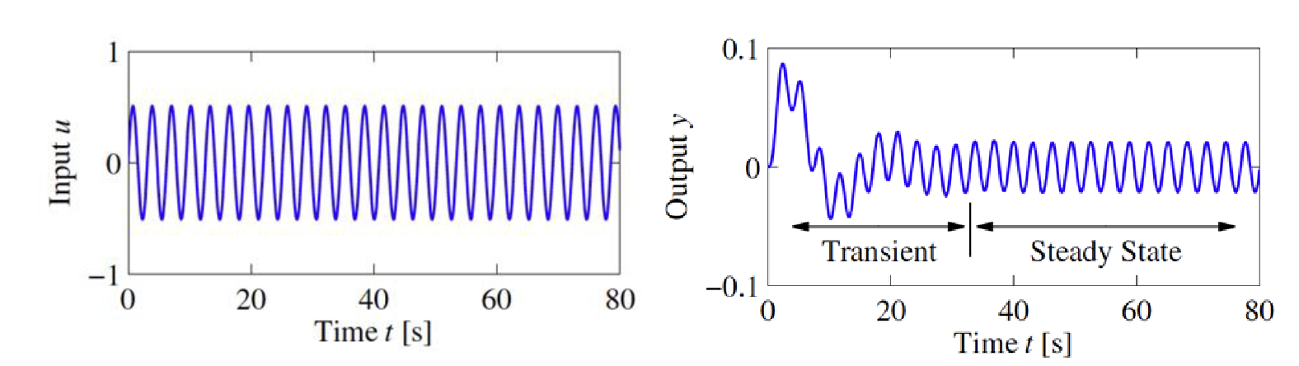
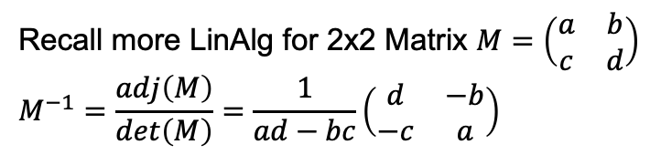



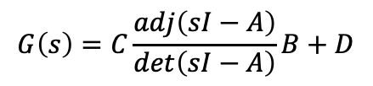
Transfer function $G(s)$
Rearranging:
$$y\left(t\right)=Ce^{At}\left(x_{0}−{\left(sI−A\right)}^{−1}B\right)+\left(C{\left(sI−A\right)}^{−1}B+D\right)e^{st}$$
transient response
steady-state response $yss$
$$yss= \left(C{\left(sI−A\right)}^{−1}B+D\right)e^{st}=G(s) e^{st}$$
Recall more LinAlg for 2x2 Matrix $M=\left(\begin{matrix}a & b \\ c & d\end{matrix}\right)$ $$M^{−1}=\frac{adj\left(M\right)}{\det\left(M\right)}=\frac{1}{ad−bc}\left(\begin{matrix}d & −b \\ −c & a\end{matrix}\right)$$
$$G\left(s\right)=C\frac{adj\left(sI−A\right)}{\det\left(sI−A\right)}B+D$$

Slide 24



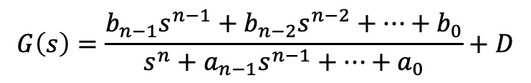
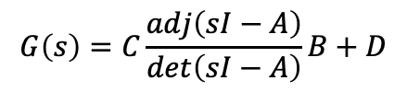
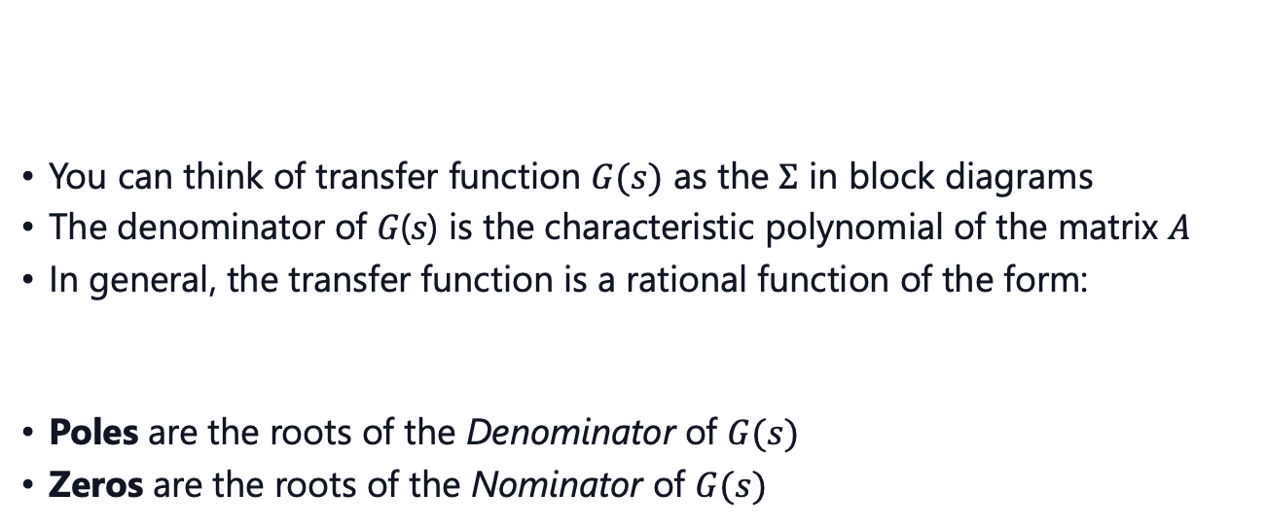

Transfer Function $G(s)$
You can think of transfer function $G(s)$ as the $Σ$ in block diagrams
The denominator of 𝐺(𝑠) is the characteristic polynomial of the matrix 𝐴
In general, the transfer function is a rational function of the form:
Poles are the roots of the Denominator of $G(s)$
Zeros are the roots of the Nominator of $G(s)$
$$G\left(s\right)=C\frac{adj\left(sI−A\right)}{\det\left(sI−A\right)}B+D$$
$$u(t)$$
$$y(t)$$
$$G\left(s\right)\hat{=}Σ$$
$$G\left(s\right)=\frac{b_{n−1}s^{n−1}+b_{n−2}s^{n−2}+⋯+b_{0}}{s^{n}+a_{n−1}s^{n−1}+⋯+a_{0}}+D$$

Slide 25
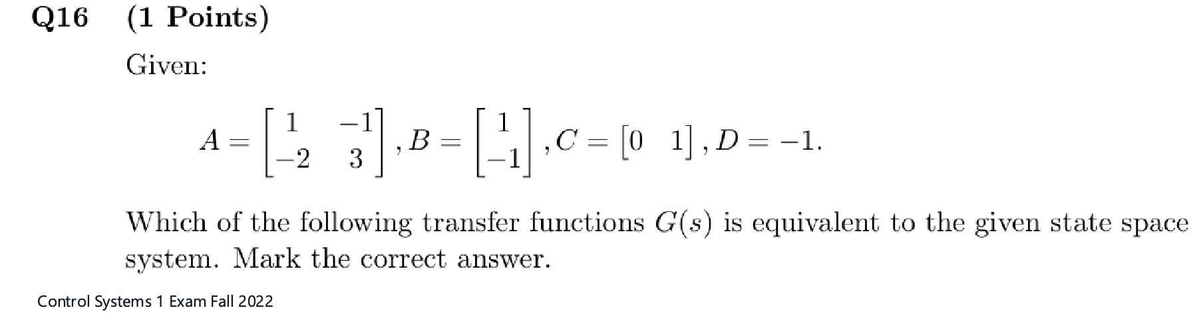
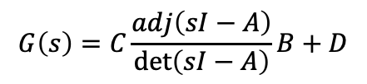




Old Exam Problem
$$G\left(s\right)=C\frac{adj\left(sI−A\right)}{\det\left(sI−A\right)}B+D$$
A. $G\left(s\right)=−\frac{s^{2}−3s+2}{s^{2}−4s+1}$
C. $G\left(s\right)=\frac{s^{2}−3s+2}{s^{2}−4s+1}$
B. $G\left(s\right)=−\frac{\left(s+2\right)\left(s−1\right)}{s^{2}−4s+1}$
D. $G\left(s\right)=−\frac{s^{2}+3s+2}{s^{2}−4s+1}$

Slide 26
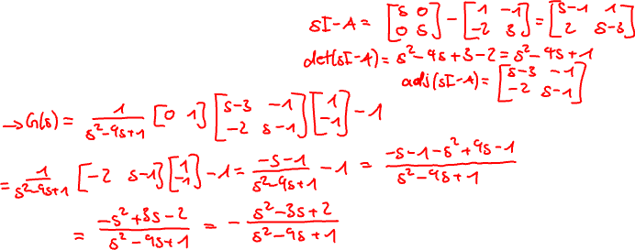
Old Exam Problem
$$G\left(s\right)=C\frac{adj\left(sI−A\right)}{\det\left(sI−A\right)}B+D$$

Slide 27

Old Exam Problem
$$G\left(s\right)=C\frac{adj\left(sI−A\right)}{\det\left(sI−A\right)}B+D$$
A. $G\left(s\right)=−\frac{s^{2}−3s+2}{s^{2}−4s+1}$
C. $G\left(s\right)=\frac{s^{2}−3s+2}{s^{2}−4s+1}$
B. $G\left(s\right)=−\frac{\left(s+2\right)\left(s−1\right)}{s^{2}−4s+1}$
D. $G\left(s\right)=−\frac{s^{2}+3s+2}{s^{2}−4s+1}$

Slide 28

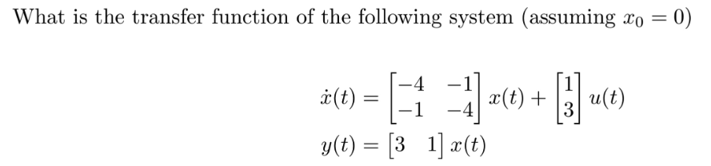
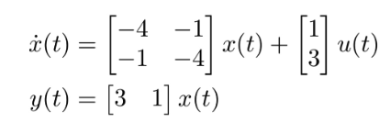




Another One
$$G\left(s\right)=C\frac{adj\left(sI−A\right)}{\det\left(sI−A\right)}B+D$$
A. $G\left(s\right)= \frac{6s+15}{\left(s+4\right)\left(s+3\right)}$
C. $G\left(s\right)=\frac{s+4}{s\left(s+1\right)}$
B. $G\left(s\right)=\frac{6s+14}{s^{2}+8s+15}$
D. $G\left(s\right)=\frac{s+4}{s^{2}+8s+15}$

Slide 29
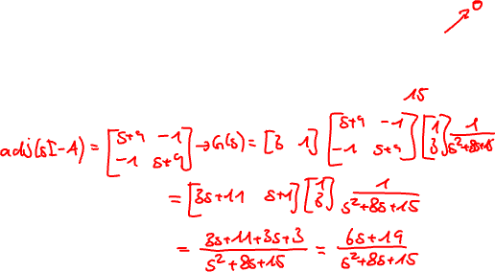


Another One
$$G\left(s\right)=C\frac{adj\left(sI−A\right)}{\det\left(sI−A\right)}B+D$$
A. $G\left(s\right)= \frac{6s+15}{\left(s+4\right)\left(s+3\right)}$
C. $G\left(s\right)=\frac{s+4}{s\left(s+1\right)}$
B. $G\left(s\right)=\frac{6s+14}{s^{2}+8s+15}$
D. $G\left(s\right)=\frac{s+4}{s^{2}+8s+15}$

Slide 30



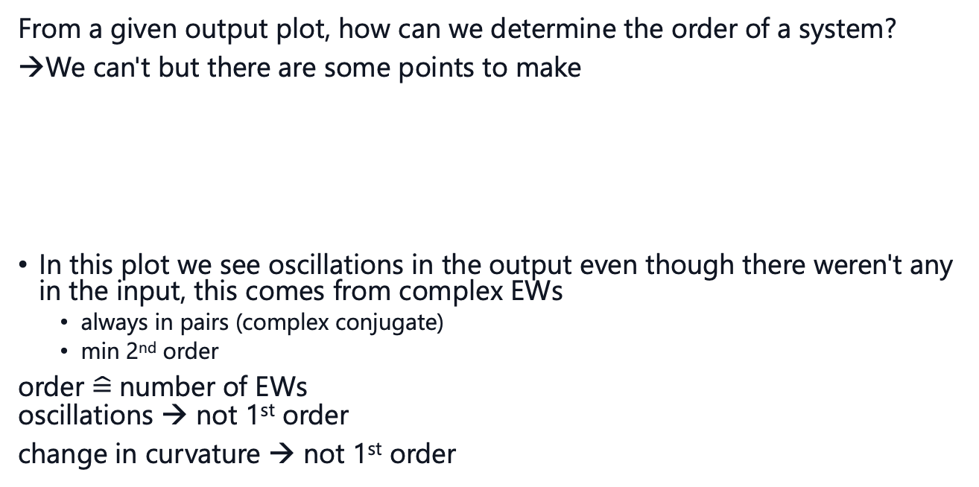



Order of a system
From a given output plot, how can we determine the order of a system?
We can't but there are some points to make
In this plot we see oscillations in the output even though there weren't any in the input, this comes from complex EWs
always in pairs (complex conjugate)
min 2nd order
order $\hat{=}$number of EWs oscillations → not 1st order
change in curvature → not 1st order
$$y$$
↻
$$y$$
↺
$$1$$
$$1$$
$$t$$
$$t$$

Slide 31
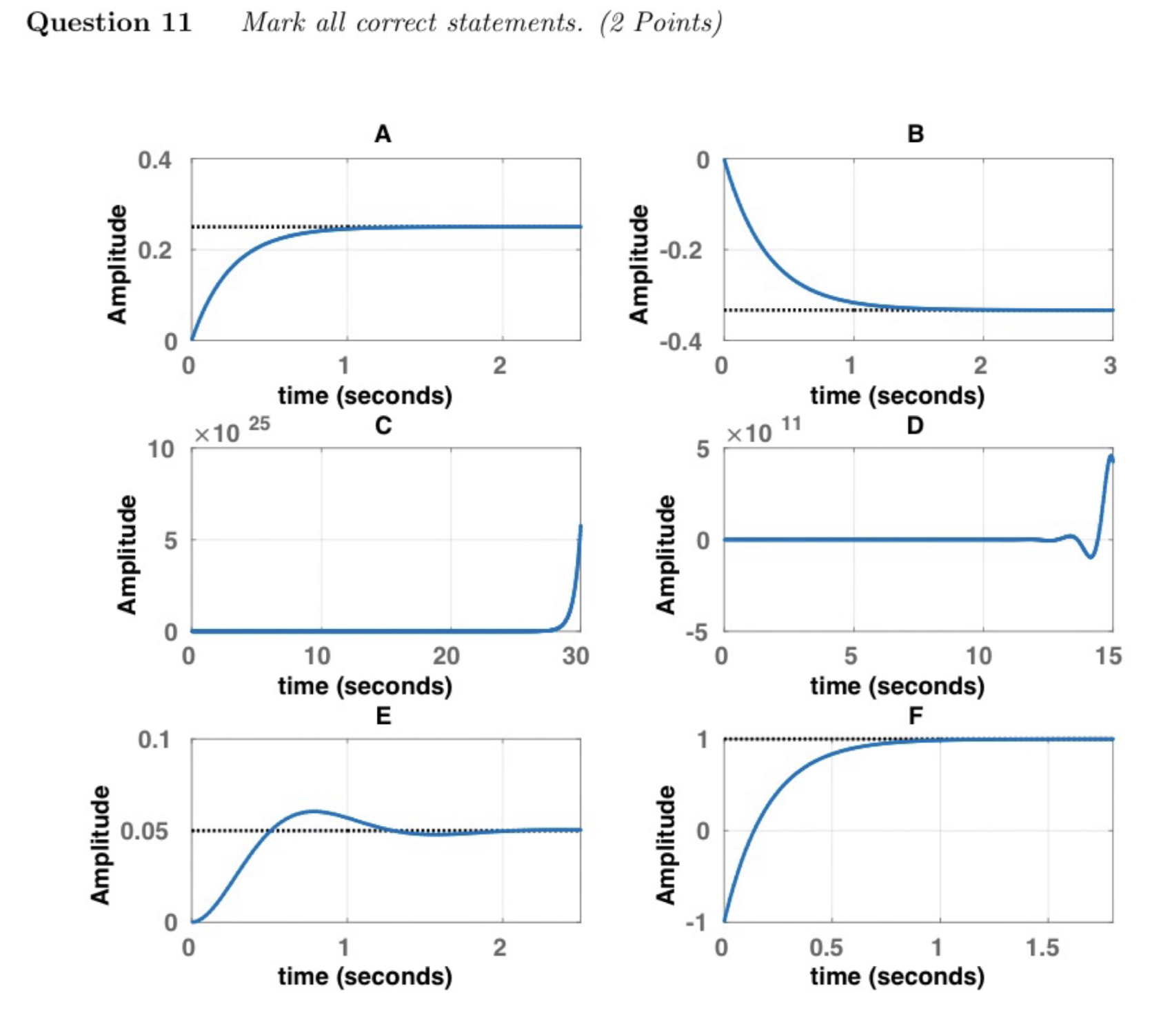
Quiz
Question isn't clear: mark all systems that have to be at least 2nd order.

Slide 32
Quiz
Question isn't clear: mark all systems that have to be at least 2nd order.
D) and E) are the only ones, which have oscillations

Slide 33
Forms of TF

Slide 34
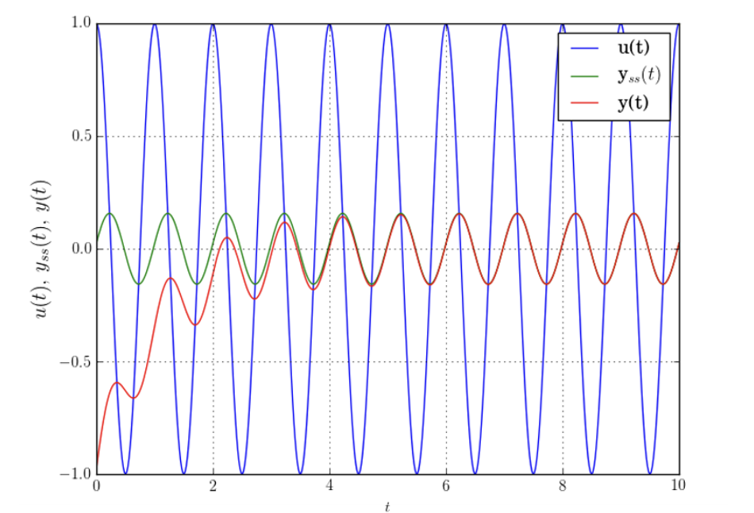
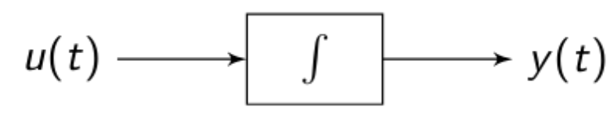
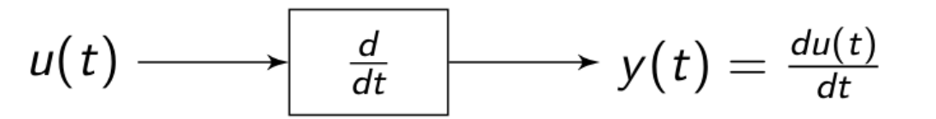


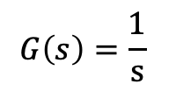
Specific Inputs and TFs
Sinusoidal Input: $u\left(t\right)=\cos\left(ωt\right)=\frac{e^{jωt}+e^{−jωt}}{2}$
output: $y\left(t\right)=M\cos\left(ωt+φ\right)$
with $M=\left|G\left(jω\right)\right|, φ=∠G\left(jω\right)$
Integrator:
For an input $u\left(t\right)=est$, the output will be $y\left(t\right)=\frac{1}{s}est$
Differentiator:
For an input $u\left(t\right)=est$, the output will be $y\left(t\right)=sest$
$$G\left(s\right)=\frac{1}{s}$$
transfer
functions
$$G(s)=s$$

Slide 35
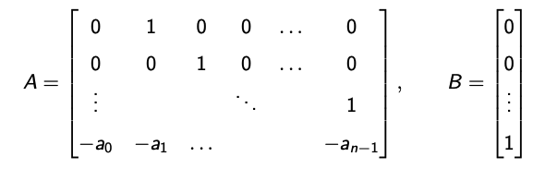



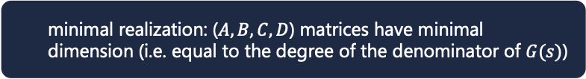
Controllable Canonical Form
minimal realization: ($A,B,C,D$) matrices have minimal dimension (i.e. equal to the degree of the denominator of $G(s)$)
What if we now want to go from Transfer Function to a state-space model?
Recall that there are many different state-space models for the same system! → state-space model is not unique
Generally, we are interested in the minimal realization of a system
For a general TF $G\left(s\right)=\frac{b_{n−1}s^{n−1}+b_{n−2}s^{n−2}+⋯+b_{0}}{s^{n}+a_{n−1}s^{n−1}+⋯+a_{0}}+D$, one minimal realization is given by the Controllable Canonical Form

Slide 36
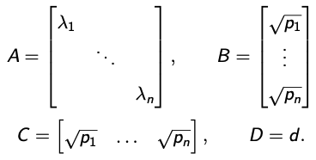

Diagonal realization
minimal realization: ($A,B,C,D$) matrices have minimal dimension (i.e. equal to the degree of the denominator of $G(s)$)
Another way to go from transfer function to state-space model is the diagonal realization
If the transfer function is written as a partial fraction expansion of the form
$G\left(s\right)=\frac{p_{1}}{s−λ_{1}}+\frac{p_{2}}{s−λ_{2}}+⋯+\frac{p_{n}}{s−λ_{n}}+d$, one minimal realization is given by:

Slide 37
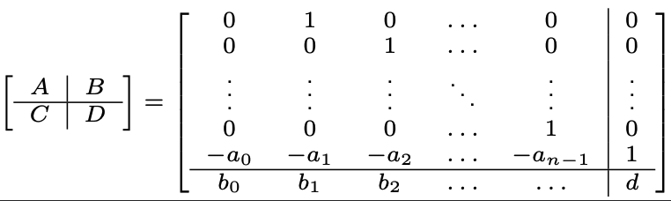
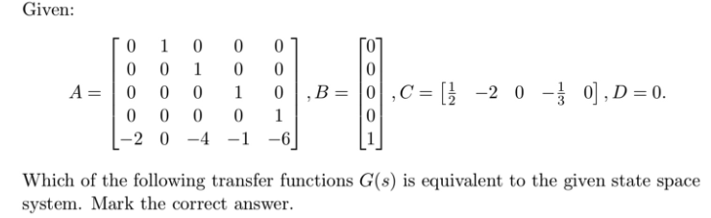
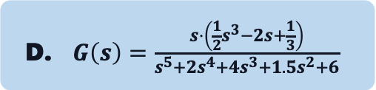
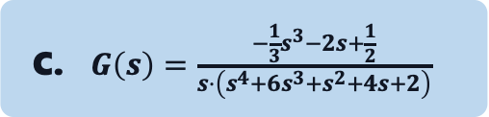
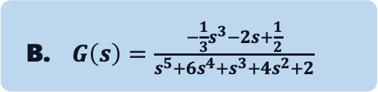

Quiz (Old Exam HS22)
A. $G\left(s\right)=\frac{\frac{1}{2}s^{3}−2s+\frac{1}{3}}{s^{5}+2s^{4}+4s^{3}+1.5s^{2}+6}$
C. $G\left(s\right)=\frac{−\frac{1}{3}s^{3}−2s+\frac{1}{2}}{s⋅\left(s^{4}+6s^{3}+s^{2}+4s+2\right)}$
B. $G\left(s\right)=\frac{−\frac{1}{3}s^{3}−2s+\frac{1}{2}}{s^{5}+6s^{4}+s^{3}+4s^{2}+2}$
D. $G\left(s\right)=\frac{s⋅\left(\frac{1}{2}s^{3}−2s+\frac{1}{3}\right)}{s^{5}+2s^{4}+4s^{3}+1.5s^{2}+6}$

Slide 38

Quiz (Old Exam HS22)
A. $G\left(s\right)=\frac{\frac{1}{2}s^{3}−2s+\frac{1}{3}}{s^{5}+2s^{4}+4s^{3}+1.5s^{2}+6}$
C. $G\left(s\right)=\frac{−\frac{1}{3}s^{3}−2s+\frac{1}{2}}{s⋅\left(s^{4}+6s^{3}+s^{2}+4s+2\right)}$
B. $G\left(s\right)=\frac{−\frac{1}{3}s^{3}−2s+\frac{1}{2}}{s^{5}+6s^{4}+s^{3}+4s^{2}+2}$
D. $G\left(s\right)=\frac{s⋅\left(\frac{1}{2}s^{3}−2s+\frac{1}{3}\right)}{s^{5}+2s^{4}+4s^{3}+1.5s^{2}+6}$

Slide 39
Laplace Transform

Slide 40



Laplace Transform
Time response: $y(t)=Ce^{At}x_{0}+C\int_{0}^{t}{e^{A\left(t−τ\right)}B}u\left(τ\right)dτ+Du\left(t\right)$
The convolution integral is difficult to compute
Idea: Use Laplace-Space to describe I/O relation easier:
$$y\left(t\right)=Σu\left(t\right)$$
$$Y\left(s\right)=G\left(s\right)U\left(s\right)$$
(time domain)
$$ℒ\{⋅\}$$
(s-domain)
Output in s-domain
Transfer Function
Input in s-domain
We can lastly take the inverse Laplace Transform of $Y(s)$, to get the time response in the time domain
Video recommendation for visual interpretation of Laplace Transform: https://www.youtube.com/watch?v=n2y7n6jw5d0

Slide 41







Derivation of $G(s)$
Use $ℒ\left\{\frac{d}{dt}f\left(t\right)\right\}=s⋅F\left(s\right)−f\left(0\right)$
$$ℒ\{⋅\}$$
$$\dot{x}=Ax+Bu$$
$$y = Cx+Du$$
$$sX\left(s\right)=AX\left(s\right)+BU\left(s\right)$$
$$Y\left(s\right)=CX\left(s\right)+DU\left(s\right)$$
transform the
whole system
solve for X
Transfer Function
$$\frac{Y}{U}=G\left(s\right)=C{\left(sI−A\right)}^{−1}B+D$$
$$sX\left(s\right)=AX\left(s\right)+BU\left(s\right)$$
$$Y\left(s\right)=CX\left(s\right)+DU\left(s\right)$$
plug in Y
→ instead of solving an ODE we have a function we can directly compute

Slide 42

Laplace Table
For more complicated functions, we can instead of solving the integral, use the Laplace table
2nd order system → oscillations

Slide 43

Summary
We looked at the following points today:
How to compute the forced response without directly solving integrals
Using the input $u\left(t\right)=e^{st}$, since any signal can be expressed as a linear combination of such exponentials
Deriving the transfer function $G(s)$, which maps input to output in block diagrams
Introducing the Controllable Canonical Form to go from transfer function to state-space representation
Applying the Laplace Transform to compute transfer functions and output responses efficiently

Slide 44

Tips for Problem Set 04
Easy | Medium | Hard
$$1, 2, 4$$ | $$3$$ | $$5$$
Nr. 1: Look at the slides if you need help with the derivation
Nr. 2: Use the formula for the transfer function, you can skip 2b) if you don't want to solve it
Nr. 3: Look at the slides for definitions of poles & for specific inputs
Nr. 4: Apply the controllable canonical form
Nr. 5: Make use of the Laplace Transform and the helpful tables. I would recommend working with the solutions and especially not wasting too much time on 5d)

Slide 45
Questions?

Slide 46
Feedback?
Too fast? Too slow? Less theory, more exercises?
I would appreciate your feedback. Please let me know.
https://docs.google.com/forms/d/e/1FAIpQLSdHl0kjWo63aNzDkAV0cnmQadCAj5L0D7v7aSh0BK7BBdEgpA/viewform?usp=header

