Slide 1

CS1 Week 6 Annotated
Transfer functions: Poles and Zeros

Slide 2
Attention
ETH no longer provides web hosting.
All my exercise class materials have been moved to GitHub Pages.
You can now find them under the following link:
https://kissanv.github.io
Or you can scan the QR-Code:

Slide 3
Recap Last week

Slide 4













Motivation
$$r(t)$$
$$e(t)$$
$$u(t)$$
$$y(t)$$
$Controller$ $C$
$$Plant P$$
$$−$$
system modeling
state-space representation
$$\dot{x}\left(t\right)=Ax\left(t\right)+Bu\left(t\right)$$
$$y(t)=Cx(t)+Du(t)$$
Linearization
Plant P
Ferrari 812
Analysis
Time response:
Synthesis
Controller C
Transfer Functions
$$y=y_{IC}+y_{F}=Ce^{At}x_{0}+C\int_{0}^{t}{e^{A\left(t−τ\right)}B}u\left(τ\right)dτ+Du(t)$$
I.C. response
Forced response
$$x_{I}C\left(t\right)=e^{Ãt}x(0)=diag\left(e^{λ1t},…,e^{λₙt}\right)$$
$$y_{I}C\left(t\right)=\tilde{C}e^{Ãt}x(0)=Σ_{i=1}^{n}cᵢe^{λᵢt}{\tilde{x}}_{0,i}$$
$$y(t)=Σu(t)$$
$$Y(s=G(s)U(s)$$
$$ℒ\{⋅\}$$

Slide 5
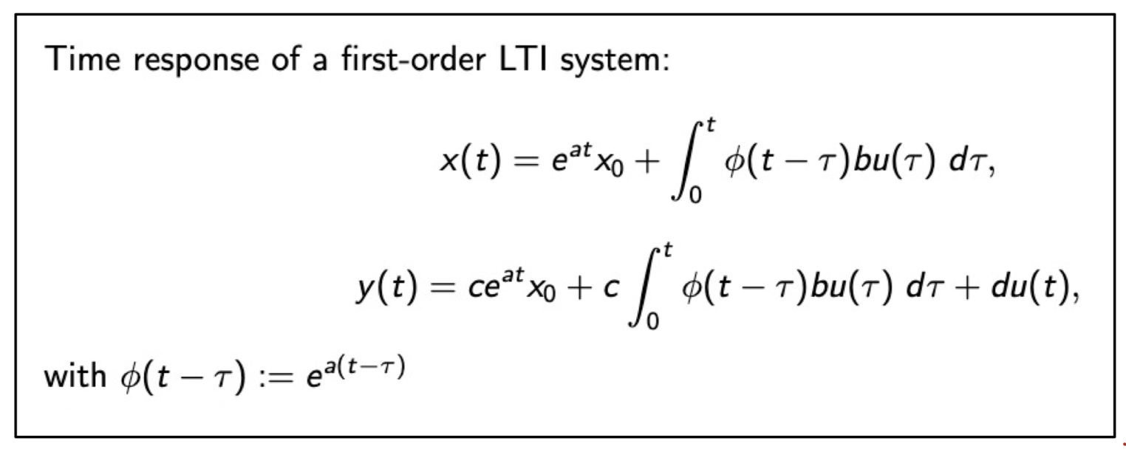
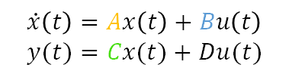
Time Response
$$\dot{x}\left(t\right)=Ax\left(t\right)+Bu\left(t\right)$$
$$y(t)=Cx(t)+Du(t)$$
We're still dealing with LTI systems:
We solved the ODE by splitting into initial and forced response
We want an easier way of describing the I/O relation
→ Transfer function
difficult to
compute

Slide 6


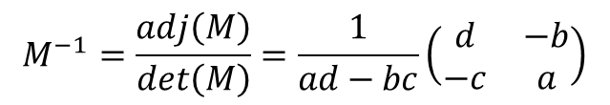



Transfer Function
$$G\left(s\right)=\frac{Y}{U}$$
$$Y=GU$$
Transfer function gives the relation between $Y$ and $U$:
We derived the general TF for LTI state-space:
To find the inverse ${\left(sI−A\right)}^{−1}$ we use Cramer's rule:
$G(s)$ is defined in the $s$-domain but describes behavior in the time domain
Remember the steady-state output to the input $u\left(t\right)=e^{st}$ is: $yss=G(s) e^{st}$
$s$-domain
$$G\left(s\right)=C{\left(sI−A\right)}^{−1}B+D$$
$$M^{−1}=\frac{adj\left(M\right)}{\det\left(M\right)}=\frac{1}{ad−bc}\left(\begin{matrix}d & −b \\ −c & a\end{matrix}\right)$$

Slide 7

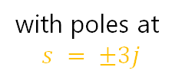
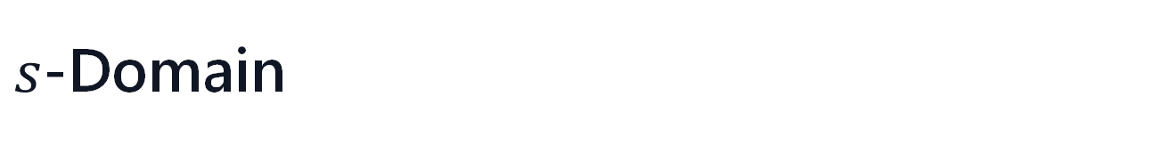
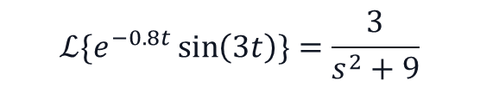


$s$-Domain
With the TFs we start to represent systems in a new domain. So instead of characterizing how systems behave in the time domain, i.e. $y(t)=…$, we start to look at how it behaves in the s-domain, i.e. $Y\left(s\right)=G\left(s\right)U\left(s\right)$. But what exactly is the s-domain? $\left(s=σ+jω\right)$
For now you can think that in the $s$-domain functions or systems are represented by their poles (and zeros) plotted in the complex plane.
x
3
2
1
$$t$$
-3
-2
-1
1
2
3
-1
-2
x
-3
$$ℒ\{e^{−0.8t}\sin\left(3t\right)\}=\frac{3}{s^{2}+9}$$
with poles at
$$s = ±3j$$
$$e^{−0.8t}\sin\left(3t\right)$$

Slide 8



Quiz 1
What are the transfer functions of an (1) integrator and a (2) differentiator?
A. $G_{1}\left(s\right)=s, G_{2}\left(s\right)=\frac{1}{s}$
B. $G_{1}\left(s\right)=\frac{1}{s}, G_{2}\left(s\right)=s$
C. They don't have transfer functions
D. $G_{1}\left(s\right)=\frac{s+1}{s}, G_{2}\left(s\right)=\frac{1}{s+1}$

Slide 9
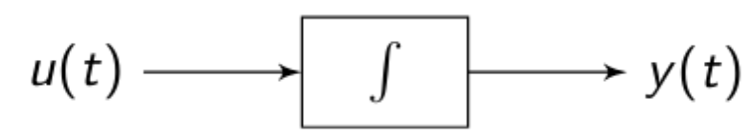
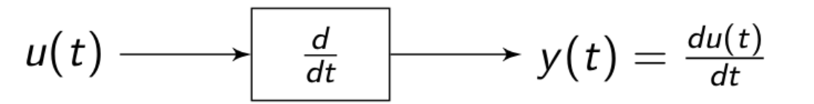

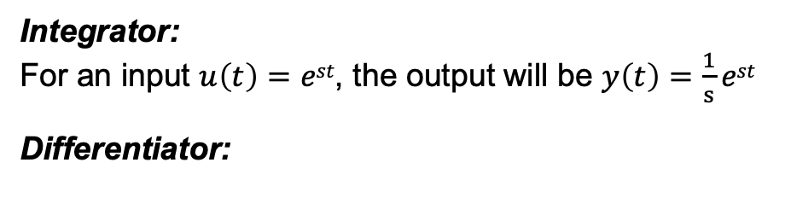
Quiz 1
What are the transfer functions of an (1) integrator and a (2) differentiator?
A. $G_{1}\left(s\right)=s, G_{2}\left(s\right)=\frac{1}{s}$
Integrator:
For an input $u\left(t\right)=est$, the output will be $y\left(t\right)=\frac{1}{s}est$
Differentiator:
B. $G_{1}\left(s\right)=\frac{1}{s}, G_{2}\left(s\right)=s$
For an input $u\left(t\right)=est$, the output will be $y\left(t\right)=sest$
C. They don't have transfer functions
D. $G_{1}\left(s\right)=\frac{s+1}{s}, G_{2}\left(s\right)=\frac{1}{s+1}$

Slide 10
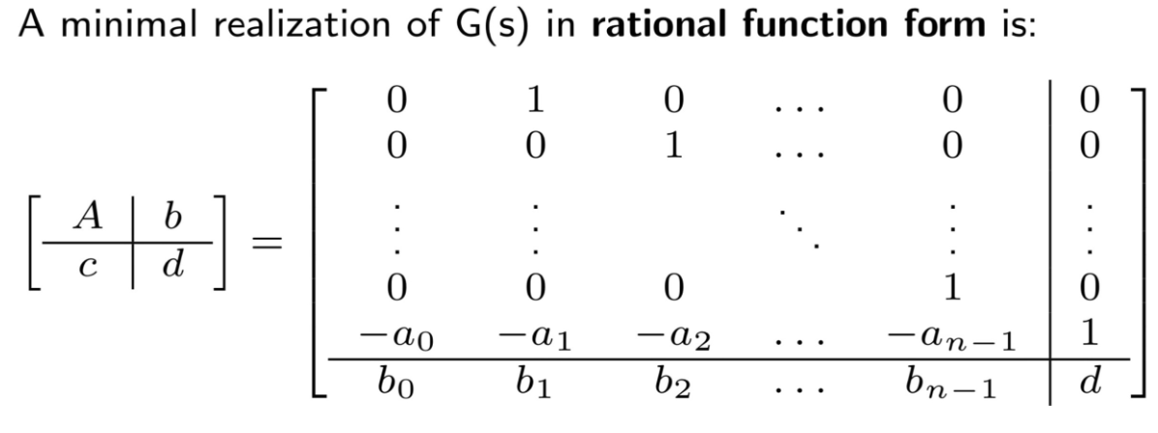

Controllable Canonical Form
We know how to go from state-space to Transfer function, for the other way we use the canonical form
For a general TF $G\left(s\right)=\frac{b_{n−1}s^{n−1}+b_{n−2}s^{n−2}+⋯+b_{0}}{s^{n}+a_{n−1}s^{n−1}+⋯+a_{0}}+d$

Slide 11
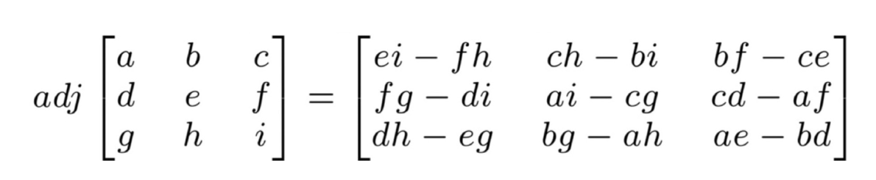
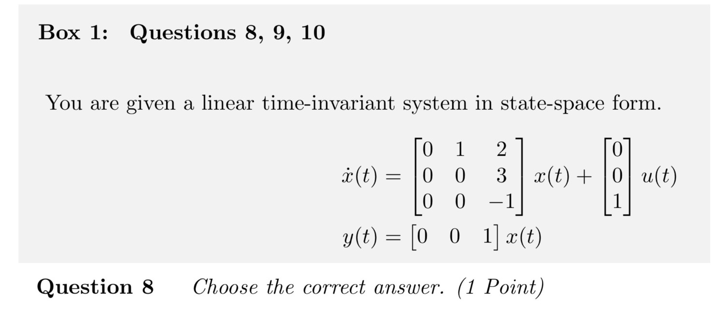




Quiz 2
A. $G\left(s\right)=\frac{3+2s}{s^{2}\left(s+1\right)}$
C. $G\left(s\right)=\frac{3−2s}{s\left(s+1\right)}$
B. $G\left(s\right)=\frac{1}{s+1}$
D. $G\left(s\right)=\frac{3}{s\left(s+1\right)}$

Slide 12

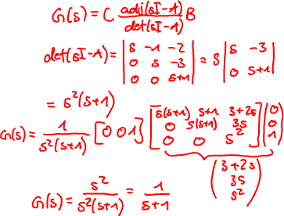
Quiz 2
A. $G\left(s\right)=\frac{3+2s}{s^{2}\left(s+1\right)}$
C. $G\left(s\right)=\frac{3−2s}{s\left(s+1\right)}$
B. $G\left(s\right)=\frac{1}{s+1}$
D. $G\left(s\right)=\frac{3}{s\left(s+1\right)}$

Slide 13
Course Schedule
Subject | Week
Introduction, Control Architectures, Motivation | 1
Modeling, Model examples | 2
System properties, Linearization | 3
Analysis: Time response, Stability | 4
Transfer functions 1: Definition and properties | 5
Transfer functions 2: Poles and Zeros | 6
Proportional feedback control, Root Locus | 7
Time-Domain specifications, PID control, Computer implementation | 8
Frequency response, Bode plots | 9
The Nyquist condition, Time delays | 10
Frequency-domain Specifications, Dynamic Compensation, Loop Shaping | 11
Time delays, Successive loop closure, Nonlinearities | 12
Describing functions | 13
Intro to Uncertainty and Robustness | 14
Modeling
Analysis
Synthesis

Slide 14
Today
Different TF Notations
System Response
Poles & Zeros

Slide 15
1. Different TF Notations

Slide 16




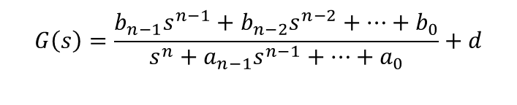
Partial Fraction Expansion
Note strictly proper$:\frac{s^{m}}{s^{n}},n>m$
$$G\left(s\right)=\frac{b_{n−1}s^{n−1}+b_{n−2}s^{n−2}+⋯+b_{0}}{s^{n}+a_{n−1}s^{n−1}+⋯+a_{0}}+d$$
Recall the General Form of transfer function:
In some cases, it's helpful to represent TF in different forms, like
the Partial Fraction Expansion:
How to determine residues
Partial Fraction Decomposition (Analysis I/II)
Cover-up method: For non-repeating poles $pi$: $r_{i}=\lim_{s→p_{i}}\left(s−p_{i}\right)G\left(s\right)$
For repeating pole $pi$ of order $m$: $r_{i}=\frac{1}{\left(m−1\right)!}\lim_{s→p_{i}}{\frac{d^{m−1}}{ds^{m−1}}\left[{\left(s−p_{i}\right)}^{m}G\left(s\right)\right]}$
Note: useful to switch between state-space and TF with canonical form
$$G\left(s\right)=\frac{r_{1}}{s−p_{1}}+\frac{r_{2}}{s−p_{2}}+…+\frac{r_{n}}{s−p_{n}}+r_{0}$$
$ri$: residues
Note: useful to use inverse Laplace to get the time response of each pole
$y\left(t\right)=r_{1}e^{p_{1}t}+r_{2}e^{p_{2}t}+…+r_{n}e^{p_{n}t}$

Slide 17
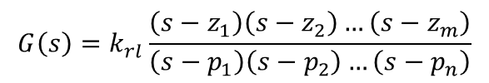


Root-Locus- & Bode-Form
These are also other forms to represent the TF, recall from last week:
Poles $pi$ are the roots of the Denominator of $G(s)$
Zeros $zj$ are the roots of the Nominator of $G(s)$
Root Locus Form:
Bode Form:
$$G\left(s\right)=k_{rl}\frac{\left(s−z_{1}\right)\left(s−z_{2}\right)…\left(s−z_{m}\right)}{\left(s−p_{1}\right)\left(s−p_{2}\right)…\left(s−p_{n}\right)}$$
Used for Root Locus
Note: we can directly see all poles & zeros
$$G\left(s\right)=\frac{k_{bode}}{s^{q}}\frac{\left(\frac{s}{−z_{1}}+1\right)\left(\frac{s}{−z_{2}}+1\right)…\left(\frac{s}{−z_{m}}+1\right)}{\left(\frac{s}{−p_{1}}+1\right)\left(\frac{s}{−p_{2}}+1\right)…\left(\frac{s}{−p_{n−q}}+1\right)}$$
Used for Bode Plots

Slide 18






























Example
$$G\left(s\right)=\frac{4\left(s+3\right)}{s^{2}+3s+2}$$

Slide 19
2. System Response

Slide 20
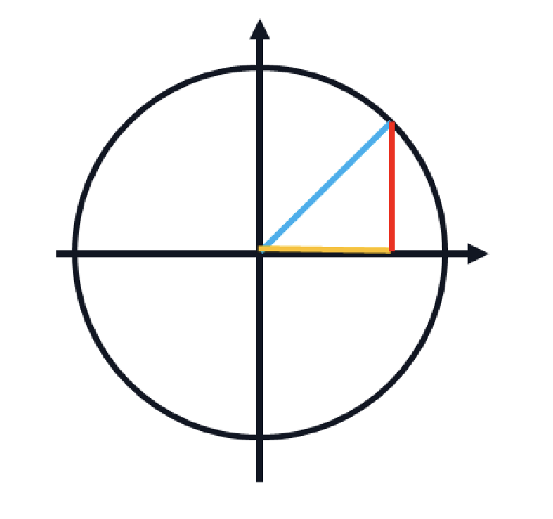


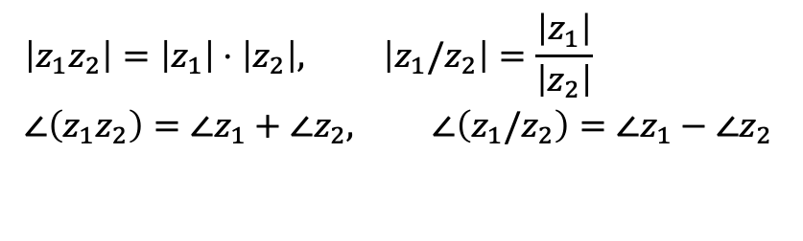
Recap Complex Numbers
Every complex number $z∈C$ can be represented by its magnitude and phase
Geometrically, $z =a+jb$corresponds to a vector in the complex plane
Computing magnitude: $\left|z\right|=\sqrt{a^{2}+b^{2}}$
Computing phase: $∠z=\tan^{−1}{(\frac{b}{a})}$
Vector interpretation: The difference$\left(z_{1}−z_{2}\right)$represents the vector from point $z_{2}$to point $z_{1}$in the complex plane
For two complex numbers $z1$ $\&$ $z2$ following rules hold:
$$\left|z_{1}z_{2}\right|=\left|z_{1}\right|⋅\left|z_{2}\right|, \left|z_{1}/z_{2}\right|=\frac{\left|z_{1}\right|}{\left|z_{2}\right|}$$
$$∠\left(z_{1}z_{2}\right)=∠z_{1}+∠z_{2}, ∠\left(z_{1}/z_{2}\right)=∠z_{1}−∠z_{2}$$

Slide 21








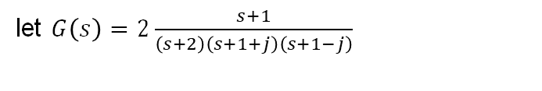













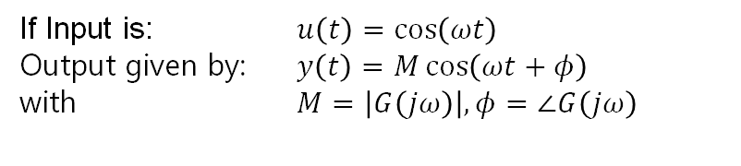
Sinusoidal Response
If Input is: $u\left(t\right)=\cos\left(ωt\right)$
Output given by: $y\left(t\right)=M\cos\left(ωt+φ\right)$
with $M=\left|G\left(jω\right)\right|,φ=∠G\left(jω\right)$
let $G\left(s\right)=2\frac{s+1}{\left(s+2\right)\left(s+1+j\right)\left(s+1−j\right)}$
Example: Given $u\left(t\right)=\cos\left(t\right)$
Goal: Compute the time response of the system:
Compute $M=\left|G\left(j\right)\right|$
Compute $φ=∠G\left(j\right)$
$$yss=$$

Slide 22
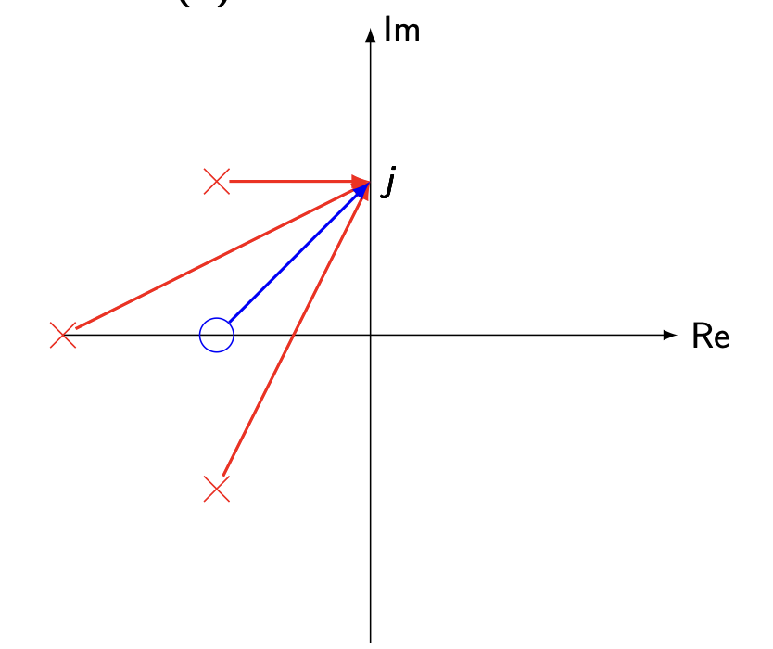





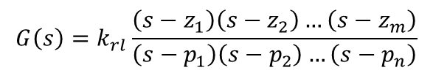



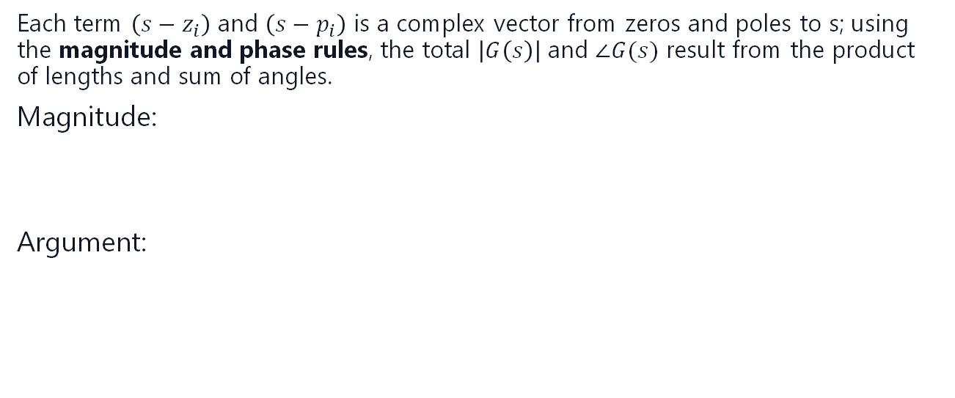




Graphical Approach
$$G\left(s\right)=k_{rl}\frac{\left(s−z_{1}\right)\left(s−z_{2}\right)…\left(s−z_{m}\right)}{\left(s−p_{1}\right)\left(s−p_{2}\right)…\left(s−p_{n}\right)}$$
Each term $\left(s−z_{i}\right)$ and $\left(s−p_{i}\right)$ is a complex vector from zeros and poles to s; using the magnitude and phase rules, the total $\left|G\left(s\right)\right|$ and $∠G(s)$ result from the product of lengths and sum of angles.
Magnitude:
Argument:
$$yss=$$

Slide 23
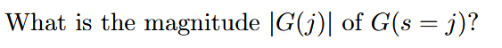
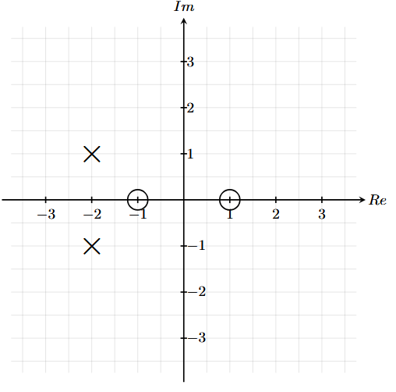





Quiz
A. $\frac{1}{2\sqrt{2}}$
B. $\frac{1}{4}$
C. $\frac{1}{2}$
D. $\frac{1}{\sqrt{2}}$

Slide 24




Quiz
A. $\frac{1}{2\sqrt{2}}$
B. $\frac{1}{4}$
C. $\frac{1}{2}$
D. $\frac{1}{\sqrt{2}}$

Slide 25
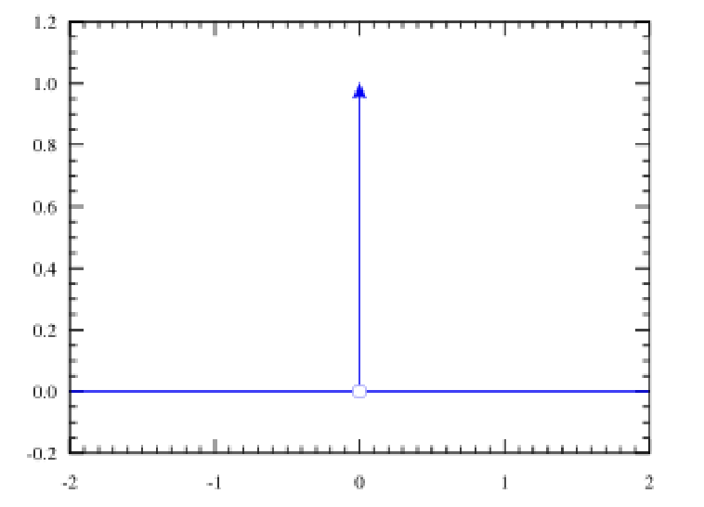



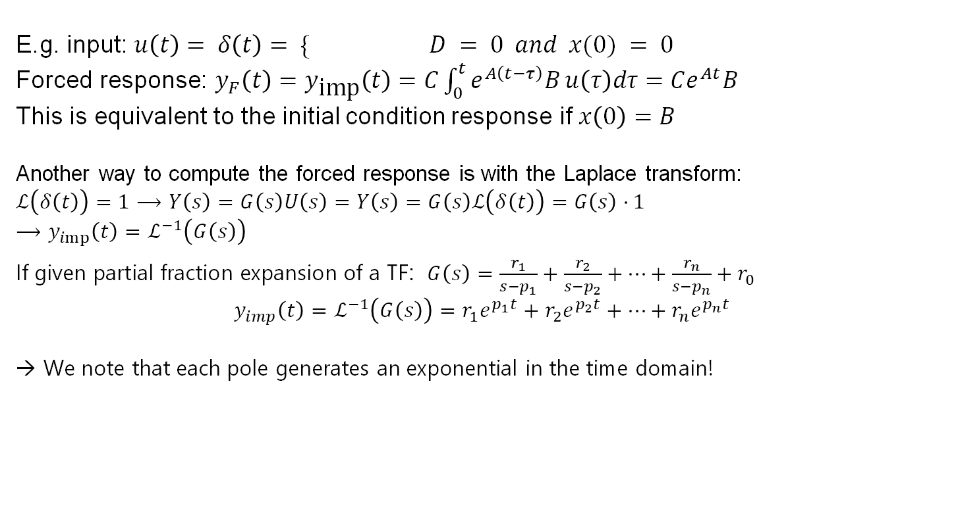
Impulse Response
$$∞ t = 0$$
E.g. input: $u\left(t\right)= δ\left(t\right)= \{$ $D = 0 and x(0) = 0$
Forced response: $y_{F}\left(t\right)=y_{\text{imp}}\left(t\right)=C\int_{0}^{t}{e^{A\left(t−τ\right)}B}u\left(τ\right)dτ=Ce^{At}B$
This is equivalent to the initial condition response if $x\left(0\right)=B$
Another way to compute the forced response is with the Laplace transform:
$ℒ\left(δ\left(t\right)\right)=1$ $⟶$ $Y\left(s\right)=G\left(s\right)U\left(s\right)=Y\left(s\right)=G\left(s\right)ℒ\left(δ\left(t\right)\right)=G\left(s\right)⋅1$
$$⟶y_{imp}\left(t\right)=ℒ^{−1}\left(G\left(s\right)\right)$$
$\text{If} \text{given} \text{partial} \text{fraction} \text{expansion} \text{of} \text{a} \text{TF}\text{: }$ $G\left(s\right)=\frac{r_{1}}{s−p_{1}}+\frac{r_{2}}{s−p_{2}}+…+\frac{r_{n}}{s−p_{n}}+r_{0}$
$$y_{imp}\left(t\right)=ℒ^{−1}\left(G\left(s\right)\right)=r_{1}e^{p_{1}t}+r_{2}e^{p_{2}t}+…+r_{n}e^{p_{n}t}$$
→ We note that each pole generates an exponential in the time domain!
$$0 otherwise$$
$$ℒ\{e^{at}\}=\frac{1}{s−a}$$
Notes:
When applying the dirac impulse we can directly observe how the poles of the system influence the time reponse

Slide 26
3. Poles & Zeros

Slide 27
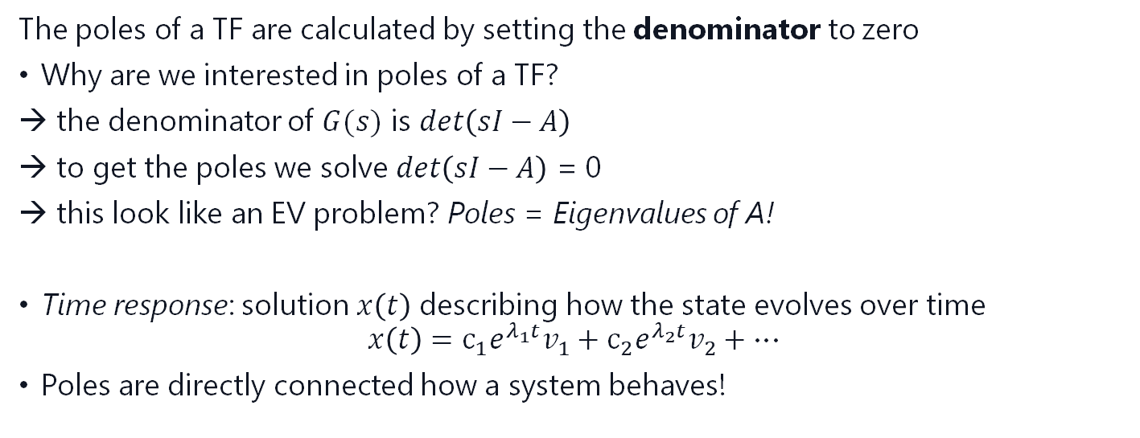
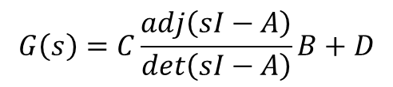
Effects of Poles
$$G\left(s\right)=C\frac{adj\left(sI−A\right)}{\det\left(sI−A\right)}B+D$$
The poles of a TF are calculated by setting the denominator to zero
Why are we interested in poles of a TF?
the denominator of $G(s)$ is $\det\left(sI−A\right)$
to get the poles we solve $\det\left(sI−A\right)$ = 0
this look like an EV problem? Poles = Eigenvalues of A!
Time response: solution $x\left(t\right)$ describing how the state evolves over time
$$x\left(t\right)=c_{1}e^{λ_{1}t}v_{1}+c_{2}e^{λ_{2}t}v_{2}+…$$
Poles are directly connected how a system behaves!

Slide 28
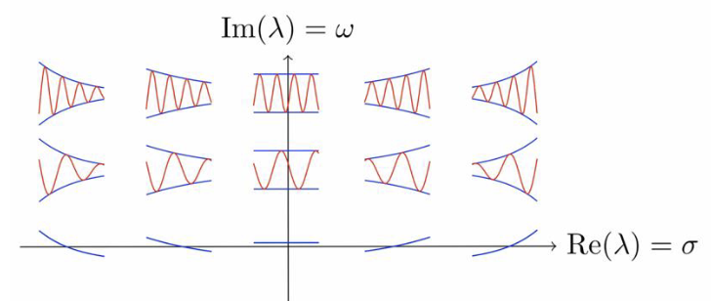
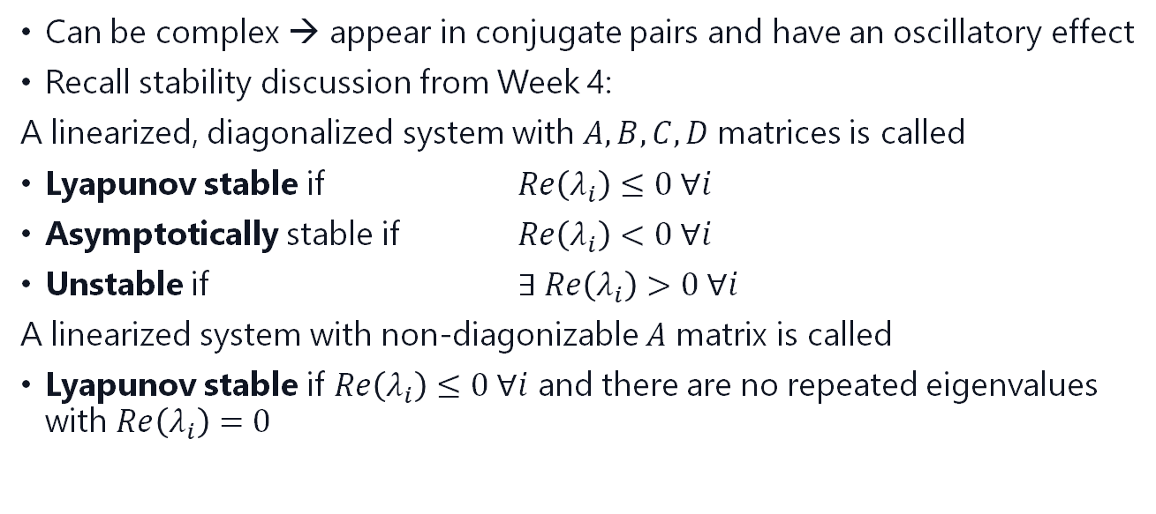
Effects of Poles
Can be complex → appear in conjugate pairs and have an oscillatory effect
Recall stability discussion from Week 4:
A linearized, diagonalized system with $A,B,C,D$matrices is called
Lyapunov stable if $Re\left(λ_{i}\right)≤0 ∀i$
Asymptotically stable if $Re\left(λ_{i}\right)<0 ∀i$
Unstable if $∃ Re\left(λ_{i}\right)>0 ∀i$
A linearized system with non-diagonizable $A$ matrix is called
Lyapunov stable if $Re\left(λ_{i}\right)≤0 ∀i$ and there are no repeated eigenvalues with $Re\left(λ_{i}\right)=0$

Slide 29


Effects of Zeros
The zeros of a TF are calculated by setting the nominator to zero
To look at the effects of zeros consider the Transfer Function $G(s)$ containing a zero:
$G\left(s\right)=\left(\frac{s}{−z}+1\right)\hat{G}\left(s\right)=\hat{G}\left(s\right)+\frac{s}{−z}\hat{G}\left(s\right)$
derivative in Laplace:
Let $\hat{y}\left(t\right)$ be the response of $\hat{G}\left(s\right)$. Then $\dot{\hat{y}}\left(t\right)$ is the response of $s\hat{G}\left(s\right)$
$$⟶Y\left(s\right)=G\left(s\right)U\left(s\right)=\left(\hat{G}\left(s\right)+\frac{s}{−z}\hat{G}\left(s\right)\right)U\left(s\right)$$
$$y\left(t\right)=ℒ^{−1}\{Y\left(s\right)\}=ℒ^{−1}\{\hat{G}\left(s\right)U\left(s\right)\}+\frac{1}{−z}ℒ^{−1}\{s\hat{G}\left(s\right)U\left(s\right)\}$$
$$y\left(t\right)=\hat{y}\left(t\right)+\frac{1}{−z}\dot{\hat{y}}\left(t\right)$$
zeros add a derivative term to the output
The closer the zero is to the origin, the stronger its effect
this means we usually have an anticipatory effect but we will discuss two cases…

Slide 30
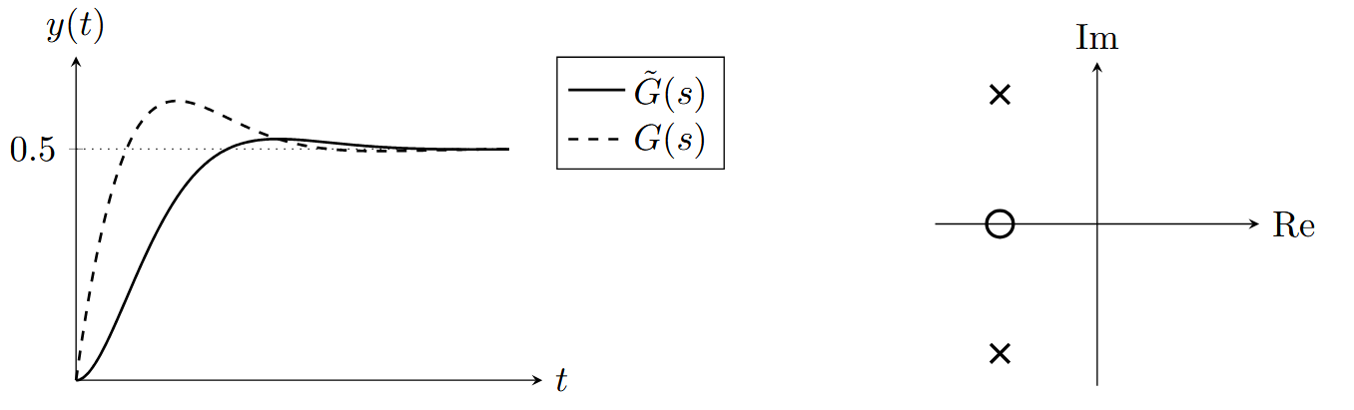
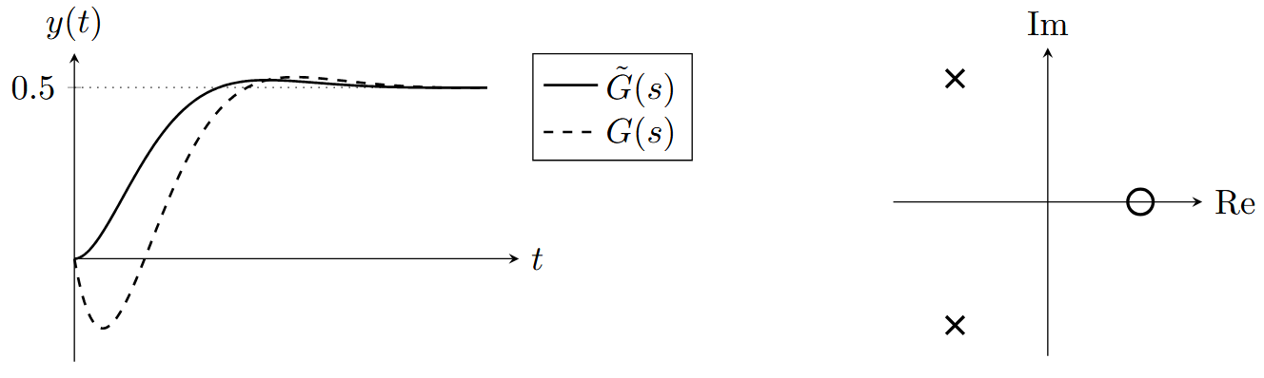
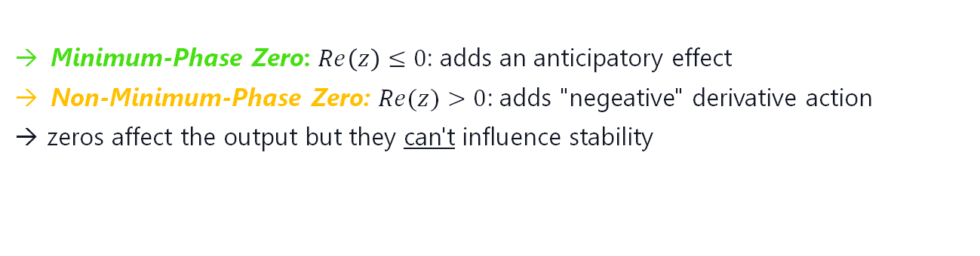

Zeros as Derivative Actions
$$y\left(t\right)=\hat{y}\left(t\right)+\frac{1}{−z}\dot{\hat{y}}\left(t\right)$$
Minimum Phase Zero
Non Minimum Phase Zero
Minimum-Phase Zero: $Re\left(z\right)≤0$: adds an anticipatory effect
Non-Minimum-Phase Zero: $Re(z)>0$: adds "negeative" derivative action
→ zeros affect the output but they can't influence stability

Slide 31
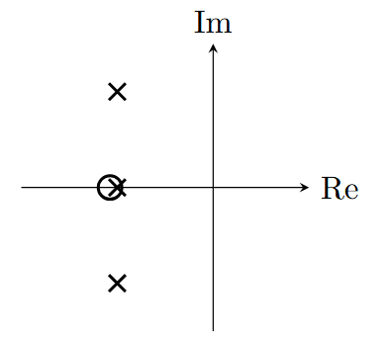
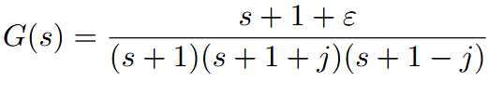
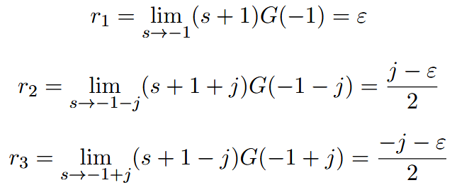
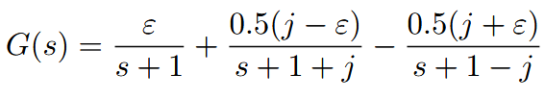
Pole-Zero Cancellation
We would like to analyse what happens when a pole and a zero are close to each other, and or if we would cancel them in the TF. Consider the following TF
Remember that looking at the partial fraction expansion, we actually see how much a pole is present in the response. So let’s compute the residues:

Slide 32

Pole-Zero Cancellation
Remember that we chose the zero being arbitrarily close to the pole. We can see now that when we move the zero closer to the pole, the residue of this pole, it’s effect on the response, gets smaller, until it gets 0 eventually.
This is fine as long as we do not cancel any unstable poles.
DO NOT CANCEL UNSTABLE POLES! (System blows up)

Slide 33



Initial & Final Value Theorem
We can use the following trick to compute the initial/final value of $y(t)$
Initial Value Theorem:
$$\lim_{t→0}{y}\left(t\right)=\lim_{s→∞}{s}Y\left(s\right)=\lim_{s→∞}{s}G\left(s\right)U\left(s\right)$$
Final Value Theorem:
$$\lim_{t→∞}{y}\left(t\right)=\lim_{s→0}{s}Y\left(s\right)=\lim_{s→0}{s}G\left(s\right)U\left(s\right)$$
We can apply this to derivatives:
$$\lim_{t→0}{\dot{y}}\left(t\right)=\lim_{s→∞}{s}\left[ℒ\left(\dot{y}\left(t\right)\right)\right]=\lim_{s→∞}{s^{2}}Y\left(s\right)=\lim_{s→∞}{s^{2}}G\left(s\right)U\left(s\right)$$

Slide 34



Old Exam Question
x: pole / o: zero

Slide 35
Old Exam Question
x: pole / o: zero
x
x
x
x

Slide 36
Summary
Today we learnt:
Different representation of transfer functions: partial fraction expansion, Root-Locus Form, Bode Form
How to compute the transfer function graphically
How poles correspond to exponentials in the time response and determine the system behavior (stability, oscillation, decay rate)
Zeros act as derivative terms in the system response: they modify the output dynamics without changing system stability
Min-phase → anticipatory | Non-min-phase → inverse response
Pole-zero cancellation reduces a pole’s effect, but canceling unstable poles makes the system blow up
Theorems to find a signal’s start and steady-state value directly from its Laplace form.

Slide 37


Tips for Problem Set 5
Easy | Medium | Hard
$1,2$, $4$ | $$3,5, 6$$
Nr. 1: Use the definitions of poles & zeros, look at the example we did together, look up the cover-up method in the slides
Nr. 2: Focus on the zeros, look at the problem from the slides
Nr. 3: think about out pole-zero cancellation in 3b)
Nr. 4: look at the discriminant i.e. $b^{2}−4ac \text{to} \text{check} \text{if} \text{complex} \text{or} \text{not}$
Nr. 5: look at the example we did for the sinusoidal input
Nr. 6: similar to Nr.5, apply the formula for sinusoidal inputs from the slides

Slide 38
Questions?

Slide 39
Feedback?
Too fast? Too slow? Less theory, more exercises?
I would appreciate your feedback. Please let me know.
https://docs.google.com/forms/d/e/1FAIpQLSdHl0kjWo63aNzDkAV0cnmQadCAj5L0D7v7aSh0BK7BBdEgpA/viewform?usp=header

