Slide 1

CS1 Week 9 Empty
Frequency Response, Bode Plots

Slide 2
Recap Last Week

Slide 3
Quiz 1
What influences the steady state error?
A. the number of poles & zeros
B. the number of integrators
C. the Bode gain
D. the reference value

Slide 4
Quiz 2
What time-domain specifications did we introduce for 2nd order systems?
A. Settling time
E. Critical time
B. Peak time
F. Peak Overshoot
C. Tea time
G. Rise time
D. Stabilty transformation
H. Peak Overshhot ratio

Slide 5
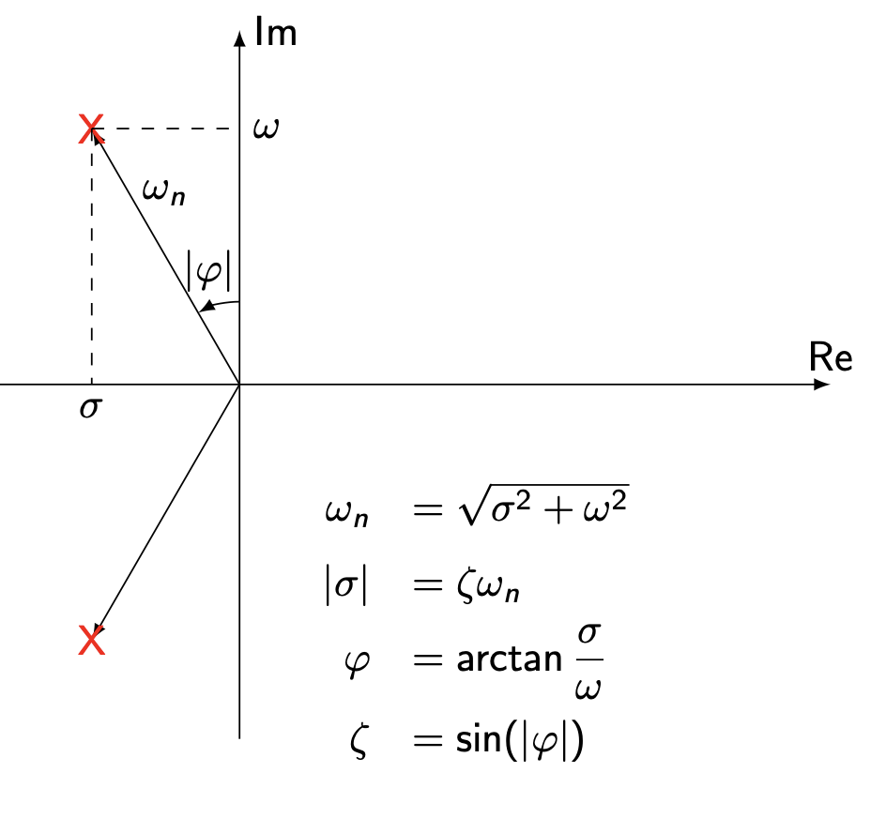
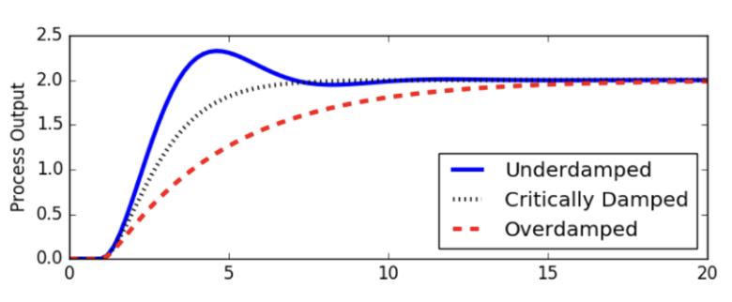
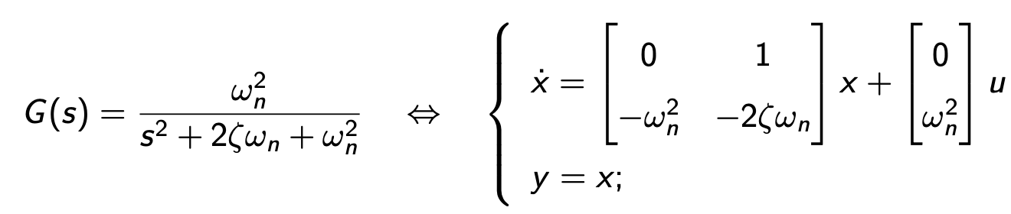
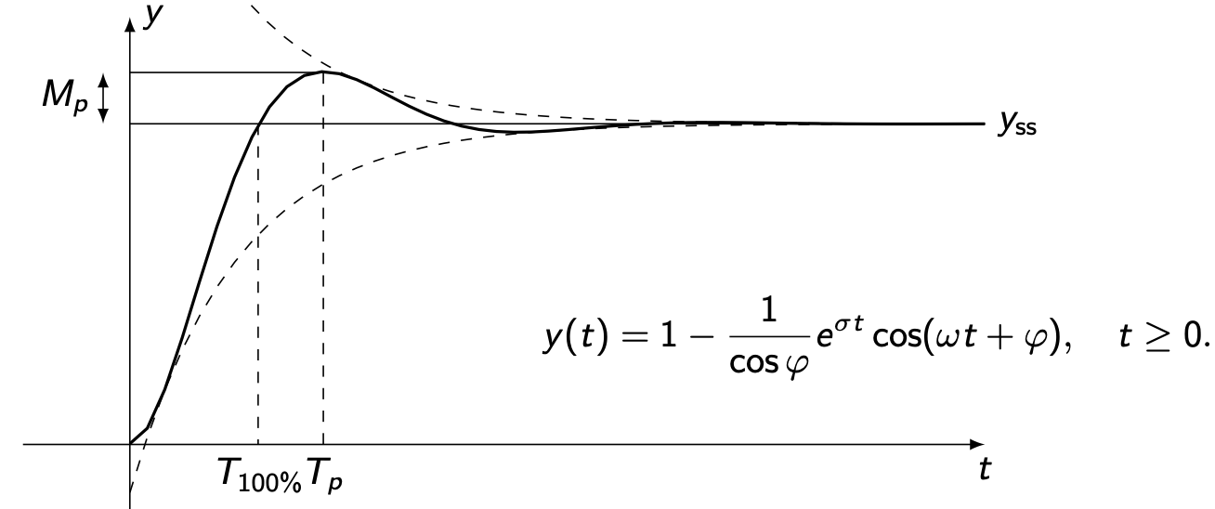
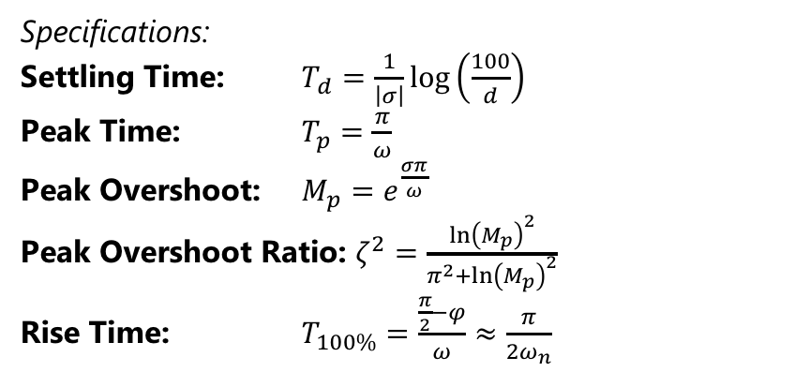

Step Response of a 2nd Order System
For an underdamped system $\left(ζ<1\right)$:
Specifications:
Settling Time: $T_{d}=\frac{1}{\left|σ\right|}log\left(\frac{100}{d}\right)$
Peak Time: $T_{p}=\frac{π}{ω}$
Peak Overshoot: $M_{p}=e^{\frac{σπ}{ω}}$
Peak Overshoot Ratio: $ζ^{2}=\frac{{\ln\left(M_{p}\right)}^{2}}{π^{2}+{\ln\left(M_{p}\right)}^{2}}$
Rise Time: $T_{100\%}=\frac{\frac{π}{2}−φ}{ω}≈\frac{π}{2ω_{n}}$

Slide 6

Quiz 3
Approximate the system $G\left(s\right)=\frac{1}{4}⋅\frac{1}{\left(s+10\right)\left(s+1+j\right)\left(s+1−j\right)}$ to 2nd order

Slide 7
Course Schedule
Subject | Week
Introduction, Control Architectures, Motivation | 1
Modeling, Model examples | 2
System properties, Linearization | 3
Analysis: Time response, Stability | 4
Transfer functions 1: Definition and properties | 5
Transfer functions 2: Poles and Zeros | 6
Proportional feedback control, Root Locus | 7
Time-Domain specifications, PID control | 8
Frequency response, Bode plots | 9
The Nyquist condition, Time delays | 10
Frequency-domain Specifications, Dynamic Compensation, Loop Shaping | 11
Time delays, Successive loop closure, Nonlinearities | 12
Describing functions | 13
Intro to Uncertainty and Robustness | 14
Modeling
Analysis
Synthesis

Slide 8
Today
Frequency Response Plots
Bode Plots
Polar Plots

Slide 9
1. Frequency Response Plots

Slide 10



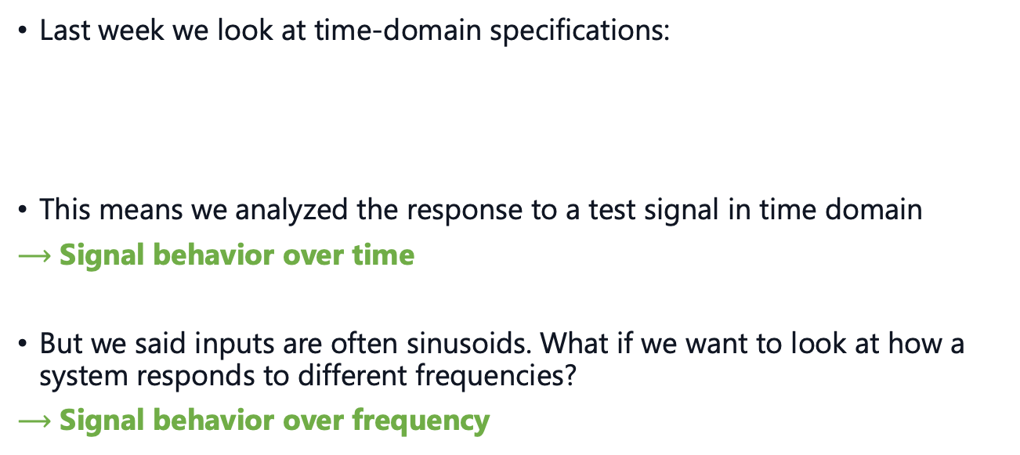




Introduction
$$y\left(t\right)$$
$$M_{p}$$
Last week we look at time-domain specifications:
This means we analyzed the response to a test signal in time domain
$⟶$ Signal behavior over time
But we said inputs are often sinusoids. What if we want to look at how a system responds to different frequencies?
$⟶$ Signal behavior over frequency
$$r$$
$$T_{d}$$
$$T_{p}$$
$$T_{100\%}$$
$$t$$

Slide 11





Why frequencies?
$$u\left(t\right)=e^{\left(jωt\right)}=cos\left(ωt\right)+jsin\left(ωt\right)$$
Many signals can be written as complex exponentials:
And with a stable system we have:
Input signals change amplitude and phase
$$y_{ss}\left(t\right)=G\left(jω\right)e^{\left(jωt\right)}=\left|G\left(jω\right)\right|e^{\left(j\left(ωt+∠G\left(jω\right)\right)\right)}$$
phase shift
amplification
CS1 TAs
$$y(t)$$
$$u\left(t\right)$$

Slide 12
Because of this…
In the extreme case of amplification, resonance can occur

Slide 13
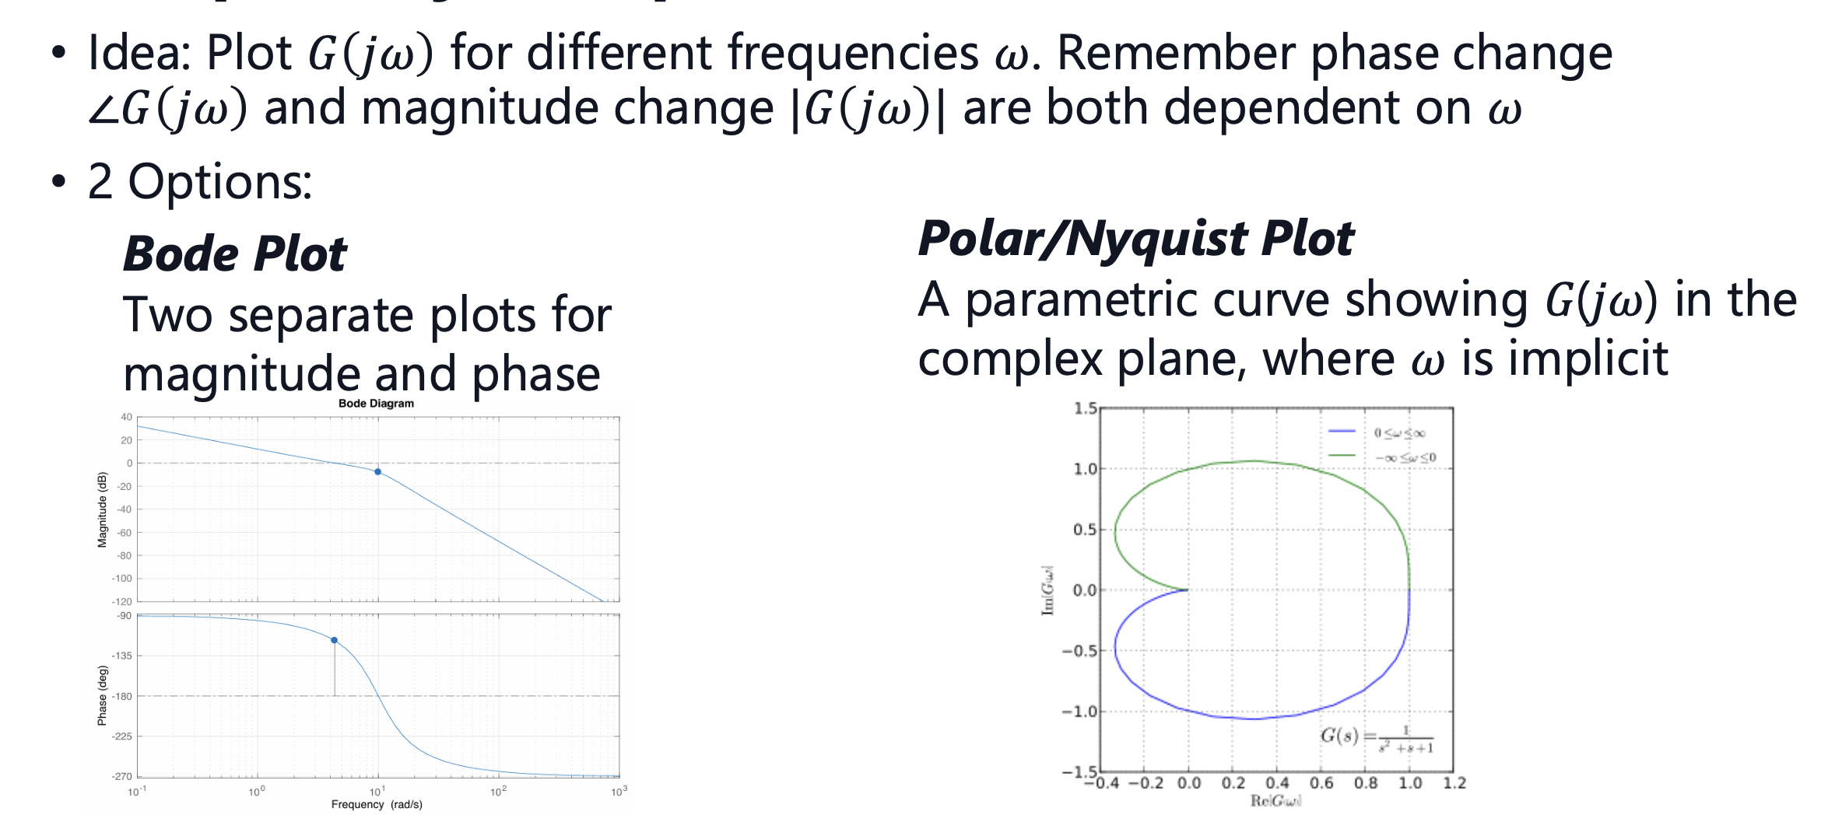
Frequency Response Plots

Slide 14
2. Bode Plots

Slide 15
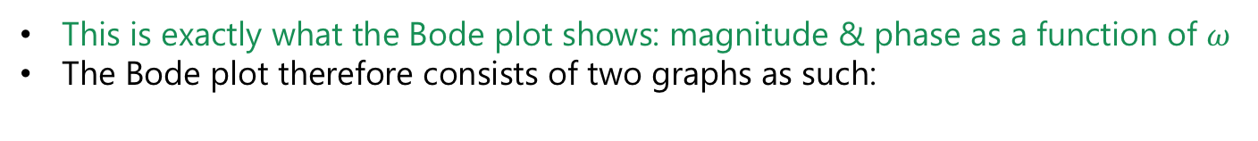





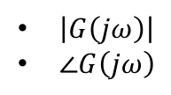
Bode Plot
Important: For a given input with frequency $ω$, an LTI-system will have constant:
The frequency of the output always stays the same $ω$
$\left|G\left(jω\right)\right|$
$∠G\left(jω\right)$
This is exactly what the Bode plot shows: magnitude & phase as a function of $ω$
The Bode plot therefore consists of two graphs as such:
$$|G(jω)|$$
$$∠G(jω)$$
$$ω$$
$$ω$$

Slide 16
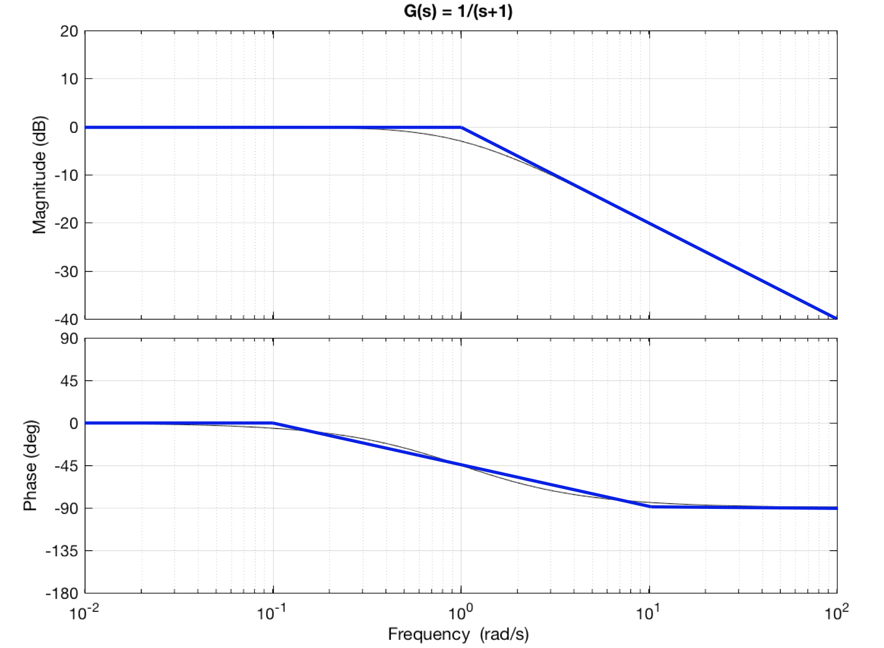
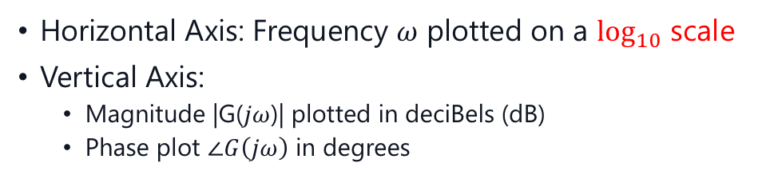



Bode Plot
Horizontal Axis: Frequency $ω$ plotted on a $\log_{10}$ scale
Vertical Axis:
Magnitude |G($jω$)| plotted in deciBels (dB)
Phase plot $∠G\left(jω\right)$ in degrees
$${\left|G\left(jω\right)\right|}_{dB}=20⋅\log_{10}\left|G\left(jω\right)\right|$$
$$\left|G_{1}\left(jω\right)\right|⋅\left|G_{2}\left(jω\right)\right|={\left|G_{1}\left(jω\right)\right|}_{dB}+{\left|G_{2}\left(jω\right)\right|}_{dB}$$
$$∠G_{1}\left(jω\right)G_{2}\left(jω\right)=∠G_{1}\left(jω\right)+∠G_{2}\left(jω\right)$$
Inverting a TF is equivalent to a reflection
about the horizontal axis
$${\left|G{\left(jω\right)}^{−1}\right|}_{dB}=−{\left|G\left(jω\right)\right|}_{dB}$$

Slide 17
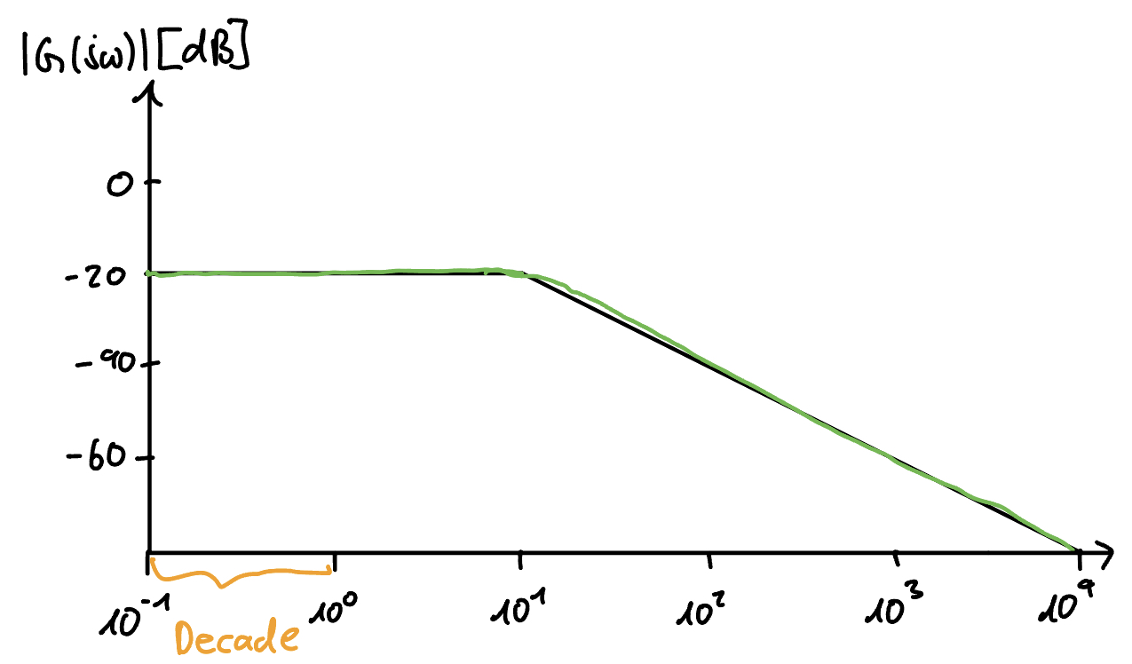
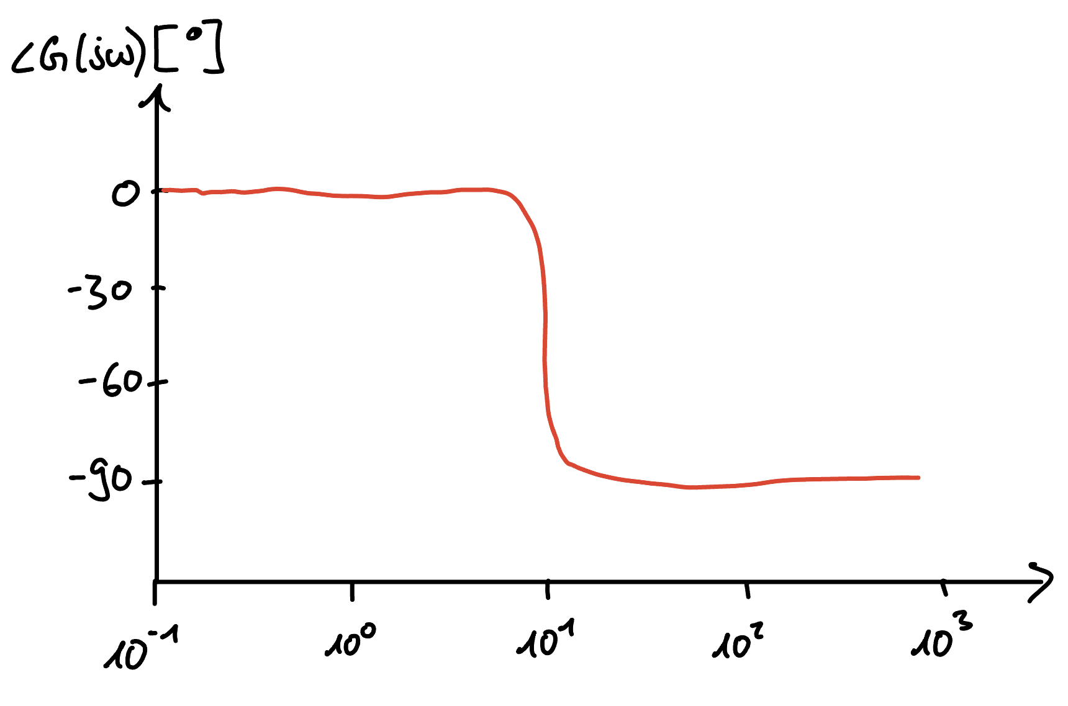

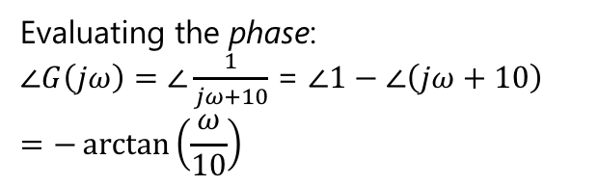

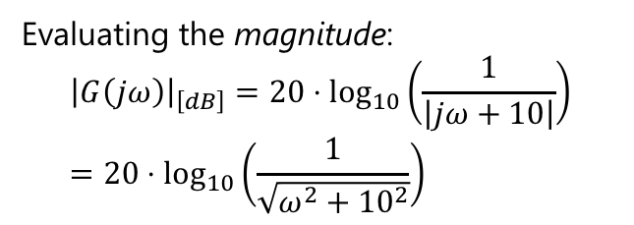

Example
$${\left|G\left(jω\right)\right|}_{dB}=20⋅\log_{10}\left|G\left(jω\right)\right|$$
You are given the following system: $G\left(jω\right)=\frac{1}{jω+10}$
Evaluating the magnitude: $${\left|G\left(jω\right)\right|}_{\left[dB\right]}=20⋅\log_{10}\left(\frac{1}{\left|jω+10\right|}\right)=20⋅\log_{10}\left(\frac{1}{\sqrt{ω^{2}+{10}^{2}}}\right)$$
Evaluating the phase:
$∠G\left(jω\right)=$ $∠\frac{1}{jω+10}$ = $∠1−∠\left(jω+10\right)$
$$=−\arctan\left(\frac{ω}{10}\right)$$
plot:
plot:
$$ω$$
$$ω$$

Slide 18
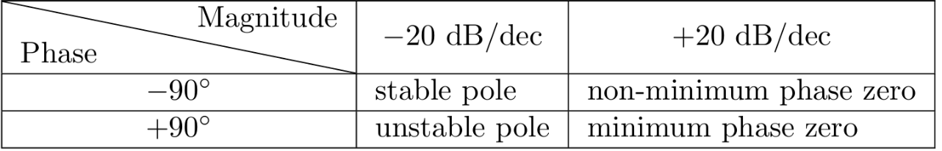


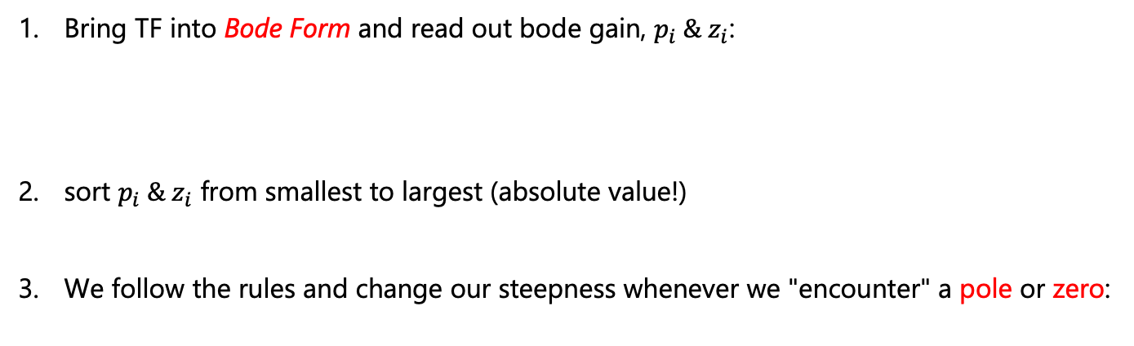
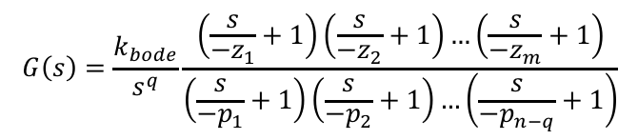
Sketch Bode Plots
Bode Form:
$$G\left(s\right)=\frac{k_{bode}}{s^{q}}\frac{\left(\frac{s}{−z_{1}}+1\right)\left(\frac{s}{−z_{2}}+1\right)…\left(\frac{s}{−z_{m}}+1\right)}{\left(\frac{s}{−p_{1}}+1\right)\left(\frac{s}{−p_{2}}+1\right)…\left(\frac{s}{−p_{n−q}}+1\right)}$$
So how do we sketch these plots by hand?
Suppose you are given a system $G\left(s\right)=\frac{\left(s−100\right)}{\left(s+10\right)\left(s−1000\right)}$
Bring TF into Bode Form and read out bode gain, $p_{i} \& z_{i}$:
sort $p_{i} \& z_{i}$ from smallest to largest (absolute value!)
We follow the rules and change our steepness whenever we "encounter" a pole or zero:
The phase change happens across two decades, one before and one after $ω$!

Slide 19
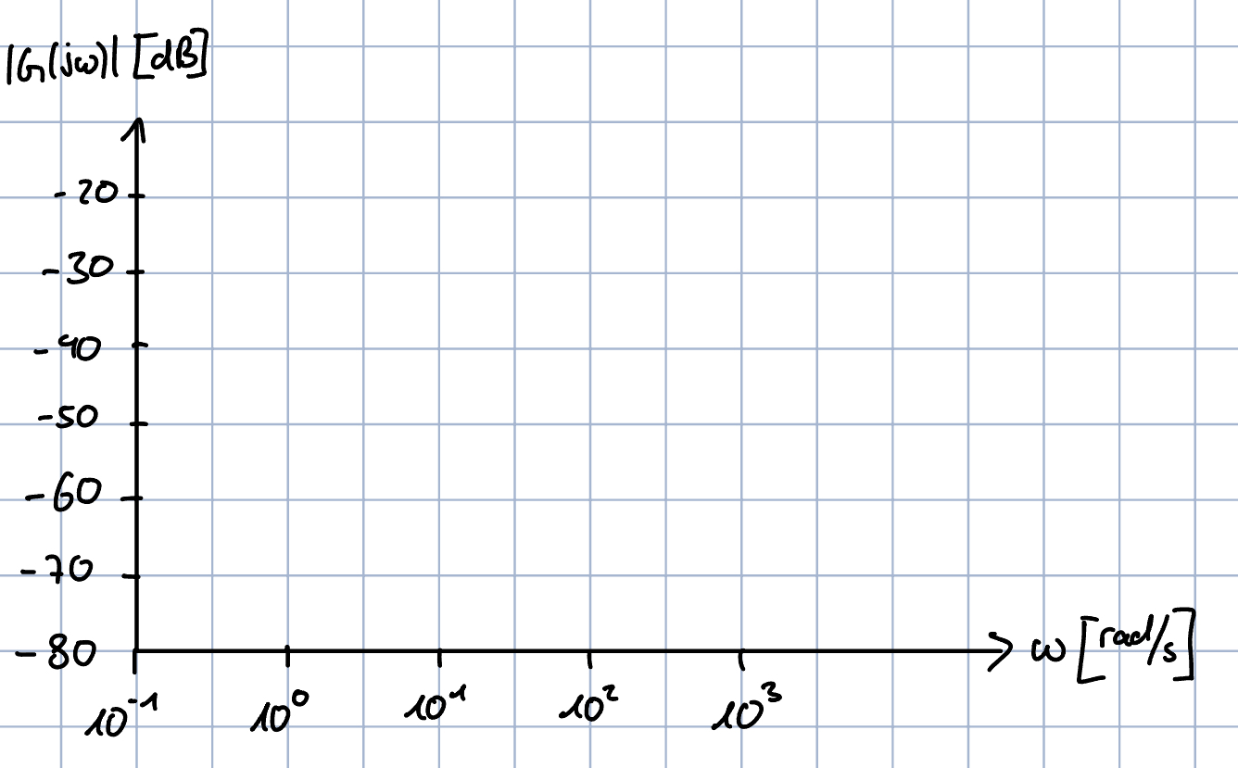
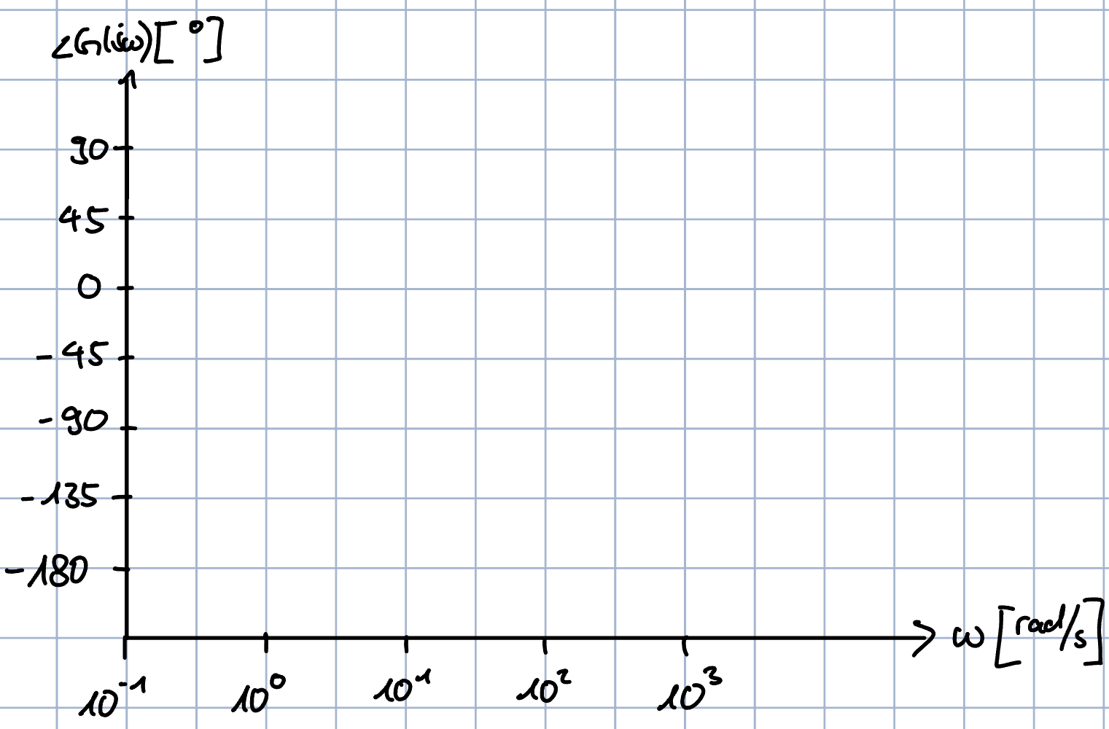

Sketch Bode Plots
$$p_{1}=−10,z_{2}=100,p_{2}=1000$$
Magnitude Plot:
Phase Plot:

Slide 20
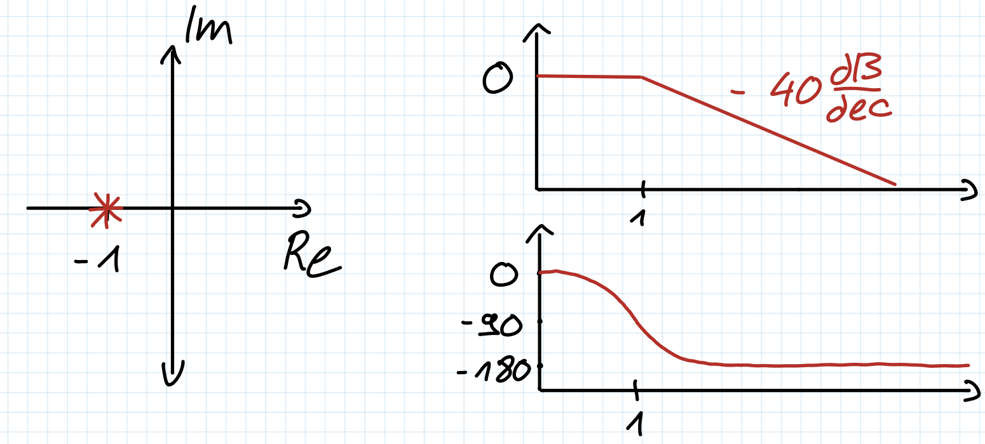
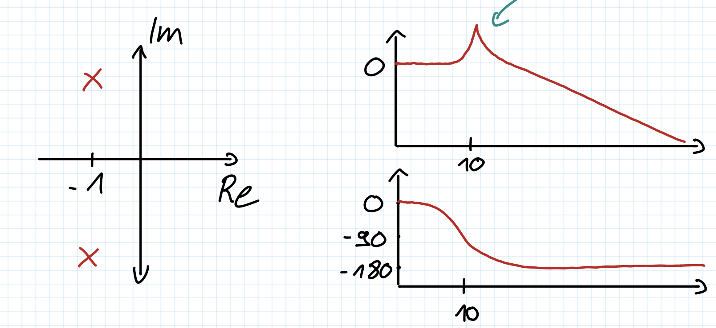
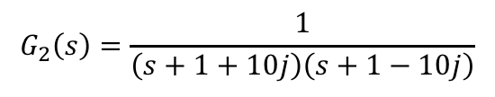
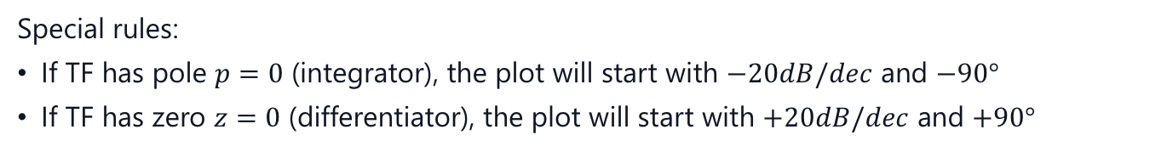

More Rules
Special rules:
If TF has pole $p=0$ (integrator), the plot will start with $−20dB/dec$ and $−90°$
If TF has zero $z=0$ (differentiator), the plot will start with $+20dB/dec$ and $+90°$
What if we have complex poles/zeros?
Let's compare the following two systems:
$$G_{1}\left(s\right)=\frac{1}{\left(s+1\right)\left(s+1\right)}$$
$$G_{2}\left(s\right)=\frac{1}{\left(s+1+10j\right)\left(s+1−10j\right)}$$
Resonance!
How can we characterize this peak?

Slide 21
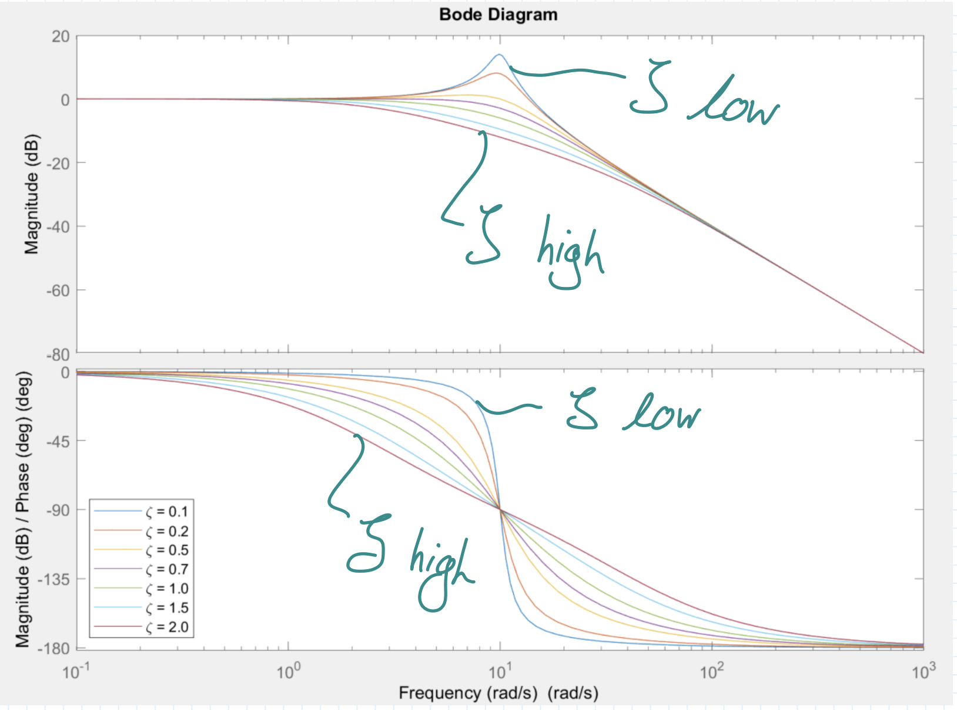
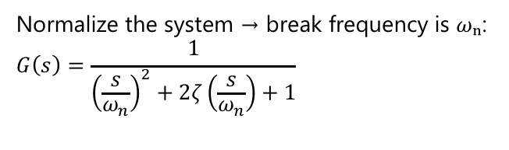
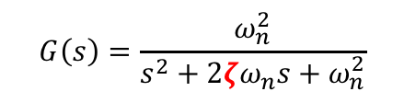

Second Order Systems
$$G\left(s\right)=\frac{ω_{n}^{2}}{s^{2}+2ζω_{n}s+ω_{n}^{2}}$$
Remember how we wrote our second order system:
It turns out the dampening factor $ζ$ defines the intensity of the resonance!
$⟶$ the stronger the dampening, the smaller the resonance!
Normalize the system → break frequency is $ωₙ$:
$$G\left(s\right)=\frac{1}{{\left(\frac{s}{ω_{n}}\right)}^{2}+2ζ\left(\frac{s}{ω_{n}}\right)+1}$$
at which frequency we encounter the complex pole

Slide 22
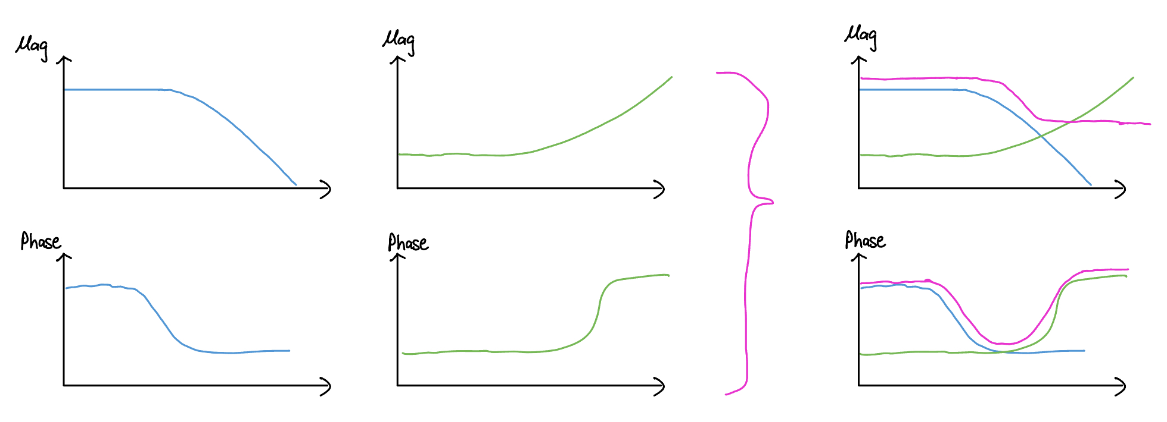





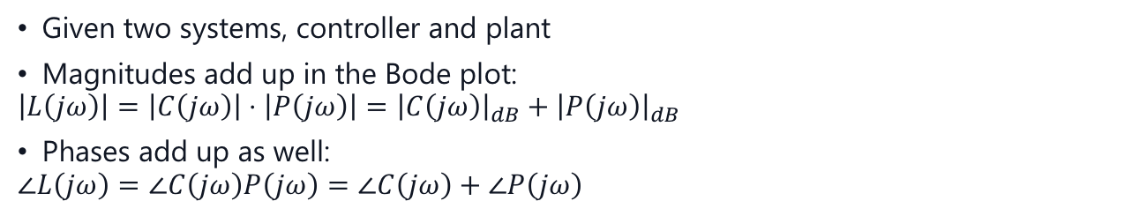


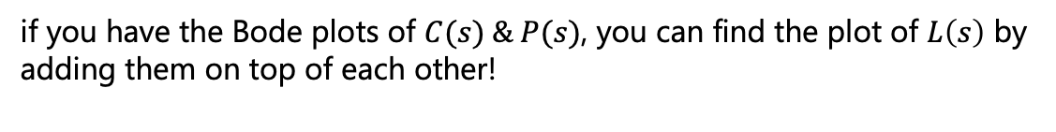



Multiple Systems
$${\left|G\left(jω\right)\right|}_{dB}=20⋅\log_{10}\left|G\left(jω\right)\right|$$
$$\left|G_{1}\left(jω\right)\right|⋅\left|G_{2}\left(jω\right)\right|={\left|G_{1}\left(jω\right)\right|}_{dB}+{\left|G_{2}\left(jω\right)\right|}_{dB}$$
$$∠G_{1}\left(jω\right)G_{2}\left(jω\right)=∠G_{1}\left(jω\right)+∠G_{2}\left(jω\right)$$
Given two systems, controller and plant
Magnitudes add up in the Bode plot:
$$\left|L\left(jω\right)\right|=\left|C\left(jω\right)\right|⋅\left|P\left(jω\right)\right|={\left|C\left(jω\right)\right|}_{dB}+{\left|P\left(jω\right)\right|}_{dB}$$
Phases add up as well:
$$∠L\left(jω\right)=∠C\left(jω\right)P\left(jω\right)=∠C\left(jω\right)+∠P\left(jω\right)$$
$$u$$
$$y$$
$$C\left(s\right)$$
$$P(s)$$
if you have the Bode plots of $C(s) \& P(s)$, you can find the plot of $L\left(s\right)$ by adding them on top of each other!
$$L\left(s\right)$$
$$u$$
$$y$$
$$L\left(s\right)$$

Slide 23
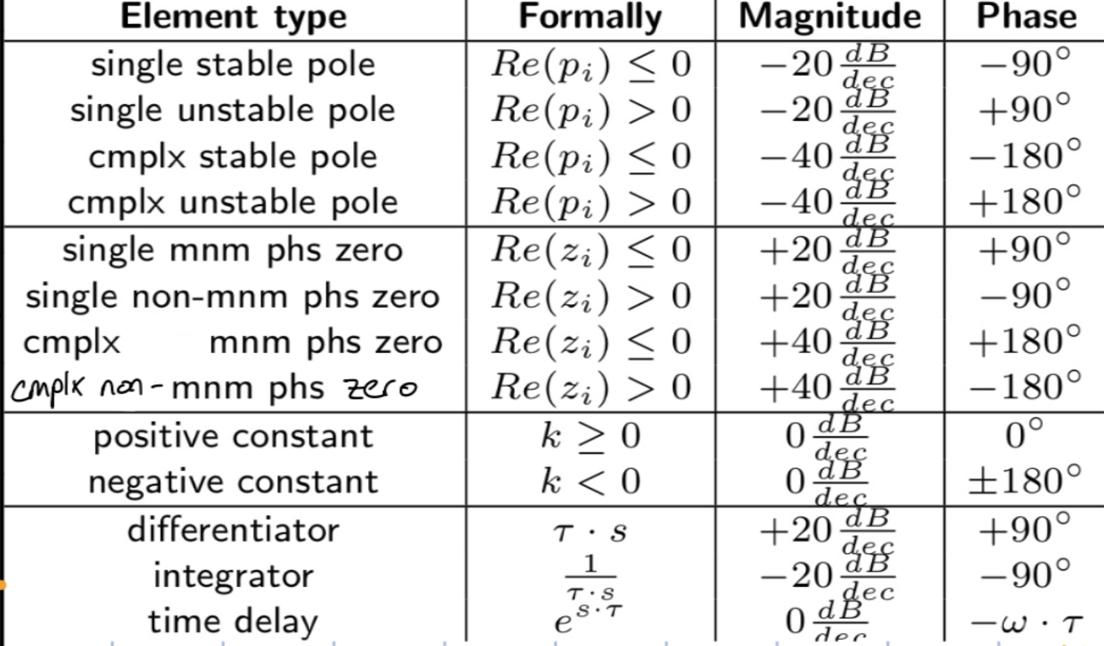
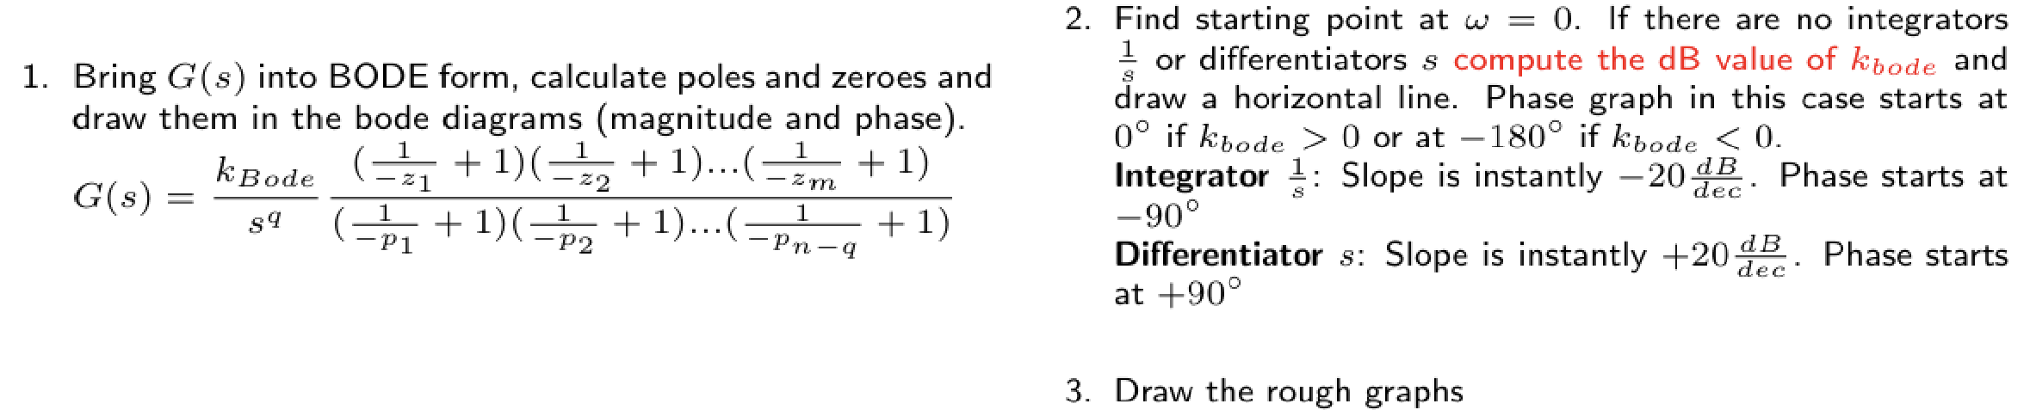
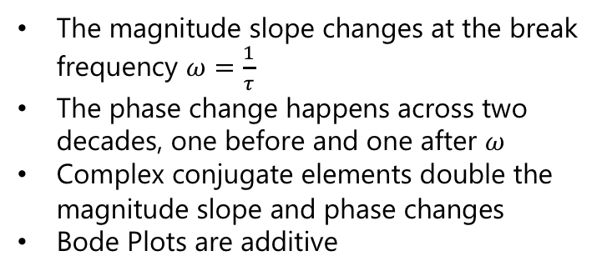

Bode Plot: Overview
Standard first-order forms:
• Zero: $G\left(s\right)=1+τs$
• Pole: $G\left(s\right)\frac{1}{1+τs}$
The magnitude slope changes at the break frequency $ω=\frac{1}{τ}$
The phase change happens across two decades, one before and one after $ω$
Complex conjugate elements double the magnitude slope and phase changes
Bode Plots are additive

Slide 24
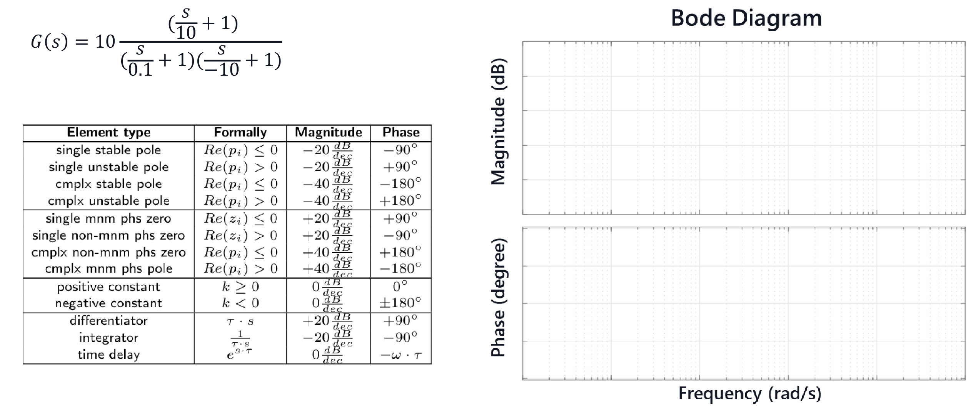
Constructing Bode Plot from TF

Slide 25
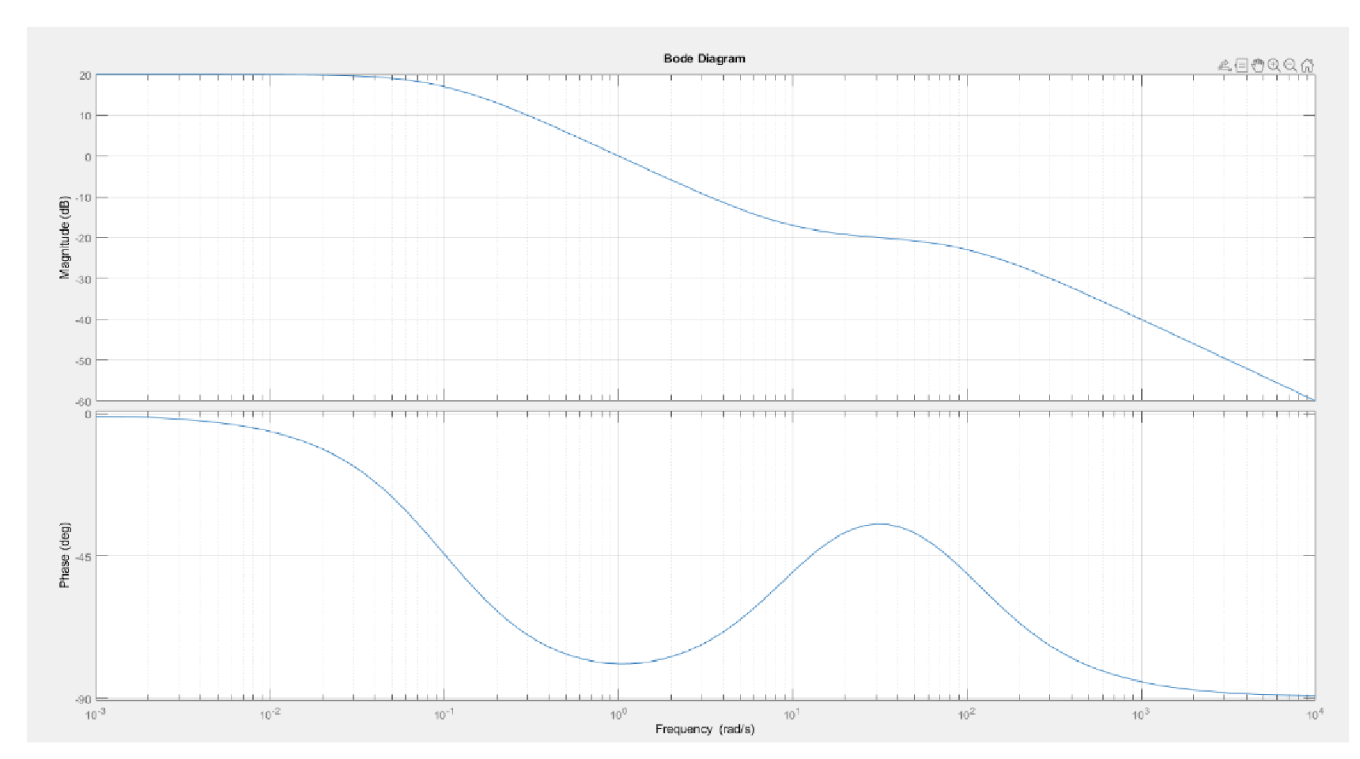
Constructing TF from Bode Plot

Slide 26
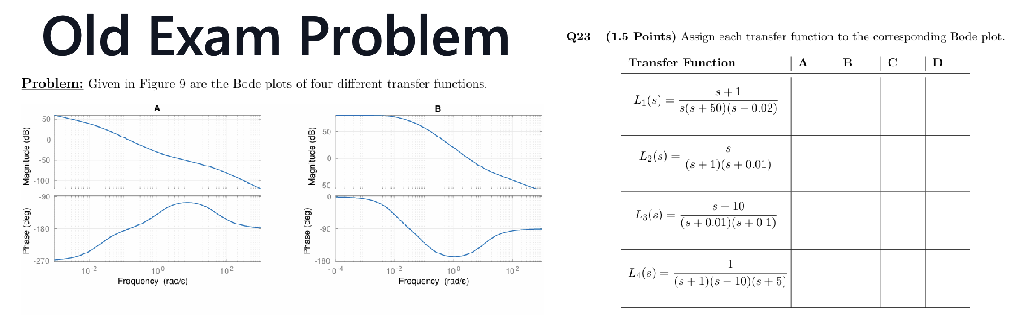
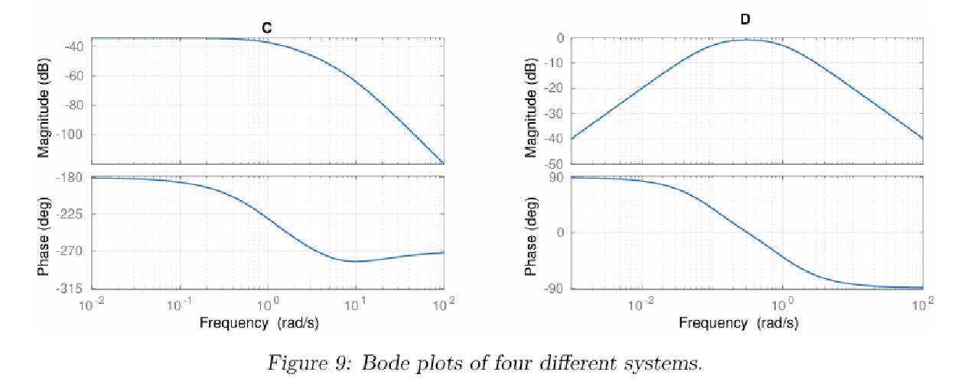

Slide 27
3. Polar Plots

Slide 28
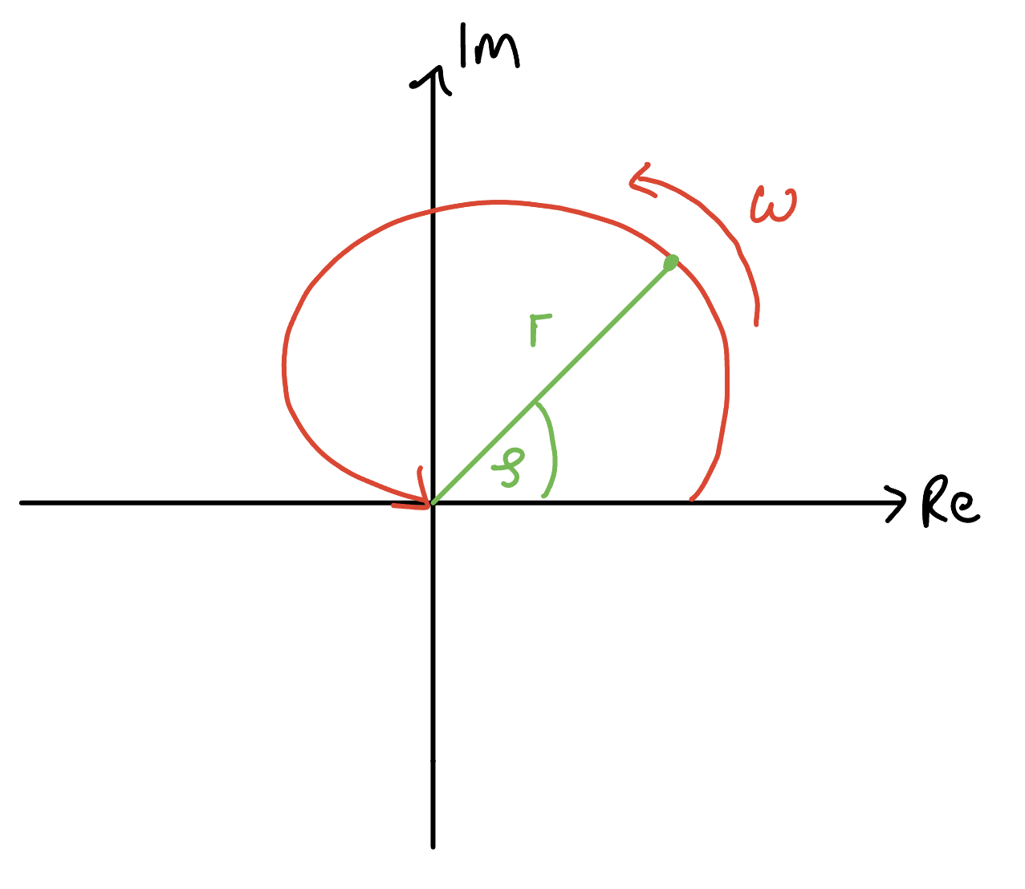

Polar Plot
In this plot we combine magnitude & phase into a single complex number
The frequency is no longer an axis but implicit, just like the gain $k$ in Root Locus

Slide 29
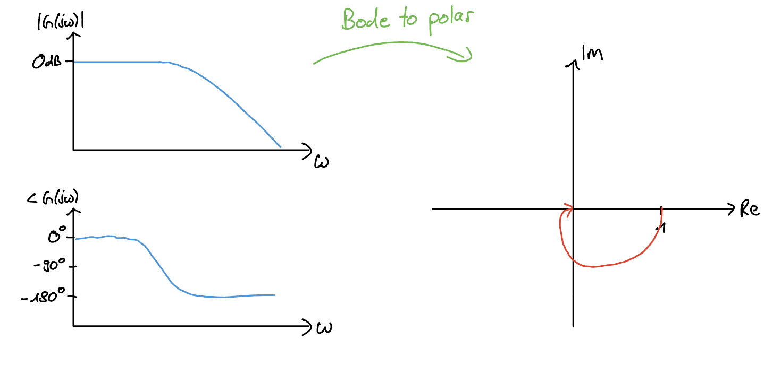
Bode to Polar Plot
If we have the Bode plot, we can extract the polar plot as such:
careful: 0dB = 1
Note: For all of these plots we are sketching, you won't have to precisely draw them, but have an intuition to correctly sketch them

Slide 30

Tips for Problem Set 8
I personally would recommend solving at least the problems marked red
Easy | Medium | Hard
 | $$1,2,3,4$$ | $$5$$
4: Look at the break points where the slopes change. Remember phase changes start one decade before and end one decade after in the phase plot. Doesn't have to be exact, if stuck consult solutions
1(i+ii): Make use of the Bode plot overview
1(iii+iv): Beware of the integrator and differentiator
2: Eliminate the easier ones first, and then the harder ones. Try looking at where the bode plot starts and what this means (integrator, differentiator, negative gain?)
5: Will help you understand nyquist plots better next week, but pretty hard imo, so work more with the solutions and try to comprehend it
3: Apply magnitude & phase rule, here I would rather try to understand the solutions
Great visualization tool for Bode Plots from Johannes Schulte-Vels: https://bodetooltest.streamlit.app/

Slide 31
Questions?

Slide 32
Feedback?
Too fast? Too slow? Less theory, more exercises?
I would appreciate your feedback. Please let me know.
https://docs.google.com/forms/d/e/1FAIpQLSdHl0kjWo63aNzDkAV0cnmQadCAj5L0D7v7aSh0BK7BBdEgpA/viewform?usp=header

