Slide 1

CS2 Week 7 Empty
Nonlinear Systems, Lyapunov Stability, Feedback Linearization

Slide 2

Exercise Classes
Shared exercise with Haixiao and Kissan
Theory recap
Notes available on Kissan's website: https://kissanv.github.io
& on Haixiao's Polybox: https://polybox.ethz.ch/index.php/s/AReA9YBeJQKxBDn
Quizzes, Examples & Old exam questions
Kissan's Website
Haixiao's Polybox

Slide 3
Course Schedule
Subject | Week
Intro – Discrete Time Systems | 1
Diagonalization, Modal Coordinates, Contr/Obs. | 2
State Feedback, Pole Placement, LQR | 3
State Estimation, Luenberger Obs., Seperation Principle, LQG | 4
DOFC with integral action, Intro to MIMO systems | 5
Norms | 6
Nonlinear Systems, Lyapunov, Feedback Linearization | 7
break | 8
Discrete-time Unconstrained Optimal Control | 9
Convex Optimization | 10
Model Predictive Control | 11
Practical Model Predictive Control | 12
Robust Model Predictive Control | 13
Implementation Methods | 14

Slide 4
Today
Nonlinear System
Lyapunov Stability
Feedback Linearization

Slide 5
1. Nonlinear Systems

Slide 6
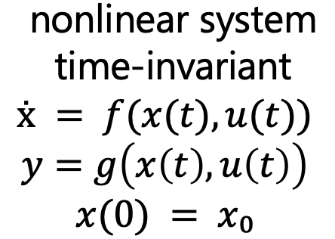
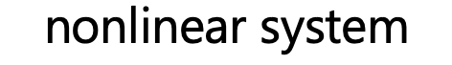
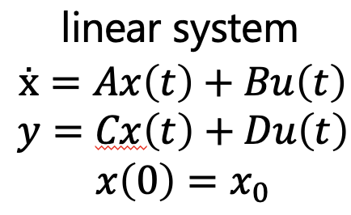
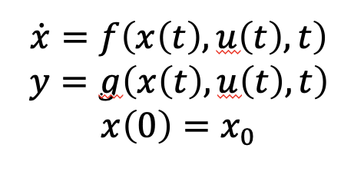

Nonlinear Systems
So far we’ve looked exclusively at linear systems
An essential property of our linear system is superposition:
Thanks to superposition, we could analyze the time response more easily and use the Laplace transform to study the system in the frequency domain
$$G\left(u_{1}+u_{2}\right)=Gu_{1}+Gu_{2}$$
Nonlinear systems do not satisfy superposition
Their behavior depends on the input and initial condition
Let’s consider their state-space model:

Slide 7
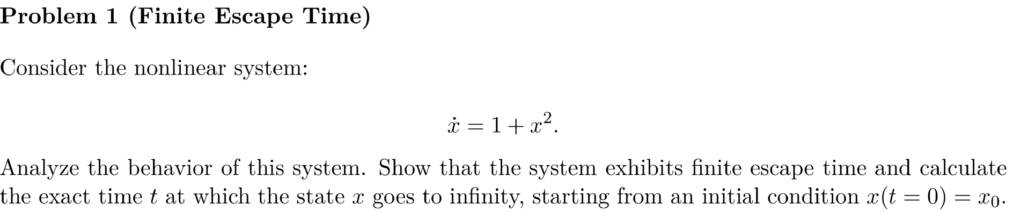
Nonlinear Systems
In general, nonlinear systems are more complex to analyze
Nonlinear systems can exhibit many interesting, though often counterintuitive, phenomena like:
Multiple Equilibria: a linear system has 1 equilibrium (if A not singular)
a nonlinear system can have 0, 1, or many equilibrium points
Finite escape time: Unstable linear systems may diverge to infinity, but only in infinite time!
Nonlinear systems may reach infinity in finite time

Slide 8
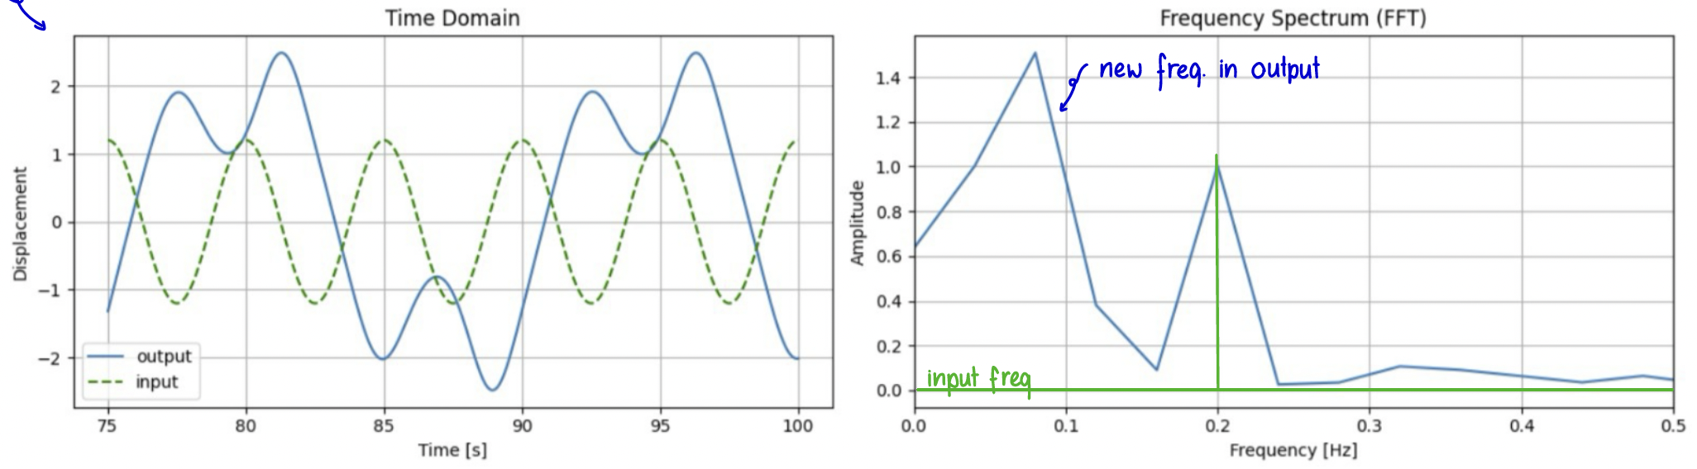
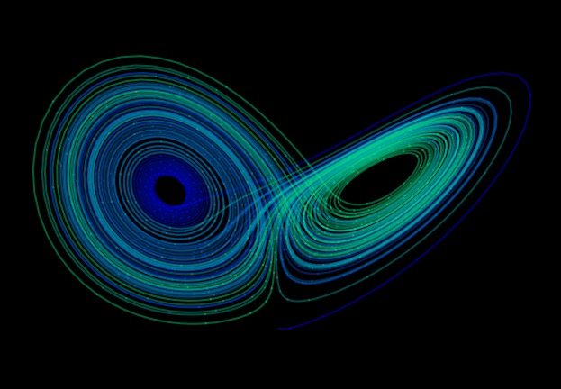
Nonlinear Systems
Limit cycles: a linear system may generate permanent oscillations
a nonlinear system may generate permanent oscillations
independent from initial conditions
Subharmonic a linear system will always output the same frequency as the input
Oscillations: a nonlinear system can generate output frequencies that are submultiples or multiples of the input frequency
Chaos: A nonlinear system can exhibit complex steady-state behavior that is neither an equilibrium nor a periodic oscillation
$⇒$ nonlinear system can exhibit any and all of the behaviors described!

Slide 9
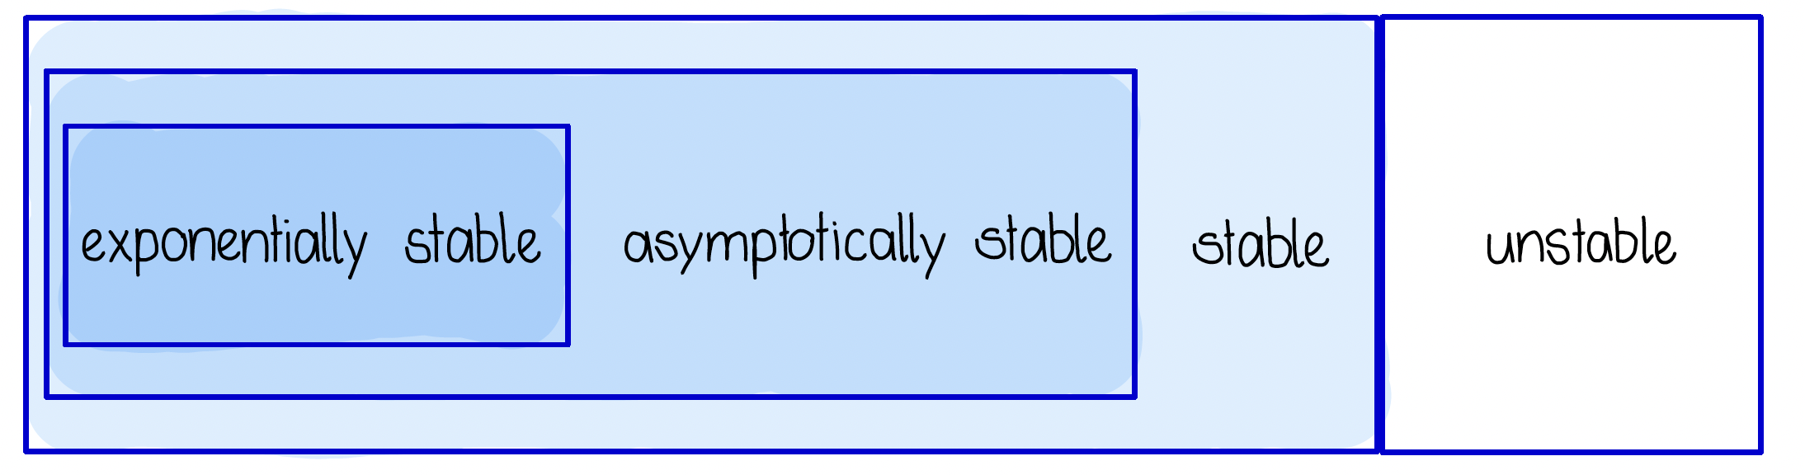
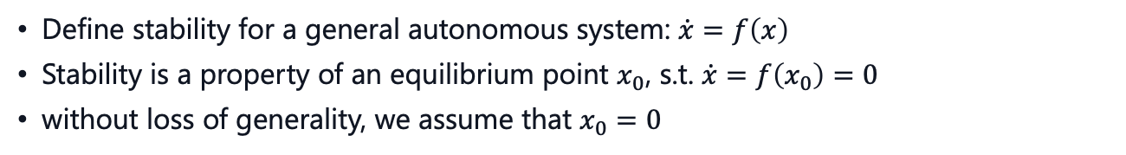
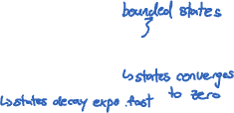
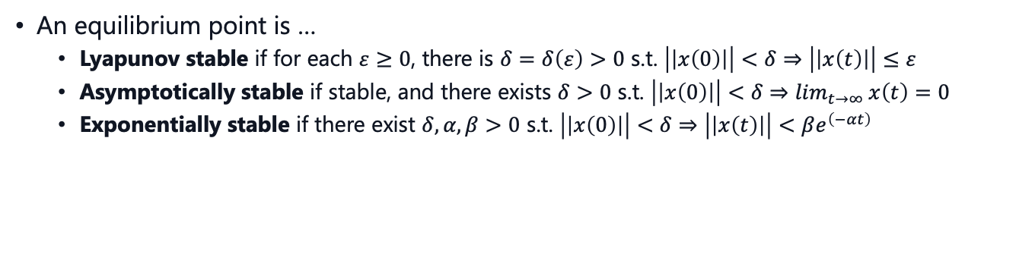
Notions of Stability
Define stability for a general autonomous system: $\dot{x}=f\left(x\right)$
Stability is a property of an equilibrium point $x_{0}$, s.t. $\dot{x}=f\left(x_{0}\right)=0$
without loss of generality, we assume that $x_{0}=0$
An equilibrium point is …
Lyapunov stable if for each $ε≥0$, there is $δ=δ\left(ε\right)>0$ s.t. $\left|\left|x\left(0\right)\right|\right|<δ⇒\left|\left|x\left(t\right)\right|\right|≤ε$
Asymptotically stable if stable, and there exists $δ>0$ s.t. $\left|\left|x\left(0\right)\right|\right|<δ⇒\lim_{t→∞}{x\left(t\right)}=0$
Exponentially stable if there exist $δ, α, β>0$ s.t. $\left|\left|x\left(0\right)\right|\right|<δ⇒\left|\left|x\left(t\right)\right|\right|<βe^{\left(−αt\right)}$
Stability assessment is easier for linear systems ($λ$'s of A), but no general test for nonlinear systems

Slide 10
2. Lyapunov Stability

Slide 11

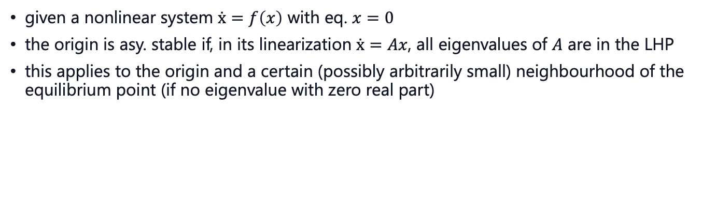
Lyapunov's Indirect Method
For arbitrary systems, there is no general way to determine stability.
given a nonlinear system $ẋ=f\left(x\right)$ with eq. $x=0$
the origin is asy. stable if, in its linearization $ẋ=Ax$, all eigenvalues of $A$ are in the LHP
this applies to the origin and a certain (possibly arbitrarily small) neighbourhood of the equilibrium point (if no eigenvalue with zero real part)
$⇒$ Basically what we did in CS1 all along!

Slide 12
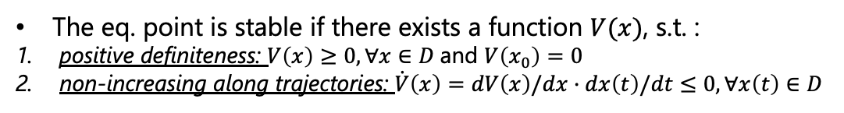
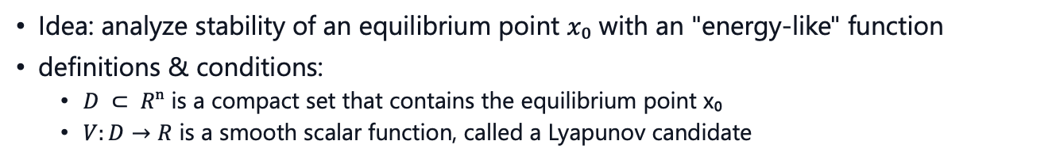
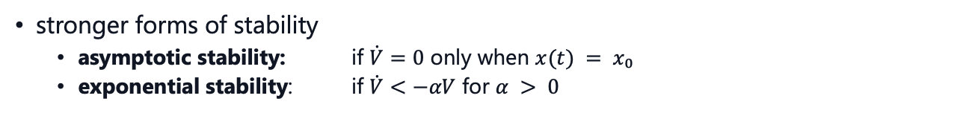

Lyapunov's Direct Method
Idea: analyze stability of an equilibrium point $x₀$ with an "energy-like" function
definitions & conditions:
$D ⊂ Rⁿ$ is a compact set that contains the equilibrium point x₀
$V:D→R$ is a smooth scalar function, called a Lyapunov candidate
The eq. point is stable if there exists a function $V(x)$, s.t. :
positive definiteness: $V\left(x\right)≥0,∀x∈D$and $V\left(x_{0}\right)=0$
non-increasing along trajectories: $\dot{V}\left(x\right)=dV\left(x\right)/dx·dx\left(t\right)/dt≤0,∀x\left(t\right)∈D$
stronger forms of stability
asymptotic stability: if $\dot{V}=0$ only when $x(t) = x₀$
exponential stability: if $\dot{V}<−αV$ for $α > 0$
$⇒$ sufficient not necessary conditions for stability

Slide 13
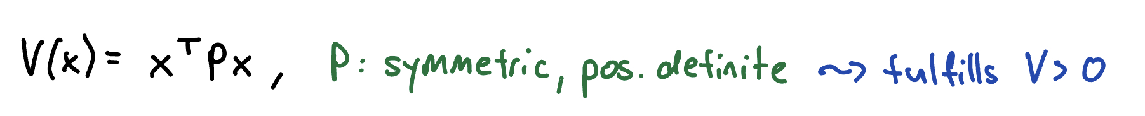
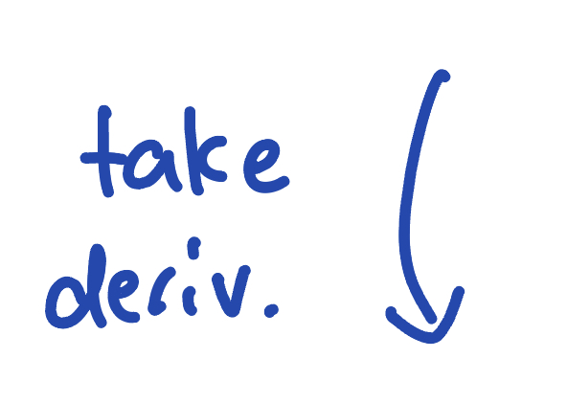
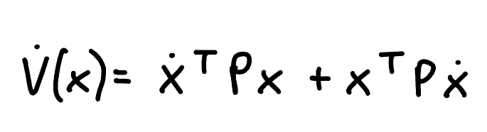
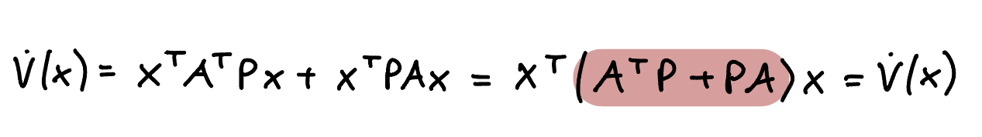
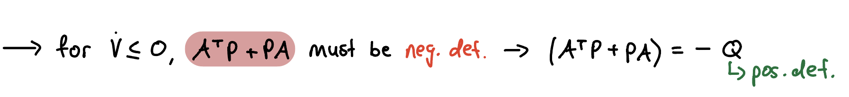
Lyapunov Equation
there is no general method of finding a Lyaponov function for arbitrary systems
for a linearized sys. $ẋ=Ax$ one can always find a quadratic Lyapunov function
$⇒$ Always has a solution if eigenvalues of $A$ are in LHP!

Slide 14
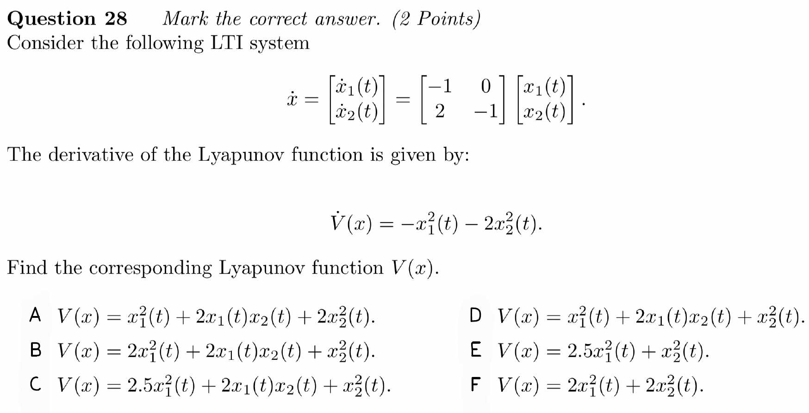

Exam Question
$$\dot{V}={−x}^{T}Qx$$
$$A^{T}P+PA=−Q$$
$$V=x^{T}Px$$

Slide 15
$$\dot{V}=−x^{T}Qx$$
$$A^{T}P+PA=−Q$$
$$V=x^{T}Px$$

Slide 16
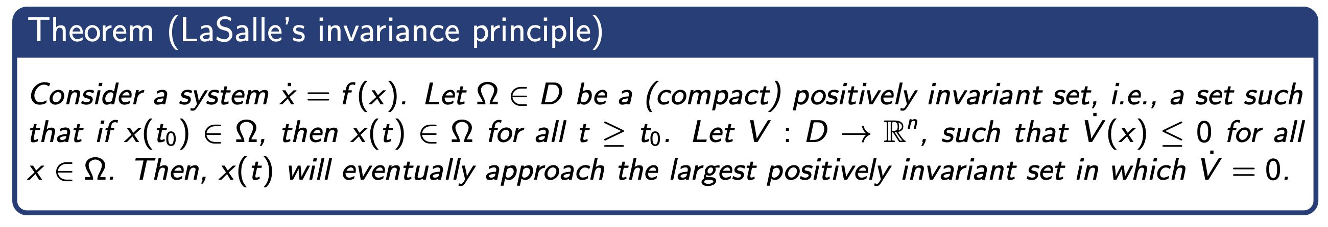
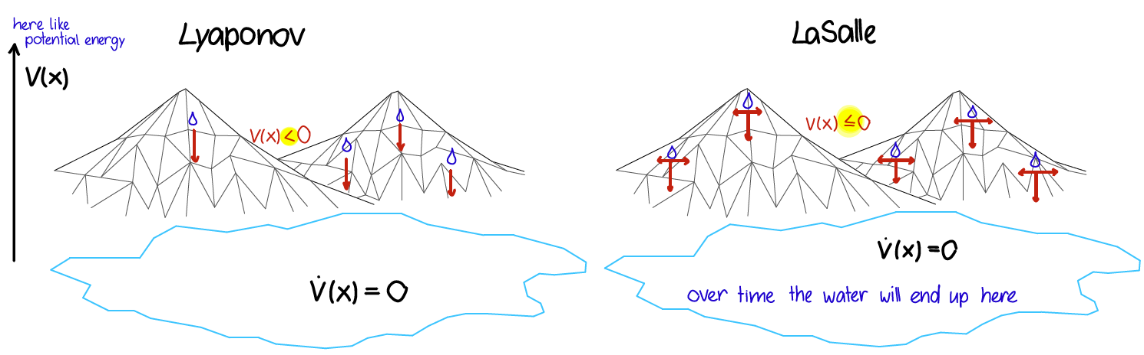
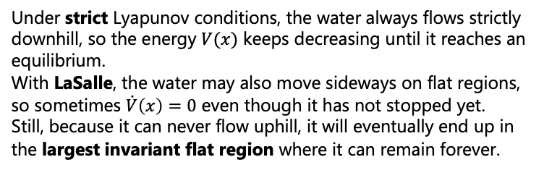
LaSalles Invariance Principle
sometimes it is difficult to find $\dot{V}<0$ for asy. stability; relax it to $\dot{V}≤0$ with LaSalle
Intuitively:
Under strict Lyapunov conditions, the water always flows strictly downhill, so the energy $V(x)$ keeps decreasing until it reaches an equilibrium.
With LaSalle, the water may also move sideways on flat regions, so sometimes $\dot{V}\left(x\right)=0$ even though it has not stopped yet.
Still, because it can never flow uphill, it will eventually end up in the largest invariant flat region where it can remain forever.

Slide 17
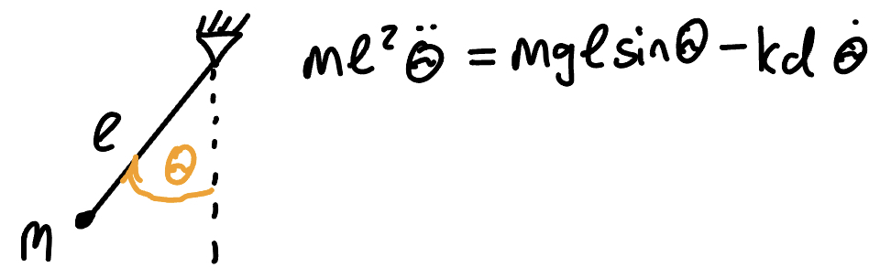
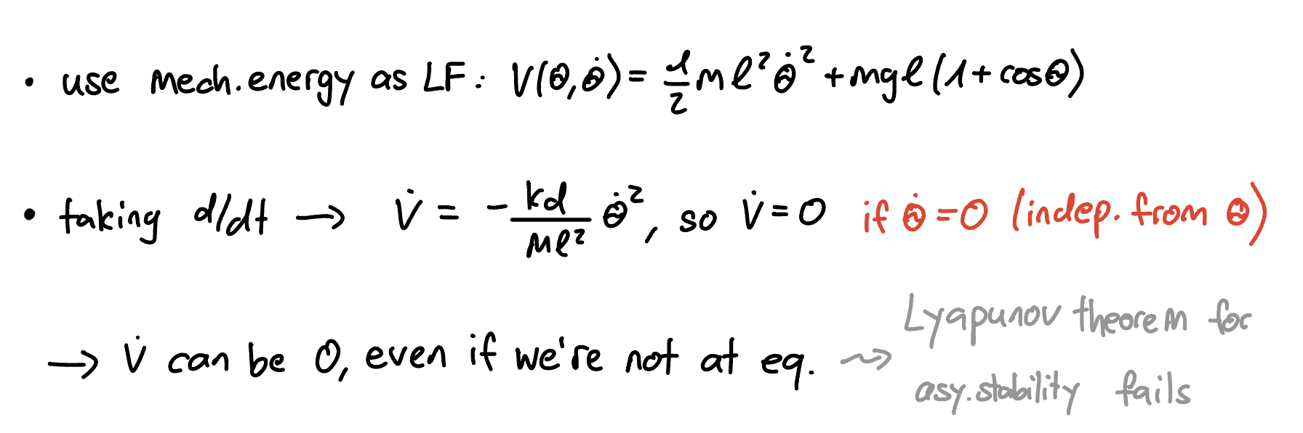
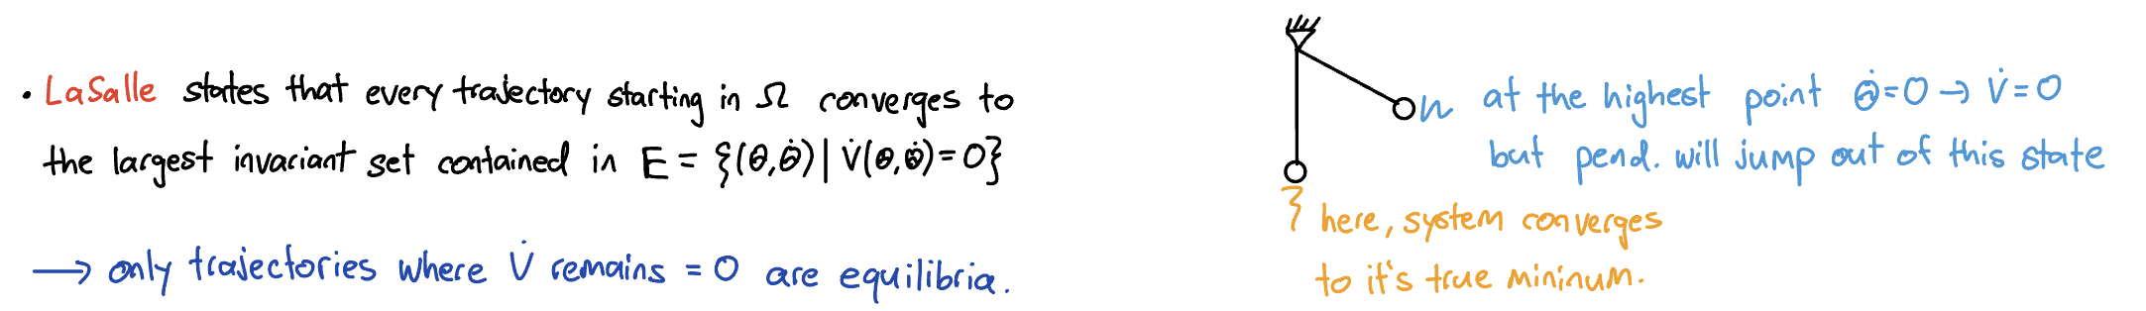
Example
let's consider this pendulum
intuitively we know, that it will go to $θ= 0$, we now want to prove this asy. stable behaviour

Slide 18
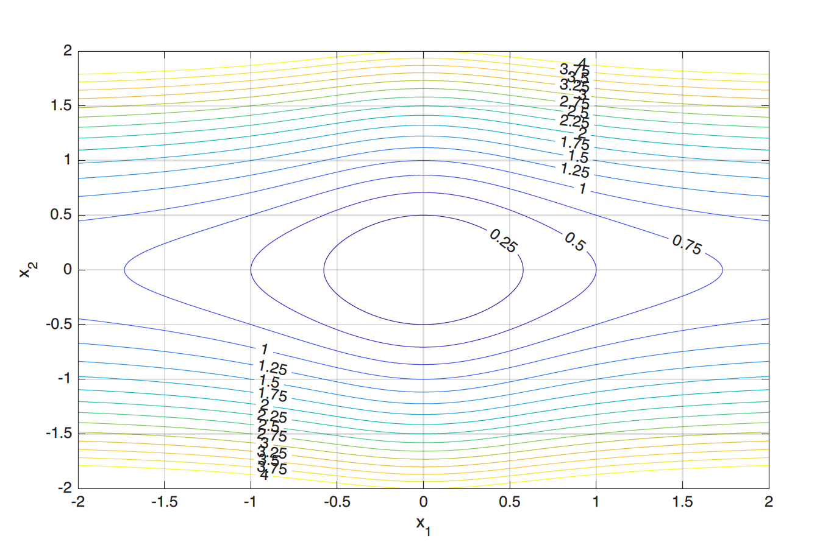
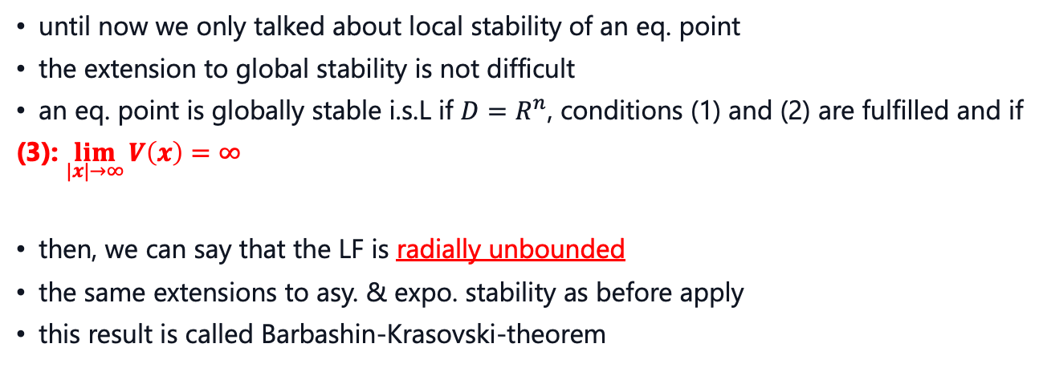
Global Stability
until now we only talked about local stability of an eq. point
the extension to global stability is not difficult
an eq. point is globally stable i.s.L if $D=R^{n}$, conditions (1) and (2) are fulfilled and if
(3): $\lim_{|x|→∞}{V\left(x\right)}=∞$
then, we can say that the LF is radially unbounded
the same extensions to asy. & expo. stability as before apply
this result is called Barbashin-Krasovski-theorem

Slide 19
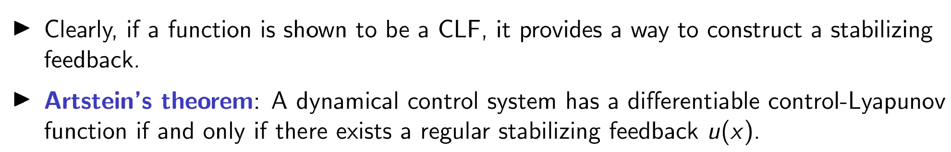

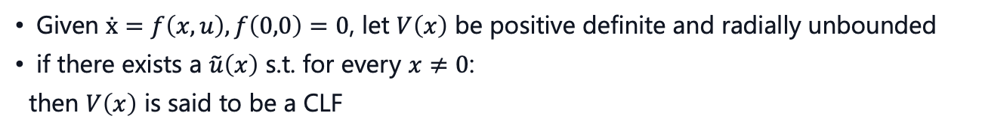
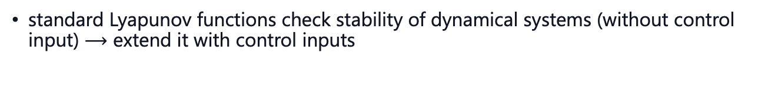
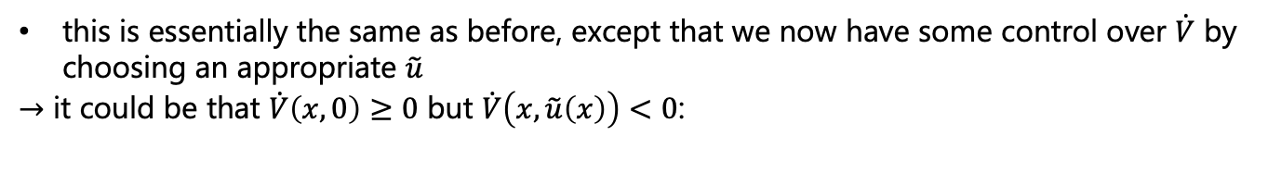
Control Lyapunov Functions
standard Lyapunov functions check stability of dynamical systems (without control input) $⟶$ extend it with control inputs
Given $ẋ=f\left(x,u\right),f\left(0,0\right)=0$, let $V\left(x\right)$ be positive definite and radially unbounded
if there exists a $\tilde{u}\left(x\right)$ s.t. for every $x≠0$:
then $V\left(x\right)$ is said to be a CLF
$$\dot{V}\left(x,\tilde{u}\left(x\right)\right)=\frac{∂V}{∂x}f\left(x,\tilde{u}\right)<0$$
this is essentially the same as before, except that we now have some control over $\dot{V}$ by choosing an appropriate $\tilde{u}$
$→$ it could be that $\dot{V}\left(x,0\right)≥0$ but $\dot{V}\left(x,\tilde{u}\left(x\right)\right)<0$:

Slide 20
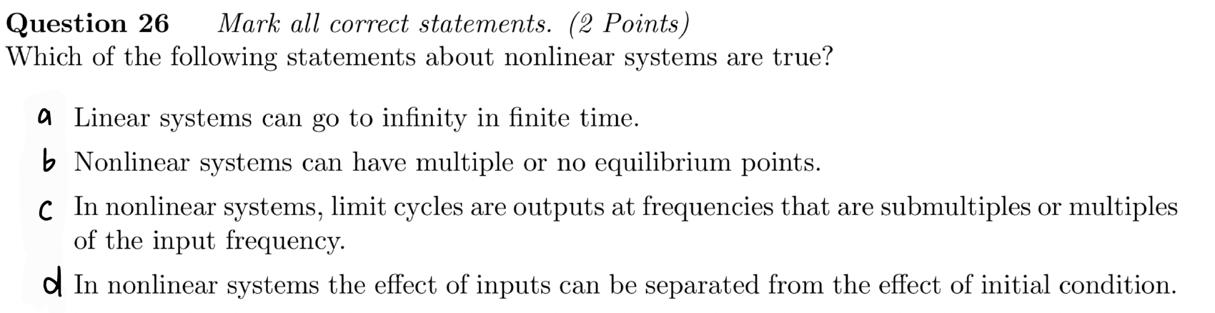
Exam Question
B)

Slide 21
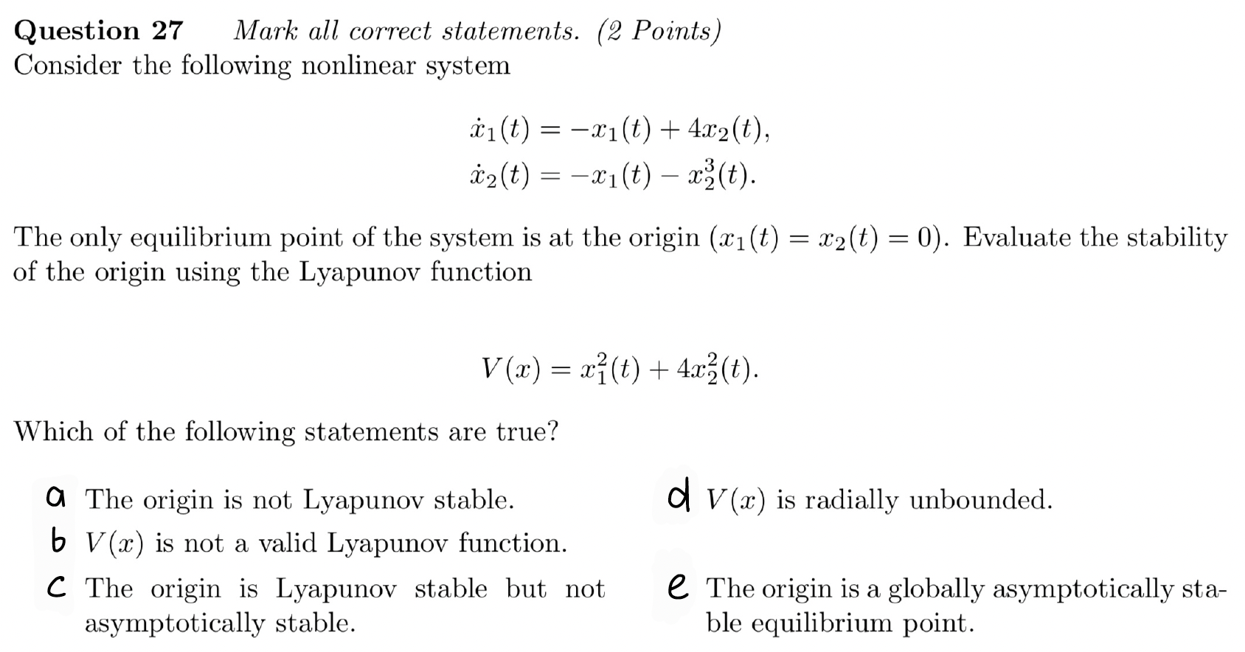
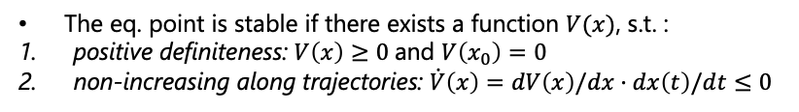
Exam Question
The eq. point is stable if there exists a function $V(x)$, s.t. :
positive definiteness: $V\left(x\right)≥0$and $V\left(x_{0}\right)=0$
non-increasing along trajectories: $\dot{V}\left(x\right)=dV\left(x\right)/dx·dx\left(t\right)/dt≤0$

Slide 22
The eq. point is stable if there exists a function $V(x)$, s.t. :
positive definiteness: $V\left(x\right)≥0$and $V\left(x_{0}\right)=0$
non-increasing along trajectories: $\dot{V}\left(x\right)=dV\left(x\right)/dx·dx\left(t\right)/dt≤0$

Slide 23
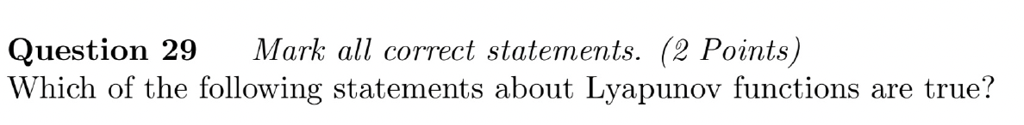
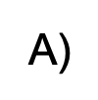
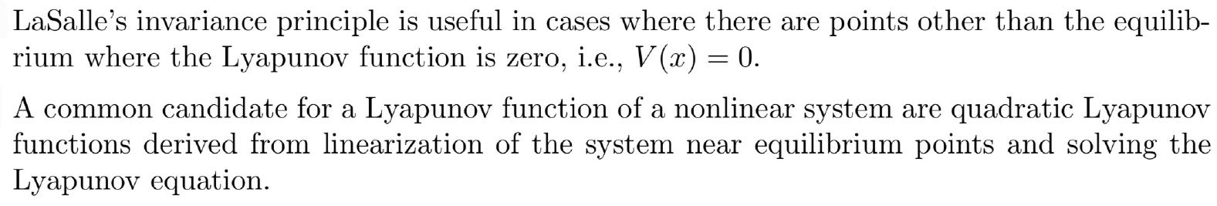


Exam Question
$$\dot{V}=0!$$
B)
$$\dot{V}={−x}^{T}Qx$$
$$A^{T}P+PA=−Q$$
$$V=x^{T}Px$$

Slide 24
3. Feedback Linearization

Slide 25
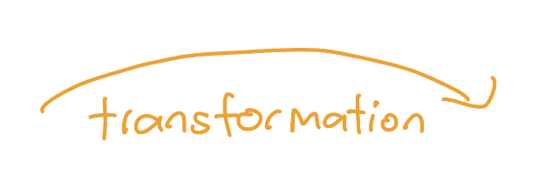
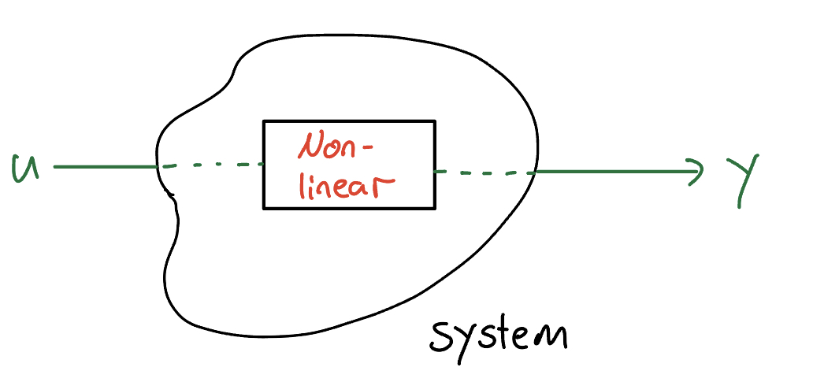
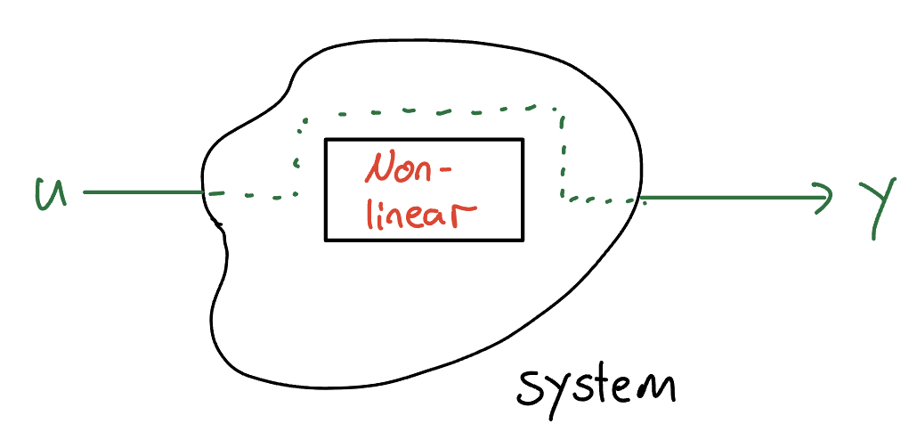
Intuition
Previously we learned how to analyze stability of nonlinear systems
Now we're looking at how we can implement a feedback loop for a nonlinear system in a clever way
this involves transforming the nonlinear system into one that behaves linear with a coordinate transformation
$⇒$ The technique we apply to get this effect is called: Feedback Linearization

Slide 26
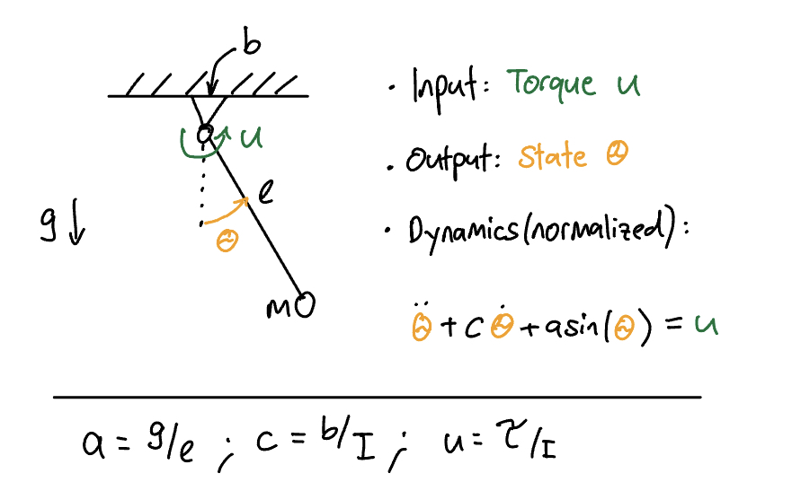
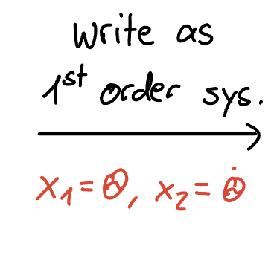
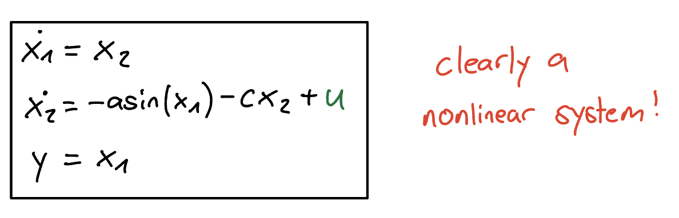
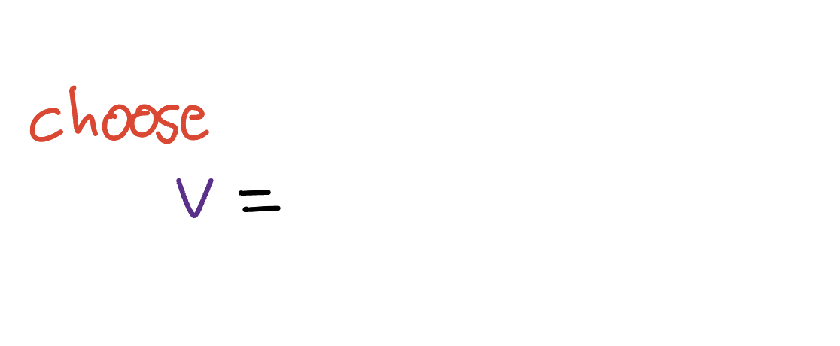
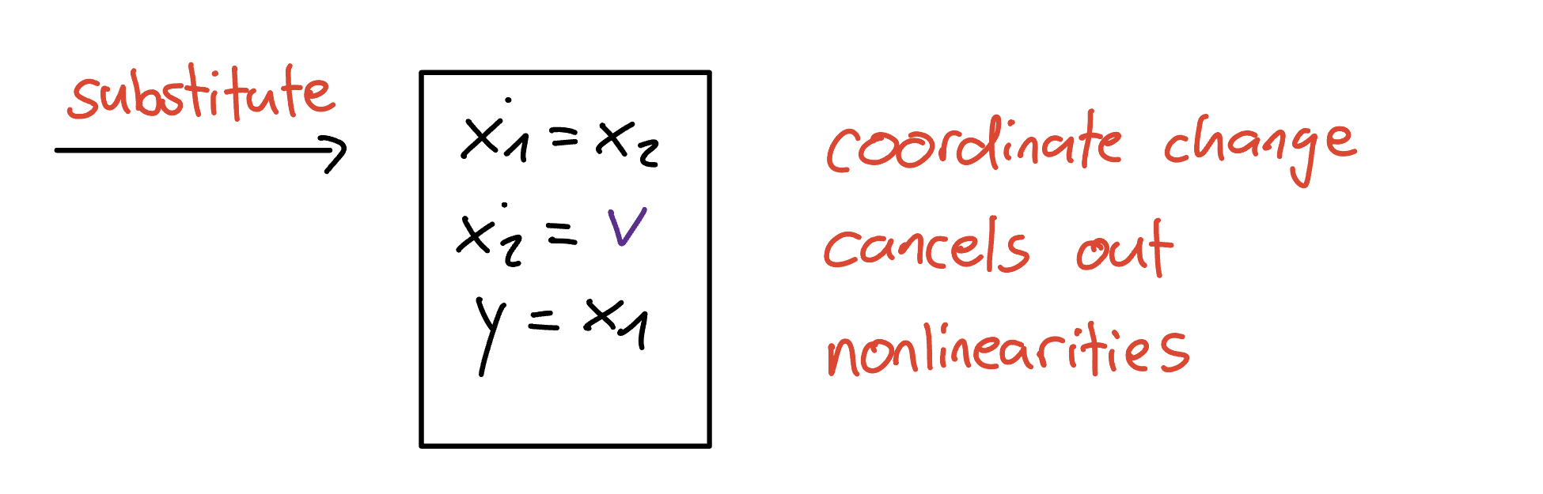
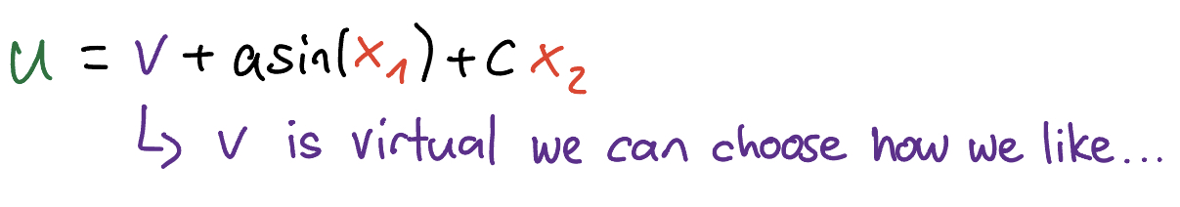


Example
The trick now is how we choose the input $u ⇒$ introduce a virtual control input $v$
The actual physical input remains $u$, we write it as:

Slide 27


Example
Design a stabilizing feedback law:
$⇒$ Eigenvalues can be chosen freely!
Can’t we just use this for any nonlinear system?
Designing a control law like this requires some assumptions:
We know the system well enough to allow for state feedback
The system must have a certain structure
Systems to which we can apply feedback linearization have a geometric property called…

Slide 28




Differential Flatness
$⇒$ iff a system is differential flat, we can apply feedback linearization
Def.: A system
$$\dot{x}=f\left(x,u\right)$$
$$y=h\left(x,u\right)$$
$⇒$ "flat output"
is differentially flat, if one can compute all $x$ and $u$ as a function of $y$ and derivatives of $y$
$⇒$ there is a mapping, s.t. $\left(x,u\right)≡\left(y,\dot{y},…,y^{\left(m\right)}\right),m\hat{=} \text{finit}\text{e}$
Note: the flat output y is not necessarily the system output
Example: is the pendulum differentially flat?

Slide 29





Last Example
Check whether all states and inputs can be expressed through a flat output and its derivatives
$→$ If yes, the system is differentially flat
$⇒$ it turns out the system is flat with the flat output $\left(p_{1},p_{2}\right)$:
$⇒$ By knowing only the car’s position over time, we can reconstruct all states and inputs at all times

Slide 30
Feedback?
Too fast? Too slow? Less theory, more exercises?
I would appreciate your feedback. Please let me know.

