Slide 1
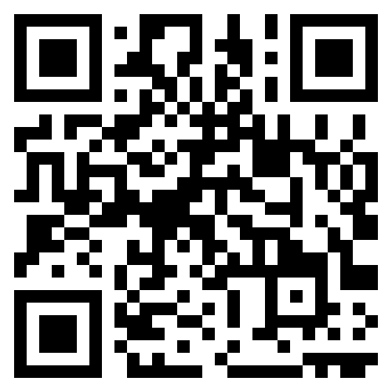
CS1 Week 8
Proportional Feedback, Root Locus

Slide 2
Recap Last Week

Slide 3
Quiz 1
The Root Locus plot is a plot that shows…
A. that shows us how a closed-loop system behaves for different poles/zeros
B. that shows us how a closed-loop system behaves for different gains
C. that shows us how a closed-loop system behaves when we close our eyes

Slide 4




Quiz 1
Pole-Zero Plot Closed-Loop
calculating closed-loop pole:
$$Im$$
$$s+k−1=0⇒s=1−k$$
x
The Root Locus plot is a plot that shows…
$$k=∞$$
$$k=0$$
$$Re$$
A. that shows us how a closed-loop system behaves for different poles/zeros
B. that shows us how a closed-loop system behaves for different gains
C. that shows us how a closed-loop system behaves when we close our eyes

Slide 5
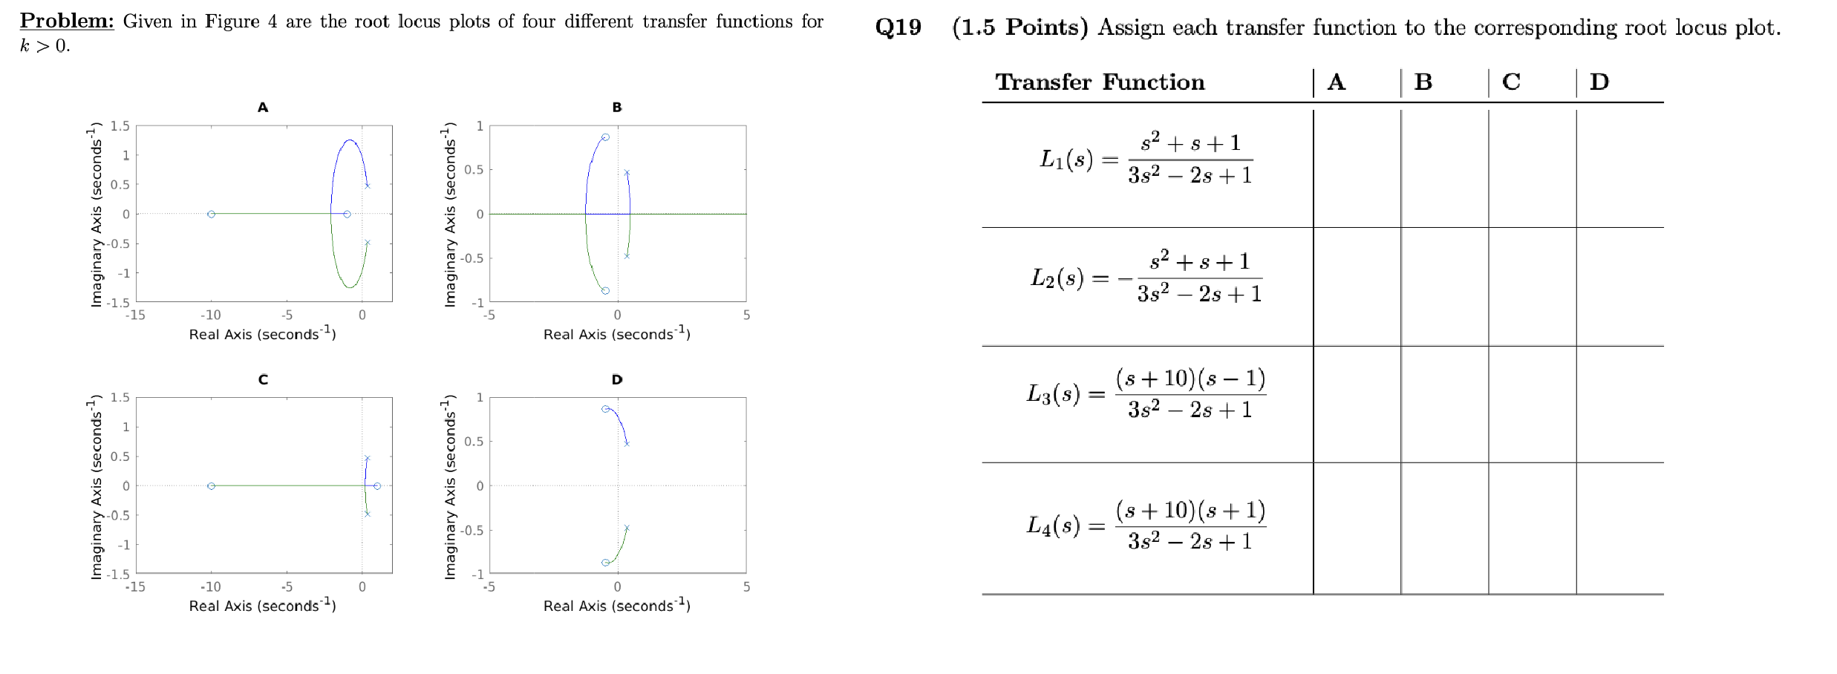
Quiz 2

Slide 6
Quiz 2
x
x
x
x

Slide 7
Course Schedule
Subject | Week
Introduction, Control Architectures, Motivation | 1
Modeling, Model examples | 2
System properties, Linearization | 3
Analysis: Time response, Stability | 4
Transfer functions 1: Definition and properties | 5
Transfer functions 2: Poles and Zeros | 6
Proportional feedback control, Root Locus | 7
Time-Domain specifications, PID control, Computer implementation | 8
Frequency response, Bode plots | 9
The Nyquist condition, Time delays | 10
Frequency-domain Specifications, Dynamic Compensation, Loop Shaping | 11
Time delays, Successive loop closure, Nonlinearities | 12
Describing functions | 13
Intro to Uncertainty and Robustness | 14
Modeling
Analysis
Synthesis

Slide 8
Today
System Specifications
Time-Domain Specifications

Slide 9
1. System Specifications

Slide 10
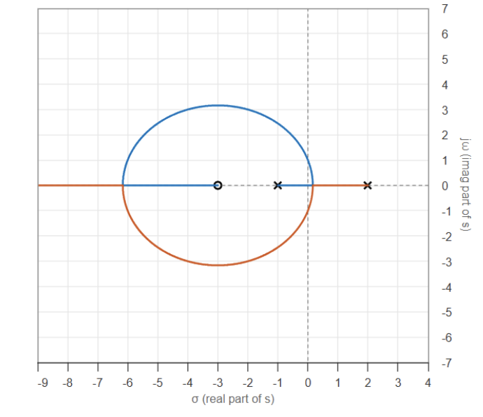

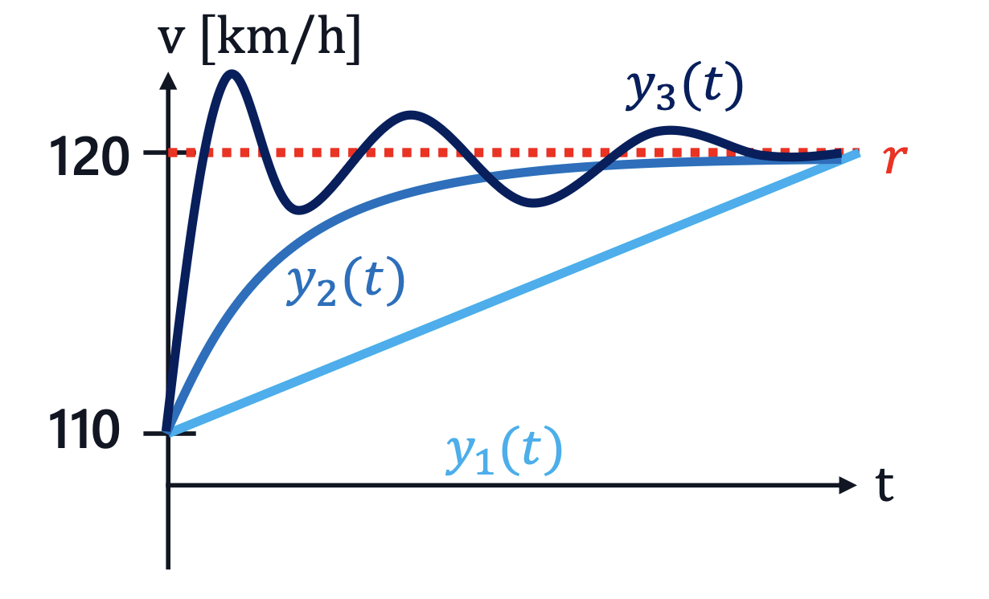







Introduction
$$r$$
$$e$$
$$u$$
$$y$$
$$k$$
$$P(s)$$
$$−$$
Week 7: Closed-Loop Stability
Job is finished?
Week 8: Closed-Loop Specifications
We need to make sure it's quick and can handle disturbances and errors well!

Slide 11




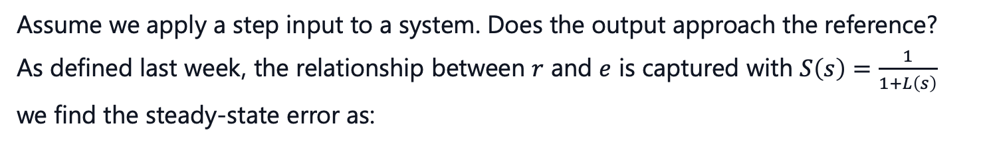






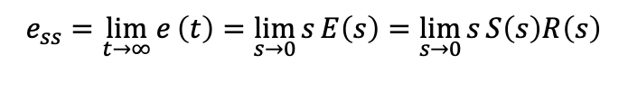
Steady-State Error
$$r$$
$$e$$
$$u$$
$$y$$
$$P(s)$$
$$C\left(s\right)$$
$$−$$
Assume we apply a step input to a system. Does the output approach the reference?
As defined last week, the relationship between $r$ and $e$ is captured with $S\left(s\right)=\frac{1}{1+L\left(s\right)}$
we find the steady-state error as:
using FVT
$$r\left(t\right)$$
$$e_{ss}=\lim_{t→∞}{e}\left(t\right)=\lim_{s→0}{s}E\left(s\right)=\lim_{s→0}{s}S\left(s\right)R\left(s\right)$$
$$e_{ss}$$
step input $R\left(s\right)=\frac{1}{s}$, hence
$$y\left(t\right)$$
$$e_{ss}=\lim_{s→0}{s}⋅\frac{1}{1+C\left(s\right)P\left(s\right)}⋅\frac{1}{s}=\frac{1}{1+C\left(0\right)P\left(0\right)}$$
$$t$$
That means, that for $e_{ss}$ to be zero $L\left(0\right)=C\left(0\right)P\left(0\right)=∞$
We need a pole at $s=0$!
$⟶$ What feature must the general $L\left(s\right)$ have this to be true?
Integrators!

Slide 12

Integrators
If constant error is integrated, it steadily grows
Controller tries to minimize this growth and drives $e(t)$ to zero

Slide 13
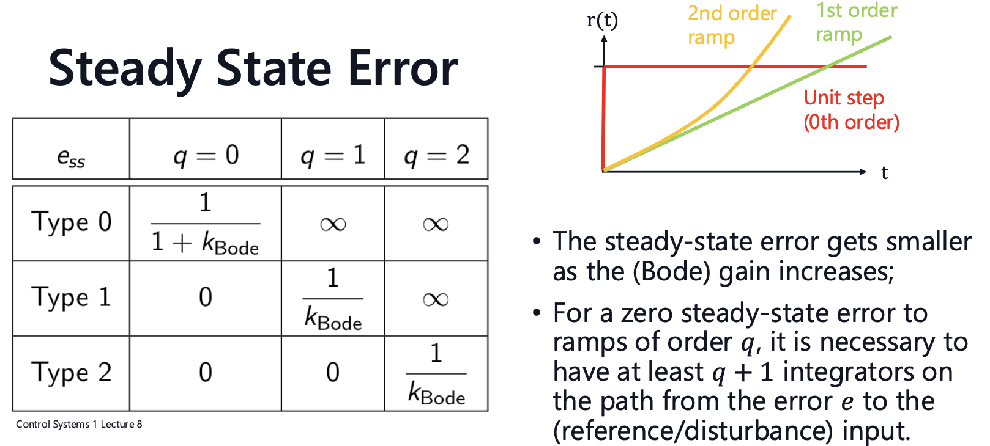

Slide 14
2. Time-Domain Specifications

Slide 15









Time-Domain Specifications
$$y\left(t\right)$$
$$M_{p}$$
$T_{100\%}$: Rise Time
$T_{p}:$ Peak Time
$T_{d}$: Settling Time
$M_{p}:$ Peak Overshoot
$$120$$
$$r$$
$$T_{d}$$
$$T_{p}$$
$$t$$
$$T_{100\%}$$

Slide 16
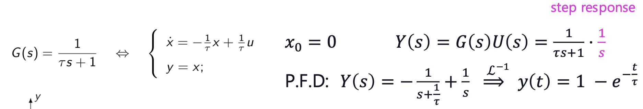

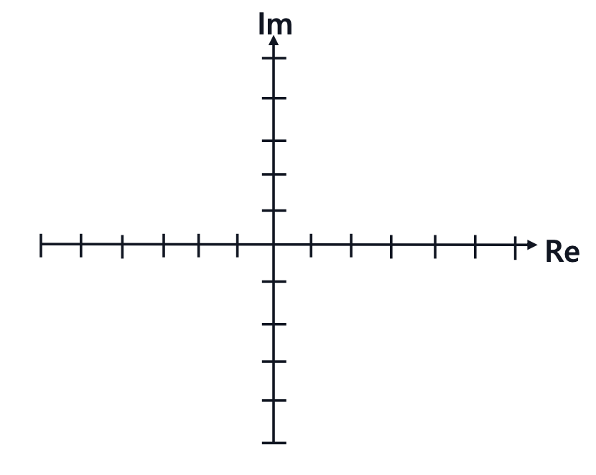
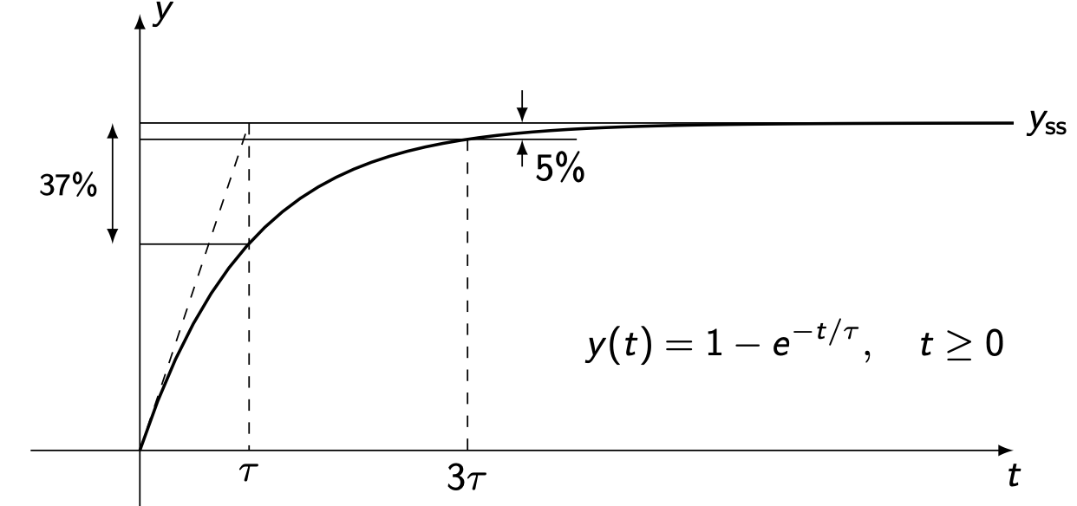

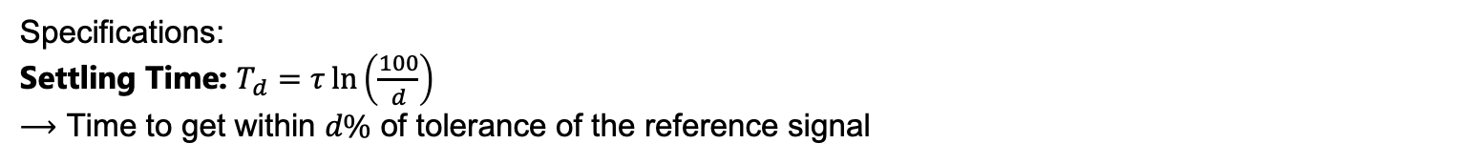


Step Response of a 1st Order System
$$y$$
$$−\frac{1}{τ}$$
x
Specifications: Settling Time:
Time to get within $d\%$ of tolerance of the reference signal

Slide 17
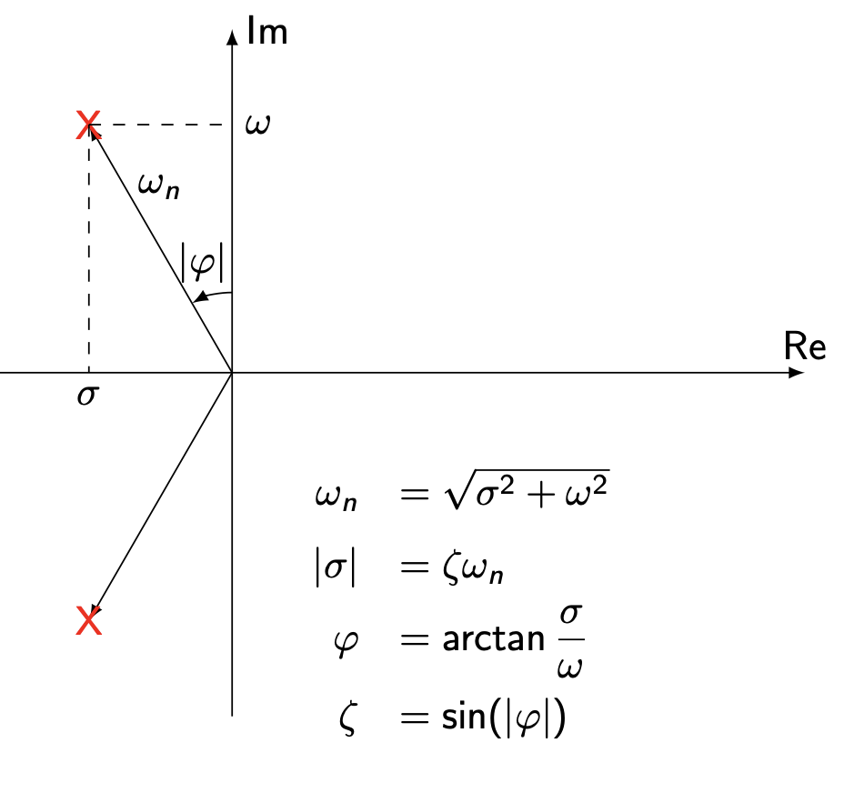
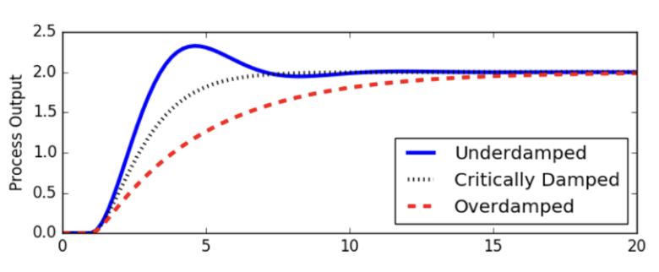
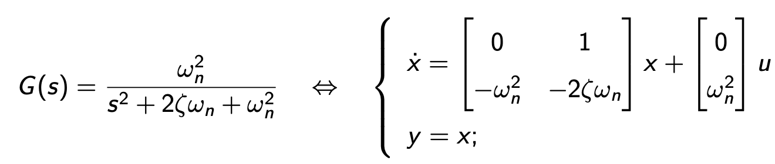
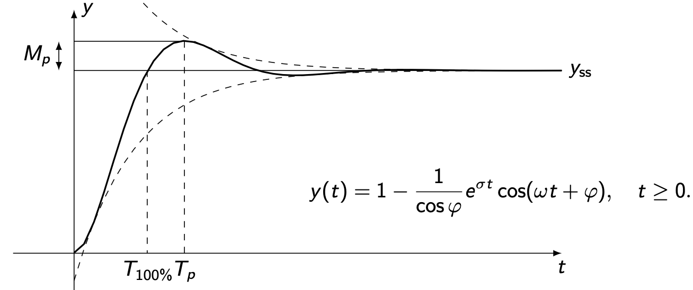
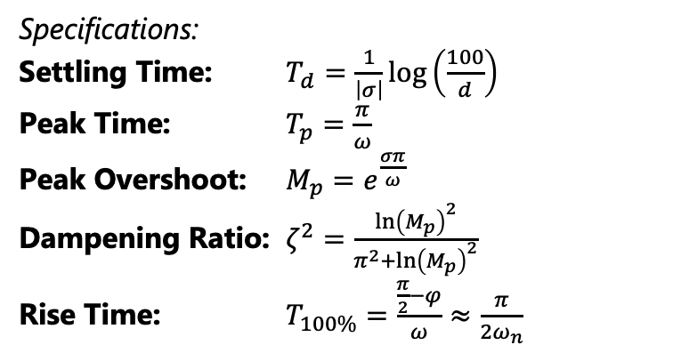

Step Response of a 2nd Order System
For an underdamped system $\left(ζ<1\right)$:
Specifications:
Settling Time: $T_{d}=\frac{1}{\left|σ\right|}log\left(\frac{100}{d}\right)$
Peak Time: $T_{p}=\frac{π}{ω}$
Peak Overshoot: $M_{p}=e^{\frac{σπ}{ω}}$
Dampening Ratio: $ζ^{2}=\frac{{\ln\left(M_{p}\right)}^{2}}{π^{2}+{\ln\left(M_{p}\right)}^{2}}$
Rise Time: $T_{100\%}=\frac{\frac{π}{2}−φ}{ω}≈\frac{π}{2ω_{n}}$

Slide 18

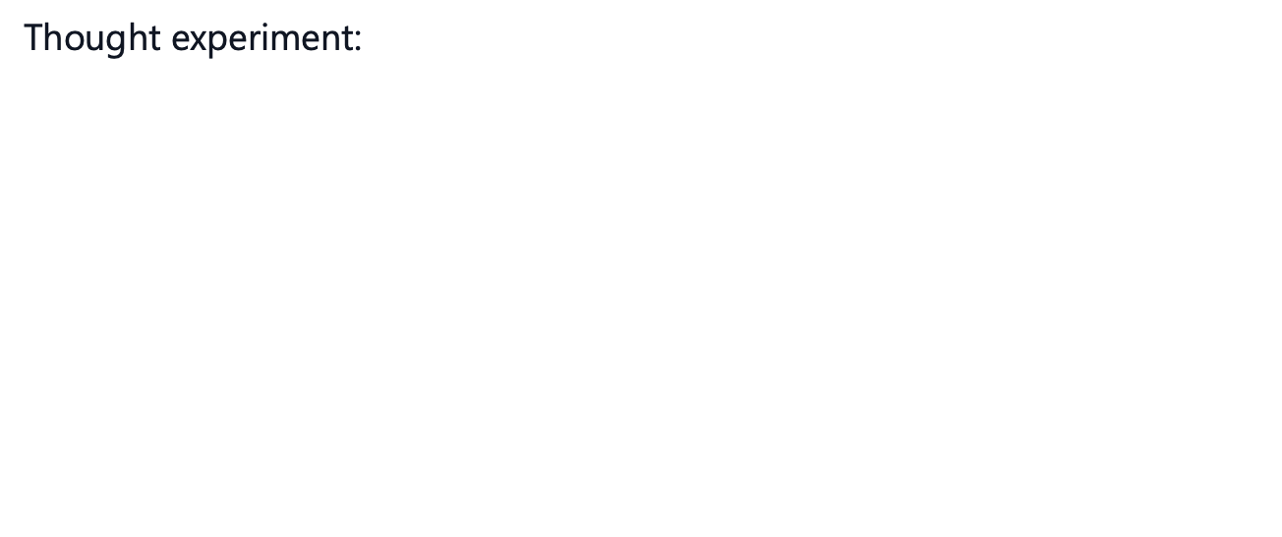
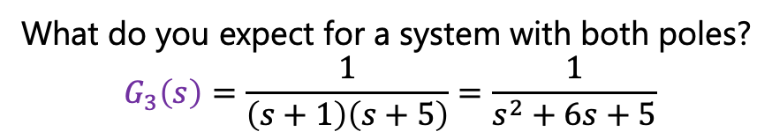
Dominant Poles Approximation
Thought experiment:
$G_{1}\left(s\right)=\frac{1}{s+1}$
$$G_{2}\left(s\right)=\frac{1}{s+5}$$
What do you expect for a system with both poles?
$$G_{3}\left(s\right)=\frac{1}{\left(s+1\right)\left(s+5\right)}=\frac{1}{s^{2}+6s+5}$$
Poles closer to the origin have a higher influence!!

Slide 19
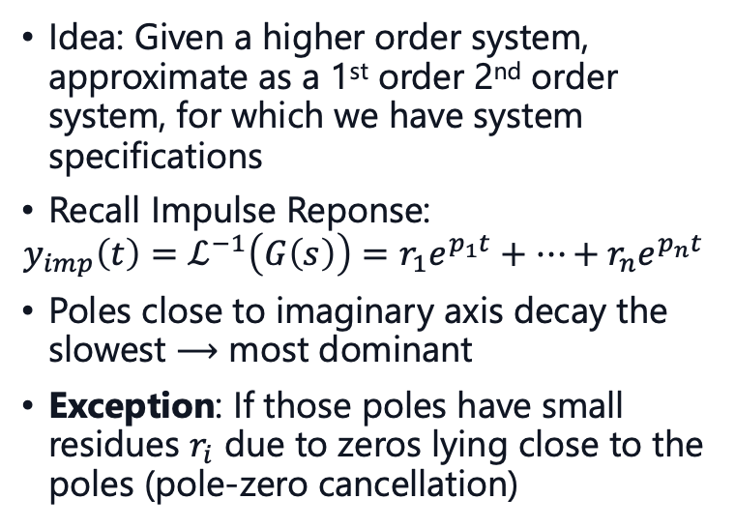
Dominant Poles Approximation
Idea: Given a higher order system, approximate as a 1st order 2nd order system, for which we have system specifications
Recall Impulse Reponse:
$y_{imp}\left(t\right)=ℒ^{−1}\left(G\left(s\right)\right)=r_{1}e^{p_{1}t}+…+r_{n}e^{p_{n}t}$
Poles close to imaginary axis decay the slowest $⟶$ most dominant
Exception: If those poles have small residues $r_{i}$ due to zeros lying close to the poles (pole-zero cancellation)
x
x
dominant
x
x
x
x
x
o
x
o
x
dominant
x

Slide 20
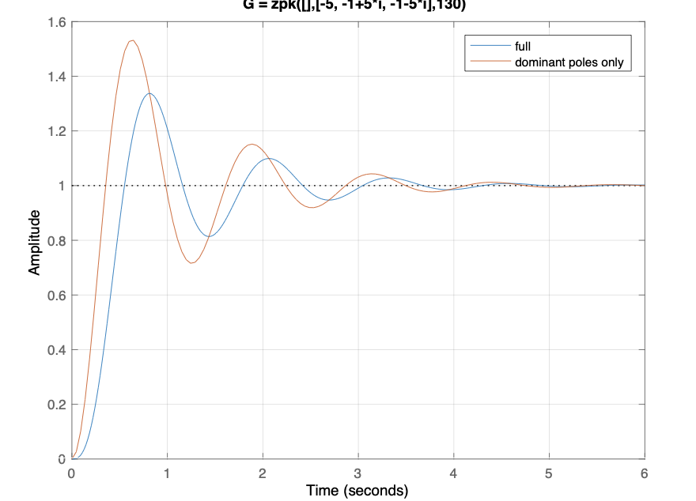
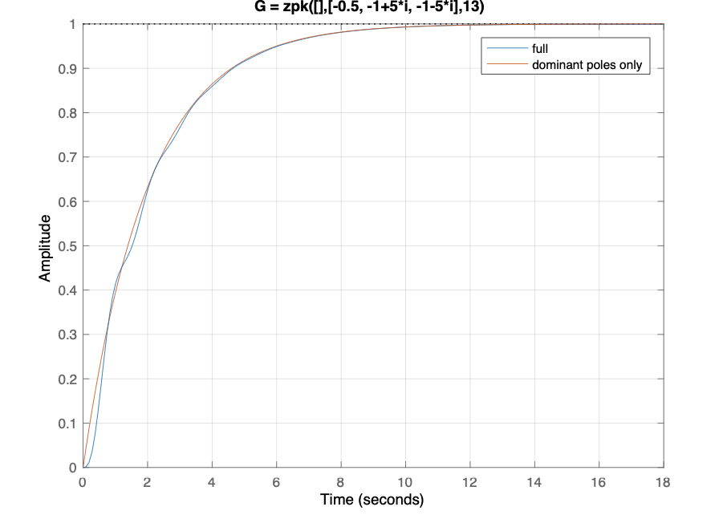
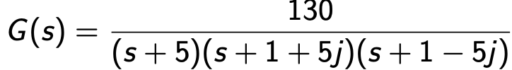
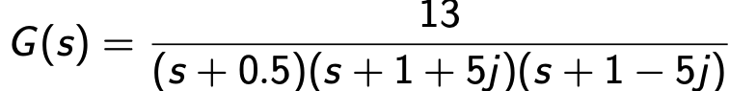
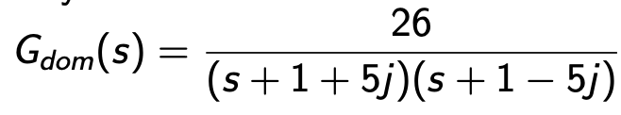
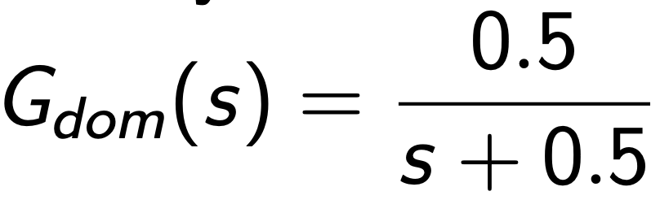
Dominant Poles Approximation

Slide 21
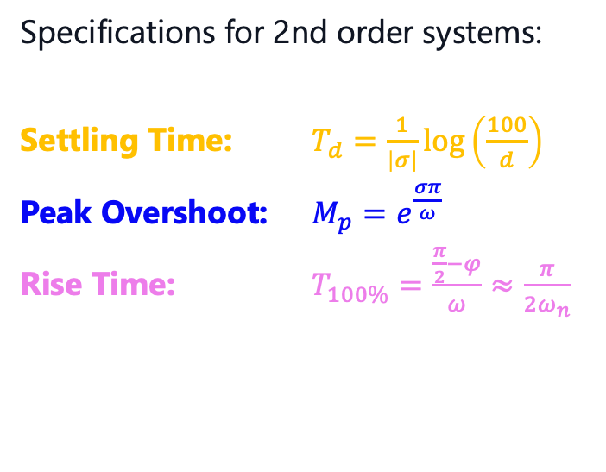
Time-Domain Specifications Visualization
Specifications for 2nd order systems:
Settling Time: $T_{d}=\frac{1}{\left|σ\right|}log\left(\frac{100}{d}\right)$
Peak Overshoot: $M_{p}=e^{\frac{σπ}{ω}}$
Rise Time: $T_{100\%}=\frac{\frac{π}{2}−φ}{ω}≈\frac{π}{2ω_{n}}$
x
o
x

Slide 22
3. PID-Control

Slide 23
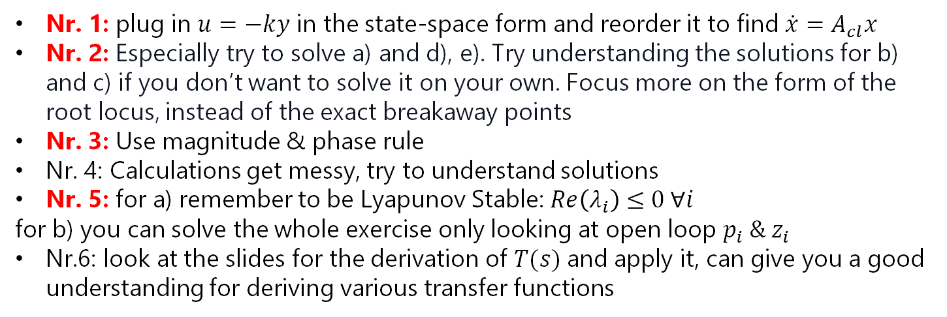

Tips for Problem Set 6
I personally would recommend solving at least the problems marked red
Easy | Medium | Hard
$$3$$ | $$1,2,5$$ | $$4,6$$
Nr. 1: plug in $u=−ky$ in the state-space form and reorder it to find $\dot{x}=A_{cl}x$
Nr. 2: Especially try to solve a) and d), e). Try understanding the solutions for b) and c) if you don’t want to solve it on your own. Focus more on the form of the root locus, instead of the exact breakaway points
Nr. 3: Use magnitude & phase rule
Nr. 4: Calculations get messy, try to understand solutions
Nr. 5: for a) remember to be Lyapunov Stable: $Re\left(λ_{i}\right)≤0 ∀i$
for b) you can solve the whole exercise only looking at open loop $p_{i} \& z_{i}$
Nr.6: look at the slides for the derivation of $T(s)$and apply it, can give you a good understanding for deriving various transfer functions

Slide 24
Questions?

Slide 25
Feedback?
Too fast? Too slow? Less theory, more exercises?
I would appreciate your feedback. Please let me know.
https://docs.google.com/forms/d/e/1FAIpQLSdHl0kjWo63aNzDkAV0cnmQadCAj5L0D7v7aSh0BK7BBdEgpA/viewform?usp=header

