Slide 1
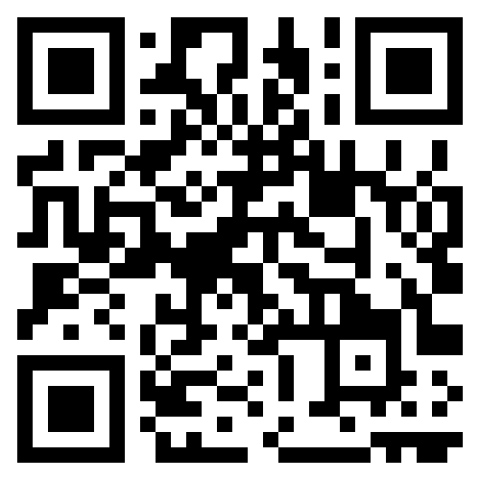
CS1 Week 11 Empty
Frequency-domain Specifications, Loop shaping

Slide 2
Recap Last Week

Slide 3

Quiz 1
What does a single point in the polar plot of a system $G\left(jω\right)$ represent?
A. The open-loop gain $k$ at frequency $ω$
B. The complex value $G\left(jω\right)$, consisting of magnitude and phase
C. Only the phase of $G\left(jω\right)$, plotted as an angle on the imaginary axis
D. Only the magnitude of $G\left(jω\right)$, plotted as a radius

Slide 4
Quiz 2
Which of the following statements are correct?
A. With Nyquist we can determine closed-loop stability only by looking at the open-loop
B. $N=Z−P$, with $N=$encirclements about $−1/k$; $Z=$open-loop zeros; $P=$ open-loop poles
C. $N=Z−P$, with $N=$encirclements about $−1/k$; $Z=$closed-loop poles; $P=$ open-loop poles
D. Nyquist is a more robust way to determine stability of a closed-loop system

Slide 5
Quiz 3
Which of the following statements about Nyquist plots are correct?
A. They are symmetric w.r.t. the real axis
B. The frequency is implicit in the Nyquist plot
C. We can add Nyquist Plots of different TFs on top of each other
D. They start at $ω=∞$ and end at $ω=0$

Slide 6
Course Schedule
Subject | Week
Introduction, Control Architectures, Motivation | 1
Modeling, Model examples | 2
System properties, Linearization | 3
Analysis: Time response, Stability | 4
Transfer functions 1: Definition and properties | 5
Transfer functions 2: Poles and Zeros | 6
Proportional feedback control, Root Locus | 7
Time-Domain specifications, PID control | 8
Frequency response, Bode plots | 9
Polar plots, The Nyquist condition | 10
Frequency-domain Specifications, Dynamic Compensation, Loop Shaping | 11
Time delays, Successive loop closure, Nonlinearities | 12
Describing functions | 13
Intro to Uncertainty and Robustness | 14
Modeling
Analysis
Synthesis

Slide 7
Today
Gain & Phase Margin
Frequecy-Domain Specifications
Loop Shaping

Slide 8
1. Gain & Phase Margin

Slide 9
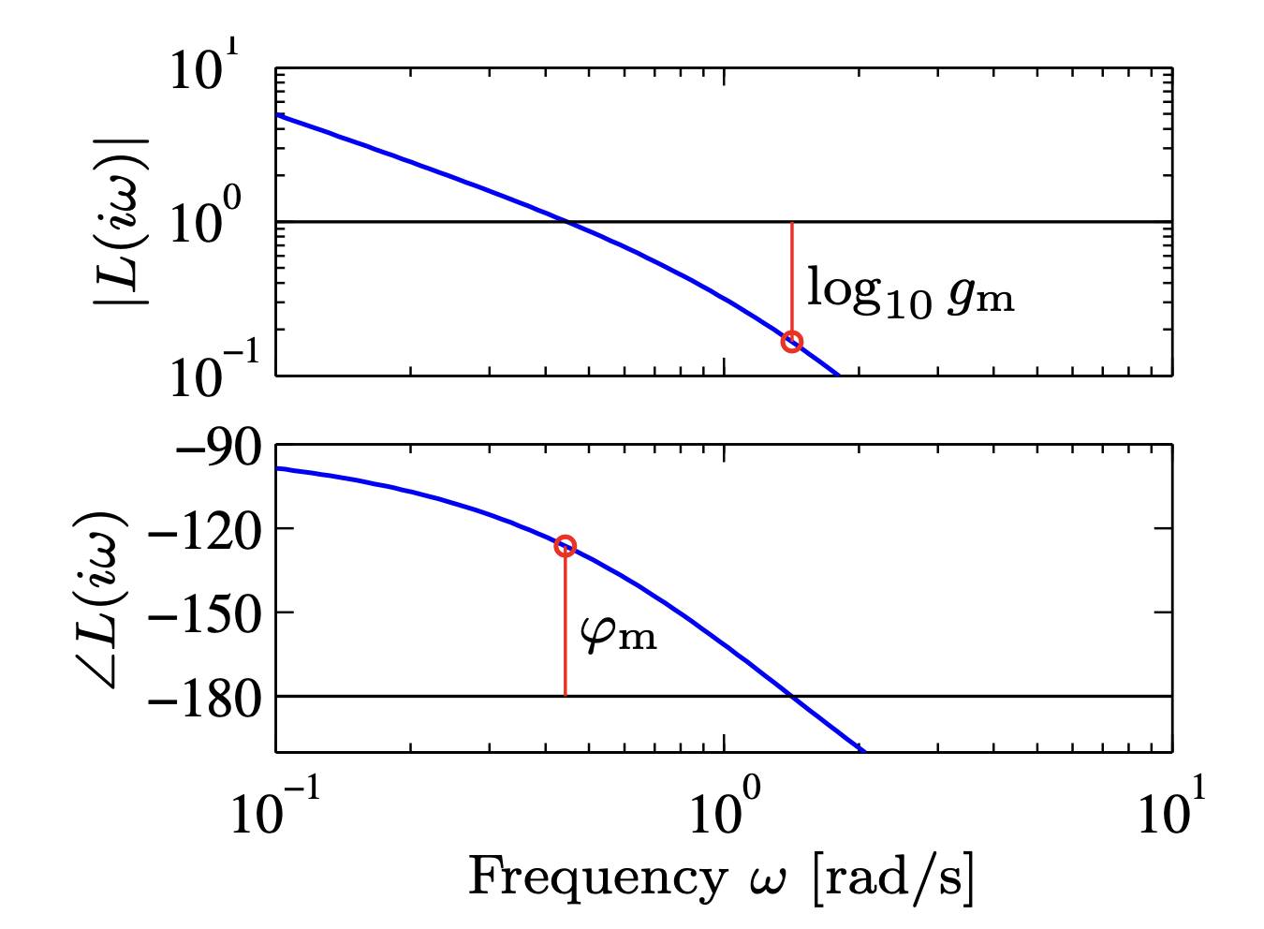
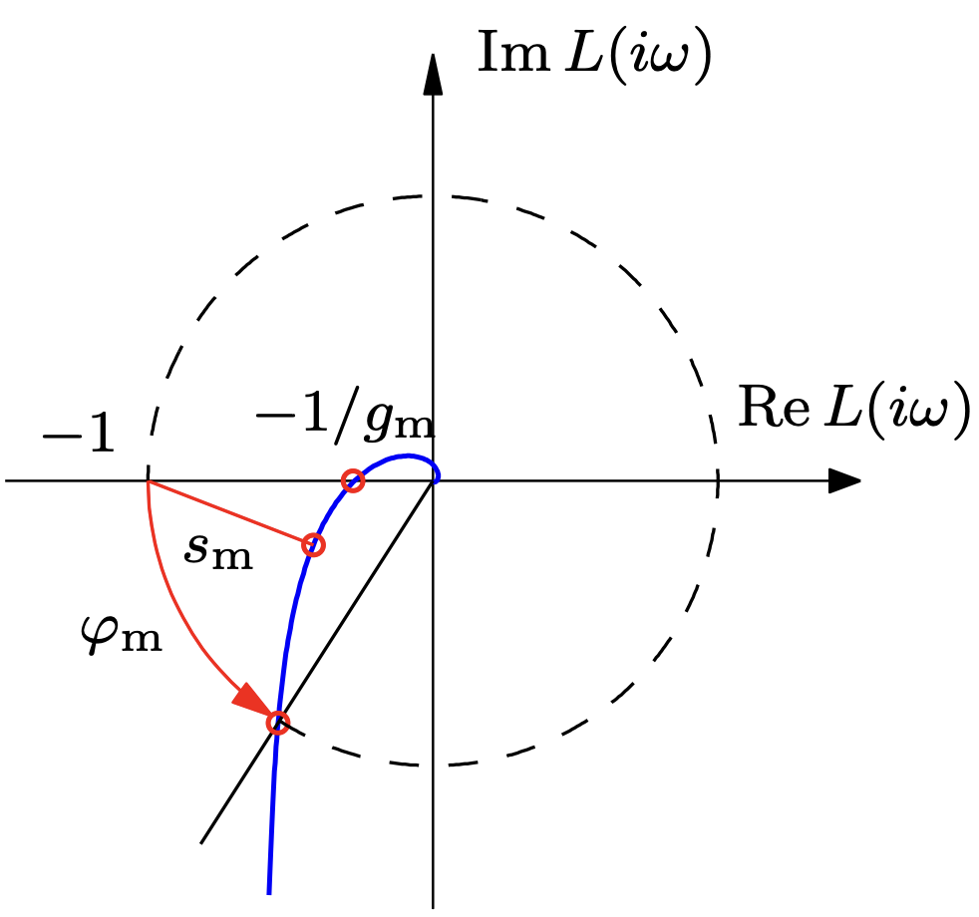
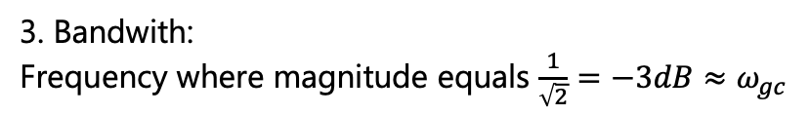
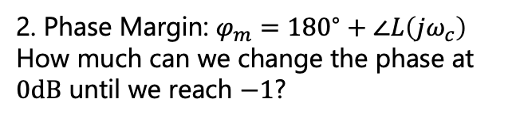
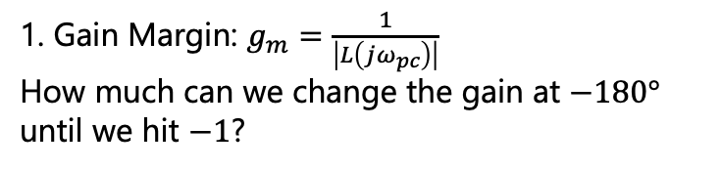

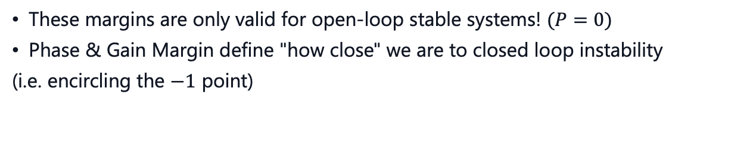

Gain & Phase Margin
$$N=Z−P$$
$⟶$for stability we need $N=0$
These margins are only valid for open-loop stable systems! $(P=0)$
Phase & Gain Margin define "how close" we are to closed loop instability
(i.e. encircling the $−1$ point)
1. Gain Margin: $g_{m}=\frac{1}{\left|L\left(jω_{pc}\right)\right|}$
How much can we change the gain at $−180°$ until we hit $−1$?
2. Phase Margin: $φ_{m}={180}^{∘}+∠L\left(jω_{c}\right)$
How much can we change the phase at $0dB$ until we reach $−1$?
3. Bandwith:
Frequency where magnitude equals $\frac{1}{\sqrt{2}}=−3dB≈ω_{gc}$
measures how fast CL-System can react

Slide 10
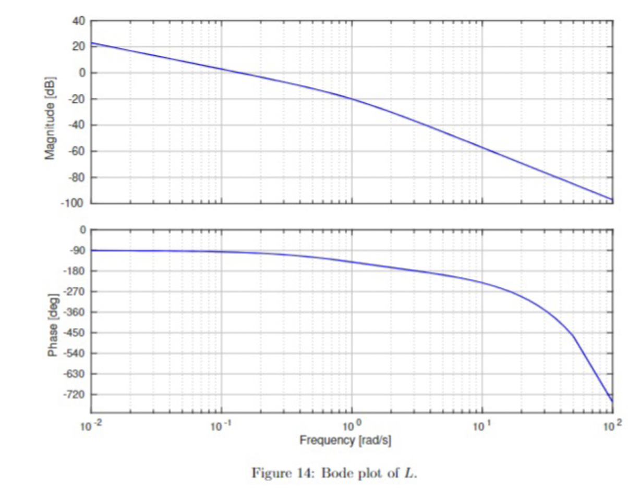
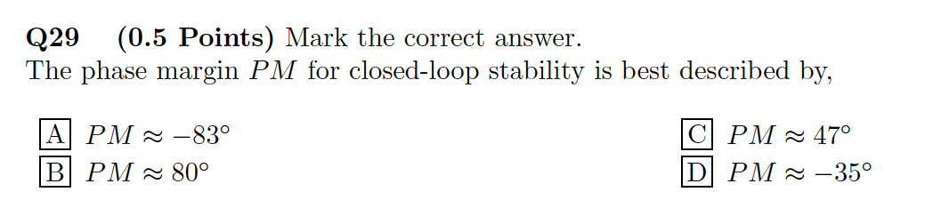
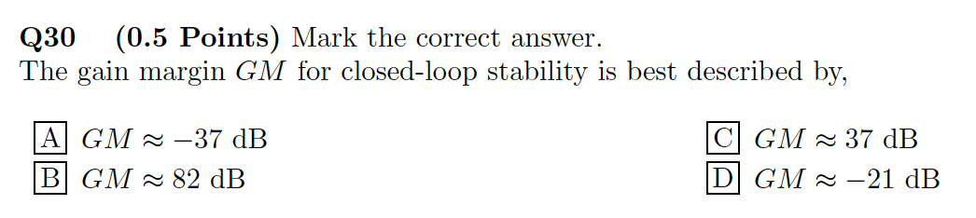
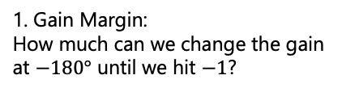
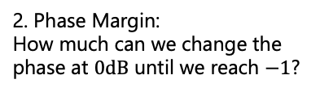
Exam Problem
1. Gain Margin:
How much can we change the gain at $−180°$ until we hit $−1$?
2. Phase Margin:
How much can we change the phase at $0dB$ until we reach $−1$?

Slide 11
2. Frequency-domain Specifications

Slide 12
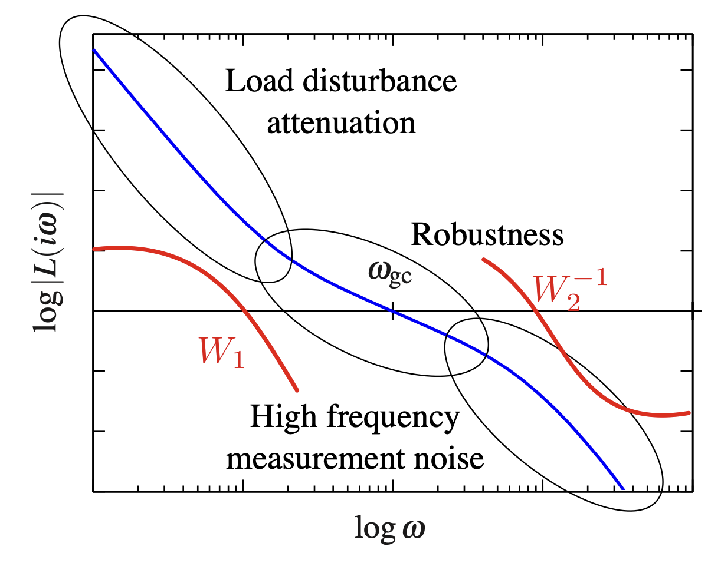
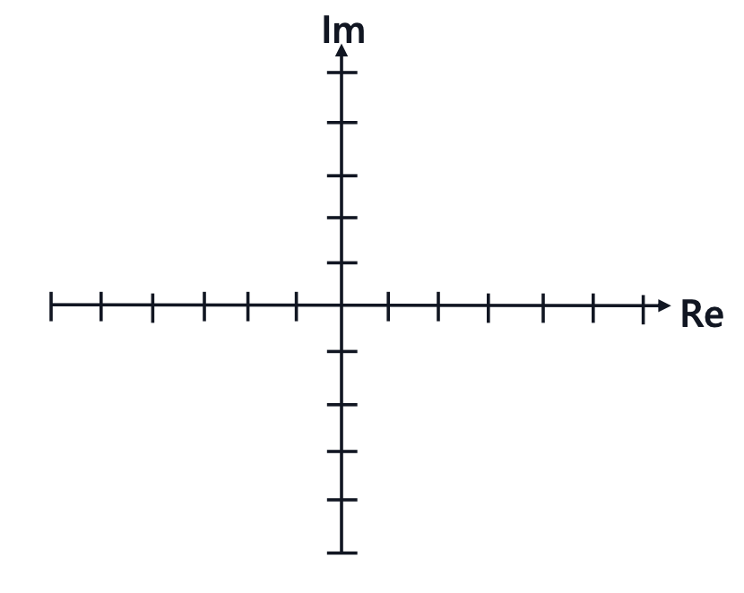

Overview
Three weeks ago, we looked at the time-domain specifications which looked like this:
Today, we're going to look at the frequency-domain specifications which look like this:
x
o
x

Slide 13

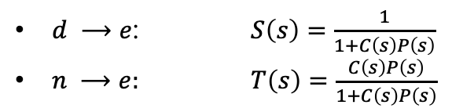








Noise & Disturbance
Let’s take a closer look at how exactly our system can be affected:
$$d$$
$$r$$
$$e$$
$$u$$
$$y$$
$$C\left(s\right)$$
$$P(s)$$
$$−$$
$$n$$
The effect of $d$ and $n$ on the system can be seen from the corresponding transfer functions:
$d ⟶e$: $S\left(s\right)=\frac{1}{1+C\left(s\right)P\left(s\right)}$
$n ⟶e:$ $T\left(s\right)=\frac{C\left(s\right)P\left(s\right)}{1+C\left(s\right)P\left(s\right)}$
The effect of both $n$ and $d$ on $e$ should be as small as possible
That means, both $S\left(s\right)$ and $T\left(s\right)$ should be as small as possible
There’s one small issue…

Slide 14
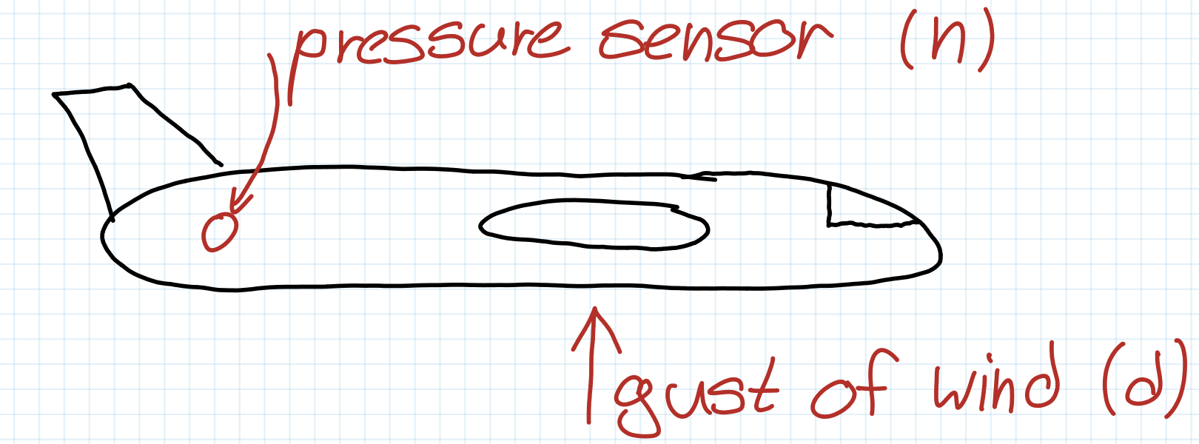
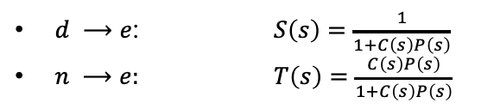
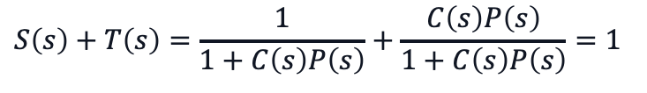
(Complementary) Sensitivity Functions
$d ⟶e$: $S\left(s\right)=\frac{1}{1+C\left(s\right)P\left(s\right)}$
$n ⟶e:$ $T\left(s\right)=\frac{C\left(s\right)P\left(s\right)}{1+C\left(s\right)P\left(s\right)}$
$$S\left(s\right)+T\left(s\right)=\frac{1}{1+C\left(s\right)P\left(s\right)}+\frac{C\left(s\right)P\left(s\right)}{1+C\left(s\right)P\left(s\right)}=1$$
$⟶$ They always add up to one!
This means that we can’t cancel both noise and disturbances…
Thankfully, they have a property we can make use of:
Noise usually occur at high frequencies
Disturbances usually occur at low frequencies

Slide 15
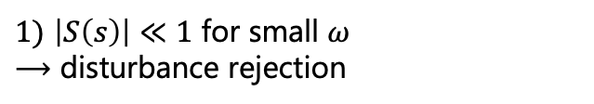
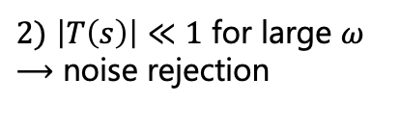
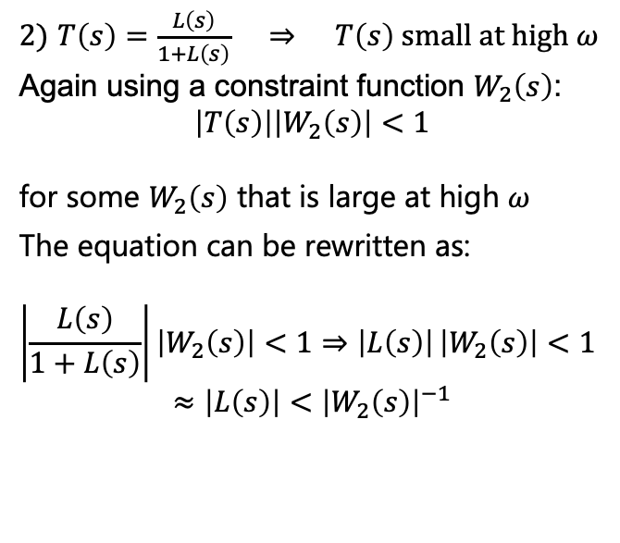
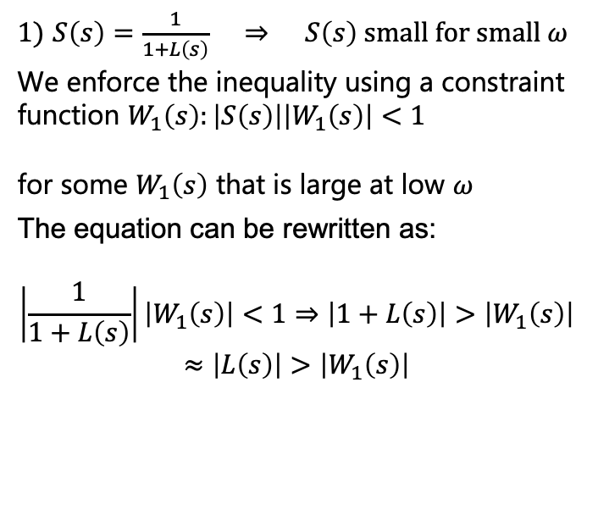
Frequency-domain Specifications
So the workaround is to require:
$1)$ $\left|S\left(s\right)\right|≪1$ for small $ω$ $⟶$ disturbance rejection
$2)$ $\left|T\left(s\right)\right|≪1$ for large $ω$ $⟶$ noise rejection
How can we guarantee
these constraints?
$1)$ $S\left(s\right)=\frac{1}{1+L\left(s\right)} ⇒ S\left(s\right) \text{small} \text{for} \text{small} ω$
We enforce the inequality using a constraint function $W_{1}\left(s\right):\left|S\left(s\right)\right|\left|W_{1}\left(s\right)\right|<1$
for some $W_{1}\left(s\right)$ that is large at low $ω$
The equation can be rewritten as:
$$≈\left|L\left(s\right)\right|>\left|W_{1}\left(s\right)\right|\left|\frac{1}{1+L\left(s\right)}\right|\left|W_{1}\left(s\right)\right|<1⇒\left|1+L\left(s\right)\right|>\left|W_{1}\left(s\right)\right|$$
$2)$ $T\left(s\right)=\frac{L\left(s\right)}{1+L\left(s\right)} ⇒ T\left(s\right) \text{small} \text{at} \text{high} ω$
Again using a constraint function $W_{2}\left(s\right)$:
$$\left|T\left(s\right)\right|\left|W_{2}\left(s\right)\right|<1$$
for some $W_{2}\left(s\right)$ that is large at high $ω$
The equation can be rewritten as:
$$\left|\frac{L\left(s\right)}{1+L\left(s\right)}\right|\left|W_{2}\left(s\right)\right|<1⇒\left|L\left(s\right)\right| \left|W_{2}\left(s\right)\right|<1$$
$$≈\left|L\left(s\right)\right|<{\left|W_{2}\left(s\right)\right|}^{−1}$$

Slide 16
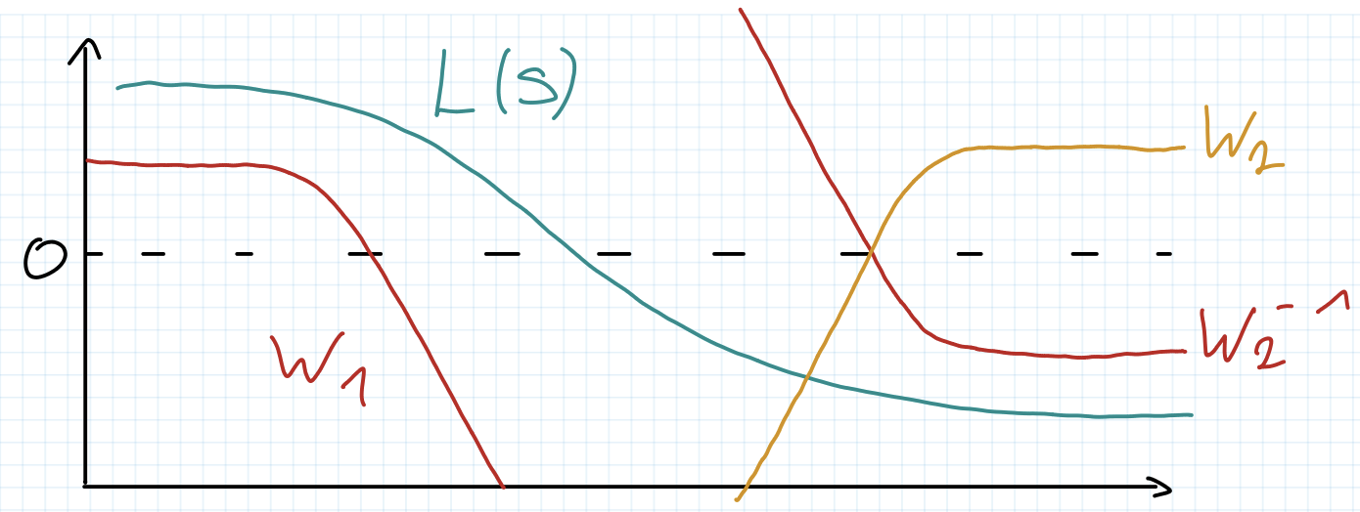


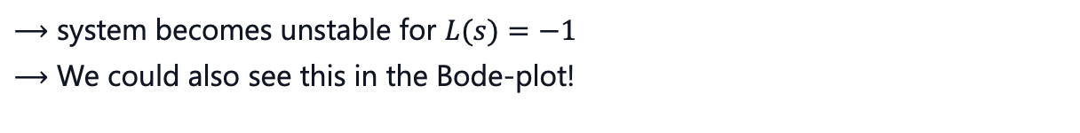
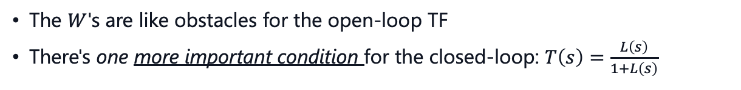
Visualization
$$\left|L\left(s\right)\right|>\left|W_{1}\left(s\right)\right|$$
$$\left|L\left(s\right)\right|<{\left|W_{2}\left(s\right)\right|}^{−1}$$
What exactly are these $W\left(s\right)$? :
The $W$'s are like obstacles for the open-loop TF
There's one more important condition for the closed-loop: $T\left(s\right)=\frac{L\left(s\right)}{1+L\left(s\right)}$
$⟶$ system becomes unstable for $L(s)=−1$
$⟶$ We could also see this in the Bode-plot!

Slide 17
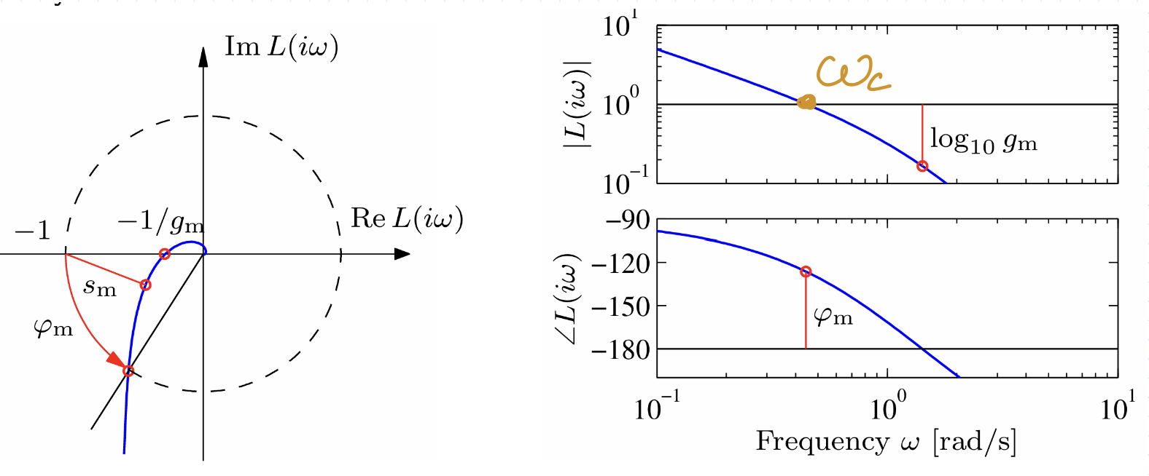
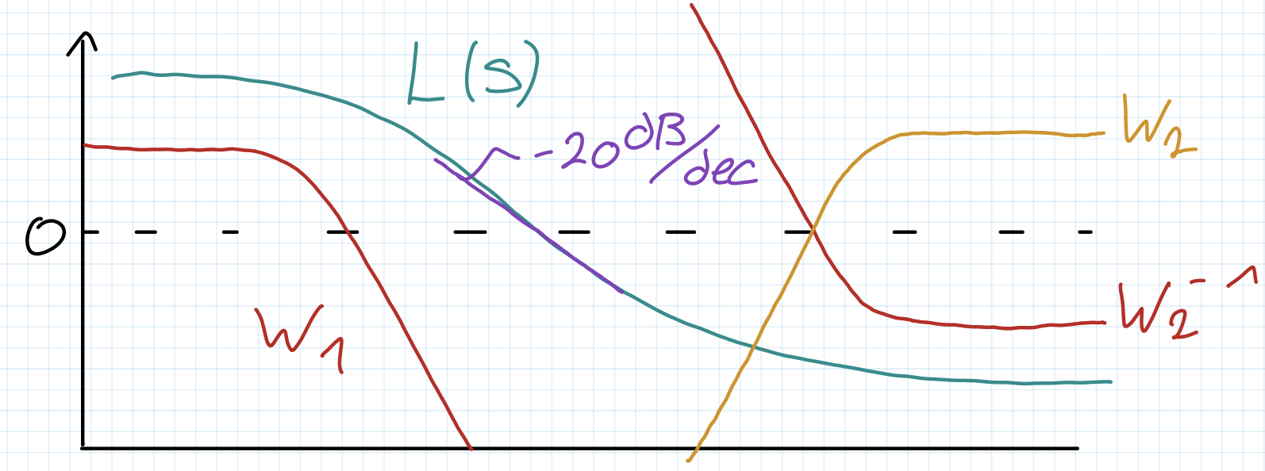
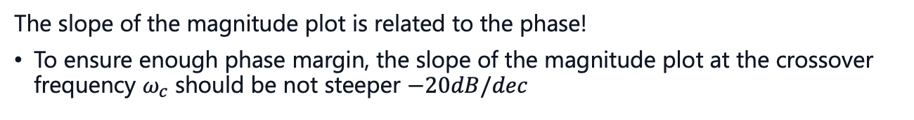
Bode Plot
Another condition:
The slope of the magnitude plot is related to the phase!
To ensure enough phase margin, the slope of the magnitude plot at the crossover frequency $ω_{c}$ should be not steeper $−20dB/dec$

Slide 18
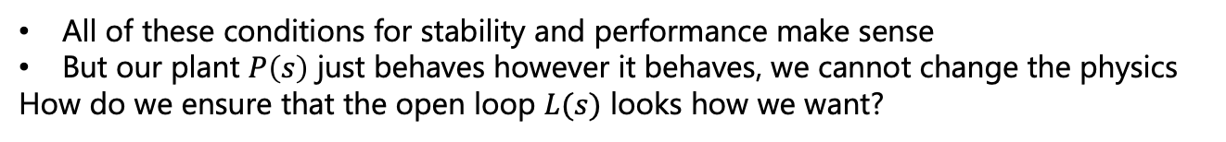
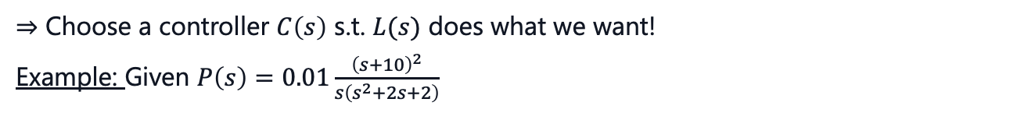
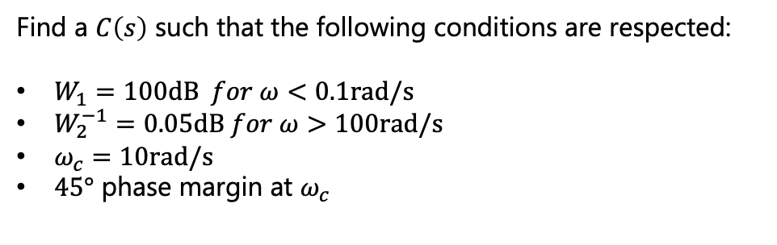
Dynamic Compensator
All of these conditions for stability and performance make sense
But our plant $P\left(s\right)$ just behaves however it behaves, we cannot change the physics
How do we ensure that the open loop $L(s)$ looks how we want?
$⇒$ Choose a controller $C\left(s\right)$ s.t. $L(s)$ does what we want!
Example: Given $P\left(s\right)=0.01\frac{{\left(s+10\right)}^{2}}{s\left(s^{2}+2s+2\right)}$
Find a $C\left(s\right)$ such that the following conditions are respected:
$W_{1}=100\text{dB} for ω<0.1\text{rad}\text{/}\text{s}$
$W_{2}^{−1}=0.05\text{dB} for ω>100\text{rad}\text{/}\text{s}$
$ω_{c}=10\text{rad}\text{/}\text{s}$
$45°$ phase margin at $ω_{c}$

Slide 19
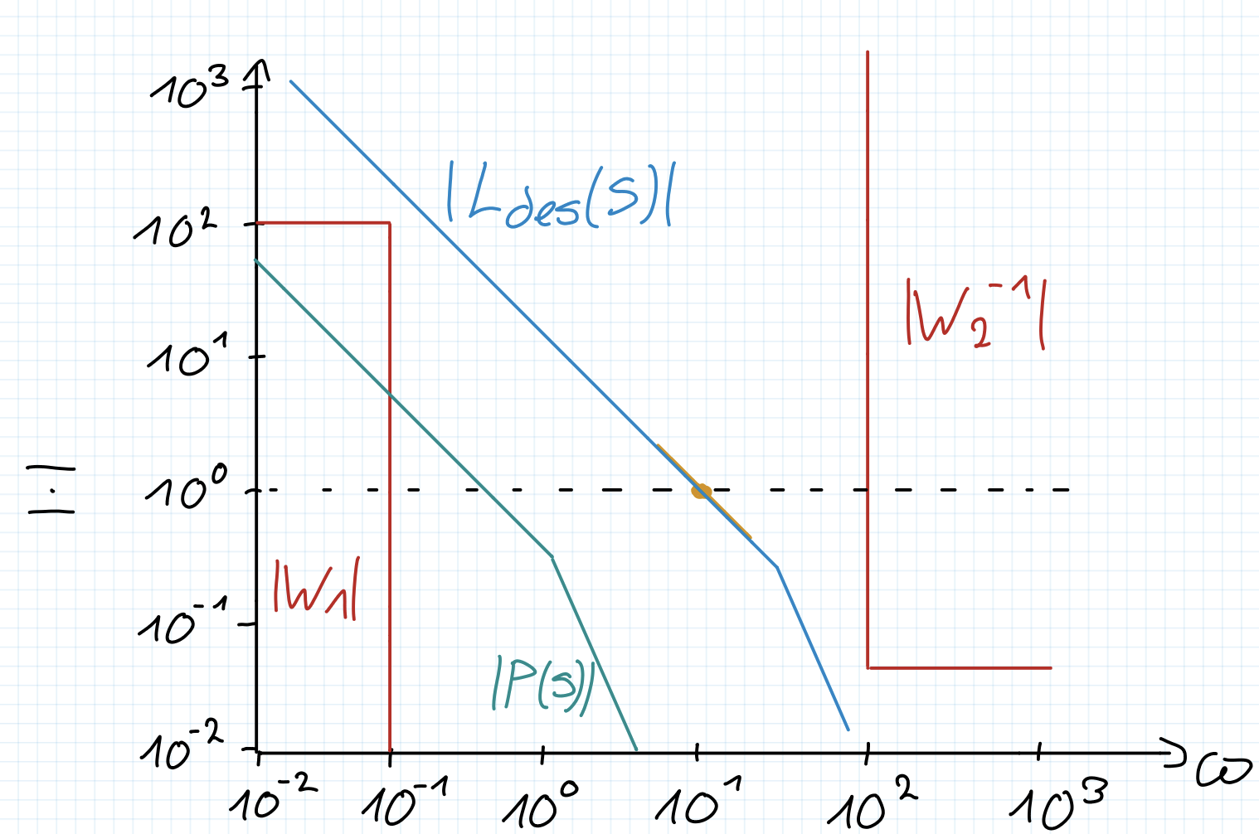
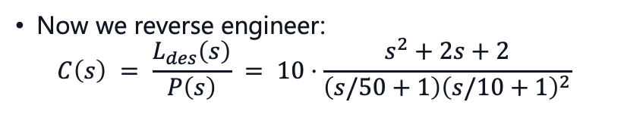

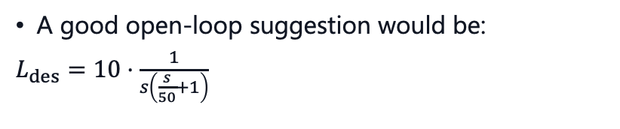
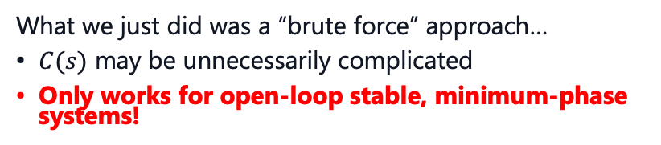
Dynamic Compensator
$$P\left(s\right)=0.01\frac{{\left(s+10\right)}^{2}}{s\left(s^{2}+2s+2\right)}$$
$W_{1}=100\text{dB} for ω<0.1\text{rad}\text{/}\text{s}$
$W_{2}^{−1}=0.05\text{dB} for ω>100\text{rad}\text{/}\text{s}$
$ω_{c}=10\text{rad}\text{/}\text{s}$
$45°$ phase margin at $ω_{c}$
A good open-loop suggestion would be:
$L_{des}=10⋅\frac{1}{s\left(\frac{s}{50}+1\right)}$
Now we reverse engineer:
$$C\left(s\right) = \frac{L_{des}\left(s\right)}{P\left(s\right)} = 10⋅\frac{s^{2}+2s+2}{\left(s/50+1\right){\left(s/10+1\right)}^{2}}$$
What we just did was a “brute force” approach…
$C(s)$ may be unnecessarily complicated
Only works for open-loop stable, minimum-phase systems!
otherwise, we would cancel
unstable poles
A more elegant approach is called Loop Shaping…

Slide 20
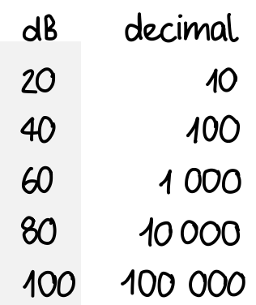
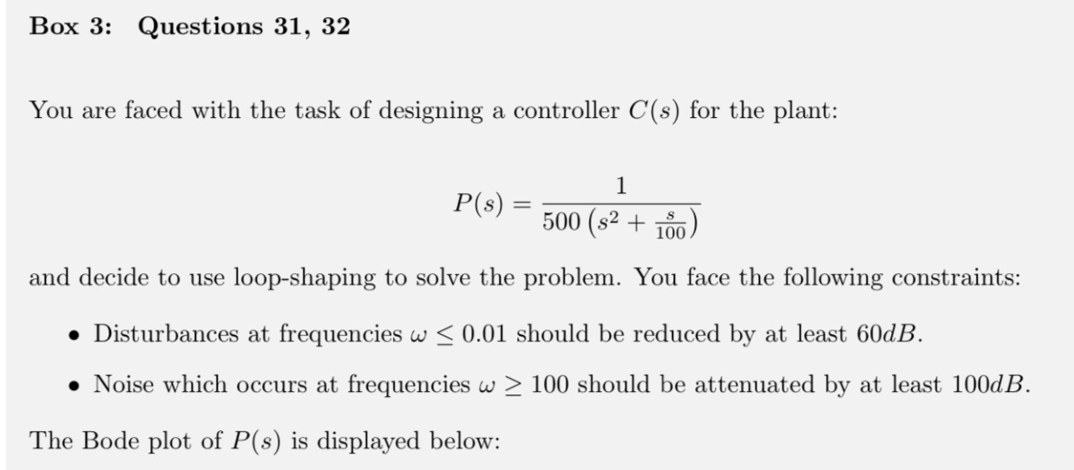
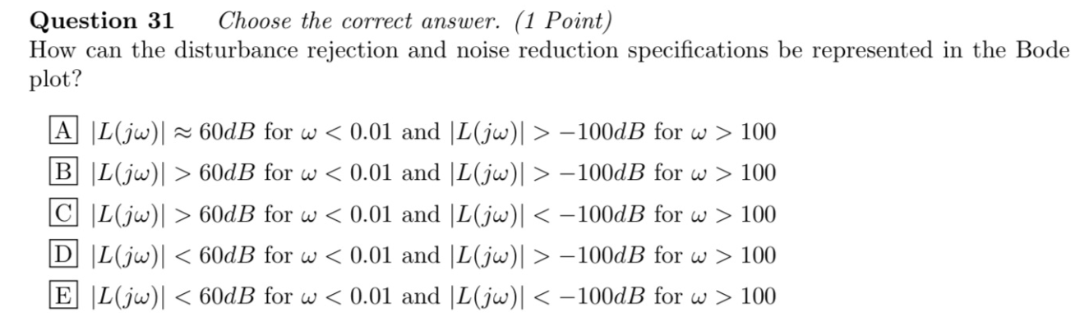
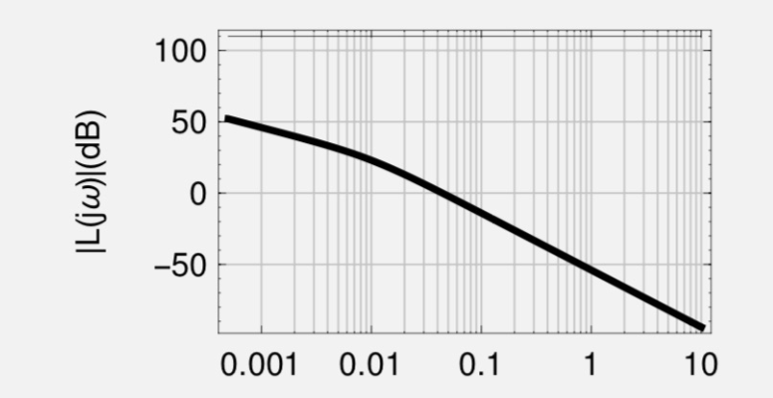
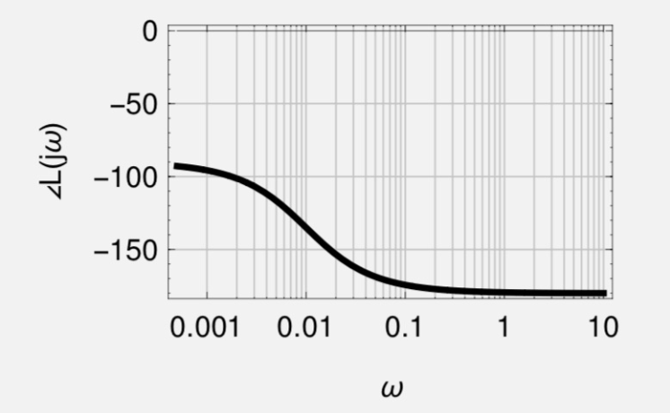
Exam Question
$$\left|L\left(s\right)\right|>\left|W_{1}\left(s\right)\right|$$
$$\left|L\left(s\right)\right|<{\left|W_{2}\left(s\right)\right|}^{−1}$$

Slide 21
3. Loop Shaping

Slide 22
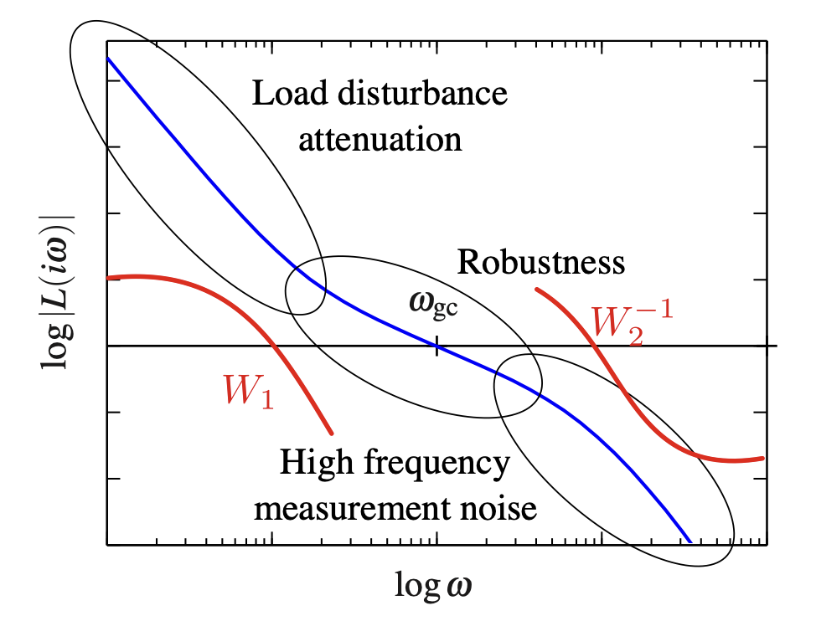

Loop Shaping
A better way to design our Compensator $C\left(s\right)$ is to use the following elements,
s.t. $L\left(s\right)$ passes the obstacle course:
Gain: $k$
Integrator: $\frac{1}{s}$
Lead: $\frac{s/a+1}{s/b+1},0<a<b$
Lag: $\frac{s/a+1}{s/b+1},0<b<a$
$⇒$ We can then add each element in series how we want, i.e. $C\left(s\right)=C_{1}\left(s\right)⋅C_{2}\left(s\right)⋯C_{n}\left(s\right)$
$⇒$ But what is the effect of Lead/Lag-elements?

Slide 23
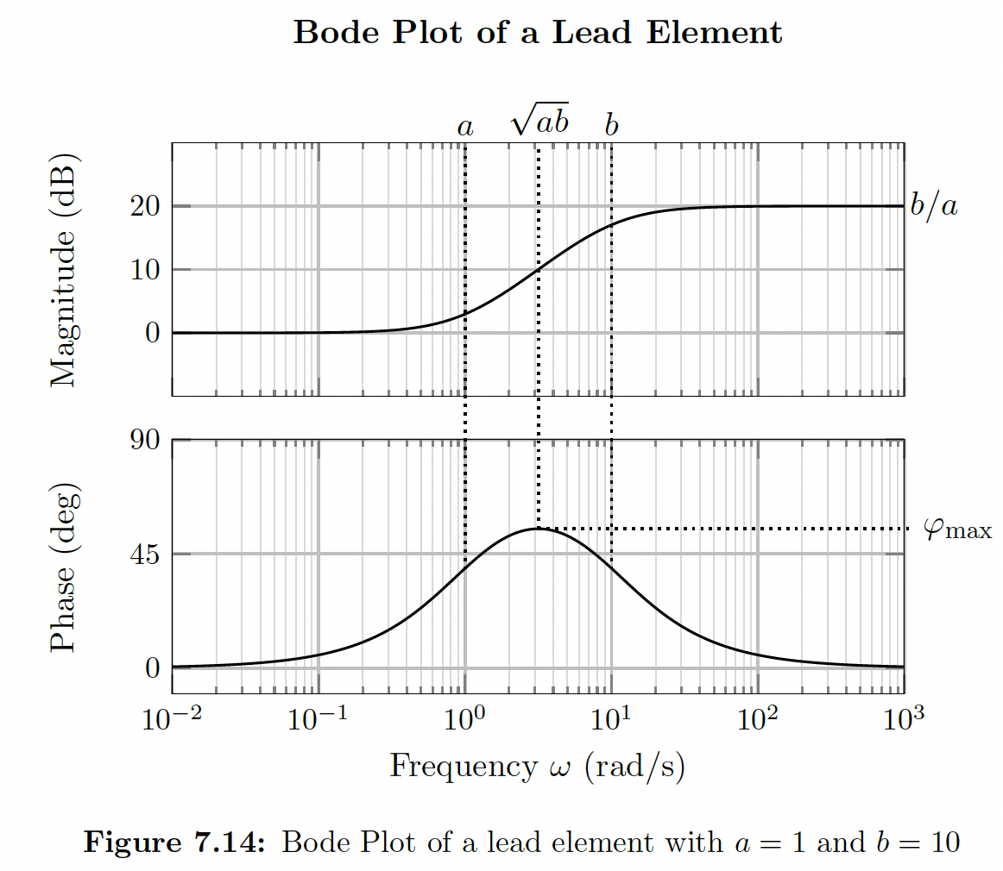
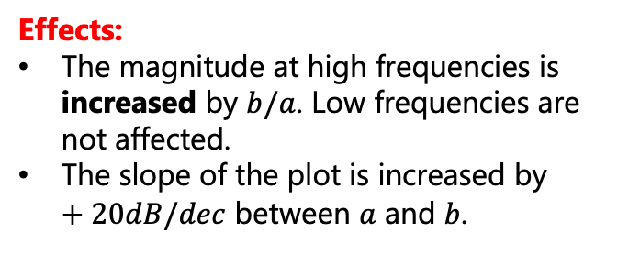
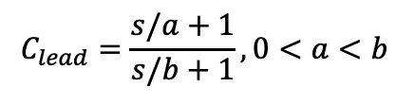
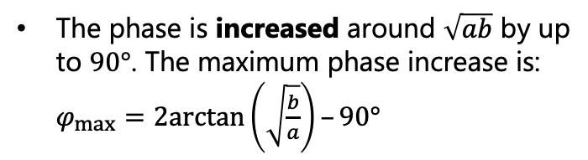
Lead-Element
In essence, Lead-Lag elements are a combination of a stable pole & mnm. phase zero
We use them to manipulate the frequency response
$$C_{lead}=\frac{s/a+1}{s/b+1},0<a<b$$
Effects:
The magnitude at high frequencies is increased by $b/a$. Low frequencies are not affected.
The slope of the plot is increased by $+20dB/dec$ between $a$ and $b$.
Magnitude
response
The phase is increased around $\sqrt{ab}$ by up to $90°$. The maximum phase increase is: $φ_{max}=2arctan\left(\sqrt{\frac{b}{a}}\right)–90°$
Phase
response

Slide 24
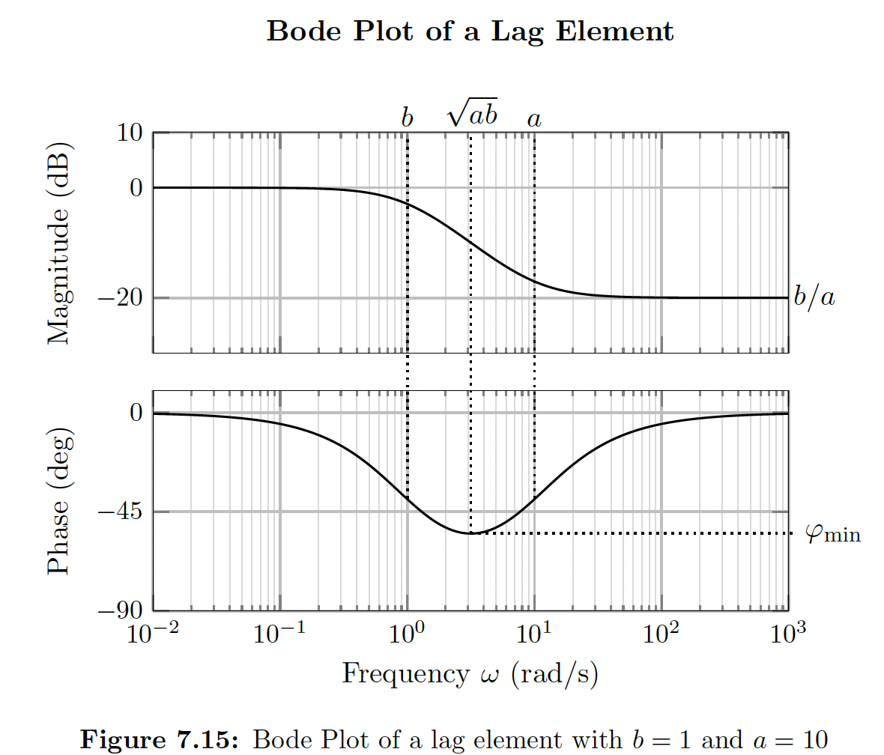

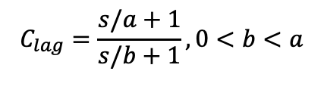

Lag-Element
A lag compensator is in many ways an inverse of the lead compensator
$$C_{lag}=\frac{s/a+1}{s/b+1},0<b<a$$
Effects:
The magnitude at high frequencies is decreased by $b/a$. Low frequencies are not affected.
The slope of the plot is decreased by $−20 dB/dec$ between $b$ and $a$.
Magnitude
response
The phase is decreased around $\sqrt{ab}$ by up to $90°$. The maximum phase decrease is: $φ_{max}=2arctan\left(\sqrt{\frac{b}{a}}\right)–90°$
Phase
response

Slide 25




Example

Slide 26

Example
$$ω_{c}={10}^{2}$$

Slide 27


Example
Hints:
Use your result from (a) to determine the phase of $P(jω)$
at $ω=ω_{c}$ and hence, the desired phase shift.
$$ω_{c}={10}^{2}$$
Lead Compensator

Slide 28



Example
Hints:
The maximum phase shift of a lead compensator occurs at $ω=\sqrt{\left(ab\right)}$
$$φ_{max}=2arctan\left(\sqrt{\frac{b}{a}}\right)–90°$$
$$ω_{c}={10}^{2}$$
Lead Compensator
57.97°

Slide 29

Example
$$ω_{c}={10}^{2}$$

Slide 30






Example
$$C_{lead}=\frac{s/a+1}{s/b+1},0<a<b$$
$$ω_{c}={10}^{2}$$
$$K=6.56$$
$$a ≈ 29 \& b = 348$$
putting everything together we get:
$$C_{\text{lead}}\left(s\right)=6.56\frac{1+s/29}{1+s/348}$$

Slide 31

Performance Limitations
The requirement to keep a shallow slope over a “large” interval near crossover may make it impossible to clear the obstacles
nmn-phase zeros and unstable OL poles may make the situation even harder
Many performance goals conflict, e.g., you cannot achieve strong disturbance rejection, noise attenuation, and good tracking at the same time

Slide 32




Tips for Problem Set 10
Easy | Medium | Hard
 | $$1,2,3$$ | $$4$$
1: a) look up the graphical definitions in the slides. c) think about negative & positive margins. d) recall the Nyquist stability criterion
3: a) we did it graphically together for intuition, try to do the calculations if you wanna get the exact results b) follow the tips and remember $e_{ss}=\lim_{s→0}{\frac{1}{1+L\left(s\right)}}$
for small $ω L\left(s\right)$ large, so $\lim_{s→0}{\frac{1}{1+L\left(s\right)}}=\frac{1}{L\left(s\right)}$
which compensator do we choose to increase magnitude?
2: a) $\left|kL\left(jω_{gc}\right)\right|=1$
b) look at the mathematical definitions for phase & gain margin and plug in the open-loop TF
4.1: we need atleast as many poles @ origin, as order of ramp b) remember the table summarizing $e_{ss}$or use FVT
4.2: use the definition of sensitivity function to calculate the error
4.3: remember how we changed $ω_{gc}$ in our example by multiplying the TF with a gain $K$

Slide 33
Questions?

Slide 34
Feedback?
Too fast? Too slow? Less theory, more exercises?
I would appreciate your feedback. Please let me know.
https://docs.google.com/forms/d/e/1FAIpQLSdHl0kjWo63aNzDkAV0cnmQadCAj5L0D7v7aSh0BK7BBdEgpA/viewform?usp=header

