Slide 1

CS2 Week 5 Empty
DOFB with Integral Action, Intro to MIMO systems

Slide 2

Exercise Classes
Shared exercise with Haixiao and Kissan
Theory recap
Notes available on Kissan's website: https://kissanv.github.io
& on Haixiao's Polybox: https://polybox.ethz.ch/index.php/s/AReA9YBeJQKxBDn
Quizzes, Examples & Old exam questions
Kissan's Website
Haixiao's Polybox

Slide 3
Recap

Slide 4
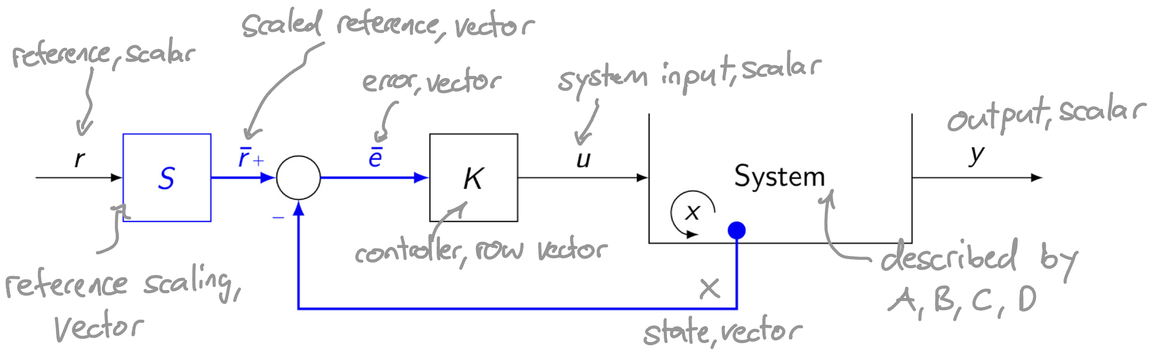
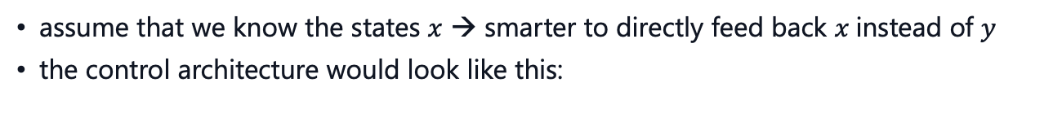
State Feedback
assume that we know the states $x$ → smarter to directly feed back $x$instead of $y$
the control architecture would look like this:

Slide 5

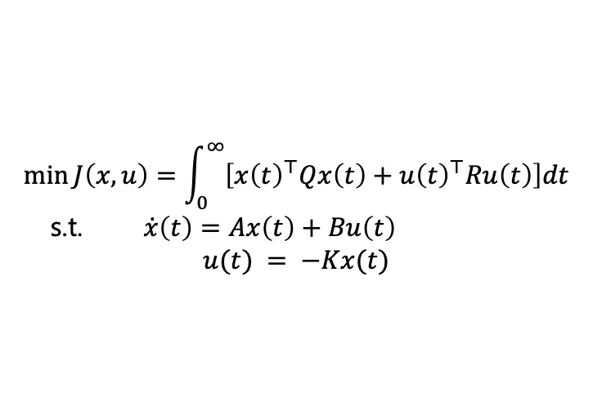

LQR
method to find optimal controller $K$ for a given task
$$\min_{}{J\left(x,u\right)}=\int_{0}^{∞}{\left[x{\left(t\right)}^{⊤}Qx\left(t\right)+u{\left(t\right)}^{⊤}Ru\left(t\right)\right]dt}$$
s.t. $\dot{x}\left(t\right)=Ax\left(t\right)+Bu\left(t\right)$
$$u(t) = −Kx(t)$$
Solution:
$$A^{⊤}P+PA+Q−PBR^{−1}B^{⊤}P=0$$
$→$ Solve this equation for $P$ (positive definite and symmetric!)
$→$ The optimal controller is calculated by: $K=R^{−1}B^{⊤}P$

Slide 6
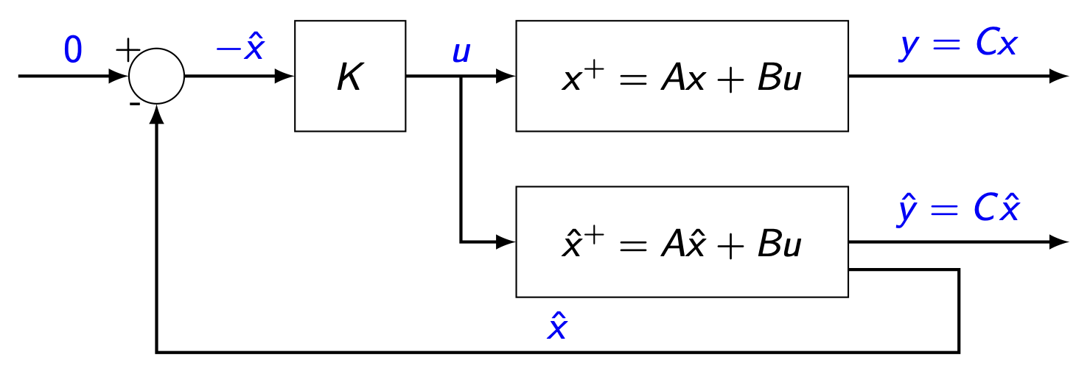
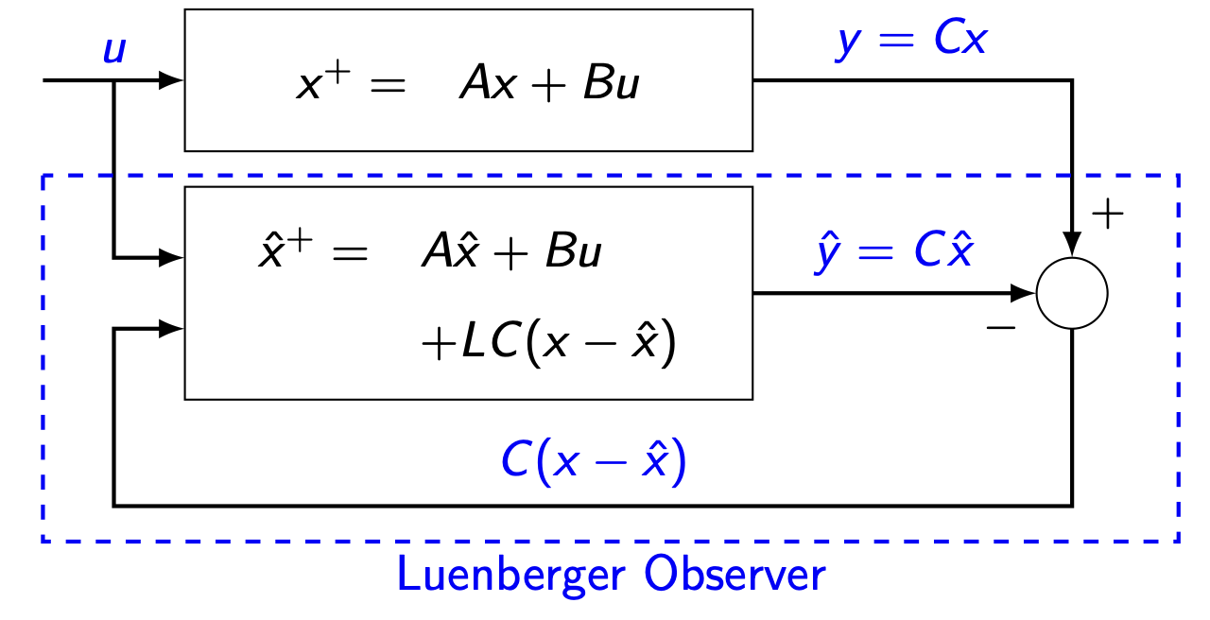
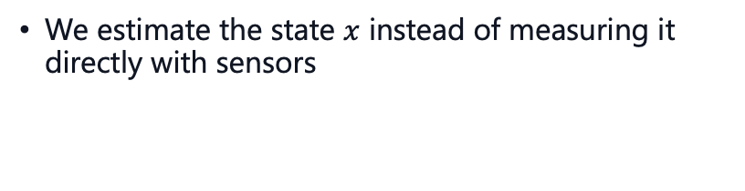
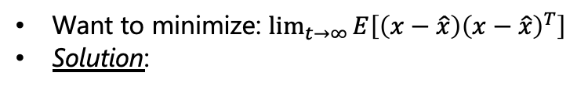
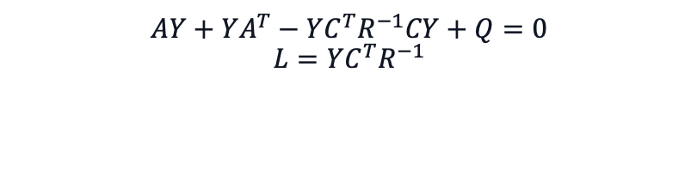
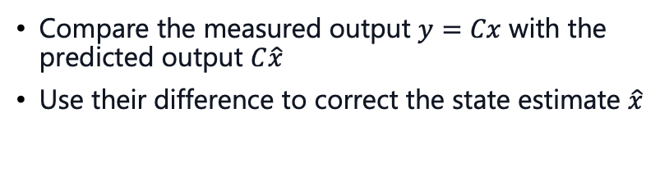
LQE
We estimate the state $x$ instead of measuring it directly with sensors
Compare the measured output $y=Cx$ with the predicted output $C\hat{x}$
Use their difference to correct the state estimate $\hat{x}$
Want to minimize: $\lim_{t→∞}{E\left[\left(x−\hat{x}\right){\left(x−\hat{x}\right)}^{T}\right]}$
Solution:
$$L=YC^{T}R^{−1}AY+YA^{T}−YC^{T}R^{−1}CY+Q=0$$

Slide 7
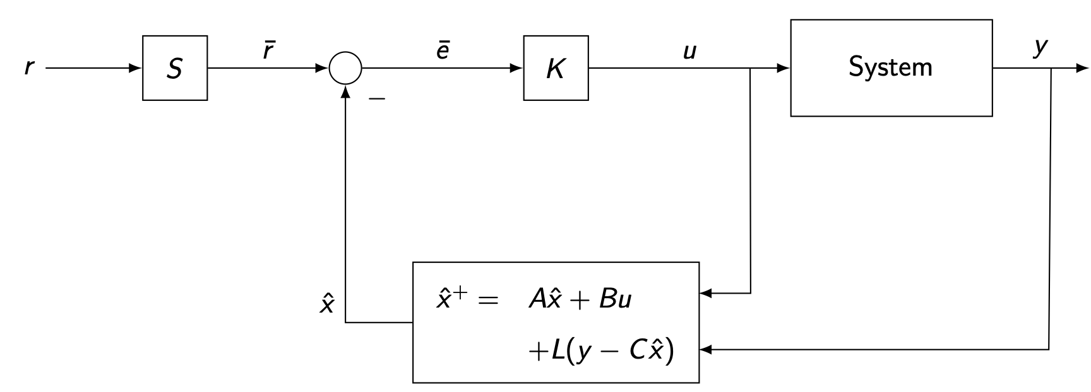
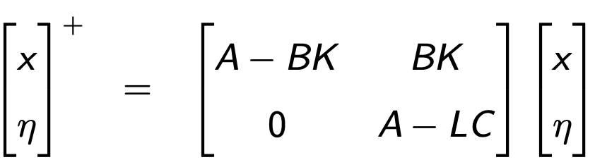
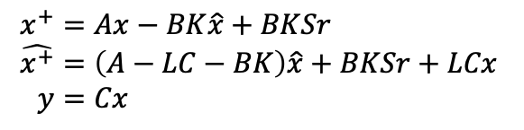

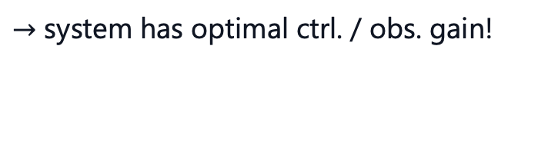

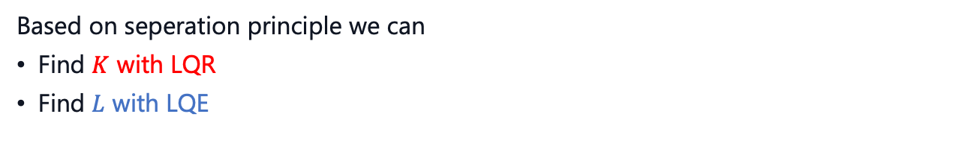
DOFB
Idea: state feedback with estimated states
The closed loop system has the following form:
$$\begin{aligned}x^{+}&=Ax−BK\hat{x}+BKSr \\ \hat{x^{+}}&=\left(A−LC−BK\right)\hat{x}+BKSr+LCx \\ y&=Cx\end{aligned}$$
introducing: $η=x−\hat{x}$
& rewriting
$⇒$ the poles are given by $\det\left(sI−A_{cl}\right)=\det\left(sI−\left(A−BK\right)\right)\det\left(sI−\left(A−LC\right)\right)$
Based on seperation principle we can
Find $K$ with LQR
Find $L$ with LQE
combine them to LQG
$→$ system has optimal ctrl. / obs. gain!

Slide 8
Quiz
Which of the following statements about state estimation in state feedback control for LTI systems are true?
A. To design a Luenberger observer for a state feedback controller, additional sensors must be installed to measure all the states in the system.
B. A Luenberger observer is sensitive to measurement noise, where high observer gains magnify measurement noise.
C. The controller and the estimator must be designed together because they interact with each other.
D. If the observer gain is chosen large enough, measurement noise will automatically disappear.

Slide 9
Course Schedule
Subject | Week
Intro – Discrete Time Systems | 1
Diagonalization, Modal Coordinates, Contr/Obs. | 2
State Feedback, Pole Placement, LQR | 3
State Estimation, Luenberger Obs., Seperation Principle, LQG | 4
DOFC with integral action, Intro to MIMO systems | 5
Nonlinear Systems | 6
Nonlinear Systems | 7
break | 8
Discrete-time Unconstrained Optimal Control | 9
Convex Optimization | 10
Model Predictive Control | 11
Practical Model Predictive Control | 12
Robust Model Predictive Control | 13
Implementation Methods | 14

Slide 10
Today
DOFB with integral action
Intro MIMO systems
Norms

Slide 11
1. DOFC w/ integral action

Slide 12
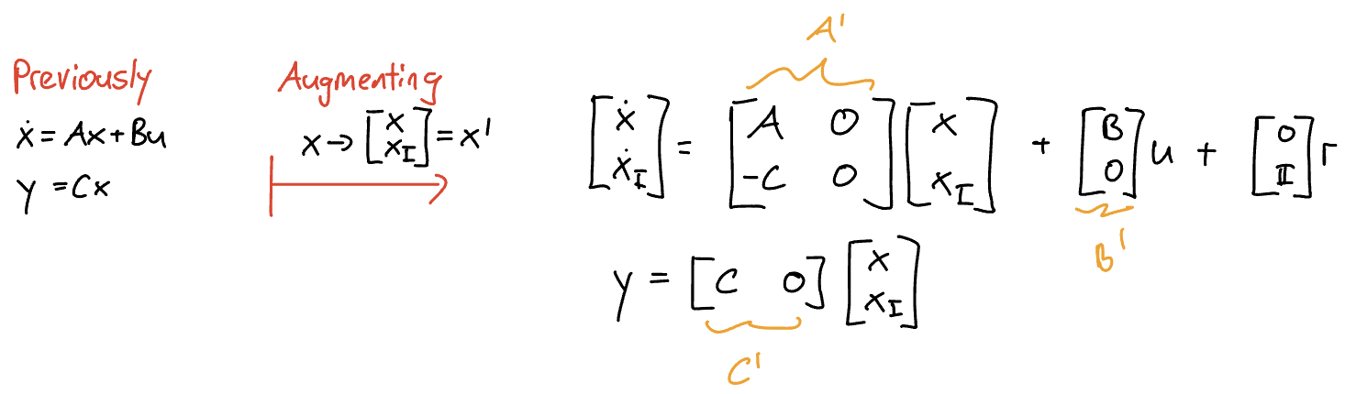
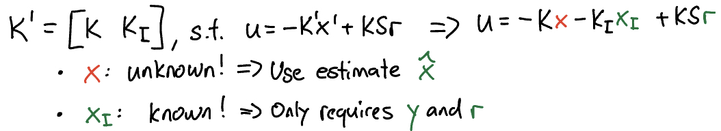
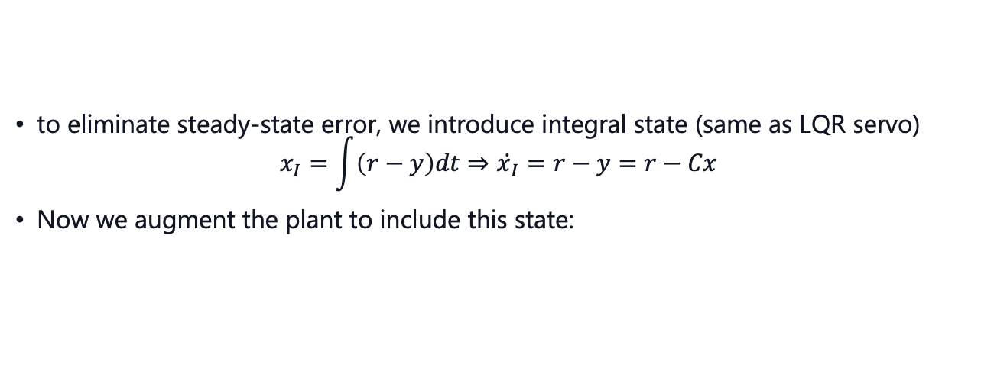
DOFC with integral action
to eliminate steady-state error, we introduce integral state (same as LQR servo)
$$x_{I}=\int{\left(r−y\right)dt}⇒ẋ_{I}=r−y=r−Cx$$
Now we augment the plant to include this state:
For $A^{′},B^{′},C^{′}$ we can find a new stabilizing feedback gain

Slide 13
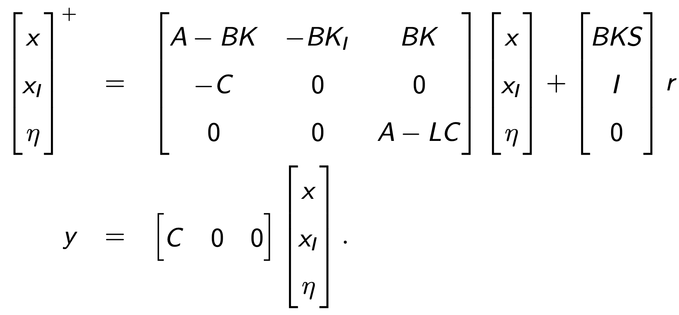
LQG stability margins
Using this feedback law and again the coordinate change $η= x− \hat{x}$:
Recall: If the conditions for state-feedback are given, then the LQR procedure always finds a stabilizing and robust controller
Also: Robustness can be measured with phase/gain margins
⇒ LQR guarantees:
• phase margin ≥ 60°
• gain margin ≥ 6 dB
NO guaranteed stability margins for LQG
Do we still guarantee robustness with an optimal observer (LQG)?

Slide 14
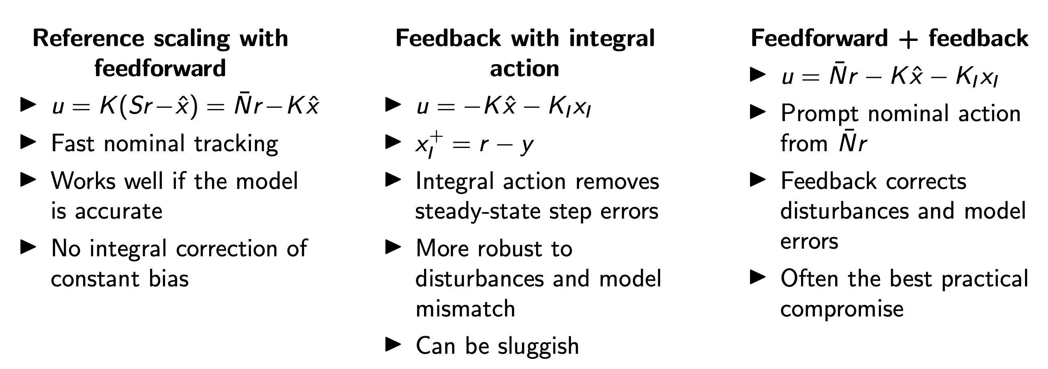
Summarized

Slide 15
2. Intro MIMO systems

Slide 16
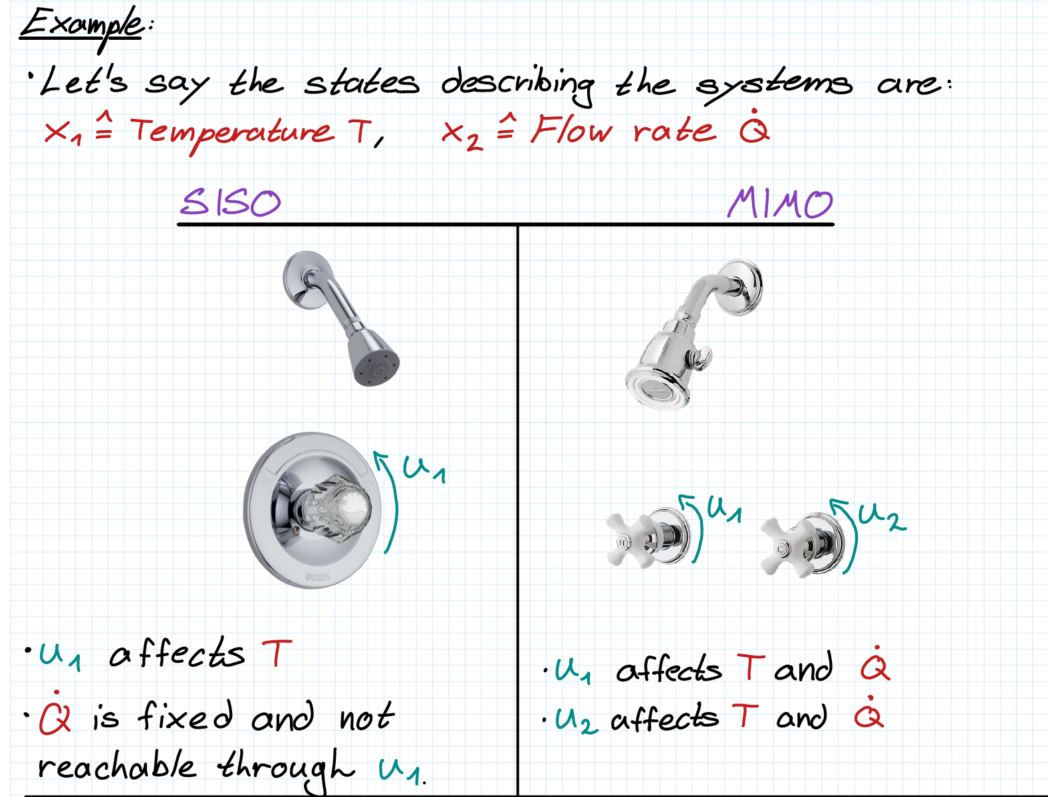
Introduction
Up to now, we have assumed all analyzed systems to be controlled by only one input and measured by only one output → SISO
In reality, many systems have multiple inputs and multiple outputs
To get a feeling for how MIMO systems affect complexity, let’s gain some intuition
In a MIMO system, we need specific combinations of inputs to obtain a desired output

Slide 17
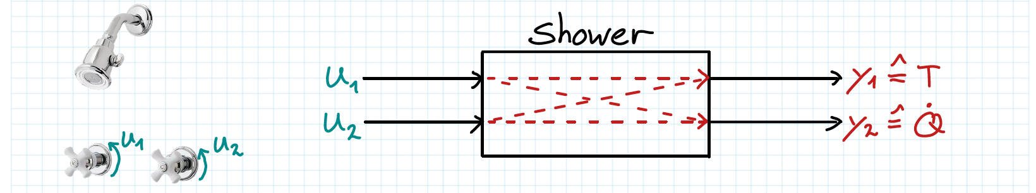
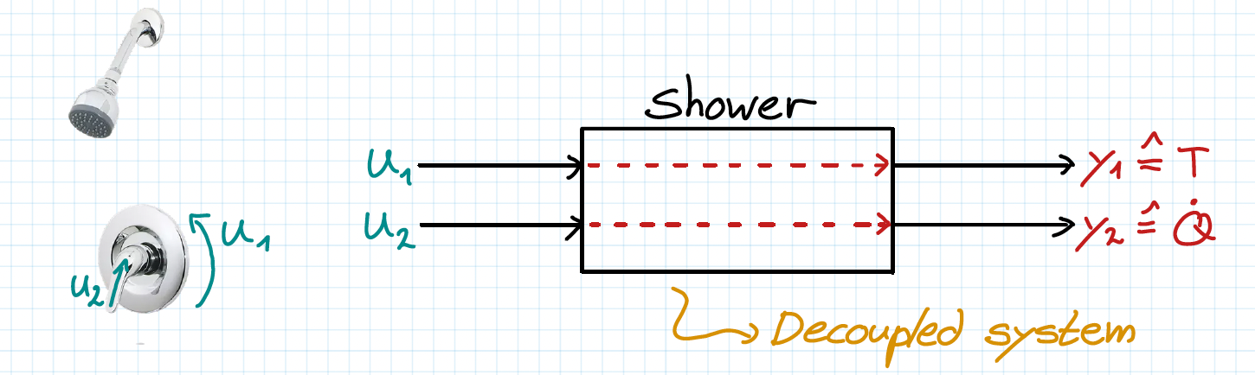
Introduction
The previous example visualizes the interconnectivity of MIMO systems
This is the general case for MIMO systems
In systems where each input affects only one separate output, we call the MIMO system decoupled
The transfer function representation makes the system’s internal connections visible, since it relates each input to each output.

Slide 18
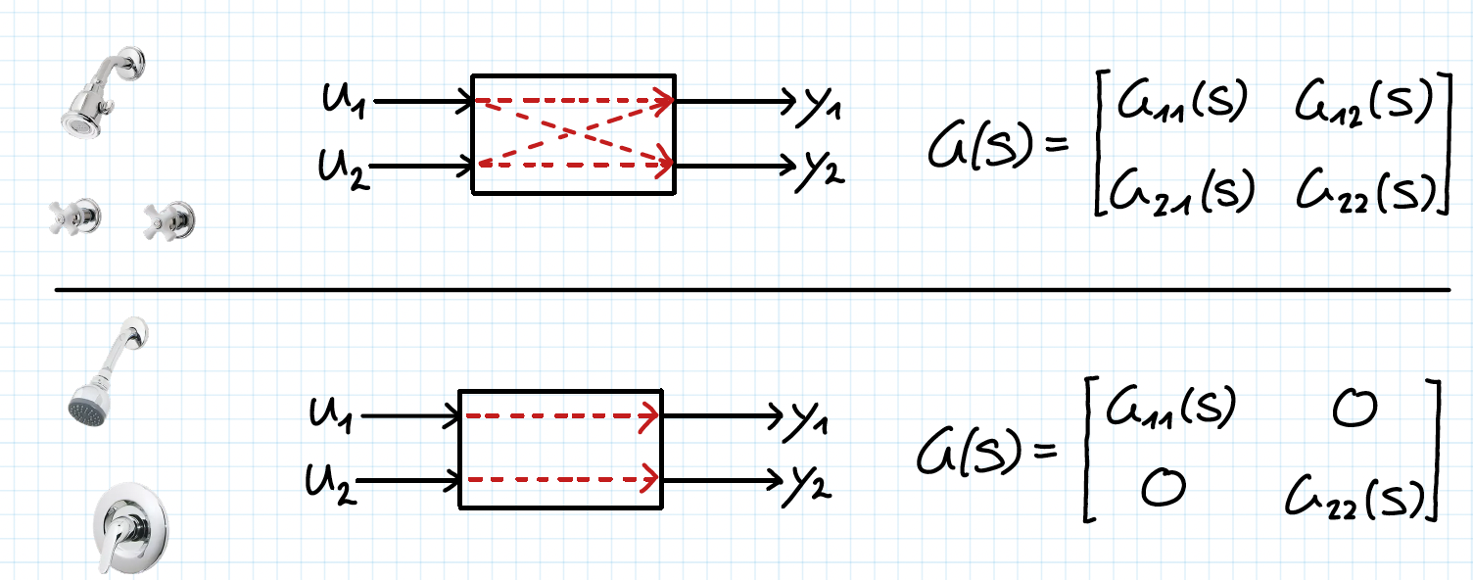
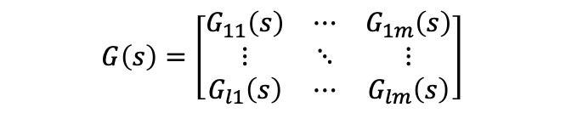
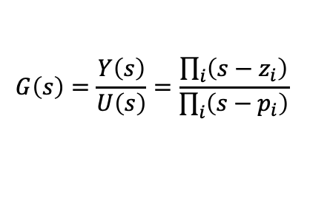
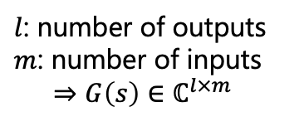
Introduction
But how can we write a transfer function for a MIMO system?
$$G\left(s\right)=\frac{Y\left(s\right)}{U\left(s\right)}=\frac{\prod_{i}{\left(s−z_{i}\right)}}{\prod_{i}{\left(s−p_{i}\right)}}$$
Recall how we wrote transfer functions for SISO systems:
→ Output to input ratio
For MIMO systems, each output has a ratio to each input
Instead of scalar transfer functions, we now have transfer function matrices.
$$G\left(s\right)=\left[\begin{matrix}G_{11}\left(s\right) & ⋯ & G_{1m}\left(s\right) \\ ⋮ & ⋱ & ⋮ \\ G_{l1}\left(s\right) & ⋯ & G_{lm}\left(s\right)\end{matrix}\right]$$
$l$: number of outputs
$m$: number of inputs
$$⇒G\left(s\right)∈ℂ^{l×m}$$

Slide 19
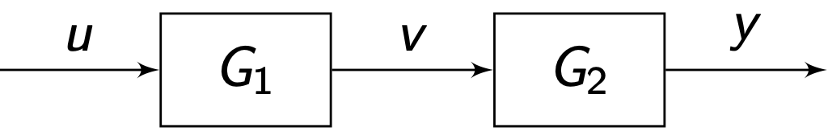
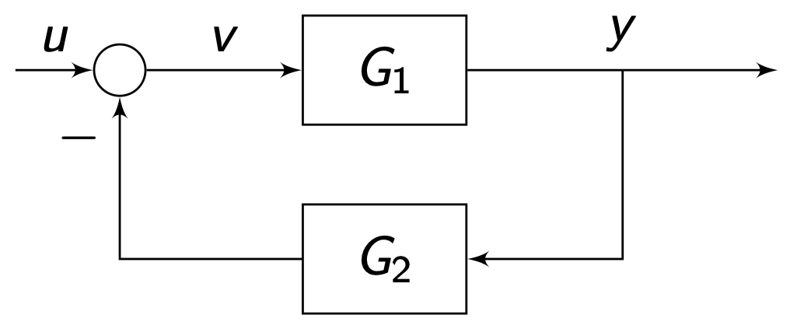
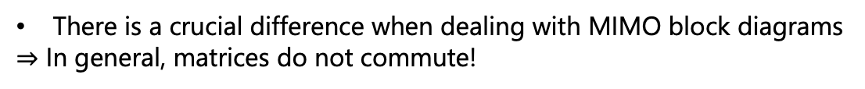
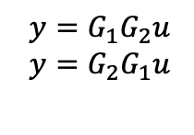

MIMO block diagrams
There is a crucial difference when dealing with MIMO block diagrams
$⇒$ In general, matrices do not commute!
$$y=G_{1}G_{2}u$$
$$y=G_{2}G_{1}u$$
wrong
✓
The following feedback loop highlights additional rules:
General rules (same as CS1):
Start from output and proceed against signal flow.
Multiply inverse on the side where the term that you want gone is.
For the derivation of more complex systems, the following rule can be handy: "Push-through identity"
$$G_{1}{\left(I+G_{2}G_{1}\right)}^{−1}={\left(I+G_{1}G_{2}\right)}^{−1}G_{1}$$

Slide 20
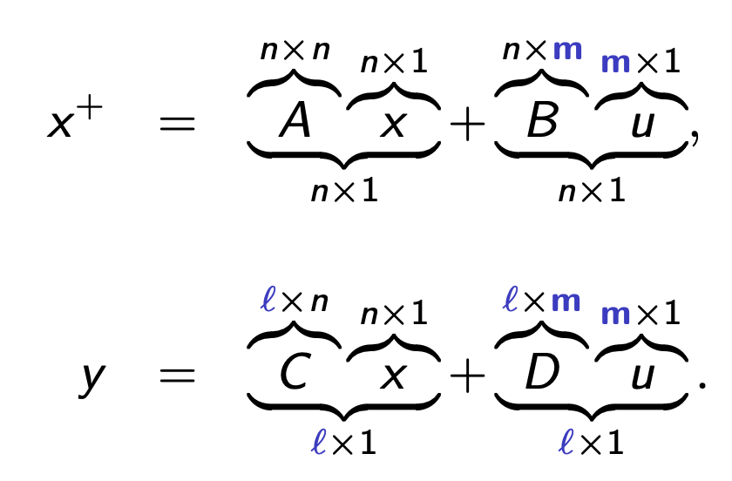
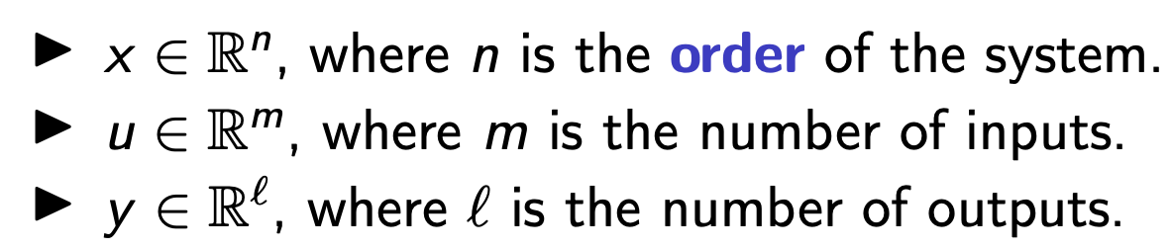


MIMO state-space
The system dynamics can be written as:
Nothing changes except for dimensionalities!
state-space $⟶$transfer function :
$$G\left(s\right)=C{\left(sI−A\right)}^{−1}B+D$$
So much for the basics. To analyze how a system behaves, we must look at its poles and zeros. But how do we do that if the transfer function is a matrix?

Slide 21
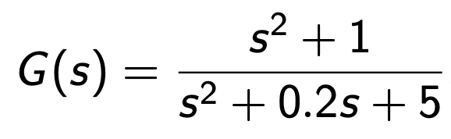
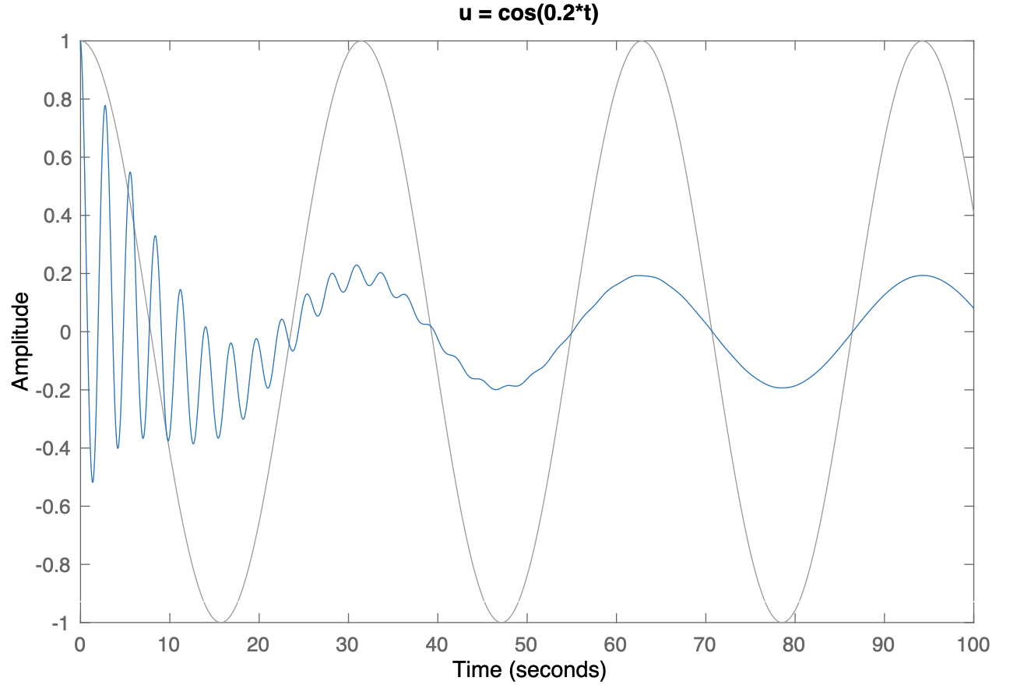
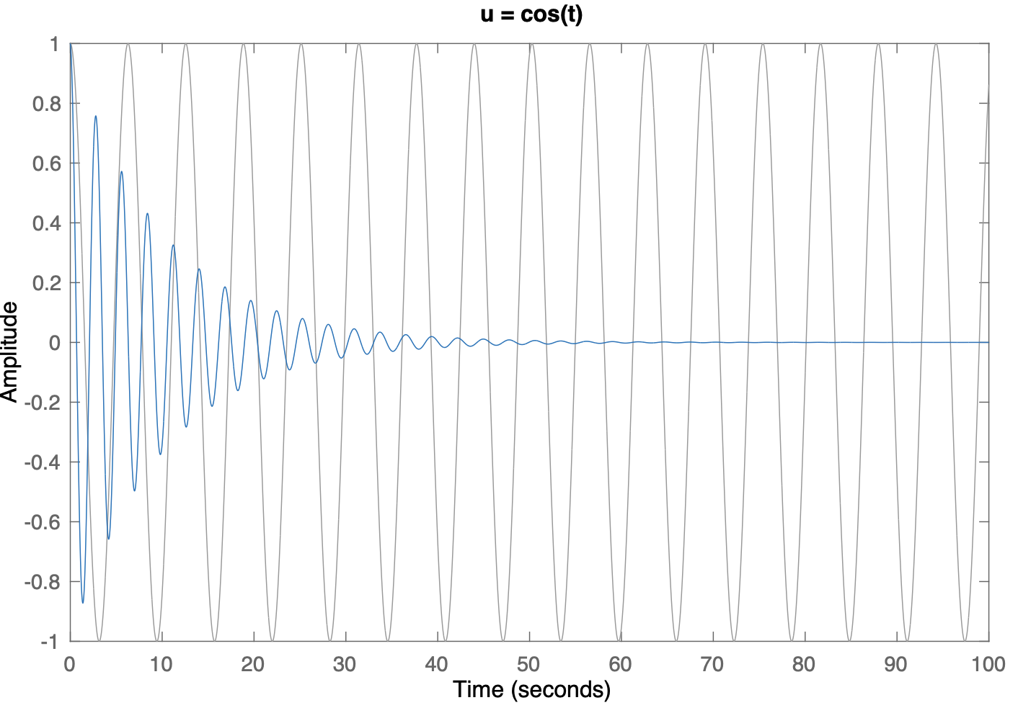
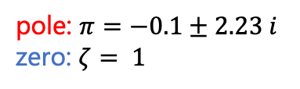
Poles & Zeros
The general meaning of poles and zeros remains the same
$⇒$ pole: "Generated frequency" at the output, regardless of the input
$⇒$ zero: "Absorbed frequency" that is not transmitted from the input to the output
pole: $π=−0.1±2.23 i$
zero: $ζ= 1$
Let's look at an example from a SISO system:
Pole frequency appears in the output independent of the input
Pole effect remains in the transient, while the zero cancels the input frequency

Slide 22
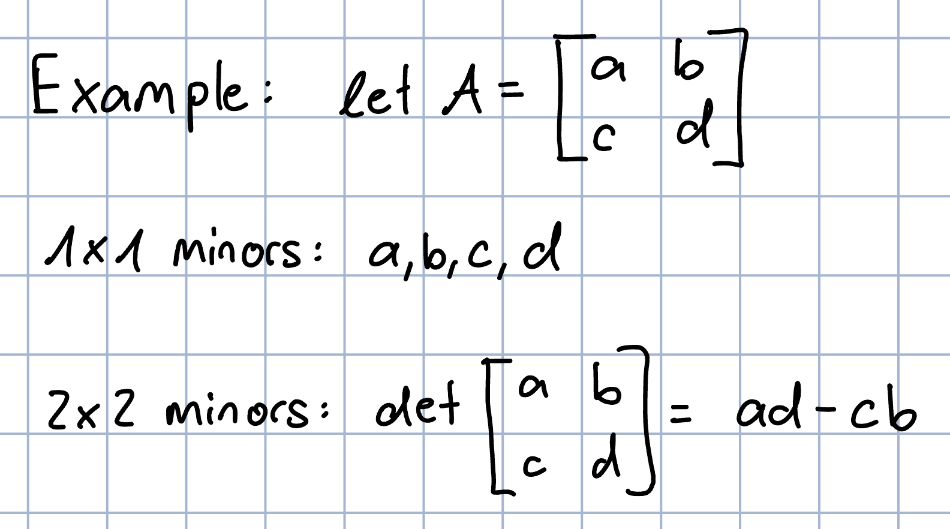
MIMO poles
Definition: MIMO poles are the roots of the pole polynomial of the least common multiple of the denominators of all possible minors of the transfer function matrix.
What are minors again?
minors are the determinants of a square sub-matrix
With this we can find the poles of a MIMO system…

Slide 23
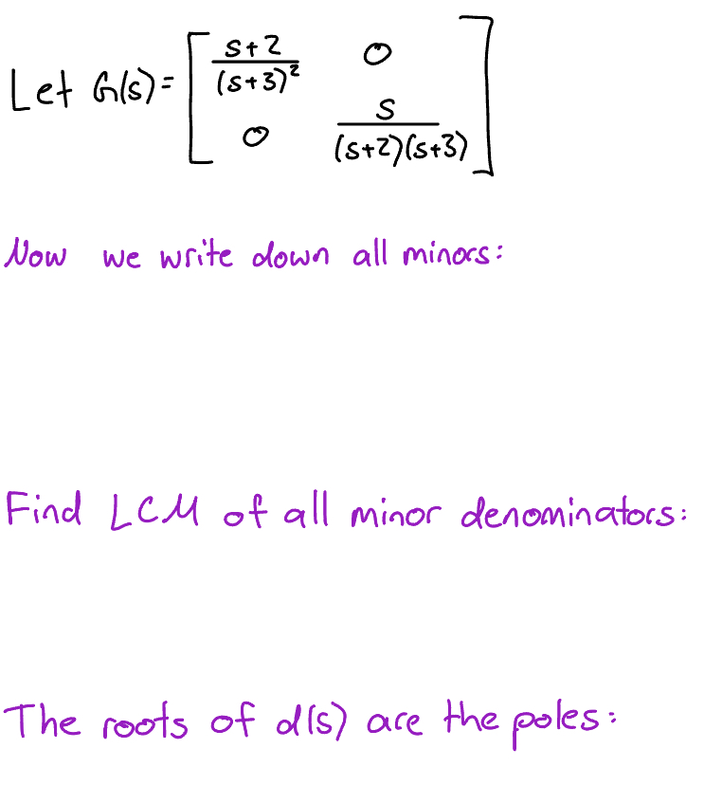
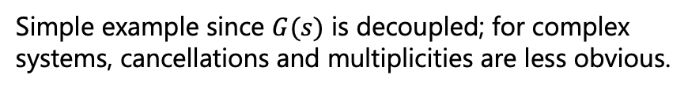
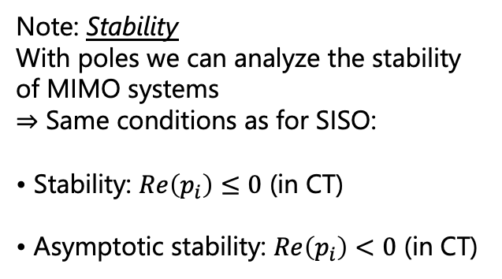
Example
Note: Stability
With poles we can analyze the stability of MIMO systems
$⇒$ Same conditions as for SISO:
• Stability: $Re\left(p_{i}\right)≤0$ (in CT)
• Asymptotic stability: $Re\left(p_{i}\right)<0$ (in CT)
Simple example since $G(s)$ is decoupled; for complex systems, cancellations and multiplicities are less obvious.

Slide 24
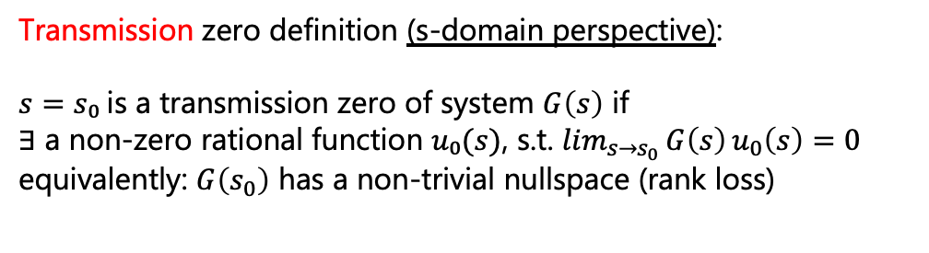
MIMO zeros
MIMO zeros are a little more complicated…
We differentiate between two types:
Transmission zeros
Invariant zeros
To properly understand their difference we look at them from different perspectives
Transmission zero definition (s-domain perspective):
$s=s₀$is a transmission zero of system $G\left(s\right)$ if
$∃$ a non-zero rational function $u₀(s)$, s.t. $\lim_{s→s_{0}}{G\left(s\right)}u_{0}\left(s\right)=0$
equivalently$\text{: }G\left(s_{0}\right) \text{has} \text{a} \text{non}\text{−}\text{trivial} \text{nullspace}\text{ (}\text{rank} \text{loss}\text{)}$
Hard to gain an intuitive understanding, but in essence we now have combinations of inputs (directions) that make the output go to zero.

Slide 25
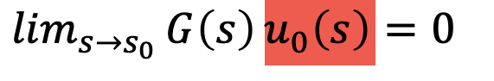
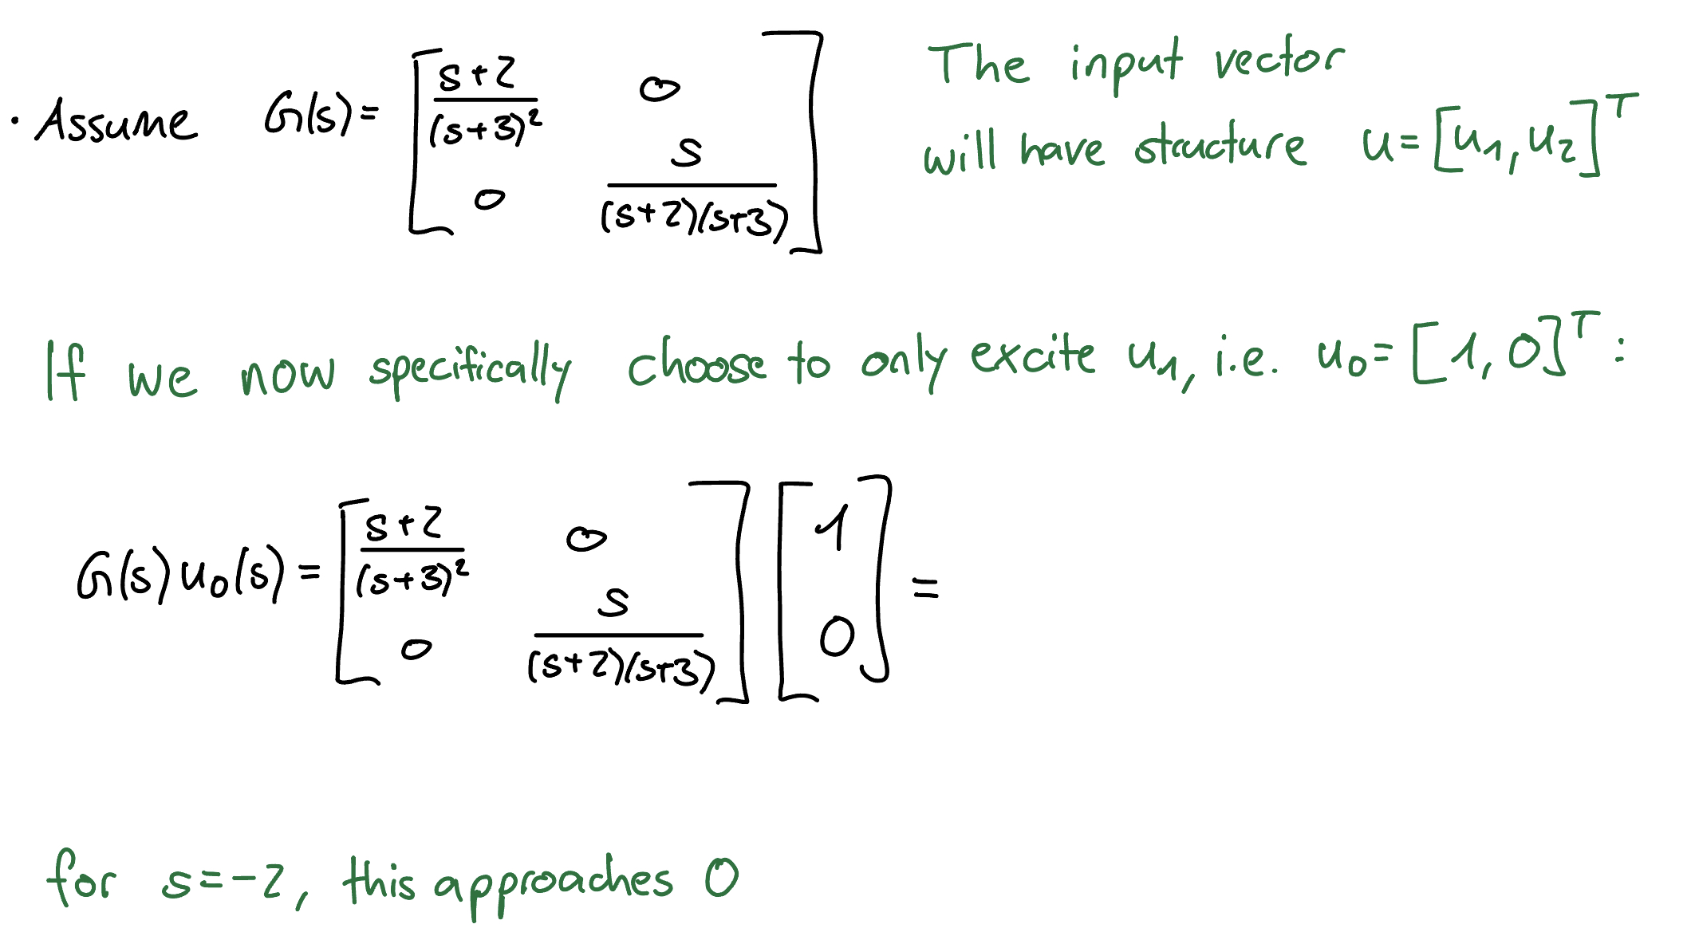
Example: decoupled
⇒ For this specific combination (i.e., direction) of inputs, we have a zero at $s=−2$.
Note: There is also a pole at $s=−2$, but they do not cancel!

Slide 26

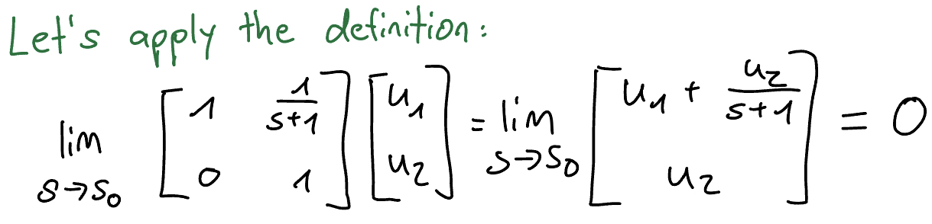
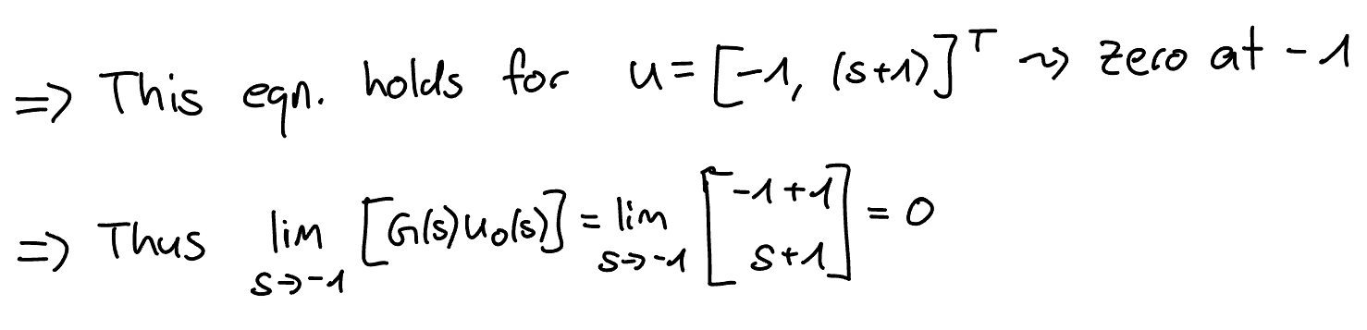
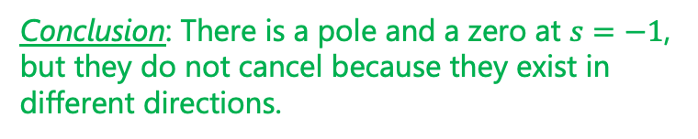
Example: coupled & unintuitive
Conclusion: There is a pole and a zero at $s=−1$, but they do not cancel because they exist in different directions.

Slide 27
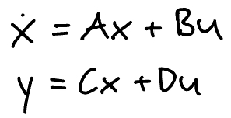
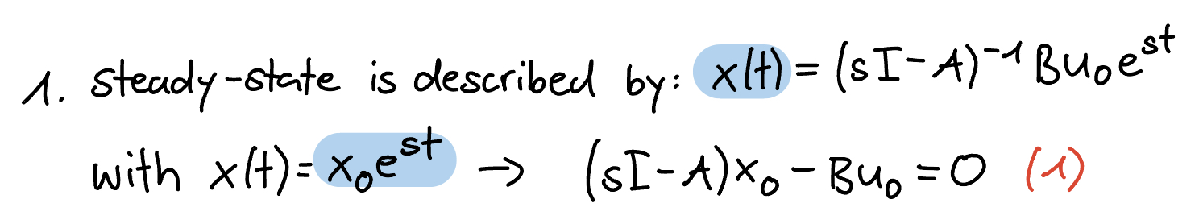
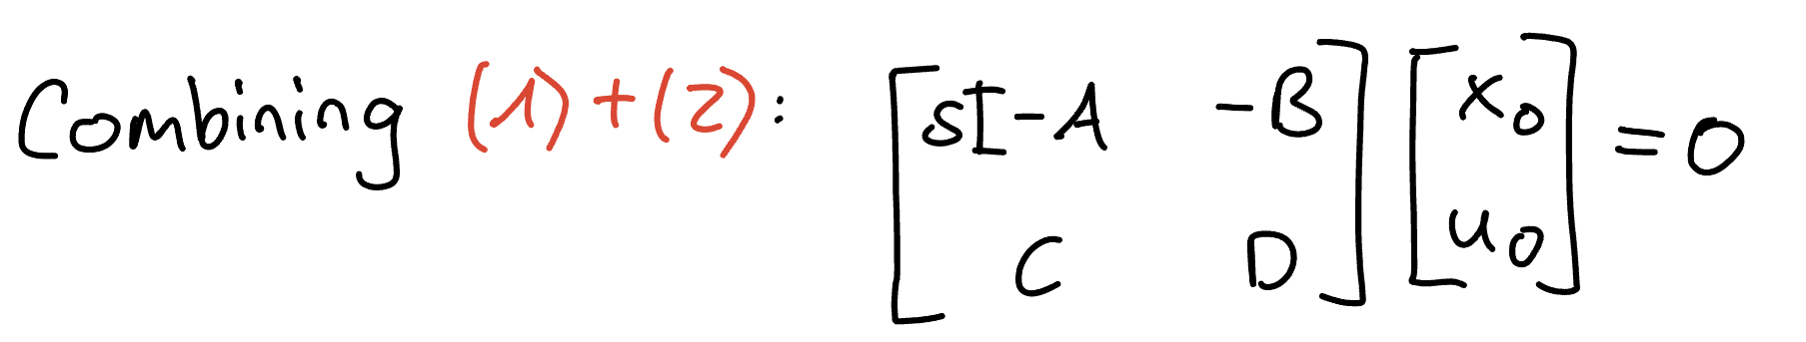
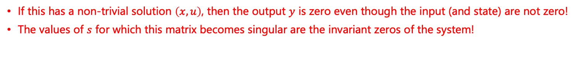

Invariant zeros
To understand invariant zeros, we look at our systems from the state-space perspective:
Assume we have a (stable) system:
Important: If the realization $\left(A,B,C,D\right)$ is minimal, then invariant zeros $≙$ transmission zeros
If this has a non-trivial solution $\left(x,u\right)$, then the output $y$ is zero even though the input (and state) are not zero!
The values of $s$ for which this matrix becomes singular are the invariant zeros of the system!

Slide 28







Reachable Cannonical Form
What we have not looked at is how to find a state-space realization given a tf matrix
What we know already: given the MIMO state-space system $\left(A,B,C,D\right)$, we find the tf matrix as: $G\left(s\right)=C{\left(sI−A\right)}^{−1}B+D$
But what about the other way? i.e., tf → SS
SISO:
MIMO:
calculate a canonical form for each $G_{ij}$?
$$G\left(s\right)=\left[\begin{matrix}G_{11}\left(s\right) & ⋯ & G_{1m}\left(s\right) \\ ⋮ & ⋱ & ⋮ \\ G_{l1}\left(s\right) & ⋯ & G_{lm}\left(s\right)\end{matrix}\right]$$
Good news: This is valid!
Bad news: This realization is not minimal

Slide 29


Gilbert's Realization

Slide 30



Slide 31


Quick analysis

Slide 32
3. Norms

Slide 33

Signal amplification in MIMO sytems
For many performance criteria we had to look at the amplification of signals in the SISO case (recall Bode plots)
We did this by analyzing the magnitudes of transfer functions
Now, how do we translate this to MIMO systems?
Let's illustrate the added complexity, assume $y=Gu$ with:
For the same size input we get very different output "sizes"
We call this directionality of MIMO systems
To quantify amplification or "size" we need new tools → norms

Slide 34



Vector norms
Measures the "length" of a vector
In higher dimensions, this notion becomes less intuitive
⇒ We need a precise mathematical definition of "length"
A norm maps vectors to a non-negative scalar with these properties:
Positivity: $||x|| > 0 ∀ x ≠ 0$
Homogeneity: $||a x|| =||a|| ||x||, ∀ a ∈ ℝ, x ∈ V$
Triangle inequality: $||x + y|| ≤ ||x|| + ||y||$

Slide 35

Matrix norms
Most relevant matrix norms belong to a subclass called induced norms
They measure how "large" a matrix is based on how much it amplifies a vector

Slide 36
Feedback?
Too fast? Too slow? Less theory, more exercises?
I would appreciate your feedback. Please let me know.

