Slide 1

CS1 Week 12 Empty
Time-delays, Designing Compensators, Non-Linearities

Slide 2
Attention! 🚨
I will have to miss next week’s exercise class on Friday, 12 December due to a review for my Focus Project…
I’m planning something a bit more fun for the last week (Recap Kahoot?, short insight into my Focus Project if you are interested?)
Let me know if you have any other suggestions for the last week!

Slide 3
Recap Last Week

Slide 4
Quiz 1
Which statements are true?
A. Commands and disturbances act at lower frequencies
B. Noise acts at lower frequencies
C. Commands and disturbances act at higher frequencies
D. Noise acts at higher frequencies

Slide 5
Quiz 2
Which statements are true?
A. The sensitivity function $S(s)$ describes the impact of disturbances on the error
B. The sensitivity function $S(s)$ describes the impact of noise on the error
C. The complementary sensitivity function $T(s)$ describes the impact of noise on the error
D. $S(s)+T(s)$ is always equal to 1

Slide 6
Quiz 3
What is the bandwidth of a system?
A. characterizes how fast the system can respond to changes in the reference signal
B. The bandwidth is the maximum $ω$ such that $\left|T\left(jω\right)\right|>1/\sqrt{2}$ ($≈ −3 dB$)
C. The bandwidth is often approximated by $ω_{c}$
D. Describes how fast your Inno Project robot will fail on qualification day

Slide 7
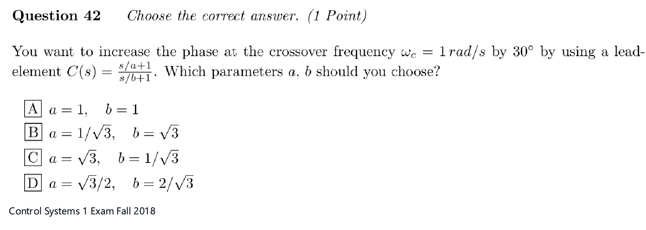
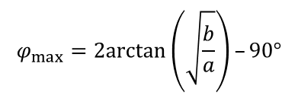

Quiz 4
The maximum phase shift of a lead compensator occurs at $ω=\sqrt{\left(ab\right)}$
$$φ_{max}=2arctan\left(\sqrt{\frac{b}{a}}\right)–90°$$

Slide 8
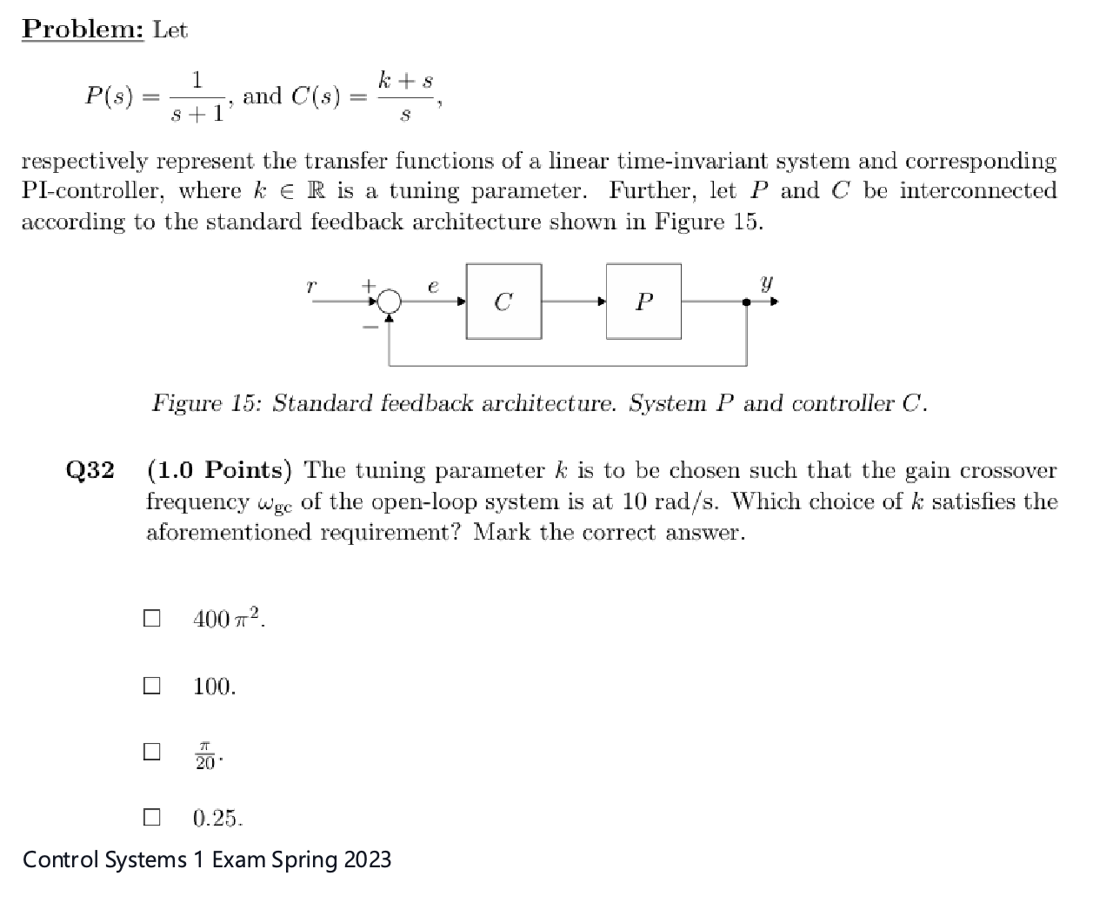
Quiz 5

Slide 9
Course Schedule
Subject | Week
Introduction, Control Architectures, Motivation | 1
Modeling, Model examples | 2
System properties, Linearization | 3
Analysis: Time response, Stability | 4
Transfer functions 1: Definition and properties | 5
Transfer functions 2: Poles and Zeros | 6
Proportional feedback control, Root Locus | 7
Time-Domain specifications, PID control | 8
Frequency response, Bode plots | 9
Polar plots, The Nyquist condition | 10
Frequency-domain Specifications, Dynamic Compensation, Loop Shaping | 11
Time delays, Compensators, Nonlinearities | 12
Describing functions | 13
Intro to Uncertainty and Robustness | 14
Modeling
Analysis
Synthesis

Slide 10
Today
Time-delays
Designing Compensators
Non-Linearities

Slide 11
1. Time-delays

Slide 12

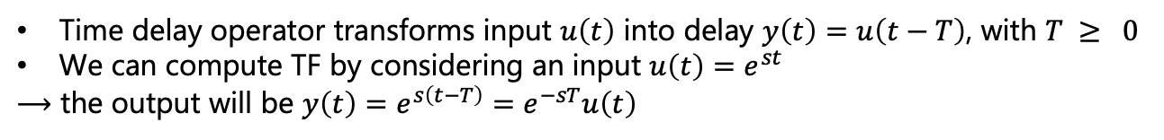




Introduction
Why?
Delays are common in control systems:
• If your controller is implemented on a computer, then reading sensor data and calculating the input for your actuator will take a finite computation time
• They can also be part of your physical plant
How?
Time delay operator transforms input $u\left(t\right)$ into delay $y\left(t\right)=u\left(t−T\right)$, with $T ≥ 0$
We can compute TF by considering an input $u\left(t\right)=e^{st}$
$⟶$ the output will be $y\left(t\right)=e^{s\left(t−T\right)}=e^{−sT}u\left(t\right)$
like we always do to compute TF
$$T$$
$$u(t)$$
$⟶$ hence $G\left(s\right)=e^{−sT}$
$$y\left(t\right)$$
$$t$$

Slide 13
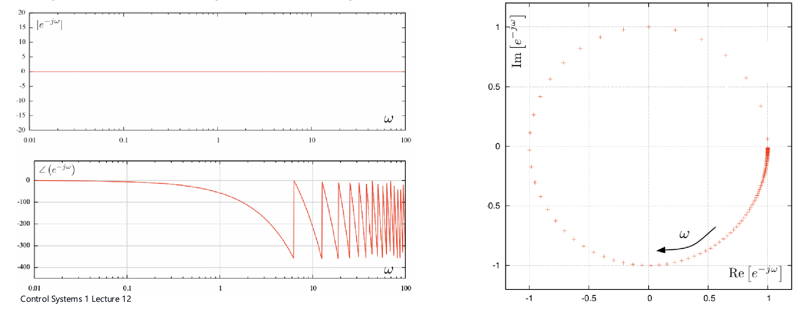

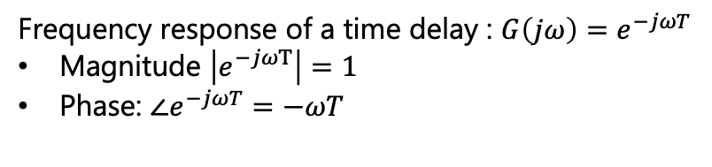
Frequency Response of Time Delays
$G\left(s\right)=e^{−sT}$
… this is NOT a rational transfer function, with which we have been dealing all this time
No poles or zeros
Frequency response of a time delay : $G\left(jω\right)=e^{−jωT}$
Magnitude $\left|e^{−jωT}\right|=1$
Phase: $∠e^{−jωT}=−ωT$
Bode & Polar Plot:

Slide 14
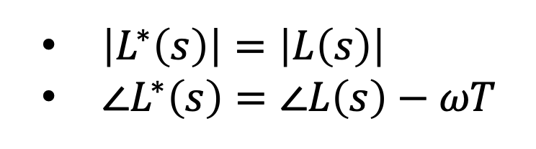
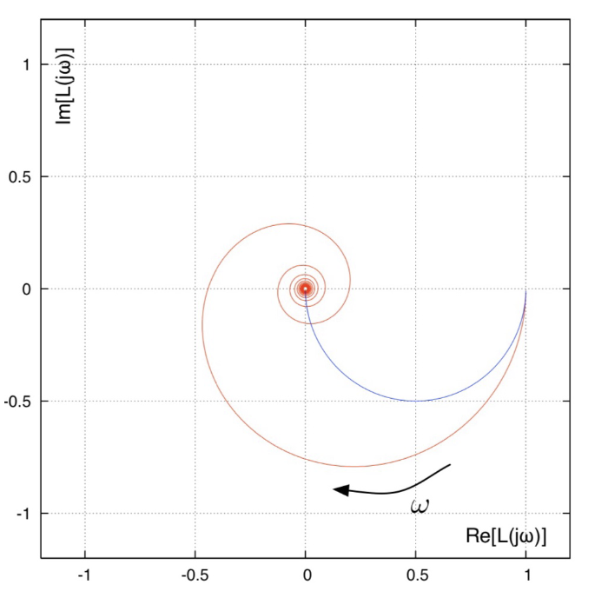
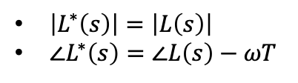

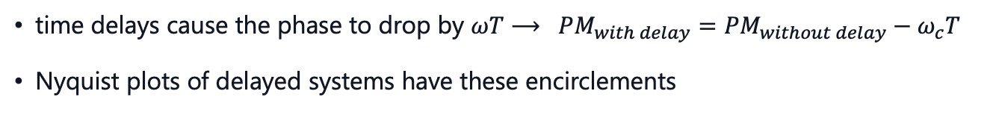




Effects of Time Delays
time delay
$$L^{∗}\left(s\right)$$
$$u$$
$$y$$
$$e^{−sT}$$
$$L(s)$$
Now that we know the behavior of a pure delay, let's combine it with a system!
time delays cause the phase to drop by $ωT$ $⟶ PM_{with delay}=PM_{without delay}−ω_{c}T$
Nyquist plots of delayed systems have these encirclements

Slide 15
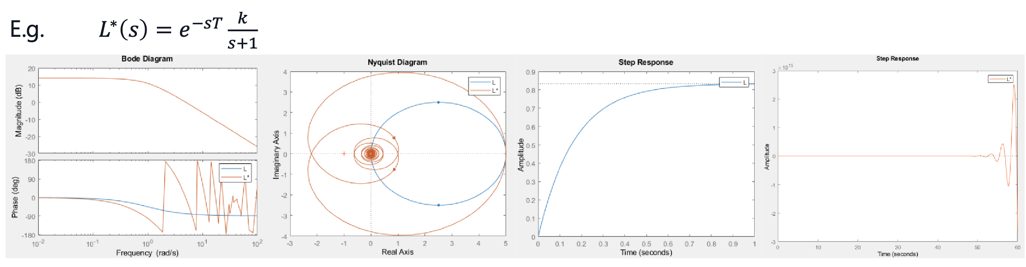
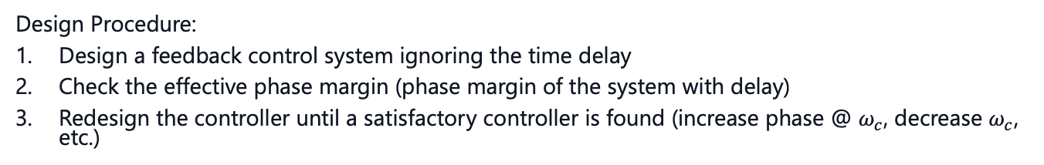
Effects of Time Delays
Design Procedure:
Design a feedback control system ignoring the time delay
Check the effective phase margin (phase margin of the system with delay)
Redesign the controller until a satisfactory controller is found (increase phase @ $ω_{c}$, decrease $ω_{c}$, etc.)

Slide 16
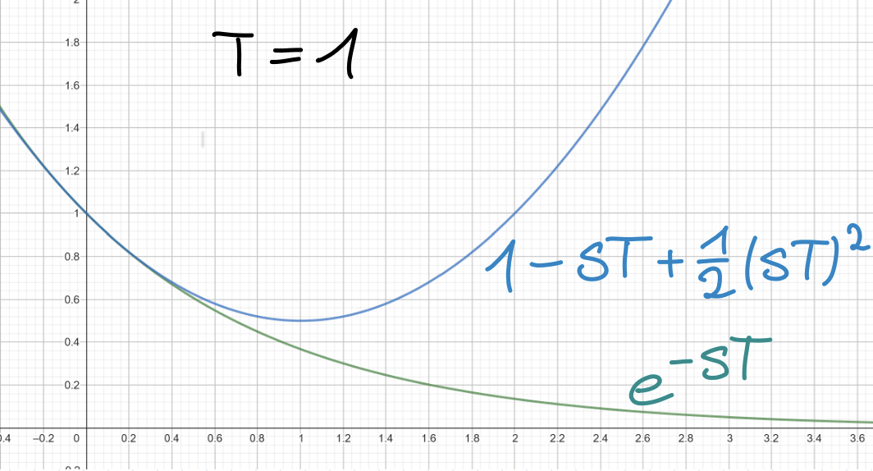
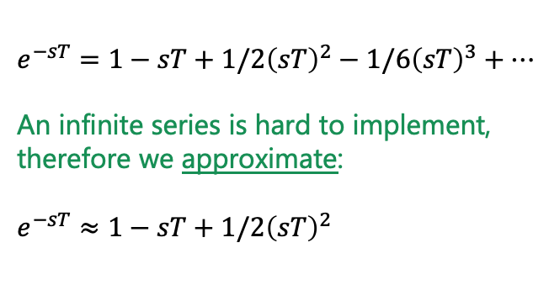
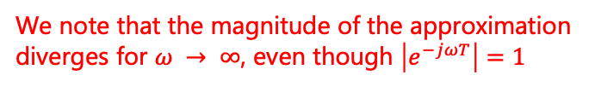
Rationalizing Time Delay TF
This is a very "duct-tape-engineering" approach… Is there another way to solve this? Yes!
We can use some mathematical tricks to change the representation of a delay
⇒ Technically we can write $e^{−sT}$ as a polynomial! Using Taylor-approximation:
⇒ Can use for e.g. Root Locus!
$$e^{−sT}=1−sT+1/2{\left(sT\right)}^{2}−1/6{\left(sT\right)}^{3}+…$$
An infinite series is hard to implement, therefore we approximate:
$$e^{−sT}≈1−sT+1/2{\left(sT\right)}^{2}$$
We note that the magnitude of the approximation diverges for $ω → ∞$, even though $\left|e^{−jωT}\right|=1$
solid for small $ω$, but bad approximation for $ω⟶∞$

Slide 17
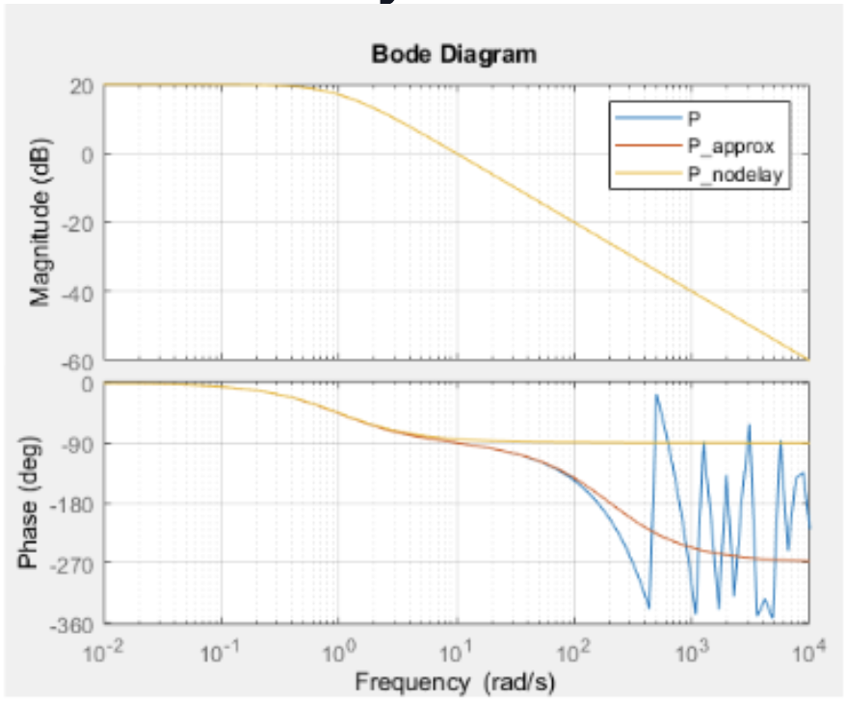
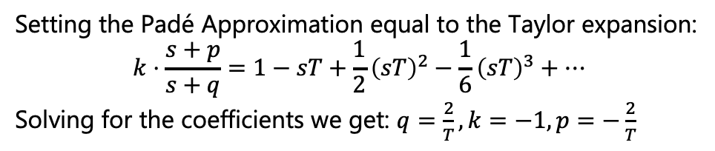
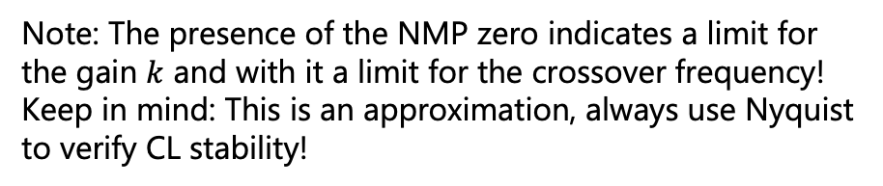

Padé Approximation
better
approximation
For simplicity we use a ratio of first order polynomials: $e^{−sT}≈k\frac{s+p}{s+q}$
Setting the Padé Approximation equal to the Taylor expansion:
$$k⋅\frac{s+p}{s+q}=1−sT+\frac{1}{2}{\left(sT\right)}^{2}−\frac{1}{6}{\left(sT\right)}^{3}+…$$
Solving for the coefficients we get: $q=\frac{2}{T},k=−1,p=−\frac{2}{T}$
Padé Approximation
$$e^{−sT}≈\frac{\frac{2}{T}−s}{\frac{2}{T}+s}$$
Note: The presence of the NMP zero indicates a limit for the gain $k$ and with it a limit for the crossover frequency!
Keep in mind: This is an approximation, always use Nyquist to verify CL stability!

Slide 18
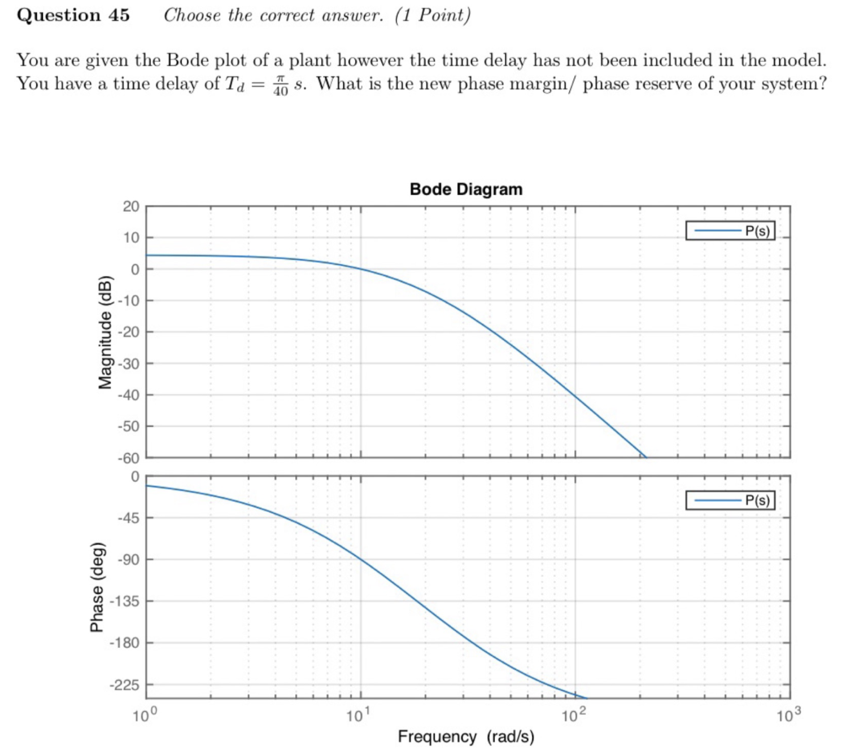
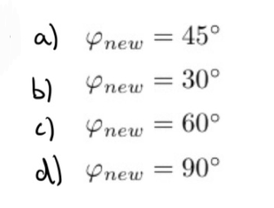

Exam Problem
$$PM_{with delay}=PM_{without delay}−ω_{c}T$$

Slide 19
2. Designing Compensators

Slide 20
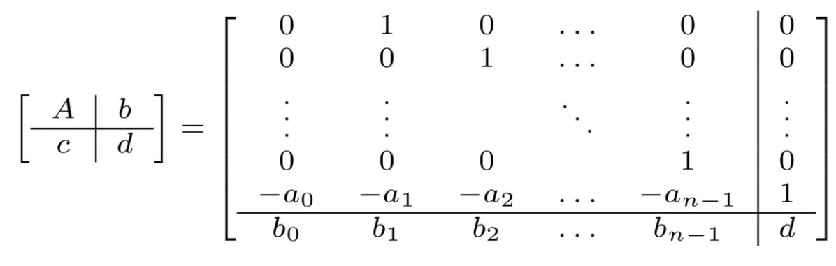

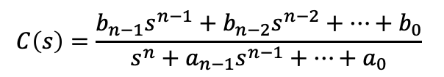
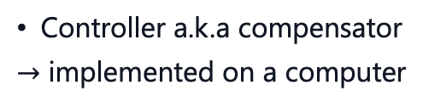






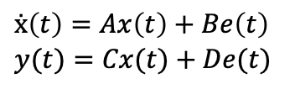




Implementing a Controller $C(s)$
$$d$$
Controller a.k.a compensator
$→$ implemented on a computer
$$r$$
$$e$$
$$u$$
$$y$$
$$C\left(s\right)$$
$$P(s)$$
$$−$$
$$n$$
Recall:
Transfer Function
$$C\left(s\right)=\frac{b_{n−1}s^{n−1}+b_{n−2}s^{n−2}+…+b_{0}}{s^{n}+a_{n−1}s^{n−1}+…+a_{0}}$$
Input: $u = e = r − y$
$$ẋ\left(t\right)=Ax\left(t\right)+Be\left(t\right)$$
$$y(t)=Cx(t)+De(t)$$

Slide 21
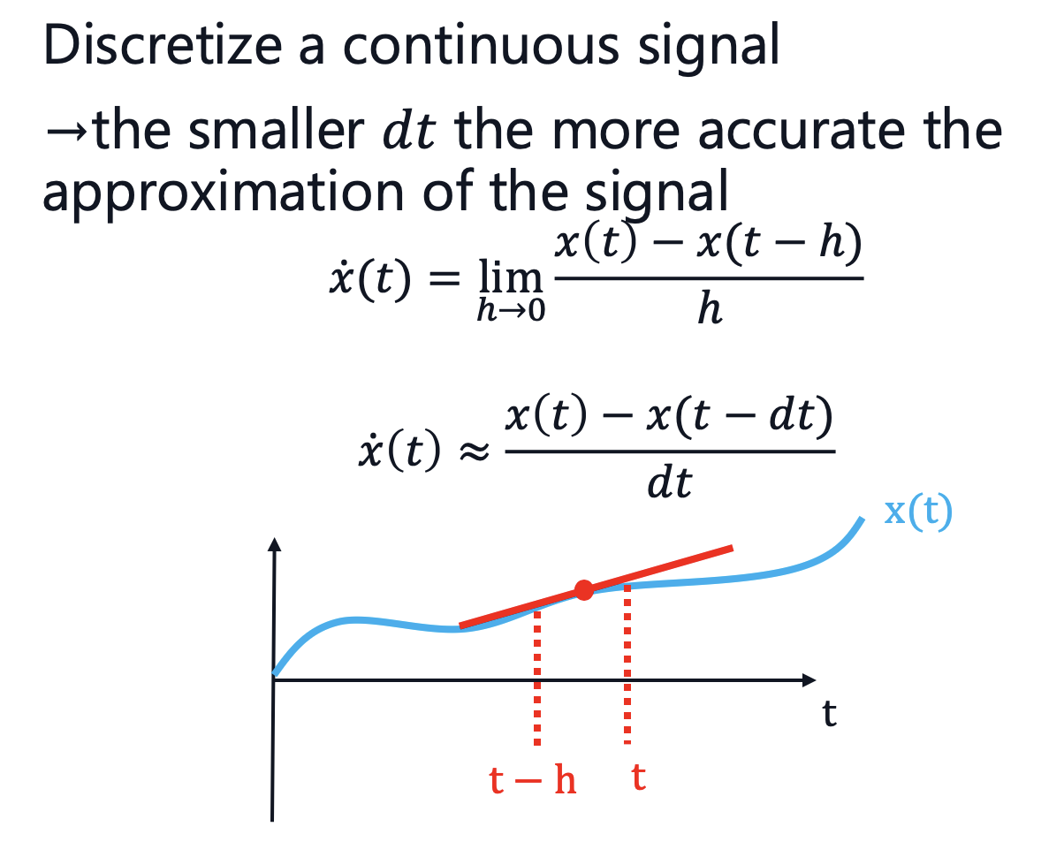
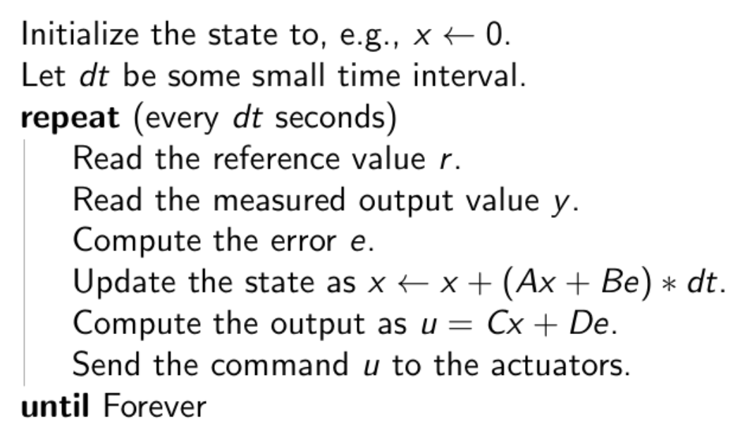
Implementing a Controller $C(s)$
$$d$$
$$r$$
$$e$$
$$u$$
$$y$$
$$C\left(s\right)$$
$$P(s)$$
$$−$$
$$n$$

Slide 22
3. Non-Linearities

Slide 23
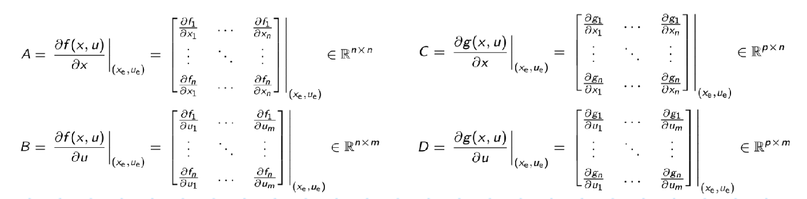
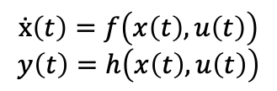

Non-Linearities
Tools we have learnt in CS1 only valid for linear systems
Most systems in real world are non-linear
to bridge this gap $→$ linearize systems around equilibrium points
we did this with Jacobian linearization procedure that takes some non-linear system:
$$ẋ\left(t\right)=f\left(x\left(t\right),u\left(t\right)\right)$$
$$y\left(t\right)=h\left(x\left(t\right),u\left(t\right)\right)$$
and produces a linearized system valid around the equilibrium point. The system is given by:

Slide 24
Hartman–Grobman
Given this linearization, the Hartman–Grobman theorem tells us that if the linearized system is closed-loop BIBO stable, then the nonlinear system is also stable in a range around the equilibrium point. We just don’t know how large that region is.
If we now want to design a controller for a nonlinear system we proceed as follows:
Design a linear compensator for the linear model
If the system is CL stable the nonlinear system will also be stable in the region of the equilibrium
Check in a nonlinear simulation if your design is robust with respect to typical deviations.

Slide 25
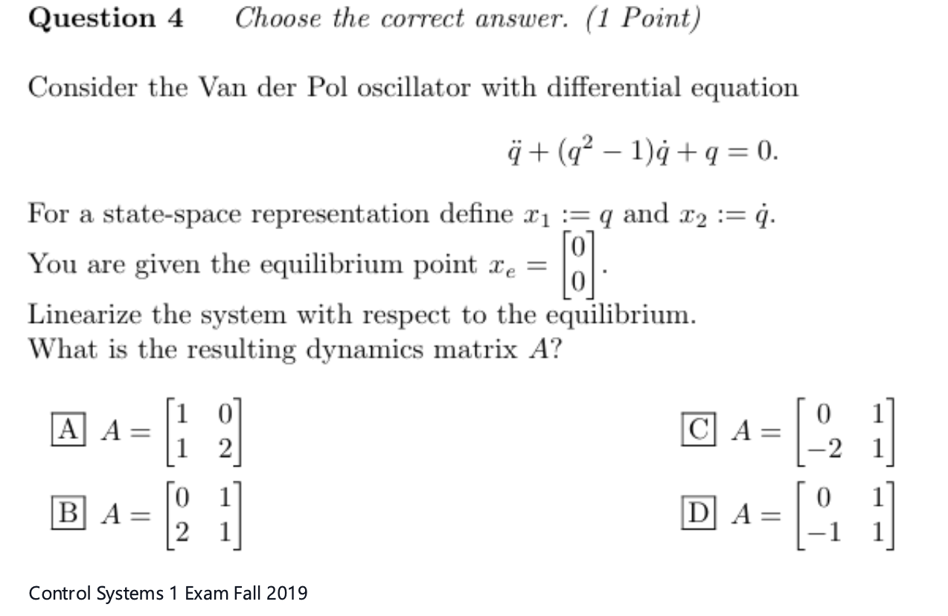
Appendix

Slide 26
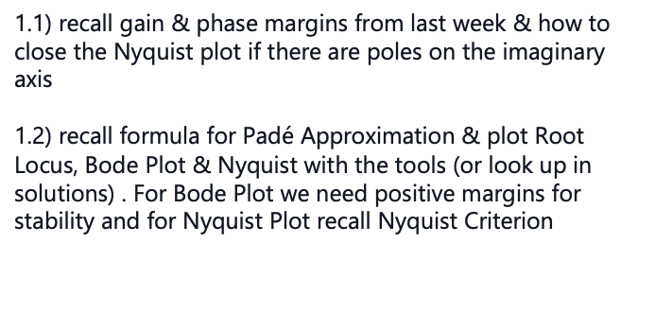

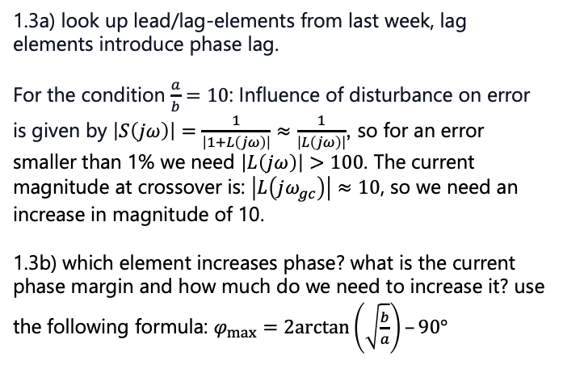
Tips for Problem Set 11
Easy | Medium | Hard
 | $$1$$
1.1) recall gain & phase margins from last week & how to close the Nyquist plot if there are poles on the imaginary axis
1.2) recall formula for Padé Approximation & plot Root Locus, Bode Plot & Nyquist with the tools (or look up in solutions) . For Bode Plot we need positive margins for stability and for Nyquist Plot recall Nyquist Criterion
1.3a) look up lead/lag-elements from last week, lag elements introduce phase lag.
For the condition $\frac{a}{b}=10$: Influence of disturbance on error is given by $\left|S\left(jω\right)\right|=\frac{1}{\left|1+L\left(jω\right)\right|}≈\frac{1}{\left|L\left(jω\right)\right|}$, so for an error smaller than 1% we need $\left|L\left(jω\right)\right|>100$. The current magnitude at crossover is: $\left|L\left(jω_{gc}\right)\right|≈10$, so we need an increase in magnitude of 10.
1.3b) which element increases phase? what is the current phase margin and how much do we need to increase it? use the following formula: $φ_{max}=2arctan\left(\sqrt{\frac{b}{a}}\right)–90°$

Slide 27
Questions?

Slide 28
Feedback?
Too fast? Too slow? Less theory, more exercises?
I would appreciate your feedback. Please let me know.
https://docs.google.com/forms/d/e/1FAIpQLSdHl0kjWo63aNzDkAV0cnmQadCAj5L0D7v7aSh0BK7BBdEgpA/viewform?usp=header

