Slide 1

CS1 Week 7
Proportional Feedback, Root Locus

Slide 2
Recap Last Week

Slide 3





Quiz 1
Which factor appears in the Bode-form of a transfer function for a real zero at $z$?
A. $\left(s−z\right)$
B. $\left(\frac{s}{−z}+1\right)$
C. $\frac{1}{s−z}$
D. $\frac{Bode}{los}$

Slide 4
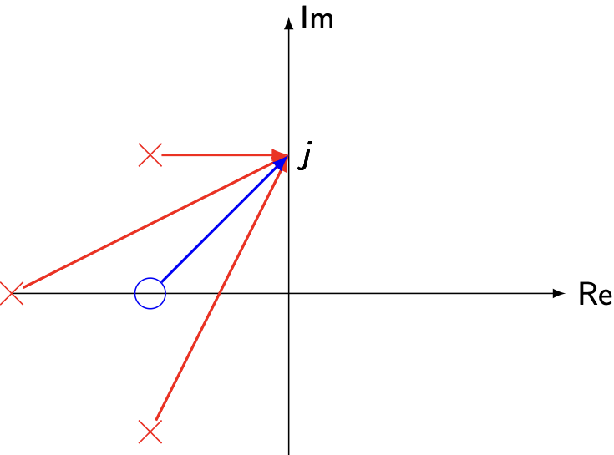

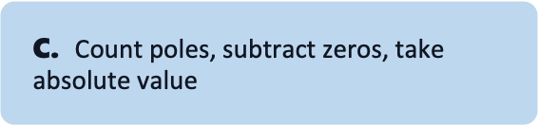
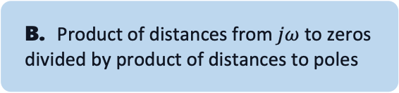
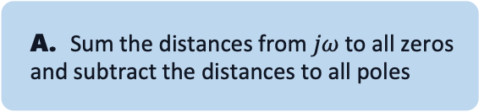
Quiz 2
How do you compute $|G\left(jω\right)|$ from a pole–zero plot?
A. $\text{Sum} \text{the} \text{distances} \text{from} jω \text{to} \text{all} \text{zeros} \text{and} \text{subtract} \text{the} \text{distances} \text{to} \text{all} \text{poles}$
B. Product of distances from $jω$ to zeros divided by product of distances to poles
C. $\text{Count} \text{poles}\text{, }\text{subtract} \text{zeros}\text{, }\text{take} \text{absolute} \text{value}$
D. Measure with a physical ruler on your screen

Slide 5
Quiz 3
What is the physical meaning of the poles of an LTI system?
A. They only set the steady-state (DC) gain
B. They quantify how much power the controller injects into the plant
C. They determine stability of the system
D. They determine the decay/growth rates and oscillation frequencies of the system’s natural response

Slide 6
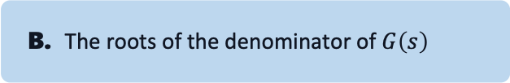
Quiz 4
What are non-minimum phase zeros?
A. Zeros in the right-half plane
B. The roots of the denominator of $G\left(s\right)$
C. They create an anticipatory effect and reduce phase lag
D. They cause an inverse initial response: the output first moves in the wrong direction before heading to the final value

Slide 7
Quiz 5
Which statements about pole-zero cancellation are true?
A. Pole-Zero cancellation is always safe
B. Cancelling an unstable pole can make I/O look stable while internals stay unstable.
C. A zero near a pole partially cancels it, weakening that mode in the I/O response
D. Pole–zero proximity always improves robustness

Slide 8
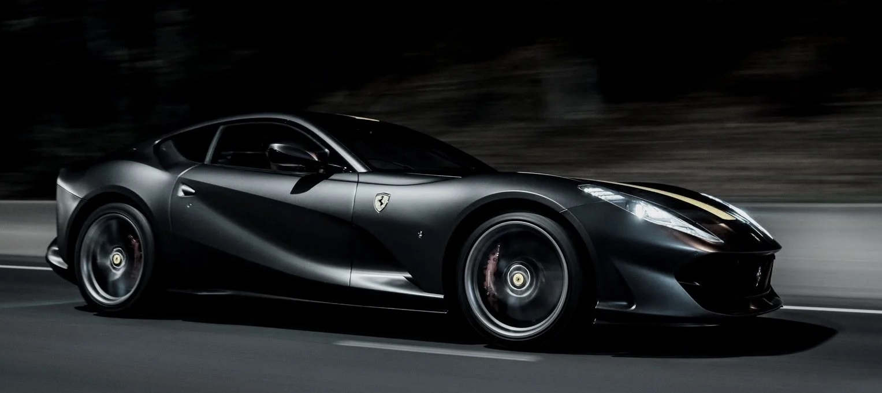
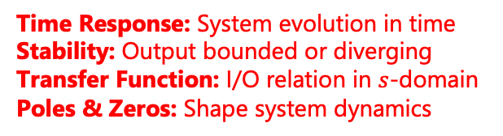

Motivation
Classification & Linearization
system modeling
state-space representation
$$\dot{x}\left(t\right)=Ax\left(t\right)+Bu\left(t\right)$$
$$y(t)=Cx(t)+Du(t)$$
Plant P
Analysis
What we looked at so far
Time Response: System evolution in time
Stability: Output bounded or diverging
Transfer Function: I/O relation in $s$-domain
Poles & Zeros: Shape system dynamics
Synthesis
Control Systems
Controller C
What we are going to look at today

Slide 9
Course Schedule
Subject | Week
Introduction, Control Architectures, Motivation | 1
Modeling, Model examples | 2
System properties, Linearization | 3
Analysis: Time response, Stability | 4
Transfer functions 1: Definition and properties | 5
Transfer functions 2: Poles and Zeros | 6
Proportional feedback control, Root Locus | 7
Time-Domain specifications, PID control, Computer implementation | 8
Frequency response, Bode plots | 9
The Nyquist condition, Time delays | 10
Frequency-domain Specifications, Dynamic Compensation, Loop Shaping | 11
Time delays, Successive loop closure, Nonlinearities | 12
Describing functions | 13
Intro to Uncertainty and Robustness | 14
Modeling
Analysis
Synthesis

Slide 10
Today
Feedback Control
Root-Locus

Slide 11
1. Feedback Control

Slide 12






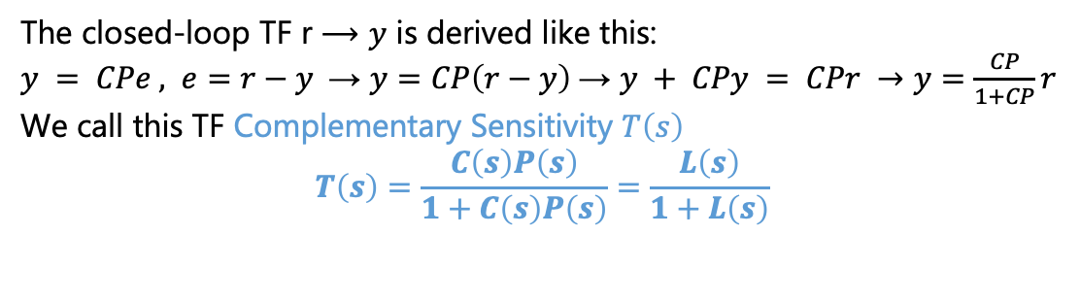
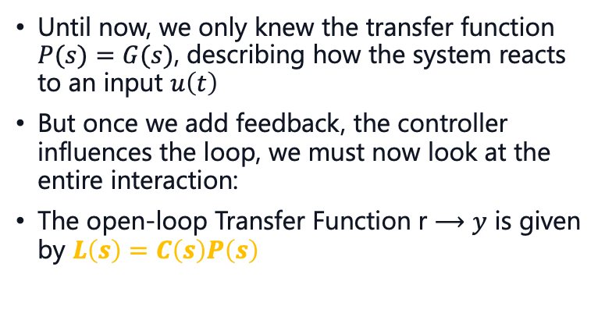








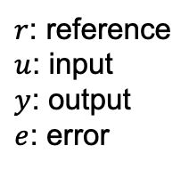

The Initial Problem
Model of a system
$$L\left(s\right)$$
$$r$$
$$u$$
$$y$$
$$C\left(s\right)$$
$$P(s)$$
Until now, we only knew the transfer function $P(s)=G(s)$, describing how the system reacts to an input $u\left(t\right)$
But once we add feedback, the controller influences the loop, we must now look at the entire interaction:
The open-loop Transfer Function r $⟶y$ is given by $L\left(s\right)=C\left(s\right)P\left(s\right)$
Our controller
We called it G(s) until now
$$T\left(s\right)$$
$$r$$
$$e$$
$$u$$
$$y$$
$$C(s)$$
$$P(s)$$
$$−$$
The closed-loop TF r $⟶y$ is derived like this: $y = CPe , e=r−y$→ $y=CP\left(r−y\right)$→ $y + CPy = CPr →y=\frac{CP}{1+CP}r$
We call this TF Complementary Sensitivity $T\left(s\right)$
$$T\left(s\right)=\frac{C\left(s\right)P\left(s\right)}{1+C\left(s\right)P\left(s\right)}=\frac{L\left(s\right)}{1+L\left(s\right)}$$
$r$: reference
$u$: input
$y$: output
$e$: error

Slide 13



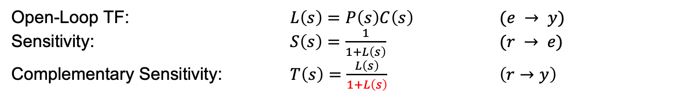






Key Relations
$$r$$
$$u$$
$$e$$
$$C(s)$$
$$y$$
$$P(s)$$
$$−$$
$$L\left(s\right)$$
Summarized are the key relations:
Important: Closed loop and open loop poles are not always equal!
$1+L(s)=0$gives us poles of closed loop transfer function
$$T\left(s\right)$$
Open-Loop TF: $L\left(s\right)=P\left(s\right)C\left(s\right)$ $(e → y)$
Sensitivity: $S\left(s\right)=\frac{1}{1+L\left(s\right)}$ $(r → e)$
Complementary Sensitivity: $T\left(s\right)=\frac{L\left(s\right)}{1+L\left(s\right)}$ $\left(r→y\right)$

Slide 14
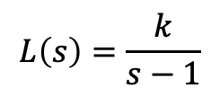
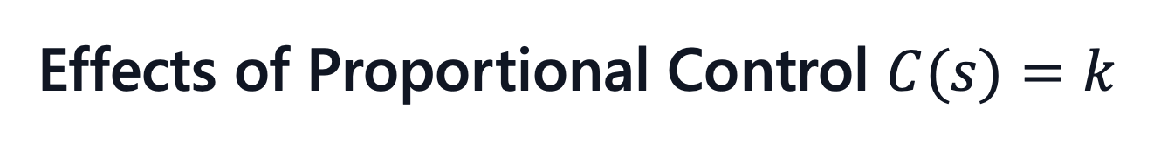

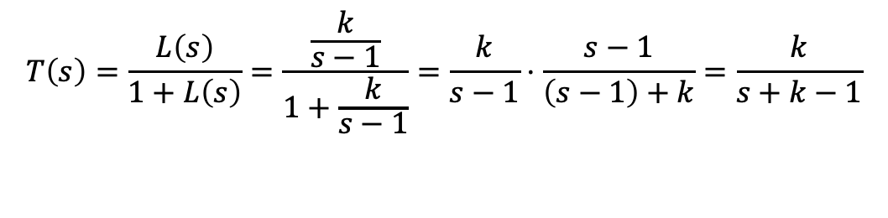


Effects of Proportional Control $C(s)=k$
The essential question is now; how does feedback affect our system?
Example:
With the feedback, the open-loop is:
$⟶$ Unstable, no matter the gain!
If we now close the loop the TF becomes:
$$L\left(s\right)=\frac{k}{s−1}$$
Pole-Zero Plot Open-Loop
$$Im$$
x
$$Re$$
$$T\left(s\right)=\frac{L\left(s\right)}{1+L\left(s\right)}=\frac{\frac{k}{s−1}}{1+\frac{k}{s−1}}=\frac{k}{s−1}⋅\frac{s−1}{\left(s−1\right)+k}=\frac{k}{s+k−1}$$

Slide 15

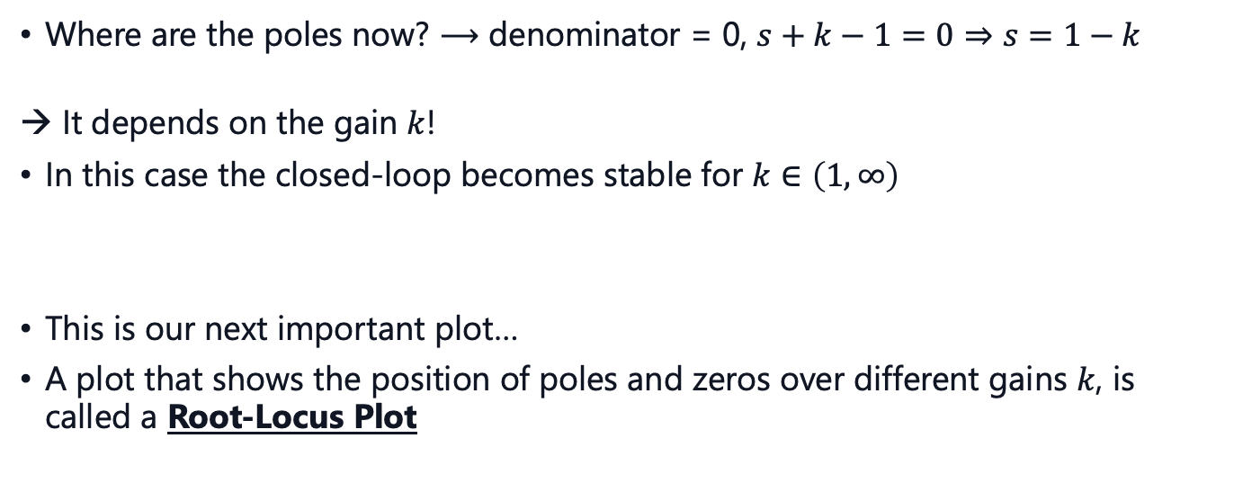

Effects of Proportional Control
Where are the poles now? $⟶$ denominator = 0, $s+k−1=0⇒s=1−k$
It depends on the gain $k$!
In this case the closed-loop becomes stable for $k∈\left(1,∞\right)$
This is our next important plot…
A plot that shows the position of poles and zeros over different gains $k$, is called a Root-Locus Plot
Pole-Zero Plot Closed-Loop
$$Im$$
x
$$Re$$

Slide 16
2. Root Locus

Slide 17



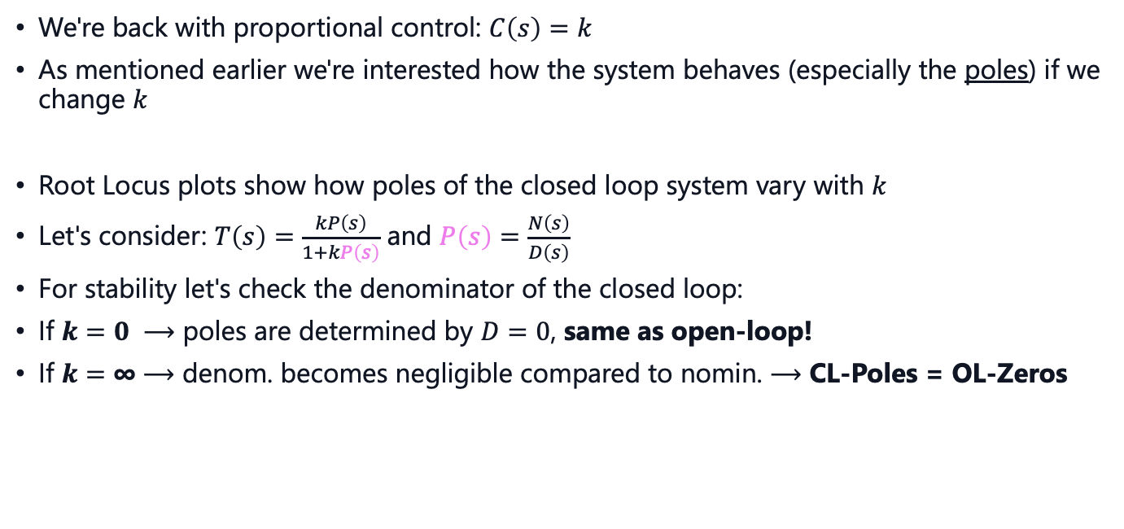




Proportional Feedback
$$e$$
$$u$$
$$k$$
$$P(s)$$
$$−$$
We're back with proportional control: $C\left(s\right)=k$
As mentioned earlier we're interested how the system behaves (especially the poles) if we change $k$
Root Locus plots show how poles of the closed loop system vary with $k$
Let's consider: $T\left(s\right)=\frac{kP\left(s\right)}{1+kP\left(s\right)}$ and $P\left(s\right)=\frac{N\left(s\right)}{D\left(s\right)}$
For stability let's check the denominator of the closed loop:
If $k=0 ⟶$ poles are determined by $D=0$, same as open-loop!
If $k=\text{∞}⟶$ denom. becomes negligible compared to nomin. $⟶$ CL-Poles = OL-Zeros
This determines
stability
$N\left(s\right)$ := Nominator
$D\left(s\right)$ := Denominator
$$1+k\frac{N}{D}=0⟺D+kN=0$$
Let's summarize these rules on the next slide…

Slide 18
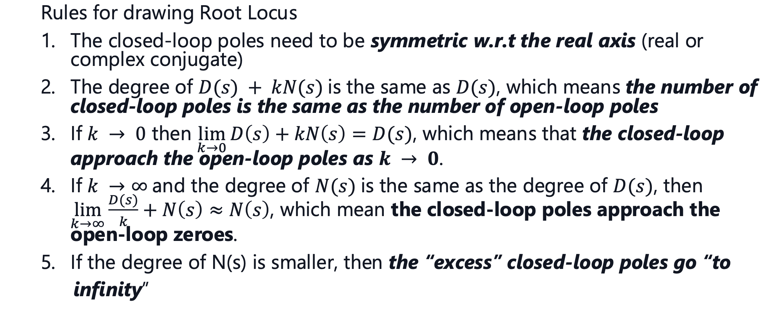
Root Locus Rules

Slide 19
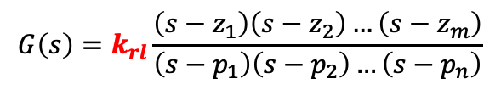
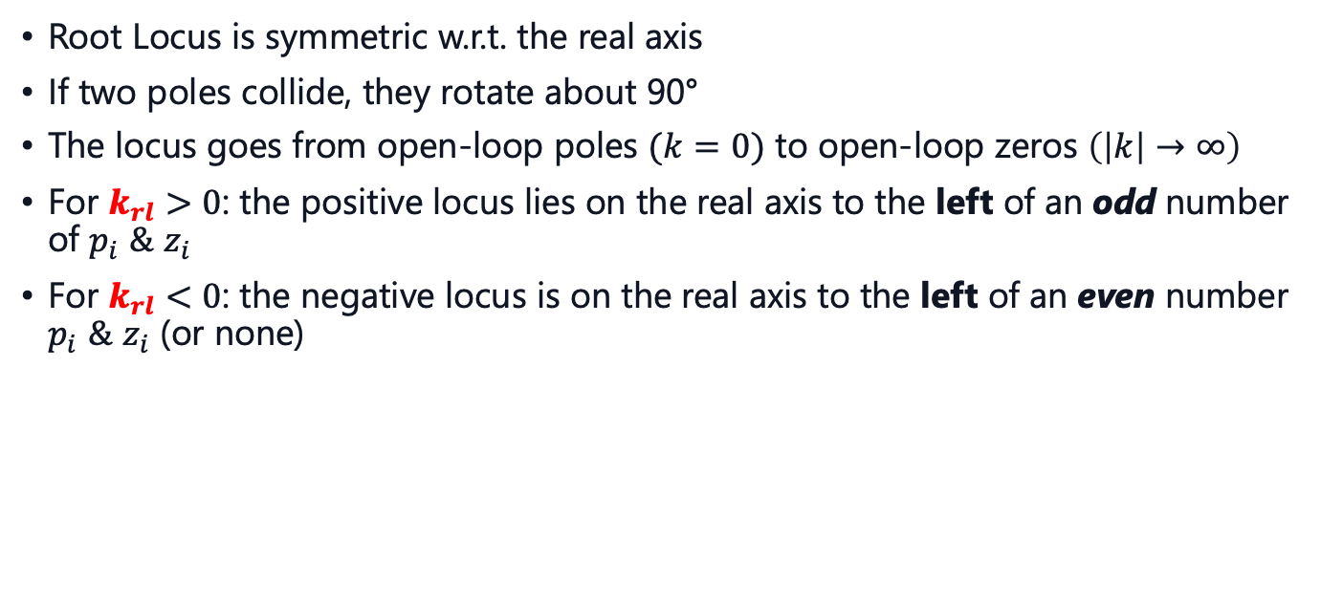
Root Locus Properties
$$G\left(s\right)=k_{rl}\frac{\left(s−z_{1}\right)\left(s−z_{2}\right)…\left(s−z_{m}\right)}{\left(s−p_{1}\right)\left(s−p_{2}\right)…\left(s−p_{n}\right)}$$
Remember:
Root-Locus Form
Root Locus is symmetric w.r.t. the real axis
If two poles collide, they rotate about 90°
The locus goes from open-loop poles $(k=0)$ to open-loop zeros $\left(\left|k\right|→∞\right)$
For $k_{rl}>0$: the positive locus lies on the real axis to the left of an odd number of $p_{i}$ $\&$ $z_{i}$
For $k_{rl}<0$: the negative locus is on the real axis to the left of an even number $p_{i}$ $\&$ $z_{i}$ (or none)
Let's establish these properties visually with an example…

Slide 20
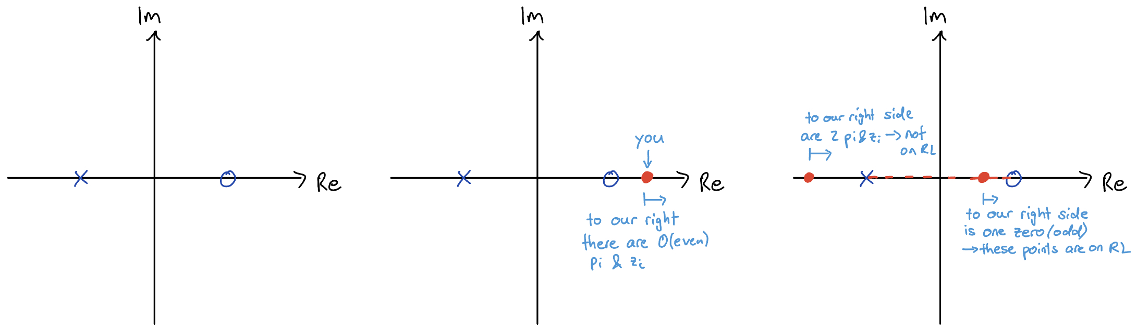
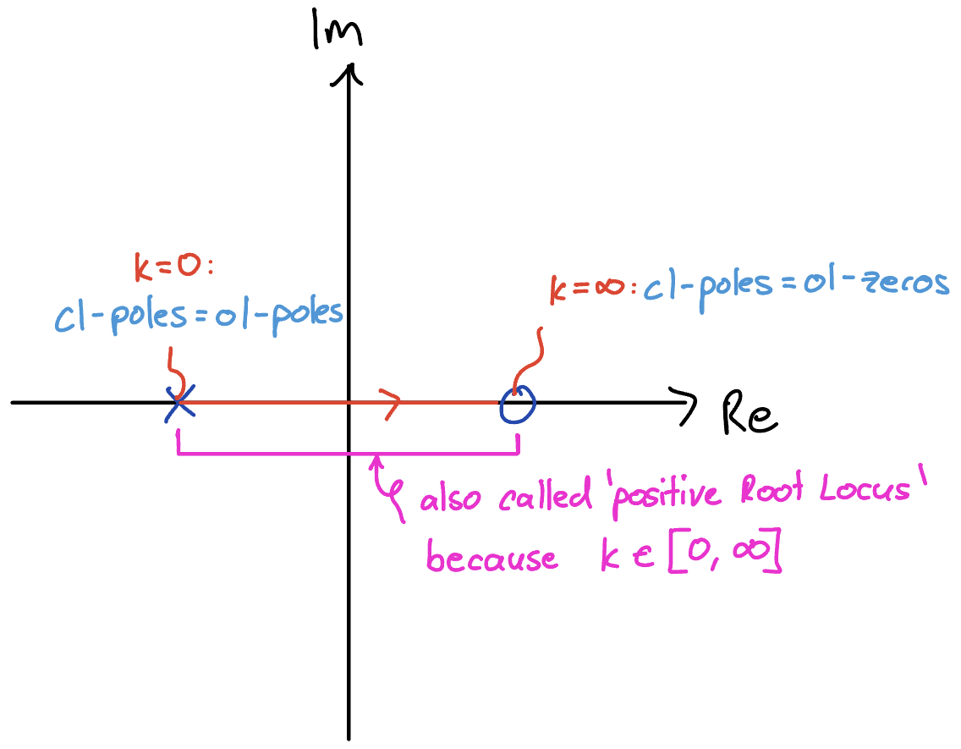
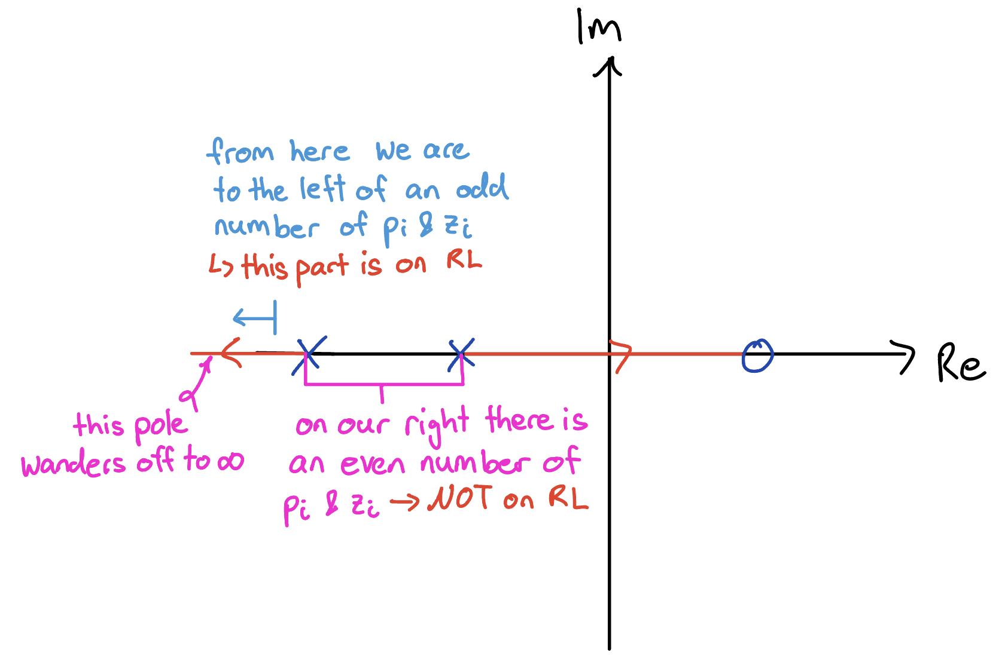


Example
We start right and go left!
$⟶$ finished plot:
what if we
add another pole? $⟶$

Slide 21
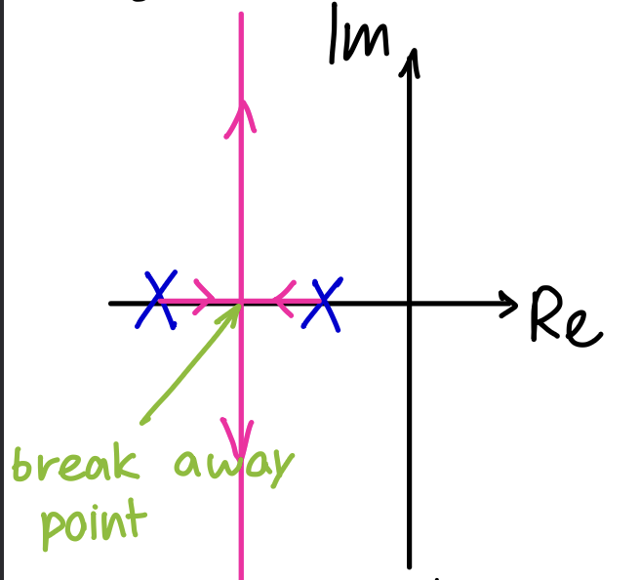
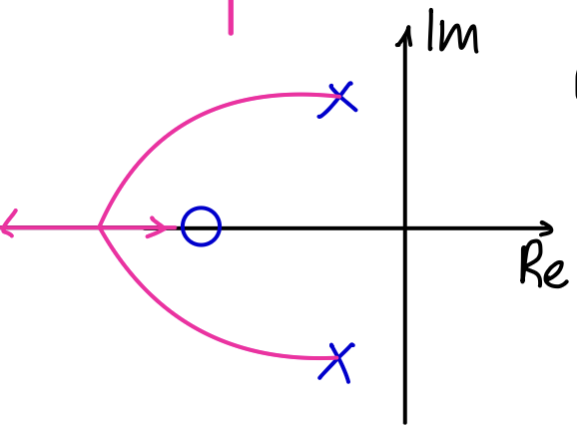
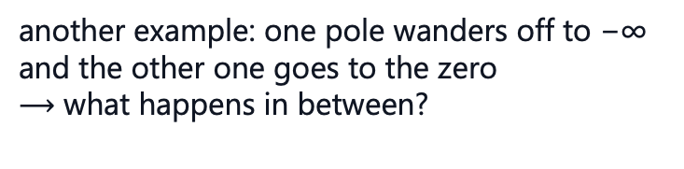

Example
It gets a bit more complicated if two poles collide
from the property before we know that the space between the poles is on the RL
new rule: if two poles collide, they rotate about 90°
$⟶$ how do they exactly wander off to ±∞ ?
$⟶$ asymptotes
$⟶$ breakaway points
another example: one pole wanders off to −∞ and the other one goes to the zero
$⟶$ what happens in between?
difficult to draw by hand not relevant to us, mostly something elliptic looking

Slide 22
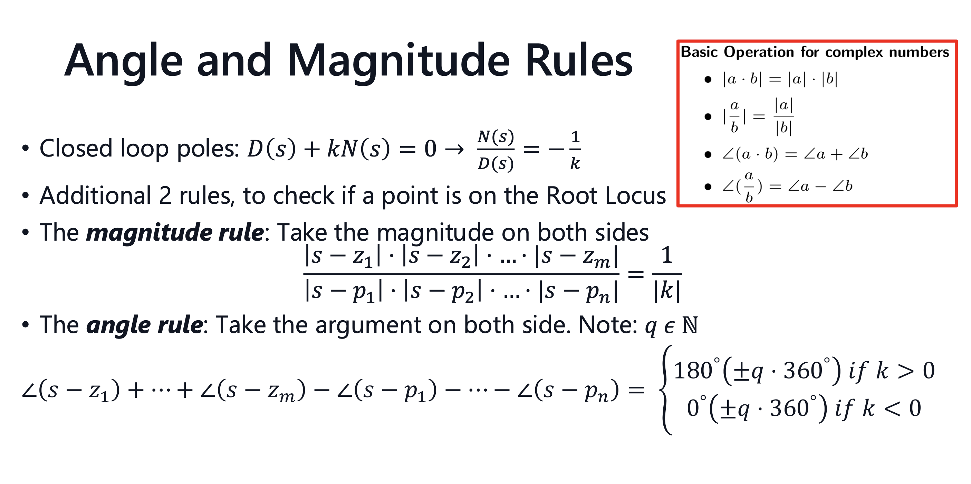
Notes:
always an exam question about this

Slide 23
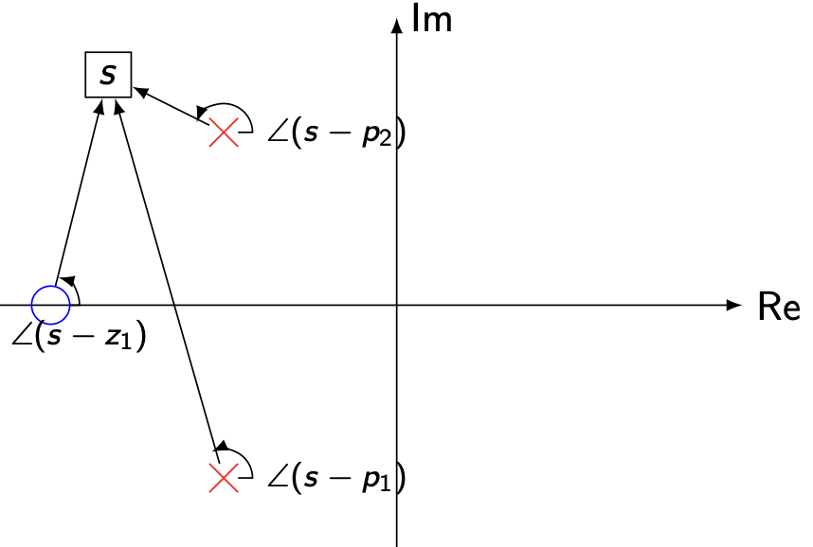
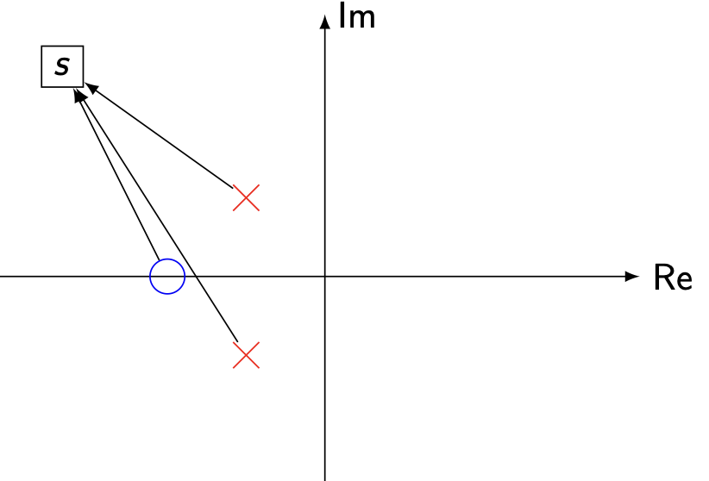
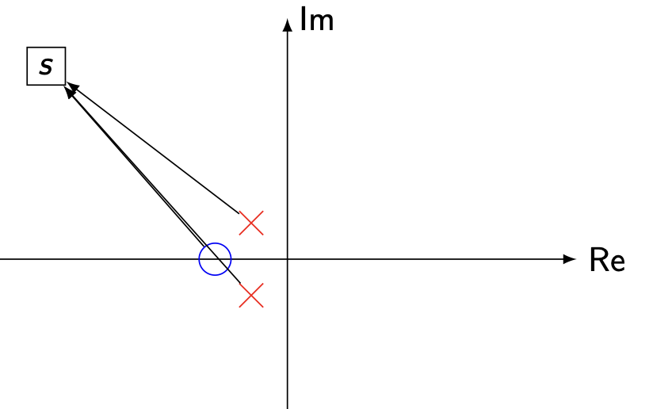
Zooming Out
So, what happens when k → ∞ and there are more open-loop poles than zeros?
We can see, e.g., from the magnitude condition, that the “excess” closed-loop poles will have to go to “to infinity”
Since this is the complex plane, we need to identify “in which direction” they go towards infinity
This is were we use the angle rule again

Slide 24
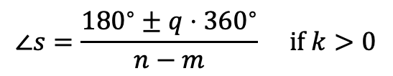
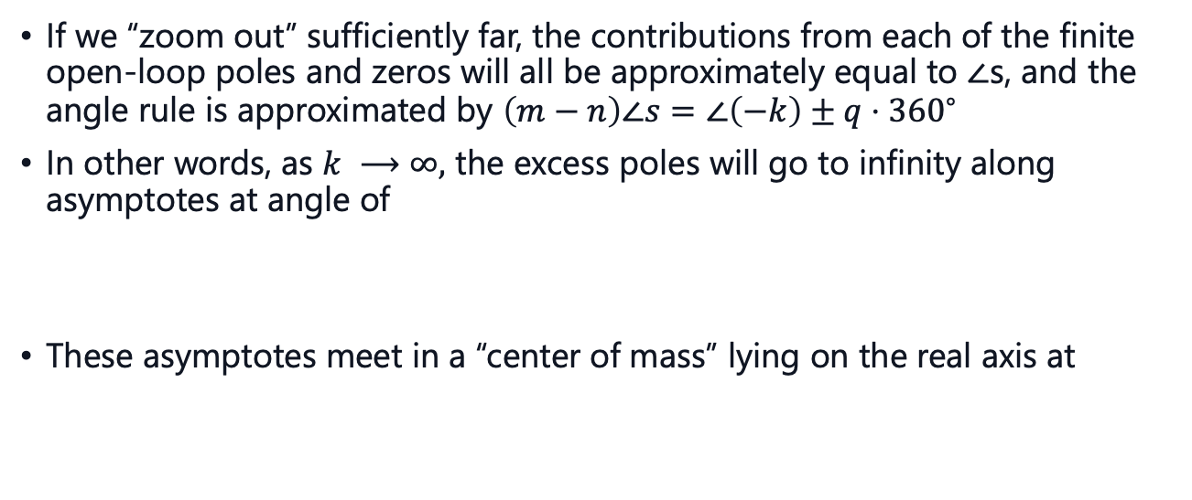
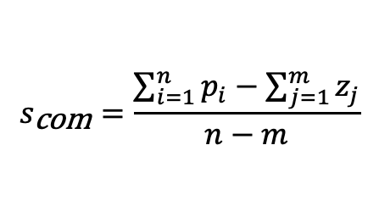
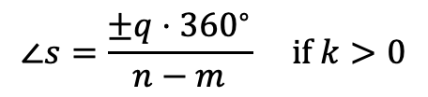
Asymptotes
If we “zoom out” sufficiently far, the contributions from each of the finite open-loop poles and zeros will all be approximately equal to ∠s, and the angle rule is approximated by $\left(m−n\right)∠s=∠\left(−k\right)±q⋅{360}^{∘}$
In other words, as $k ⟶∞,$ the excess poles will go to infinity along asymptotes at angle of
These asymptotes meet in a “center of mass” lying on the real axis at
$$∠s=\frac{{180}^{∘}±q⋅{360}^{∘}}{n−m} \text{if} k>0$$
$$∠s=\frac{±q⋅{360}^{∘}}{n−m} \text{if} k>0$$
$$s_{\text{com}}=\frac{\sum_{i=1}^{n}{p_{i}}−\sum_{j=1}^{m}{z_{j}}}{n−m}$$
(poles are “positive” unit masses, and zeros are “negative” unit masses in this analogy)

Slide 25

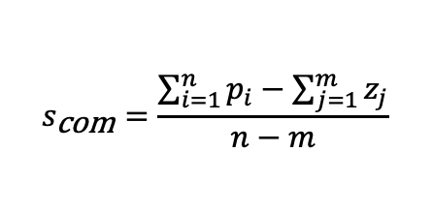

How to Draw Root Locus
Now that we have all the tools, this is the final cookbook to follow when sketching the Root Locus
Calculate poles & zeros of the open-loop and draw them in the complex plane (start & end points of Root Locus)
Analyze the real axis (which segments are on RL?)
Calculate the asymptotes for the excess poles: "center of mass": Angle:
Draw the Root Locus
$$s_{\text{com}}=\frac{\sum_{i=1}^{n}{p_{i}}−\sum_{j=1}^{m}{z_{j}}}{n−m}$$
$$∠s=\frac{{180}^{∘}±q⋅{360}^{∘}}{n−m} \text{if} k>0$$
$$∠s=\frac{±q⋅{360}^{∘}}{n−m} \text{if} k<0$$

Slide 26
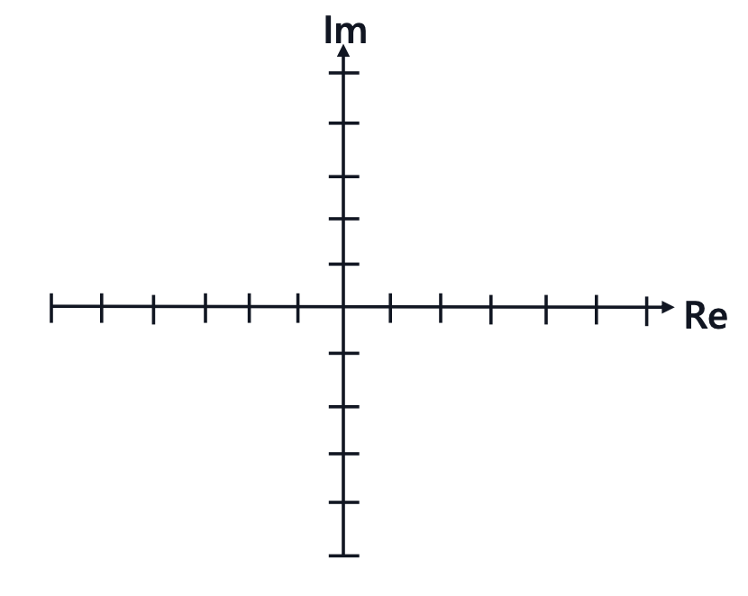
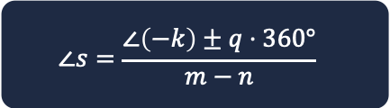
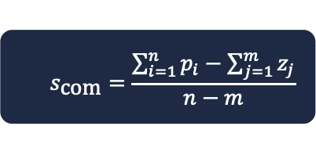
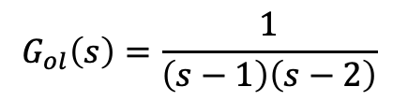
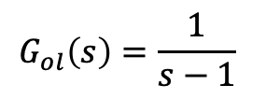
Examples
$$∠s=\frac{∠\left(−k\right)±q⋅360°}{m−n}$$
$$s_{\text{com}}=\frac{\sum_{i=1}^{n}{p_{i}}−\sum_{j=1}^{m}{z_{j}}}{n−m}$$
$$G_{ol}\left(s\right)=\frac{1}{s−1}$$
$$G_{ol}\left(s\right)=\frac{1}{\left(s−1\right)\left(s−2\right)}$$

Slide 27
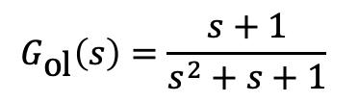
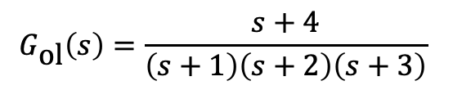
Examples
$$∠s=\frac{∠\left(−k\right)±q⋅360°}{m−n}$$
$$s_{\text{com}}=\frac{\sum_{i=1}^{n}{p_{i}}−\sum_{j=1}^{m}{z_{j}}}{n−m}$$
$$G_{\text{ol}}\left(s\right)=\frac{s+4}{\left(s+1\right)\left(s+2\right)\left(s+3\right)}$$
$$G_{\text{ol}}\left(s\right)=\frac{s+1}{s^{2}+s+1}$$

Slide 28
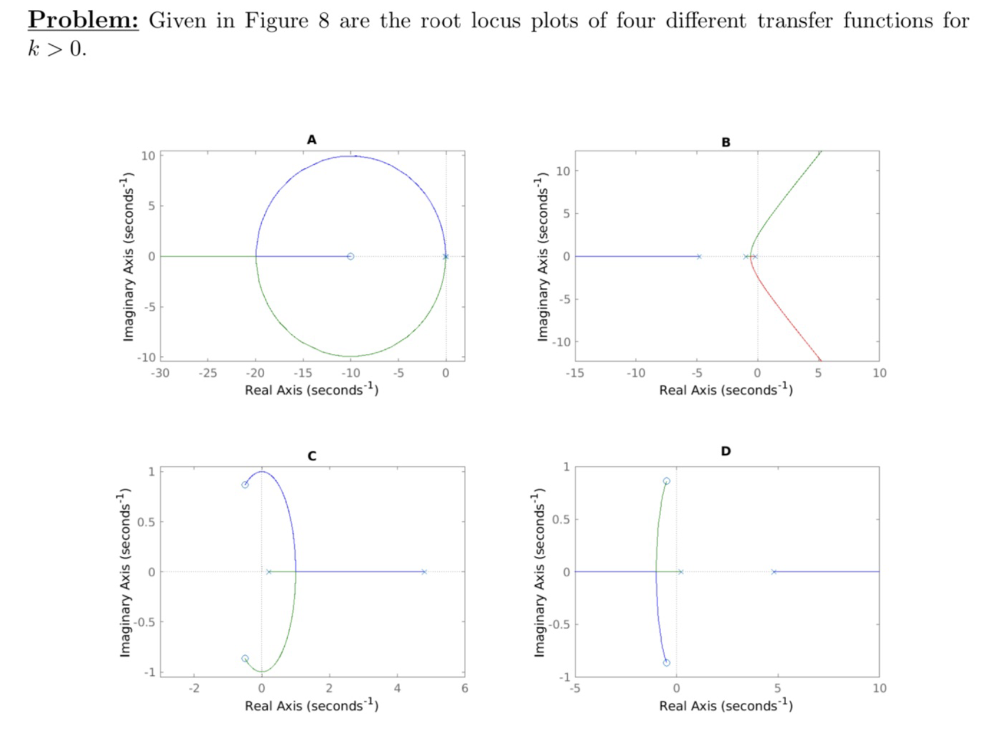
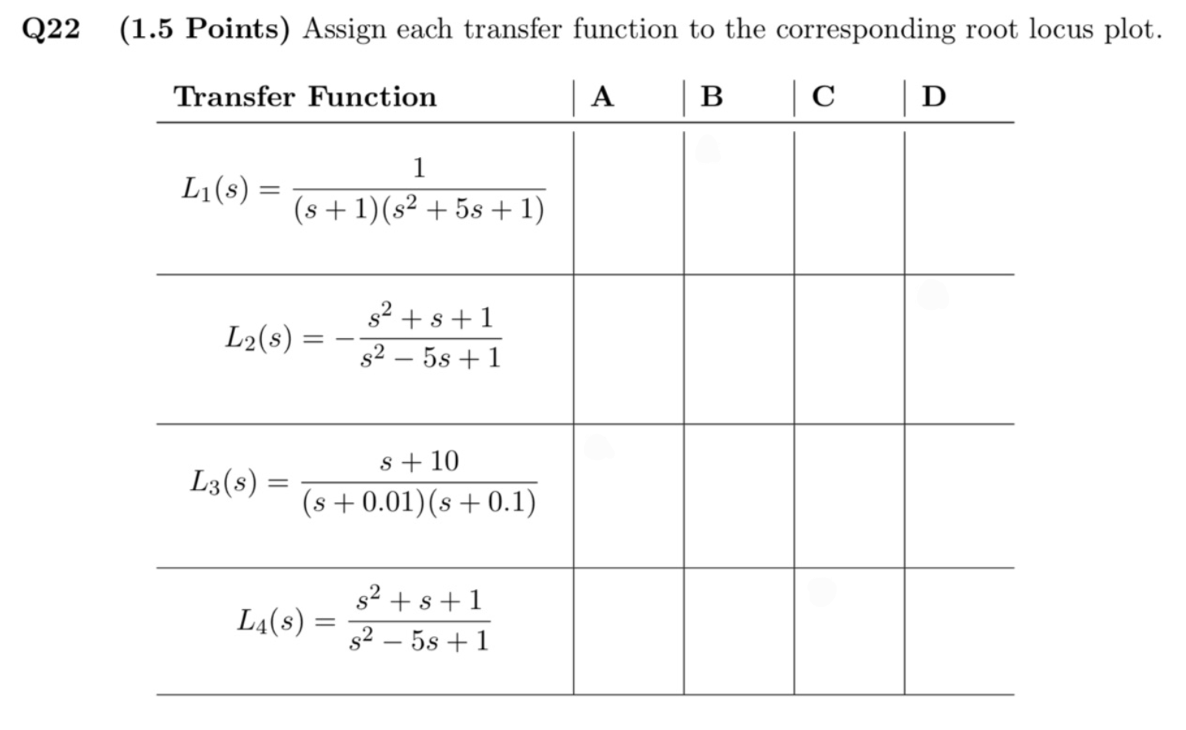
Exam Question

Slide 29








Different Controllers
We saw how powerful a simple scalar $k$ as a controller can be
But most times, our controller will be a dynamic compensator itself!
A typical $C(s)$ design is combining these three components:
Proportional action: $k_{p}$
Integral action: $k_{i}⋅\frac{1}{s}$
Derivative action: $k_{d}⋅s$
$⟶$ This is called a PID-controller: $C_{PID}\left(s\right)=k_{p}+k_{i}⋅\frac{1}{s}+k_{d}⋅s$
$$r$$
$$e$$
$$u$$
$$y$$
$$C(s)$$
$$P(s)$$
$$−$$

Slide 30


Tips for Problem Set 6
I personally would recommend solving at least the problems marked red
Easy | Medium | Hard
$$3$$ | $$1,2,5$$ | $$4,6$$
Nr. 1: plug in $u=−ky$ in the state-space form and reorder it to find $\dot{x}=A_{cl}x$
Nr. 2: Especially try to solve a) and d), e). Try understanding the solutions for b) and c) if you don’t want to solve it on your own. Focus more on the form of the root locus, instead of the exact breakaway points
Nr. 3: Use magnitude & phase rule
Nr. 4: Calculations get messy, try to understand solutions
Nr. 5: for a) remember to be Lyapunov Stable: $Re\left(λ_{i}\right)≤0 ∀i$
for b) you can solve the whole exercise only looking at open loop $p_{i} \& z_{i}$
Nr.6: look at the slides for the derivation of $T(s)$and apply it, can give you a good understanding for deriving various transfer functions

Slide 31
Questions?

Slide 32
Feedback?
Too fast? Too slow? Less theory, more exercises?
I would appreciate your feedback. Please let me know.
https://docs.google.com/forms/d/e/1FAIpQLSdHl0kjWo63aNzDkAV0cnmQadCAj5L0D7v7aSh0BK7BBdEgpA/viewform?usp=header

