Slide 1
Store Box
- Central Storage And Quick post

Slide 2
agenda
Architecture of Store Box
Why use Store Box
Store Box Posting Client (Rsync)(BRE)
Others
Reference

Slide 3

Architecture Of Store Box
Storage
Post
Claudio
NetApp
RSync Server
Store Box
BRE
Store Box
Client
RSync Client

Slide 4
Architecture Of Store Box
US West Coast
US East Coast + Canada
EMEA
Singapore
Shanghai
US West Coast
US East Coast + Canada
EMEA
Singapore
Shanghai
Deer
Chamois
Lion
Panda

Slide 5
Why use Store Box
Central Storage
Quick post
Simple and consolidate the masters dispatching
Control posting process
Same and fix folder structure
Common permission model

Slide 6
Central Storage
For QAs, Developers, just need remember one location.
For IT, more easier to backup. (5 NetApps already back up each other)
More benefit for the technique that the same files just store one copy.

Slide 7
Quick Post
Quick, very quick, very very quick…
unprecedented performance
If you use it you will know

Slide 8
Control posting process
Must use ‘Store Box Posting Client Rsync(setup exe)’ to post/repost/remove the masters. (no back door)
‘Store Box Posting Client Rsync’ is just for BRE.

Slide 9
Same and fix folder structure
The same structure in all NetApps.
4 level folder structure to find the masters
Such as: \\Panda
|-BRE_MASTERS_AEC
|-Map
|-Reeses
|-px64

Slide 10
Common permission model
Products Under Development (Current Release)
Locked Masters
Volume Name | Permission Group | Permission
BRE_MASTERS_AEC | BRE_MASTERS_AEC | Read Only
BRE_MASTERS_MFG | BRE_MASTERS_MFG | Read Only
BRE_MASTERS_PSEB | BRE_MASTERS_PSEB | Read Only
Unlocked Masters are posted only on this volume
Volume Name | Permission Group | Permission
BRE_MASTERS_UNL | BRE_MASTERS_UNL | Read Only

Slide 11
Common permission model
Archived Products (Old Release)
Locked Masters
Volume Name | Permission Group | Permission
BRE_MASTERS_ARCHIVE_AEC | Domain Users | Read Only
BRE_MASTERS_ARCHIVE_MFG | Domain Users | Read Only
BRE_MASTERS_ARCHIVE_PSEB | Domain Users | Read Only
Unlocked Masters
Volume Name | Permission Group | Permission
BRE_MASTERS_ARCHIVE_UNL | BRE_MASTERS_UNL | Read Only

Slide 12
Store Box Posting Client RSync
Install
3 steps to use
issues
Can support Windows / Mac (Linux)

Slide 13
Install for windows
Setup file: Store Box Posting Client Rsync
Two things when install
Set server environment variable which point to your closest Rsync server.
Add the path of store box client executable file to the environment variable PATH.
Set Server=sharsync02.autodesk.com
Set path= C:\StoreBoxPostingClient;%path%

Slide 14
3 steps to post
Tag file
Create MD5
Post via Rsync

Slide 15
Tag example
[info]
; ~~~ Only one e-mail address can be present here
Built_by=xiaohong.zhu@autodesk.com
Built_in=Shanghai
; Target_Volume syntax:
; Taget_Volume:<DIVISION>\ProductName\CodeName\Platform
; Example of Target_volume
; Target_volume=AEC\Desktop\2012\px86
; Target_volume=MFG\ACE\Cassini\px64
; Target_volume=PSEB\AutoCAD\Ironman\macosx
;
Target_volume=AEC\AUD\Pegasus\px86
[action]
; ~~~ Severs which are targets for your build
; Dispatch=NEU,PET,SIN,SHA,MAN
Dispatch=NEU,PET,SIN,SHA,MAN
; ~~~ Put here your list of people waiting on e-mail message
Inform=gbu.build.group@autodesk.com
RSS=yes
Pegasus.tag
copy C:\StoreBoxPostingClient\Pegasus.tag $BF_CALLER_ROOT\Install\${BUILDLABEL}_swl\${BUILDLABEL}_swl.tag

Slide 16
Create MD5
6ea805997f1e7c5f63b2d36e2e732cdb *x86\CER\img\Autodesk_logo_blue_TY.gif
faa6cc7da0ffb0ca6f7398d48aa861c7 *x86\CER\img\connecting.gif
82e23b80c30c8f80a14ab10f8f0d8790 *x86\CER\client.css
aa249c2e30c78a4a7b72ad628fda1626 *x86\en-US\CER\exampleDesc.htm
48f5a03a8894b791ec0858b1d326e267 *x86\en-US\CER\thankYou.htm
712efd481e1589f97adf8f4cfa3959eb *x86\en-US\Docs\contexthelp\ADEXPCUSTSETTINGS.htm
8d7ab51404919b144df0a3af11b1a0dd *x86\en-US\Docs\contexthelp\ADIMPCUSTSETTINGS.htm
971810e5efd6a93817de70dedca13425 *x86\en-US\Docs\contexthelp\ADMIGRATE.htm
C:\StoreBoxPostingClient\CalcVolMd5.bat $BF_CALLER_ROOT\Install\${BUILDLABEL}_swl

Slide 17
Post via Rsync
Steps:
Post MD5 and Tag
Wait Rsync server process
Get the files list from Rsync server, the list contains the files really need post
Post the files as the file list
C:\StoreBoxPostingClient\Post2StoreBox.bat $BF_CALLER_ROOT\Install\${BUILDLABEL}_swl

Slide 18
remove/repost/rename via Rsync
Remove/repost via Rsync
Rename files via Rsync
Run 3 steps again for a empty folder or the folder contains new masters to remove or repost the masters.
Remember : RSync will keep the same between your local masters
and Rsync Server
Because MD5 doesn’t matter with file name, so for renaming files you can directly change MD5 file and run Rsync(3rd step) again

Slide 19
One wrapper
postToRsyncNetapp.bat
if .%1==. goto usage
if .%2==. goto usage
if .%3==. goto usage
goto main
:usage
echo usage:
echo %0 MASTERDIR TAG TAGWITHBUILDNUM
echo example:
echo C:\StoreBoxPostingClient\postToRsyncNetapp.bat D:\Map2012\BUILD_34_R017B\ReleaseMasters\R017Bp_swl map2012px64.tag R017Bp_swl.tag
goto end
:main
set STOREBOXROOT=C:\StoreBoxPostingClient
cd /d %STOREBOXROOT%
set MASTERDIR=%1
set TAG=%2
set TAGWITHBUILDNUM=%3
copy /Y %STOREBOXROOT%\%TAG% %MASTERDIR%\%TAGWITHBUILDNUM%
call %STOREBOXROOT%\CalcVolMd5.bat %MASTERDIR%
call %STOREBOXROOT%\Post2StoreBox.bat %MASTERDIR%
goto end
:end
exit %errorlevel%

Slide 20
4 level structure + Build Types
4 level structure for Target_volume in Tag file
such as: AEC\Desktop\2012\px86
Build Types
Code | Description
px86 | production 32 bit
npx86 | non production 32 bit
px64 | production 64 bit
npx64 | non production 64 bit
pmac | production Mac OS X
npmac | non production Mac OS X
plnx32 | production Linux 32 bit
nplnx32 | non production Linux 32 bit
plnx64 | production Linux 64 bit
nplnx64 | non production Linux 64 bit
dev | Development (only for Revit)
px86x64 | Production 32bit and 64bit
npx86x64 | Non production 32bit and 64bit

Slide 21
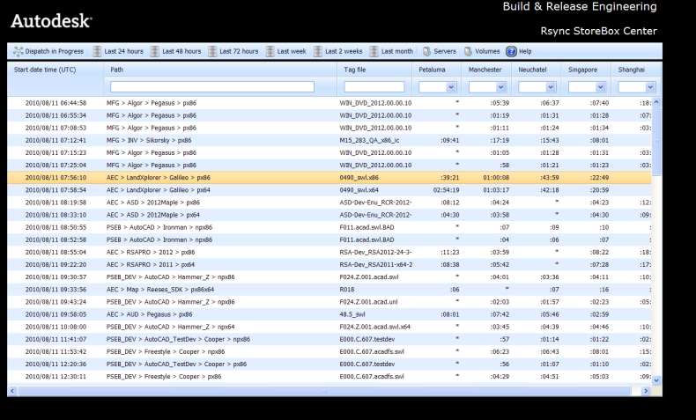
Status site
http://rsync.autodesk.com/

Slide 22
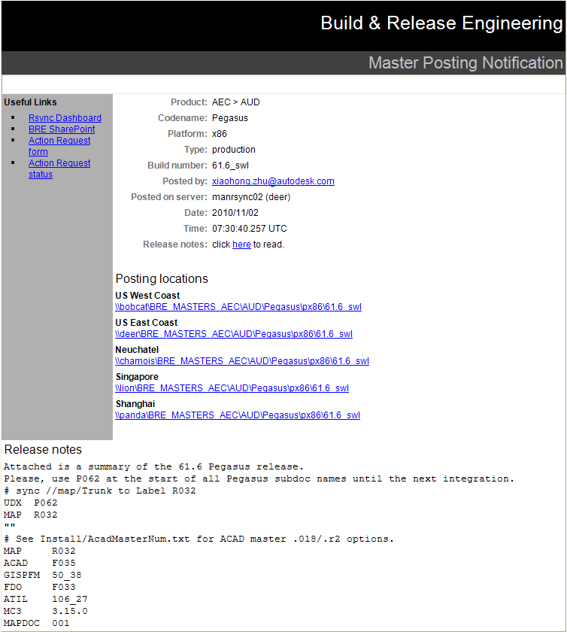
notify email
Can put PostingNotes.txt or PostingNotes.html in the directory of tag and md5.
and the contents of postingNotes file will be show in the notify email.

Slide 23
Other
Only for masters post, Not for ISO, EF (big Zip files)
The maters will be post to Localization Server automatically in the future.
For the places where have not NetApps, Claudio can help to set up ‘virtual NetApps’ to sync the masters to these places automatically.

Slide 24
Reference
Build and Release Engineering > BRE Technology Architecture > Documents > Rsync
BRE StoreBox Support (Claudio)

Slide 25
The process of posting
Build Engineer uses command to post to StoreBox.
Transfer to server is completed.
Server processes new files and create master folder.
In steps 1, 2 and 3 your master is not visible in the “dispatch in progress”.
When first master is available you get the notification email from the system.
Your master will now be listed in “dispatch in progress”.
The server that received the initial posting starts a dispatch process.
Dispatching is done following the shortest path resolution. Example posting in Petaluma will first post to Manchester and Manchester will post to Neuchatel.
Once all destinations have been reached your master will no longer be listed in the dispatch in progress view.
Master will be listed in the “Last 24 hours” and so on as times advances.

Slide 26
Q&A

Slide 27
How the store box implement
MD5
RSync
Linux Hand link
Same files just store one copy
Just RSync the files which are not existed in Rsync Server

Slide 28
MD5 identify one file
Use MD5 to identify one file, different file will have different MD5.
The file MD5 doesn’t matter with the file name, just is relative with the file content.
Fsum.exe
fsum -jnc -md5 CRK-Tools.zip > CRK-Tools.zip.md5

Slide 29
RSync

Slide 30
Linux Hand Link
Hard links
Cannot links directories
Cannot cross file system boundaries
Still can access the content even if the source file is removed
Only all last hard links and source file are removed, the file is removed
Soft links
Can links directories
Can cross file system boundaries
Cannot access the content when the source file is removed
All soft links don’t work when the source file is removed

Slide 31
Same files just store one copy

Slide 32
Just RSync the files which are not existed in Rsync Server

