Slide 1
Project milestone 1 -Design plan-
20100463 Kisuk Park

Slide 2
Milestone1
Define tech stack & Search for references(including proper tutorials)
Sequence Diagram

Slide 3





Define Tech Stacks
ScalaPB: Protocol Buffers compile plugin for Scala
Protocol Buffers(proto3): Google’s language-neutral, platform-neutral, extensible mechanism for serializing structured data
gRPC: Open source high performance RPC framework
Sbt: Scala build tool

Slide 4
Tutorials
Tutorial of ScalaPB’s gRPC support
https://scalapb.github.io/docs/grpc
Simple gRPC & Scala sample code on Github
https://github.com/xuwei-k/grpc-scala-sample
Official Page for required tech stacks
Protocol buffer: https://developers.google.com/protocol-buffers
gRPC: https://grpc.io/

Slide 5
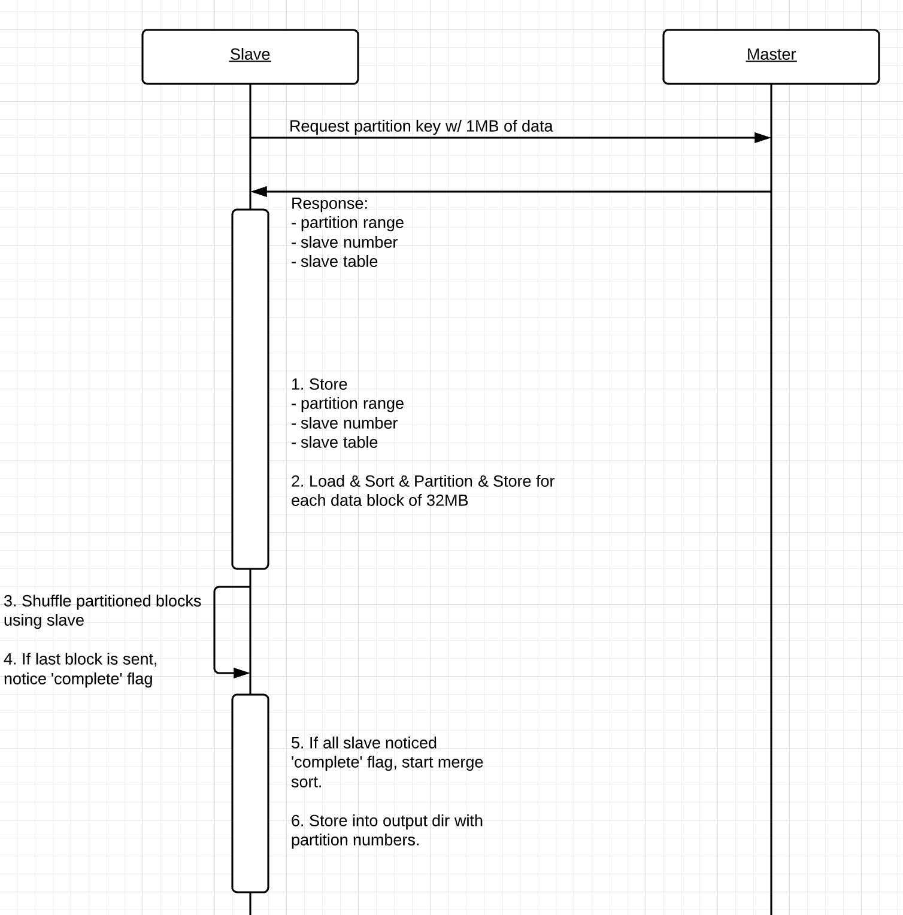
Sequence Diagram
Master should store
Slave Table: List(String)
E.g) ”1.1.1.1:8081”
Sampling Completion Table: List(Boolean)
Slave should store
Master’s IP:port
Partition Key range: (String?, String?)
Slave Number: Int
Slave Table: List(String)
e.g) ”1.1.1.1:8081”
Shuffling Completion Table: List(Boolean)
Input dir path: String

Slide 6
Reference
https://scalapb.github.io/docs/grpc/
https://github.com/xuwei-k/grpc-scala-sample/blob/master/grpc-scala/src/main/scala/io/grpc/examples/helloworld/HelloWorldServer.scala

Slide 7
Questions
# of Input directories == # of slaves ?

