Slide 1
Distributed Sorting System Project Final Report, cs434
20100463 Kisuk Park

Slide 2
Contents
Tech Stacks
Directory Structure
Blueprint
Sequence Diagram
Demo
Result
References

Slide 3





Tech Stacks
ScalaPB: Protocol Buffers compile plugin for Scala
Protocol Buffers(proto3): Google’s language-neutral, platform-neutral, extensible mechanism for serializing structured data
gRPC: Open source high performance RPC framework
Sbt: Scala build tool

Slide 4
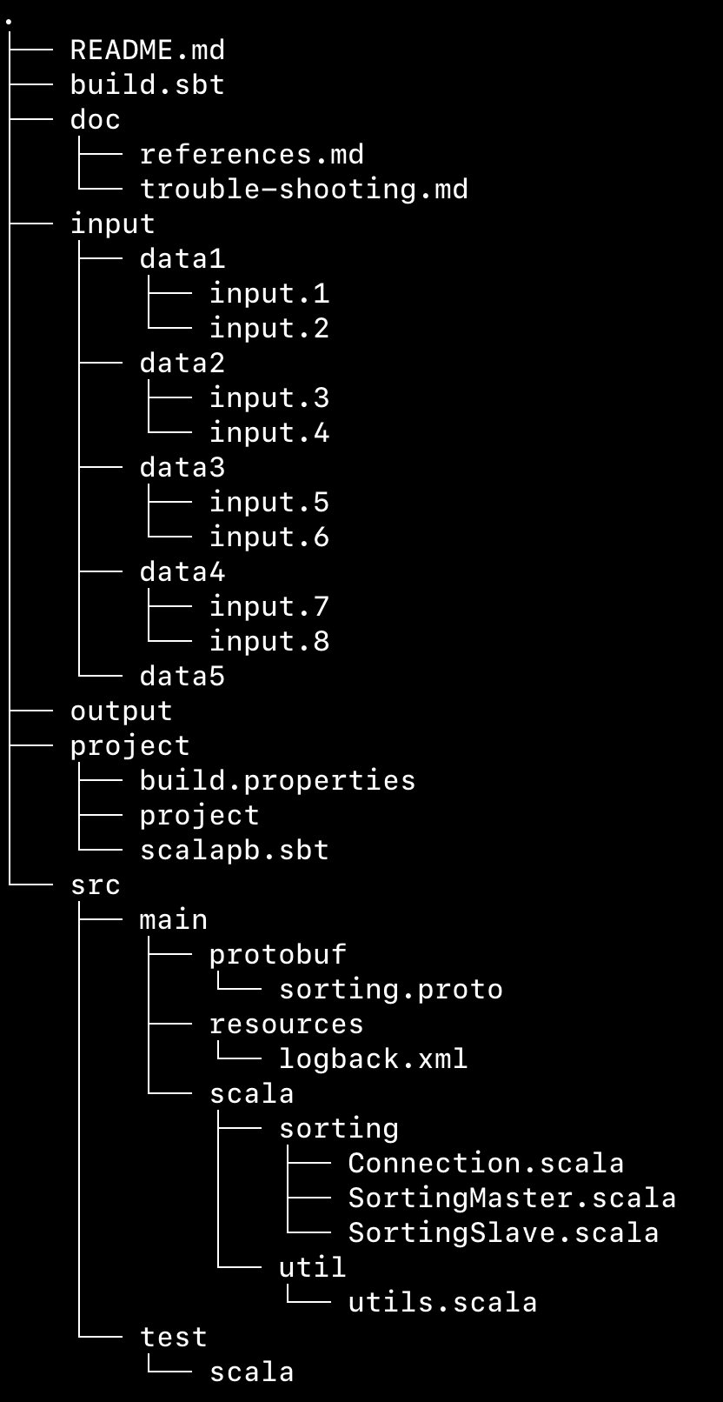
Directory structure
input : Input data
output: Merged output file will be stored here.
src/main/protobuf/sorting.proto : protobuf declaration file
src/main/scala : master/slave code & other codes

Slide 5
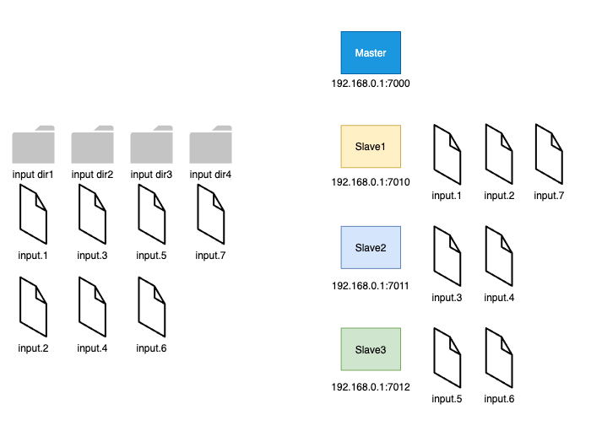
Blueprint (1/2)

Slide 6
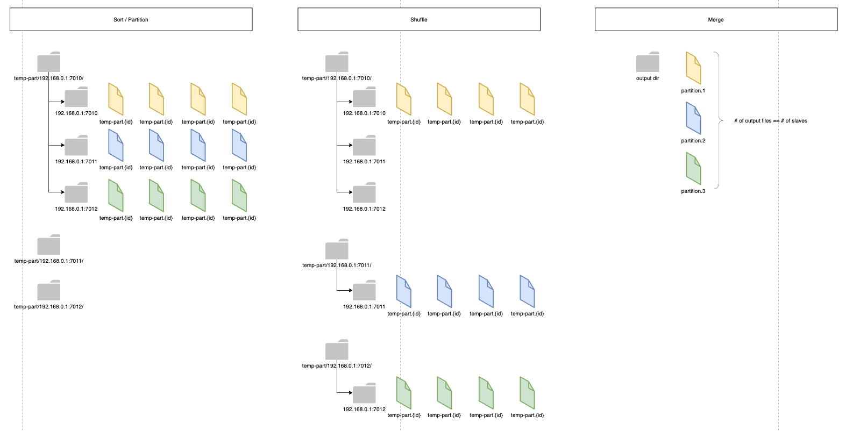
Blueprint (2/2)

Slide 7
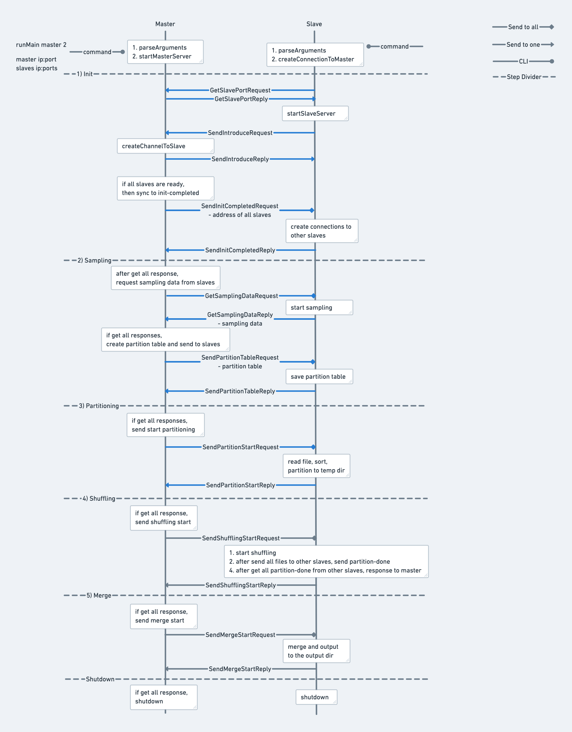
Sequence Diagram
Start with CLI
Run Master -> Run Each Slave
Step1) Init
Run Master & Slave Servers
Establish connections b/w Master & Slaves
Sync slaves’ address table
Step2) Sampling
Request sampling data from slaves
Send partition key to slaves
Step3) Partitioning
Notify partitioning start to slaves
For each slave, read file/sort/create temp dir/partitioning
Step4) Shuffling
Notify shuffling start to slaves
Shuffling to each other
Step5) Merge
Notifiy merge start to slaves
Merge

Slide 8
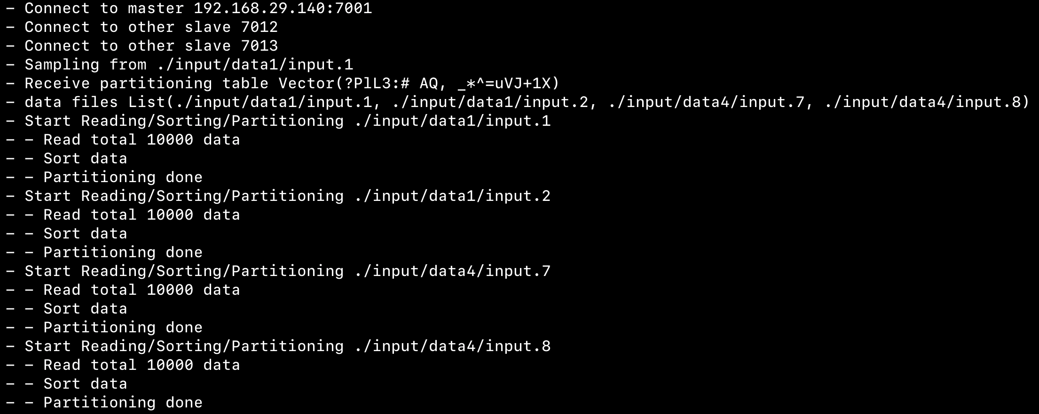
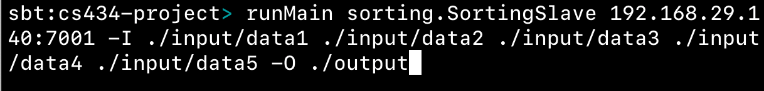
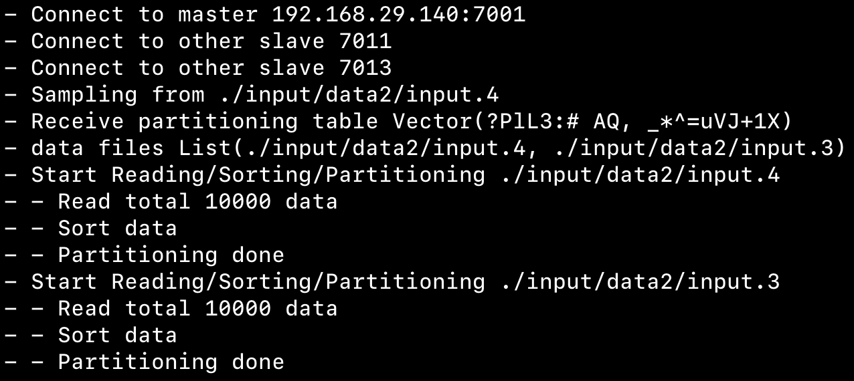
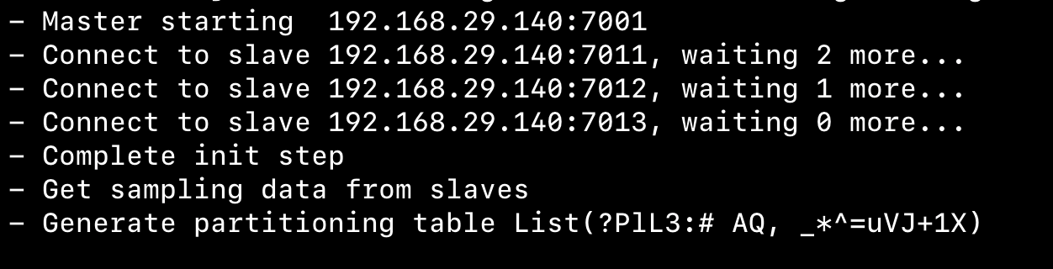
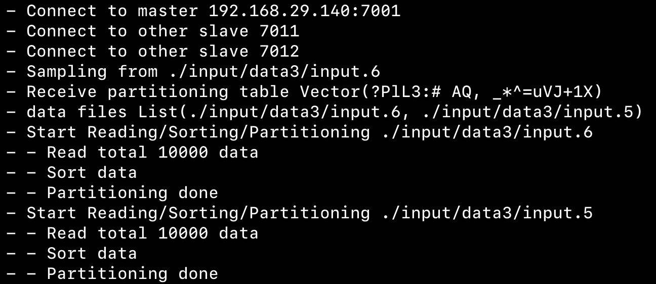
Demo
Slaves’ log
Open sbt console
runMaster
runSlave
Master’s log

Slide 9
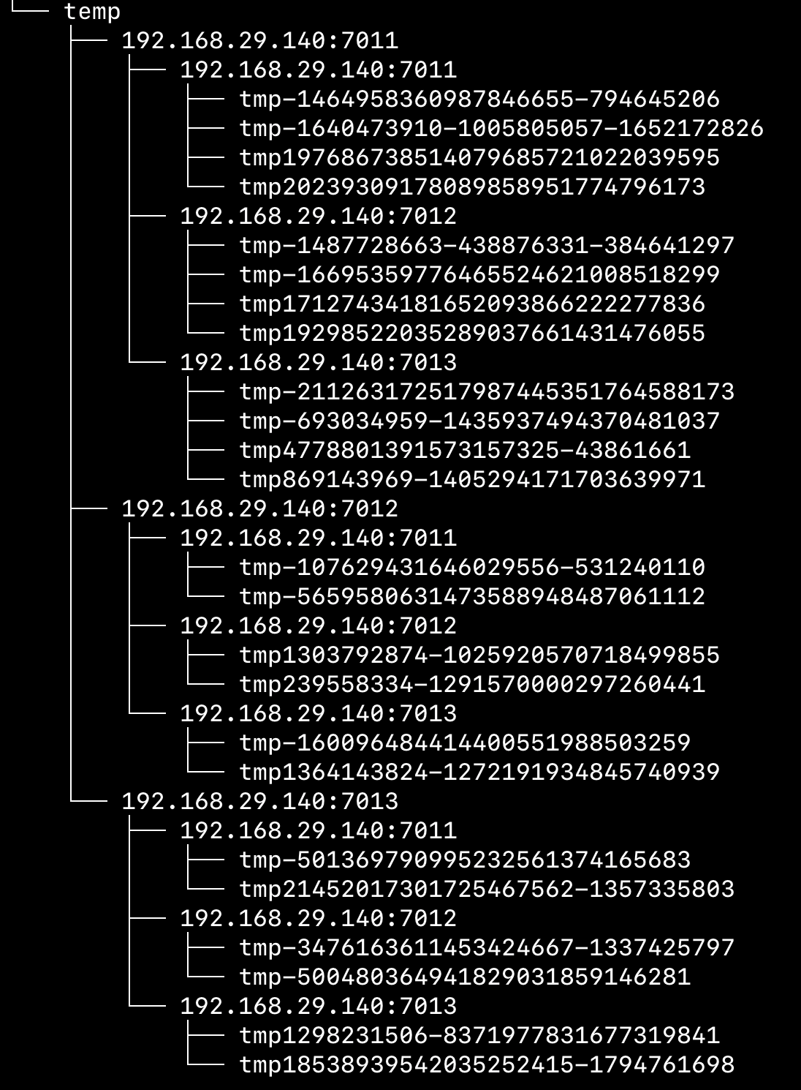
Result
Environment
1 Master
3 Slaves
Input 4 directories with 2 files each (total 8 files)
Result
Slave 1 : run 2 dir & 4 files
Slave 2, 3 : run 1 dir & 2 files
Steps
[v] Init Step
[v] Sampling
[v] Partitioning -> partition into ./temp directory
[x] Shuffling
[x] Merge
Restrictions
Using blocking stub
# of input dir >= # of slaves

Slide 10
References
Tutorial of ScalaPB’s gRPC support
https://scalapb.github.io/docs/grpc
Simple gRPC & Scala sample code on Github
https://github.com/xuwei-k/grpc-scala-sample
Official Page for required tech stacks
Protocol buffer: https://developers.google.com/protocol-buffers
gRPC: https://grpc.io/
https://scalapb.github.io/docs/grpc/
https://github.com/xuwei-k/grpc-scala-sample/blob/master/grpc-scala/src/main/scala/io/grpc/examples/helloworld/HelloWorldServer.scala

