Slide 1
Distributed Sorting System Project Final Report, cs434
20100463 Kisuk Park

Slide 2
Contents
Tech Stacks
Directory Structure
Blueprint
Sequence Diagram
Demo
Result
References

Slide 3





Tech Stacks
ScalaPB: Protocol Buffers compile plugin for Scala
Protocol Buffers(proto3): Google’s language-neutral, platform-neutral, extensible mechanism for serializing structured data
gRPC: Open source high performance RPC framework
Sbt: Scala build tool

Slide 4
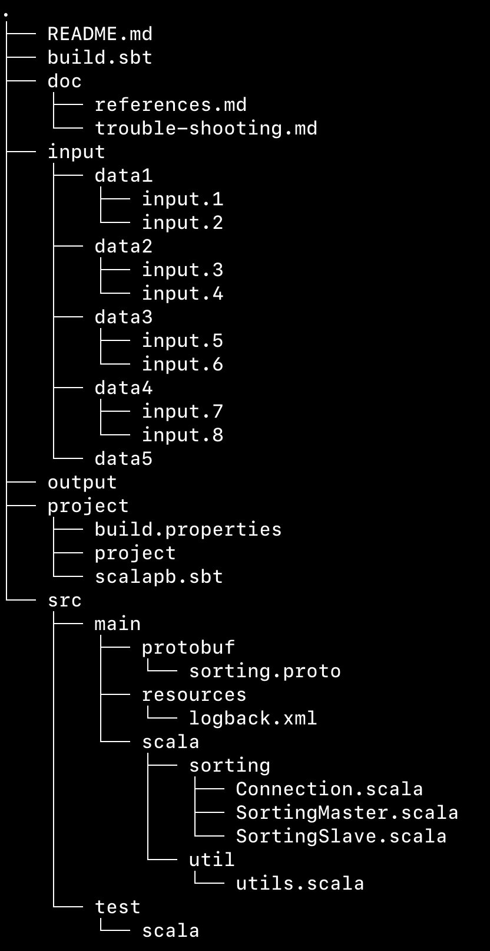
Directory structure
input : Input data
output: Merged output file will be stored here.
src/main/protobuf/sorting.proto : protobuf declaration file
src/main/scala : master/slave code & other codes

Slide 5
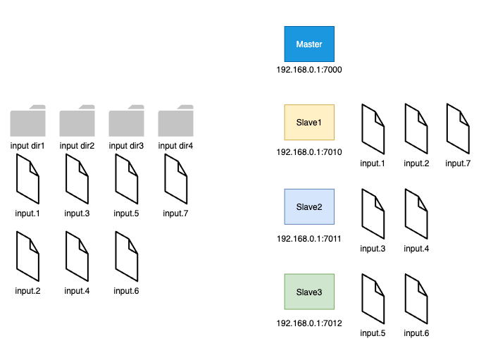
Blueprint (1/2)

Slide 6
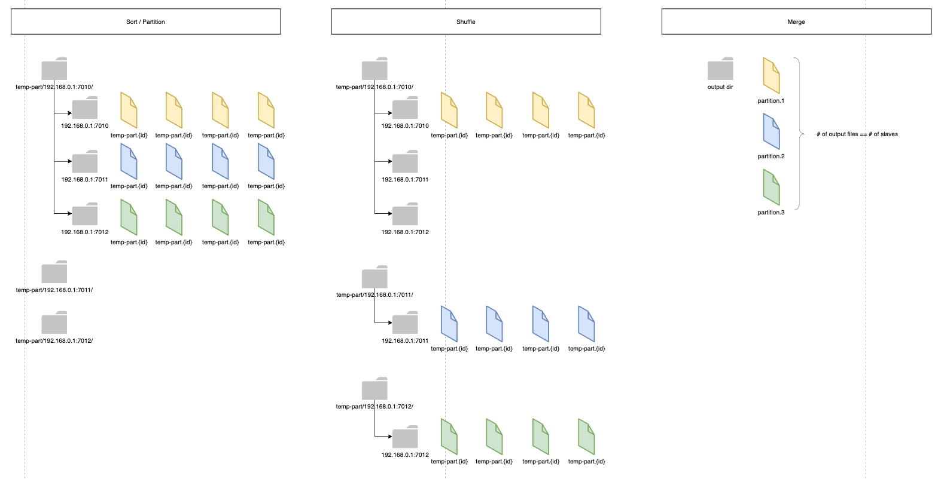
Blueprint (2/2)

Slide 7
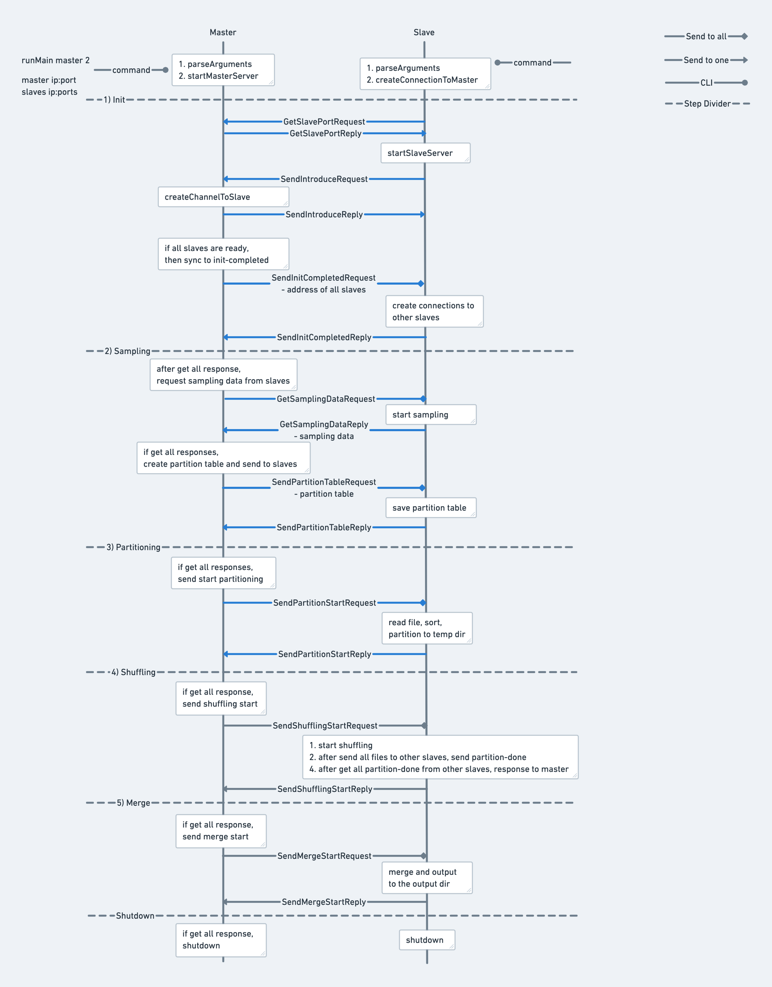
Sequence Diagram
Start with CLI
Run Master -> Run Each Slave
Step1) Init
Run Master & Slave Servers
Establish connections b/w Master & Slaves
Sync slaves’ address table
Step2) Sampling
Request sampling data from slaves
Send partition key to slaves
Step3) Partitioning
Notify partitioning start to slaves
For each slave, read file/sort/create temp dir/partitioning
Step4) Shuffling
Notify shuffling start to slaves
Shuffling to each other
Step5) Merge
Notifiy merge start to slaves
Merge

Slide 8
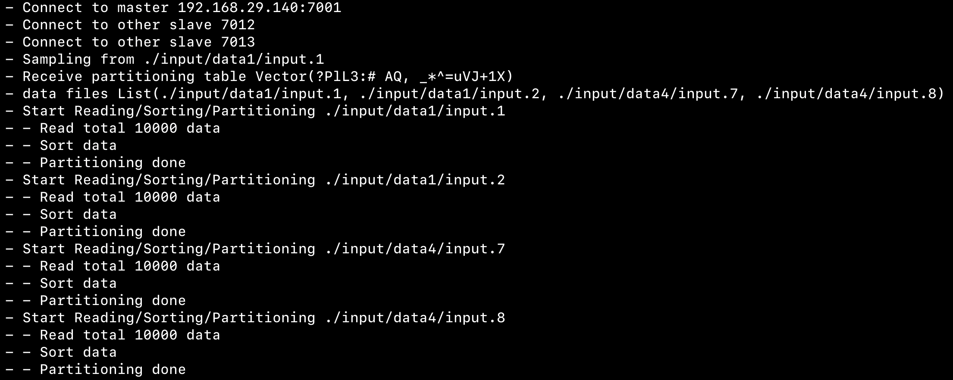
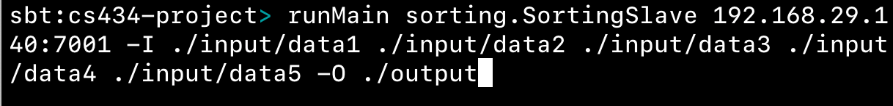
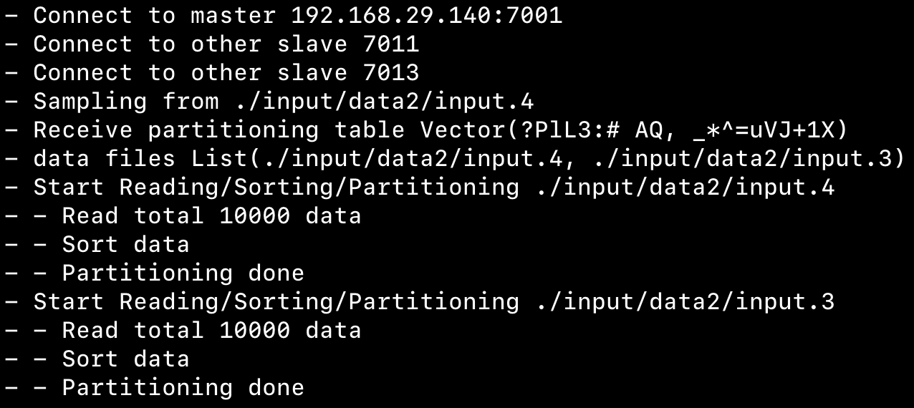
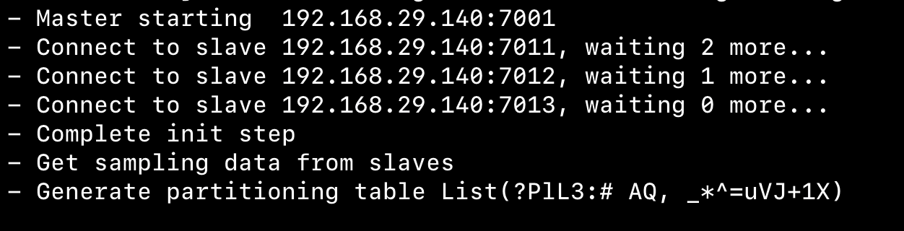
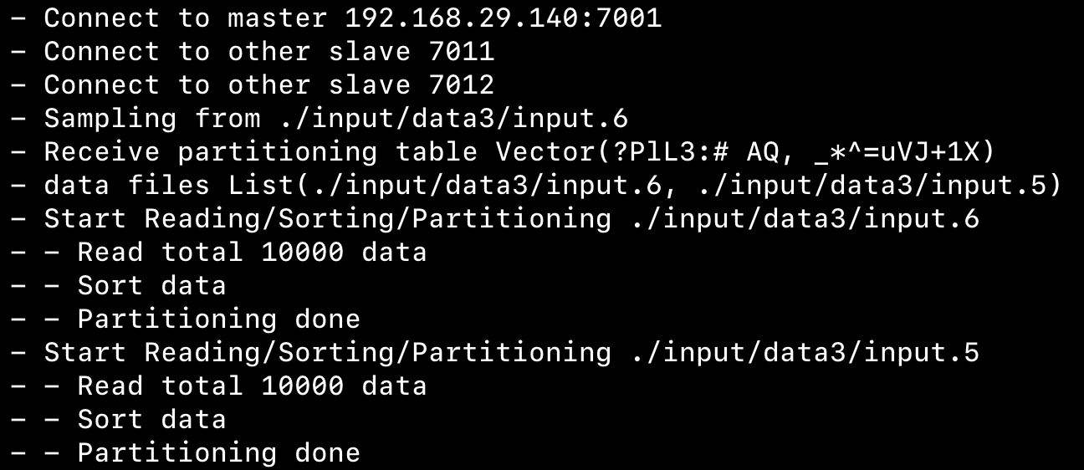
Demo
Slaves’ log
Open sbt console
runMaster
runSlave
Master’s log

Slide 9
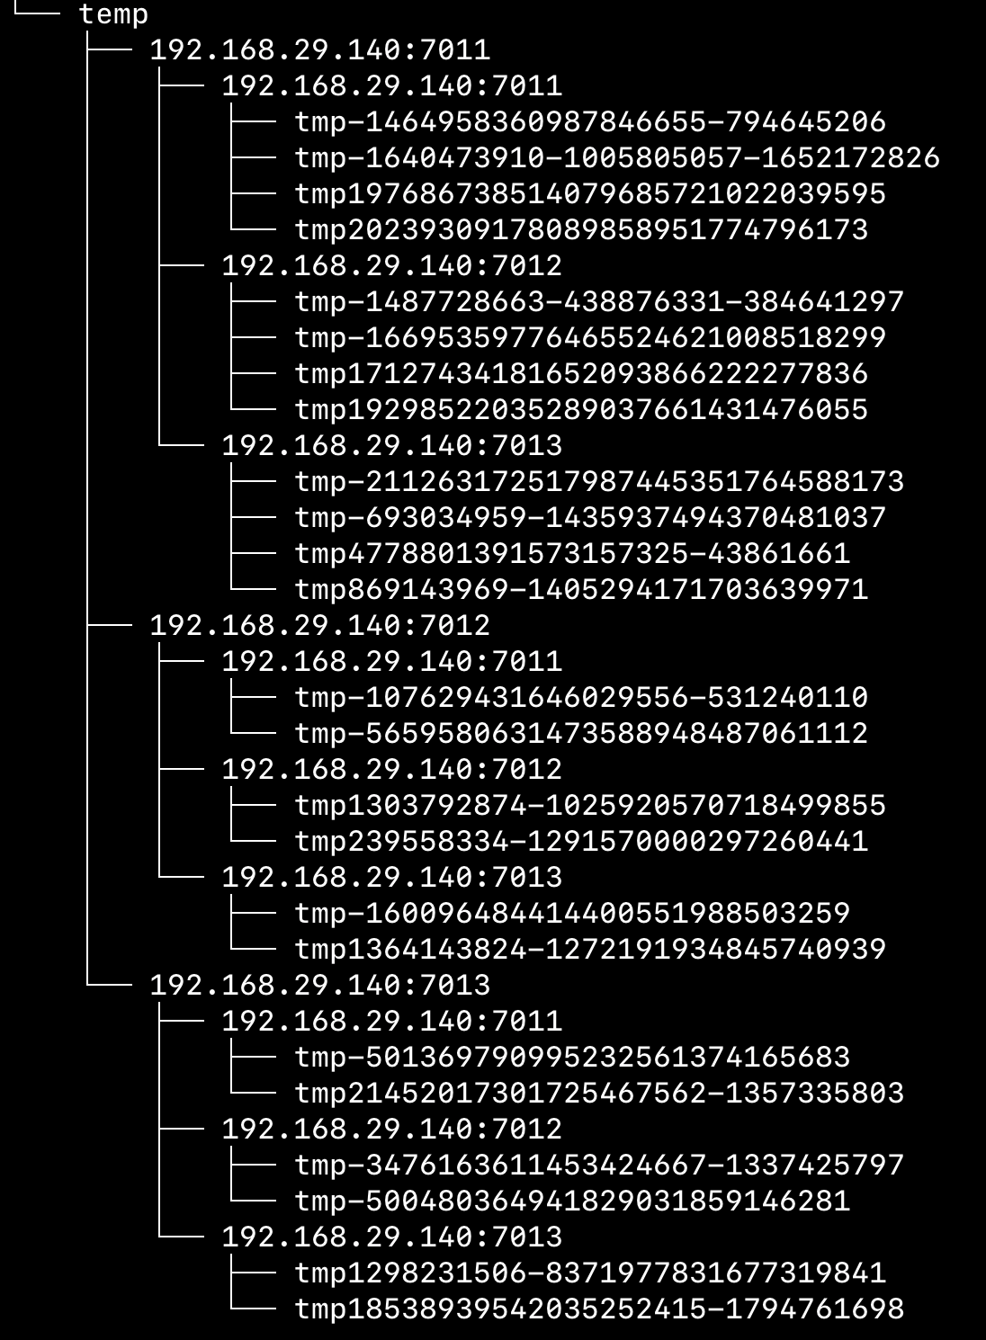
Result
Environment
1 Master
3 Slaves
Input 4 directories with 2 files each (total 8 files)
Result
Slave 1 : run 2 dir & 4 files
Slave 2, 3 : run 1 dir & 2 files
Steps
[v] Init Step
[v] Sampling
[v] Partitioning -> partition into ./temp directory
[x] Shuffling
[x] Merge
Restrictions
Using blocking stub
# of input dir >= # of slaves

Slide 10
End of project
What I’ve learned
(+) Documentation matters
todos, temporal notes, design doc helped to reduce confusions.
(+) Small size commits
Easy to rollback, Less debugging time, Easy to understand current situation.
(-) Underestimated schedule
(-) Absence of test code
(-) Need refactoring : Using lint, prettier Tool
Trouble Shooting
‘Gensort’ not working on MacOS
Run ubuntu machine via Docker and generate data files to mounted volume.
This should be announced before the project begin, if needed.

Slide 11
References
Tutorial of ScalaPB’s gRPC support
https://scalapb.github.io/docs/grpc
Simple gRPC & Scala sample code on Github
https://github.com/xuwei-k/grpc-scala-sample
Official Page for required tech stacks
Protocol buffer: https://developers.google.com/protocol-buffers
gRPC: https://grpc.io/
https://scalapb.github.io/docs/grpc/
https://github.com/xuwei-k/grpc-scala-sample/blob/master/grpc-scala/src/main/scala/io/grpc/examples/helloworld/HelloWorldServer.scala

