Slide 1
Project milestone 1 -Design plan-
20100463 Kisuk Park

Slide 2
Milestone2
Implement examples with protobuf, gRPC

Slide 3





Tech Stacks
ScalaPB: Protocol Buffers compile plugin for Scala
Protocol Buffers(proto3): Google’s language-neutral, platform-neutral, extensible mechanism for serializing structured data
gRPC: Open source high performance RPC framework
Sbt: Scala build tool

Slide 4
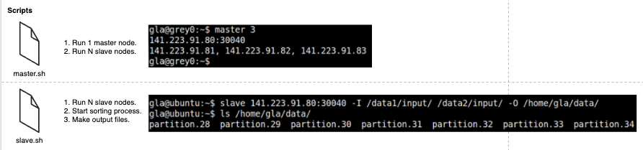
System Requirements
1 master node.
N slave nodes.
M input directories with an arbitrary number of 32MB files.
1 output directory with numbered & ordered file.
# of output files in the output directory is equal to the # of slaves.

Slide 5
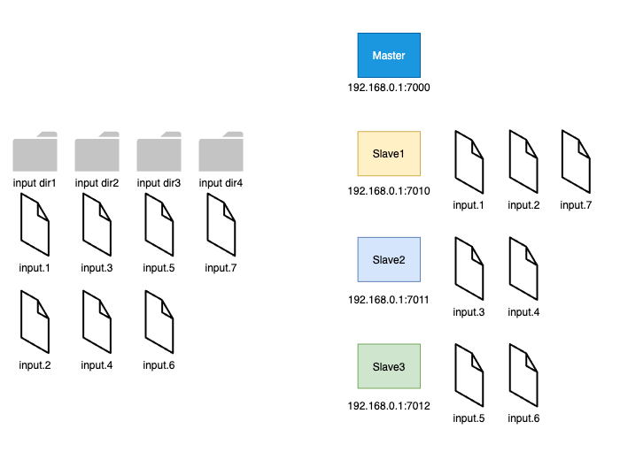
Example - setup

Slide 6
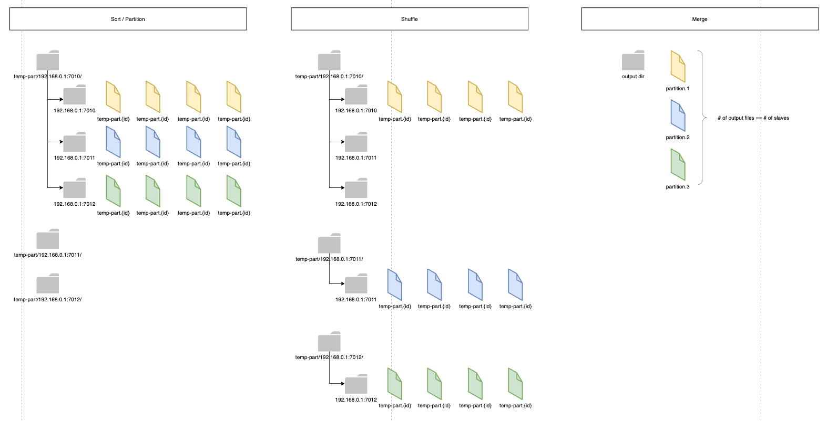
Example - process

Slide 7
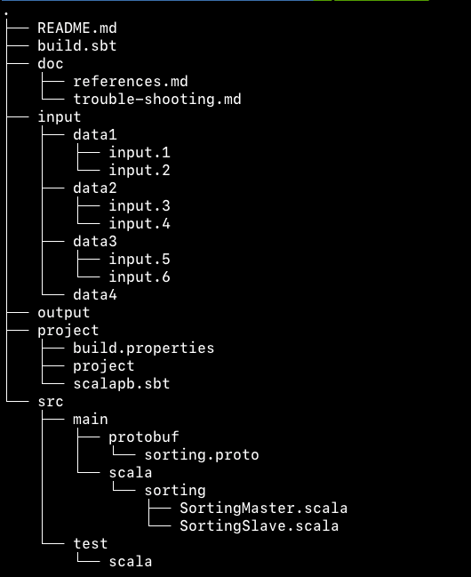
Directory structure
input : Example input data blocks.
output: Merged output file will be stored here.
src/main/protobuf : protobuf declaration file
src/main/scala : master/slave code

Slide 8
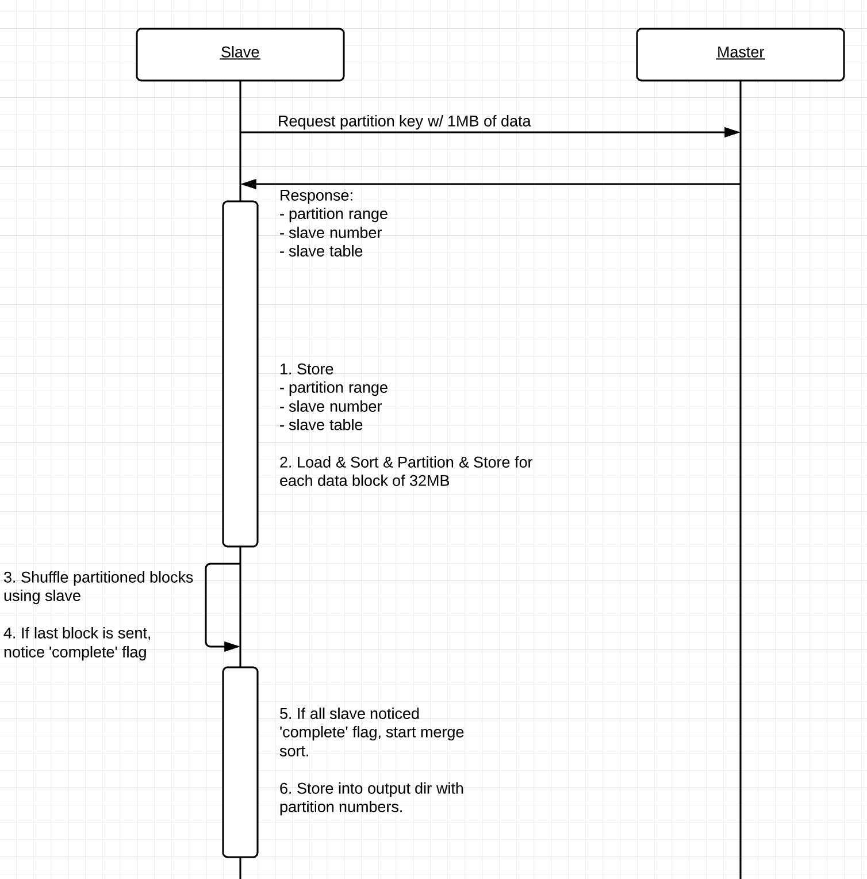
Sequence Diagram
Master should store
Slave Table: List(String)
E.g) ”1.1.1.1:8081”
Sampling Completion Table: List(Boolean)
Slave should store
Master’s IP:port
Partition Key range: (String?, String?)
Slave Number: Int
Slave Table: List(String)
e.g) ”1.1.1.1:8081”
Shuffling Completion Table: List(Boolean)
Input dir path: String

Slide 9
References
Tutorial of ScalaPB’s gRPC support
https://scalapb.github.io/docs/grpc
Simple gRPC & Scala sample code on Github
https://github.com/xuwei-k/grpc-scala-sample
Official Page for required tech stacks
Protocol buffer: https://developers.google.com/protocol-buffers
gRPC: https://grpc.io/
https://scalapb.github.io/docs/grpc/
https://github.com/xuwei-k/grpc-scala-sample/blob/master/grpc-scala/src/main/scala/io/grpc/examples/helloworld/HelloWorldServer.scala

