Slide 1

Practical
Project – Part 2
By Kit Horwood
(Week 5)

Slide 2
Today, we will be continuing our practical projects.
Paste your saved projects into https://editor.p5js.org/?version=2.3.3
If you thought of anything fun to create in p5.js instead, feel free to do so!

Slide 3
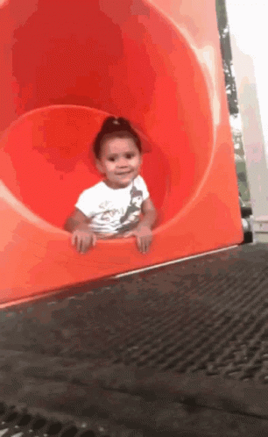
See you next week!

