Slide 1


NYCity Watch
A Data Driven Visual into New York Public Safety
Enhancements and Machine Learning Integration
10/31/2019
Members:
Kit Rana
Suvarna Sampale
Charlie Blasi

Slide 2
EMS Response Time:
Machine Learning

Slide 3
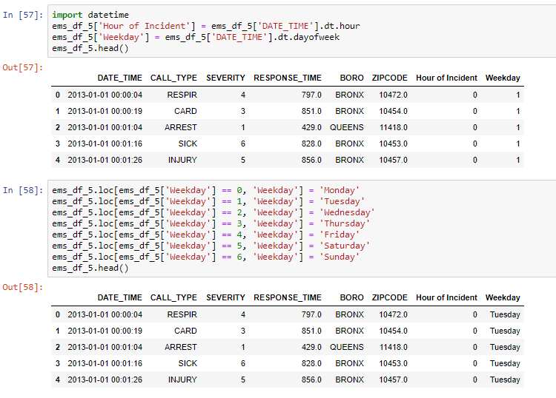
Data Cleaning
Removing null values
Renaming column headers and values for clearer visualization
Removing columns that are excluded from the machine learning model
Converting date and time column from object to timestamp
Extracting the hour of the day and day of the week from the timestamp

Slide 4
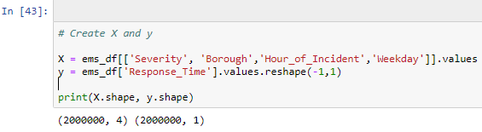

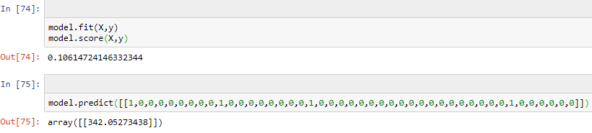
One-Hot Encoding
Step 1:
Create X and y for the machine learning model
--------------------------------------------------------------------
Step 2:
Use the one hot encoder function to fit and transform your non-numerical values
--------------------------------------------------------------------
Step 3:
Fit your newly encoded X and y to the model. You can now score the accuracy of your model and make predictions.

Slide 5
Park Felony Crime Complaints:
Machine Learning

Slide 6
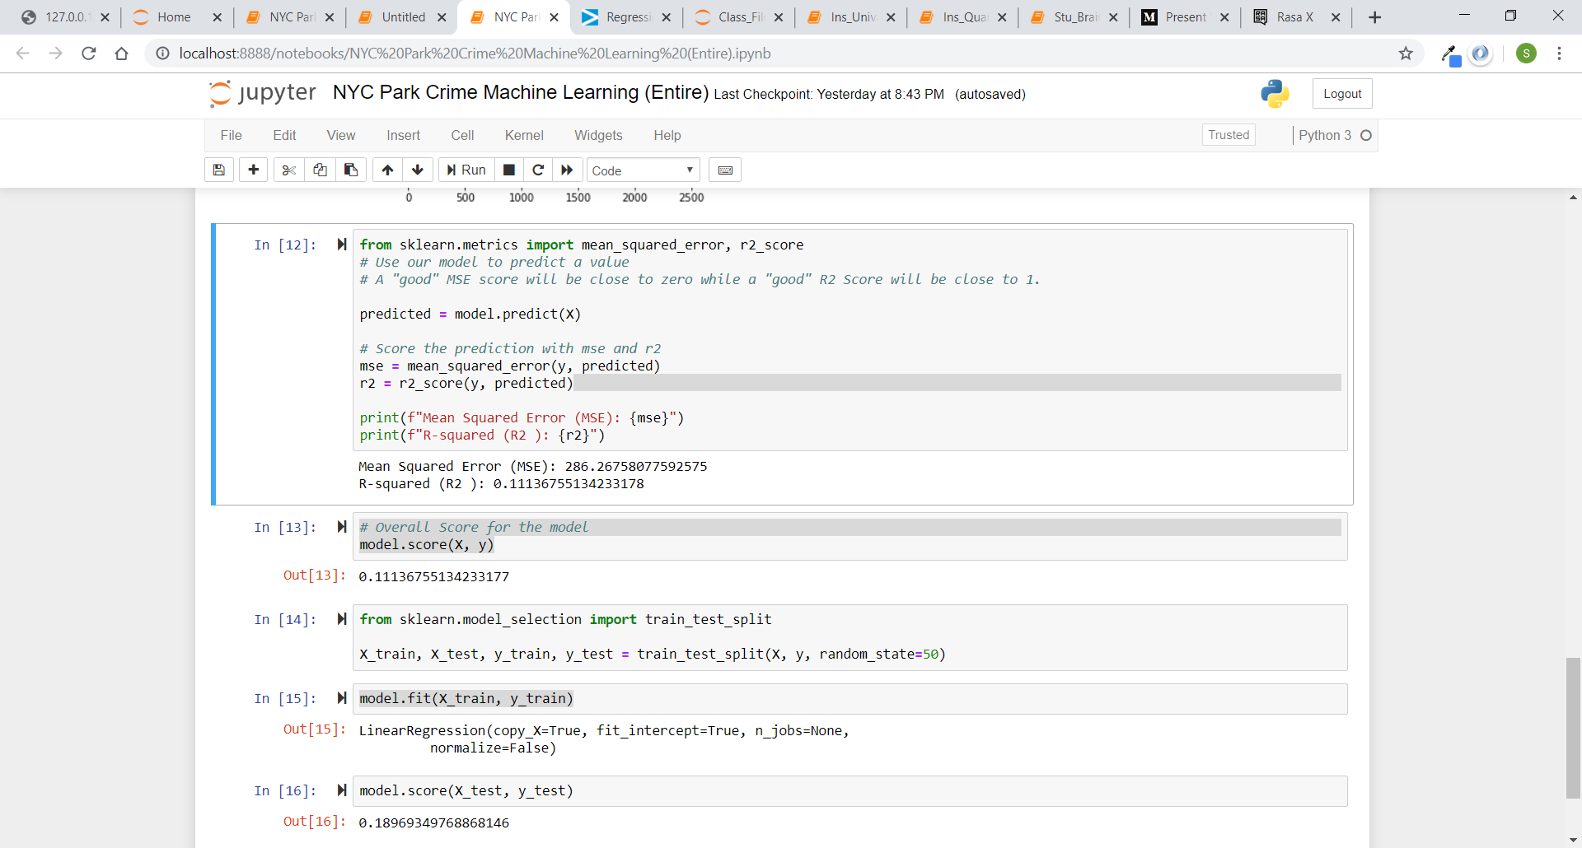
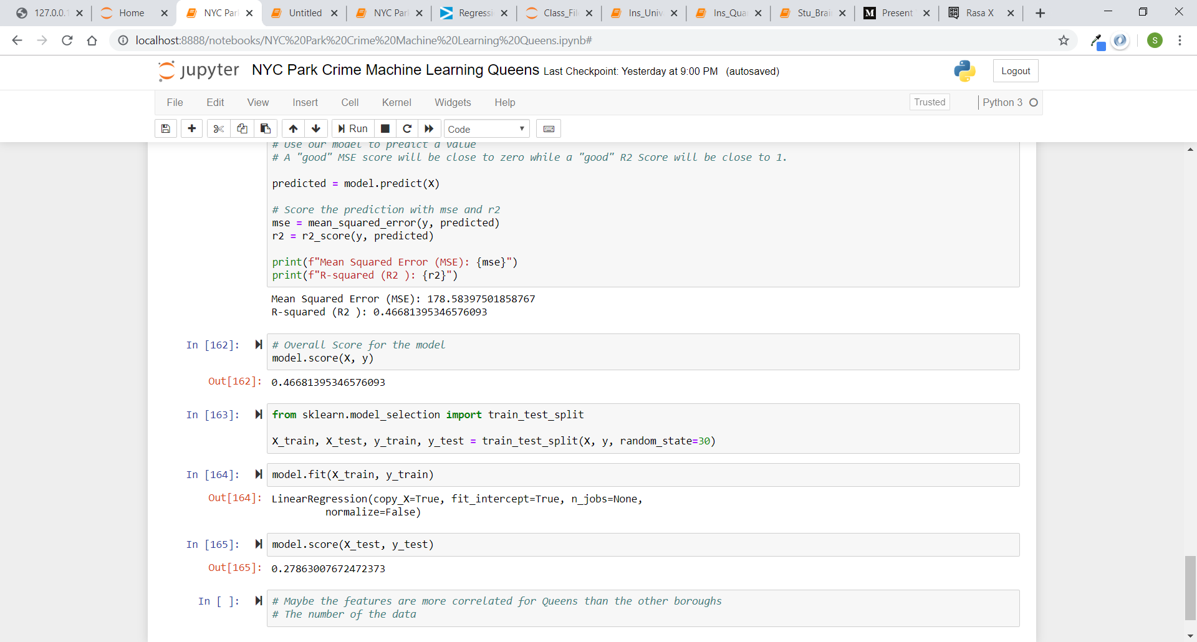
Univariate Linear Regression
x: Size of Park in Acres
Y: # of Felony Complaint Crimes Reported (per park 2014 – 2019)
R2 score increased for single boroughs v. multiple boroughs

Slide 7
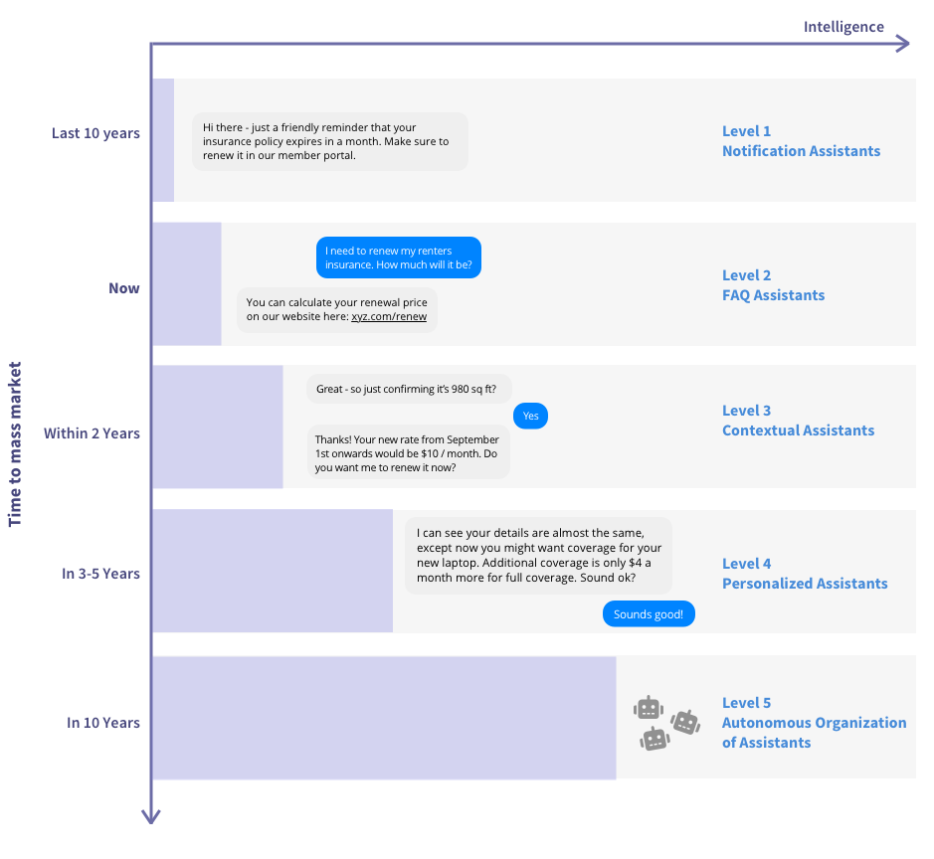
Rise of the Artificial Intelligence

Slide 8
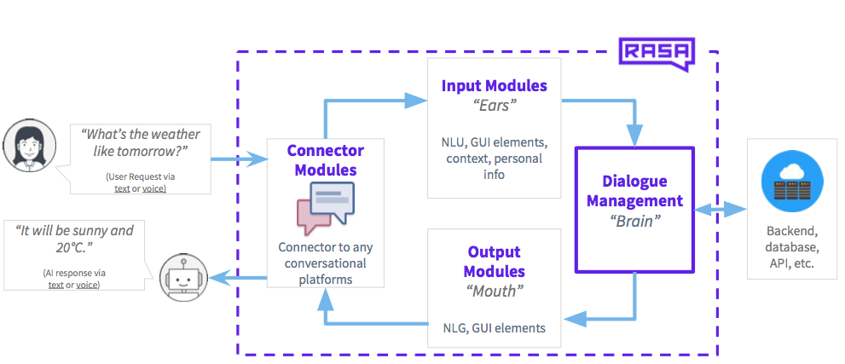
Rasa NLU/Core Process

Slide 9
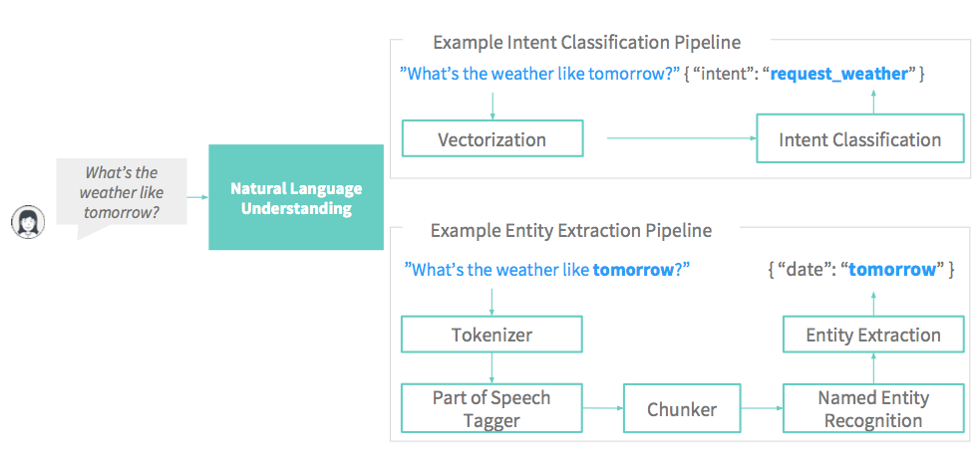
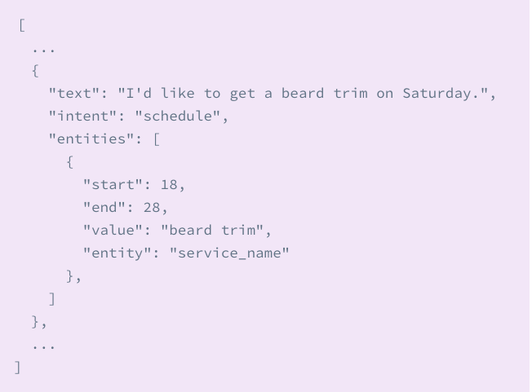
Rasa NLU: Natural Language Understanding

Slide 10
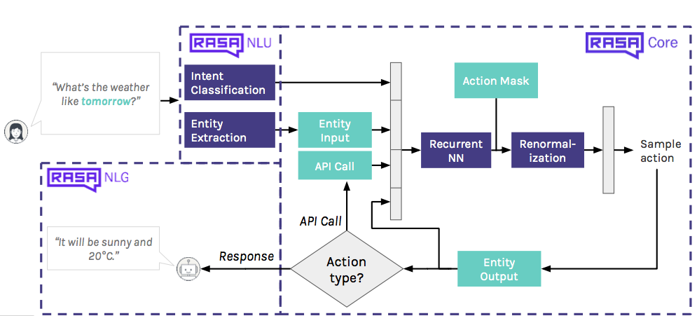
Rasa Core: Dialogue Handling

Slide 11
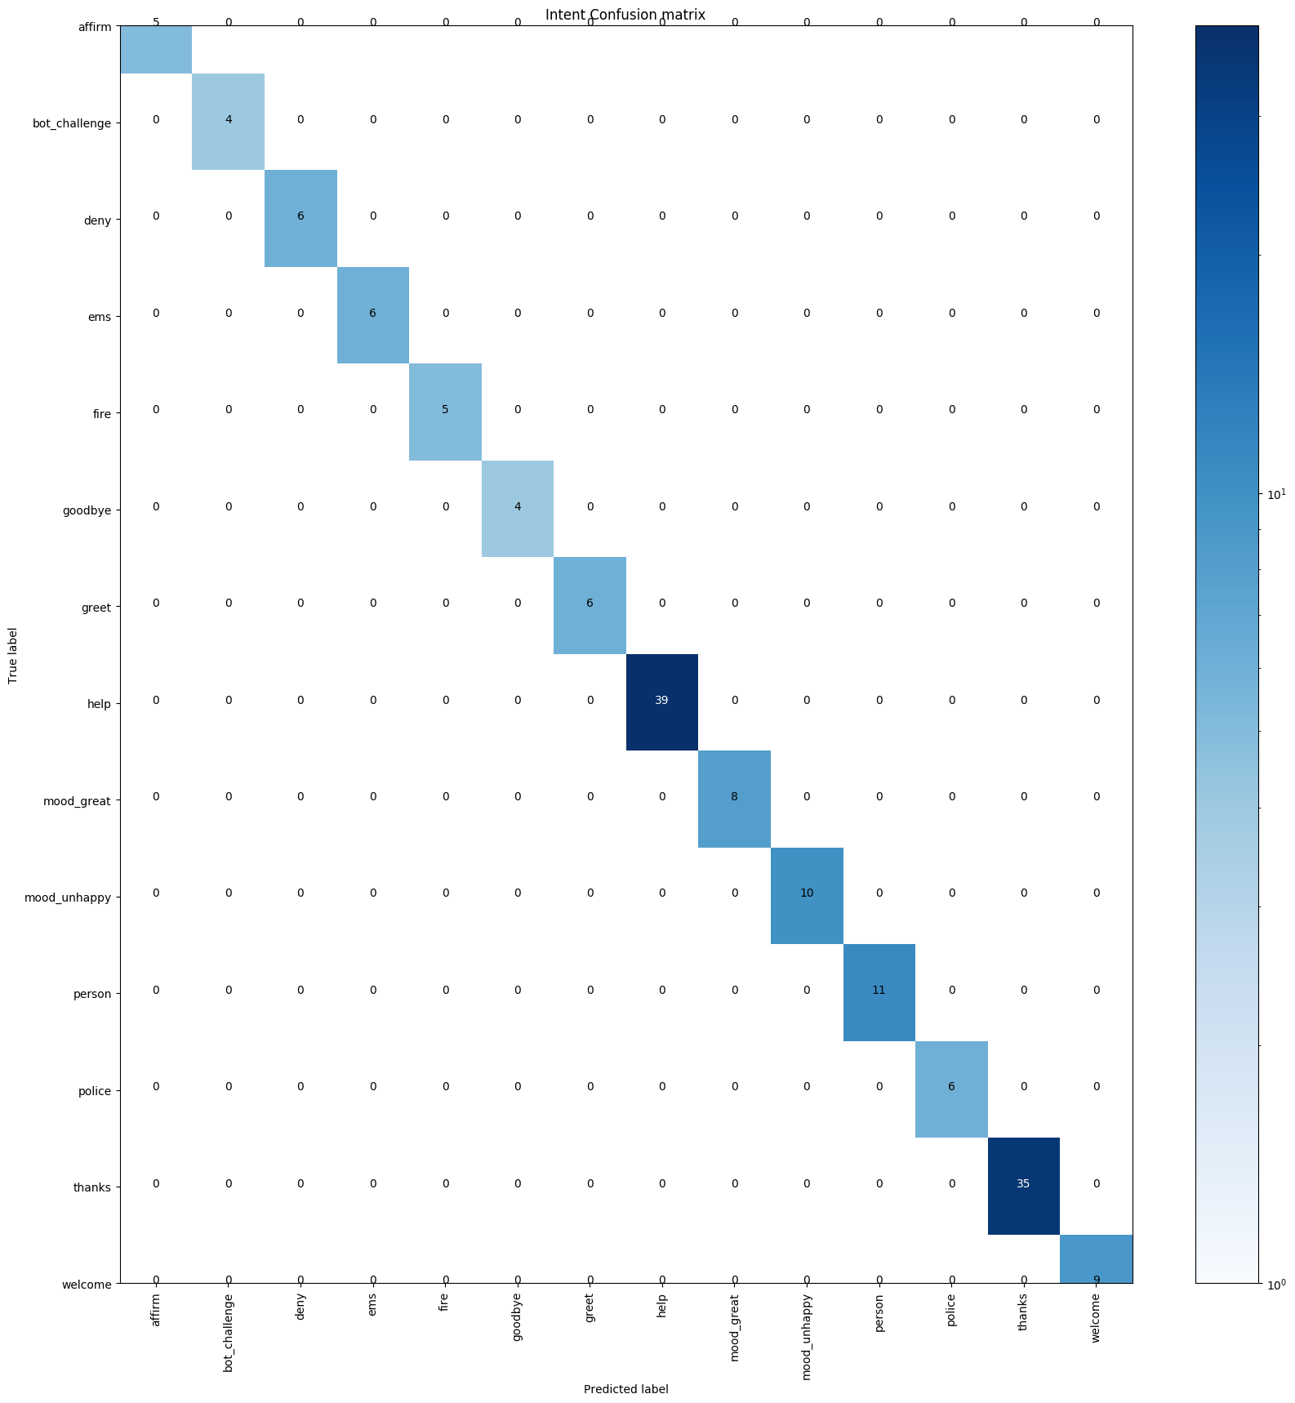
Evaluating the Model
NLU
Core

Slide 12
DEMO

Slide 13
Future Updates/Development
Further training on AI to include API calls, business logic, and voice support.
Integrate AI to existing site
Further tweaks to site responsiveness
Explore possibilities of other industries and AI application
And more!

