Slide 1
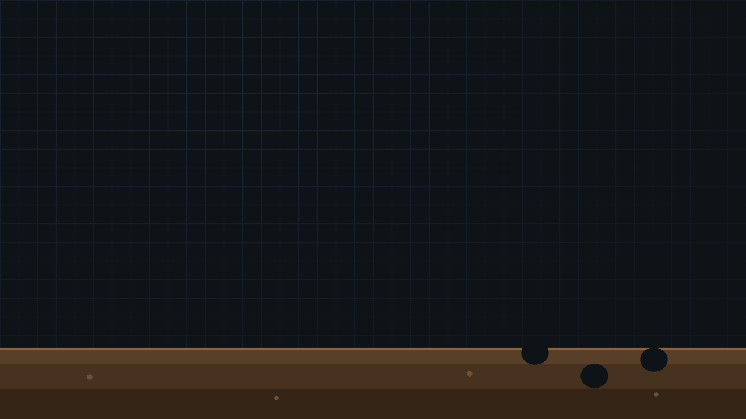
UCT HONOURS · ARTIFICIAL LIFE · LIFE ENGINE
DIGGING
THEIR OWN
GRAVES
PLANT
BURROWER
PREDATOR
Burrowing, soil and extinction: can a trait that saves each individual doom the population?
Group final presentation
01

Slide 2

THE ORGANISM
A world of cells, soil and one new trait
Organisms are built from cells. Each cell type does one job, and offspring mutate by adding, removing or changing a cell.
Soil fertility. Plants are only born where the soil under them averages at least 7 of 10. Unoccupied soil slowly regains fertility.
The claw cell. A prey with a claw that sees a predator burrows: it is invisible for 100 ticks and doesn't age, but each burrow strips 10 fertility from the soil under it.
Roles come from the body. A killer cell and no producer makes a predator; a producer that can't move is a plant; everything else is prey.
PLANT
PREY
makes food
eats food, flees
CLAWED PREY
PREDATOR
can burrow
eats prey only
producer
mouth
mover
eye
killer
claw
food
Starting organisms as built in the simulator (cell layouts from RandomOrganismGenerator)
02

Slide 3
THE BIOLOGY
Evolutionary suicide: when adaptation causes extinction
Natural selection favours whatever helps individuals leave more offspring, even when it harms the population. If a favoured trait degrades something everyone depends on, selection can drive its own carriers extinct.
Our hypothesis
1 · INDIVIDUAL GAIN
Burrowing hides a prey from predators
2 · SELECTION
Gyllenberg & Parvinen (2001), Bull. Math. Biol.; Rankin & López-Sepulcre (2005), Oikos, "Can adaptation lead to extinction?"; Hardin (1968), "The tragedy of the commons", Science.
Claws spread through the prey
3 · SHARED COST
Every burrow drains the soil plants need
A real echo: burrowers reshape soil
4 · COLLAPSE
Burrowing animals are ecosystem engineers. Introduced European rabbits in Australia, for example, burrow and graze so heavily that they strip vegetation and drive soil erosion.
Plants fail, food runs out, burrowers die
The test: does the population survive without the trait, and only collapse with it?
Mis-adaptation = a trait that is favoured yet ruinous · failure to adapt = no suitable trait in time
03

Slide 4
THE EXPERIMENT
Nearly 2,000 simulations, run like a field study
Same code, no screen. A headless runner drives the simulator's own code, so hundreds of runs go in parallel.
Seeded layouts, random lives. Soil and starting positions come from seeds; everything after that is stochastic, so replicates differ.
Controls, like knockout experiments: the same starting layouts with one thing changed.
claws seeded at the start, or left to evolve by mutation
burrowing switched off, or harmless to the soil
soil density, patch size, regrowth; predator strength; plant regrowth
Study
Focus
Runs
Tarique
evolved claws, soil cost, predators
456
Nik
evolved claws, soil settings, maps
170+
Jenna
plant regrowth, plant death
936
Josh
seeded vs evolved claws, soil layouts
380
Plus browser runs. 100,000–250,000 ticks each. Proportions compared with Fisher's exact test.
Settings differ slightly between studies; each comparison is made within one study
04

Slide 5
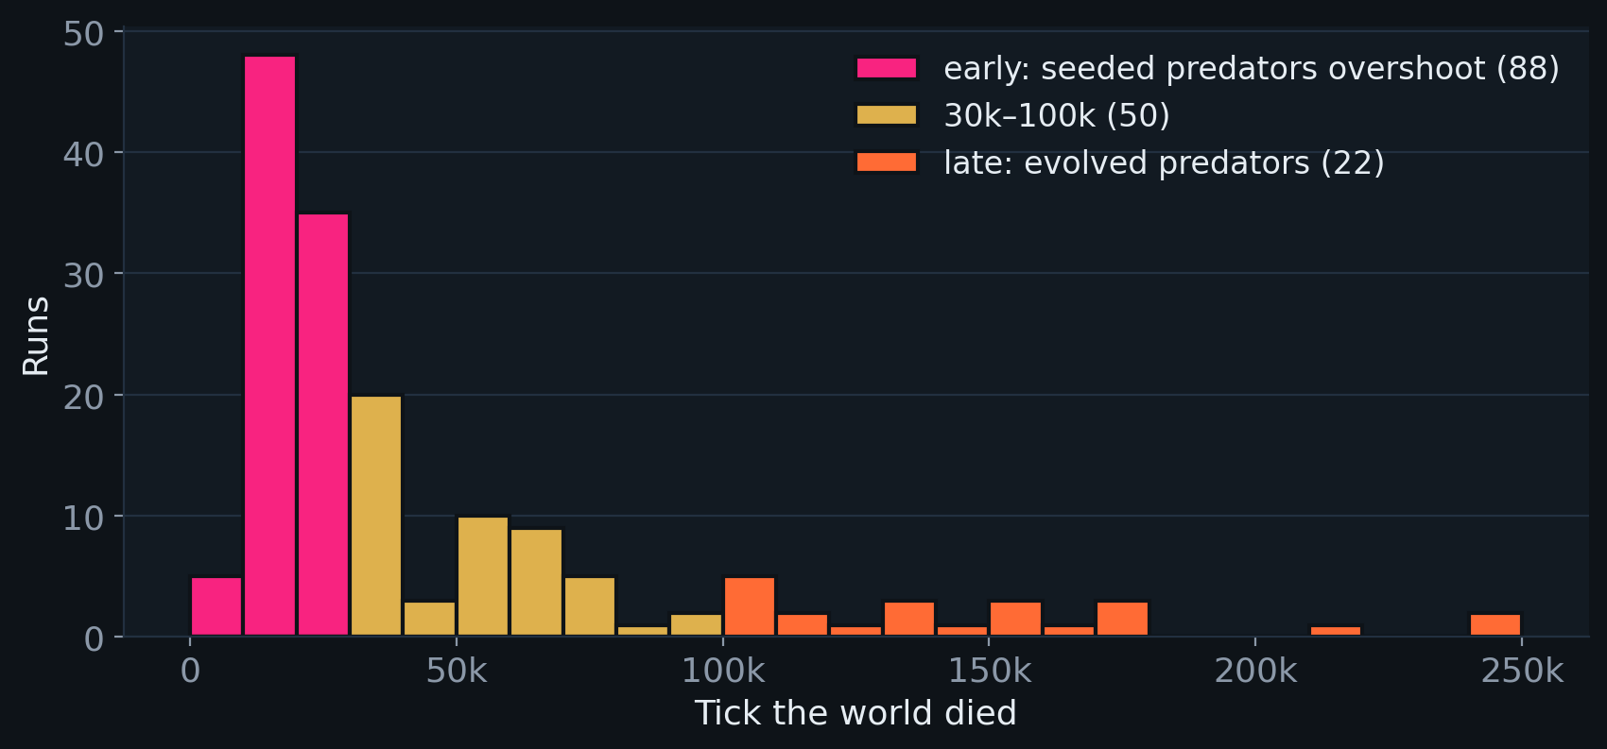
QUESTION 1 · DID AN EXTINCTION EVENT OCCUR?
Yes, at every level, and often
167/380
of our headless runs ended with every organism dead; in Nik's sweep, 111 of 111
21/40
runs where evolved claws took over and then every prey died (Tarique)
LINEAGES
When 160 worlds died (batches with seeded claws, 300 runs). Most die early, a few after 100k ticks of apparent stability.
The seeded predators died out in every batch run; seeded burrowing prey died out in every run with all the claw's benefits switched off
Whole-world extinction usually ends with plants: with no animals to eat it, food piles up and blocks plant offspring
05

Slide 6
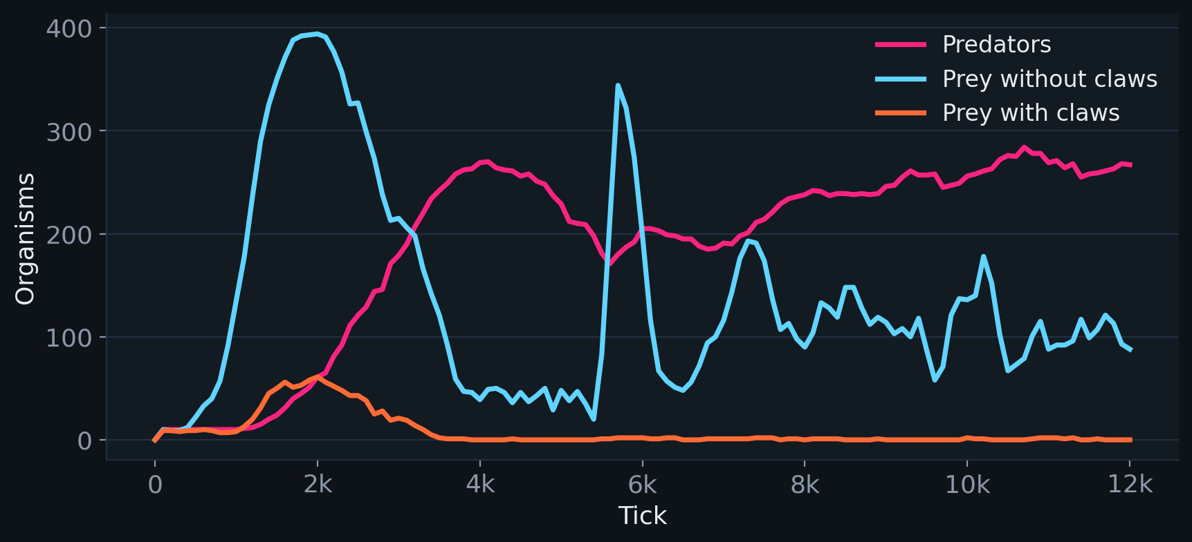
QUESTION 2 · MIS-ADAPTATION OR FAILURE TO ADAPT?
FAILURE TO ADAPT
Most worlds die before evolution can act
The first predator wave. Seeded predators feed on the first prey boom, multiply about 25×, and overshoot.
88 of 160 world extinctions came before 30,000 ticks. When the prey died, 82% of predators were still the seeded ones.
Claws appear within ~1,200 ticks, but prey were usually gone by 5,500, while claws were on only ~4% of them (Nik).
With all the claw's benefits off, the seeded burrowers bred at half the rate of other prey and were the first to vanish.
Browser run, claw benefits off: predators boom and the clawed prey are gone by tick 4,000.
Ecological overshoot, not evolution: the prey had no time to adapt
06

Slide 7
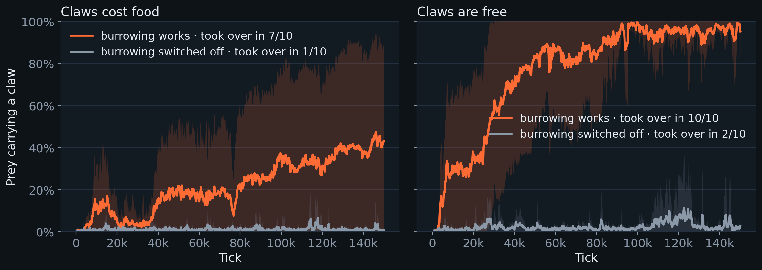
QUESTION 2 · MIS-ADAPTATION OR FAILURE TO ADAPT?
MIS-ADAPTATION
Given time, the claw evolves, because it works
No organism starts with a claw. It appears by mutation in every run (80 of 80), within a median of about 1,000 ticks.
It spreads only when burrowing works: 7/10 take-overs against 1/10 when claws cost food (p = 0.02), 10/10 against 2/10 when free (p = 0.0007). Selection favours the claw for burrowing.
Josh's claw-evolution batch · 10 runs per setup · predator lifespan multiplier 2 · bands are ±1 std
07

Slide 8
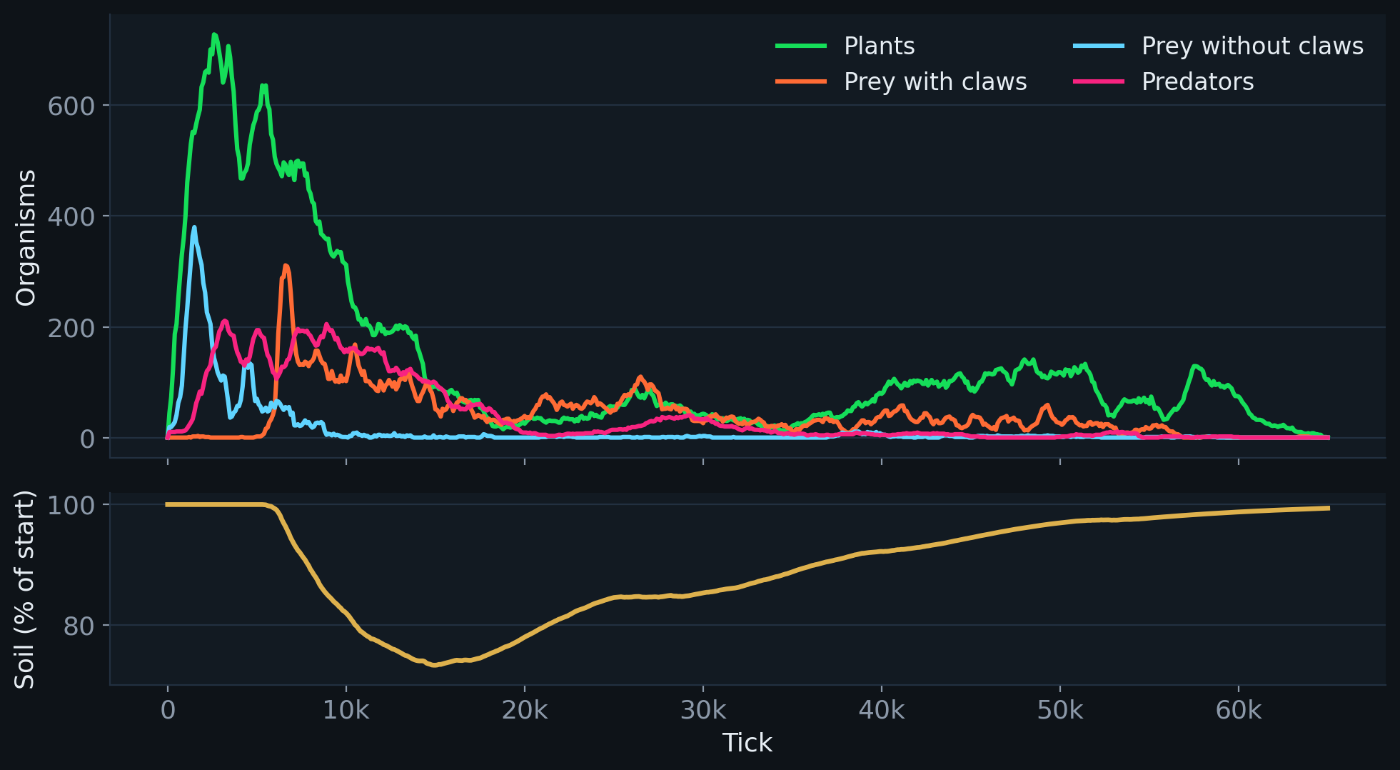
QUESTION 2 · MIS-ADAPTATION OR FAILURE TO ADAPT?
MIS-ADAPTATION
…and then the burrowers dig their own grave
8K
8K → 15K
→ 20K
→ 57K
65K
Evolved claws take over the prey
Burrows drain the soil to 74%
Plants crash from 468 to 35
Clawed prey dwindle and die
Nothing is left
21/40 vs 0/20
prey extinct after claws took over, damaging vs harmless burrowing (Tarique, p = 0.00002). Without working claws, prey survived 17/20.
11/11 vs 0/5
burrower populations extinct after spreading, with vs without soil damage (Nik, p ≈ 0.0002).
One run (claws evolved, free, burrowing on). The soil recovers after the burrowers die, too late for them.
08

Slide 9
QUESTION 2 · MIS-ADAPTATION OR FAILURE TO ADAPT?
Both, depending on how far evolution gets
FAILURE TO ADAPT
MIS-ADAPTATION
The common route
Evolutionary suicide, when the claw gets a chance
Strong seeded predators, prey with no defence yet
Collapse within ~30k ticks, before the claw spreads
Happens just as often with burrowing switched off (Nik's controls)
The claw evolves and spreads because it protects (vs burrowing off)
It kills only when burrowing damages the soil (vs harmless burrowing)
Prey survive without the claw: the collapse is the trait's doing
A second, subtler route
Clawed prey that grow a killer cell can become predators. In 9 of 22 late collapses, the predator that wiped out the prey had evolved from the prey's own lineage, and in about 10 a newly evolved predator spread and the world died within a few thousand ticks. Suggestive of evolutionary suicide, but not yet proven by replay.
Not yet measured: whether clawed prey still out-reproduce clawless prey as the population declines
09

Slide 10
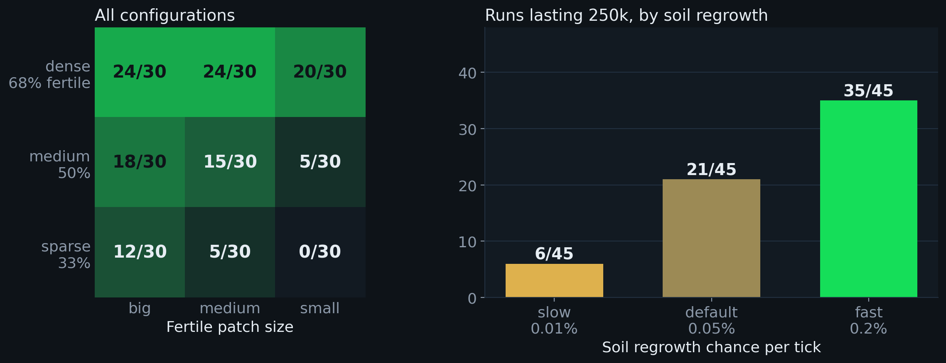
QUESTION 3 · ENVIRONMENT VS THE INITIAL SEEDED SPECIES?
The seeded species decide whether burrowers get a chance; the environment decides what happens to them
SEEDED SPECIES
Predator strength sets the first wave: at lifespan ×3, predators killed all prey in 7/8 runs even without burrowing; ×2 lets prey survive (Tarique)
Seeding claws lets prey skip the wait and survive the first wave
The seeded predators never last: evolved predators replace them
ENVIRONMENT
Josh's soil-layouts batch: 270 runs, 6 setups × 9 soil layouts × 5 soil seeds. Runs lasting 250,000 ticks.
Soil density, patch size and regrowth (right)
Plant regrowth rescues worlds from the claw (Jenna)
Map luck: the pattern appeared on one soil map, not another (Nik)
Same starting species, different soil: survival ranges from 80% to 0%
10

Slide 11
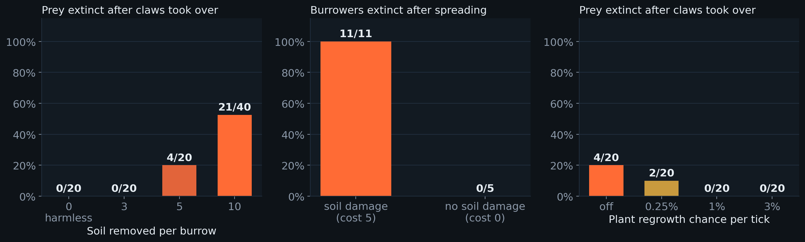
QUESTION 4 · INSTRUMENTAL FEATURES AND TRAITS
What made the difference
Left: Tarique, soil removed per burrow. Middle: Nik, soil damage on vs off. Right: Jenna, plant regrowth (reference settings).
ENVIRONMENT
TRAITS
Soil damage per burrow: 0 or 3 never collapses; 10 collapses half
Soil and plant regrowth: fast recovery rescues the world
Food blocking: without consumers, food chokes plant offspring
Claw: the trait that both saves and dooms
Eye: claw mutations often replace it; 11 of 12 clawed prey in one replay were blind and never burrowed
Killer cell: turns clawed prey into predators; hide length: at 30 ticks the claw never pays
A window of settings: predators strong enough to make burrowing pay, burrows damaging enough to matter
11

Slide 12
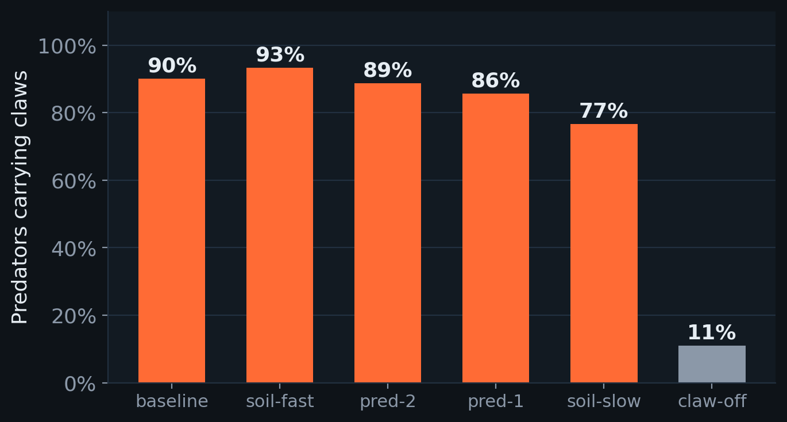
EVOLUTION FINDS LOOPHOLES
When claws were free, predators took them, and lost their eyes
→
SEEDED PREDATOR
EYELESS CLAWED PREDATOR
6 cells · 11 food to breed
5 cells · 4 food to breed
A free claw adds lifespan and health but costs no food, so predators keep them; none ever burrowed.
Mouths are useless to predators and eyes cost food: a cheap random walker breeding ~3× as often beats a hunter.
It came to dominate some worlds on its own: selection optimises the rules, not the design.
Share of predators carrying claws late in the runs, across 9 soil layouts. Claw-off: claws cost food.
Eyeless predator layout is illustrative; its cells (mover, killer, 3 claws) are from the species record
12

Slide 13
ANSWERS TO THE BRIEF
In four lines
1
Did an extinction event occur?
Yes: whole worlds, prey populations and lineages went extinct in a large share of runs.
2
Mis-adaptation or failure to adapt?
Mostly failure to adapt, as the first predator wave struck before the claw spread. When the claw had time, it was a mis-adaptation: favoured for hiding, fatal through the soil it destroyed.
3
Environment vs the initial seeded species?
The seeded predators decide whether burrowers get a chance; soil and plant recovery decide whether the burrowers then destroy themselves.
4
Instrumental features and traits?
Soil damage per burrow, soil and plant regrowth, food blocking; the claw, the eye it replaces, and the killer cell that turns prey into predators.
13

Slide 14
LIMITATIONS AND NEXT STEPS
What we can't claim yet
Limitations
Next
10–40 runs per setup: differences of 2–3 runs could be chance
Studies used slightly different settings and grids
Collapse rate depends on behaviour settings: with "burrow only when a predator is close" on, evolved claws collapsed 2 of 20 worlds here, against 21 of 40 in Tarique's runs with it off
Proximate cause of death is mostly predation; the soil acts by stopping plants recovering
Measure fitness of clawed vs clawless prey during a decline: does selection still favour the claw?
Replay suspected suicides with and without the invading predator
Close the free-claw loophole for predators
More soil maps per setup
14

Slide 15
THANK YOU
QUESTIONS?
Built on The Life Engine by Max Robinson, extended with soil fertility, burrowing claws, role tagging, seeded run setup and a headless experiment runner.
References: Gyllenberg, M. & Parvinen, K. (2001). Necessary and sufficient conditions for evolutionary suicide. Bulletin of Mathematical Biology 63, 981–993. · Rankin, D. J. & López-Sepulcre, A. (2005). Can adaptation lead to extinction? Oikos 111, 616–619. · Hardin, G. (1968). The tragedy of the commons. Science 162, 1243–1248.
Reports: Burrowing Into Extinction (Tarique) · Soil study (Nik) · Plant regrowth (Jenna) · Claw evolution and soil layouts (Josh)
15

